Slide 1





ROMAN SOKOLOV & RICARIO

Slide 2
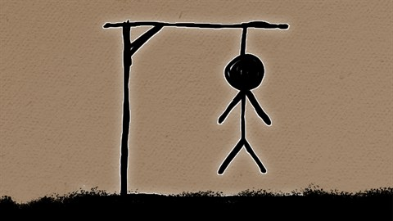
What is Hangman?
A game in which the object is for one player to guess the letters of an unknown word before the player who knows the word creates a stick figure of a hang man by drawing one line for each incorrect guess

Slide 3
INSTRUCTIONS:
1. Choose one person to be the "host“ In this case the host will be the computer itself. This is the person that invents the puzzle for the other person to solve. They will be tasked with choosing a word or phrase that "the players" will have to solve.
2. There are few blank spaces provided corresponding to the length of the word to be guessed.
3. For every correct letter that Is guessed, the letter will appear in Its appropriate position belonging to the word.
4. For every Incorrect guess, a part of the man being hung will appear on the screen.
5. The players wins when they guess the correct word.
6. The players lose if the fail to guess and all the parts of the man being hung has appeared.

