Slide 1
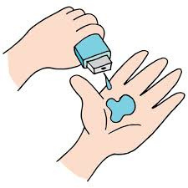
Data Analytics in Healthcare: Doctor Visits Analysis Using AI-Driven Insights
Leveraging Data-Driven Insights for Enhanced Healthcare Decision-Making.
Student Name: Rugved Bharat Gaikwad
College: Ajeenkya DY Patil School Of Engineering
Branch: Computer Engineering
AICTE No.: APPLY_172716747966f27bf748998
‹#›

Slide 2

PROBLEM STATEMENT
Challenge:
Healthcare systems often struggle to understand patient flow, anticipate demand, and allocate resources effectively due to a lack of comprehensive, actionable data on patient visits and diagnoses.
Objective:
Provide healthcare professionals with data-driven insights on patient visit frequencies, demographics, and primary conditions.
Utilize AI and machine learning models to reveal patterns that inform better scheduling, resource planning, and improved patient care delivery.
‹#›

Slide 3
Project Description
Overview:
This project analyzes a dataset of patient doctor visits, focusing on visit frequencies, patient demographics, and diagnosis codes to better understand healthcare demand and trends.
Project Aim: To derive insights from historical doctor visit data, exploring patterns in patient behavior and visit reasons that could aid in more informed healthcare administration.
Key Actions:
Data Cleaning & Preparation: Organized and refined data to ensure quality analysis.
Analysis of Trends: Investigated trends in patient visits across different demographics and medical needs.
Predictive Modeling: Applied machine learning techniques to forecast future visit patterns and support decision-making in healthcare facilities.
10/30/2024
Annual Review
‹#›

Slide 4

WHO ARE THE END USERS?
Primary End Users:
Healthcare Providers: Benefit from insights to optimize appointment scheduling, reduce wait times, and manage patient flow.
Administrative Staff: Use data trends to make informed decisions about staffing, resources, and patient handling.
Data Analysts: Analyze healthcare data to reveal trends and support policy-making, contributing to better public health management.
Secondary Users:
Public Health Researchers: Leverage data to understand broader healthcare needs and patient demographics.
Patients: Indirectly benefit from streamlined healthcare services and reduced wait times through improved healthcare management.
10/30/2024
Annual Review
‹#›

Slide 5

Technology Used
Technologies Applied:
Data Analysis: Python (libraries such as Pandas, NumPy, and Matplotlib) for cleaning, processing, and analyzing doctor visit data.
AI and Machine Learning Models: Utilized large language models (e.g., GPT-based LLMs) to interpret data trends and perform predictive analysis.
Data Visualization: Seaborn and Matplotlib for creating visual representations of patient demographics, visit trends, and diagnosis frequencies.
Tools & Platforms: Google Colab and Jupyter Notebook for development and testing.
Model Selection: Machine learning models for predictive analytics to understand future patterns in healthcare demand.
10/30/2024
Annual Review
‹#›
Notes:
5

Slide 6
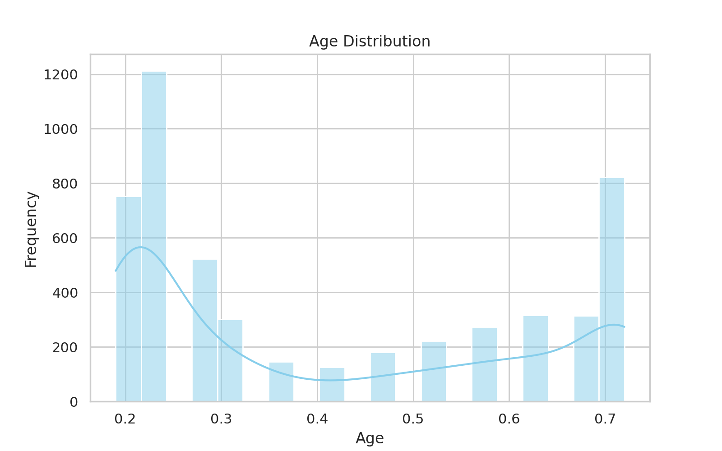
RESULTS
Age Distribution: A histogram showing the distribution of ages among the participants.
‹#›

Slide 7
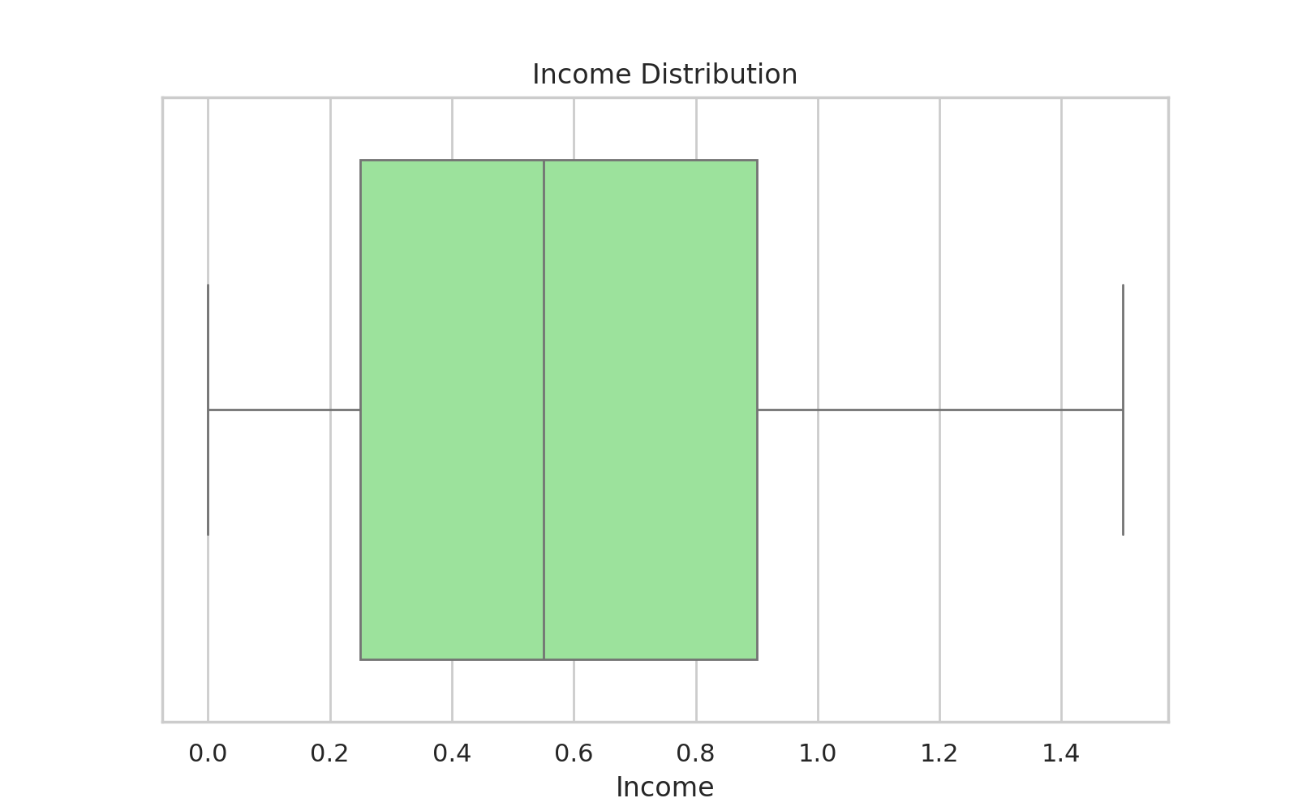
RESULTS
Income Distribution: A box plot illustrating the spread and outliers in income data.
‹#›

Slide 8
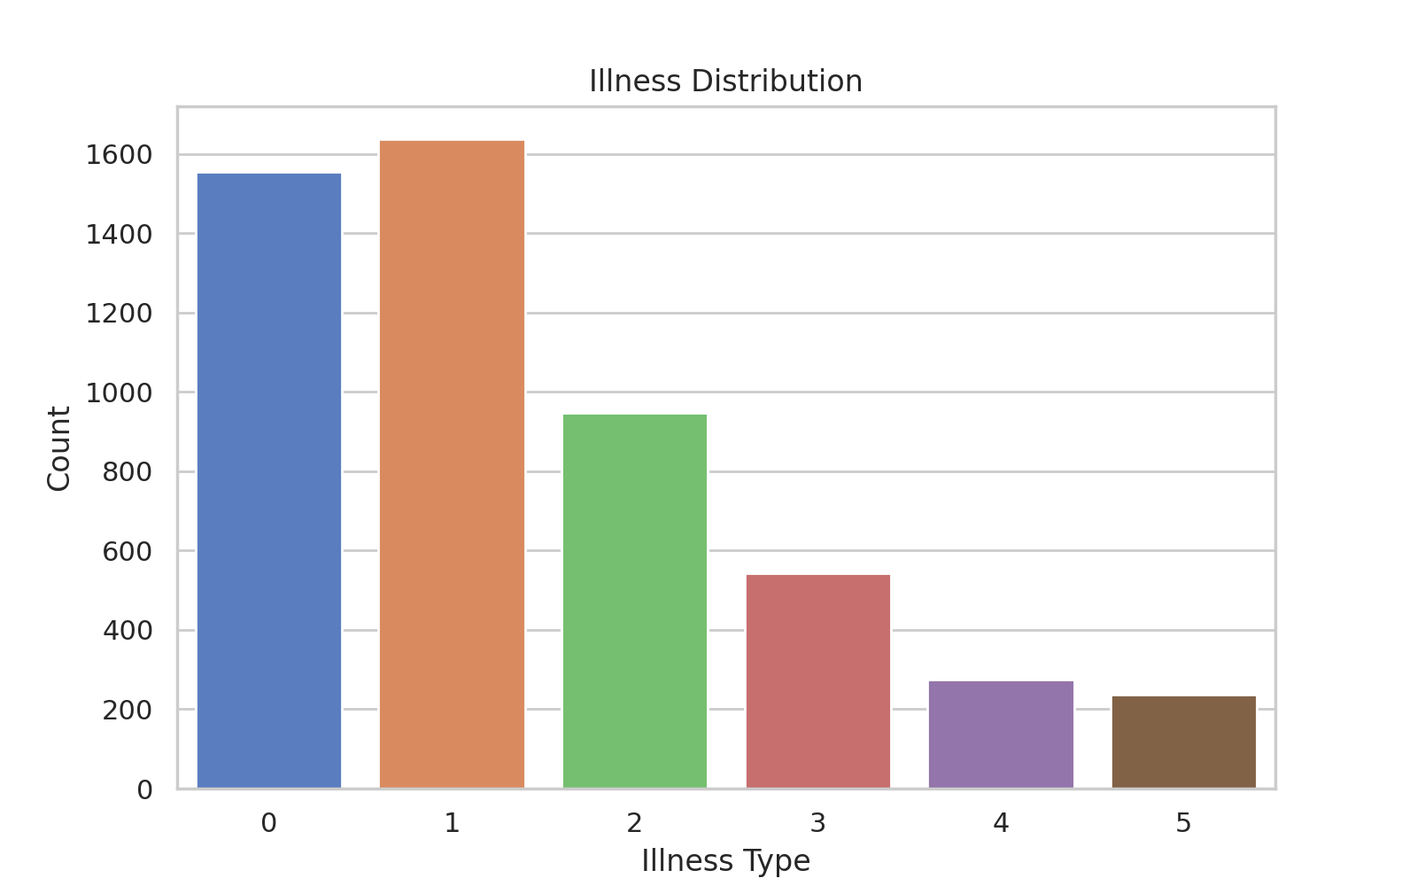
RESULTS
Illness Distribution: A count plot displaying the frequency of different illness types reported.
‹#›

Slide 9
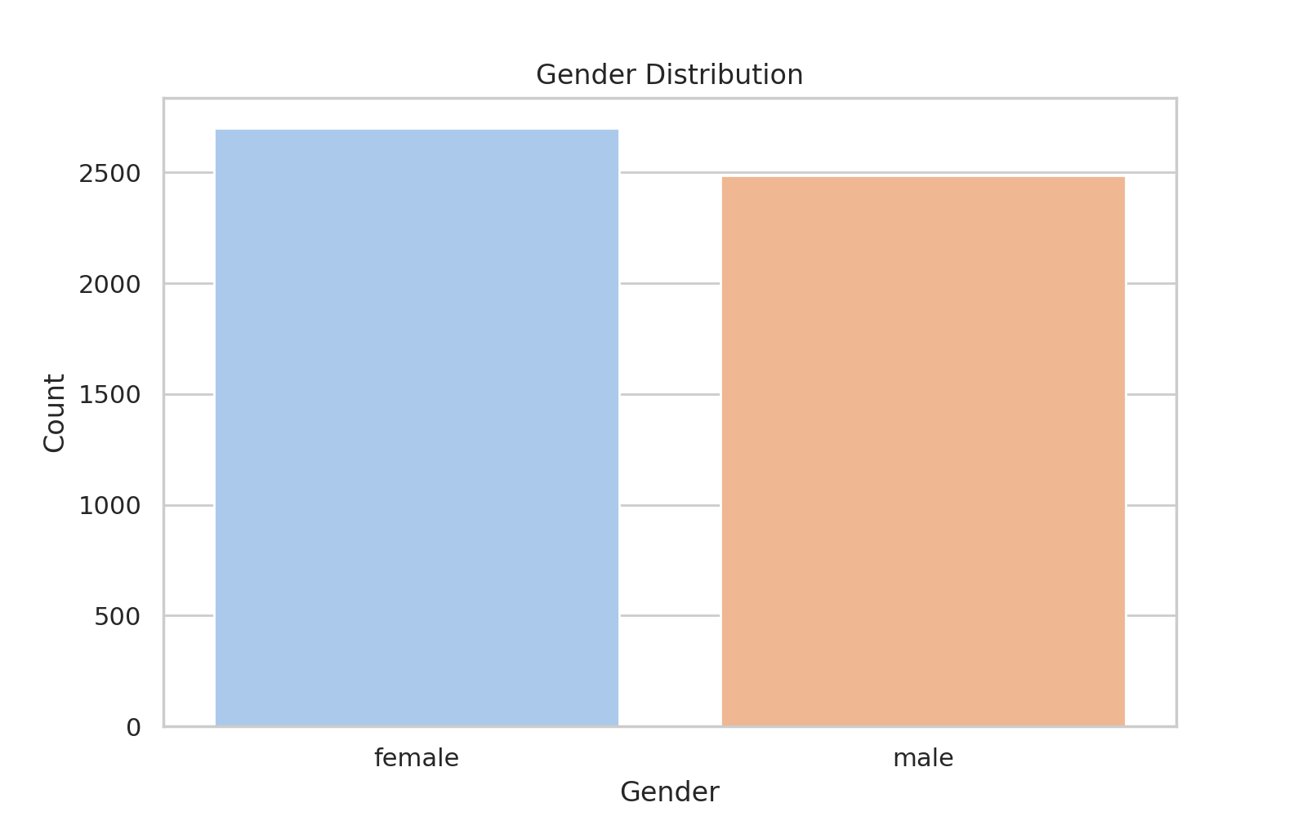
RESULTS
The bar chart for gender distribution showing the counts of each gender in the dataset
‹#›

Slide 10
Thank you
‹#›

