Slide 1
Healthcare Dialysis
P_373 (Group-2)

Slide 2
Team Members
Ms. Rutuja Raju Mane
Mrs. Naziya Banu Badagan
Mr. Ranjit Mahendra Singh
Mr. Nikhil Kumar Bachha
Mr. Rugved Anil Chaudhari
Mr. Kishan Kumar Pradhan

Slide 3
INRODUCTION
Dialysis analysis involves analysis of key performance indicators (KPI) to gain insight into that particular data to make the right decision in the dialysis field.
It includes monitoring the number of Dialysis stations in the region, Number of the patients in various summaries, Comparing profit vs Non-Profit organizations, Comparing category and their expected outcomes, and tracking of reduction rate in payments.
Once we analyze these details Healthcare organizations can provide better treatment to every patient. It will help to optimize the healthcare system, at the end dialysis patients will get better infrastructure for their treatment.

Slide 4
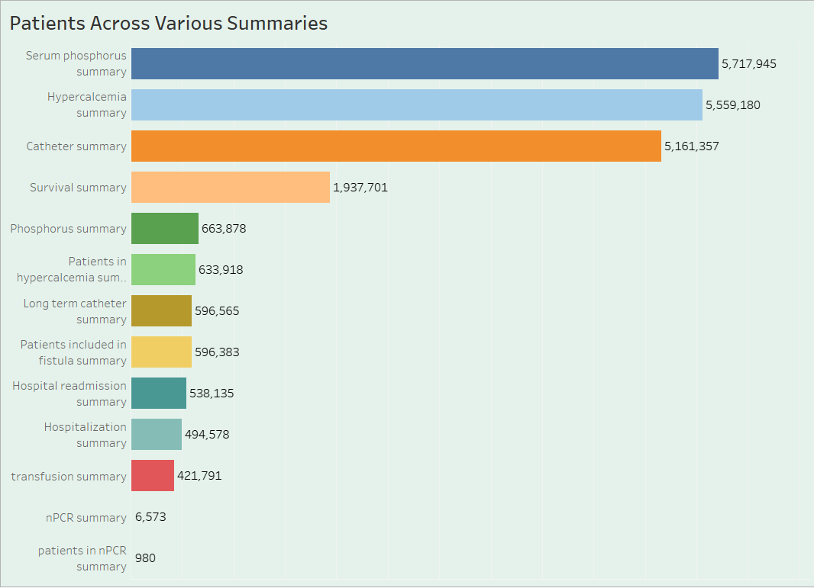
Number of Patients across various summaries
Analyzing patients in various summaries is the crucial thing to do, By doing this we can exactly know how many people are in which category of dialysis.
This KPI provides us an insight into the demand for dialysis services once we get numbers we can assist the dialysis service provider on which they have to focus more to improve their infrastructure

Slide 5
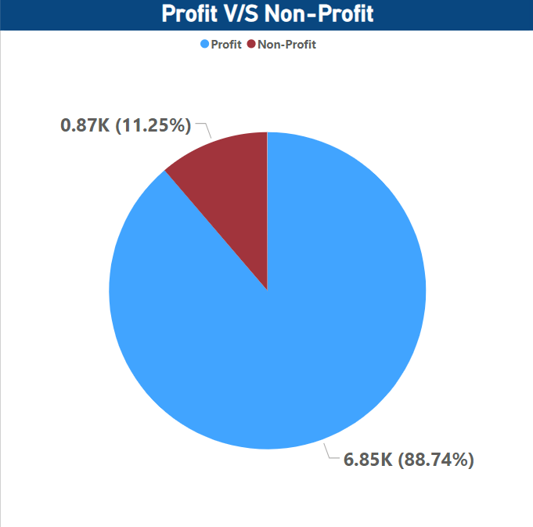
Profit Vs Non-Profit Stats
Comparing organizations that they’re profit-based or non-profit organizations it’s an important aspect of healthcare.
This analysis involves key financial metrics such as revenue, expenses, and return on investment to understand the economic landscape in the dialysis sector.
This KPI helps to identify differences between Profit and Non-Profit organizations, and it enables dialysis care providers to make informed decisions like allocation of resources and work on cost management.

Slide 6
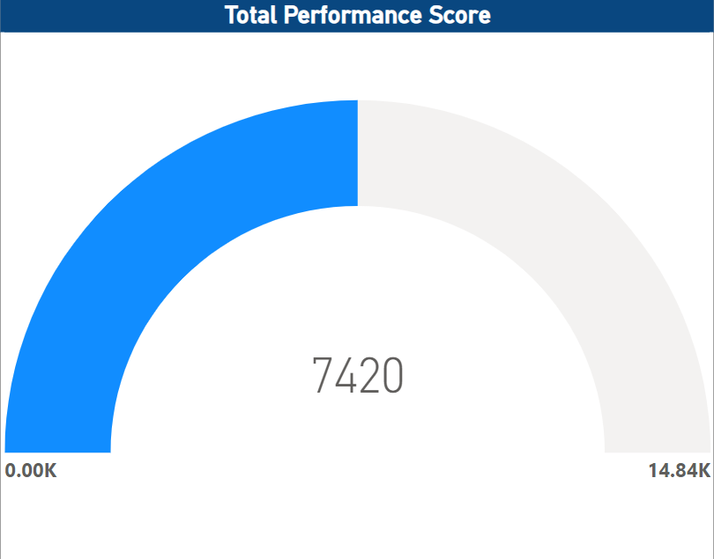
Chain Organizations w.r.t. Total Performance Score as No Score
Evaluating chain organizations based on their total performance score is a crucial key performance indicator (KPI) in dialysis healthcare analytics.
especially for those with no score. The total performance score considers several quality measures, patient outcomes, and adherence to best practices.
By analyzing chain organizations in terms of their total performance score, healthcare providers can identify areas for improvement, compare themselves with industry standards, and enhance the quality of care delivery across various chains.

Slide 7
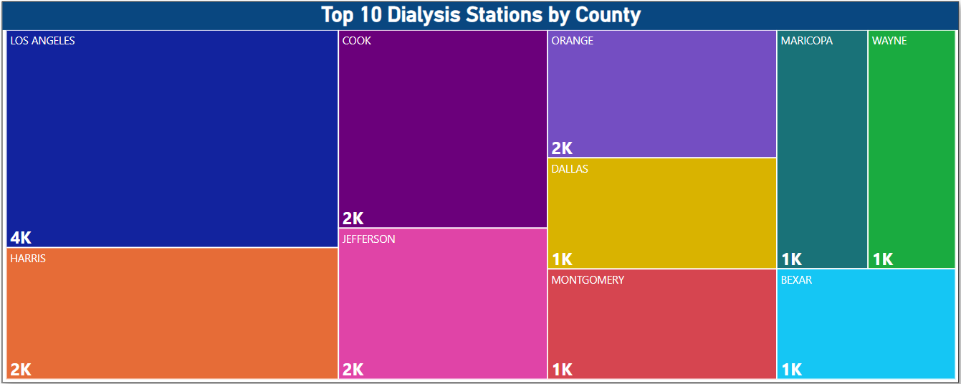
Chain Organizations w.r.t. Total Performance Score as No Score
Keeping track of the statistics of dialysis stations is a critical performance indicator for dialysis healthcare analytics.
It involves monitoring the number of dialysis stations, their utilization rates, availability, and operational efficiency.
By analyzing these statistics, healthcare providers can allocate resources more efficiently, identify areas of underutilization or overcrowding, ensure fair access to dialysis services, and enhance the overall operational efficiency in delivering care.

Slide 8
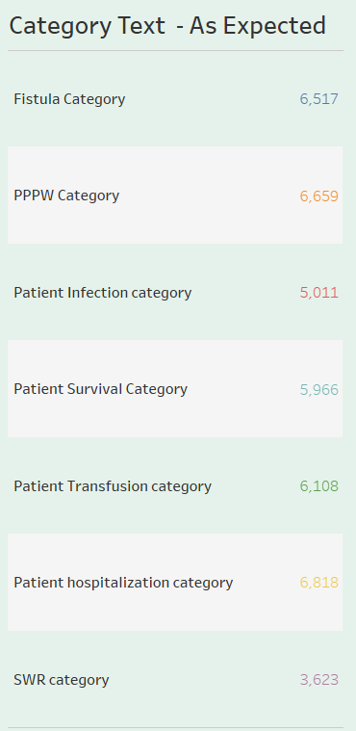
Category Text - As Expected
Analyzing the number of category texts, such as patient classifications or other relevant criteria, is an essential key performance indicator (KPI) in dialysis healthcare analytics.
This process involves categorizing patients based on specific criteria and examining their outcomes.
By comparing these outcomes with expectations, healthcare providers can assess the effectiveness of different treatment plans, identify patterns, and tailor care strategies to specific patient categories. Ultimately, this can lead to the improvement of the quality of care provided to dialysis patients.

Slide 9
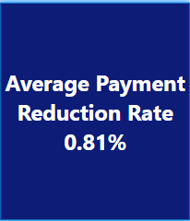
Average Payment Reduction Rate
Monitoring the average payment reduction rate is a crucial key performance indicator (KPI) in dialysis healthcare analytics.
This KPI measures the speed at which payments for dialysis services are reduced, either through reimbursement adjustments or contractual agreements.
By analyzing this KPI, healthcare providers can evaluate their financial performance, identify the factors that lead to payment reductions, and develop strategies to minimize the impact on revenue while maintaining high-quality care standards.

Slide 10
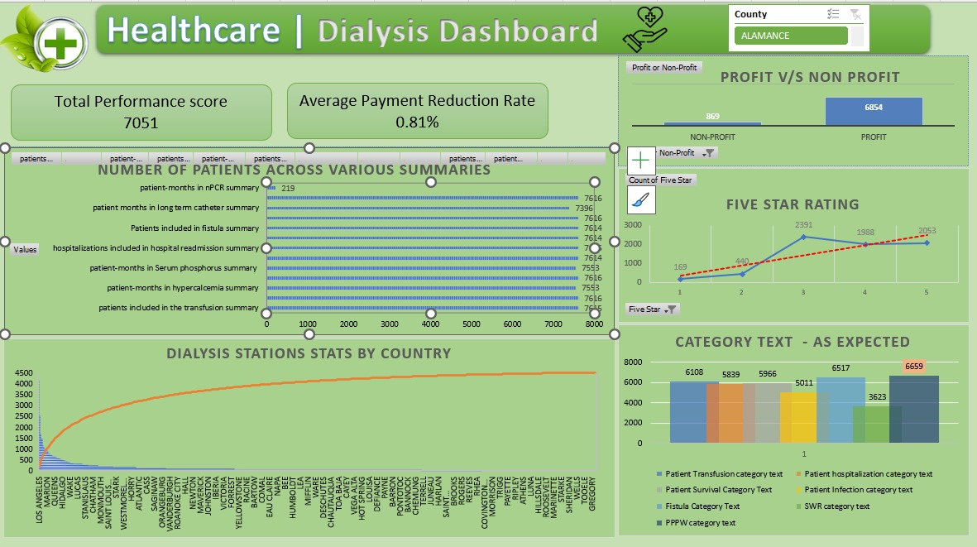
Excel Dashboard

Slide 11
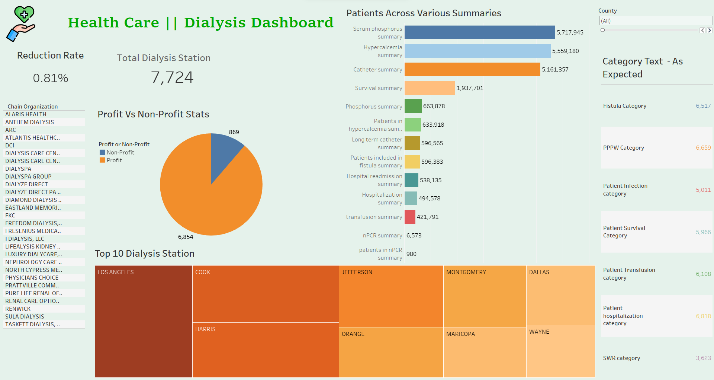
Tableau Dashboard

Slide 12
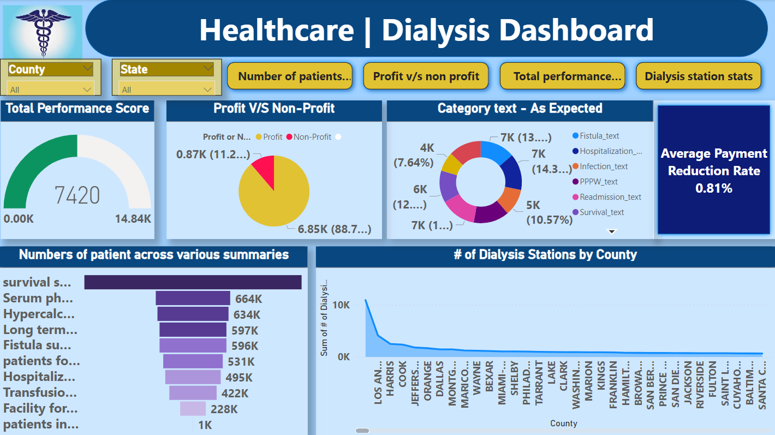
Power BI Dashboard

Slide 13
CONCLUSION
In summary, the survival category has shown positive outcomes with the highest patient count, while the npcr summary has the lowest count.
Unfortunately, the count of profitable facilities decreased from 2018 to 2020, indicating a concerning trend. DAVITA and Fresenius Medical Care have a majority of profitable facilities.
Approximately 88.75% of facilities generate profit, while non-profit facilities require further analysis.
The highest performance score was recorded in 1969, while the lowest was in 1971.
Intermountain Healthcare and Memorial Hermann have high performance scores, while others need improvement.
The number of dialysis stations increased until 2018, but then started declining, which is also concerning.
To reduce costs, it is recommended to implement cost containment strategies such as improving operational efficiency and optimizing supply chain management.
Transitioning to value-based care models and leveraging technology and innovation can also optimize healthcare delivery and potentially reduce payments.
Quality improvement initiatives, such as reducing readmissions and preventing medical errors, can lead to cost savings and better payment rates.

Slide 14
THANK YOU

