Slide 1

DS CA-4
Bank Deposit Analysis: A Data-Driven Understanding of India’s Banking Deposit Landscape (2019–2022)
From Raw CSV to an Interactive Streamlit Dashboard
By- Rugwed Yawalkar (22070521010)
Under the Guidance of – Dr. Piyush Chauhan

Slide 2

The Core Finding: The “Population Group Deposit Divide”
📈 Urban & Metro Dominance
Increase
Deposit contribution heavily concentrated in Urban and Metro population groups.
📉 Rural Deposit Density is Low
Decrease
Despite high number of accounts, deposit volume per account is significantly lower.
Key Insight: Urban + Metro regions account for the majority of deposits, while rural regions hold more accounts but lower value.
Takeaway: India’s banking system demonstrates broad access but uneven financial depth across population groups.

Slide 3


An End-to-End Data Science Project
Streamlit Dashboard
EDA & Segmentation
Predictive Modeling
Auto-cleaning & preprocessing pipeline
📊
🧮
🤖
📁
This was not just analysis — it was a complete, production-ready data product, powered by:

Slide 4
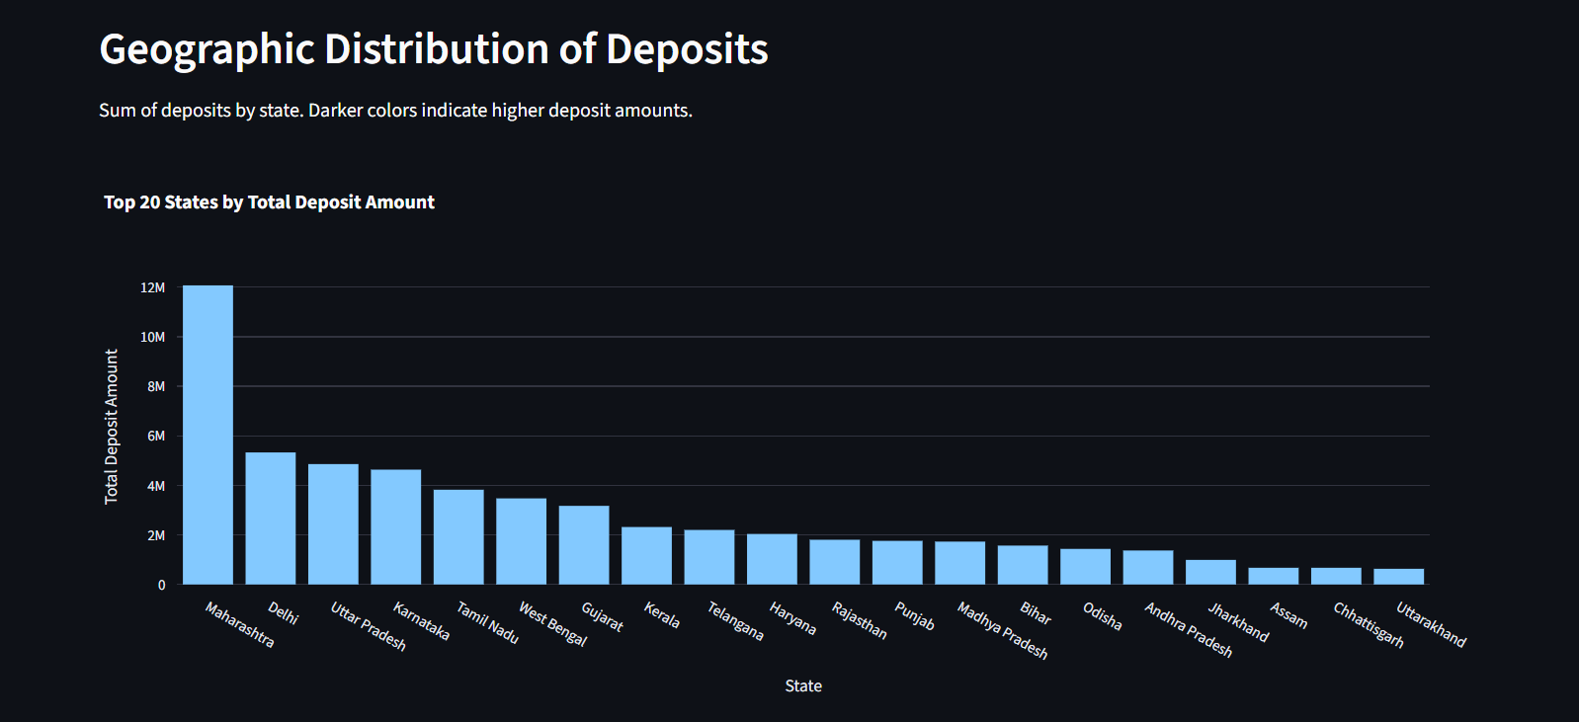
India’s Banking “Deposit Heartland” (EDA)
The Key Insights:
1. Deposit activity is not uniform.
Clear financial concentration visible.
2. Top States.
Maharashtra, Karnataka, Tamil Nadu and Delhi dominate deposit volume.
3. District “Hotspots” emerge.
A few districts contribute disproportionately high deposits.
A one-size-fits-all banking strategy is inefficient. Need region-specific deposit development plans.

Slide 5
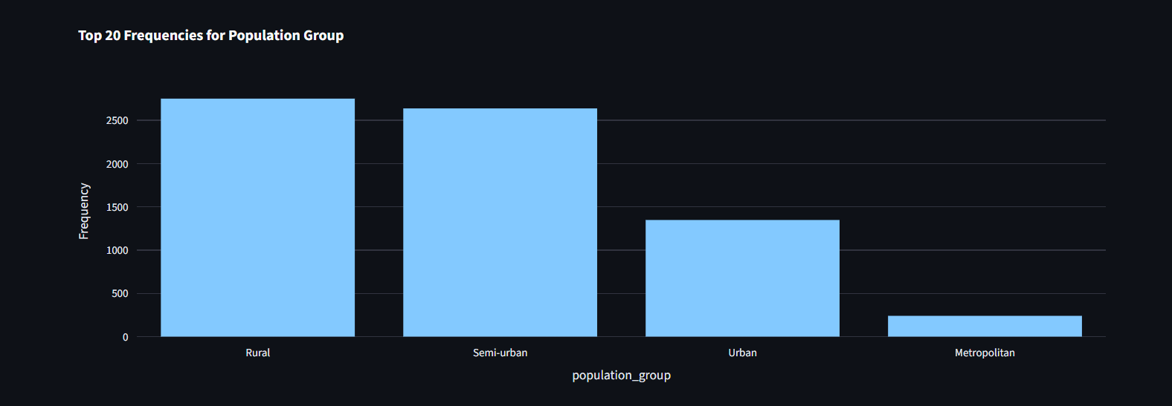
The 5 Population Group ‘Archetypes’ (Segmentation)
1: Metro Powerhouses
Highest deposits, strong account penetration, large office presence.
2: Urban Growth Engines
Moderately high deposits, strong middle-income activity.
3: Semi-Urban Balancers
Balanced accounts but inconsistent deposit value.
4: Rural Volume-Heavy, Value-Light
High account counts but low deposit amount per account.
5: Under-Served Regions
Sparse offices, low deposits — require targeted financial inclusion strategies.
Insight: Population groups differ not only by geography but by financial behavior patterns.

Slide 6
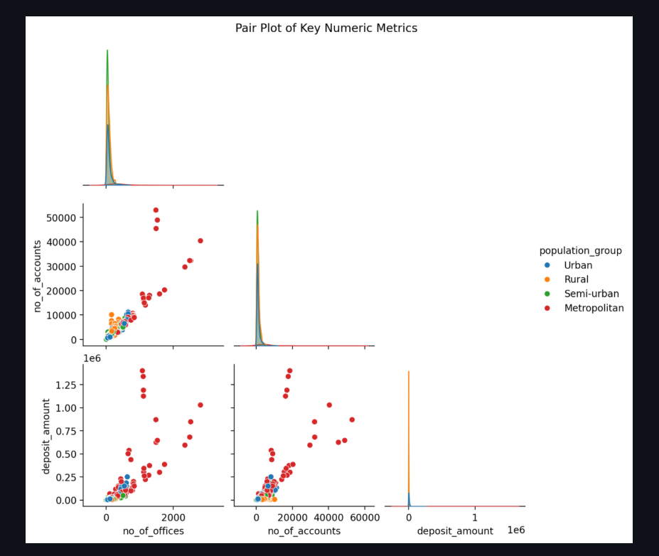
Predictive Analytics
Deposit Amount Is NOT Driven Only by Accounts or Offices
Our machine learning exploration showed surprising factors:
🏆 Top Predictors for Deposit Amount:
Number of Accounts (expected)
Population Group (surprisingly strong)
Region Type
State-Level Banking Penetration
Insight: Population group and region type were more predictive than simply number of offices or raw account count.
This proves demographics and geography strongly influence banking behavior.

Slide 7
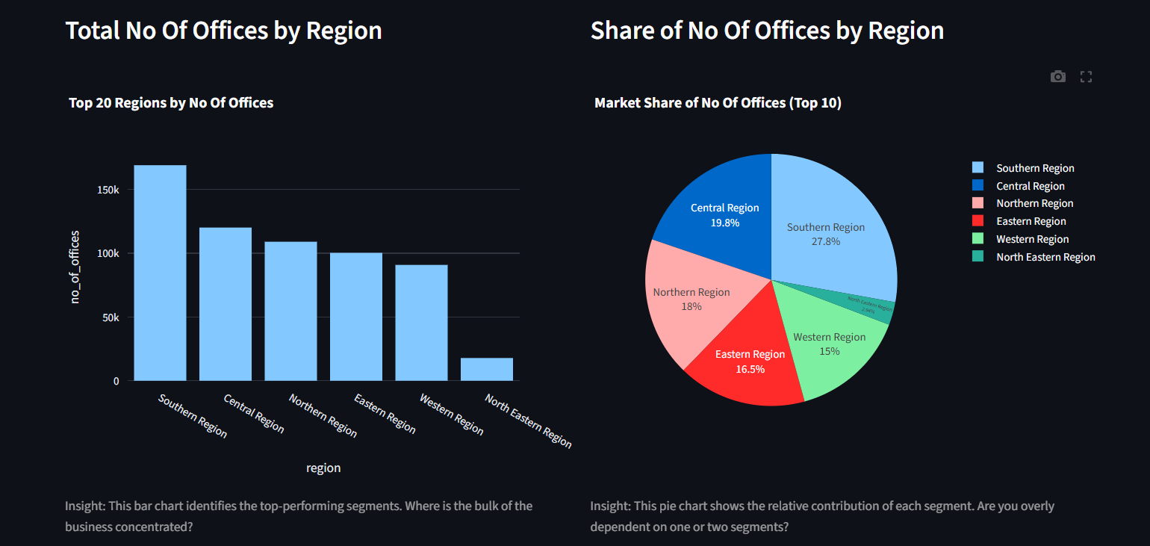
The Deposit Intelligence Tool (Streamlit Dashboard)
Our dashboard transforms raw data into:
📍 Geo-level deposit visualization
📊 Population group segmentation
🔎 Year-wise trend analysis
🤖 Predictive insights (future-ready)
It not only presents numbers —
it explains WHY deposit patterns differ across India.

Slide 8
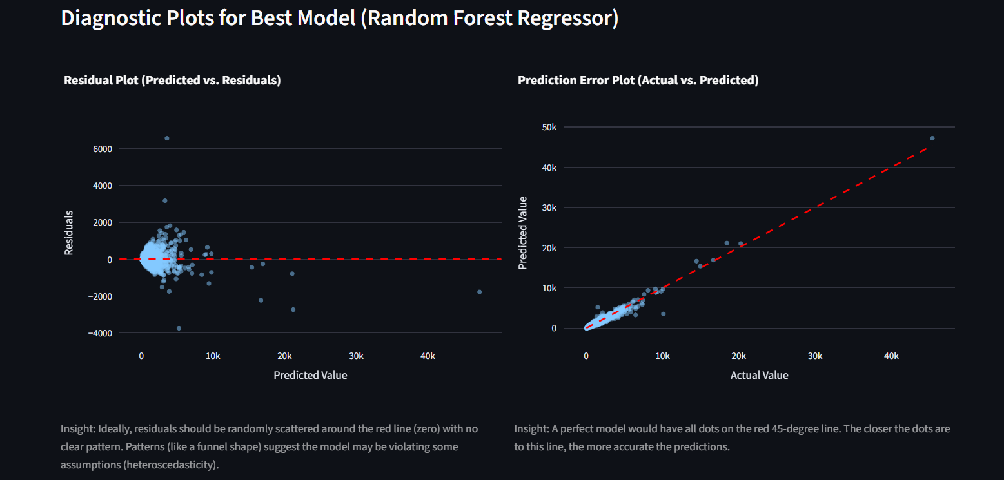
Experiment-Based Improvement
Step 1 — Baseline Metrics
Simple aggregations + summary modeling.
Step 2 — Enhanced Segmentation
Using region & population groups to introduce structure.
Step 3 — ML-Based Predictions
Regression-based modeling to understand key drivers.
Step 4 — Final System
An interactive interface that connects:
EDA → Segmentation → Modeling → Visualization
📌 Result:A full analytics system, not just a report.

Slide 9
Conclusion & Recommendations
Grand Finding:
India’s deposit ecosystem is driven by two independent forces:
Deposit Scale
Population Group Demographics
Key Recommendations:
✔ Customize deposit mobilization policies based on population group behavior
✔ Increase rural deposit depth through targeted financial products
✔ Strengthen semi-urban banking infrastructure
✔ Use ML insights for yearly strategic planning
Future Work:
Integrate:
🏦 Loan performance
💳 Account type segmentation
🤖 ML forecasting of future deposit inflows
This would create a full financial intelligence platform.

Slide 10
THANK YOU

