Slide 1
Powerbi Capstone Project
Visualizations and Insights of Covid-19 Spread and Vaccinations
Under the Guidance of
Kaustubh Kulkarni
Prepared by
Ruchi Yadav

Slide 2
CONTENTS:
Covid-19 Cases Data Visualization.
Insights drawn from covid-19 cases data visualization.
Covid-19 Vaccines Data Visualization.
Insights drawn from covid-19 vaccines data visualization.
Summary of Covid-19 Analysis for a Specific Country.
Insights drawn from summary of covid-19 analysis for a specific Country

Slide 3
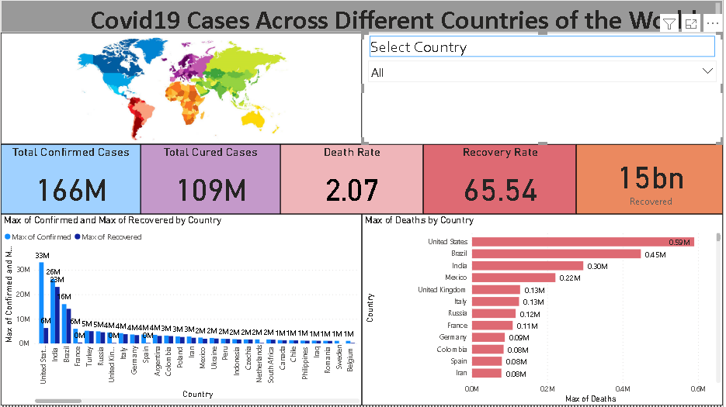
Covid-19 Cases Data of all the Countries (Visualization)

Slide 4
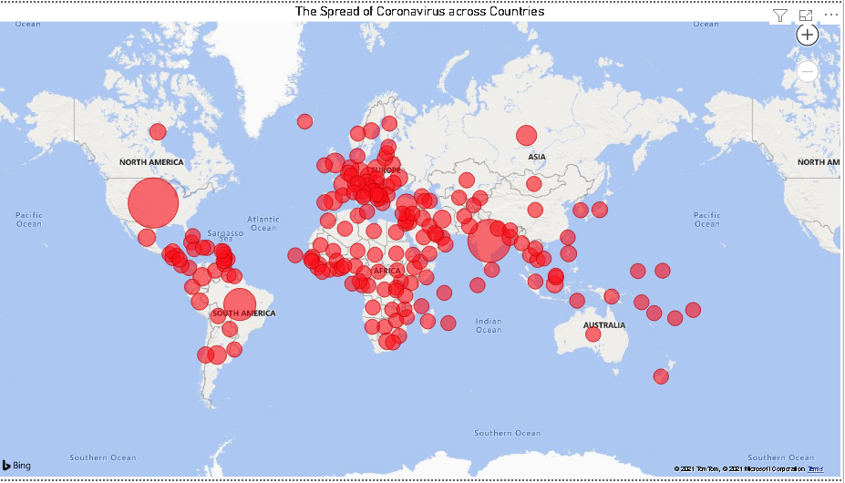

Slide 5
Insights from Covid-19 Cases Data of all the Countries
From the given data we can visualize that the total confirmed cases of Covid across different countries are 166 million and out of the total confirmed cases almost 109 million have been cured.
The Recovery and Death Rates are 65.54% and 2.07% respectively when all the countries are taken into consideration, but it varies from country to country for some countries it may be high and for other countries it may be low.
The maximum confirmed cases are in United States with 33 million cases and followed by India with a total of 26 million cases.
The maximum deaths were reported in United States, followed by Brazil at second position and India at third position.
The spread of Coronavirus is also shown on a Geographical map where size of the bubbles represent the intensity of confirmed cases.

Slide 6
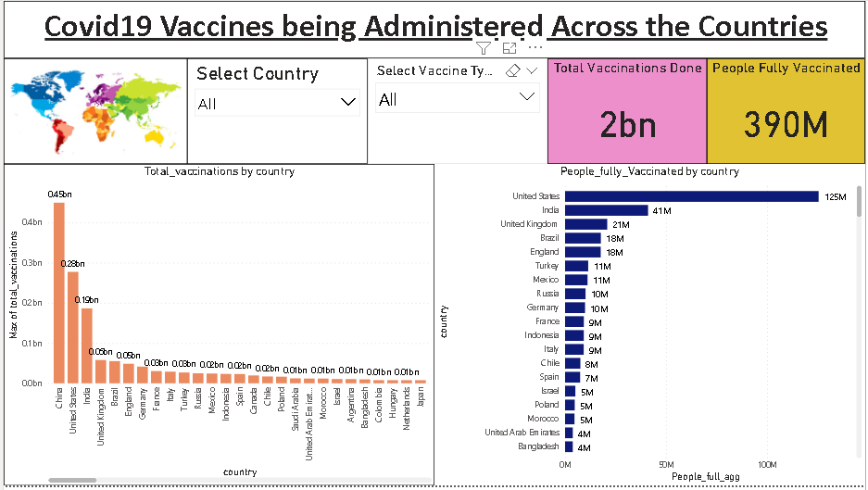
Covid-19 Vaccines Data of all the Countries (Visualization)

Slide 7
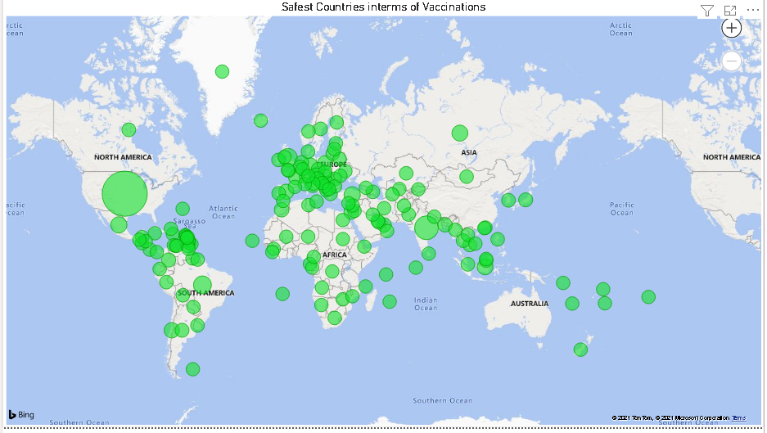

Slide 8
Insights from Covid-19 Vaccines Data of all the Countries
From the given data we can visualize that the vaccines that are being administered across all the countries are approximately 2 billion.
The people fully vaccinated across all countries are 390 million and there are wide variety of vaccines produced or manufactured by different countries.
When we take into consideration the total vaccines administered, China is at the top with 0.45 billion, followed by United States with 0.28 billion and India with 0.19 billion.
When we consider people fully vaccinated United States is at the top with 125 million, followed by India with 41 million and Brazil at third position with 21 million.
The Safest Countries interms of Vaccination is also shown on a geographical map where size of the bubbles represent people fully vaccinated and are at lower risk of getting infected.

Slide 9
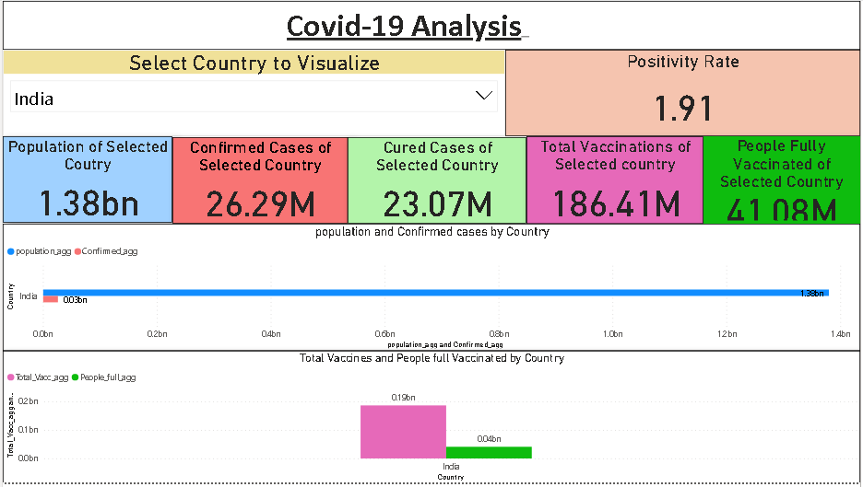
Summary of Covid-19 Analysis for a Specific Country (Visualization)

Slide 10
Insights drawn from summary of covid-19 analysis for a specific Country
Here we can select a particular country to visualize the summary of Covid-19 Analysis.
After selecting the country we get information regarding the total population, confirmed cases, cured cases, positivity rate with respect to population, total vaccinations done and the number of people fully vaccinated of that respective country.
Incase if we select country as India we get the following information
Population of Selected Country – 1.38 bn
Confirmed Cases of Selected Country – 26.29 M
Cured Cases of Selected Country – 23.07 M
Positivity Rate – 1.91%
Total Vaccinations of Selected Country – 186.41 M
People Fully Vaccinated of Selected Country – 41.08 M
This gives us complete information regarding Covid-19 for the specific country selected.

Slide 11
Summary of DATA
Total Vaccinated people are 1131M
People who fully vaccinated are 389 M
We should increase the speed vaccination, and increase in vaccinated centres
United state is on top country for vaccinated to people
India is on 2nd top country for vaccinated to people
United Kigdom is 3rd top country for vaccinated to people
China has highest population
Unitited State country has highest covid19 confirmed cases
India country has highest Recovey Cases
Unitited_State has highest deaths

