Slide 1
ComplaintScope
An End-to-End Text, Topic & Network Analytics System
for Consumer-Complaint Triage and Systemic Risk Early Warning
Course:
CBS3009 – Advanced Social, Text and Media Analytics
Team:
Ruhaan Bansal (23BBS0046) | Vedant Rajesh (23BBS0037) | Anish Desai (23BBS0119)
Faculty:
Prof. Sathish Kumar K
Institute:
Vellore Institute of Technology (VIT), Vellore
Date:
October 2026
Marks:
20 Marks — CO5 & CO6
CBS3009 | ComplaintScope | VIT Vellore

Slide 2
Presentation Agenda
A structured walkthrough from problem to deployed solution
01
Problem Statement & Motivation
02
Dataset & Methodology
Why does this project exist?
CFPB data, filtering, preprocessing, feature engineering
03
Component 1: Product Classification
04
Component 2: Relief-Risk Prediction
9-class triage system — Models, Results, Drift Analysis
Probability scoring & triage queue simulation
05
Component 3a: Topic Discovery
06
Component 3b: Burst Detection
LDA vs NMF vs K-Means — coherence sweep & themes
Dual-engine early-warning system — CUSUM & Z-Score
07
Components 4 & 5: Network & SRI
08
Results, Discussion & Conclusions
Institutional risk network & Systemic Risk Index
Key findings, limitations, future work
09
Interactive Dashboard & Deployment
10
References
Streamlit 5-page app demo
Academic sources and citations
CBS3009 | ComplaintScope | VIT Vellore

Slide 3
Problem Statement
The CFPB receives 5,000–10,000 consumer financial complaints every weekday
The US Consumer Financial Protection Bureau (CFPB) maintains the world's largest public database of financial grievances. Consumer narratives within this database encode critical regulatory intelligence — yet manual triage at this scale is impossible. Four critical bottlenecks demand automation:
🗂️ Triage Bottleneck
5,000–10,000 complaints arrive daily. Manual routing to product specialists takes 3–8 min each, is inconsistent across reviewers, and error-prone at category boundaries (credit reporting vs. debt collection).
⚠️ Relief Risk Blindness
Only 16.3% of complaints result in consumer relief. Without predictive scoring, caseworkers review complaints in random order—systematically missing high-priority cases.
📡 Late Crisis Detection
Emerging fraud schemes and regulatory crises (e.g., COVID-19 forbearance disputes) appear in complaint narratives months before official enforcement actions. Manual trend analysis is far too slow.
🕸️ Systemic Risk Blind Spots
Individual case review misses institution-wide complaint patterns and cross-institutional networks of shared regulatory issues—invisible to complaint-by-complaint analysis.
CBS3009 | ComplaintScope | VIT Vellore

Slide 4
ComplaintScope: System Architecture
Five analytical engines transforming unstructured complaints into actionable regulatory intelligence
Raw CFPB Data
878K Narratives
19,998 Clean
Narratives
TF-IDF + MiniLM
Embeddings
5 Analytical
Engines
Streamlit
Dashboard
→
→
→
→
Layer 1
Ingestion
Layer 2
Filtering
Layer 3–4
Preprocessing
& Features
Layer 5
Analysis
Layer 6
Deployment
↑
↑
↑
↑
↑
Component 1
Component 2
Component 3a
Component 3b
Comps. 4–5
Product
Classification
Relief-Risk
Prediction
Topic
Discovery
Burst
Detection
Network
Analysis + SRI
9-class NLP Triage
Macro-F1 = 0.7394
Accuracy = 87.43%
Binary Risk Scoring
PR-AUC = 0.3865
Lift@5% = 1.41×
LDA k=16
C_V = 0.5009
16 Complaint Themes
EWMA-CUSUM
F1 = 0.8000
+2–3 months lead
Q=0.2568, p<0.001
Top SRI = 0.7819
3 Institutions Flagged
CBS3009 | ComplaintScope | VIT Vellore

Slide 5
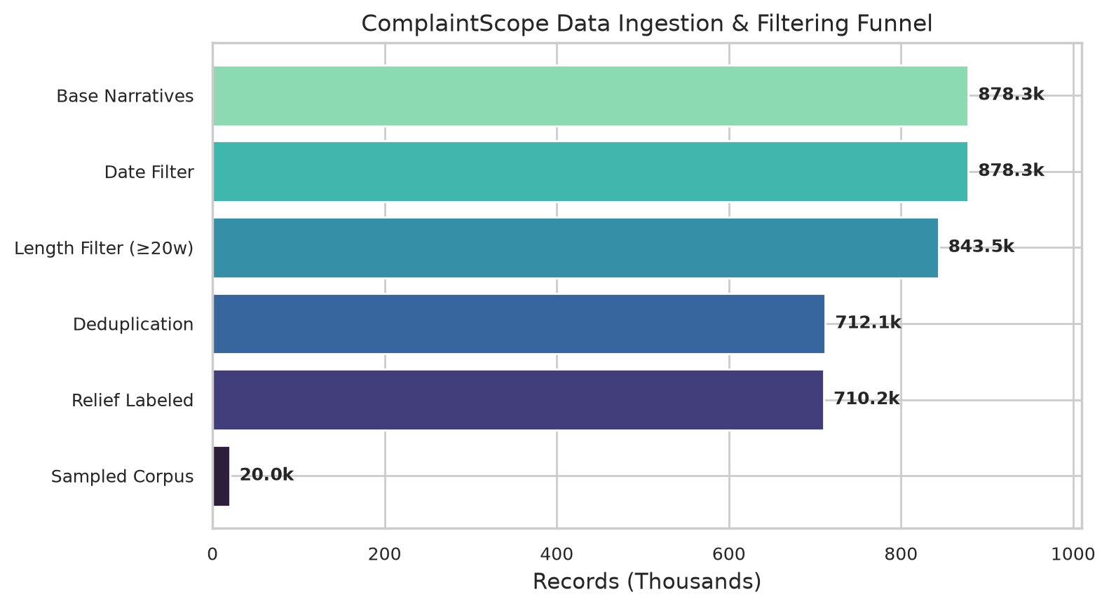
Dataset: CFPB Consumer Complaint Database
The world's largest public financial grievance dataset — CC0 Public Domain
>8 Million
7-Stage Filtering Pipeline
1. All CFPB records: >8M
2. Non-null narratives: 878K
3. Date: 2018–2023
4. Length ≥ 20 tokens
5. SHA-256 deduplicate −131K
6. Definite relief labels only
7. Stratified sample → 19,998
Total CFPB complaints
(as of 2026)
878,262
Complaints with
consumer narratives
19,998
Final filtered study
corpus (2018–2023)
CBS3009 | ComplaintScope | VIT Vellore

Slide 6
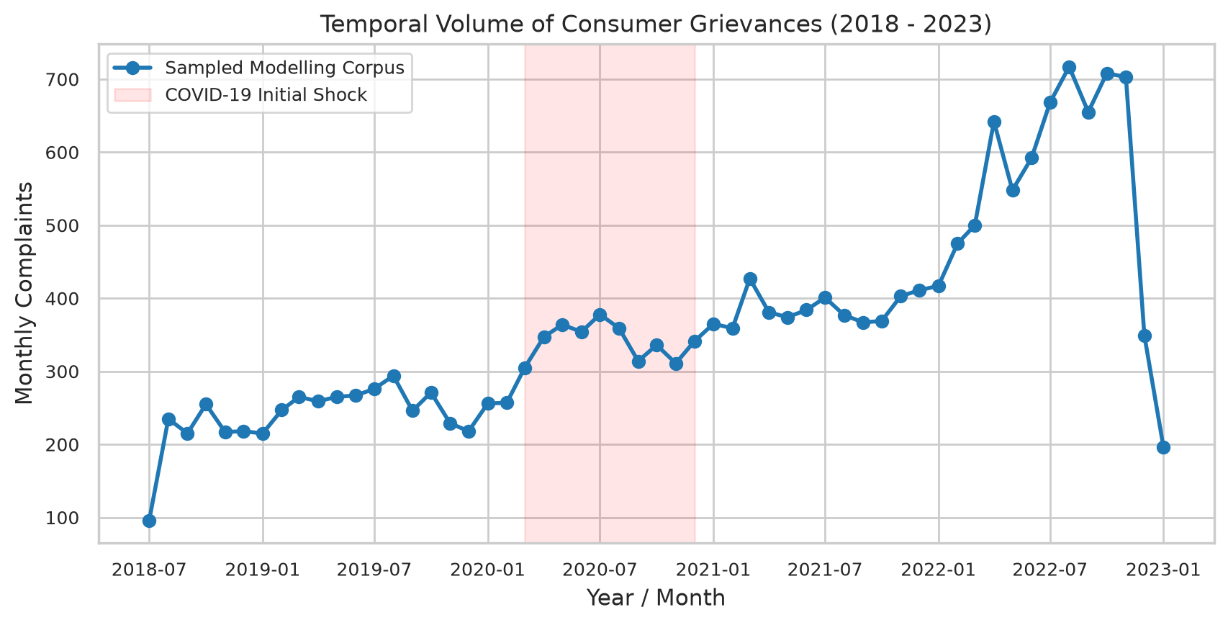
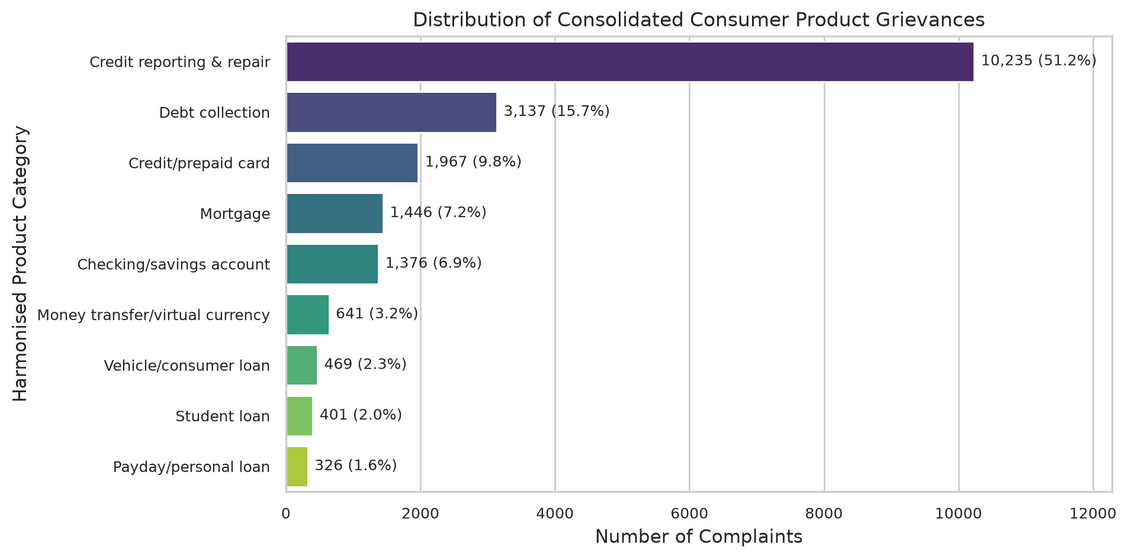
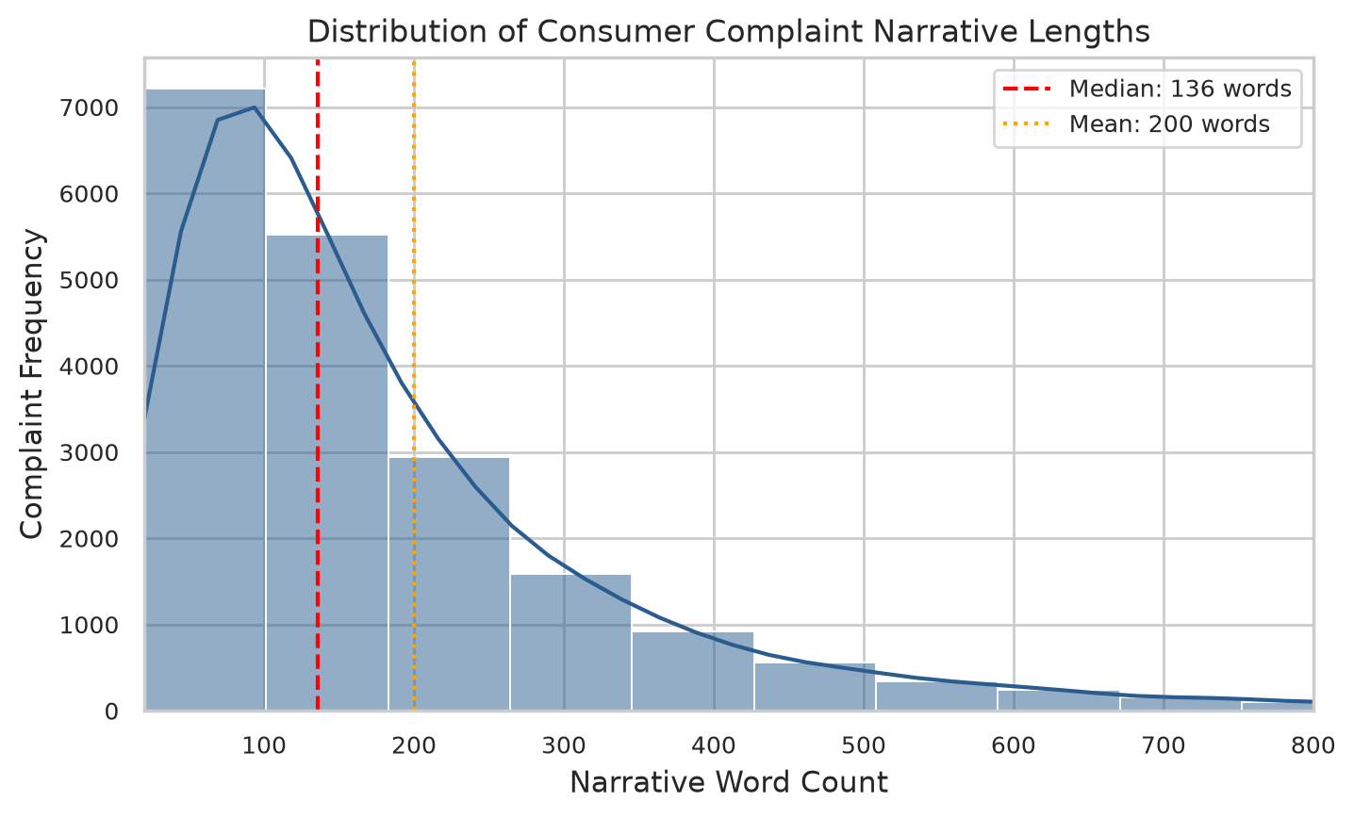
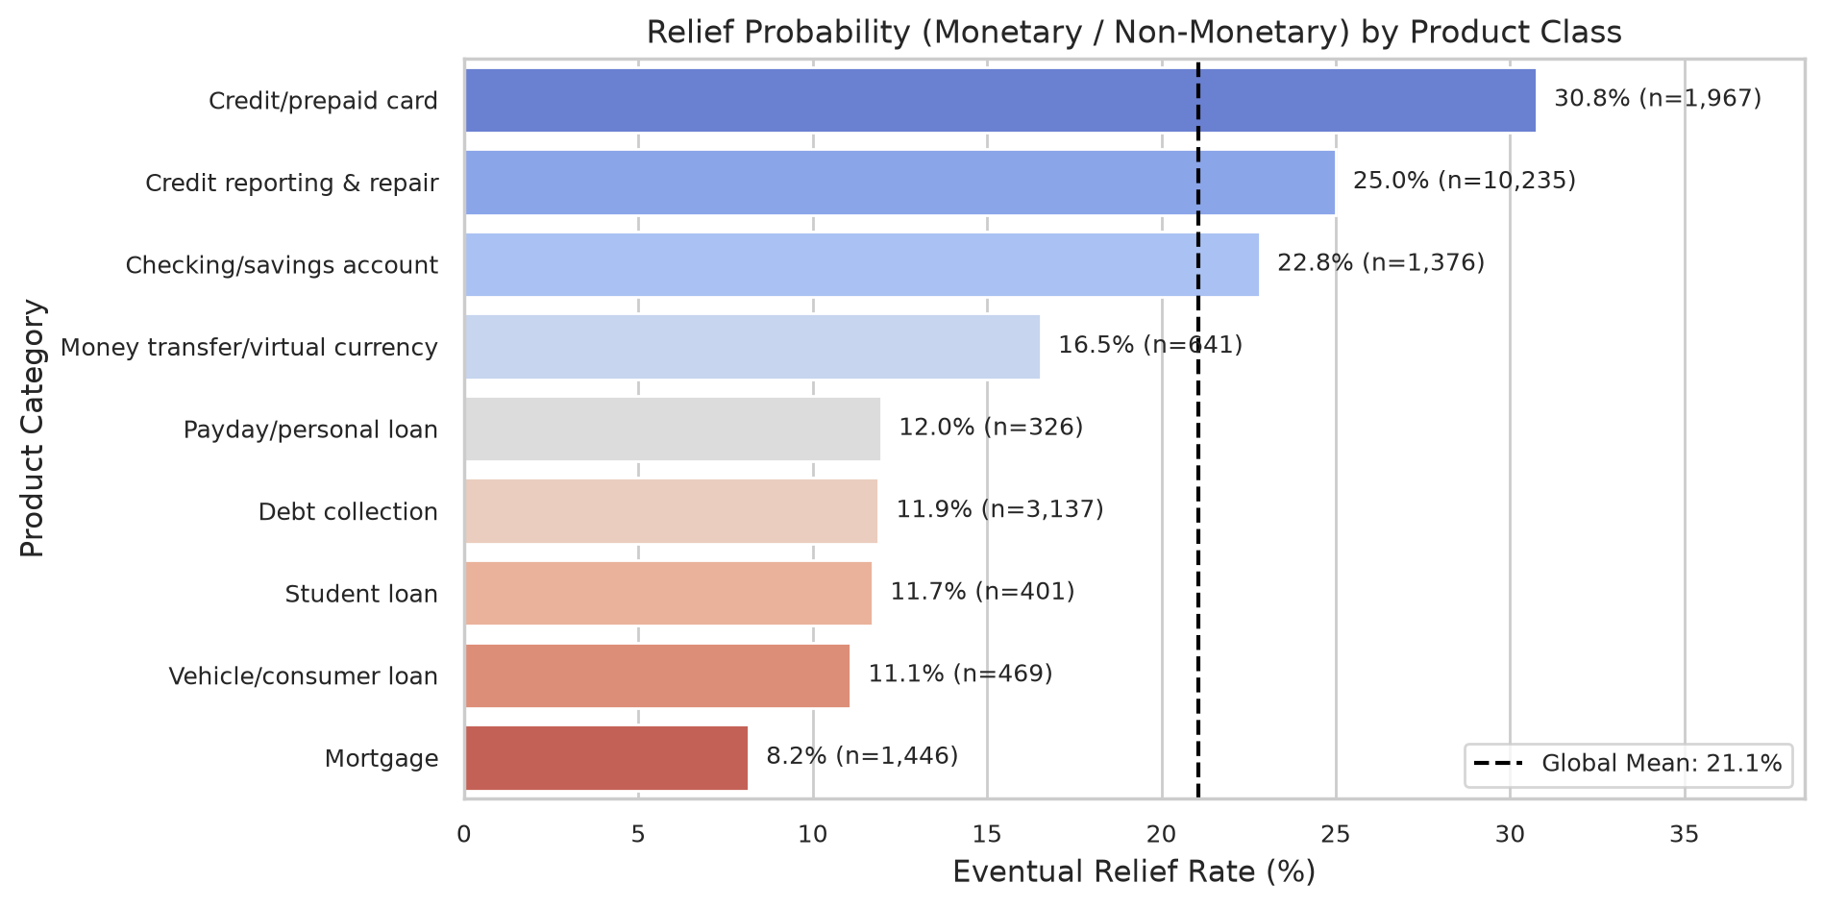
Exploratory Data Analysis
Understanding the complaint corpus: temporal trends, class imbalance, and narrative characteristics
Fig: Monthly complaint volume (2018–2023). COVID-19 surge clearly visible in 2020–2021.
Fig: 9-class product distribution. Credit Reporting = 51.2% (severe imbalance).
CBS3009 | ComplaintScope | VIT Vellore

Slide 7
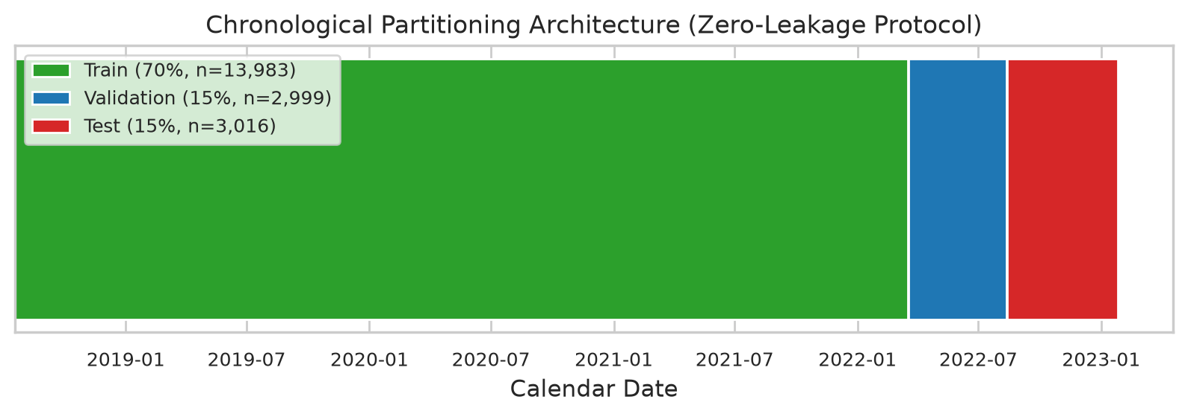
Chronological Data Partitioning
The single most critical methodological decision — preventing temporal data leakage
Why Chronological Splits?
▸ Financial complaint language is non-stationary — it evolves with new products, regulations, and events
▸ COVID-19, CARES Act, and new fintech products create novel terminology in 2020–2023
▸ Random splits leak future terms into training data → artificially inflated accuracy
▸ AQ3 Evidence: Random split = 0.9330 F1 vs. Chronological = 0.7317 F1 (Δ = −20.13 pp)
▸ Any CFPB complaint classifier evaluated with random splits overstates real performance by ~20 pp
Split Summary:
Split
Records
Date Range
Train (70%)
13,983
2018-07-19 → 2022-03-17
Val (15%)
2,999
2022-03-18 → 2022-08-12
Test (15%)
3,016
2022-08-13 → 2023-01-26
CBS3009 | ComplaintScope | VIT Vellore

Slide 8
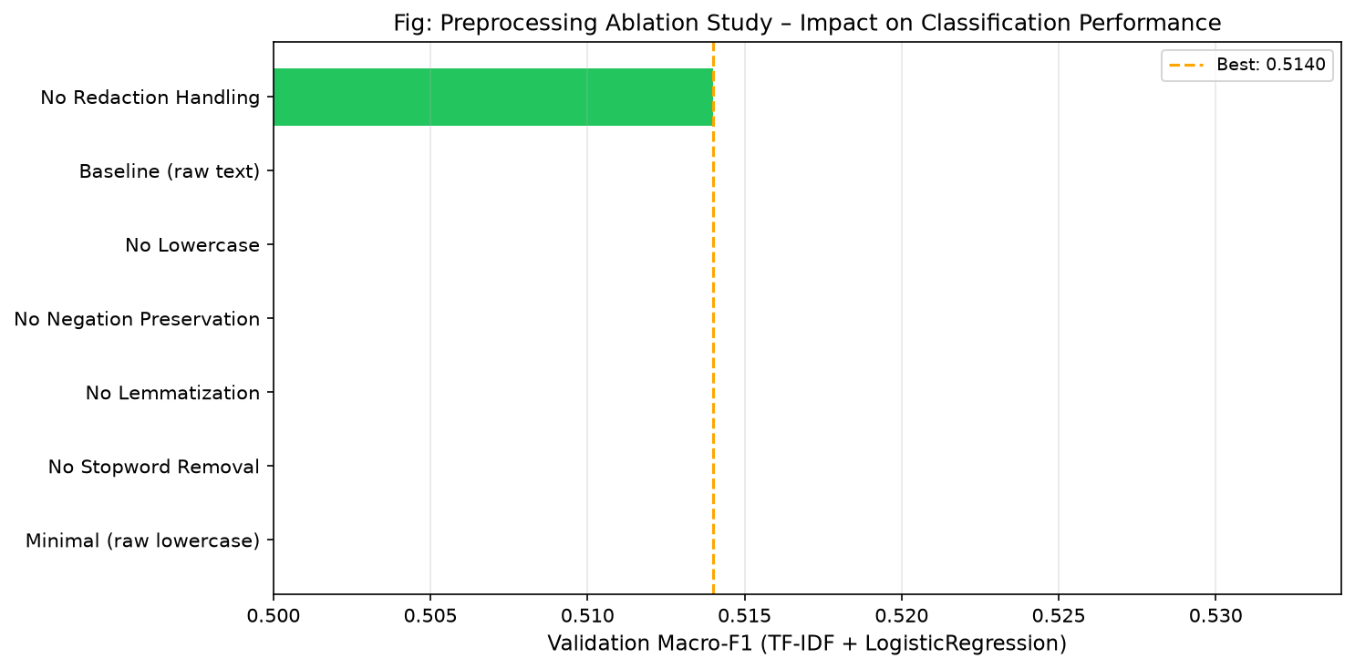
Text Preprocessing & Ablation Study (AQ4)
Every preprocessing decision is empirically justified — not assumed
Ablation Results (7 Configurations)
★ ★ No Redaction (remove XXXX)
0.5140
+1.49pp
Baseline (placeholder tokens)
0.4991
—
No Lowercasing
0.4978
−0.13pp
No Negation Preservation
0.4976
−0.15pp
No Lemmatisation
0.4635
−3.56pp
No Stopword Removal
0.4236
−7.55pp
Minimal (raw lowercase only)
0.4203
−7.88pp
Key Takeaway: Stopword removal (+7.55pp) and lemmatisation (+3.56pp) are the two most critical preprocessing steps. Negation preservation prevents semantic inversion in dispute sentences.
CBS3009 | ComplaintScope | VIT Vellore

Slide 9
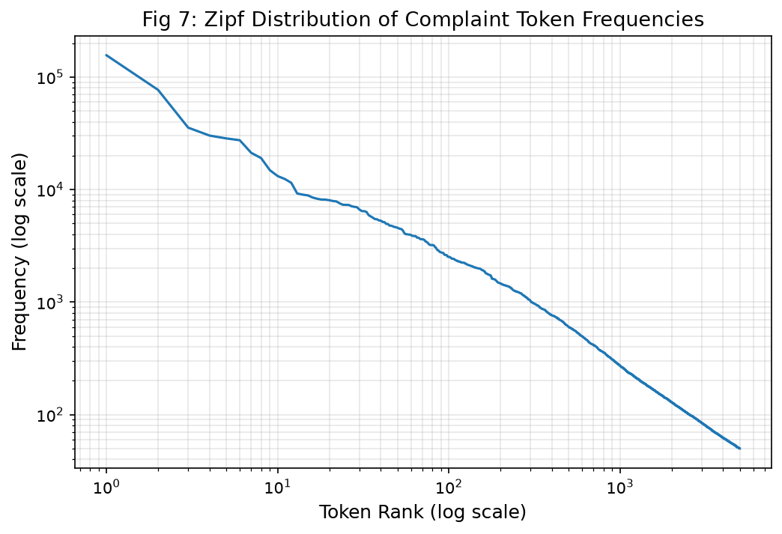
Feature Engineering
Three complementary representations — ALL fitted strictly on training data only
Sublinear TF-IDF
MiniLM-L6-v2 Embeddings
30,000 features, bigrams (1–2)
Sublinear tf = 1 + log(tf)
Zipf α≈1.05 justifies dampening
For: Classification & Relief
384-dim dense vectors
Pre-trained on 1B+ sentence pairs
L2-normalised, cached to .npy
For: kNN Retrieval & Classification
Bag of Words
Operational Metadata
30,000 features, raw counts
Bigrams (1–2), min_df=2
No IDF weighting
For: Naïve Bayes baselines
One-hot: channel, tags, state
Company ID EXCLUDED (prevents drift)
Ablation shows company overfits
For: Relief Prediction experiment
CBS3009 | ComplaintScope | VIT Vellore
P@k Retrieval (MiniLM embeddings): P@1=80.2% P@3=91.9% P@5=94.3% P@10=96.7%

Slide 10
Section 01
Product Classification
9-Class Complaint Routing — Benchmark Results & Temporal Concept Drift Analysis
CBS3009 | ComplaintScope | VIT Vellore

Slide 11
Component 1: Product Classification Benchmark
9 models trained on identical chronological splits — champion selected by Validation Macro-F1
Model
Val F1
Test F1
Test Acc
95% Bootstrap CI
★ LinearSVC (Calibrated) ← Champion
0.7349
0.7394
87.43%
[0.708, 0.767]
LogisticRegression (Val-Tuned)
0.7171
0.7319
87.27%
[0.698, 0.761]
MiniLM-L6-v2 + LR
0.7157
0.7002
85.68%
[0.668, 0.730]
LogisticRegression (Default)
0.6644
0.7054
87.30%
[0.667, 0.734]
ComplementNB
0.6264
0.6457
85.48%
[0.617, 0.673]
MultinomialNB
0.6206
0.6218
84.85%
[0.592, 0.647]
DecisionTree (depth=10)
0.5070
0.4765
77.25%
[0.445, 0.505]
Dummy (Stratified Baseline)
0.0923
0.0950
31.07%
[0.086, 0.105]
0.7394
87.43%
χ²=535.64
p<10⁻¹¹⁸
20/20
Test Macro-F1
(Champion LinearSVC)
Test Accuracy
(Champion)
McNemar Significance
vs. Baseline
Automated Tests
Passing ✓
CBS3009 | ComplaintScope | VIT Vellore

Slide 12
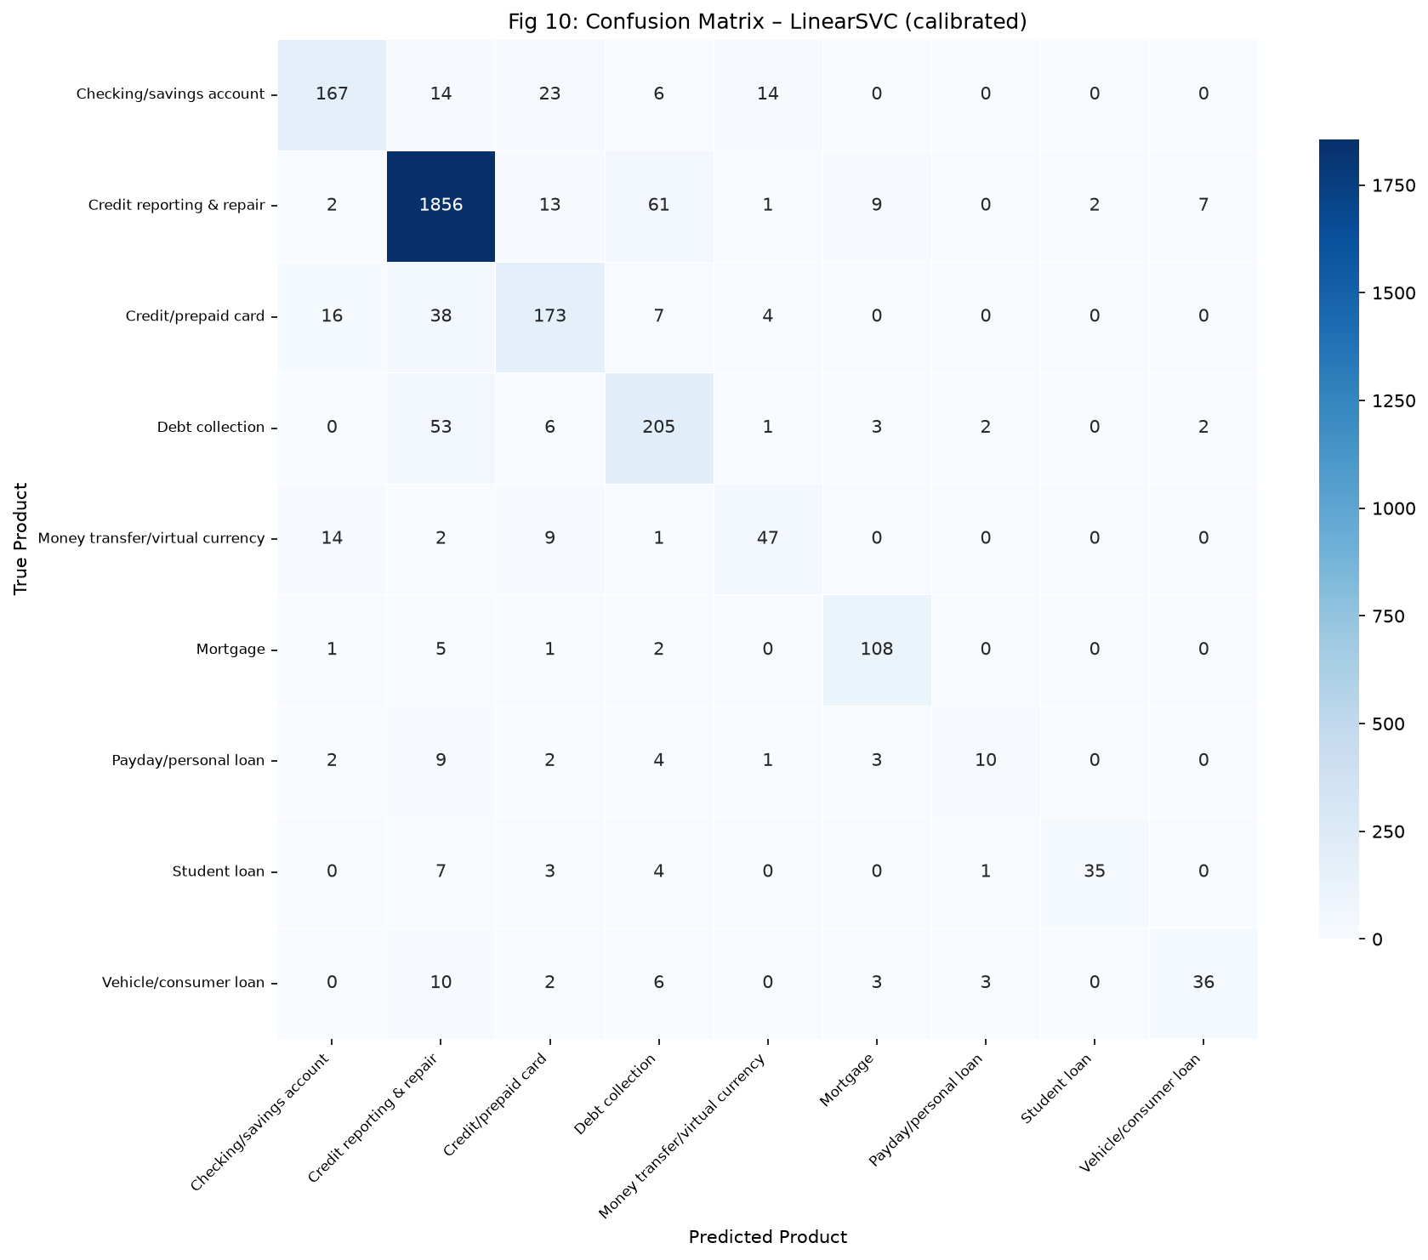
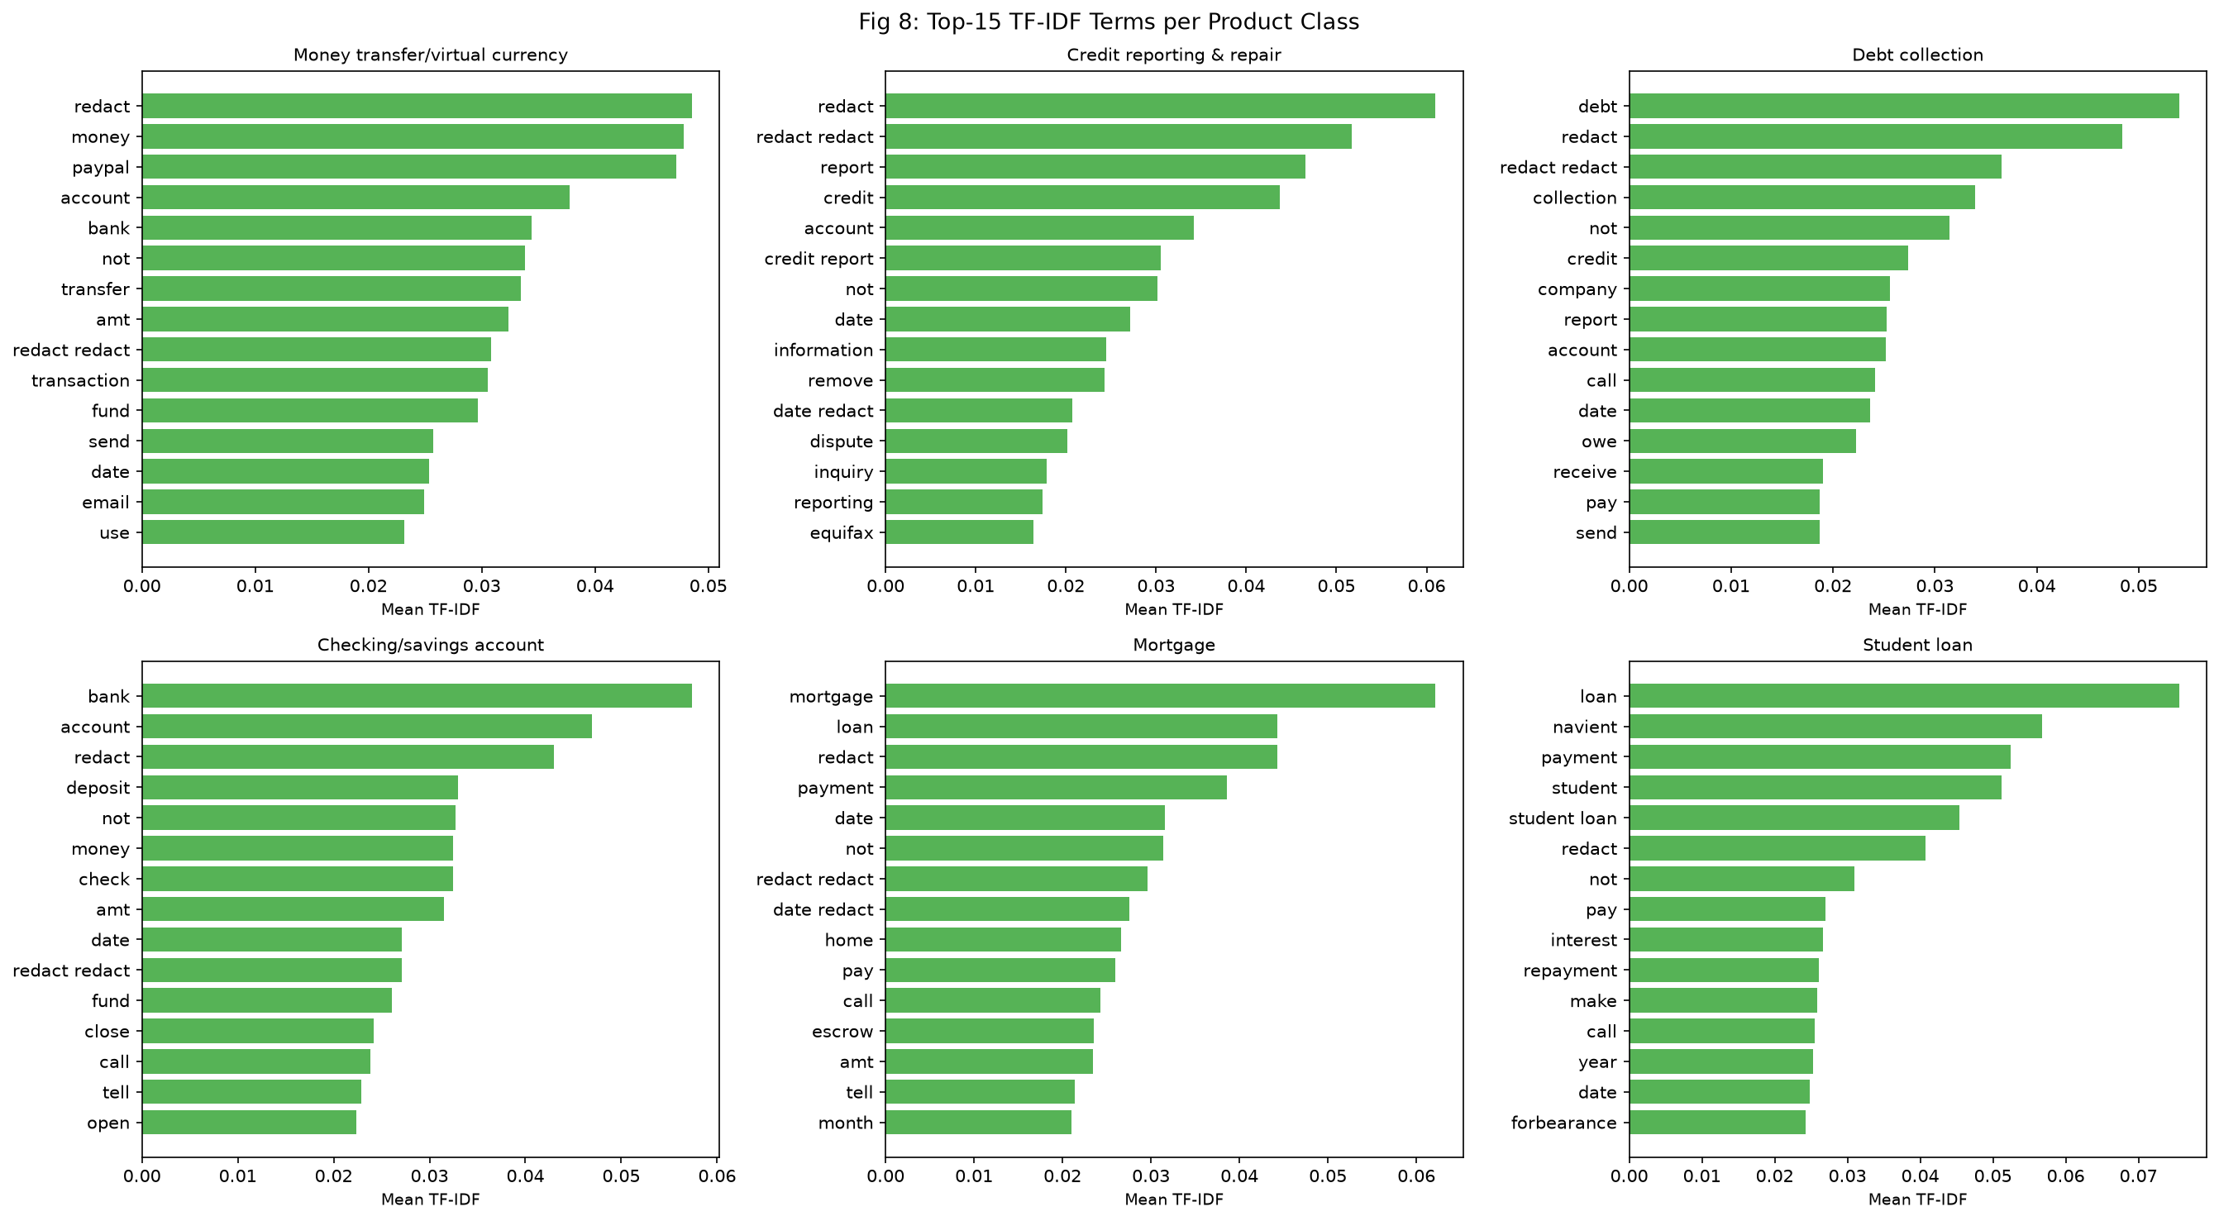
Classification Results: Confusion Matrix & Top Terms (AQ1)
Primary error boundary: Credit Reporting ↔ Debt Collection (31.7% of all misclassifications)
Error Analysis: Credit Reporting ↔ Debt Collection confusion arises because third-party debt collectors routinely threaten credit bureau filings as enforcement tactics, creating overlapping lexical signatures in both categories.
CBS3009 | ComplaintScope | VIT Vellore

Slide 13
Temporal Concept Drift Analysis (AQ3)
Why random train/test splits are dangerously misleading for financial NLP models
0.9330
0.7317
−20.13 pp
Macro-F1
Random Split
(data-leaking — INVALID)
Macro-F1
Chronological Split
(honest evaluation)
Absolute Performance Drop
(Temporal Concept Drift)
Δ = −0.2013
What this means — and why it matters:
▸ Random k-fold cross-validation would report 93.3% Macro-F1 — a dangerously overconfident and misleading estimate
▸ Real production performance is only 73.2% Macro-F1 — 20 percentage points lower than what random splits show
▸ The gap is caused by temporal concept drift: COVID-19 terminology, CARES Act language, and new fintech products post-2022
▸ Operational implication: Any deployed CFPB complaint classifier MUST be retrained every 6 months to maintain accuracy
▸ Academic implication: Prior CFPB NLP papers reporting >90% accuracy with random splits are systematically overstating performance
CBS3009 | ComplaintScope | VIT Vellore

Slide 14
Section 02
Relief-Risk Prediction
Prioritising the 16.3% of complaints that result in consumer remediation
CBS3009 | ComplaintScope | VIT Vellore

Slide 15
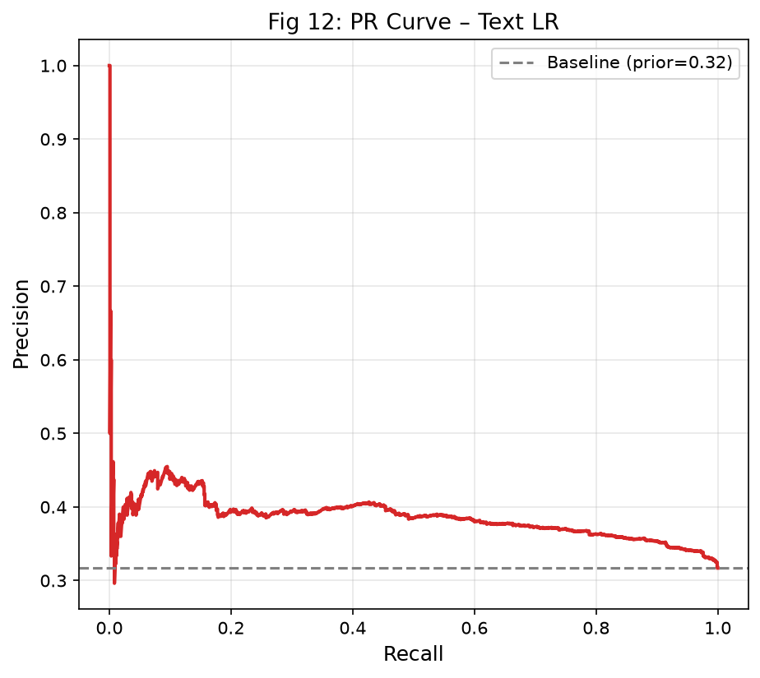
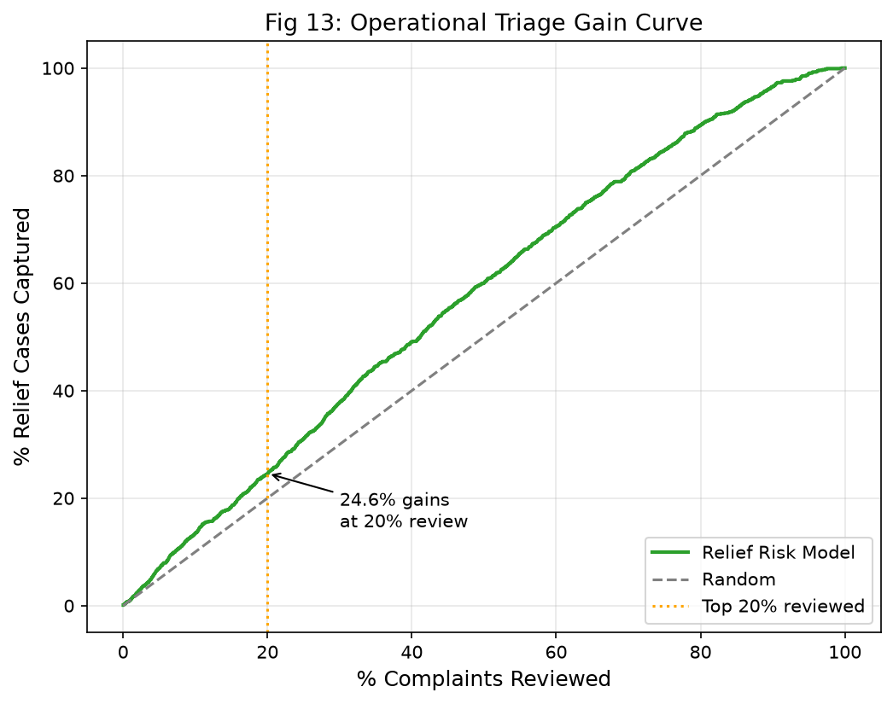
Component 2: Relief-Risk Prediction & Triage Simulation (AQ2 & AQ7)
Predicting consumer relief probability to prioritise investigator workload
relief = 1: 'Closed with monetary/non-monetary relief' | Base rate = 16.3% | Class weight ratio = 5.15:1 | Metric: PR-AUC (class-imbalance robust)
Triage Simulation
Random review rate:
16.3%
(base rate)
Top 5% audit queue:
44.67% precision
1.41× lift
Top 20% audit queue:
Captures 24.48%
of ALL relief cases
Brier Score:
Model
PR-AUC
ROC-AUC
Prec@5%
Lift@5%
0.2316
(well-calibrated)
★ Text LR (Champion)
0.3865
0.6063
44.67%
1.41×
Text + Meta LR
0.3796
0.6023
40.00%
1.26×
PR-AUC 95% CI:
HistGradientBoosting
0.3780
0.5929
44.00%
1.39×
[0.359, 0.415]
Prior-Rate Baseline
0.3170
0.5000
34.00%
1.07×
CBS3009 | ComplaintScope | VIT Vellore

Slide 16
Section 03
Topic Discovery
What hidden complaint themes exist in 19,998 narratives? — LDA, NMF & K-Means benchmarked
CBS3009 | ComplaintScope | VIT Vellore

Slide 17
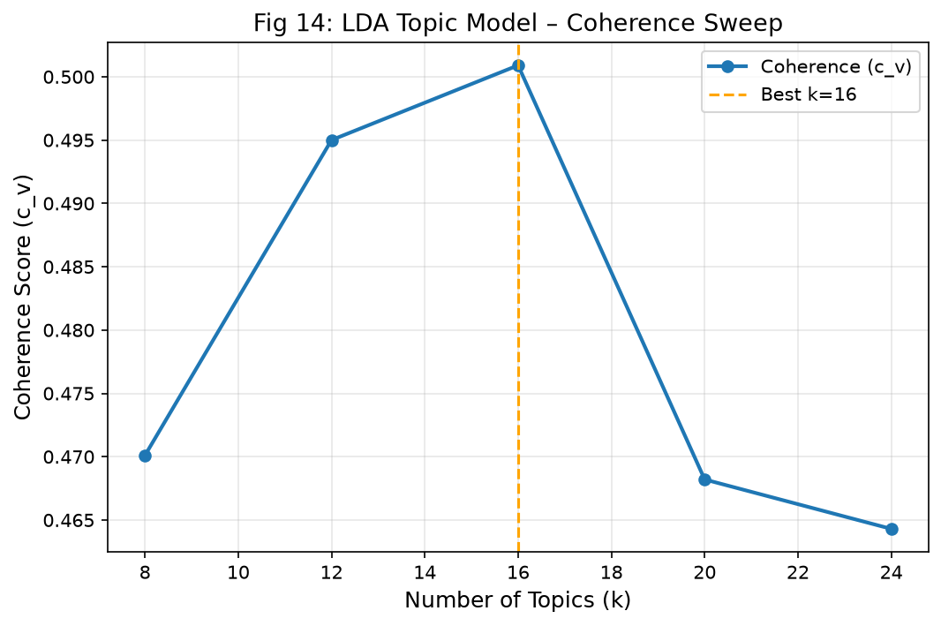
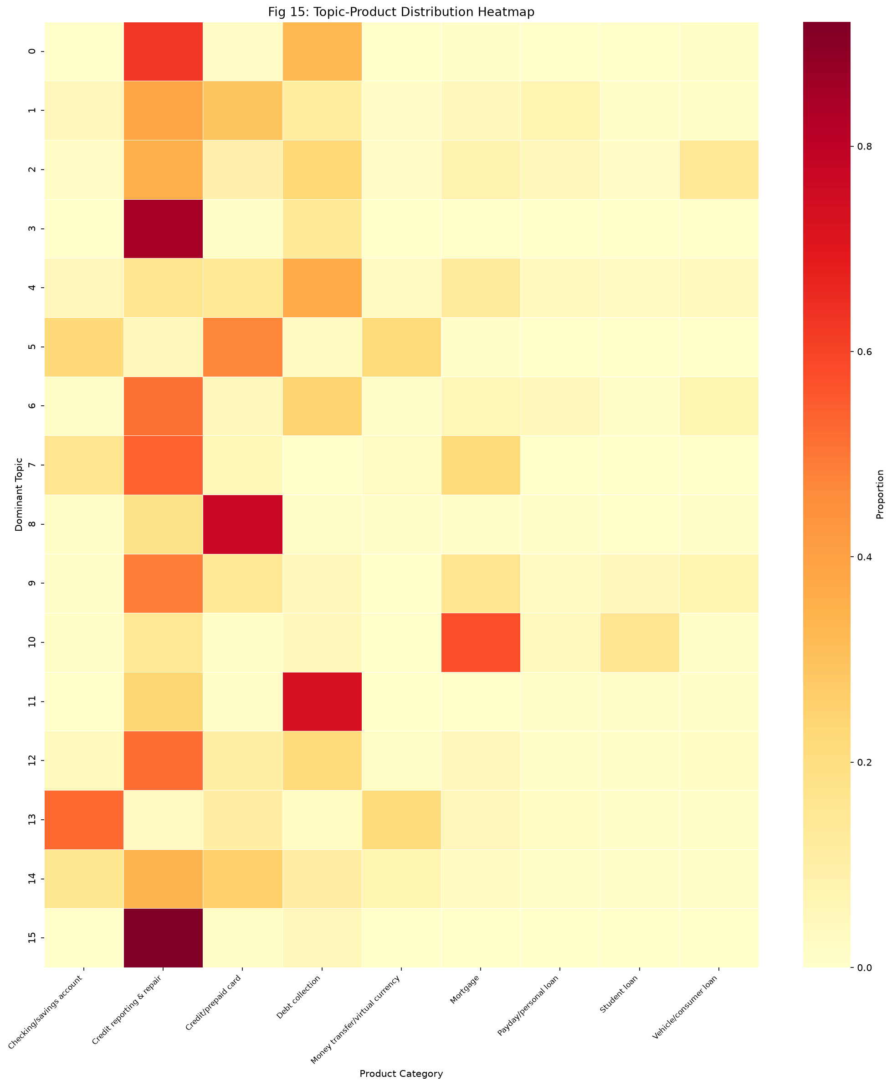
Component 3a: Topic Discovery — LDA Coherence Sweep
k ∈ {8, 12, 16, 20, 24} evaluated for LDA, NMF, and K-Means on dense embeddings
k = 16
0.5009
0.7312
K-Means Failed
0.021–0.026
Optimal Topics
(LDA)
C_V Coherence
(semantic quality)
Topic Diversity
(non-redundancy)
Silhouette Score
(too low to use)
Heatmap confirms semantic validity: discovered topics map specifically to known CFPB product categories (e.g., Topic 3 = Mortgage only; Topic 0 = Credit Reporting only).
CBS3009 | ComplaintScope | VIT Vellore

Slide 18
16 Discovered Complaint Themes
LDA k=16 reveals interpretable regulatory complaint categories beyond CFPB's official taxonomy
T0
T1
T2
T3
T4
T5
T6
T7
Credit Bureau
Disputes
Debt Collection
Harassment
Student Loan
Servicing
Mortgage
Forbearance
Payday & High-
Interest Lending
Identity Theft
& Fraud
Checking Account
Overdrafts
Credit Card
Billing
credit, report, dispute, bureau
debt, collection, validate, call
loan, student, servicer, federal
mortgage, forbearance, escrow
payday, interest, lender, fee
identity, theft, fraud, police
account, overdraft, bank, fee
card, charge, dispute, merchant
T8
T9
T10
T11
T12
T13
T14
T15
Auto Loan
Repossession
Foreclosure
& Property
Consumer Rights
& Communication
Personal Data
& Privacy
Credit Inquiry
& Application
Wire Transfer
& Money Services
Account Closure
& Funds Access
COVID Relief
& Stimulus
vehicle, repossess, auto, loan
foreclosure, escrow, servicer
contact, cease, right, letter
information, personal, data, share
inquiry, hard pull, approve
transfer, wire, money, send
account, close, fund, hold
covid, stimulus, relief, deferral
CBS3009 | ComplaintScope | VIT Vellore

Slide 19
Section 04
Burst Detection
Dual-Engine Early-Warning System — Detecting crises 2–3 months before they peak
CBS3009 | ComplaintScope | VIT Vellore

Slide 20
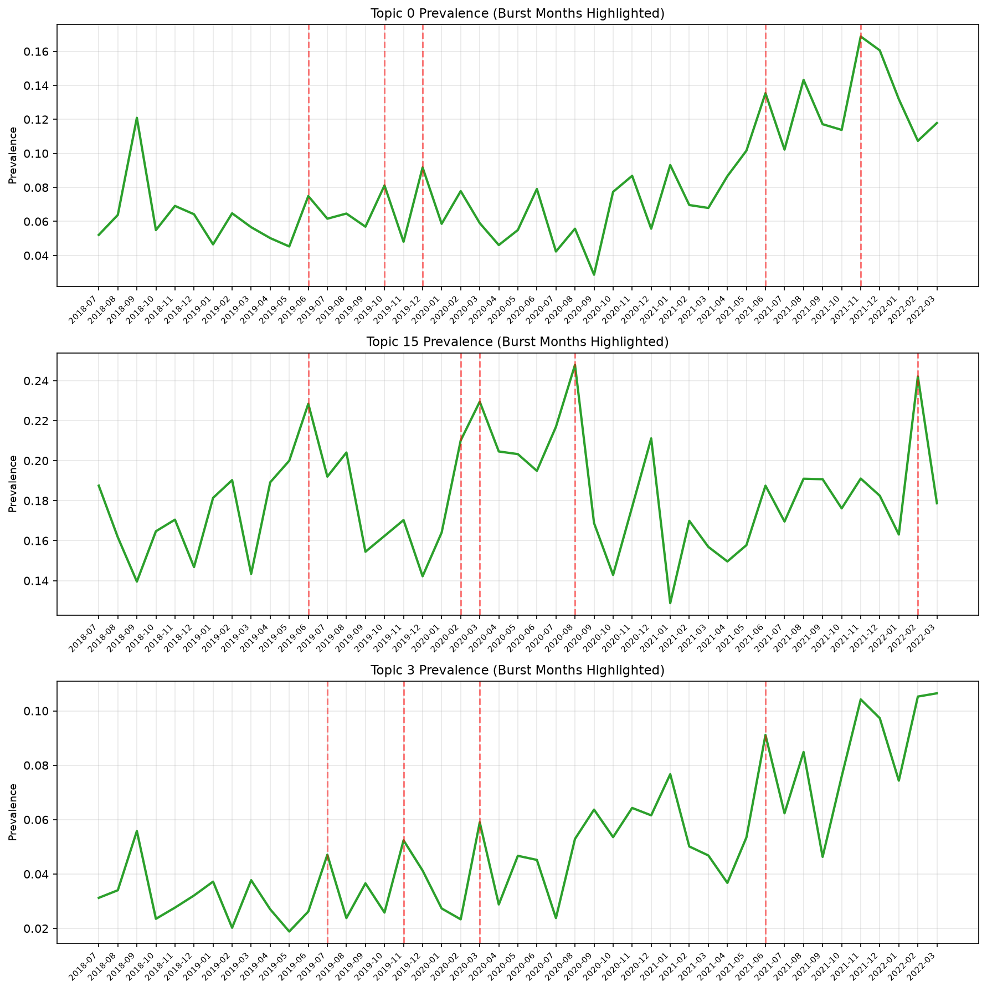
Component 3b: Emerging-Issue Burst Detection (AQ5)
Validated against 5 pre-registered keyword-proxy ground truths — 2–3 month early-warning lead time
Detector A: Rolling Z-Score
Detector B: EWMA-CUSUM Control Chart
Formula: z_t = (x_t − μ_{t−12:t−1}) / σ_{t−12:t−1}
Window: 12-month trailing baseline
Alert threshold: z > 2.0σ
Strength: Ultra-high precision (100% on overdraft & mortgage forbearance)
Use case: Immediate sharp-spike alerts
EWMA span = 6 months | CUSUM threshold h = 4.0
S_t = max(0, S_{t−1} + (x_t − EWMA_t))
Strength: Detects slow-burning multi-month regulatory escalations
Achieves F1 = 0.8000 (Mortgage Forbearance), 0.7568 (COVID-19)
Use case: Policy preparation with 2–3 month lead time
Validation Results (5 Proxies)
Proxy
Z F1
CUSUM F1
Lead
COVID-19 Relief
0.24
0.757
+2 mo
Overdraft Fees
0.35
0.250
≈0
Credit Disputes
0.22
0.703
3yr drift
Debt Coll. Reg F
0.38
0.750
+1 mo
Mortgage Forbear.
0.25
0.800
+3 mo
CBS3009 | ComplaintScope | VIT Vellore

Slide 21
Section 05
Network Analysis & Systemic Risk Index
Bipartite Institutional Graph Projection → Louvain Community Detection → Composite SRI
CBS3009 | ComplaintScope | VIT Vellore

Slide 22
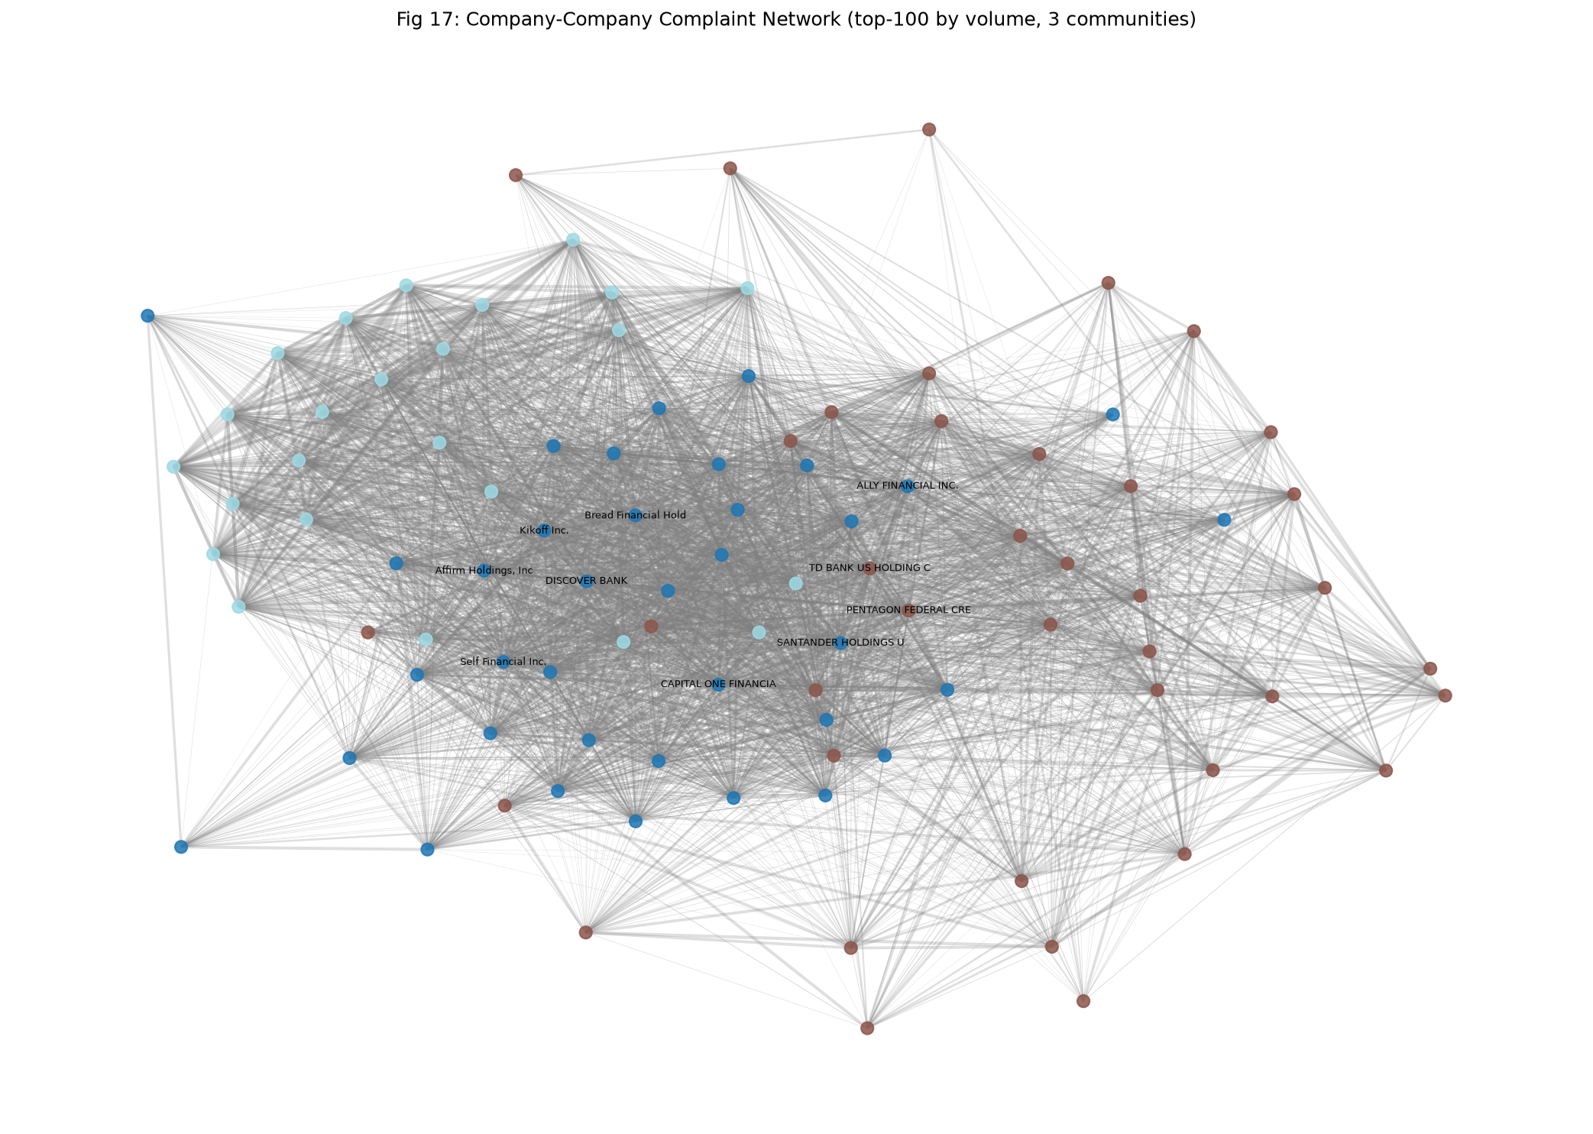
Component 4: Bipartite Network Analysis & Community Detection (AQ6)
2,502 institutions × 170 CFPB issues → projected co-occurrence network → Louvain communities
Network Metrics
Bipartite nodes: 2,502 companies + 170 issues
Bipartite edges: 18,204 weighted
Projected nodes: Top-100 institutions
Projected edges: 3,774 (Jaccard sim ≥ 0.1)
Communities: 3 (Louvain algorithm)
Modularity Q: 0.2568
Null model Q̄: 0.0671 ± 0.0084
Significance: p = 0.000 (< 0.001)
Community 0 (Blue)
Community 1 (Orange)
Community 2 (Green)
Credit bureaus & FinTech credit builders
TransUnion, Experian, Equifax
Mega-banks & consumer lenders
JPMorgan, Wells Fargo, BofA
Mortgage servicers & specialty lenders
Nationstar, Ocwen, Freedom
CBS3009 | ComplaintScope | VIT Vellore

Slide 23
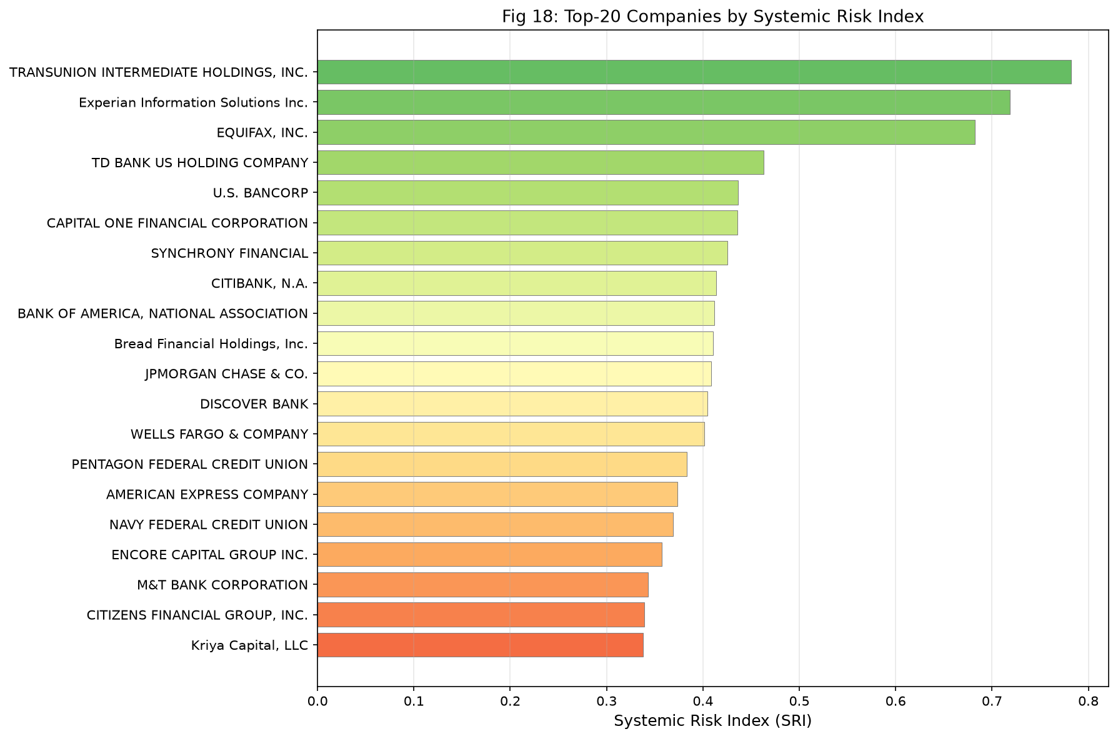
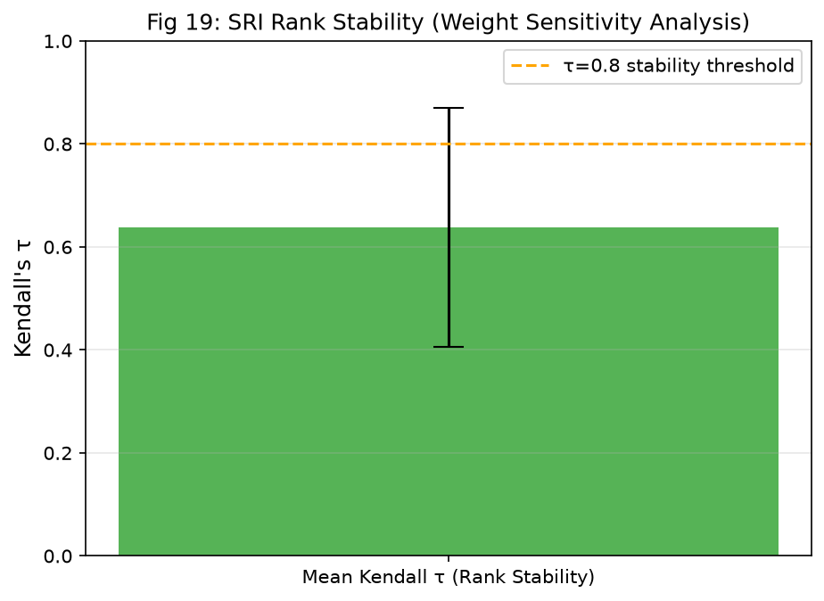
Component 5: Composite Systemic Risk Index (SRI)
5-dimension normalised risk ranking — robust to weight variation (Dirichlet sensitivity τ = 0.6374)
SRI Formula: SRI = 0.25 × V_volume + 0.20 × R_relief_deficit + 0.20 × B_breadth + 0.20 × C_centrality + 0.15 × S_burst_intensity
Caption: Top-25 institutions by SRI. Three credit bureaus dominate risk ranking.
Caption: Sensitivity analysis — top-3 bureaus maintain ranks 1–3 in >94% of Dirichlet simulations.
Rank
Institution
SRI Score
Relief Rate
Key Risk
1
TransUnion Intermediate Holdings
0.7819
46.3%
Highest volume + centrality
2
Experian Information Solutions
0.7187
33.4%
Very high volume + breadth
3
EQUIFAX, INC. ⚠
0.6825
4.3%
CRITICAL relief deficit — 10× below peers
4
TD Bank US Holding Company
0.4631
45.7%
High issue breadth (150/170)
CBS3009 | ComplaintScope | VIT Vellore
5
U.S. Bancorp
0.4365
41.8%
High breadth (162/170)

Slide 24
Results Summary — All 5 Components at a Glance
ComplaintScope delivers five distinct tiers of actionable regulatory intelligence
Component 1
Component 2
Component 3a
Component 3b
Comps. 4–5
Product Classification
Relief-Risk Prediction
Topic Discovery
Burst Detection
Network + SRI
Macro-F1 = 0.7394
Accuracy = 87.43%
95% CI [0.708, 0.767]
PR-AUC = 0.3865
Lift@5% = 1.41×
Recall@20% = 24.48%
C_V = 0.5009
16 Themes @ k=16
Diversity = 0.7312
CUSUM F1 = 0.8000
+2–3 months lead
Z-Score P = 100%
Q = 0.2568, p<0.001
3 Communities
Top SRI = 0.7819
9-class triage, LinearSVC
Statistical sig. p<10⁻¹¹⁸
Text LR champion
Calibrated probabilities
LDA > NMF > K-Means
Ground-truth validated
Dual-engine: Z-Score + CUSUM
5 proxy validations
Louvain + Dirichlet robustness
τ = 0.6374 sensitivity
Full Reproducibility: Global Seed = 42 | 20/20 pytest tests passing | <10 MB artifacts | Zero external API dependencies
CBS3009 | ComplaintScope | VIT Vellore

Slide 25
Conclusions & Future Work
ComplaintScope delivers validated, deployable regulatory intelligence from raw financial complaint narratives
Key Contributions
Future Work Directions
✓ Rigorous temporal evaluation framework — exposed −20.13 pp concept drift gap that invalidates prior random-split literature
✓ Calibrated multi-task relief prediction with Lift@5% = 1.41× operational triage efficiency gain
✓ Integrated topic discovery + burst detection validated against independently-defined keyword ground truths (CUSUM-F1 = 0.80)
✓ Statistically validated institutional network communities (Q = 0.2568, p < 0.001 vs. 100 null rewirings)
✓ 5-dimension Composite SRI with Dirichlet robustness — identifies TransUnion, Experian & Equifax as top systemic risks
✓ End-to-end reproducible pipeline: Seed=42, 20/20 tests, <10MB artifacts, Streamlit dashboard
→ Fine-tune FinBERT / LegalBERT on CFPB narratives for improved domain-specific classification
→ Online learning with ADWIN / Reservoir Sampling to adapt to temporal concept drift without full retraining
→ Causal inference (Double ML, IV regression) to identify what institutional practices cause low relief rates
→ Multilingual extension (Spanish, etc.) to improve coverage of underserved CFPB complaint populations
→ Dynamic temporal network snapshots (quarterly) to capture institutional risk trajectory over time
→ Deploy as CFPB API integration for real-time triage scoring and burst monitoring
CBS3009 | ComplaintScope | VIT Vellore

Slide 26
Academic References
26 peer-reviewed publications underpinning ComplaintScope's methodology
[1] Blei, Ng & Jordan (2003). LDA. JMLR, 3, 993–1022.
[2] Wang & Manning (2012). Baselines & Bigrams. ACL 2012.
[3] Reimers & Gurevych (2019). Sentence-BERT. EMNLP 2019.
[4] Pedregosa et al. (2011). Scikit-learn. JMLR, 12.
[5] Röder, Both & Hinneburg (2015). Topic Coherence. WSDM.
[6] Saito & Rehmsmeier (2015). PR vs ROC. PLOS ONE.
[7] Joachims (1998). Text Classification with SVM. ECML.
[8] Newman (2006). Modularity in Networks. PNAS.
[9] Blondel et al. (2008). Louvain Algorithm. J.Stat.Mech.
[10] Battiston et al. (2012). DebtRank. Scientific Reports.
[11] Kleinberg (2003). Bursty Streams. DMKD.
[12] Montgomery (2019). Statistical Quality Control (8th ed.).
[13] Niculescu-Mizil & Caruana (2005). Good Probabilities. ICML.
[14] Araci (2019). FinBERT. arXiv:1908.10063.
[15] Chalkidis et al. (2020). LEGAL-BERT. EMNLP Findings.
[16] Lancichinetti & Fortunato (2010). Community Detection. PRE.
[17] Lee & Seung (1999). NMF. Nature, 401.
[18] Efron (1979). Bootstrap Methods. Ann. Statistics.
[19] Gebru et al. (2021). Datasheets for Datasets. CACM.
[20] McNemar (1947). Paired Proportions Test. Psychometrika.
[21] Kogan et al. (2009). Financial Reports. NAACL-HLT.
[22] Hagberg et al. (2008). NetworkX. SciPy.
[23] Honnibal & Montani (2017). spaCy 2. NLP.
[24] Řehůřek & Sojka (2010). Gensim. LREC.
[25] Leskovec et al. (2009). Meme-Tracking. KDD.
[26] CFPB. (2023). Consumer Complaint Database. CFPB.gov.
CBS3009 | ComplaintScope | VIT Vellore

Slide 27
Thank You
Questions & Discussion
Ruhaan Bansal (23BBS0046) | Vedant Rajesh (23BBS0037) | Anish Desai (23BBS0119)
CBS3009 — Advanced Social, Text and Media Analytics
📦 19,998 CFPB narratives | 2018–2023 | CC0 Public Domain
🏆 Test Macro-F1 = 0.7394 | Lift@5% = 1.41× | AUC-PR = 0.3865
🔍 LDA k=16, C_V = 0.5009 | CUSUM F1 = 0.80 | 2–3 months lead time
🕸️ Q = 0.2568, p < 0.001 | Top SRI = 0.7819 (TransUnion) | 3 Communities
✅ 20/20 pytest tests pass | Seed = 42 | Fully reproducible

