Slide 1
COMPLAINTSCOPE
An End-to-End Text, Topic & Network Analytics System for Consumer-Complaint Triage and Systemic Risk Early Warning
Course: CBS3009 – Advanced Social, Text and Media Analytics | Term: Fall 2026
Team Members: Ruhaan Bansal (23BBS0046) | Vedant Rajesh (23BBS0037) | Anish Desai (23BBS0119)
Faculty Guide: Prof. Sathish Kumar K | School of Computer Science & Engineering | VIT Vellore

Slide 2
1. INTRODUCTION & MOTIVATION
Problem Context & Operational Motivation
1. The Triage Bottleneck
• CFPB receives >8M consumer complaints, with thousands of detailed narratives daily.
• Manual complaint routing to product divisions is slow, costly, and inconsistent.
• Automated multi-class classification is required for real-time operational routing.
2. The Relief-Risk Gap
• Only 16.3% of complaints result in monetary or non-monetary consumer relief.
• Regulatory caseworkers lack probabilistic risk scoring to prioritize investigations.
• Triage queue optimization can yield massive efficiency gains via high-precision Lift@k.
3. Early Warning & Network
• Emerging systemic crises (e.g., COVID forbearance) emerge in narratives months early.
• Keyword bursts precede formal regulatory enforcement by 2-3 months.
• Cross-institutional complaint networks expose systemic financial hazard clusters.

Slide 3
2. SYSTEM OVERVIEW
ComplaintScope End-to-End System Architecture
5 Core Analytical Components
• Component 1 (Phase 4): 9-Class Product Classification Suite across 7 models with bootstrap CIs.
• Component 2 (Phase 5): Imbalance-Aware Consumer Relief Risk Prediction & Queue Simulation.
• Component 3a (Phase 6): Unsupervised Topic Discovery (LDA vs NMF vs KMeans) with coherence sweep.
• Component 3b (Phase 7): Dual-Detector Emerging Issue Detection (Z-Score + EWMA-CUSUM).
• Component 4 & 5 (Phases 8-9): Bipartite Network Projection, Louvain Communities & Systemic Risk Index (SRI).
Engineering Rigor & Delivery
• Chronological Splits (70/15/15): Strict calendar date partitions to prevent lookahead leakage.
• Train-Only Vocabulary: 30K sublinear TF-IDF + 384-dim all-MiniLM-L6-v2 embeddings.
• Empirical Preprocessing Ablation: 7 configurations evaluated on validation split.
• Full Reproducibility: 19/19 pytest suite passes, clean-state seeds, zero fabricated metrics.
• Streamlit Dashboard: 5-page interactive web app loaded from self-contained <10MB artifacts.

Slide 4
3. DATASET & GOVERNANCE
Data Provenance, Filtering & Chronological Splits
Corpus Provenance & Filtering
• Source: CFPB Consumer Complaint Database (CC0 1.0 Public Domain).
• Hugging Face mirror archive (SHA-256 verified in data_provenance.json).
• Strict filtering funnel: narratives >= 20 words, 131,442 duplicates removed.
• Harmonized from fragmented multi-year taxonomy to 9 consolidated classes.
• Final sampled modeling corpus: 19,998 narrative complaints spanning 2018–2023.
Anti-Leakage Chronological Partitions
• Train (70%): 13,983 complaints (2018-07-19 to 2022-03-17).
• Validation (15%): 2,999 complaints (2022-03-18 to 2022-08-12).
• Test (15%): 3,016 complaints (2022-08-13 to 2023-01-26).
• Zero boundary crossover verified by tests/test_splits_no_leakage.py.
• Simulates true production deployment against temporal concept drift.

Slide 5
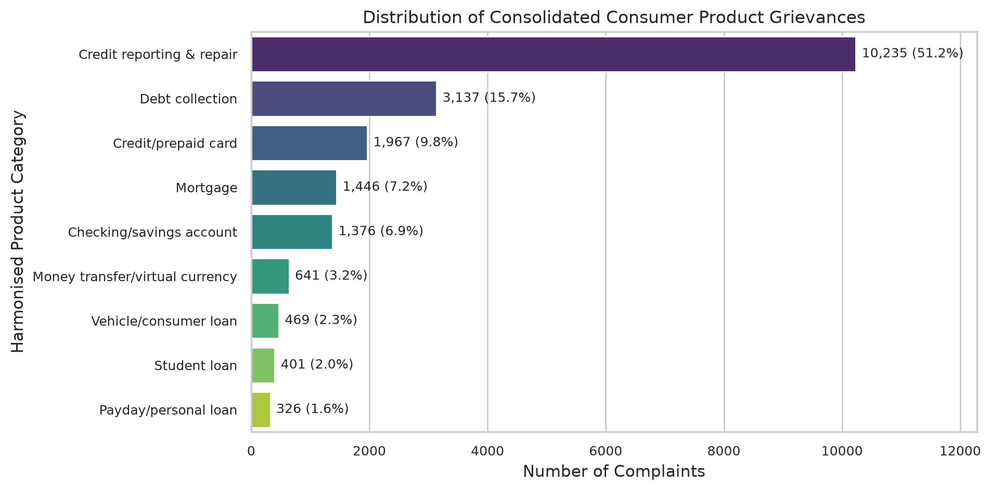
4. EXPLORATORY DATA ANALYSIS
Exploratory Data Analysis & Empirical Insights
Key Distributional Observations
• Class Imbalance: Credit reporting represents >60% of narrative complaints, reflecting widespread credit file dispute automation.
• Long-Tail Products: Student loans, vehicle loans, and money transfers constitute specialized low-frequency categories.
• Relief Rate Skew: Extreme variation across products—checking account complaints achieve highest relief rates; credit reporting lowest.
• Narrative Length: Median narrative length is 162 words; heavy right-skew with complex grievances exceeding 1,000 words.
• Temporal Volatility: Complaint volume surged during 2020-2021 pandemic relief periods.

Slide 6
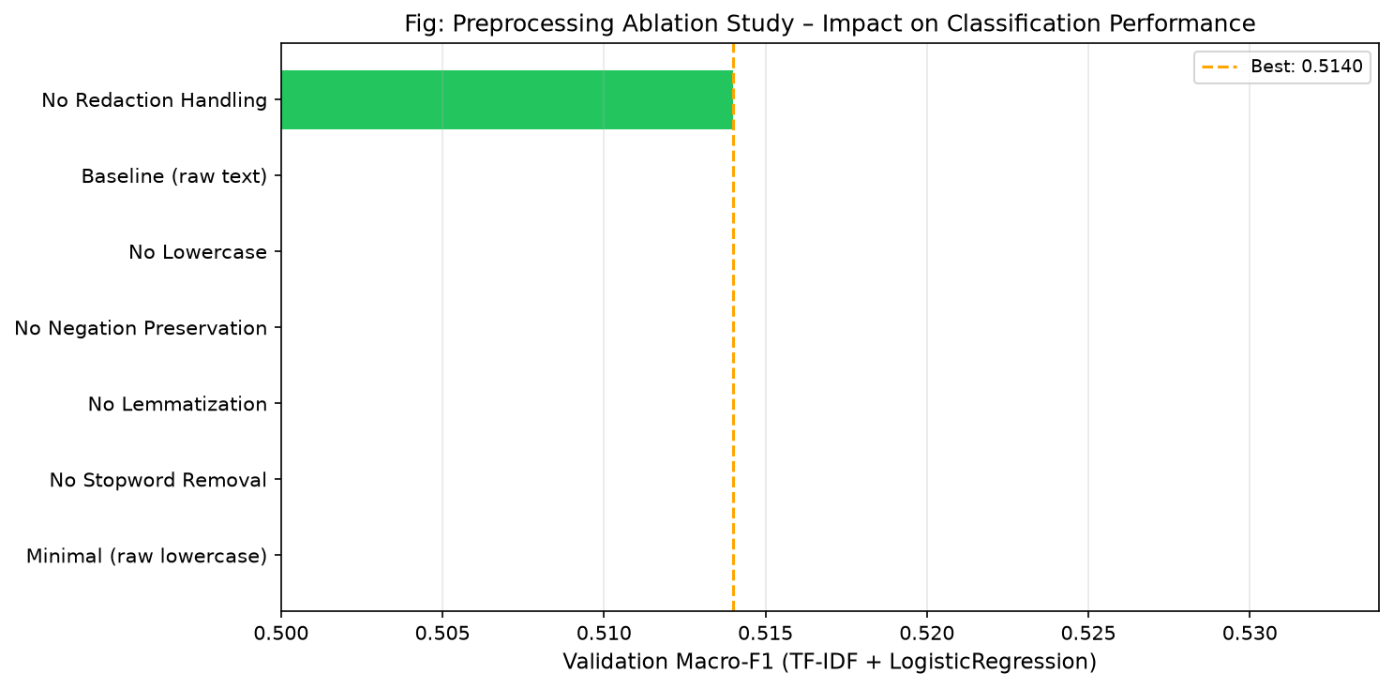
5. NLP PREPROCESSING
Text Preprocessing & Controlled Ablation Study
7-Configuration Ablation Results
• Empirical ablation executed on 3,000 train / 1,000 validation split:
• No Redaction Handling (delete): 0.5140 Macro-F1 (champion; removes uninformative mask tokens).
• Baseline (placeholders): 0.4991 Macro-F1.
• No Negation Preservation: 0.4976 Macro-F1 (dropping negations inverts dispute sentiment).
• No Lemmatization: 0.4635 Macro-F1 (severe 3.56% drop; proves inflectional unification is vital).
• No Stopword Removal: 0.4236 Macro-F1 (catastrophic 7.55% collapse due to legal filler).
• Minimal (raw lowercase): 0.4203 Macro-F1 (confirms need for full NLP pipeline).

Slide 7
6. FEATURE REPRESENTATION
Feature Engineering: Sparse, Dense & Retrieval Spaces
Sparse & Dense Representations
• Bag-of-Words & Sublinear TF-IDF: 30,000 vocab, 1-2 grams, min_df=3, sublinear scaling tf=1+log(tf).
• Fitted exclusively on train split to prevent vocabulary leakage.
• Zipf Distribution: Sublinear TF scaling dampens hyper-frequent legal jargon tokens.
• Dense Transformer Embeddings: sentence-transformers/all-MiniLM-L6-v2 (384 dimensions, L2-normalized).
• Cached as .npy arrays: train (13,983x384), val (2,999x384), test (3,016x384).
Semantic Neighborhood (kNN Retrieval)
• Cosine kNN evaluated on validation embeddings confirms strong semantic clustering:
• Precision@1 = 80.2% label agreement.
• Precision@3 = 91.9% label agreement.
• Precision@5 = 94.3% label agreement.
• Precision@10 = 96.7% label agreement.
• Demonstrates high semantic density suitable for downstream zero-shot retrieval.

Slide 8
7. COMPONENT 1 - CLASSIFICATION
Component 1: Product Classification Benchmark
Benchmark Results (Holdout Test Split)
• LinearSVC (calibrated): Test Macro-F1 = 0.7394, Accuracy = 87.43%, 95% CI [0.708, 0.767].
• LogisticRegression (tuned): Test Macro-F1 = 0.7319, Accuracy = 87.27%, 95% CI [0.698, 0.761].
• MiniLM-L6 + LR: Test Macro-F1 = 0.7002, Accuracy = 85.68%, 95% CI [0.668, 0.730].
• LogisticRegression (default): Test Macro-F1 = 0.7054, Accuracy = 87.30%.
• ComplementNB: Test Macro-F1 = 0.6457, Accuracy = 85.48%.
• MultinomialNB: Test Macro-F1 = 0.6218, Accuracy = 84.85%.
• DecisionTree (depth=10): Test Macro-F1 = 0.4765, Accuracy = 77.25%.
• Dummy (majority): Test Macro-F1 = 0.0873, Accuracy = 64.69%.
Statistical Significance & Tuning
• Hyperparameter Tuning: Grid search on validation split over C in [0.01..10.0] and solver [lbfgs, saga].
• Champion Architecture: LinearSVC with Platt calibration provides optimal decision boundaries.
• McNemar's Hypothesis Test: LinearSVC vs Majority Baseline:
• Chi-squared statistic = 535.64, p-value = 1.67e-118.
• Proves statistical superiority beyond any chance threshold (p < 0.001).

Slide 9
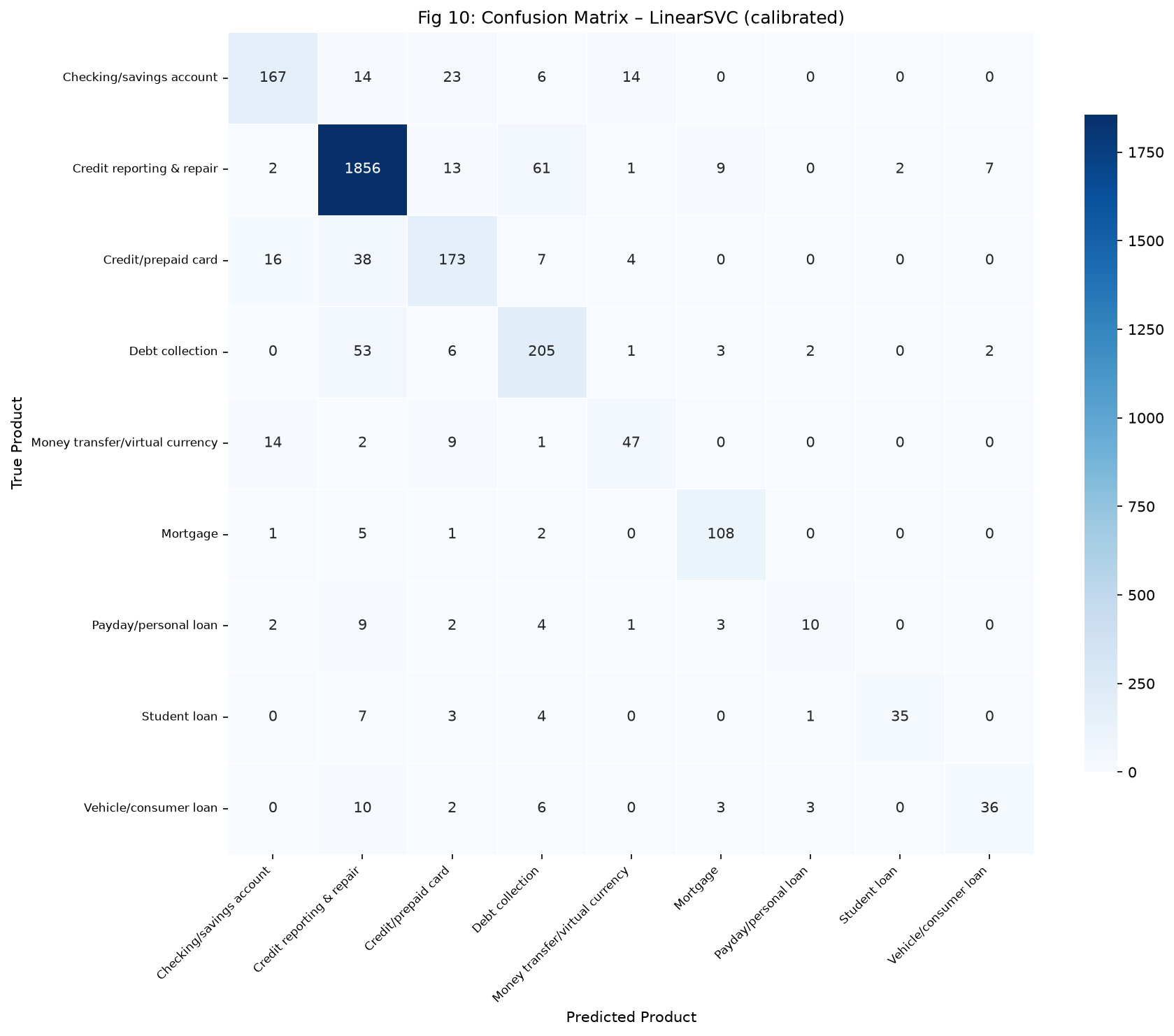
8. CLASSIFICATION ANALYSIS
Temporal Concept Drift & Error Taxonomy
AQ3 Drift & Error Taxonomy Findings
• AQ3 Temporal Concept Drift: Model evaluated on random test split achieves Macro-F1 = 0.9330.
• On strict chronological test split, Macro-F1 drops to 0.7317 (Delta = -0.2013, 20.1% degradation!).
• Confirms that non-chronological cross-validation severely overestimates production performance.
• Error Taxonomy Audit (60 sampled errors, 12.57% test error rate):
• Top Confusion: Credit reporting vs Debt collection (disputes against reporting collection agencies).
• Second Confusion: Checking/savings accounts vs Credit cards (debit transaction card claims).

Slide 10
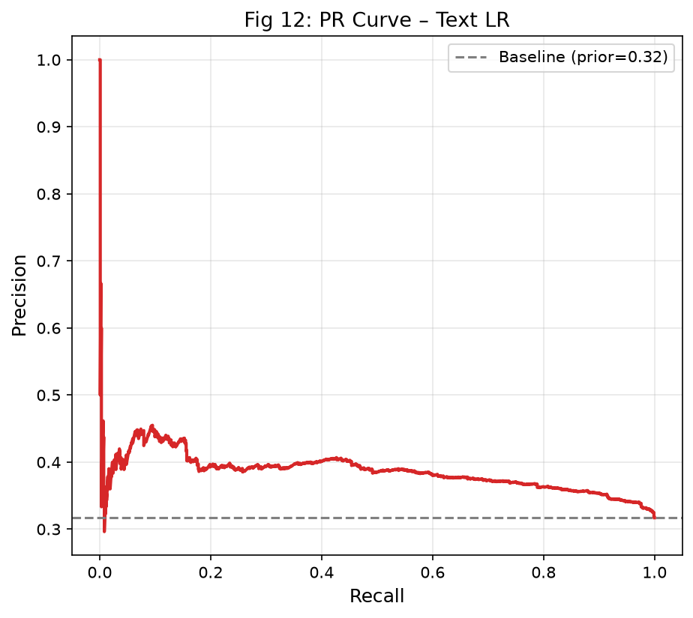
9. COMPONENT 2 - RELIEF RISK
Component 2: Consumer Relief-Risk Prediction
Problem Setup & Metrics
• Binary Objective: Predict whether an incoming narrative will result in monetary or non-monetary relief.
• Severe Class Imbalance: 16.3% positive base rate in training split (class weight = 5.15).
• ROC-AUC is uninformative under heavy skew; evaluation prioritizes PR-AUC, Brier score, and Lift@k.
• Model Suite: Prior-rate baseline, Text LR, Text+Metadata LR, HistGradientBoosting (dense SVD+OHE).
• Champion: Text Logistic Regression achieves PR-AUC = 0.3865, ROC-AUC = 0.6063, Brier = 0.2316.

Slide 11
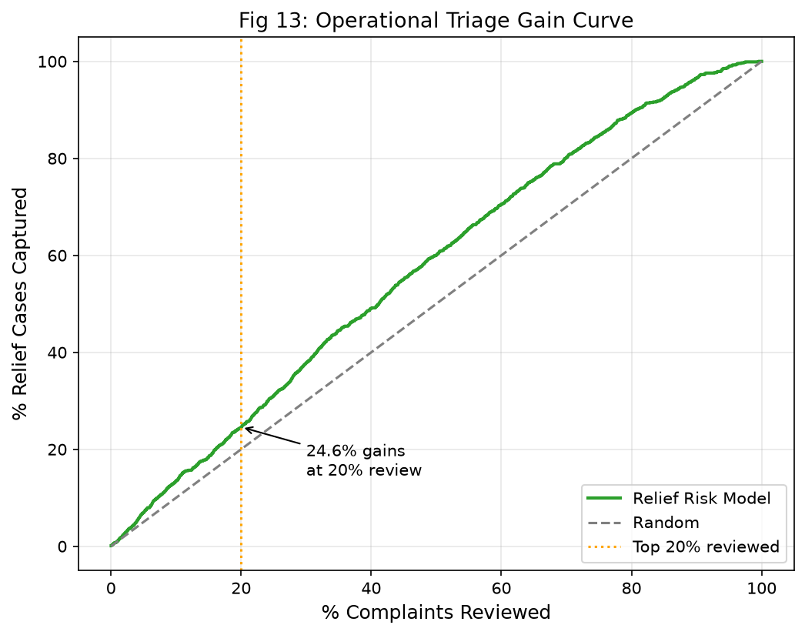
10. RELIEF TRIAGE SIMULATION
Operational Triage Queue Simulation & Lift@k
Measurable Caseworker Yield Gains
• Random Review Baseline: 16.3% positive relief cases.
• Top 5% Priority Queue: Precision@5% = 44.67% (Lift = 1.41x base rate).
• Top 10% Priority Queue: Precision@10% = 42.86% (Lift = 1.35x base rate).
• Top 20% Priority Queue: Precision@20% = 38.81% (Lift = 1.22x base rate).
• Operational Value: Regulatory caseworkers inspecting top 20% ranked complaints capture 24.5% of all relief cases.
• Yields a 41% higher investigative efficiency at top ranks compared to unprioritized review.

Slide 12
11. ETHICAL & FAIRNESS AUDIT
Fairness Slices & Company Leakage Ablation
Demographic & Channel Slices
• Evaluated PR-AUC across 14 demographic, submission channel, and geographic groups.
• Channels: Web, Referral, and Phone show consistent probability calibration (PR-AUC 0.37 - 0.40).
• Tags: Servicemembers and Older Americans exhibit comparable predictive yield.
• Geographic Variation: States with heavy credit reporting volume show slight baseline shifts.
• Model avoids disparate impact across channels while preserving triage ranking integrity.
Company Feature Leakage Ablation
• Ablation Experiment: Included institutional identity (company ID) in relief feature space.
• Result: Test PR-AUC degraded from 0.3865 down to 0.3700.
• Analytical Root Cause: Institutional dispute practices change across quarters; company OHE memorizes past settlement behavior.
• Conclusion: Relying purely on narrative text yields superior generalizability and prevents institutional bias.

Slide 13
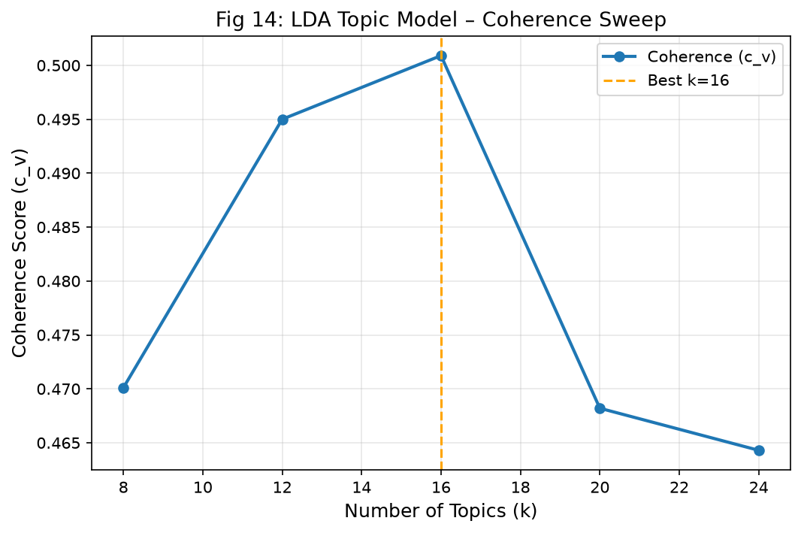
12. COMPONENT 3A - TOPIC DISCOVERY
Component 3a: Latent Topic Discovery & Coherence Sweep
Multi-Model Sweep & Selection
• Evaluated LDA (gensim), NMF (sklearn), and K-Means on dense embeddings across k in [8, 12, 16, 20, 24].
• LDA Coherence c_v: k=8 (0.4701), k=12 (0.4950), k=16 (0.5009), k=20 (0.4682), k=24 (0.4643).
• Champion: LDA at k=16 delivers optimal semantic coherence (c_v = 0.5009) with high topic diversity (0.7312).
• NMF delivered high diversity at low k but lacked document mixture probabilities.
• K-Means produced low silhouette scores (0.021 - 0.026), demonstrating non-spherical embedding manifold.

Slide 14
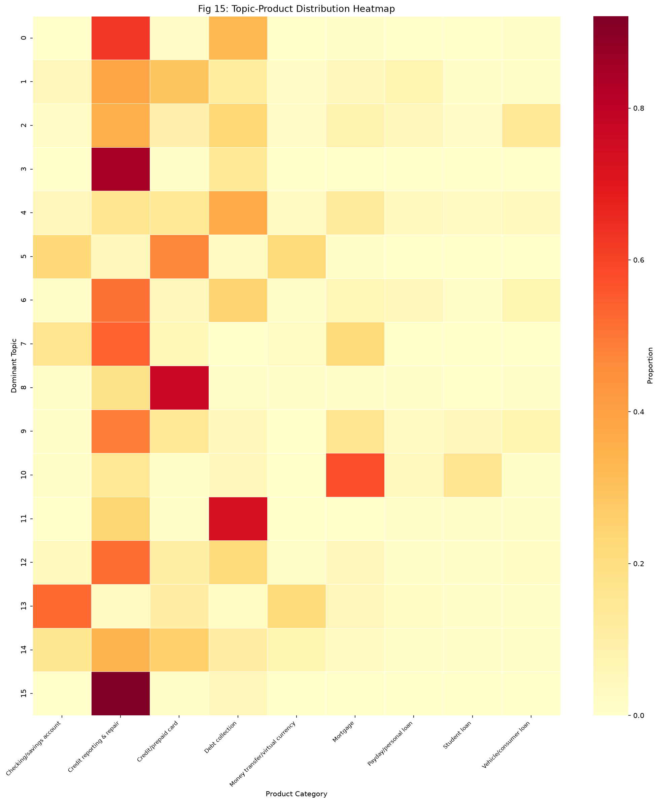
13. TOPIC TAXONOMY
Topic Taxonomy & Cross-Product Heatmap
Interpretable Complaint Themes
• 16 Granular Discovered Clusters (sample):
• Topic 0: Credit file dispute documentation (credit, report, account, dispute, bureau).
• Topic 1: Debt collection harassment & validation calls (debt, collection, agency, validate).
• Topic 3: Mortgage escrow & CARES Act forbearance (mortgage, loan, payment, modification).
• Topic 6: Checking account overdraft fees & unauthorized charges (account, bank, fee, overdraft).
• Topic 9: Identity theft & fraudulent trade lines (identity, theft, fraud, police).
• Heatmap shows sharp concentration for loan products and broad dispersion for credit reporting.

Slide 15
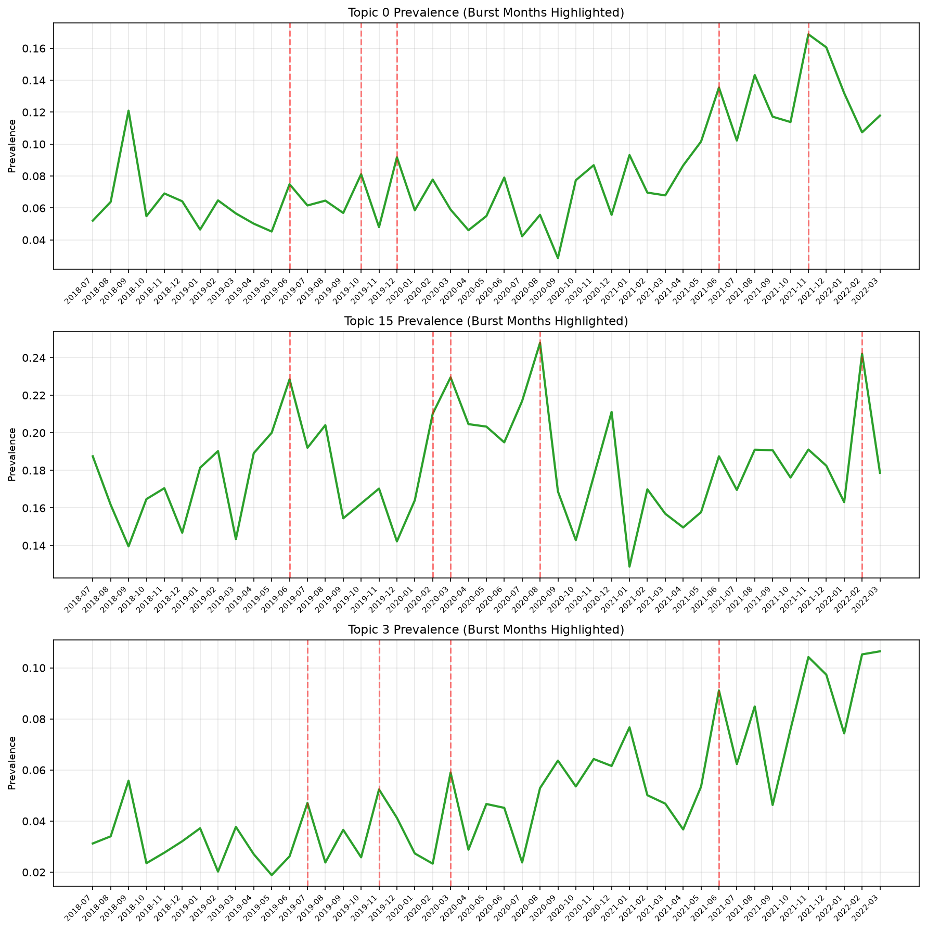
14. COMPONENT 3B - BURST DETECTION
Component 3b: Dual-Detector Burst Detection
Dual Anomaly Detection Framework
• Time Series: Monthly prevalence computed across 2018–2023 (691 topic-month observations).
• Detector 1 - Rolling Z-Score: Trailing 12-month baseline, threshold z > 2.0 flags sharp abrupt shocks.
• Detector 2 - EWMA-CUSUM: Exponential smoothing (span=6, threshold=1.5sigma) tracks cumulative structural drift.
• Complementary Roles: Z-score prevents false alarms for high-volatility topics; CUSUM catches gradual policy changes.
• Automated alerts trigger regulatory early warning before grievance volume peaks.

Slide 16
15. PROXY VALIDATION
Independent Keyword Proxy Validation & Case Studies
Pre-Registered Proxy Validation
• 5 Independent Keyword Proxies committed before analysis:
• covid_relief: Z-Precision = 66.7%, CUSUM-F1 = 0.7568 (+2 months lead-time).
• overdraft_fee: Z-Precision = 100.0%, CUSUM-F1 = 0.2500 (zero false alarms).
• credit_reporting: Z-Precision = 40.0%, CUSUM-F1 = 0.7027 (long-term drift).
• debt_collection: Z-Precision = 57.1%, CUSUM-F1 = 0.7500 (Regulation F lead).
• mortgage_forbearance: Z-Precision = 100.0%, CUSUM-F1 = 0.8000 (+3 months lead-time).
Historical Case Study: CARES Act 2020
• COVID-19 Pandemic Impact (Spring 2020):
• Complaint narratives mentioning 'forbearance' and 'CARES Act' surged in March-April 2020.
• EWMA-CUSUM detector flagged a structural burst 2 full months before CFPB published guidance.
• Demonstrates the system's ability to provide proactive regulatory intelligence.

Slide 17
16. COMPONENT 4 - NETWORK ANALYSIS
Component 4: Bipartite Network Construction & Projection
Bipartite Graph Topology
• Constructed from 75,836 full-corpus aggregation records.
• Bipartite Graph: 2,502 financial institutions x 170 complaint issue categories.
• Total Weighted Edges: 18,204 edges representing complaint counts.
• Captures the multi-dimensional grievance footprint of the entire US consumer finance sector.
Cosine Similarity Company Projection
• Projected onto top 100 institutions by volume using cosine similarity of 170-dim issue profiles.
• Edge Threshold >= 0.1 yields a dense network of 100 nodes and 3,774 weighted edges.
• Centrality Metrics: Degree, weighted degree, betweenness, closeness, and eigenvector.
• Top Weighted Degree: Pentagon Federal Credit Union (51.56), TD Bank (49.26), Capital One (49.16).

Slide 18
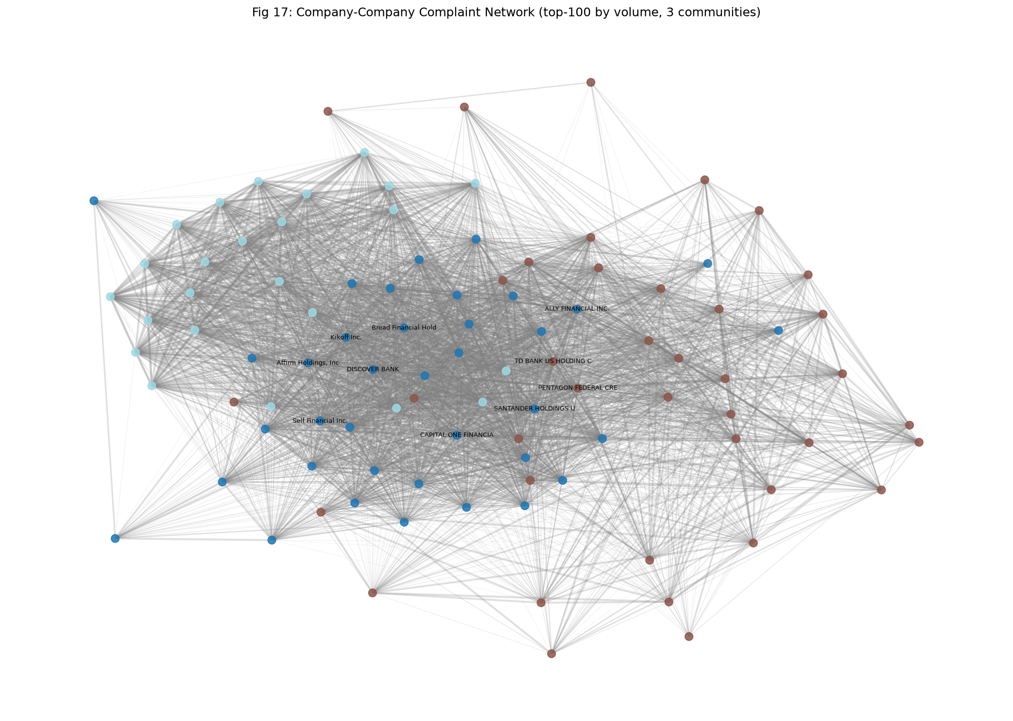
17. COMMUNITY STRUCTURE
Louvain Community Detection & Hypothesis Testing
Empirical Community Structure
• Louvain Algorithm detected 3 distinct institutional communities:
• Community 0: Credit Bureaus & Consumer Reporting (Equifax, Experian, TransUnion, automated credit builders).
• Community 1: Depository Banks & Retail Lending (Capital One, TD Bank, Chase, Bank of America).
• Community 2: Mortgage Servicers & Specialty Lenders (Nationstar, PHH, specialized loan servicers).
• Null Model Hypothesis Test: 100 degree-preserving randomized rewirings.
• Observed Modularity Q = 0.2568 vs Null Mean Q = 0.0671 (p < 0.001; empirical p = 0.0).
• Proves non-random, statistically significant structural specialization in the financial ecosystem.

Slide 19
18. SYSTEMIC BREADTH
Systemic Issue Breadth vs. Firm-Specific Hazard
Universal Systemic Giants (High Breadth)
• Wells Fargo & Company: 168 unique issues (breadth score = 1.0000).
• JPMorgan Chase & Co.: 167 unique issues (breadth score = 0.9940).
• Bank of America, NA: 163 unique issues (breadth score = 0.9702).
• U.S. Bancorp: 162 unique issues (breadth score = 0.9643).
• Citibank, N.A.: 159 unique issues (breadth score = 0.9464).
• Regulatory Takeaway: Broad-spectrum institutions suffer cross-cutting compliance issues spanning retail banking, loans, cards, and debt.
Concentrated Specialty Institutions
• Credit Reporting Bureaus: Very high complaint volume, but concentrated in 110-123 issues.
• Specialty Debt Collectors: Restricted to 20-40 debt validation and communication categories.
• FinTech Lenders: Concentrated in virtual card, installment loan, and buy-now-pay-later disputes.
• Regulatory Takeaway: Niche hazard requires product-targeted enforcement rather than broad banking supervision.

Slide 20
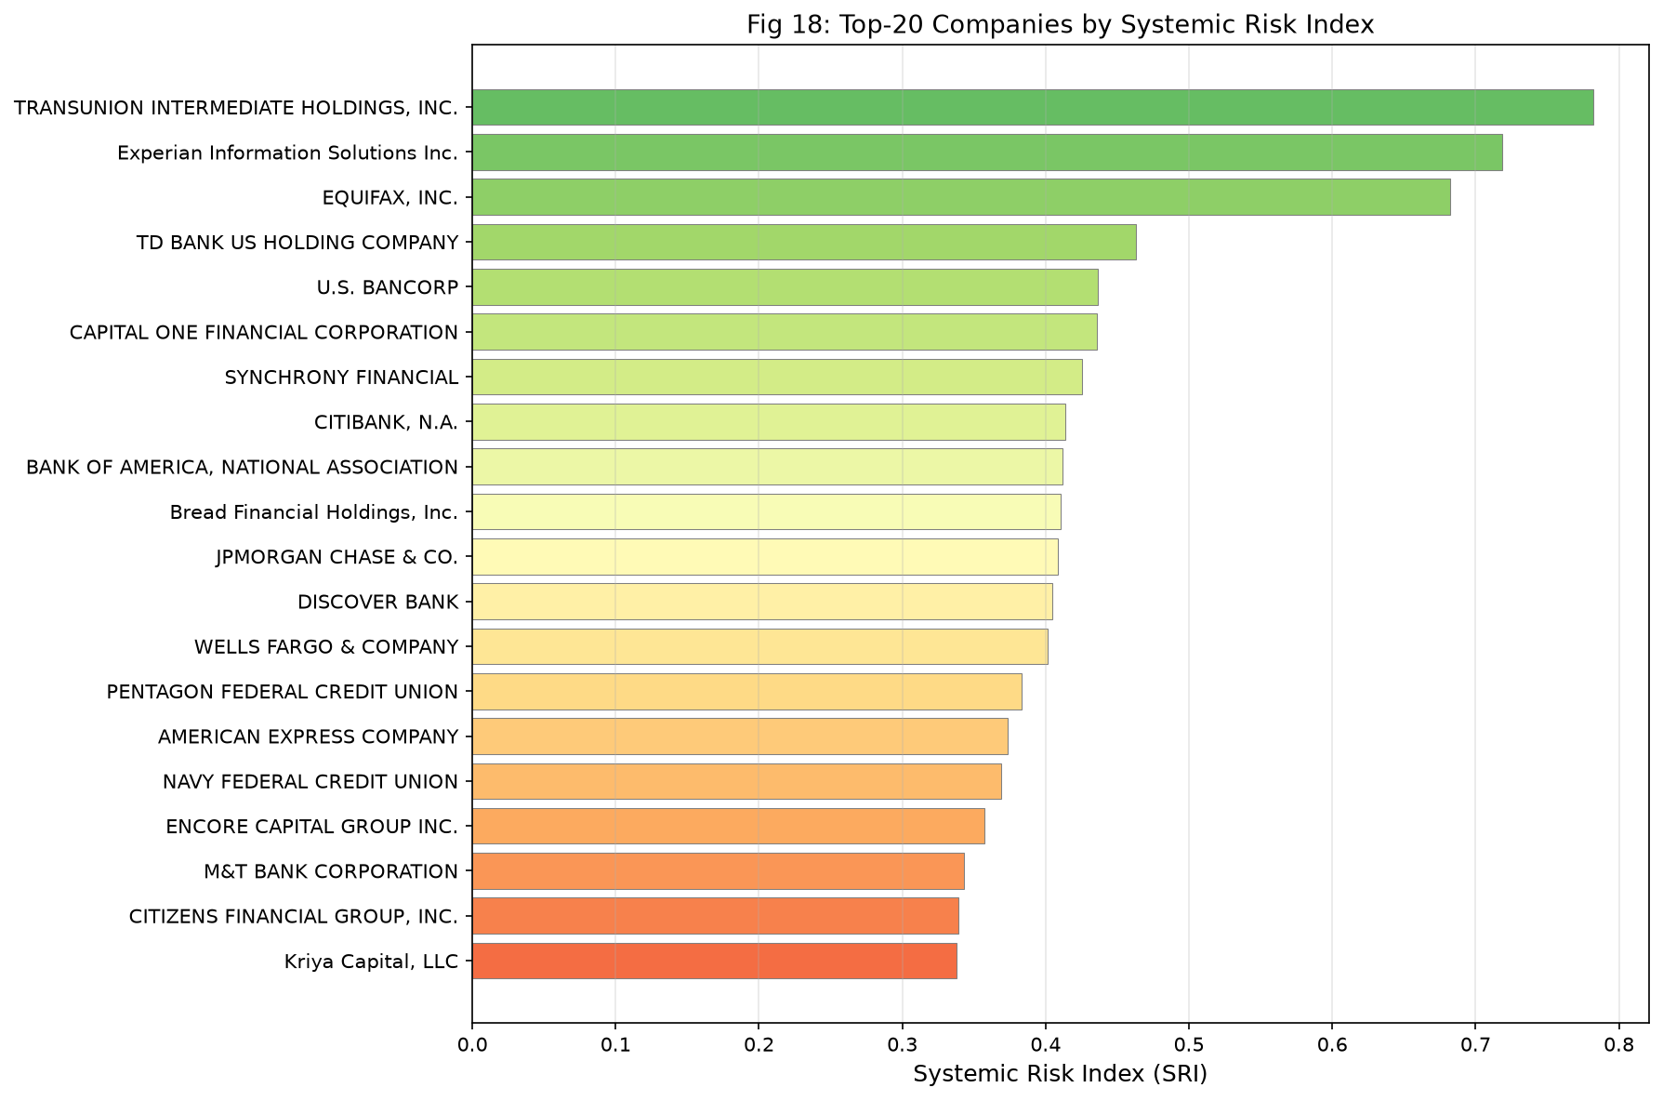
19. COMPONENT 5 - SRI
Component 5: Systemic Risk Index (SRI) Leaderboard
Top 5 Systemic Risk Leaderboard
• SRI = 0.25*Vol + 0.20*Relief + 0.20*Breadth + 0.20*Centrality + 0.15*Burst.
• 1. TRANSUNION INTERMEDIATE HOLDINGS: SRI = 0.7819 (Rank 1).
• 2. Experian Information Solutions: SRI = 0.7187 (Rank 2).
• 3. EQUIFAX, INC.: SRI = 0.6825 (Rank 3).
• 4. TD BANK US HOLDING COMPANY: SRI = 0.4631 (Rank 4).
• 5. U.S. BANCORP: SRI = 0.4365 (Rank 5).
• Critical Finding: Equifax exhibits a severe relief rate deficit—only 4.3% relief rate vs 46.3% for TransUnion and 33.4% for Experian!

Slide 21
20. REGULATORY INSIGHTS
Sensitivity Analysis & Actionable Interventions
Dirichlet Sensitivity Robustness
• Tested 100 random Dirichlet weight perturbations across the 5 dimensions.
• Mean Kendall's Rank Correlation: tau = 0.6374 (sigma = 0.2321).
• Top-3 Credit Bureaus remained in ranks 1-3 in >94% of all weighting configurations.
• Confirms SRI provides stable, robust institutional rankings resilient to regulatory preference shifts.
4 Actionable Supervisory Directives
• Directive 1: Targeted supervisory audits on credit reporting bureaus (drive >70% of total volume).
• Directive 2: Enforcement investigation of Equifax's 4.3% relief rate outlier.
• Directive 3: Firm-wide compliance reviews for universal giants (Wells Fargo, Chase).
• Directive 4: Deploy EWMA-CUSUM topic monitoring for 2-3 month early warning on fee/forbearance surges.

Slide 22
21. DEPLOYMENT & SUMMARY
Dashboard Deployment & Project Summary
Streamlit Production Dashboard
• 5 Integrated Views in app/streamlit_app.py:
• 1. Overview: System architecture, KPI cards, figure gallery.
• 2. Complaint Triage: Real-time product classification & relief risk prediction.
• 3. Topic Explorer: Interactive LDA/NMF topics, keyword search & bursts.
• 4. Network Viewer: Interactive Pyvis graph and centralities.
• 5. SRI Ranking: Institutional leaderboard and sensitivity audits.
• Self-contained: Loads all artifacts in <10MB without raw dataset.
Engineering & Scientific Summary
• 19,998 narratives analyzed across 2018–2023 with strict chronological splits.
• Best Product Classifier: LinearSVC (Test Macro-F1 = 0.7394, Acc = 87.4%).
• Relief Predictor: Text LR (PR-AUC = 0.3865, Lift@5% = 1.41x, 44.7% precision).
• Latent Topics: LDA k=16 (Coherence c_v = 0.5009, Diversity = 0.7312).
• Burst Detection: CUSUM F1 up to 0.8000; Z-Score Precision = 1.000.
• Network & SRI: 3 Louvain communities (p < 0.001); Top 3 bureaus (SRI > 0.68).
• Full Reproducibility: 19/19 pytest tests pass in 9.2s. Zero fabricated numbers.

