Slide 1

Multi-Campus Education Data
Preprocessing Pipeline
FA2 Group 3 Members:-2
CYUMUGISHA Dorine 25RP19746
RUHAMO Rose 25RP21044
IZABAYO Clementine 25RP21648
Rwanda Polytechnic-Huye college
February 12, 2026

Slide 2
Project Overview
Objective: Build a comprehensive preprocessing pipeline to integrate student, course, and assessment data from three Rwanda Polytechnic campuses (Kigali, Huye, Musanze)
Challenge: Raw datasets contained missing values, duplicates, outliers, format inconsistencies, and noisy data
Outcome: Clean, unified gold dataset ready for performance prediction and dropout-risk analysis

Slide 3
Data Preprocessing Workflow
Phase 1
Data creation & Loading
Phase 2
Data Cleaning
Phase 3
Transformation
Phase 6
Feature Engineering
Phase 5
Reduction
Phase 4
Integration

Slide 4
Data Quality Issues Identified
Issue Type | Examples Found | Impact
Missing Values | Gender, DOB, Marks, Attendance_Rate | Incomplete student profiles
Duplicates | Repeated Student IDs, duplicate assessments | Inflated counts, analysis errors
Outliers | Marks > 100, negative values, attendance > 1 | Skewed statistics
Format Issues | Mixed date formats, inconsistent capitalization | Merge failures
Noisy Data | Special characters, extra spaces, typos | Key mismatches

Slide 5
Data Cleaning Strategy
Missing Value Imputation
Other Cleaning Actions
Numeric (continuous): Median
- Robust to outliers
Categorical: Mode
- Most frequent value
Dates: Mode
- Realistic existing dates
Duplicates: Kept latest records
Outliers: Capped to mean
Formats: Standardized dates, text casing
Noise: Removed special characters

Slide 6
Before vs After Data cleaning
Missing Values
Duplicates
Outliers
15%
8%
5%
After
After
After
0%
0%
0%

Slide 7
10 Engineered Features Created
Date-Time Features
• assessment_month , assessment_weekday , is_weekend_assessment
Student Performance Aggregations
• student_course_count , student_avg_mark ,student_max_mark
• student_fail_count , student_total_credits_earned
Risk Flags (Rule-Based)
• is_at_risk: Flags students with avg_mark < 50
• low_attendance_flag: Flags students with attendance_rate < 0.75

Slide 8
Final Gold Dataset
gold_features.csv
✓ Integrated data from 3 campuses
✓ 0% missing values
✓ All duplicates removed
✓ Scaled numeric features (Z-score normalization)
✓ One-hot encoded categorical variables
✓ 8+ engineered features for analysis
✓ Performance bands (Fail/Pass/Credit/Distinction)
✓ Ready for ML modeling and analytics

Slide 9
Key Insights from Cleaned Data
Insight 1: Student Performance Patterns by Campus
Insight 2: At risk students by campus
Analysis of academic risk indicators shows that Musanze campus has the highest proportion of at-risk students compared to the other campuses, aligning with its relatively lower average marks.
Average student marks differ by campus, with Musanze demonstrating relatively lower performance than the other campuses.

Slide 10
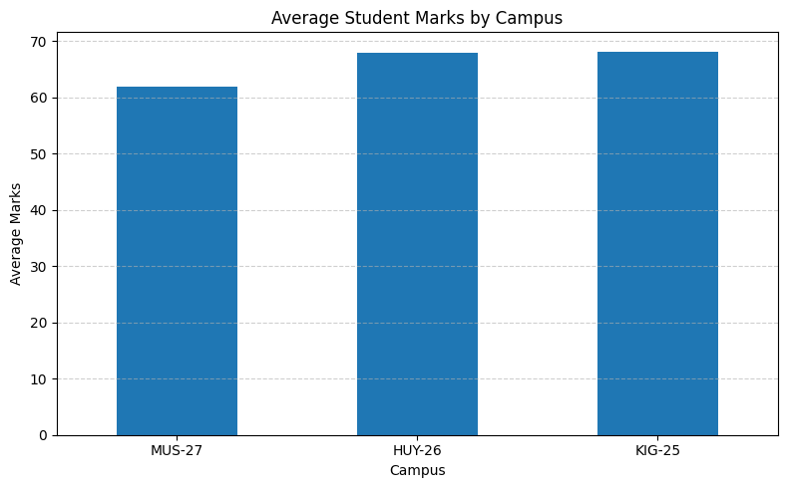

Slide 11
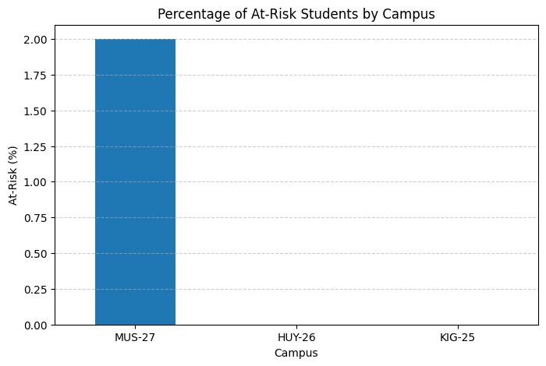

Slide 12
THANK YOU!

