Slide 1

easywork
Group 03(A2)
1705033
1705045
1705047
1705050
1705051
1705056
Project Management Tool
Requirement Analysis Using BPMN Diagram

Slide 2
BPMN Diagram - Overview
3 pools
Developer
Project Manager
Site Admin

Slide 3
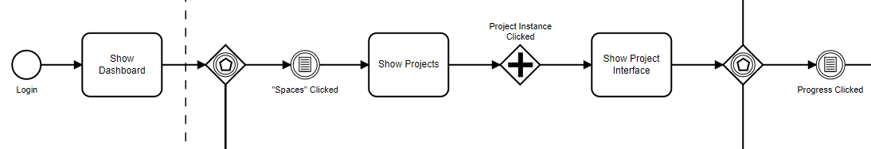
Developer Pool - Start

Slide 4
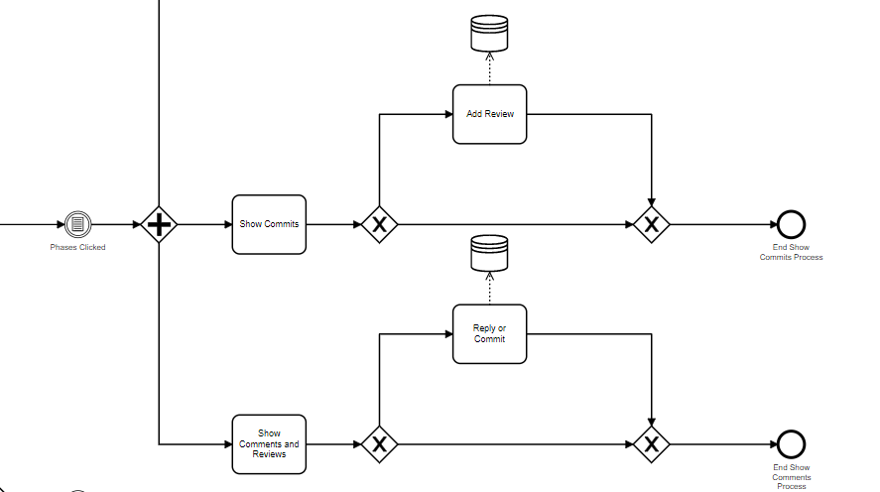
Developer Pool – Phase 1

Slide 5
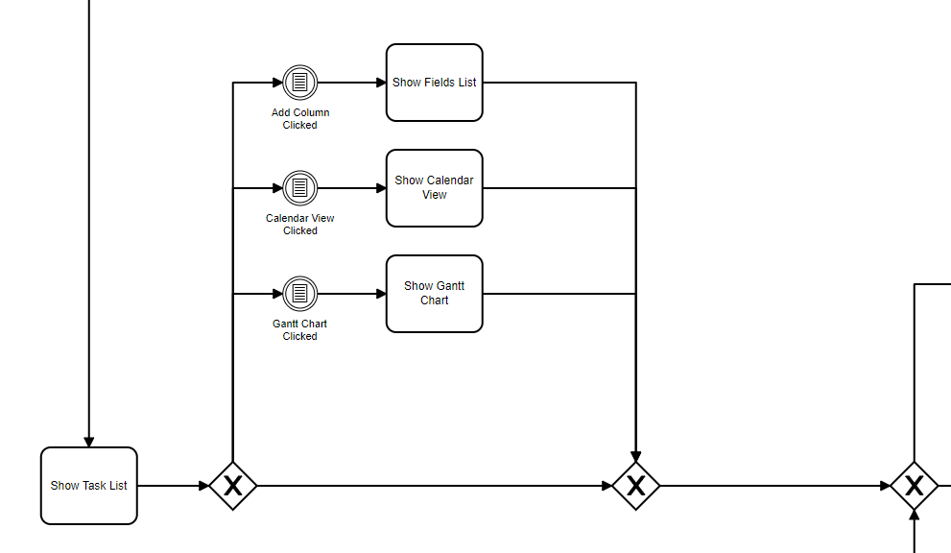
Developer Pool – Phase 2

Slide 6
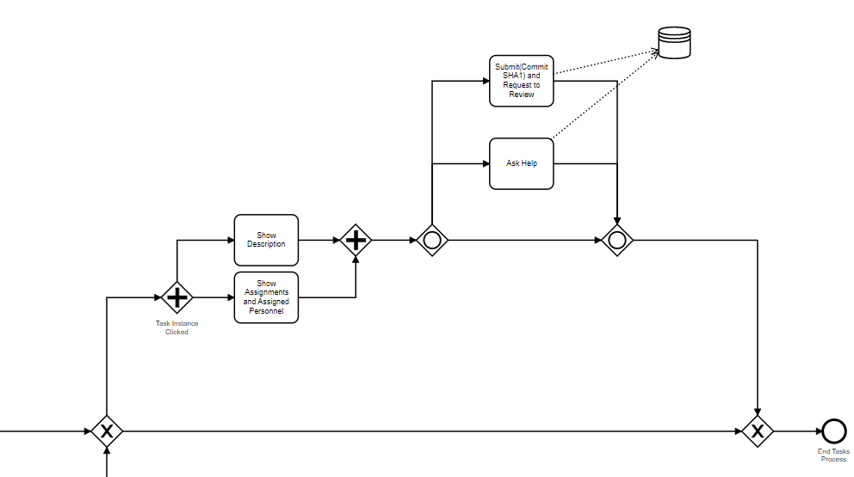
Developer Pool – Phase 3

Slide 7
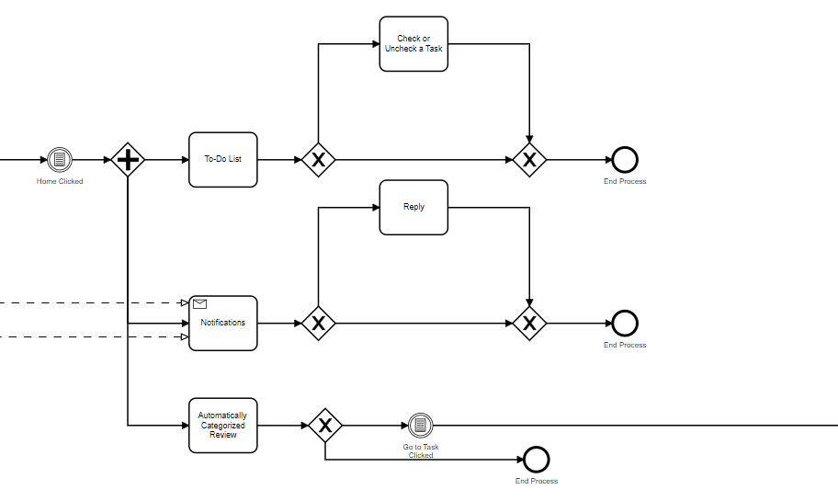
Developer Pool – Home 1

Slide 8
Developer Pool – Home 2

Slide 9
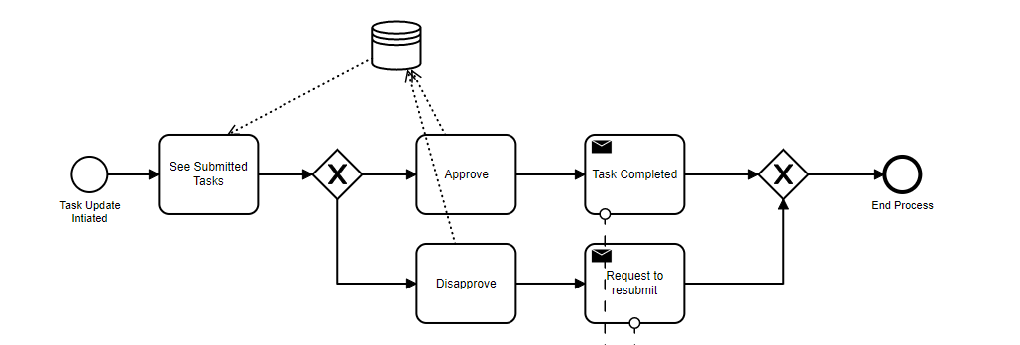
Manager Pool – Task Update

Slide 10
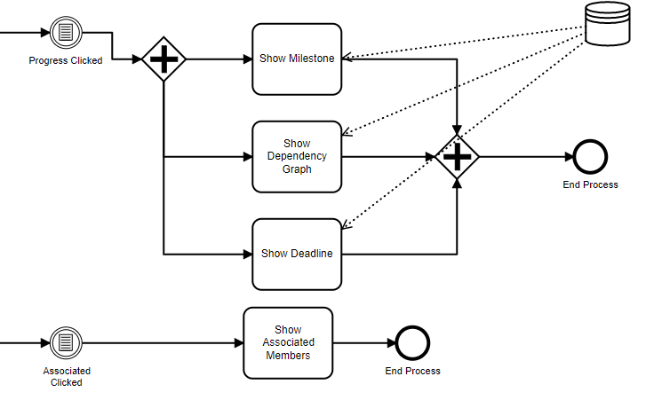
Developer Pool – Progress Associate

Slide 11
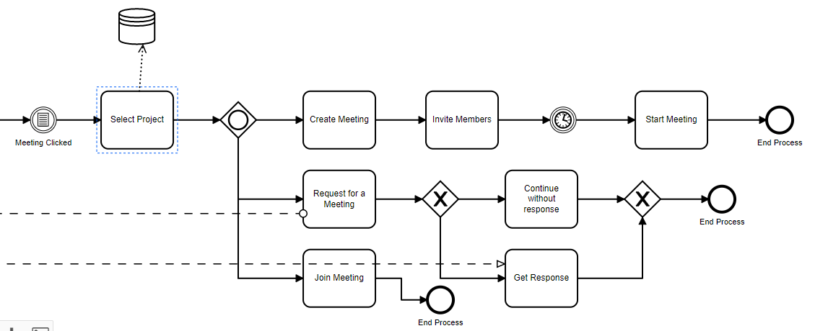
Developer Pool – Meeting

Slide 12
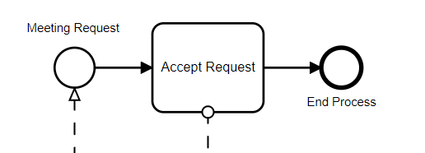
Manager Pool – Meeting Request

Slide 13
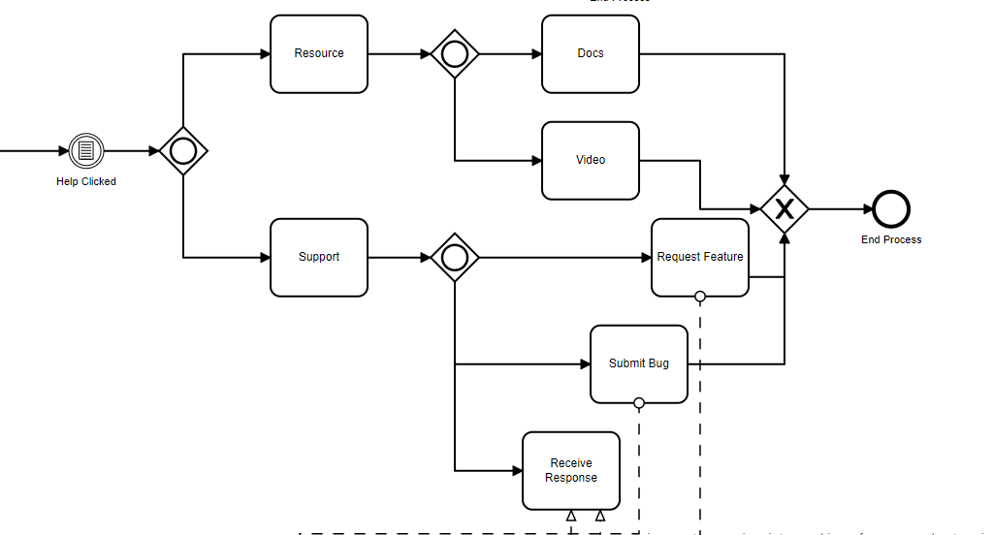
Developer Pool – Help

Slide 14
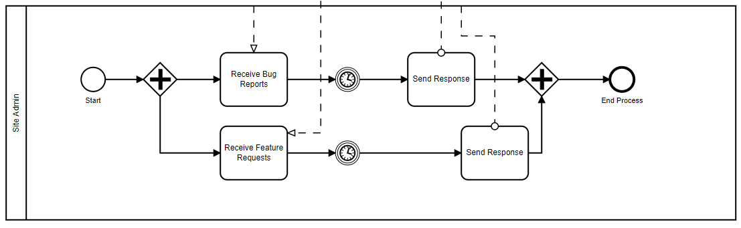
Site Admin Pool

Slide 15
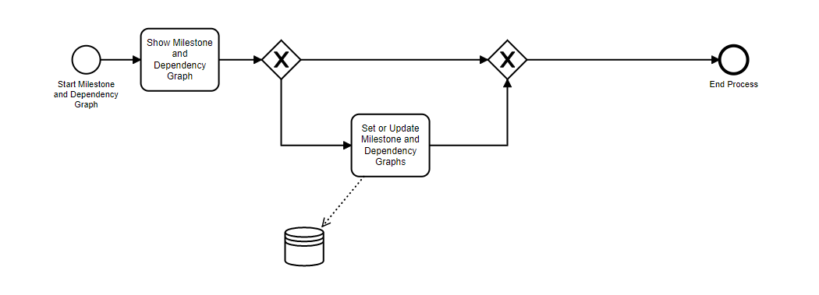
Manager Pool – Milestone and Dependency

Slide 16
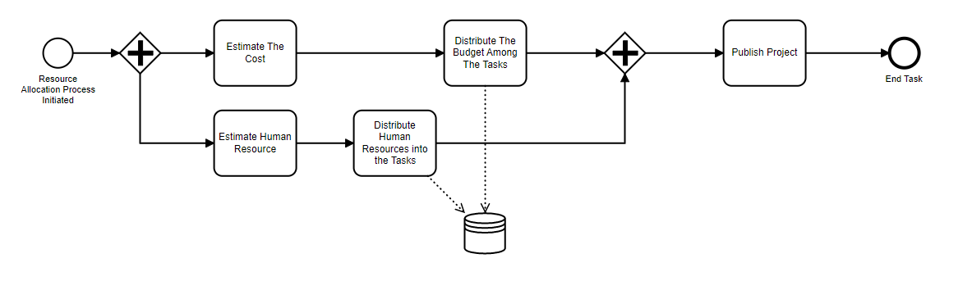
Manager Pool – Resource Allocation

Slide 17
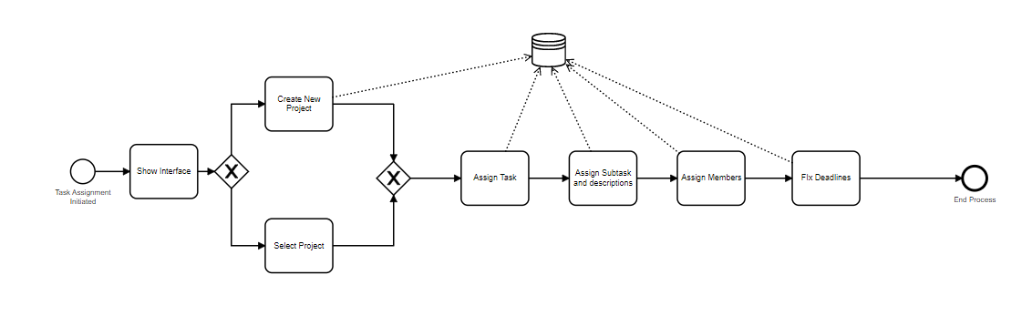
Manager Pool – Task Assignment

Slide 18

Thank you

