Slide 1
Easywork (ER Diagram)
Presented by: With the help of:
1705050 1705033
1705045
1705047
1705051
1705056

Slide 2
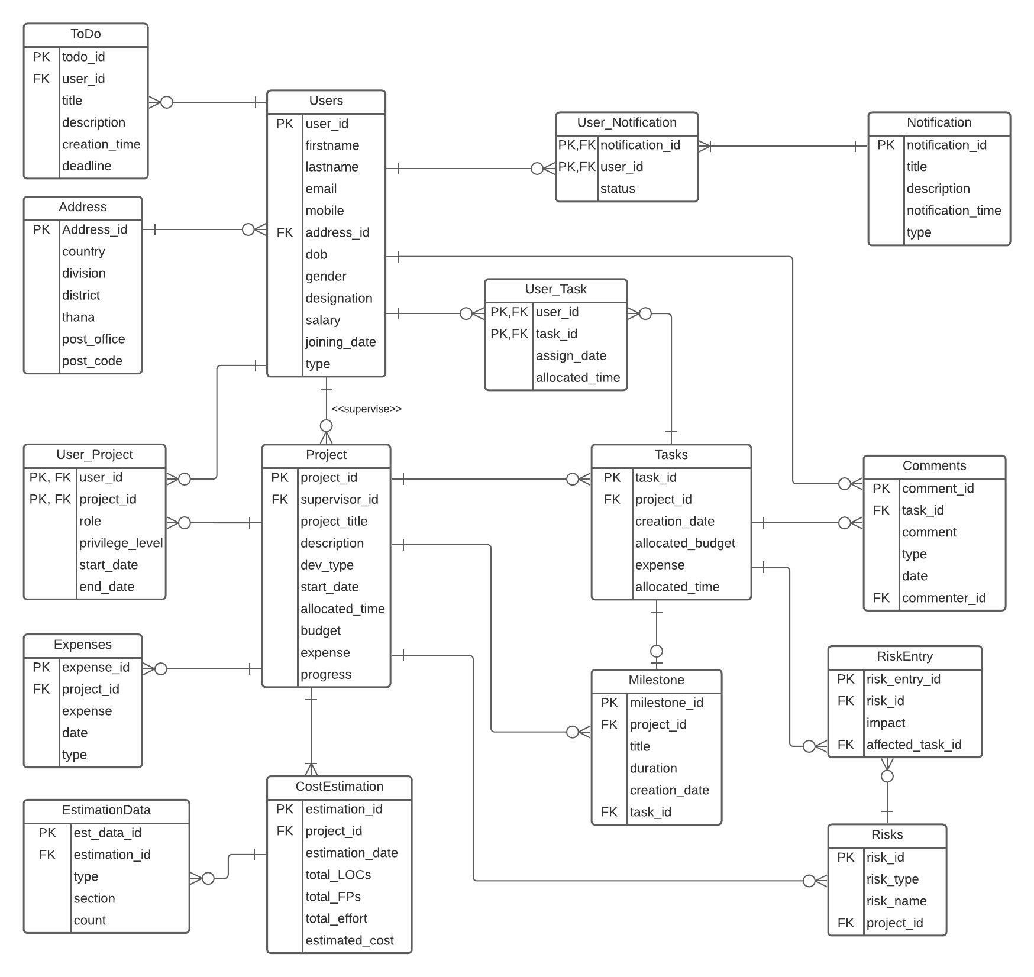
FULL ERD

Slide 3
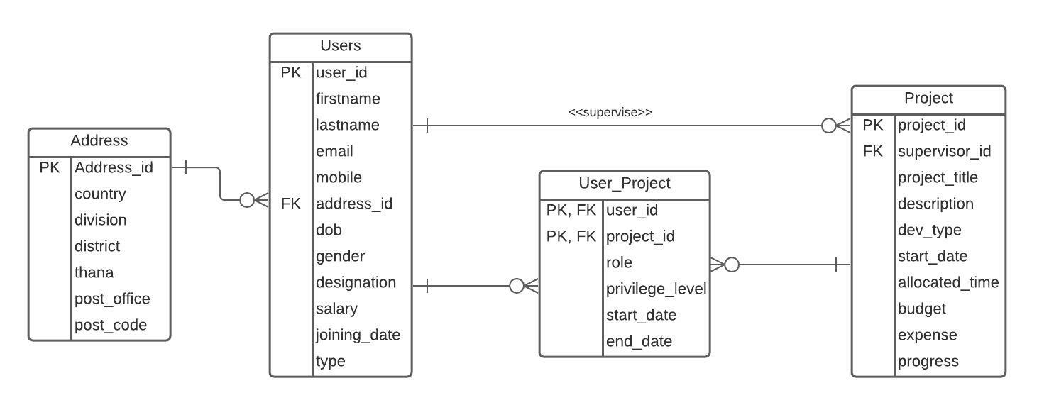
User-project

Slide 4
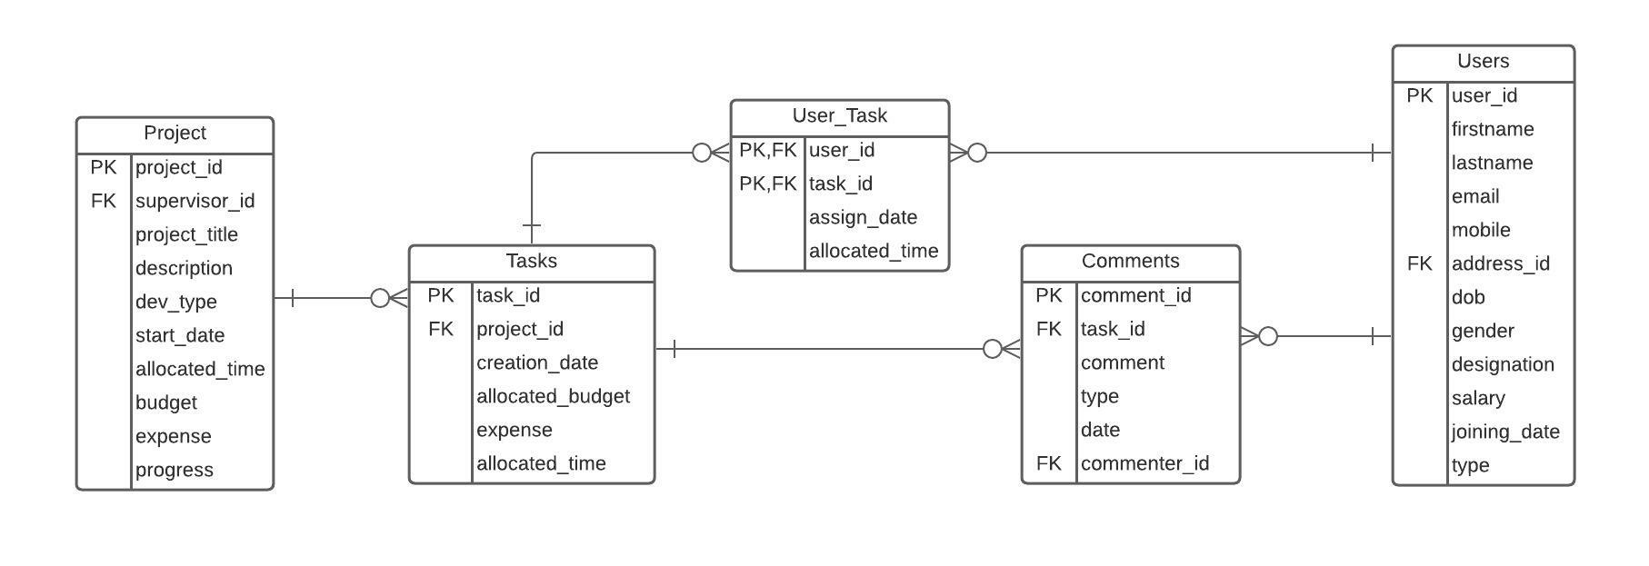
User-task-comments

Slide 5
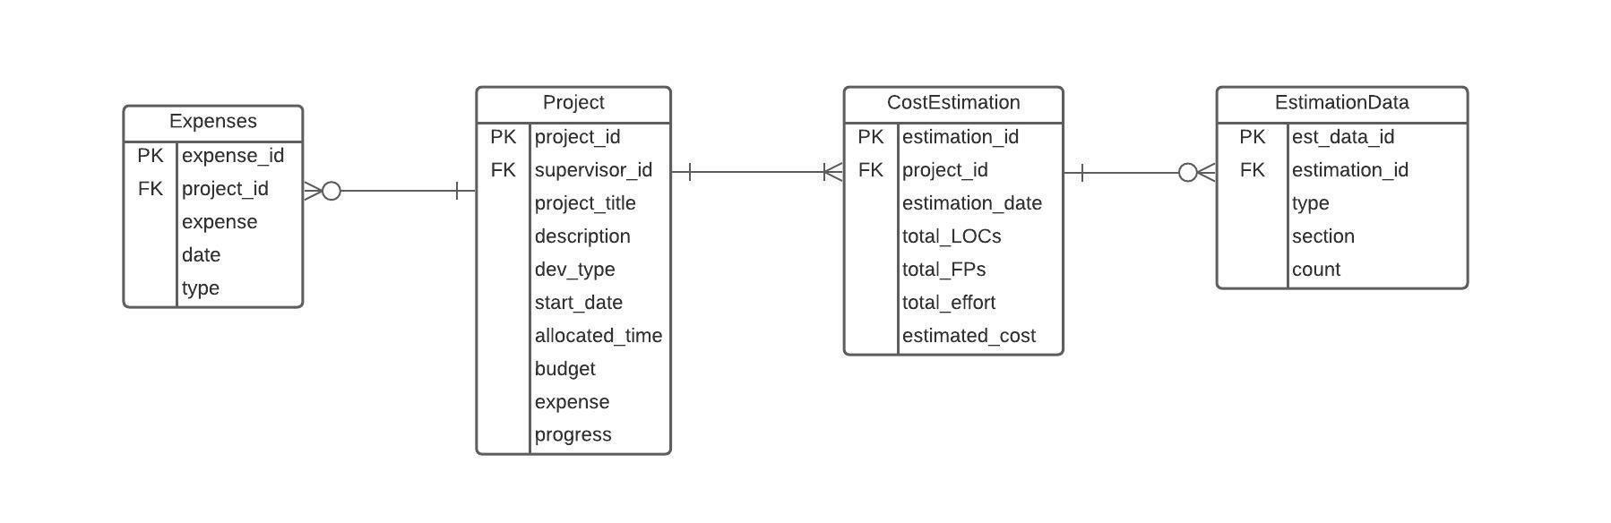
Cost-expenses

Slide 6
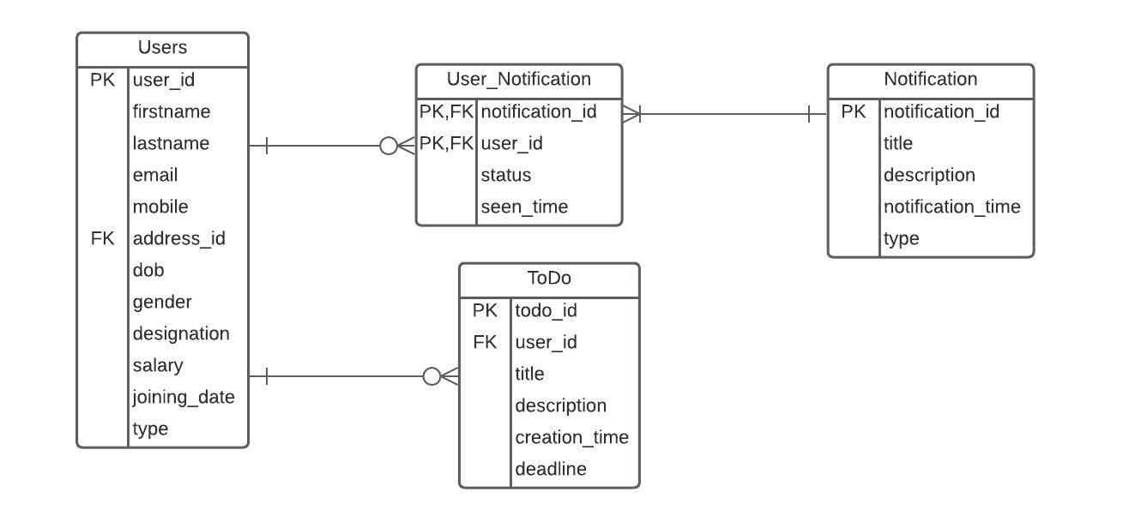
Todo-notifications

Slide 7
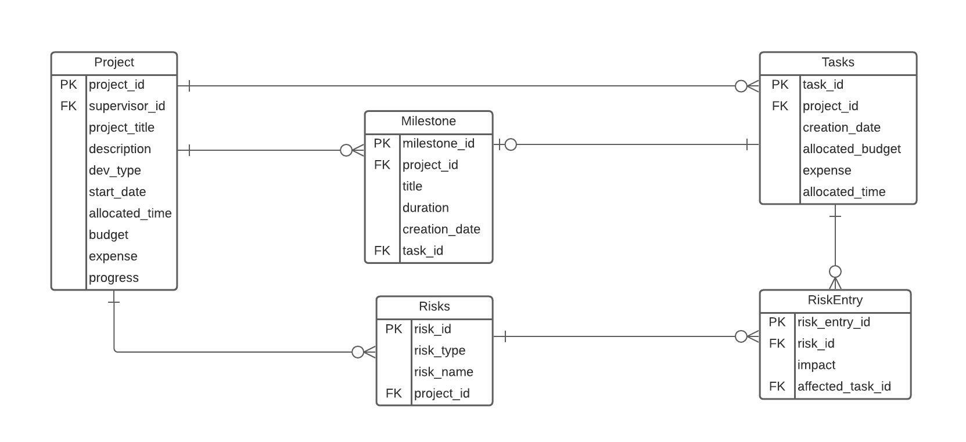
Milestone-risks

Slide 8
FULL ERD

Slide 9

Thank you

