Slide 1
Easywork (Sequence and Collaboration Diagram)
Presented By: Group Members:
1705045 1705033
1705056 1705045
1705047
Group 03 – A2 1705050
1705051
1705056

Slide 2
Major Use Cases
Create Project
Add Task
Update Task Dependency
Update Cost
View Gantt Chart
Submit and Approve Work
Project Risk
Leave Request

Slide 3
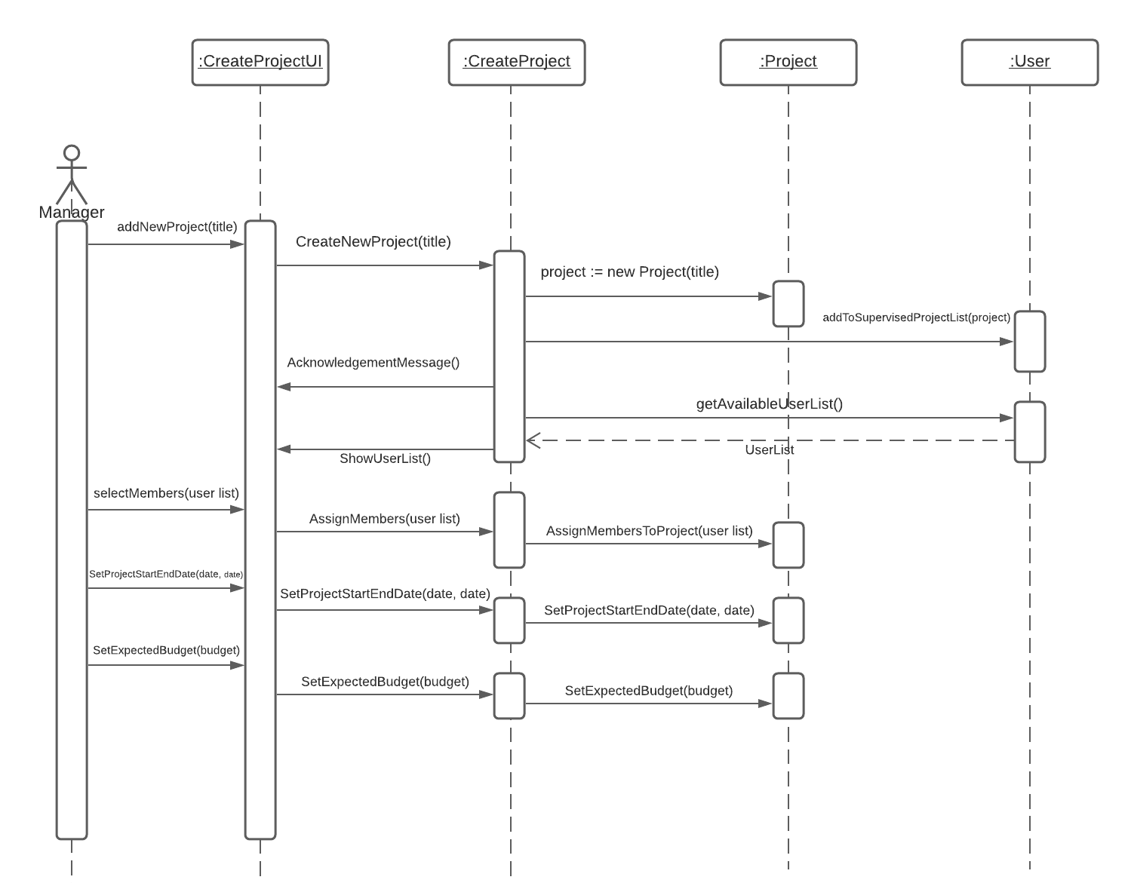
Create Project

Slide 4
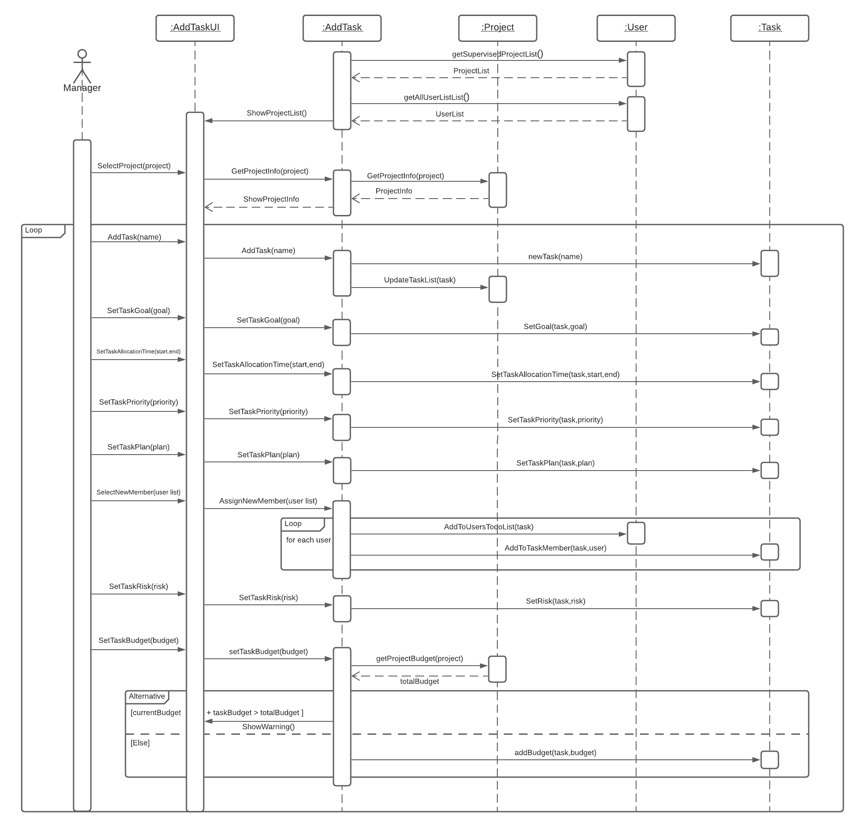
Add Task

Slide 5
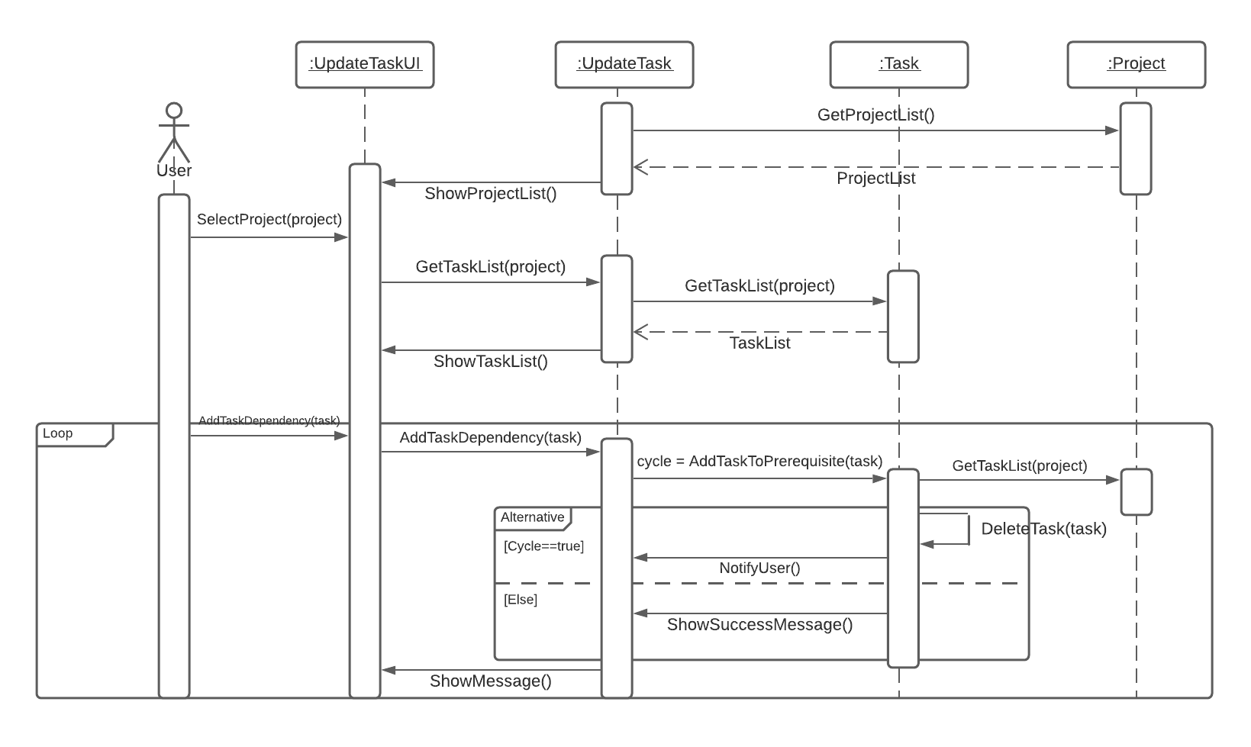
Update Task Dependency

Slide 6
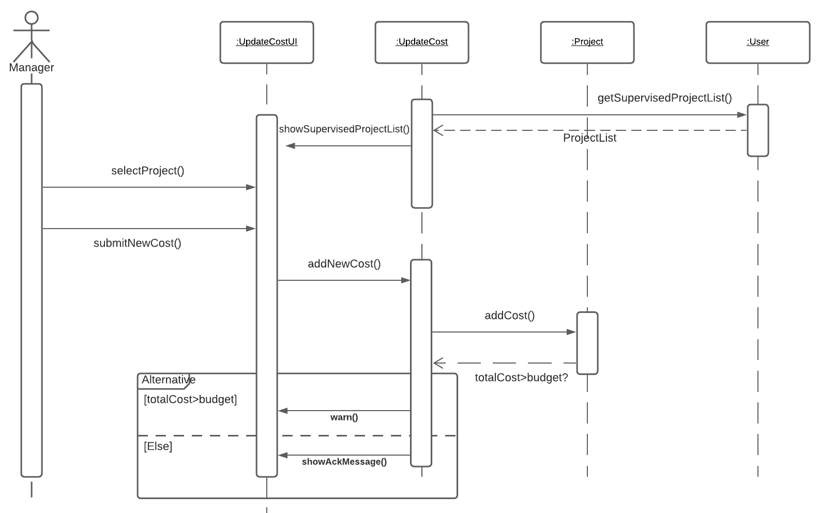
Update Cost

Slide 7
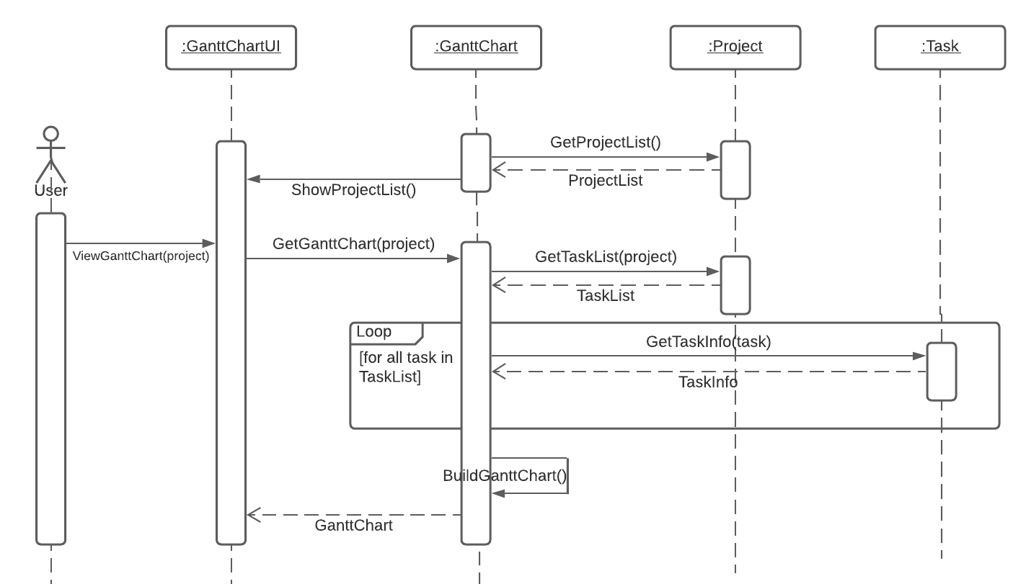
View Gantt Chart

Slide 8
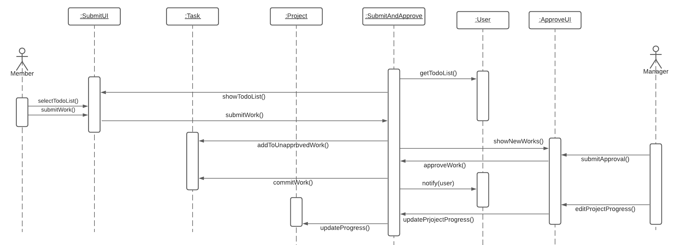
Submit and Approve Work

Slide 9
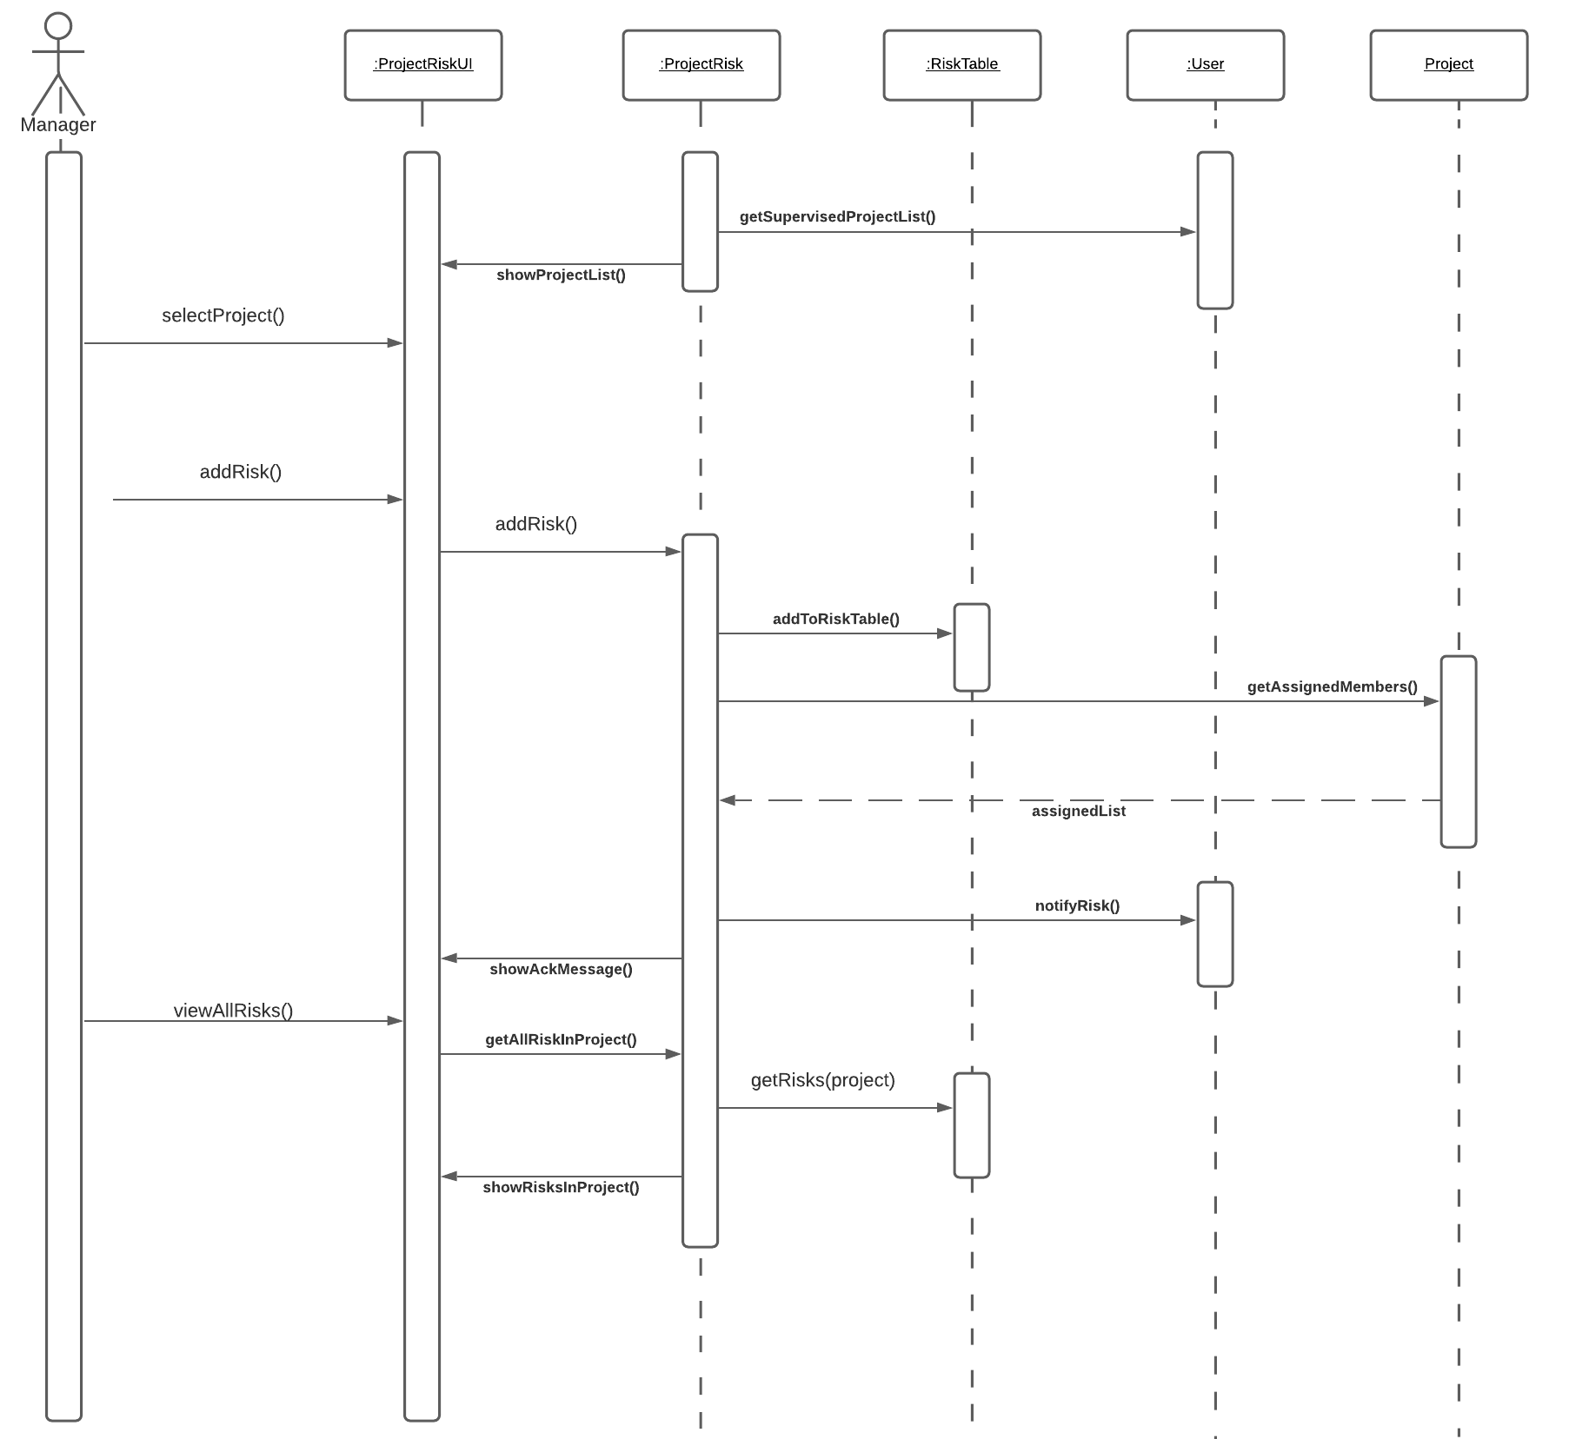
Project Risk

Slide 10
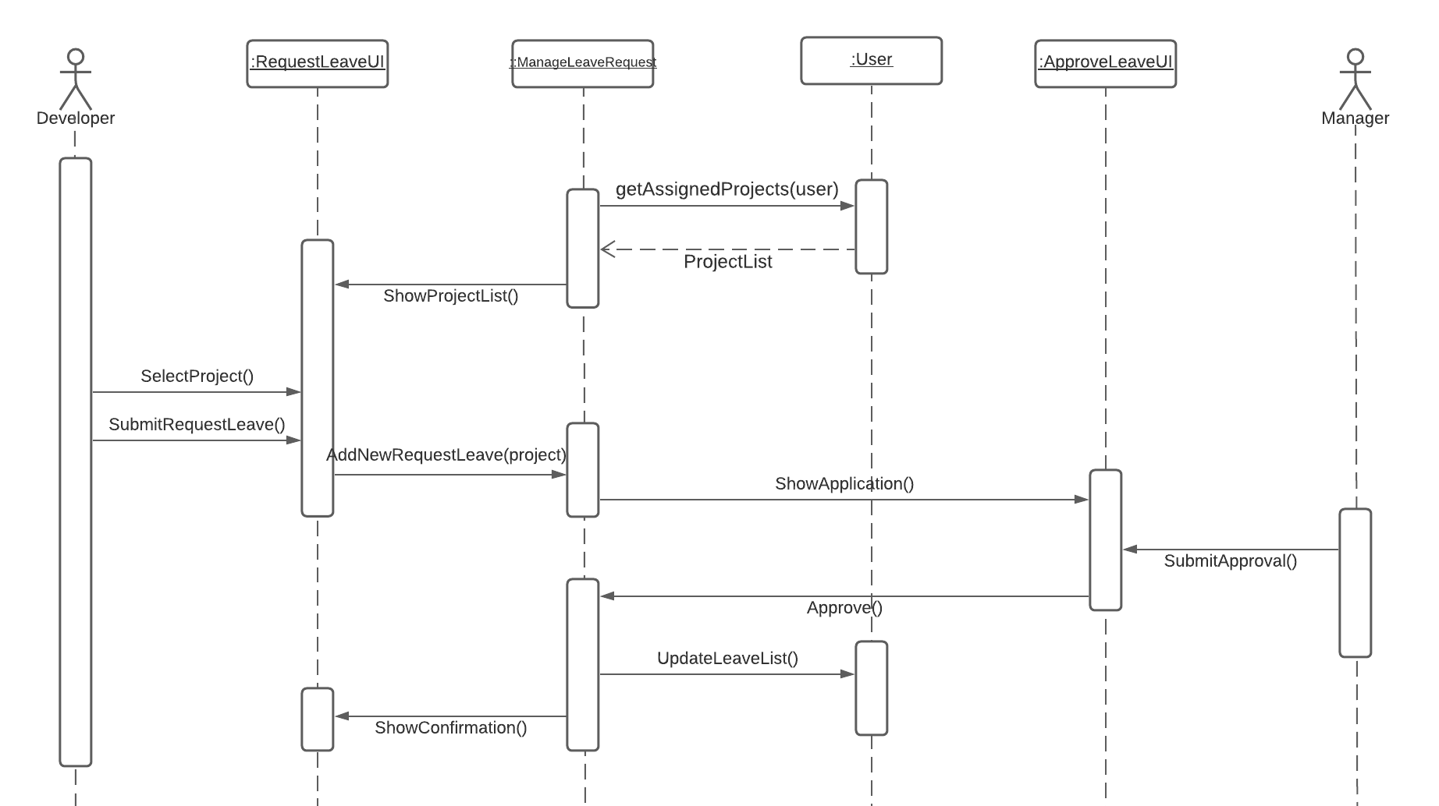
Leave Request

Slide 11
Major Use Cases
Create Project
Add Task
Update Task Dependency
Update Cost
View Gantt Chart
Submit and Approve Work
Project Risk
Leave Request

Slide 12
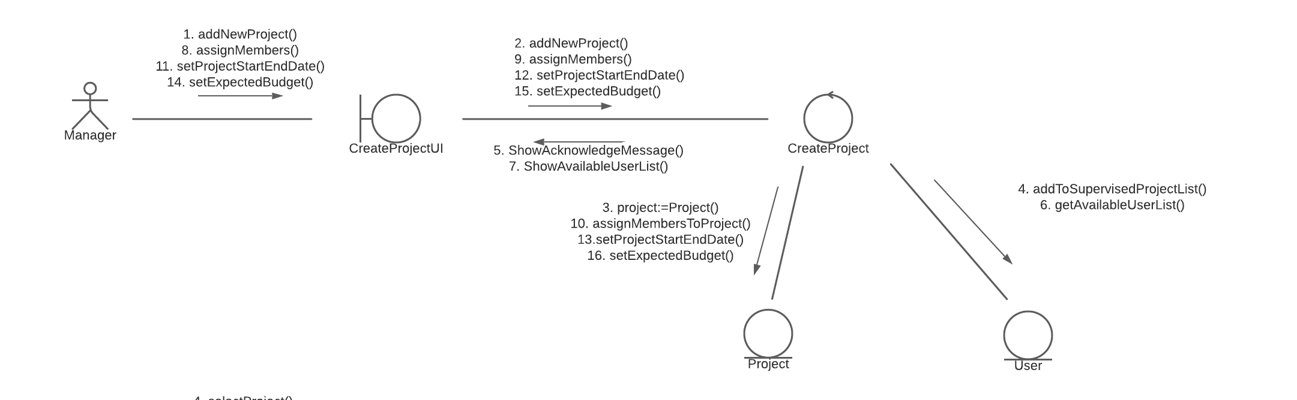
Create Project

Slide 13
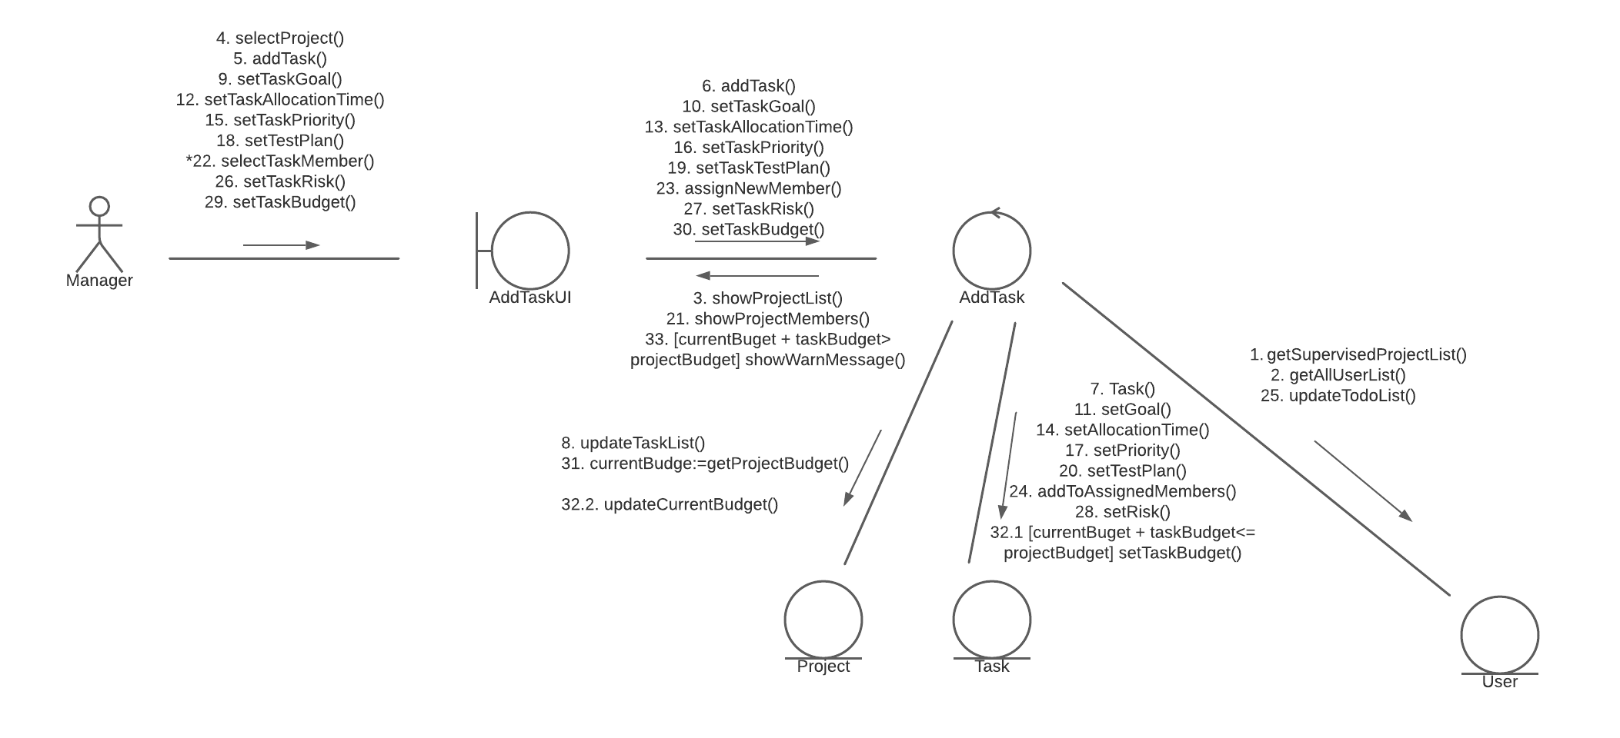
Add Task

Slide 14
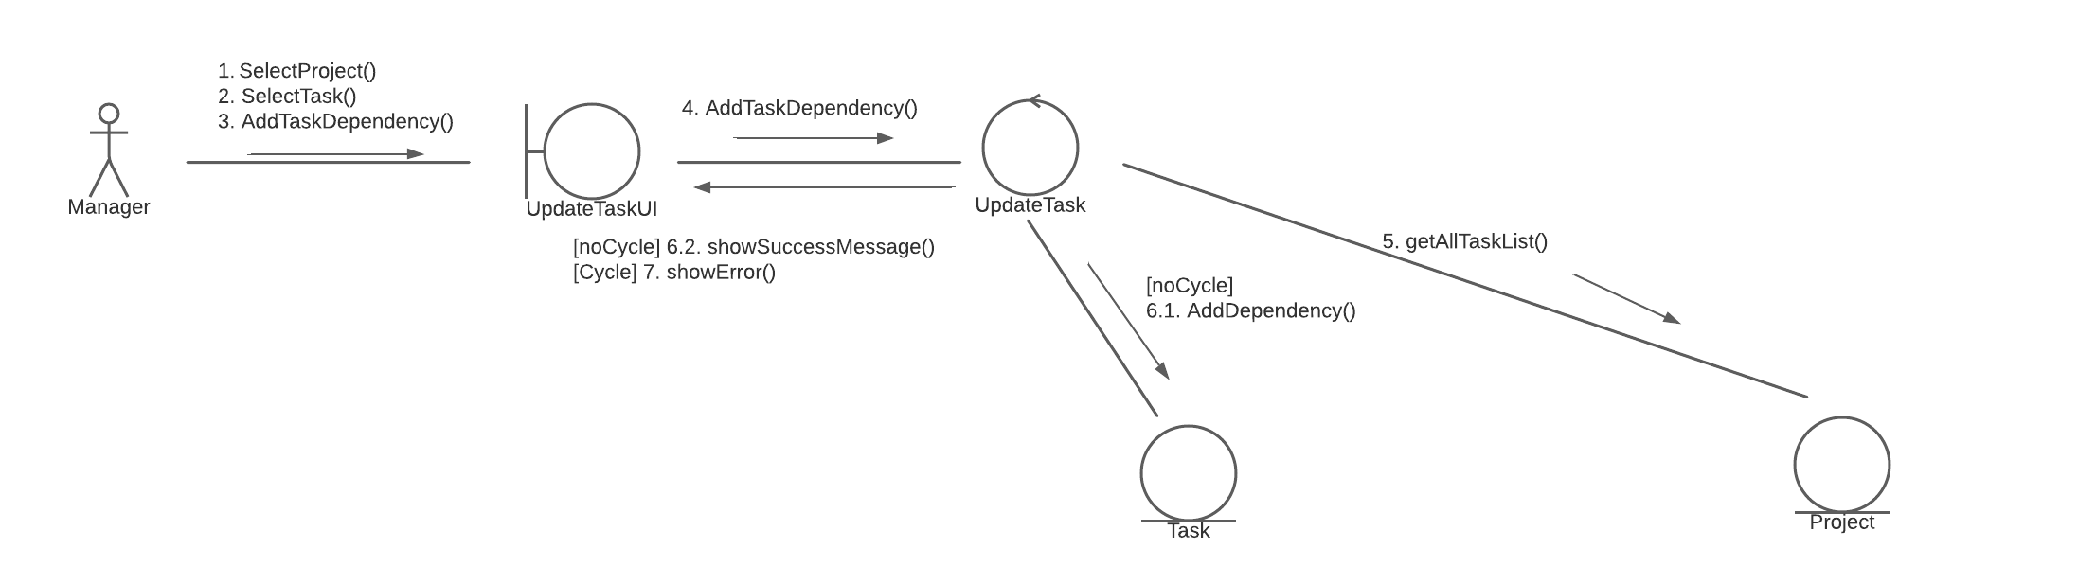
Update Task Dependency

Slide 15
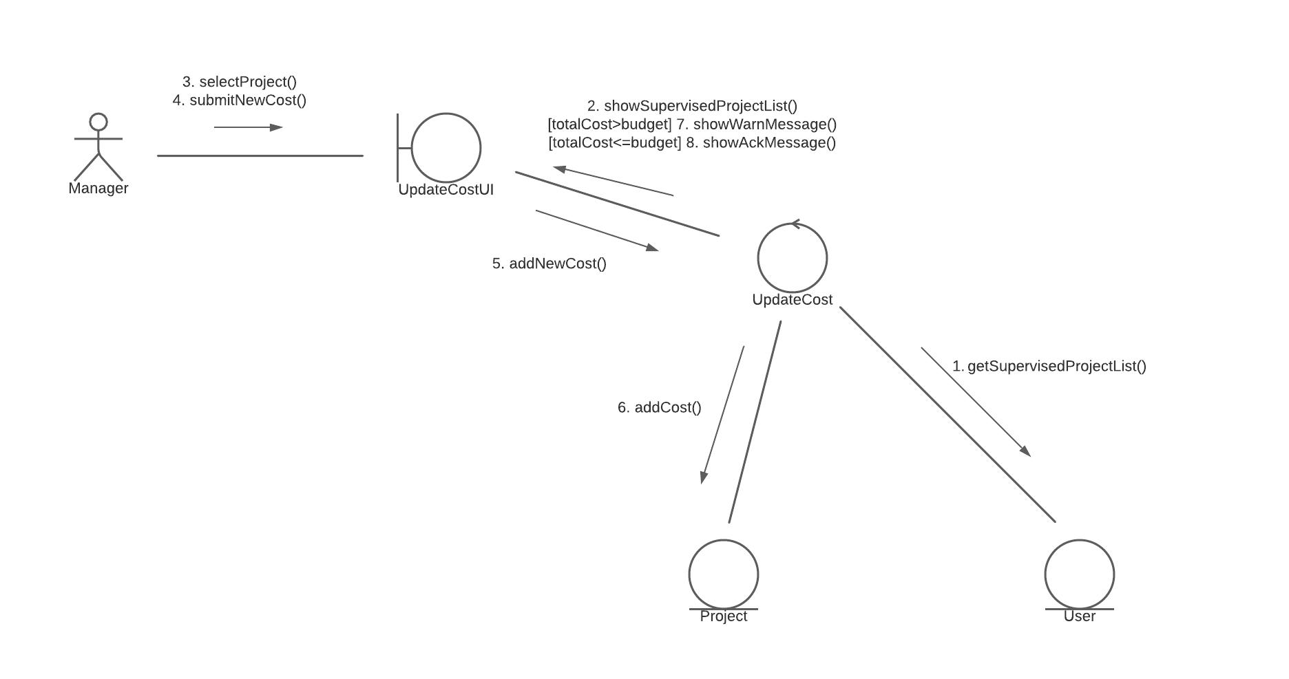
Update Cost

Slide 16
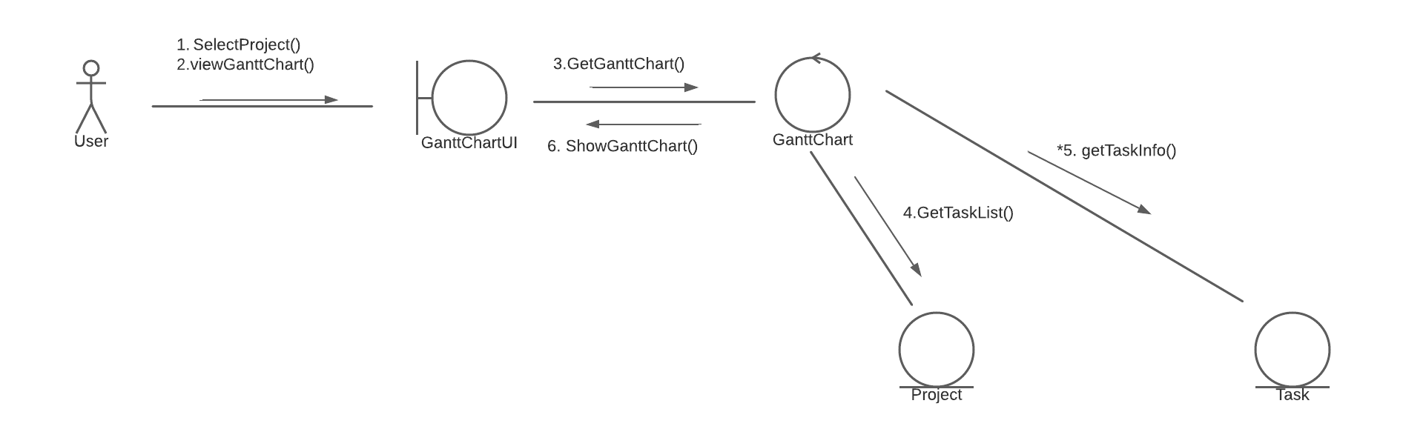
View Gantt Chart

Slide 17
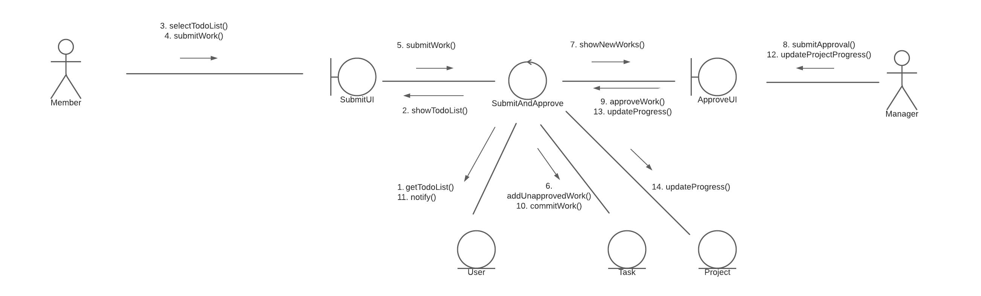
Submit and Approve Work

Slide 18
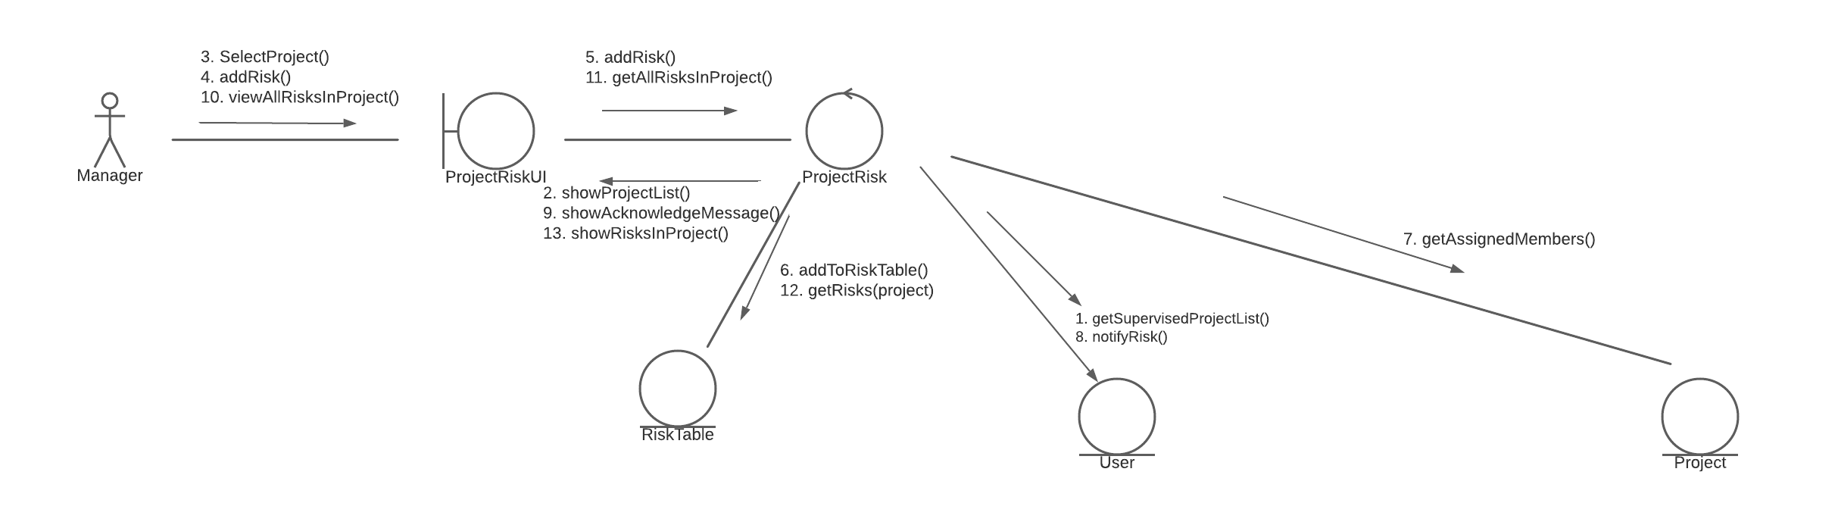
Project Risk

Slide 19
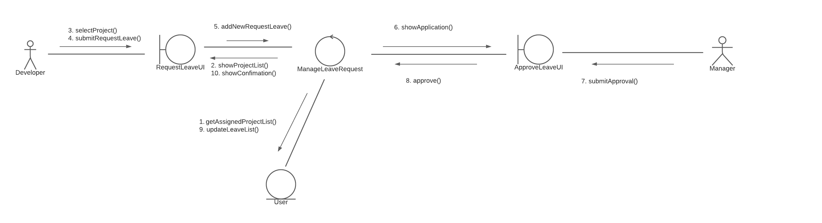
Leave Request

Slide 20

Thank you

