Slide 1

Deepfake Voice Detection
ASVspoof → Real-World Generalization
Prepared by:
MD A RAHMAN RUHEL
Data Analyst | Data Science Fellow @ Springboard

Slide 2

Project Motivation
Recent advancements in neural speech synthesis and voice cloning have made it possible to generate highly realistic fake human speech. These deepfake voices pose serious risks in:
  AI voice cloning is getting frighteningly realistic
  Used for authentication bypass & financial scams
Traditional speech processing systems are not designed to detect synthetic voices and often fail when exposed to modern voice conversion (VC) or text-to-speech (TTS) models.

Slide 3

Project Goal
Train a deepfake voice detector using ASVspoof 2019 (LA)
Evaluate robustness on ASVspoof (unlabeled eval split) before deployment testing
Test on real-world speech (LibriSpeech, Common Voice) to simulate deployment
Study generalization across speakers, accents, and recording conditions — a key challenge in anti-spoofing

Slide 4
Dataset Overview
ASVspoof 2019 (LA)
→ real & spoofed speech (TTS/VC) + protocol labels
→ used for training/validation/test
→ Source: asvspoof.org
LibriSpeech
→ natural speech, multi-speaker
→ used to test out-of-domain false positives
→ Source: Hugging Face (PyTorch)

Slide 5
Data Wrangling
Parsed ASVspoof 2019 (LA) protocol files
Built a unified metadata table
split | file_id | attack | label | filepath
train | LA_T_1138215 | None | 0 | /content/asvspoof/ASVspoof2019_LA_train/flac/L…
train | LA_T_1271820 | None | 0 | /content/asvspoof/ASVspoof2019_LA_train/flac/L…
train | LA_T_1272637 | None | 0 | /content/asvspoof/ASVspoof2019_LA_train/flac/L…

Slide 6
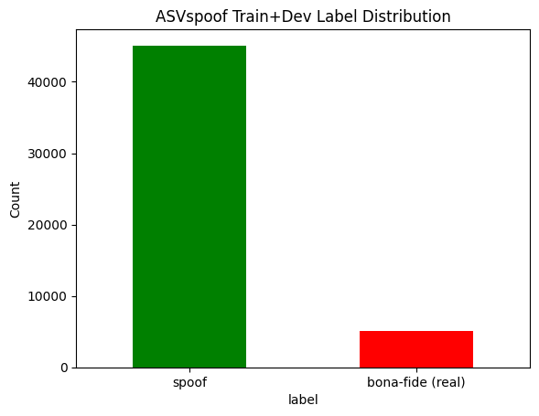
Exploratory Data analysis - EDA
Label Distribution (Real VS Spoof)
Spoofed: 45,096
Real: 5,128
This imbalance is
intentional and
reflects the task setting

Slide 7
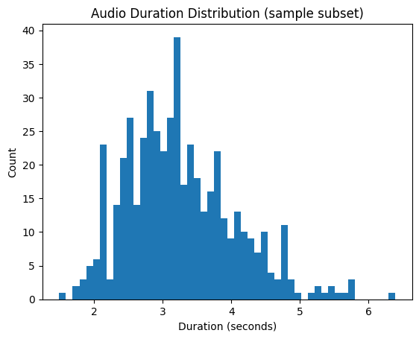
Exploratory Data analysis - EDA
Audio Duration Analysis
Narrow duration distribution (2.5–4.5s typical)
Occasional long-tail outliers (~>5s)
Consistent lengths reduce temporal padding complexity

Slide 8

Exploratory Data analysis - EDA
Listening to Real vs Spoof Samples
Real sample audio clip
Spoof sample audio clip
spoof audio in ASVspoof LA is noticeably distinguishable from real speech.

Slide 9
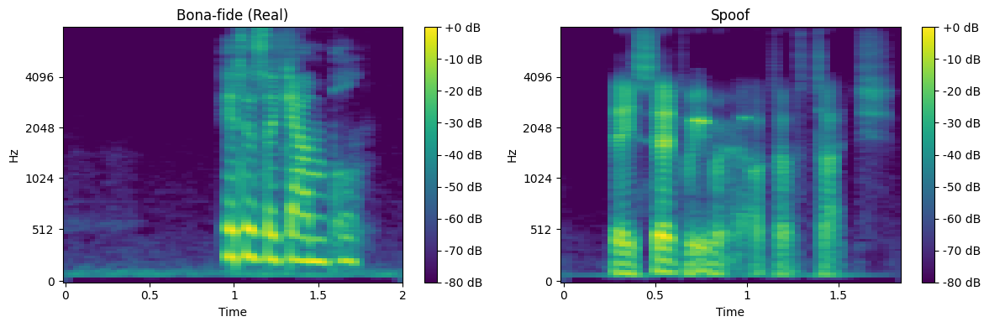
Exploratory Data analysis - EDA
Spectrogram Inspection (Real vs Spoof)
Real (Bona-fide) Speech:
natural variability
imperfect harmonics
Spoofed
stable harmonics
synthetic/vocoder artifacts

Slide 10
Preprocessing
Preprocessing pipeline
Audio (.flac/.wav)
↓
Load & Normalize (librosa)
↓
LFCC Extraction
↓
Precompute Features
↓
PyTorch DataLoader
↓
Model

Slide 11
Preprocessing
Motivation for LFCC:
Linear Frequency Cepstral Coefficients (LFCC) has been widely validated in the ASVspoof community as a more effective feature for detecting synthetic artifacts due to its higher spectral resolution.
Why LFCC?
Preserves linear frequency detail
Better retains high-frequency artifacts
Sensitive to vocoder/TTS artifacts
Proven in anti-spoofing research

Slide 12
Preprocessing
LFCC Extraction Parameters:
Sample Rate (SR) = 16000
Number of Coefficients (N_LFCC) = 60
FFT Size (N_FFT) = 512
Window Length = 25 ms
Hop Length = 10 ms

Slide 13
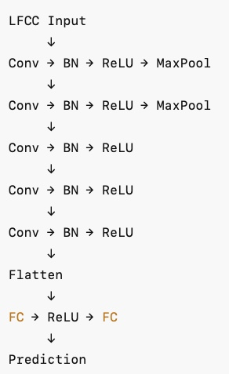
Modeling
Baseline LFCC-CNN Classifier
Component | Description
Input | LFCC features (1 × 60 × T)
Backbone | 5 × Conv blocks
Block Structure | Conv2D → BatchNorm → ReLU
Downsampling | MaxPool applied in Blocks 1–2
Channel Progression | 1 → 16 → 32 → 64 → 128 → 128
Classifier Head | Flatten → FC(256) → FC(1)
Output | Spoof probability (sigmoid)
Purpose | Baseline LFCC feature learning for anti-spoofing

Slide 14
Loss, Optimizer & Scheduling
Loss & Class Imbalance
BCEWithLogitsLoss with pos_weight ≈ 8.84
Corrects spoof-heavy imbalance in ASVspoof
Prevents trivial “always spoof” predictions
Training Setup
Optimizer
Adam (lr = 1e-4)
Small lr chosen for stability with LFCC + CNN pipeline
Learning Rate Scheduling
ReduceLROnPlateau to lower LR when validation stalls
Helps convergence refinement & reduces overfitting tendencies

Slide 15
Training & Validation
Training
Mini-batch gradient descent
Train loss: 0.537 → 0.0005 (10 epochs)
Smooth convergence, no underfitting signs
Validation
Validation-only forward passes (no gradients)
Val loss: 0.0076 (strong in-distribution performance)
Small mid-epoch fluctuations (expected under class imbalance)
Summary
Model learned LFCC patterns quickly
Mild overfitting after plateau, but validation still improved overall

Slide 16
Development Split Evaluation
Metric | Value
AUC | ~ 1
EER | < 0.3%
ACCURACY | > 99.8%
Interpretation
Near-perfect discrimination in-distribution
Model effectively learns LFCC spoof vs bona-fide patterns
Performance reflects exposure to similar spoofing attacks during training

Slide 17
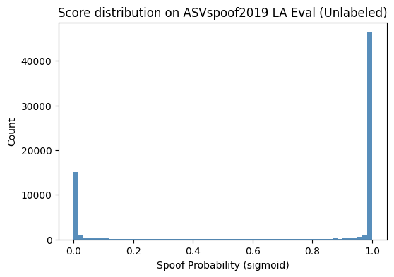
Zero-Shot Evaluation on ASVspoof
Unlabeled Eval Split
Applied to unseen spoof attacks
Bimodal spoof score distribution
Predicted spoof ≈ 72%
Boundary preserved → no collapse
Model shows zero-shot generalization on new attack types without collapsing to trivial predictions

Slide 18
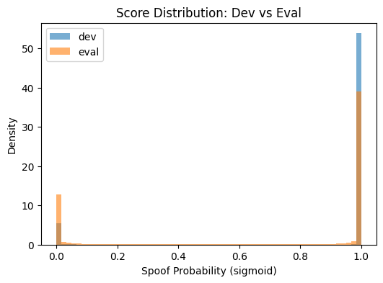
Comparison – Dev Vs Eval
Predicted Spoof (p > 0.5)
Dev: ~90%
Eval: ~72%
Score Behavior
Both splits show bimodal distributions
Eval distribution shifts slightly toward bonafide region
Unseen attacks are harder to classify but decision boundary remains intact

Slide 19
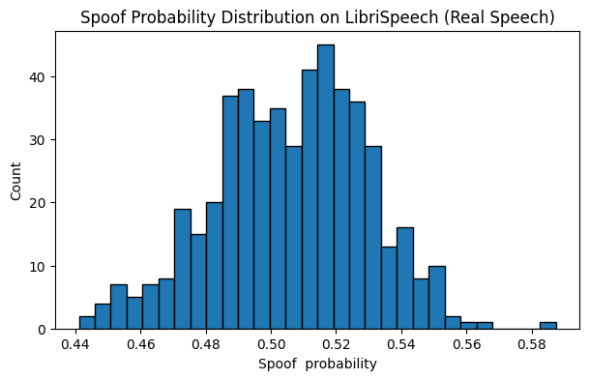
Out-of-Domain Real Speech Evaluation
LibriSpeech / Common Voice
500 real speech clips
No spoof attacks (all bona fide)
Results
False positives: 298 / 500
FPR: 59.6%
Spoof probability distribution biased toward spoof
Model fails to recognize out-of-domain bona fide speech, leading to high false alarms

Slide 20
Why model failed to generalize?
Domain & style mismatch: controlled ASVspoof vs natural LibriSpeech/Common Voice
Speaker & channel variability: more diverse speakers, mics, and environments in real speech
Overfitting to spoof artifacts: model learned “what spoof looks like” but not diverse bona fide speech
Calibration shift: ASVspoof score thresholds do not transfer to real-world data
Results
False positives: 298 / 500
FPR: 59.6%
Spoof probability distribution biased toward spoof

Slide 21
Future Work
Obtain ASVspoof Eval labels to measure unseen-attack performance
Test on additional real speech datasets (e.g., Common Voice, VoxCeleb)
Increase bona fide speech diversity for better real-world generalization
Improve threshold calibration to reduce false positives in deployment
Results
False positives: 298 / 500
FPR: 59.6%
Spoof probability distribution biased toward spoof

Slide 22
Conclusion
The model solved the ASVspoof benchmark task but failed to generalize to out-of-domain real speech, highlighting a gap between benchmark success and real-world usability.
Results
False positives: 298 / 500
FPR: 59.6%
Spoof probability distribution biased toward spoof

