Slide 1
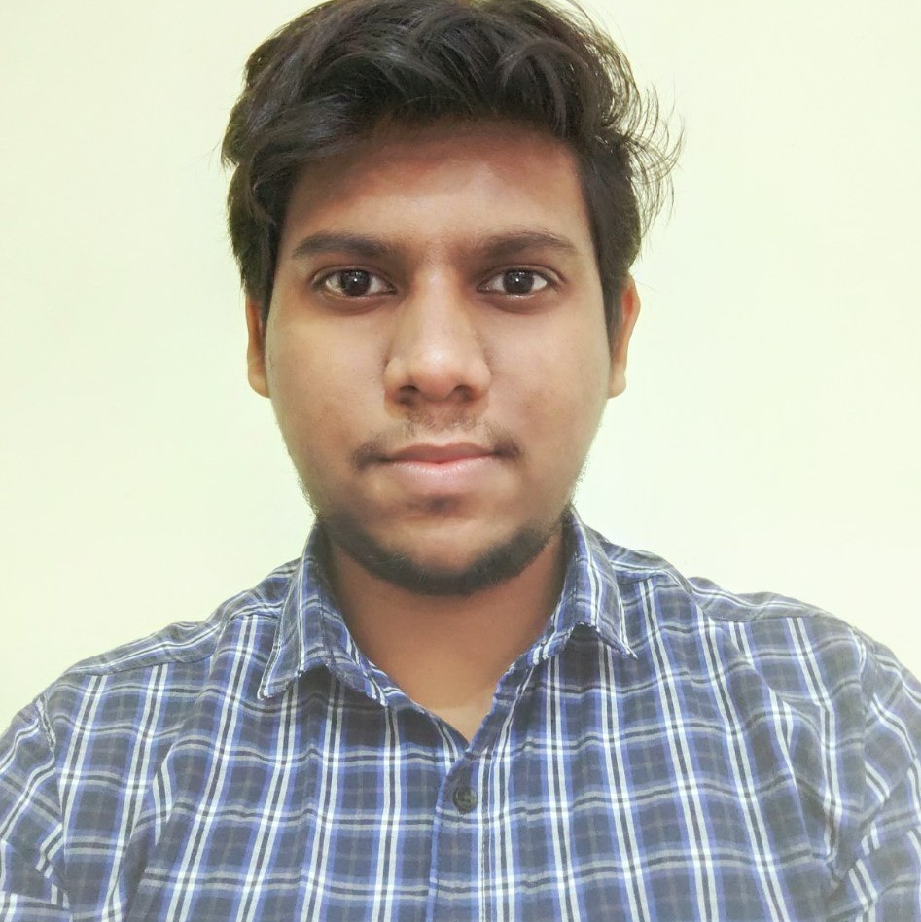



Rushikesh Kaikade
Bachelor of Engineering
Information Technology : 2017 - 2021
Skills
Java 11
Spring Cloud
Angular
Database
No SQL database – MongoDB
Web Technologies
HTML5
CSS3
Javascript
AddOns
Github
Maven
Postman
Additional Details
Problem Solving
Fast Learner
Team management
Analyst/Software Engineer
Mumbai
rushikesh.kaikade@capgemini.com
9511635486
A4
Software Engineer who is Strong in design and integration with intuitive problem-solving skills. Passionate about implementing and launching new projects.
Ready to learn new technologies and implement them to further improve my knowledge.
Eager to work in a team of dedicated people and serve a key role in the enhancement and development of the project.
Has working knowledge on Angular and Java Microservice Development using Spring framework on an intermediate level.
Agriculture Crop System
Completed end to end case study of Agriculture Crop system Application along with JWT authentication, Swagger and payment testing.
Angular Material-UI and used for user interface.
Check out my work on GitHub & Video Profile

