Slide 1
Understanding Emoji Interpretation through User Personality and Context
Sarah Theres Völkel, Daniel Buschek, Jelena Pranjic, Heinrich Hussmann
MobileHCI '19: Proceedings of the 21st International Conference on Human-Computer Interaction with Mobile Devices and Services, October 2019 (Pages 1-12)
Human-Computer Interaction
19th february 2020
Hugo Paiva de Almeida 93195 LEI
Rui Fernandes 92952 LEI

Slide 2
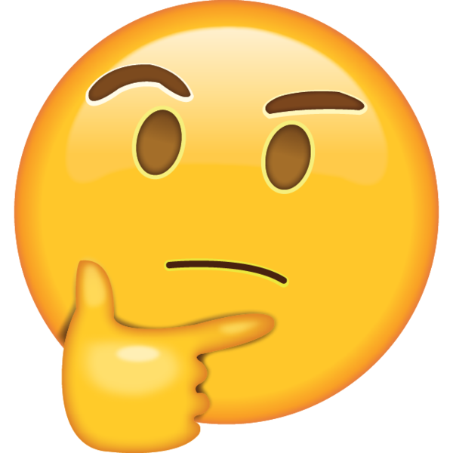



Why this paper?
Popularity
Used frequently
Common problem

Slide 3
Contextualization
Emoji
Pictogram that displays a facial expression, symbol, object or an action.

Slide 4
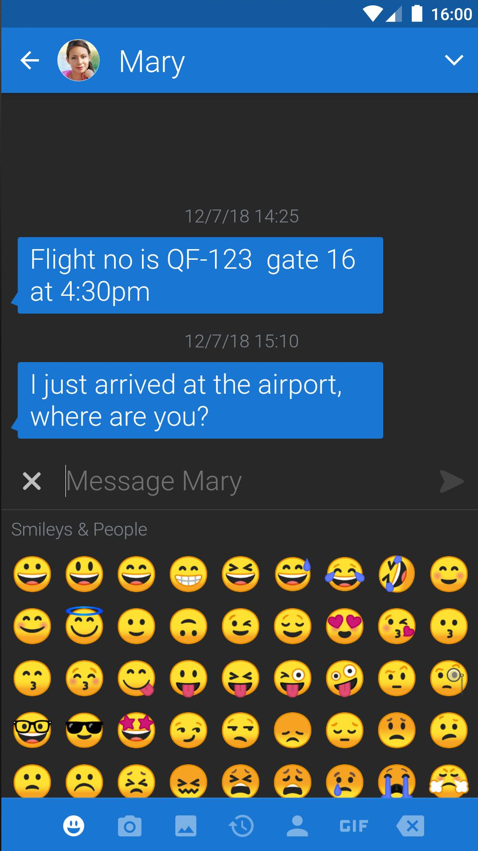
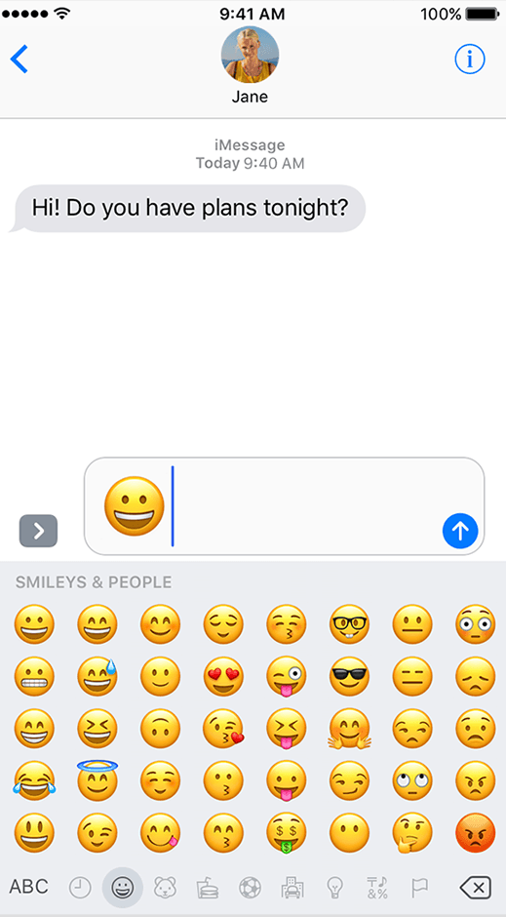
Emoji ambiguity
Place your screenshot here
🤷‍♂️
Intercultural differences
Personality
Different representations

Slide 5
Study approach
Interpersonal communication
Investigate personality and emojis in text messages in interpersonal communication.
Contextualisation
Interpretation of emojis with context factors.
Open human interpretation
Freely interpretation of emojis and their differences in a given context.
Direct personality assessment
Personality measure using the German version of the Big Five Inventory-2 questionnaire.

Slide 6
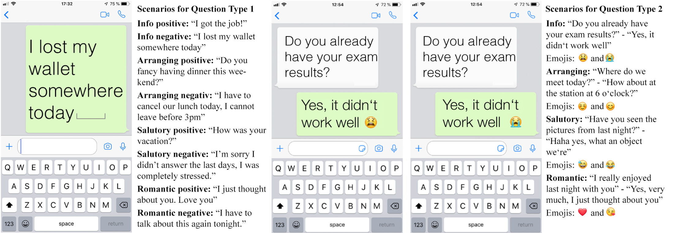
Online Survey
1
Active interpretation
2
Passive interpretation
3
Personal Information

Slide 7
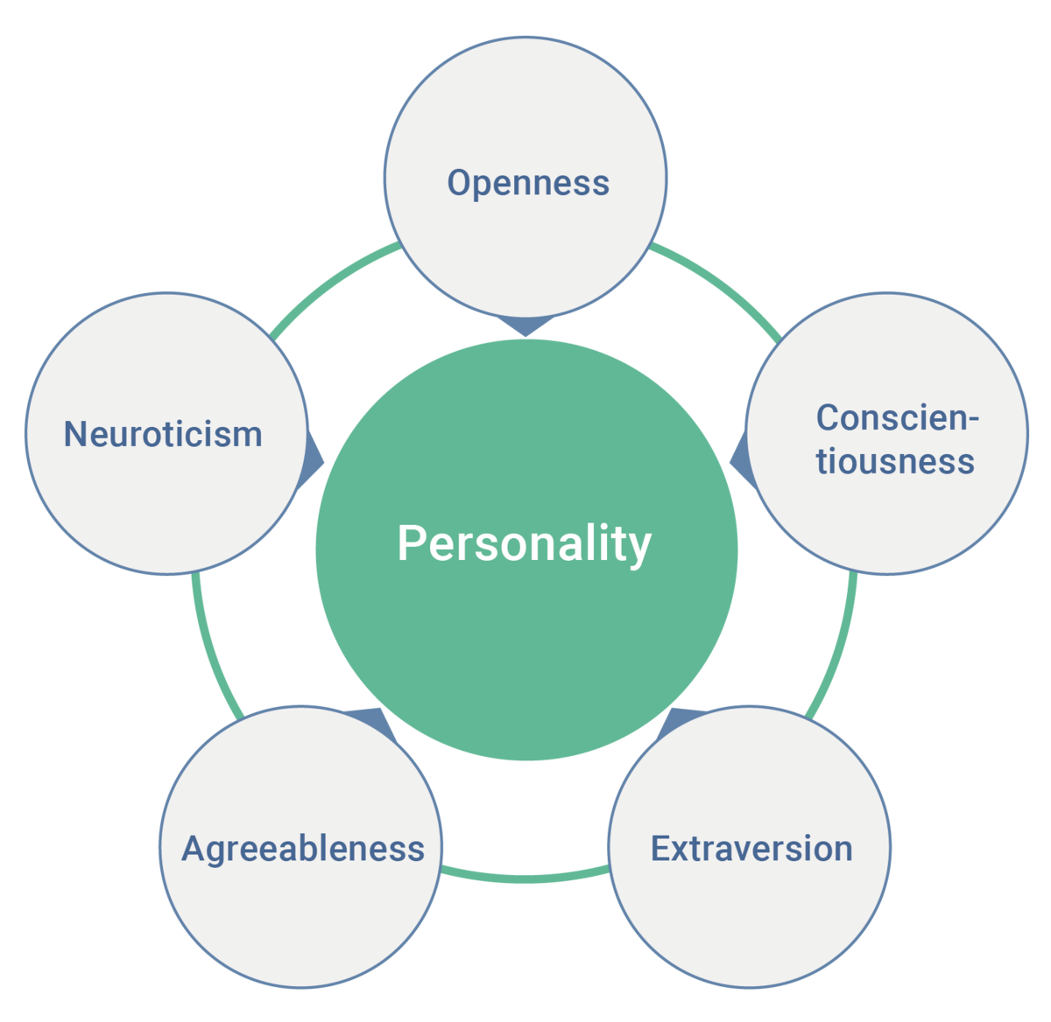
Big Five Inventory
🖐🏻

Slide 8
Emoji Choice
Participants
Total: 646 people
Female: | 74.5%
Range: | 17-68 years
Android: | 57%
iPhone: | 42%
Blackberry, Windows Phone, other | Less than 1%
emojitracker.com
📊

Slide 9
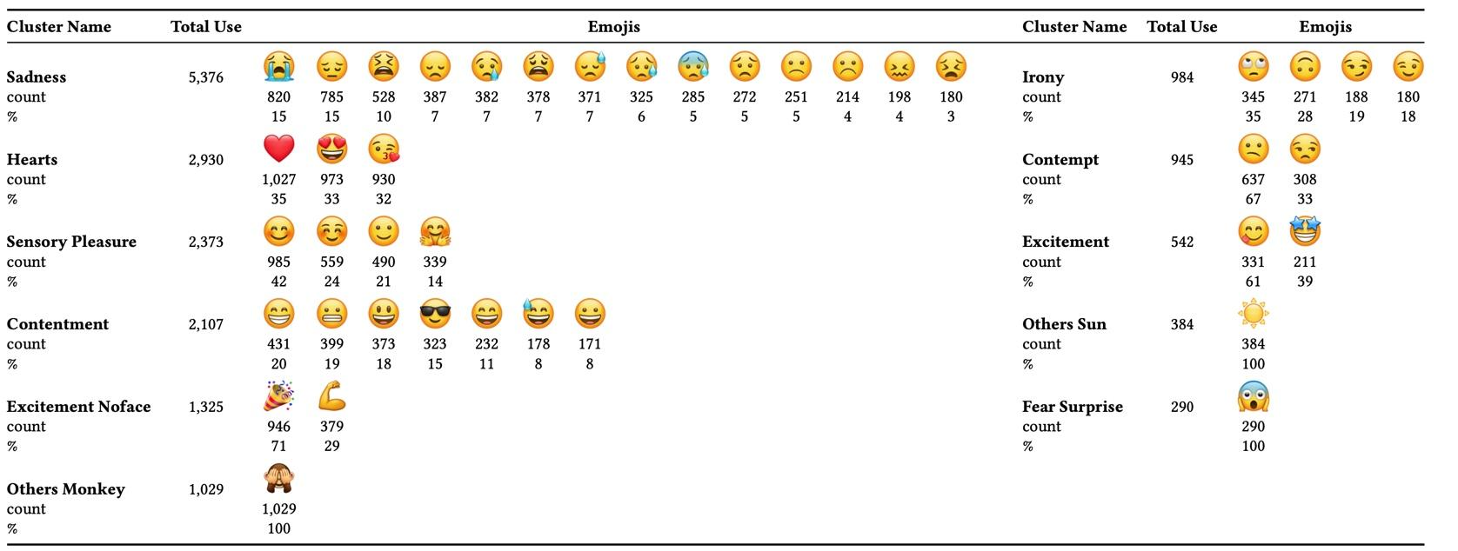
Emoji Clustering

Slide 10
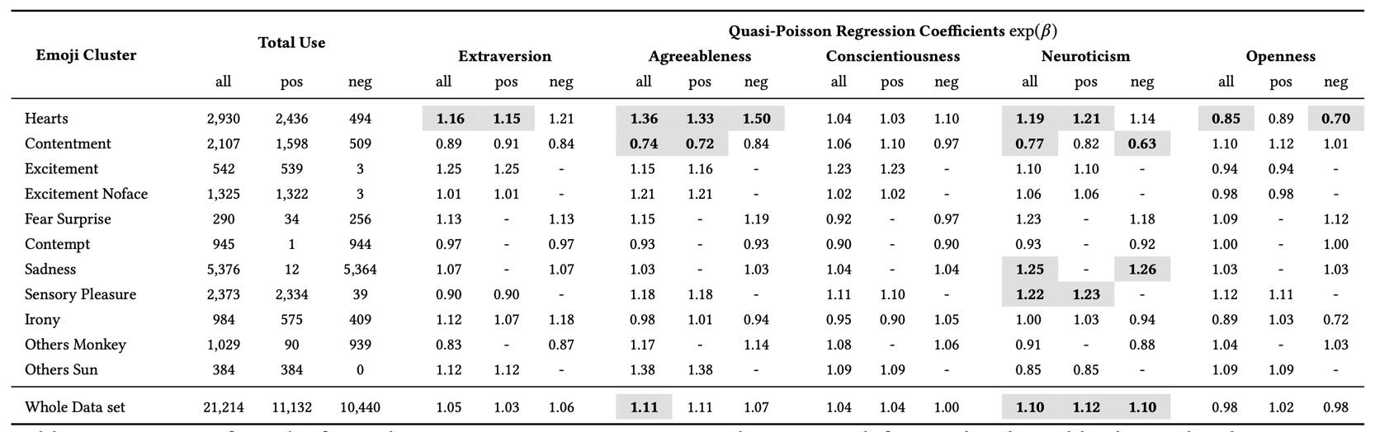
Quantitative Analysis

Slide 11
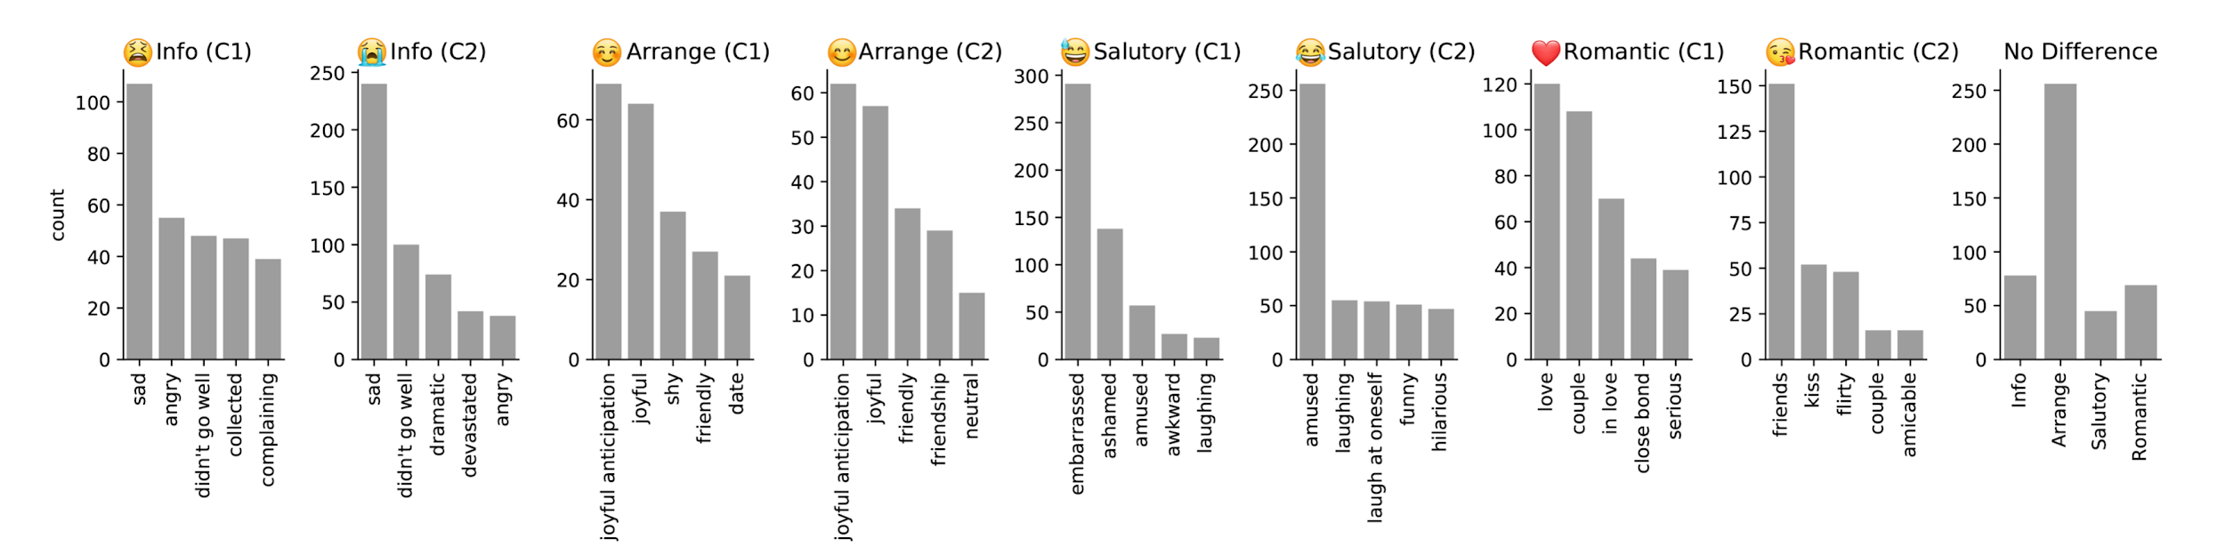
Qualitative Analysis

Slide 12

Limitations
Heavy presence of female participants in the population sample
Limited amount of available emojis for choice
The receiver’s relationship to the sender is omitted in question type 2
Everyday life scenarios of interactions are not fully covered

Slide 13


Implications
Mobile Application
Future Research

Slide 14

Conclusions
Emojis may lead to misunderstanding since their intended meaning often remains ambiguous
User personality has been linked to the understanding of emojis
Emojis interpretation varies greatly between users, even if emojis are presented in a defined message context
Emojis interpretation differs between public platforms and private messages

Slide 15
References
Sarah Theres Völkel, Daniel Buschek, Jelena Pranjic, and Heinrich Hussmann. 2019. Understanding Emoji Interpretation through User Personality and Message Context. In Proceedings of the 21st International Conference on Human-Computer Interaction with Mobile Devices and Services (MobileHCI ’19). Association for Computing Machinery, New York, NY, USA, Article 3, 1–12. DOI:https://doi.org/10.1145/3338286.3340114
Built With :heart: In Nyc. This Is A Mroth :man: Project. realtime emoji use on twitter. Retrieved February 17, 2020 from http://emojitracker.com/

