Slide 1


Ge`ez (Ethiopic) Image Data
&
Clustering Analysis
Presenters: Jiepeng Yuan, Rui Jing, Yichao Zhao, Yiyang Xiong
05/08/2024

Slide 2

Research Introduction and Motivation
Introduction
Ge'ez (Ethiopic) Significance
Project Goal: Recognize Ge'ez numbers 1-10
Clustering Application: Enhance recognition accuracy
Motivation
Improve efficiency of data processing
Better understanding of attribute of images
Notes:
Ge'ez Significance: Ge'ez is an ancient Ethiopian script, and studying it holds historical importance.
Project Goal: Recognize Ge'ez numbers 1-10 and apply clustering algorithms learned in Stat 437.
Clustering Application: Cluster Ge'ez number samples to enhance recognition accuracy.
Geez pronounce: https://www.youtube.com/watch?v=52hKZ0xUBgY

Slide 3
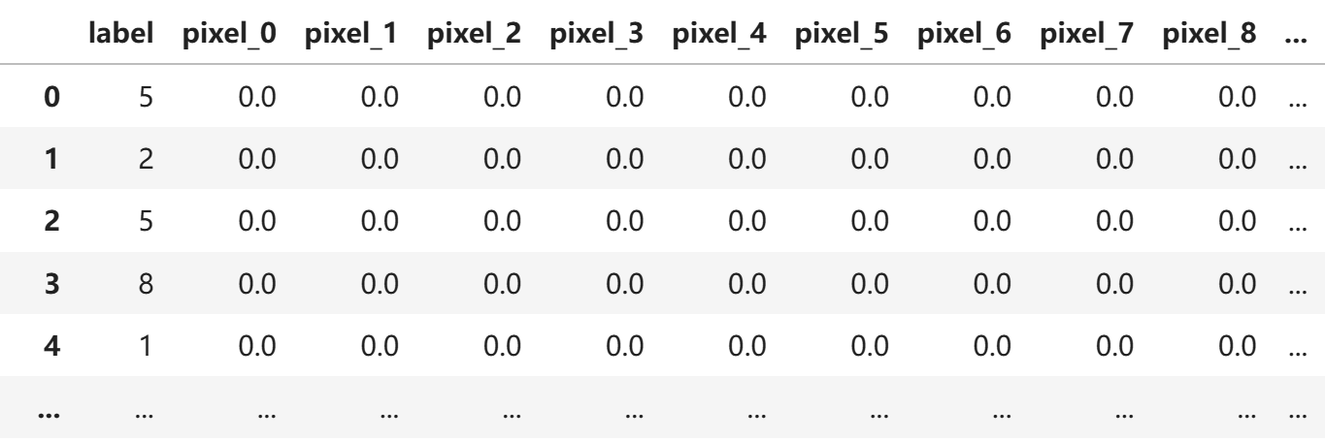
About the Dataset
Data structure
1000 observations of artificial generated images
785 columns (1st column represents pre-assinged labels)
Notes:
10 labels.

Slide 4
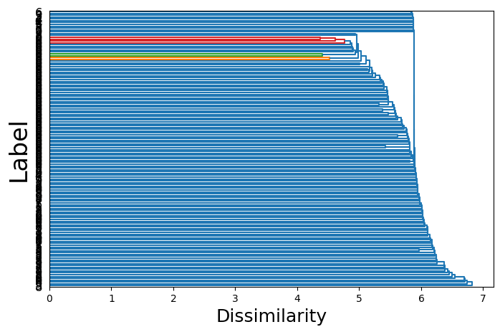
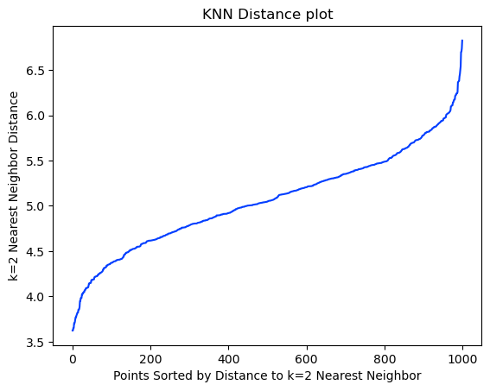
Data Cleaning
Do not have value missing
Do not have outlier
HAC Single Linkage Dendrogram

Slide 5
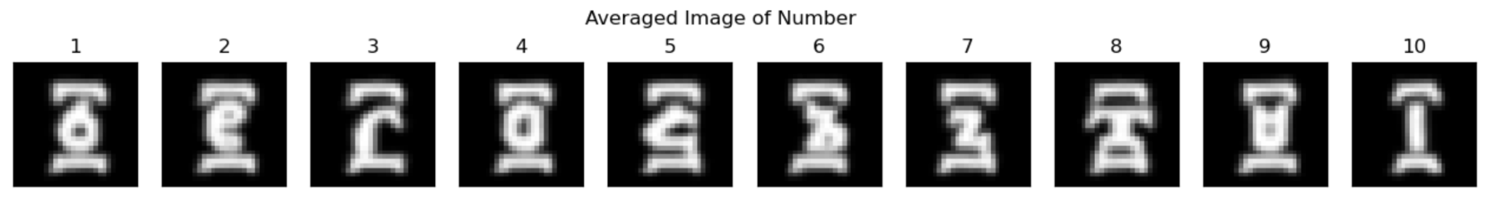
Visualizations of Dataset
Average Image Ge'ez Number:

Slide 6
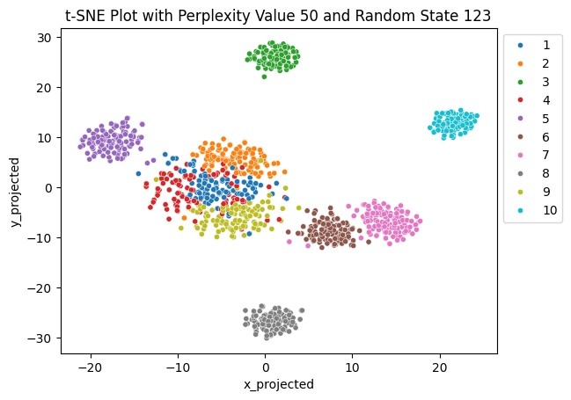
Color Coded t-SNE Plot
Mostly well separated, some are closer.
Roughly spherical.
Most have similar sparcity, slight differences in middle.
Balance in size
Straddle nodes exist between the middle clusters

Slide 7
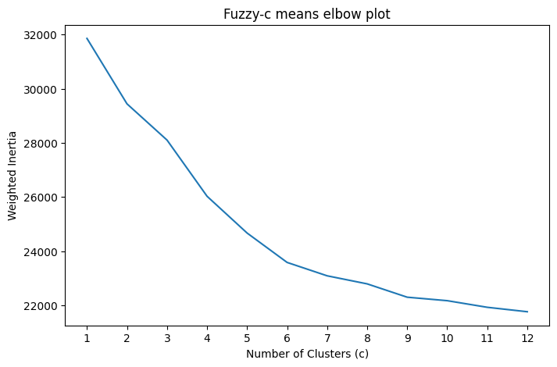
Clustering #1: Fuzzy C-Means
Elbow at 6
Choose c=6 in Fuzzy C-Means.
Choose p=1.05 after testing multiple p values.

Slide 8
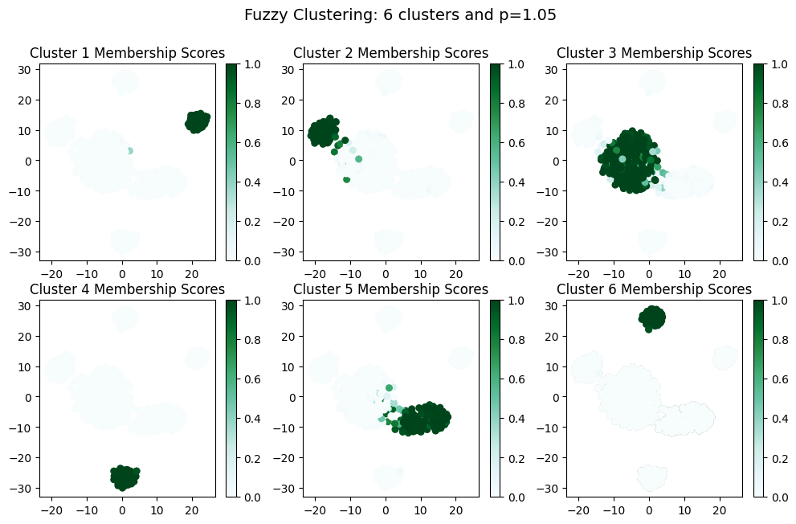
Clustering #1: Fuzzy C-Means
The cluster 3 consists of observations from label 1, 2, 4, and 9.
The cluster 5 consists of observations from label 6 and 7.
The rest aligns with label separation.

Slide 9
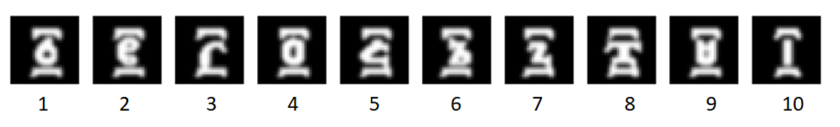
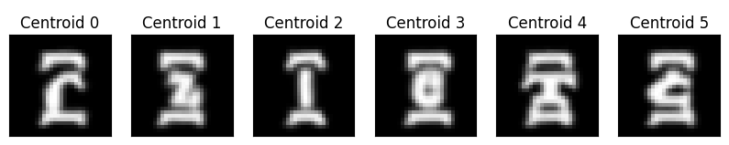
Clustering #1: Fuzzy C-Means

Slide 10
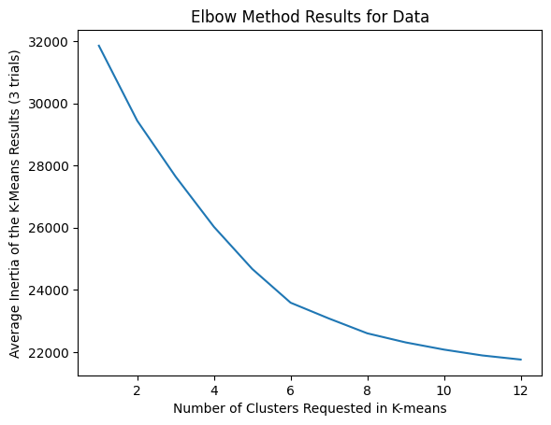
Clustering #2: K-Means
Elbow at 6
Choose k=6 in K-Means.

Slide 11
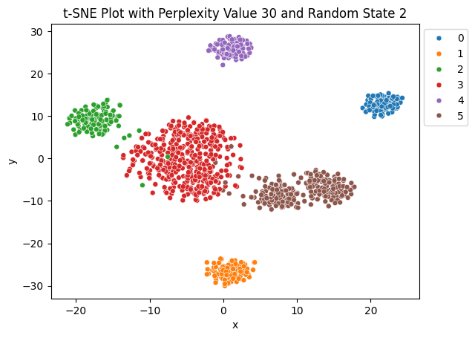
Clustering #2: K-Means
The red cluster consists of observations from label 1, 2, 4, and 9
The brown cluster consists of observations from label 6 and 7
The rest aligns with label separation

Slide 12
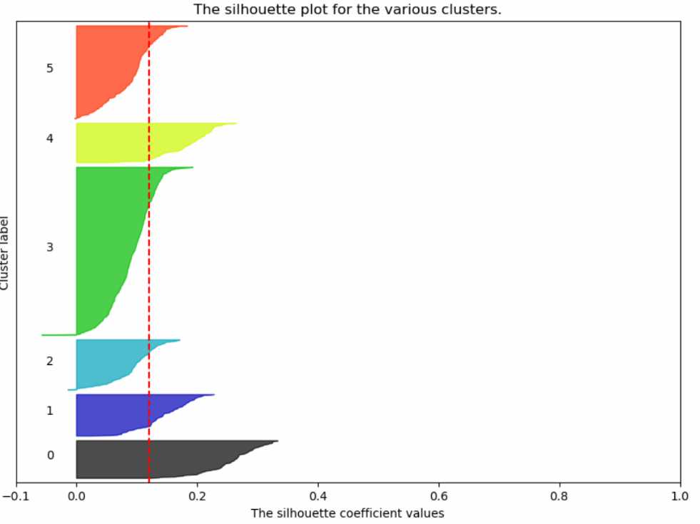
Clustering #2: K-Means
The cluster 2, 3, 5 have negative silhouette score.
Match our insight with t-SNE plot.
The rest aligns with label separation.
Notes:
average silhouette_score is : 0.12049462192586023

Slide 13
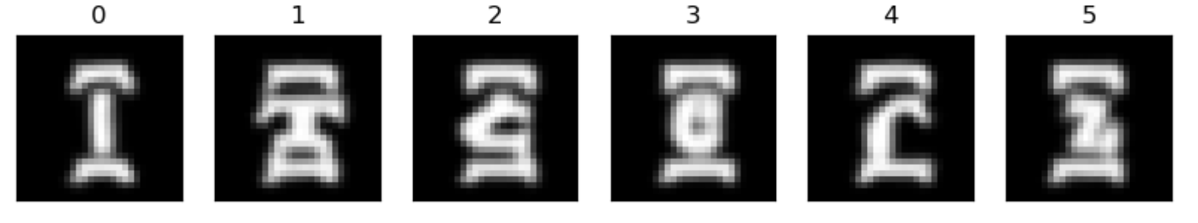
Clustering #2: K-Means
Average image of clusters

Slide 14
Key insights & Algorithm comparisons
 | Fuzzy c-means | K-means
Cluster Number | 6 clusters | 6 clusters
Adjusted Rand Score | 0.5086 | 0.5101
"Inherent" Clusters | No major difference
Insights | * Good at revealing overlapping clusters * Uncertainty | * Suits our well-separated, spherical T-SNE plot * Computationally efficient and simple
Trustworthiness | Fuzzy c-means
Notes:
说Adjusted Rand Score的时候顺带一提两种算法的silhouette plot表现相当
fuzzy c-means is more preferred in terms of trustworthiness given it takes account the uncertainties, which closely align with the nature of the image data

Slide 15
Conclusion
Summary: Fuzzy c-means & K-means
Recommendation: Attention to the numbers with similar structures
Shortcomings:
Lack of outlier and missing values
Trained with ideal images
Future Work: Application to supervised learning models

Slide 16
Thank you for listening!

