Slide 1
CS542 Project Report
Rui Zhang
A20365519

Slide 2
Content
The description of the program design
Test case report
The description of algorithm
Instructions of compilation and running

Slide 3
The description of the program design
This program is used to realize the functions listed in the Project Description, which contains:
Create a menu show the functions and the users can input the number to select the functions to use .
Show the topology which scan from the input files.
Users can select one router as the source and output interface of each router as destination.
Users can select one router as destination and output the specific shortest path from the source router to the destination, and the total cost.
Users can select one router to remove then output the topology after remove and the shortest path and total cost from the source router to the destination selected before.
Users can look at the shortest paths from every router to others and their cost.
Exit the program.

Slide 4
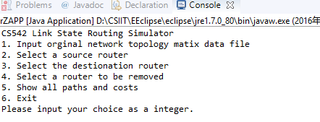
Test case report
Show the menu.
When runs the program, the console will output the menu which is available the user to
to select the functions.
Then, the user can input a number as the choice.

Slide 5
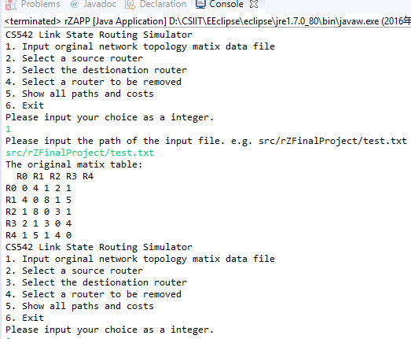
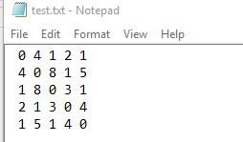
Test case report(Cont.)
Input the file path and output the topology in the file.
Select “1” in the menu, the console will let user to input the path of the file.
Then input the path of the file like ‘src/rZFinalProject/test.txt’.
Then the topology will be output.
After input the file into the program:
The contain in the test file is :

Slide 6
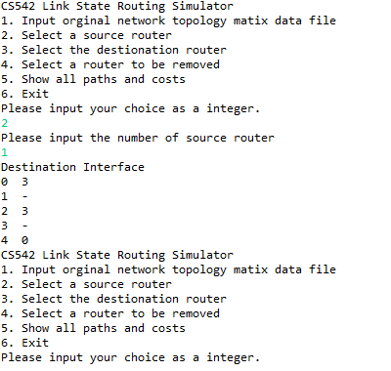
Test case report(Cont.)
Input the source number and show the destination and interface.
Select ‘2’ in the menu, the console will let use to input the source router
Then, input the source router, like ‘1
Then the Destination and Interface will be output, and automatically return to the main menu.
Interface means the last router before the destination from the source router.
If shows ‘-’, it means there is no interface just source router then the destination directly.

Slide 7
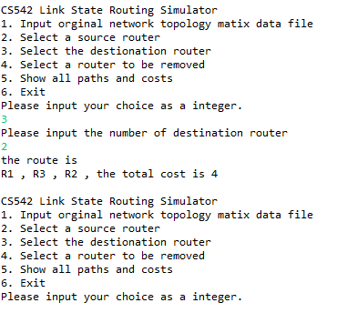
Test case report(Cont.)
Input the destination router and output the specific path and total cost.
Select ‘3’ in the menu, and the console will let user to input the destination router.
Then input the destination router like ‘2’
Then the specific path from router ‘1’ to router ‘2’ and the total cost of the path will be showed in the console.
Then path is R1 to R3 to R3, total cost is 4.
And then, back to the menu automatically.

Slide 8
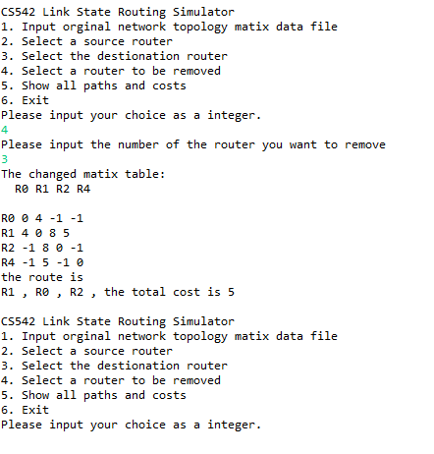
Test case report(Cont.)
Choose a router to remove then output the topology after remove and the path and total cost between the two routers chosen in the last two steps.
Select ‘4’ in the menu, and the console will let user to input the router to remove.
Then input the number like ‘3’.
Then the console will show the topology path and total cost after remove.
The path is R1 to R0 to R2, the total cost is 5.

Slide 9
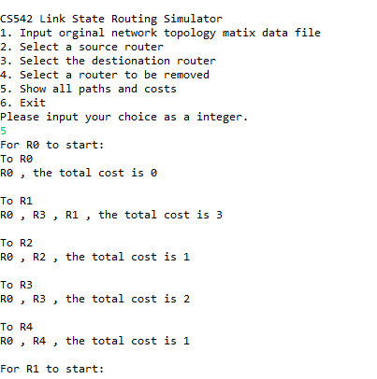
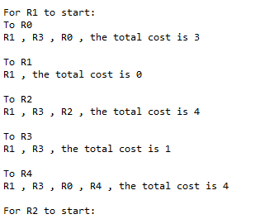
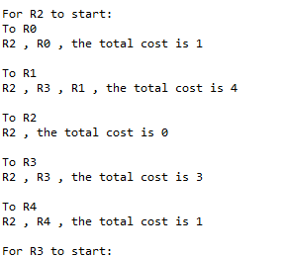
Test case report(Cont.)
Show the all the results of the path and total cost from one router to others in the topology.
Select ‘5’ in the menu, and the console will output the all results.
Continue in the next slide….

Slide 10
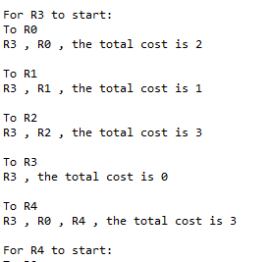
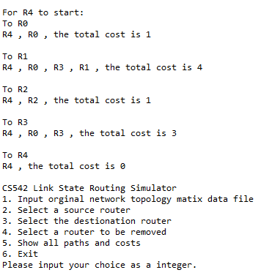
Test case report(Cont.)

Slide 11
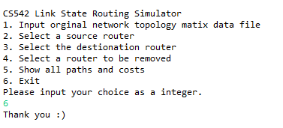
Test case report(Cont.)
Exit the program.
Select ‘6’ in the menu, and end the program.

Slide 12
The description of algorithm
Dijkstra’s Algorithm:
Dijkstra’s algorithm is a typically algorithm to calculate the shortest path from source node to the destination node. Its main character is the diffusion from the source as a center, until arrive the destination.
Specific steps in my program:
Chose a router as the source node, and mark it.
Create a integer array to store the distance from the chosen router to every router from the topology.
Chose a router from the unmarked routers with the shortest distance to the source router and mark it.
Use the router marked in the step 3 as the middle node. If the cost from the source router to the destination router directly is longer than the path from the source router to the destination while use the middle node, modify the distances in the distance array.
Repeat the step 3 and step 4, until all router is marked.

Slide 13
Instructions of compilation and running
In my program, I compile the source code to the .jar which is CS542Project_team92_Rui_Zhang.jar
I use the eclipse to code my program and after finish it,
1. Click the ‘File’ in the top menu, then click ‘Export’
2. Select the type of export file as ‘JAR file’, and click ‘Next’.
3. Chose the resource which to export, in my program, it is ‘rZFinalProject’. And browse the destination to store the export file.
4. Click ‘Next” until the ‘Jar Manifest Specification’, click generate the manifest file, and browse a place to store the .MF file. Then set the Main class as the main class in my program, which is “rZFinalProject.rZpp”.
5. Finally, click the ‘Finish’, the compiled file will show in the place you stored

Slide 14
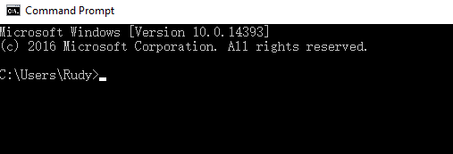
Instructions of compilation and running (Cont.)
Instructions of the running
After I compile the program as .jar, I need to open the file.
first, open the ‘cmd’ to run the program.

Slide 15
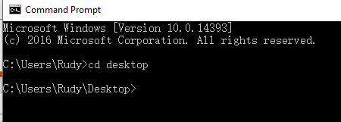
Instructions of compilation and running (Cont.)
Instructions of the running
Then, input the path where the .jar located in.

Slide 16
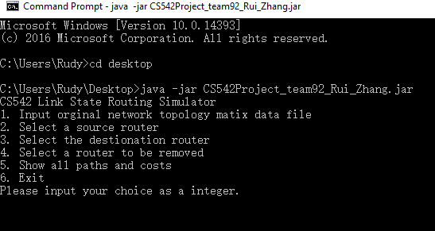
Instructions of compilation and running (Cont.)
Instructions of the running
Finally, input the code which is ‘java –jar ’ + the name of the .jar file
In my program, which is ‘java –jar CSProject_team92_Rui_Zhang.jar’
Then the menu displayed.

