Slide 1
COMP9444 · Neural Networks & Deep Learning · Term 2, 2026
Breast Cancer Classification &
Segmentation on Ultrasound Images
A leakage-free benchmark of 15 deep-learning models on the BUSI dataset
Group Project 047
Classification · Segmentation · Dual-stage pipeline
13 reproduced + 2 improved
Notes:
Welcome. Our project (047) tackles two clinical tasks on breast ultrasound — telling normal/benign/malignant apart (classification) and outlining the tumour (segmentation). Our headline contribution is a *fair* benchmark: we reproduced 13 published models and built 2 of our own, all under one carefully cleaned, leakage-free data split, so the comparison is honest.

Slide 2
AGENDA
What we'll walk through
1
Introduction
2
Data & EDA
3
Models
Problem statement & literature review
Dataset, 10 analyses, pre-processing
13 reproduced: seg · cls · combined
4
Improvements
5
Results
6
Discussion
2 segmenters + 1 dual-stage + ablation
Horizontal & vertical comparison
Findings, limits, future work
COMP9444 · Group Project 047 · Breast Ultrasound (BUSI)
1
Notes:
Six parts: the clinical problem and prior work; the data and what our exploration revealed; the 13 models we reproduced; our own two improved models with an ablation; results with two kinds of comparison; and finally what we learned.

Slide 3
1 · INTRODUCTION
Problem statement: why breast-ultrasound CAD?
• Clinical stakes: breast cancer is a leading cause of cancer death in women; early detection is the single biggest lever on survival.
• Ultrasound (BUS): safe, cheap, radiation-free — ideal for screening, dense breasts and younger patients.
• But it's hard: speckle noise, low contrast, acoustic shadows, blurred lesion boundaries — reading is slow and operator-dependent, even for experts.
• Our goal: a deep-learning CAD system that supports radiologists on two tasks:
– Classification — normal / benign / malignant
– Segmentation — delineate the tumour boundary
TASK 1 · CLASSIFICATION
Assign each image to normal / benign / malignant.
3 classes · imbalanced · malignant recall matters most.
TASK 2 · SEGMENTATION
Predict a pixel-level lesion mask vs. background.
Dice / IoU · tiny benign lesions are the challenge.
COMP9444 · Group Project 047 · Breast Ultrasound (BUSI)
2
Notes:
Frame the clinical problem first. Ultrasound is the workhorse for breast screening because it's safe and cheap, but it is genuinely hard to read. That's the motivation for computer-aided diagnosis. We attack two complementary tasks — classify the image, and outline the mass — and note up front that missing a malignant case is the costliest error.

Slide 4
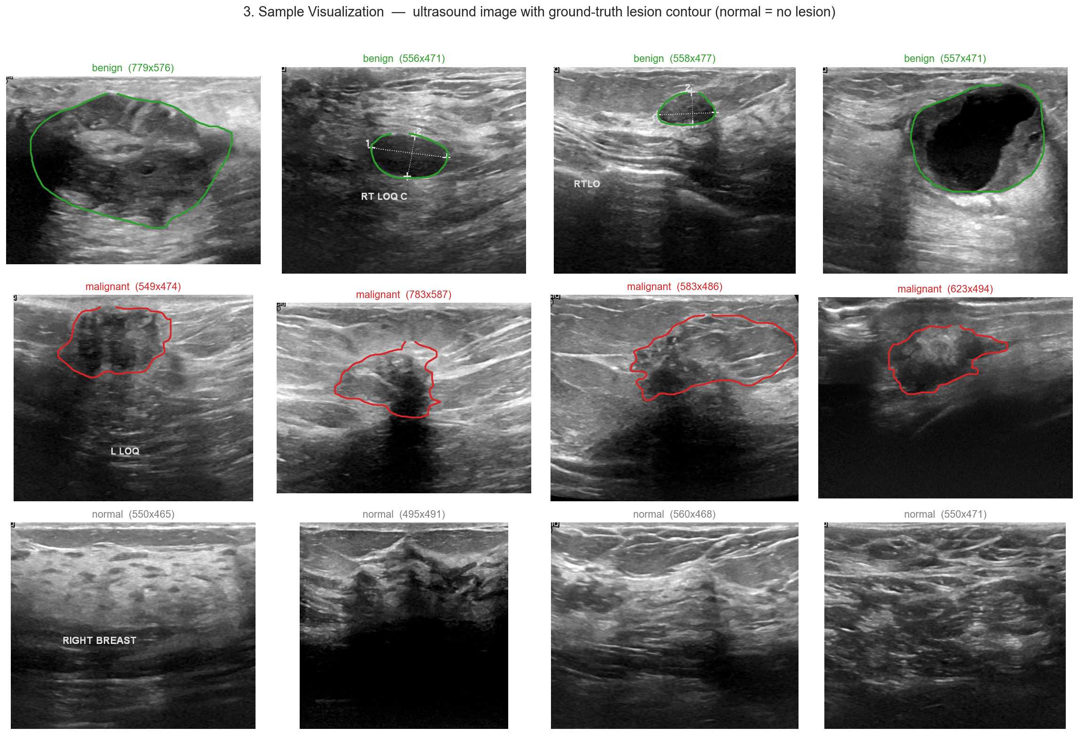
1 · INTRODUCTION
Why ultrasound is hard to read
What makes it hard
› benign & malignant masses overlap in look
› boundaries are fuzzy / low-contrast
› speckle noise + acoustic shadows
› annotation text baked into images
› normal = no lesion at all
COMP9444 · Group Project 047 · Breast Ultrasound (BUSI)
3
Notes:
These are real BUSI images with the radiologist's ground-truth contour. Notice benign (green) and malignant (red) masses can look similar; boundaries blur into surrounding tissue; there's speckle, shadowing and even caliper/text annotations burnt into the frame. Normal images have no lesion. This is why hand-crafted features struggle and why we need learned representations.

Slide 5
1 · LITERATURE REVIEW
Foundation: the three papers in the project brief
[1] BUSI dataset
[2] Yap et al.
[3] U-Net
Al-Dhabyani et al., 2020
CNN lesion detection, 2018
Ronneberger et al., 2015
780 images, 3 classes + ground-truth masks. The de-facto benchmark; small, so augmentation matters.
First deep BUS study: patch-LeNet vs. U-Net vs. transfer-learned FCN-AlexNet (FCN best).
Encoder–decoder with skip connections — the foundational biomedical segmentation net.
These three define our required reproductions. We reproduce all three (U-Net, patch-LeNet, FCN-AlexNet) — then go far beyond them.
COMP9444 · Group Project 047 · Breast Ultrasound (BUSI)
4
Notes:
The brief points us at three papers: the BUSI dataset itself, Yap's early CNN detection study, and the original U-Net. These are our mandatory reproductions and the backbone of the literature. Everything else we added builds outward from here.

Slide 6
1 · LITERATURE REVIEW
The architecture landscape we drew from
CLASSIFICATION BACKBONES
SEGMENTATION ARCHITECTURES
• ResNet [4]: residual shortcuts → very deep nets trainable (ILSVRC'15).
• DenseNet [5]: dense connectivity → feature reuse, parameter-efficient, good on small data.
• EfficientNet [6]: compound depth/width/resolution scaling; small variants transfer well.
• Note: Grad-CAM for interpretable heatmaps; caution on 'near-perfect' BUSI numbers (leakage).
• Skip-connection: U-Net family — UNet++, UNet3+, Attention U-Net (learns *where to look*).
• DeepLabV3+ [7]: atrous separable conv + ASPP for multi-scale context.
• AAU-Net [12]: BUS-specific attention for fuzzy boundaries / irregular shapes.
• CResU-Net [13]: residual + dense Co-Blocks; strong reported BUSI Dice.
• nnU-Net [20]: self-configuring U-Net; strong general baseline.
COMP9444 · Group Project 047 · Breast Ultrasound (BUSI)
5
Notes:
For classification we lean on the three canonical CNN backbones — ResNet, DenseNet, EfficientNet — all ImageNet-pretrained. For segmentation we cover the U-Net family plus attention variants, DeepLab's atrous convolutions, two BUS-specific nets (AAU-Net, CResU-Net), and nnU-Net as a strong self-configuring baseline. A recurring theme in the literature is inflated BUSI scores from data leakage — which we deliberately fix.

Slide 7
1 · LITERATURE REVIEW
Combining the two tasks — our design space
SEQUENTIAL · Dual-stage [17]
JOINT · Multi-task [24]
Bruno et al., 2025
Segment first → crop the lesion ROI → classify the ROI (benign/malignant).
Focusing the classifier on the lesion removes background clutter.
Lu et al., 2025 (MTL-OCA)
One shared encoder feeds two heads: a segmentation head (object-contextual attention) and a classification head.
Solves both at once — but sharing capacity is a compromise.
→ We adopt this and then improve it.
→ We reproduce it as the joint alternative.
These two lines — sequential vs. joint — frame our combined-task experiments.
COMP9444 · Group Project 047 · Breast Ultrasound (BUSI)
6
Notes:
The most relevant prior work combines both tasks two ways. Bruno's dual-stage pipeline is sequential: segment, crop, classify. Lu's MTL-OCA is joint: one backbone, two heads. We reproduce both, and then extend the dual-stage line into our own improved pipeline. This slide sets up the design space for our combined experiments.

Slide 8
2 · DATA
The BUSI dataset at a glance
780
3
600
~500²
ultrasound images
classes (n/b/m)
female patients (25–75y)
avg px · PNG + masks
We ran a 10-part exploratory analysis; four questions drove every downstream design choice:
How imbalanced?
How big are lesions?
benign 56% · malignant 27% · normal 17% → class weights
benign median just 3.8% of image → hard to segment
Can intensity classify?
Is the data clean?
distributions overlap → need learned features + normalisation
36% are near-duplicates, some cross-class → leakage risk!
COMP9444 · Group Project 047 · Breast Ultrasound (BUSI)
7
Notes:
BUSI: 780 images from 600 patients, three classes, with ground-truth masks. We didn't just look — we ran ten analyses. Four of them changed what we did next: the class imbalance drove loss weighting; the tiny benign lesions explain why segmentation is hard; overlapping intensities mean we can't threshold, we need learned features; and — crucially — a third of the data are near-duplicates, which forces a special data split.

Slide 9
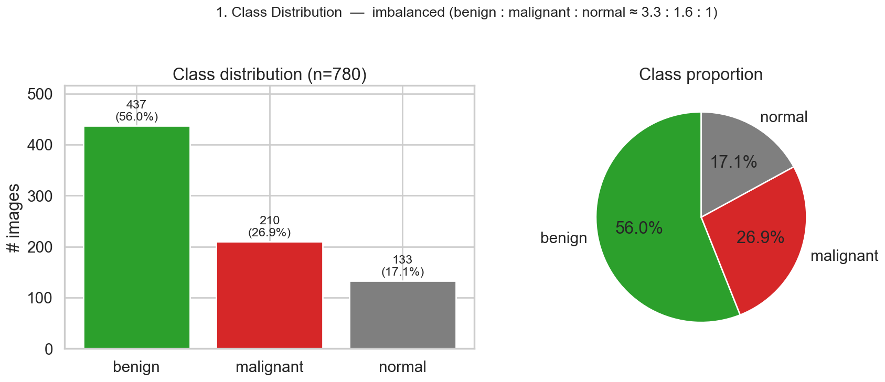
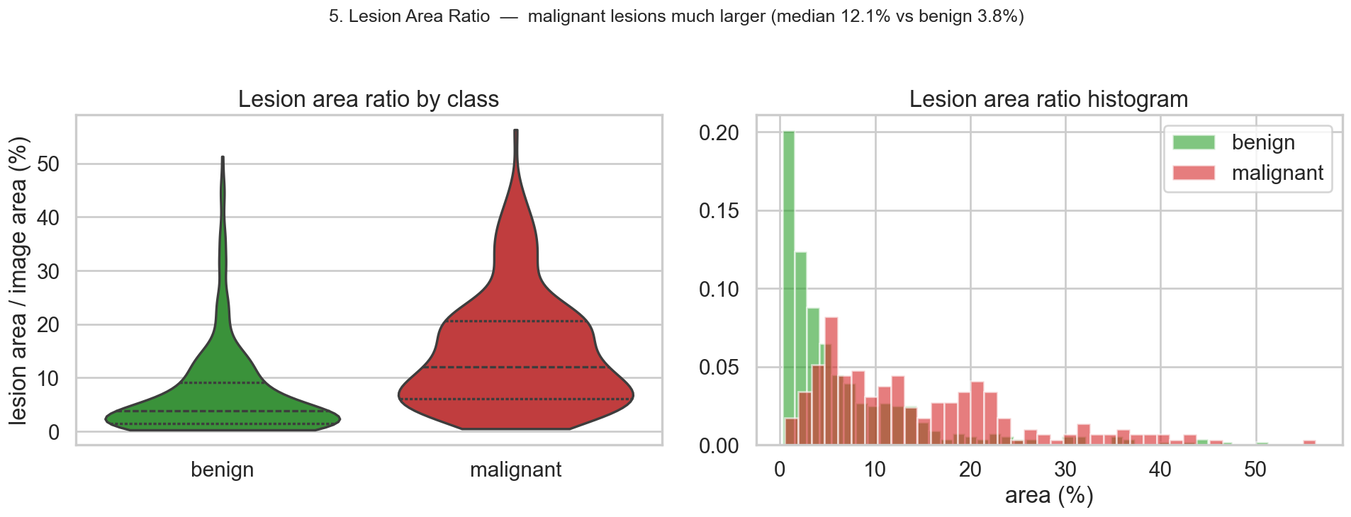
2 · EDA
Imbalanced classes & tiny benign lesions
Read-outs → design choices
• Imbalance: benign 56% / malignant 27% / normal 17%.
– → inverse-frequency class weights in the loss; report macro-F1 not accuracy.
• Lesion size: malignant median 12.1% of image vs. benign only 3.8%.
– → tiny benign masses are the hardest to segment; Dice is very sensitive here.
– → score Dice per-image then average (don't pool pixels — big lesions would dominate).
COMP9444 · Group Project 047 · Breast Ultrasound (BUSI)
8
Notes:
Two findings. Top: the classes are imbalanced — benign dominates, normal is rare — so we weight the loss by inverse frequency and report macro-F1, which treats every class equally. Bottom: malignant lesions are large but benign lesions are tiny, a median of under 4% of the image. Small targets are exactly where Dice punishes you, so we average Dice per image rather than pooling all pixels.

Slide 10
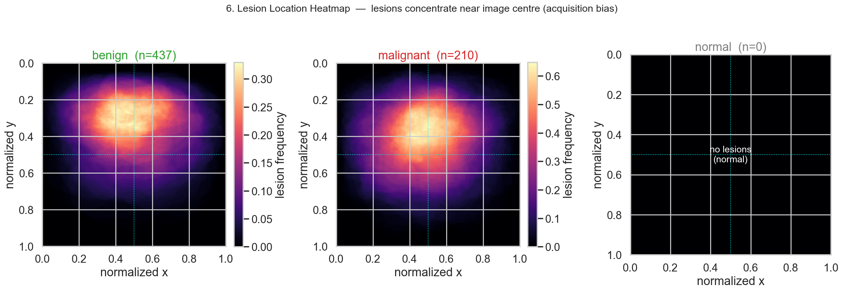
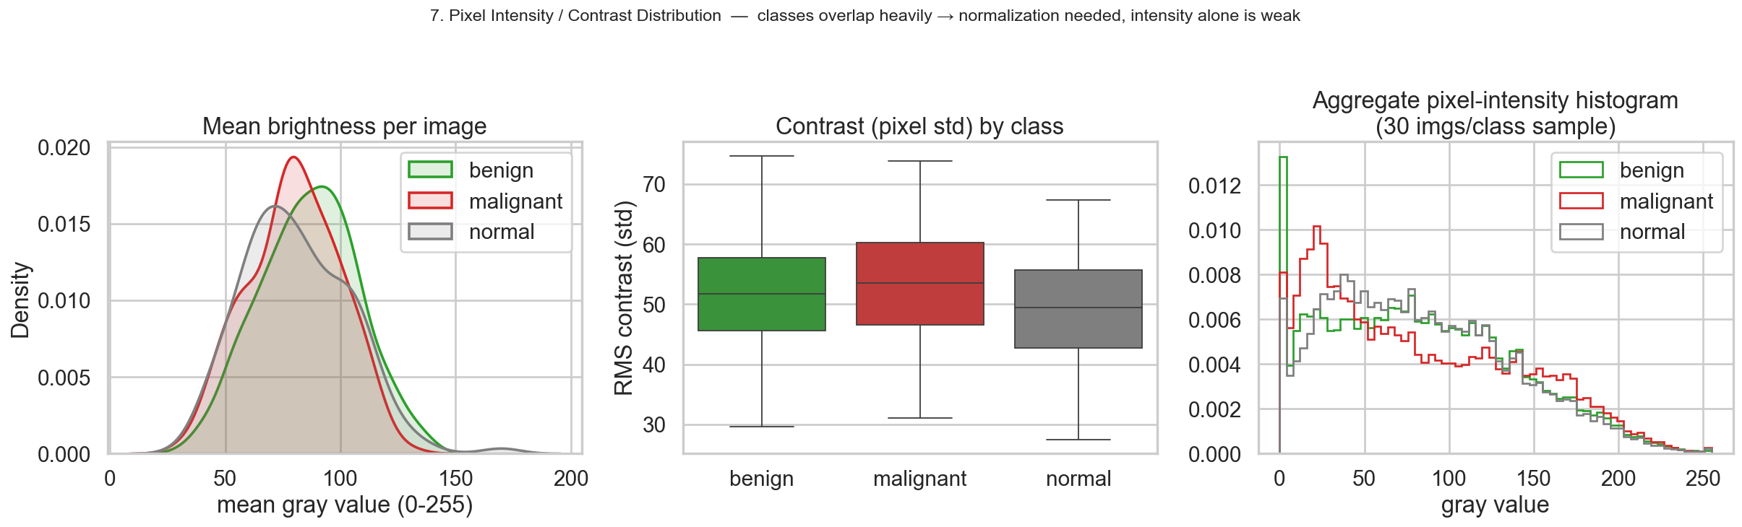
2 · EDA
Location bias & why intensity alone fails
Takeaways
› lesions cluster near image centre (acquisition bias).
› class intensity/contrast overlap heavily.
› → pixel brightness is a weak feature; need learned features + normalisation.
COMP9444 · Group Project 047 · Breast Ultrasound (BUSI)
9
Notes:
Top: lesions concentrate near the image centre — an acquisition bias worth knowing when we crop ROIs. Bottom-left: the brightness and contrast distributions of the three classes overlap almost completely. So a simple intensity threshold can't separate classes — we genuinely need learned features, and we normalise inputs so brightness differences don't dominate training.

Slide 11
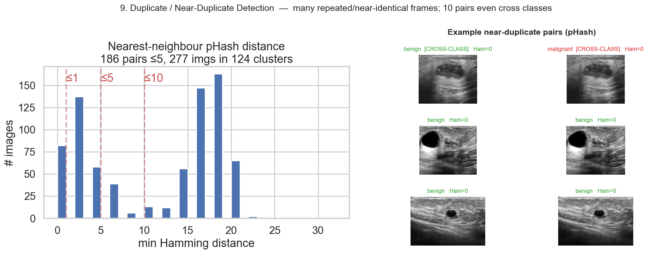
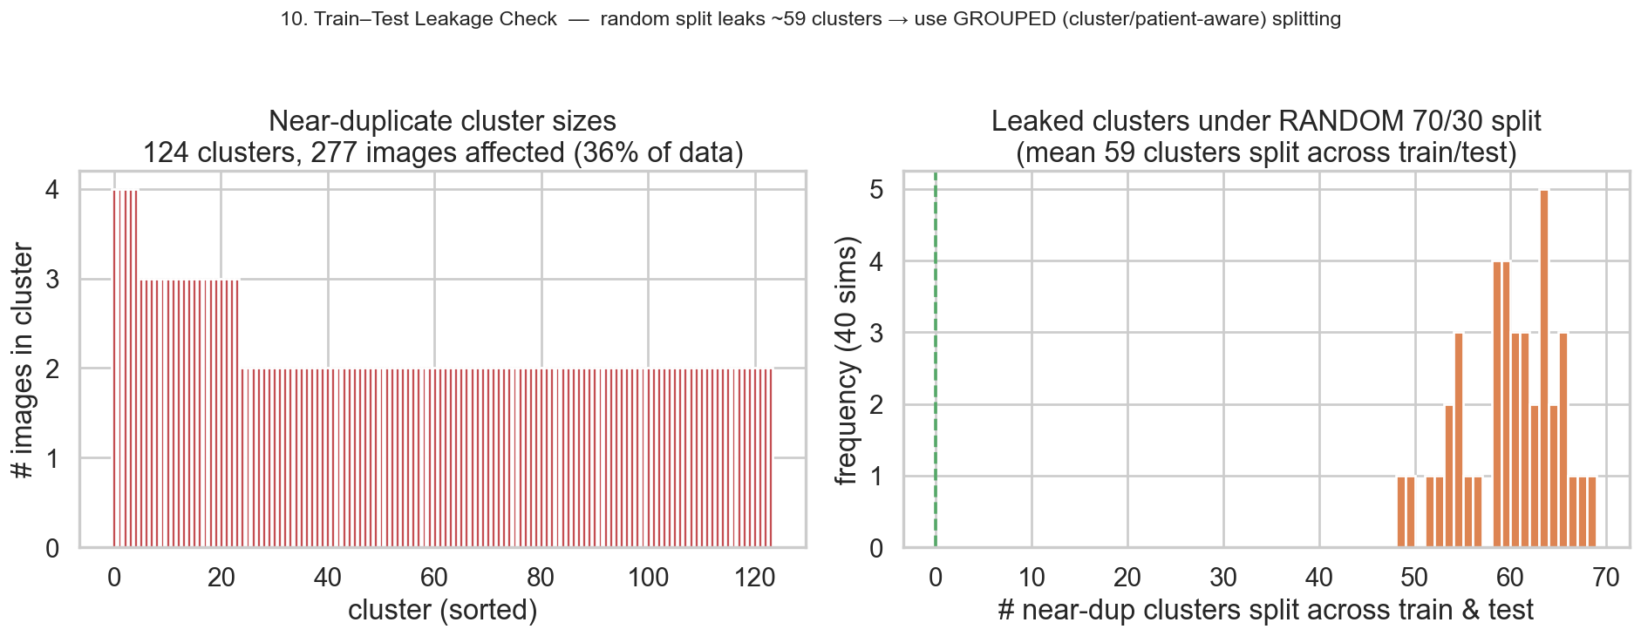
2 · EDA — KEY FINDING
Hidden trap: near-duplicates cause data leakage
THE PROBLEM
› pHash finds 277 imgs (36%) in 124 near-duplicate clusters.
› some duplicates even span classes (benign≈malignant copy!).
› a random 70/30 split leaks ~59 clusters across train & test.
Our fix:
cluster-level, class-stratified 70/15/15 split — no duplicate can cross the train/test line.
COMP9444 · Group Project 047 · Breast Ultrasound (BUSI)
10
Notes:
This is our most important methodological finding. Using perceptual hashing we discovered that a THIRD of BUSI images are near-duplicates — repeated frames of the same scan — and a few duplicates even carry conflicting benign/malignant labels. If you split randomly, the same lesion lands in both train and test, and your scores are inflated. Our fix is a cluster-level split: near-duplicates stay together on one side. This single decision is why our numbers are lower — but honest — than many published papers.

Slide 12
2 · PRE-PROCESSING
One shared, leakage-free data pipeline
CLEAN
DE-LEAK
PRE-PROCESS
AUGMENT
drop cross-class duplicate · merge multi-masks by union
pHash → 124 clusters · cluster-level stratified 70/15/15
letterbox 256×256 · grayscale · normalise [-1,1] or ImageNet
train-only: h-flip · affine · brightness/contrast jitter
How the splits are used
Evaluation metrics
• Segmentation: 645 benign+malignant lesion images → 445 / 102 / 98.
• Classification: all 3 classes, 778 → 540 / 120 / 118.
• Same split: every model sees the identical split → fair comparison.
• Classification: macro-F1 (primary), balanced-acc, macro-AUC, confusion matrix.
• Segmentation: Dice & IoU (per-image mean) + pixel P/R; Yap detection metrics.
• Robustness: multi-seed mean ± std + bootstrap 95% CI on final pipeline.
COMP9444 · Group Project 047 · Breast Ultrasound (BUSI)
11
Notes:
Every model runs through the same four-stage pipeline. We clean conflicting labels and merge masks; we de-leak with cluster-level splitting; we letterbox to 256×256 preserving aspect ratio, go grayscale, and normalise; and we augment the training split only. Because the split is identical for all models, differences in the results come from the architecture, not from data handling. Metrics: macro-F1 for classification, per-image Dice/IoU for segmentation, and confidence intervals for our final pipeline.

Slide 13
3 · MODELS & METHODS
13 reproduced models + 2 of our own
SEGMENTATION (8)
CLASSIFICATION (3)
COMBINED (2)
OUR IMPROVEMENTS (2)
U-Net [3]*
ResNet-18 [4]
Dual-stage [17]
★ Improved segmenter
(pretrained EffB4 U-Net)
Attention U-Net [9]
DenseNet-121 [5]
MTL-OCA [24]
DeepLabV3+ [7]
EfficientNet-B0 [6]
nnU-Net [20]
AAU-Net [12]
★ Improved dual-stage
(rigorous eval)
CResU-Net [13]
FCN-AlexNet [2]*
Patch-LeNet [2]*
* = the three papers named in the project brief. Every reused backbone is pretrained torchvision; every head, loss & training loop is our own.
COMP9444 · Group Project 047 · Breast Ultrasound (BUSI)
12
Notes:
Here's the full menu. Eight segmentation models — including the three mandatory reproductions marked with a star — three classification backbones, and two combined models. Then our two contributions in amber: an improved segmenter and an improved dual-stage pipeline. For each reproduction we reused only the pretrained backbone where relevant; the heads, losses and training loops are our own implementation, which matters for the marking rubric.

Slide 14
3 · REPRODUCTION
The three required papers, from scratch
U-Net [3]
Patch-LeNet [2]
FCN-AlexNet [2]
Ronneberger 2015
Yap 2018
Yap 2018 · best
4-level encoder/decoder, skip connections, Dice+BCE. Built entirely from scratch in PyTorch.
Tiny LeNet classifies 28×28 patches; balanced hard-negative sampling; sliding-window detection map.
Pretrained AlexNet → fully-convolutional; fc6/fc7 recast as conv + bilinear upsample. Yap's best method.
from-scratch
detection
transfer
Own work: full U-Net; the LeNet + hard-negative patch sampler + sliding-window inference; the FCN head & fine-tuning. Only the AlexNet backbone is a pretrained component.
COMP9444 · Group Project 047 · Breast Ultrasound (BUSI)
13
Notes:
The three mandatory reproductions. We wrote the U-Net from scratch. We reproduced Yap's patch-based LeNet detector — including the tricky balanced hard-negative sampling and sliding-window inference — and Yap's best model, the transfer-learned FCN-AlexNet. We're careful to state exactly what is our own code versus a reused pretrained backbone, which the rubric explicitly rewards.

Slide 15
3 · SEGMENTATION
Five stronger segmentation architectures
Attention U-Net [9]
additive attention gates on skips — *same recipe* as our U-Net, so it isolates the gate's effect.
DeepLabV3+ [7]
pretrained ResNet-50 + ASPP (atrous rates 6/12/18) + light decoder. Our strongest reproduced baseline.
nnU-Net [20]
the fixed blueprint 2D U-Net + deep supervision (InstanceNorm, poly-LR, SGD). A strong general baseline.
AAU-Net [12]
BUS-specific Hybrid Adaptive Attention Module: multi-receptive-field + channel & spatial self-attention.
CResU-Net [13]
block-scheduled encoder: Co-Block (dense concat) + ResNet + MultiRes blocks; pure-Dice loss.
COMP9444 · Group Project 047 · Breast Ultrasound (BUSI)
14
Notes:
Beyond the required nets we reproduced five stronger segmenters. Attention U-Net is a controlled comparison — same recipe as our U-Net — so any change is due purely to the attention gate. DeepLabV3+ with a pretrained ResNet-50 is our best baseline. nnU-Net is the famous self-configuring net, here as its blueprint. AAU-Net and CResU-Net are BUS-specific designs with reported state-of-the-art numbers we test honestly under our split.

Slide 16
3 · CLASSIFICATION
Three ImageNet-pretrained backbones
ResNet-18 [4]
DenseNet-121 [5]
EfficientNet-B0 [6]
He 2016
Huang 2017
Tan & Le 2019
smallest residual net (BUSI is tiny) · fresh 3-way head · SGD fine-tune
dense feature reuse · dropout + 3-way head · AdamW + early stop
smallest compound-scaled variant · dropout + 3-way head · Adam
Shared recipe
3-channel ImageNet-normalised 256×256 (grayscale→pseudo-RGB) · final layer replaced by a fresh 3-way head · inverse-frequency weighted cross-entropy to counter class imbalance.
COMP9444 · Group Project 047 · Breast Ultrasound (BUSI)
15
Notes:
For classification we fine-tune the three canonical pretrained backbones. We deliberately pick the smallest variant of each — ResNet-18, DenseNet-121, EfficientNet-B0 — because BUSI is small and larger nets overfit. All share the same recipe: pseudo-RGB inputs, a fresh three-way head, and class-weighted cross-entropy so the rare malignant class isn't ignored.

Slide 17
3 · COMBINED
Baseline combined models we reproduced
Dual-stage [17] — segmentation-guided classification (sequential)
Input
image
DeepLabV3+
(segment)
ROI crop
(mask→bbox)
EfficientNet-B0
(classify)
Benign /
Malignant
MTL-OCA [24] — multi-task, one shared backbone (joint)
Shared Res-UNet encoder
Segmentation head (OCA attention)
Loss = 0.4·CE(soft) + CE(final) + CE(cls).
Solves both tasks at once, but shares capacity — we'll see it underperforms specialists.
Classification head (3-way)
COMP9444 · Group Project 047 · Breast Ultrasound (BUSI)
16
Notes:
Two combined baselines. The dual-stage pipeline is a clean sequence: DeepLabV3+ segments, we crop the lesion ROI, and EfficientNet classifies that crop — so the classifier only sees the tumour, not the clutter. MTL-OCA is the joint alternative: one Res-UNet backbone with two heads and a weighted three-term loss. We reproduce both, and we'll show the joint model pays a price for sharing capacity.

Slide 18
4 · IMPROVEMENT — DESIGN DECISION
Which combined model do we improve — and why?
We reproduced both combined approaches — sequential dual-stage [17] and joint multi-task MTL-OCA [25]. We chose to optimise the dual-stage line. Here's the reasoning:
HEAD-TO-HEAD (our reproductions)
① Modular & swappable
② Controlled science
improve Stage 1 (segmenter) and Stage 2 (classifier) independently.
fix Stage 2 byte-for-byte, swap Stage 1 → isolate the segmenter's effect (impossible in a joint net).
Segmentation Dice
MTL-OCA
0.612
dual-stage seg
0.760
Classification macro-F1
③ Best-of-breed reuse
④ Clinical interpretability
MTL-OCA
0.720
plug in our strongest segmenter + strongest classifier; gains compound.
explicit lesion mask + ROI shows the radiologist *where* — not just a label.
specialist cls
0.828
One shared backbone makes MTL-OCA underperform on both tasks. Dual-stage instead plugs in our best specialists.
Decision: extend & rigorously evaluate the dual-stage pipeline.
Stage 1 = our improved segmenter · Stage 2 = strengthened classifier.
COMP9444 · Group Project 047 · Breast Ultrasound (BUSI)
17
Notes:
Before improving, we had to pick which combined design to build on. Head-to-head, the joint MTL-OCA model loses on both tasks because it forces one backbone to serve segmentation and classification at once — a compromise that's too costly on small data. The dual-stage pipeline instead lets us plug in our best specialist for each stage. Four reasons sealed it: it's modular, so we can improve each stage on its own; it enables a controlled experiment — fix the classifier, swap the segmenter, and measure the segmenter's true contribution; it reuses our strongest models; and it produces an explicit mask and ROI, which is far more interpretable for a clinician. So we extend the dual-stage line.

Slide 19
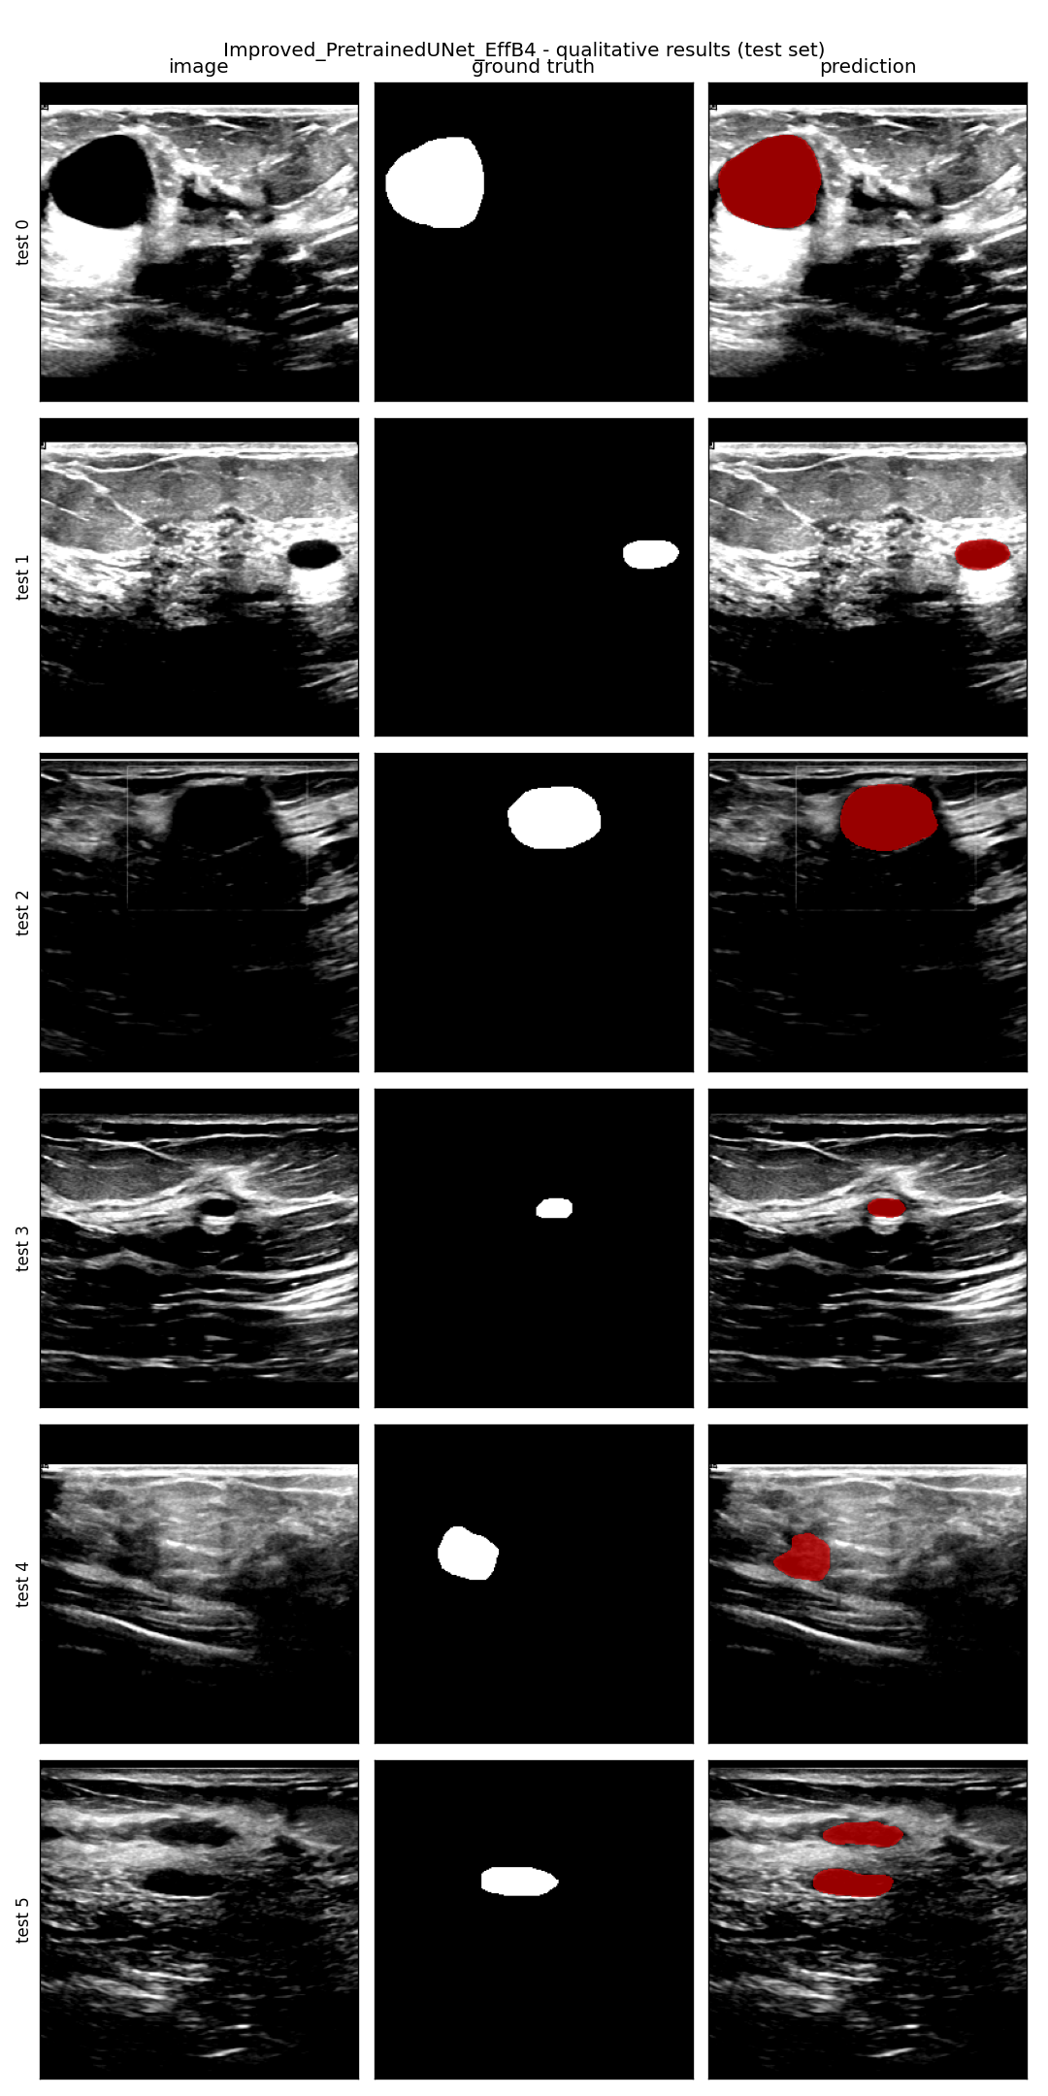
4 · IMPROVEMENT
Improved segmenter: transfer learning first
Insight from baselines: the only nets that used transfer learning (DeepLabV3+) beat the from-scratch ones. So we build a pretrained-encoder U-Net.
① Pretrained EffB4 encoder
② Focal Tversky + BCE loss
③ TTA + post-processing
ImageNet EfficientNet-B4 encoder + U-Net decoder (via smp).
penalises false negatives to attack the missed-lesion tail.
flip/multi-scale test-time aug + largest-connected-component.
the decisive ingredient
trades precision↔recall
no Dice gain here
Every idea is tested in a controlled ablation →
We add one component at a time and measure test Dice, so we can attribute the gain precisely — not just claim it. (Result on next slide.)
COMP9444 · Group Project 047 · Breast Ultrasound (BUSI)
18
Notes:
Our improved segmenter is motivated directly by the baselines: transfer learning helped, so we make it central. We take a U-Net decoder but swap in an ImageNet-pretrained EfficientNet-B4 encoder. On top we add a Focal Tversky loss to chase missed lesions, and test-time augmentation with post-processing. Crucially, we don't just stack tricks — we ablate each one to see what actually helps.

Slide 20
4 · ABLATION
What actually makes the segmenter work?
Configuration (add one component each row) | Dice | Dice std | pixel recall
From-scratch U-Net (Dice+BCE) | 0.648 | 0.362 | 0.637
+ ImageNet-pretrained EffB4 encoder | 0.765 | 0.285 | 0.763
+ Focal Tversky loss | 0.760 | 0.282 | 0.800
+ TTA + post-processing (full model) | 0.760 | 0.307 | 0.790
Verdict
• Pretrained encoder = +0.117 Dice, and far fewer completely-missed lesions (std 0.362→0.285).
– essentially the ENTIRE gain.
• Focal Tversky: no overall Dice gain, but raises recall 0.76→0.80 — a precision/recall knob.
• TTA + post-proc: no measurable Dice gain on this data.
Lesson: on small, noisy BUSI, transfer learning beats architectural/loss cleverness.
COMP9444 · Group Project 047 · Breast Ultrasound (BUSI)
19
Notes:
This is the payoff of ablating. Read down the table: the from-scratch U-Net scores 0.648. Adding the pretrained encoder jumps it to 0.765 — that one change is essentially the entire improvement, and it also halves the number of completely-missed lesions. The fancy Focal Tversky loss doesn't raise Dice; it just trades precision for recall. TTA does nothing measurable. The lesson is blunt: transfer learning matters more than architectural cleverness on a dataset this small.

Slide 21
4 · IMPROVEMENT
Improved dual-stage pipeline
Input US
image
STAGE 1
Improved U-Net
ROI extract
STAGE 2
EfficientNet-B0
Benign /
Malignant
256×256 grayscale
EffB4 encoder → mask
largest CC · bbox +15% crop
classify the ROI crop
+ optional shape features
Controlled substitution: Stage-1 swapped for our stronger segmenter; Stage-2 kept byte-for-byte → any change is attributable to segmentation alone.
Rigorous evaluation — the part most papers skip
Out-of-fold masks
5-seed ensemble
Bootstrap 95% CI
5-fold cross-fitting: each training image's mask comes from a segmenter that never saw it (no train/test mismatch).
every configuration run with 5 seeds and ensembled — kills single-run luck.
confidence interval on the 98-image test set — is a difference real or just noise?
COMP9444 · Group Project 047 · Breast Ultrasound (BUSI)
20
Notes:
Our improved pipeline. Same skeleton as Bruno, but Stage 1 is now our pretrained segmenter, and — importantly — Stage 2 is kept identical, so any change in the end-to-end score is due to segmentation alone. The real contribution is the evaluation rigour along the bottom: masks generated out-of-fold so the classifier never trains on its own test-time inputs, five-seed ensembling to remove luck, and a bootstrap confidence interval to tell a real gain from noise. This is what most BUSI papers skip.

Slide 22
4 · ABLATION
Dual-stage ablation: which ideas survive honest evaluation?
We test every pipeline idea the honest way — out-of-fold masks · 5 seeds · bootstrap 95% CI — and ask which gains are actually real.
Configuration (all OOF cross-fit) | per-seed F1 | 5-seed ens. | 95% CI
Strengthened Stage-2 (pure CNN) | 0.847 ± 0.011 | 0.875 | [0.80, 0.94]
+ shape features | 0.861 ± 0.016 | 0.875 | [0.80, 0.94]
+ radiomics (shape + texture) | 0.862 ± 0.013 | 0.863 | [0.79, 0.93]
WHAT IS OUT-OF-FOLD (OOF)?
each row = one fold
its mask is predicted by
a model trained on the
other 4 folds only.
held-out image (mask predicted, never self-seen)
Why: Stage-2 must train on predicted-mask crops. OOF generates realistic (imperfect) masks for the training images without a segmenter ever seeing its own image.
→ removes the train-on-clean / test-on-imperfect mismatch. A correctness fix, not a score trick.
Verdict
• Hand features: shape / radiomics CIs fully overlap the pure-CNN baseline → NO reliable gain. Dropped.
• 5-seed ensembling: per-seed 0.847 → ensemble 0.875 — the ONLY component that robustly helps.
• Lesson: on 98 test images, single-run gains up to ~±0.05 are noise → always report CIs.
COMP9444 · Group Project 047 · Breast Ultrasound (BUSI)
21
Notes:
This is the dual-stage counterpart to the segmenter ablation — and arguably the most important methodological result of the project. First, OOF: to train the Stage-2 classifier on predicted-mask crops, we need predicted masks for the TRAINING images. If we used a segmenter that had already seen those images, the masks would be unrealistically perfect. So we use 5-fold cross-fitting — each image's mask comes from a segmenter trained only on the other folds. That gives realistic masks and removes the train-clean / test-imperfect mismatch. It's a correctness fix, not a way to inflate the score. Then the ablation: we add shape features, then radiomics. Read the confidence intervals — they all overlap the pure-CNN baseline, so hand-crafted features give no reliable gain and we drop them. The only thing that survives is ensembling: averaging five seeds lifts the per-seed 0.847 to 0.875. The lesson: on 98 images, single-run differences of a few points are just noise.

Slide 23
5 · RESULTS
Segmentation leaderboard (leakage-free, 98 imgs)
Model | Type | Dice | IoU | F-meas | Params | Paper
Improved Pretrained-UNet (ours) | ours | 0.760 | 0.688 | 0.854 | 20.2M | —
DeepLabV3+ | transfer | 0.739 | 0.652 | 0.810 | 26.7M | —
AAU-Net | reprod. | 0.730 | 0.638 | 0.723 | 42.7M | 0.775
nnU-Net | reprod. | 0.717 | 0.627 | 0.781 | 8.5M | —
CResU-Net | reprod. | 0.693 | 0.600 | 0.772 | 33.5M | 0.829
U-Net | scratch | 0.648 | 0.570 | 0.779 | 31.0M | —
Attention U-Net | scratch | 0.629 | 0.540 | 0.631 | 31.4M | —
MTL-OCA (seg) | joint | 0.612 | 0.515 | — | 8.2M | 0.838
FCN-AlexNet | transfer | 0.582 | 0.471 | 0.804 | 28.7M | —
Reading the board
• ① our pretrained U-Net wins (Dice 0.760).
• ② reproductions fall below paper numbers (CResU 0.829→0.693) — leakage removed = honest.
• ③ nnU-Net (0.717) does NOT dominate — a good pretrained encoder beats a heavy framework.
• ④ U-Net 0.648 vs Attn 0.629 (same recipe) → attention gate doesn't help here.
COMP9444 · Group Project 047 · Breast Ultrasound (BUSI)
22
Notes:
Segmentation results, ranked by Dice. Four things to notice. First, our improved segmenter is top. Second, our reproductions of published models score below their reported numbers — that's the leakage removal, and it's the honest number. Third, the heavyweight nnU-Net does not win; a good pretrained encoder beats it. Fourth, the controlled U-Net versus Attention U-Net pair shows the attention gate actually hurts slightly here. Bigger and fancier is not better on small ultrasound data.

Slide 24
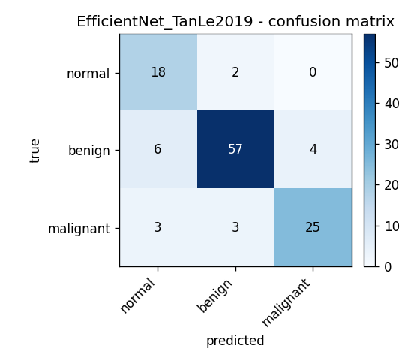
5 · RESULTS
Classification results (3-class, 118 imgs)
Model | Type | macro-F1 | Accuracy | AUC
EfficientNet-B0 | transfer | 0.828 | 0.848 | 0.969
ResNet-18 | transfer | 0.810 | 0.822 | 0.966
DenseNet-121 | transfer | 0.793 | 0.805 | 0.947
MTL-OCA (cls) | joint | 0.720 | 0.746 | 0.900
Analysis
• Winner: EfficientNet-B0 leads (macro-F1 0.828, AUC 0.969).
• Specialists win: all 3 pretrained backbones beat the joint MTL-OCA (0.720).
• Why: MTL underperforms on BOTH tasks — sharing one backbone is a compromise too costly on small data.
• Error analysis: malignant (minority class) is the hardest and the main error source for every model.
Best model confusion matrix
COMP9444 · Group Project 047 · Breast Ultrasound (BUSI)
23
Notes:
Classification. EfficientNet-B0 wins with macro-F1 0.828 and an excellent AUC. All three specialist backbones clearly beat the joint multi-task model, which underperforms on both tasks — confirming that on small data a shared backbone is a false economy. The confusion matrix shows the expected clinical pattern: the minority malignant class is hardest, and it's where every model makes most of its mistakes — exactly the errors that matter most.

Slide 25
5 · RESULTS
Dual-stage: the bottleneck is the classifier
Swapping in a much stronger Stage-1 segmenter barely moves the end-to-end score (everything after Stage-1 is fixed):
single-run · indicative only
Where the error really is
Pipeline | Stage-1 Dice | Pipeline F1 | Accuracy | GT-ROI F1
Bruno (DeepLabV3+ → EffB0) | 0.739 | 0.804 | 0.827 | 0.865
Ours: Improved-UNet Stage 1 | 0.760 | 0.807 | 0.827 | 0.884
Ours: + strengthened Stage 2 | 0.760 | 0.817 | 0.837 | 0.882
Ours: + shape features | 0.761 | 0.840 | 0.857 | 0.850
• Stronger mask ≠ better pipeline: Stage-1 Dice 0.739→0.760, yet pipeline F1 only 0.804→0.807.
• Upper bound: even a perfect mask tops out at ~0.87 — far above what we reach — so the gap is the classifier's own error, not bad ROIs.
• Implication: the mask is already good enough to crop the ROI → spend capacity on the classifier.
“GT-ROI F1” = classifier fed ground-truth-mask crops = the perfect-segmentation upper bound (~0.87).
Which classifier tweaks are real? → only ensembling (0.875) — see ablation.
COMP9444 · Group Project 047 · Breast Ultrasound (BUSI)
24
Notes:
The key dual-stage result: the pipeline is bottlenecked by its classifier, not its segmenter. Read across the table — we lift Stage-1 Dice from 0.739 to 0.760, but the end-to-end F1 hardly moves, from 0.804 to 0.807, because everything after Stage-1 is held fixed. The clincher is the GT-ROI column: if we feed the classifier perfect ground-truth-mask crops, it still only reaches about 0.87. That ceiling sits far above our achieved score, which means the remaining error is the classifier's own, not caused by imperfect masks. So a rough mask is already good enough to crop the ROI — the place to invest is the classifier. And which classifier tweaks actually help? As the ablation slide showed, only ensembling survives the confidence intervals.

Slide 26
5 · COMPARISON
Two comparisons: across models & vs. reported
HORIZONTAL — best per task (ours vs baseline)
VERTICAL — our leakage-free vs. paper-reported Dice
Seg · Improved U-Net
CResU-Net
0.760
paper 0.829
Seg · DeepLabV3+ (base)
ours 0.693
0.739
Cls · EfficientNet-B0
AAU-Net
0.828
paper 0.775
ours 0.730
Cls · MTL-OCA (base)
0.720
MTL-OCA
Dual · OOF+ensemble (ours)
paper 0.838
0.875
ours 0.612
Dual · Bruno (base)
0.804
The drop = removed near-duplicate leakage. Our numbers are lower but trustworthy.
COMP9444 · Group Project 047 · Breast Ultrasound (BUSI)
25
Notes:
Two ways to compare. On the left, horizontal: for each task our model versus the strongest baseline — we win on all three. On the right, vertical: our leakage-free Dice against the numbers those same papers reported. The consistent drop is not our models being weak — it's the near-duplicate leakage we removed. Same models, honest split, lower-but-trustworthy numbers. This contrast is, in a sense, our main scientific point.

Slide 27
6 · DISCUSSION
Three findings that generalise
1
Evaluation hygiene matters most
Removing near-duplicate leakage drops published BUSI scores substantially (CResU 0.829→0.693). Much 'SOTA' rests on how you split.
2
Transfer learning is decisive
An ImageNet encoder alone lifts Dice 0.648→0.765 and slashes missed lesions — beating attention gates, custom losses & nnU-Net.
3
Fix the real bottleneck
The dual-stage pipeline is limited by its classifier, not its segmenter. Invest capacity where the measured gap is — and report CIs.
COMP9444 · Group Project 047 · Breast Ultrasound (BUSI)
26
Notes:
Zooming out, three findings that go beyond BUSI. One: evaluation hygiene dominates — how you split the data changes the headline more than the architecture does. Two: transfer learning is the decisive lever on small medical datasets, beating clever losses and self-configuring frameworks. Three: always find and fix the real bottleneck — here it was the classifier, not the segmenter — and report confidence intervals so you don't chase noise.

Slide 28
6 · DISCUSSION
Strengths, limitations & future work
STRENGTHS
LIMITATIONS
FUTURE WORK
› one leakage-free split for all 15 models → truly fair
› controlled ablations & substitutions attribute gains
› multi-seed + bootstrap CIs → statistically honest
› best-in-class segmenter (0.760) & pipeline (0.875)
› single small dataset (98-image test) → wide CIs
› no full nested cross-validation (compute)
› 2D only; no external / multi-centre validation
› hand-crafted radiomics gave no reliable lift
› foundation-model segmenters (MedSAM)
› stronger / ensembled ROI classifiers
› nested CV under the same leakage-free protocol
› multi-centre external validation
COMP9444 · Group Project 047 · Breast Ultrasound (BUSI)
27
Notes:
Strengths: one fair split, controlled experiments, honest statistics, and best-in-class results on both our segmenter and our pipeline. Limitations: it's a single small dataset with a 98-image test set, so confidence intervals are wide; we couldn't afford full nested cross-validation; we're 2D and single-centre; and our radiomics features didn't help. Future work: try foundation models like MedSAM, strengthen and ensemble the ROI classifier, run nested cross-validation, and validate on external multi-centre data.

Slide 29
IN ONE SENTENCE
On small, noisy ultrasound data,
clean evaluation + transfer learning beat
architectural complexity — every time.
0.760
0.828
0.875
Dice · segmentation · 98 imgs
macro-F1 · 3-class cls · 118 imgs
macro-F1 · 2-class pipeline · 98 imgs
Three different tasks & metrics on different test sets — not a single like-for-like ranking.
COMP9444 · Group Project 047
Breast Cancer Classification & Segmentation · BUSI
Thank you — questions?
Notes:
To close: the whole project distils to one line — on small, noisy ultrasound data, clean evaluation and transfer learning beat architectural complexity every time. Our headline numbers: 0.760 Dice for the segmenter, 0.828 macro-F1 for the 3-class classifier, and 0.875 for the dual-stage pipeline. Important caveat if asked: these are NOT comparable — they are different tasks, metrics and test sets. The pipeline's 0.875 is a 2-class (benign/malignant) problem on 98 images, which is inherently easier than the 3-class 0.828, and it also benefits from ROI cropping and 5-seed ensembling; the 0.760 Dice measures pixel overlap, a different quantity entirely. So the pipeline scoring above the classifier is expected, not a paradox. Thank you — happy to take questions.

Slide 30
APPENDIX
Paper index — 25 references
# | Reference | Task
1 | Al-Dhabyani et al. (2020). Dataset of breast ultrasound images | Dataset
2 | Yap et al. (2018). Automated BUS lesion detection using CNNs | Seg/Detect
3 | Ronneberger et al. (2015). U-Net: CNNs for biomedical segmentation | Seg
4 | He et al. (2016). Deep residual learning (ResNet) | Cls
5 | Huang et al. (2017). Densely connected CNNs (DenseNet) | Cls
6 | Tan & Le (2019). EfficientNet: rethinking model scaling | Cls
7 | Chen et al. (2018). DeepLabV3+: atrous separable convolution | Seg
8 | Zhou et al. (2018). UNet++: nested U-Net | Seg
9 | Oktay et al. (2018). Attention U-Net | Seg
10 | Huang et al. (2020). UNet 3+: full-scale connected UNet | Seg
11 | Chen et al. (2021). TransUNet: transformers for medical seg | Seg
12 | Chen et al. (2023). AAU-Net: adaptive attention U-Net (BUS) | Seg
13 | Derakhshandeh & Mahloojifar (2024). CResU-Net (BUSI) | Seg
# | Reference | Task
14 | Latha et al. (2024). EfficientNet-B7 + explainable AI (BUSI) | Cls
15 | Sulaiman et al. (2024). Attention U-Net on BUSI | Seg
16 | Anari et al. (2025). Explainable attention tumor seg (UNet+enc.) | Seg
17 | Bruno et al. (2025). Dual-stage seg + classification framework | Both
18 | Xian et al. (2018). BUS image segmentation: a survey | Survey
19 | Cheng et al. (2010). BUS detection & classification: a survey | Survey
20 | Isensee et al. (2021). nnU-Net: self-configuring segmentation | Seg
21 | Kirillov et al. (2023). Segment Anything (SAM) | Seg
22 | Ma et al. (2024). MedSAM: segment anything in medical images | Seg
23 | Selvaraju et al. (2017). Grad-CAM: gradient-based localization | XAI
24 | Al-Dhabyani et al. (2019). DL augmentation & classification (BUS) | Cls
25 | Lu et al. (2025). Multi-task joint seg + classification (OCA) | Both
reproduced / used in our benchmark
cited as context / background
Task colour: Seg · Cls · Both · Survey
COMP9444 · Group Project 047 · Breast Ultrasound (BUSI)
A1
Notes:
Appendix reference index. All 25 papers we engaged with, numbered as cited throughout the deck. Green numbers are the models we actually reproduced or the data we used in our leakage-free benchmark; grey numbers are cited for context — surveys, foundation models, and closely related work. The task tag shows whether each paper targets segmentation, classification, both, or is a survey.

