Slide 1
Exploratory Data Analysis
Breast Ultrasound Images Dataset (BUSI) — 780 images, 3 classes, with lesion masks
COMP9444 Group Project 047 — Breast Cancer Classification & Segmentation
Source: Al-Dhabyani et al. (2020), Data in Brief 28:104863

Slide 2
Dataset at a Glance
• Total images: 780 (benign 437 / malignant 210 / normal 133)
• Class balance: 56.03% / 26.92% / 17.05% → imbalanced
• Masks: 780/780 images have ≥1 lesion mask (100%); 17 images have multiple masks (max 3)
• Images with a real lesion: 647 (all normal images have empty masks)
• Image sizes: NOT uniform — 639 unique sizes; width 190–1048 px, height 310–719 px (median 564×474)
• Lesion area (median): malignant 12.1% vs benign 3.8% of image
• Data quality: 1 exact duplicate (labeled 2 classes), 186 near-duplicate pairs, 277 images (36%) in 124 clusters, 10 cross-class pairs

Slide 3
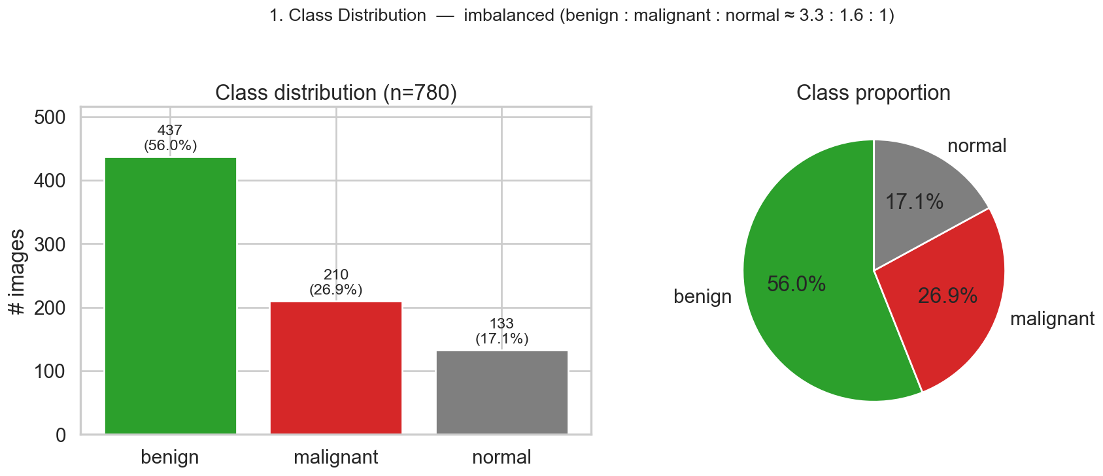
1. Class Distribution
Key takeaways
• 780 images, heavily imbalanced: benign 56% > malignant 27% > normal 17%.
• Benign is ~3.3× the normal class → majority-class bias risk.
• Mitigate with stratified splits, class weights, and balanced augmentation.
• Normal images carry no lesion → segmentation effectively uses 647 lesion images.
EDA analysis 1

Slide 4
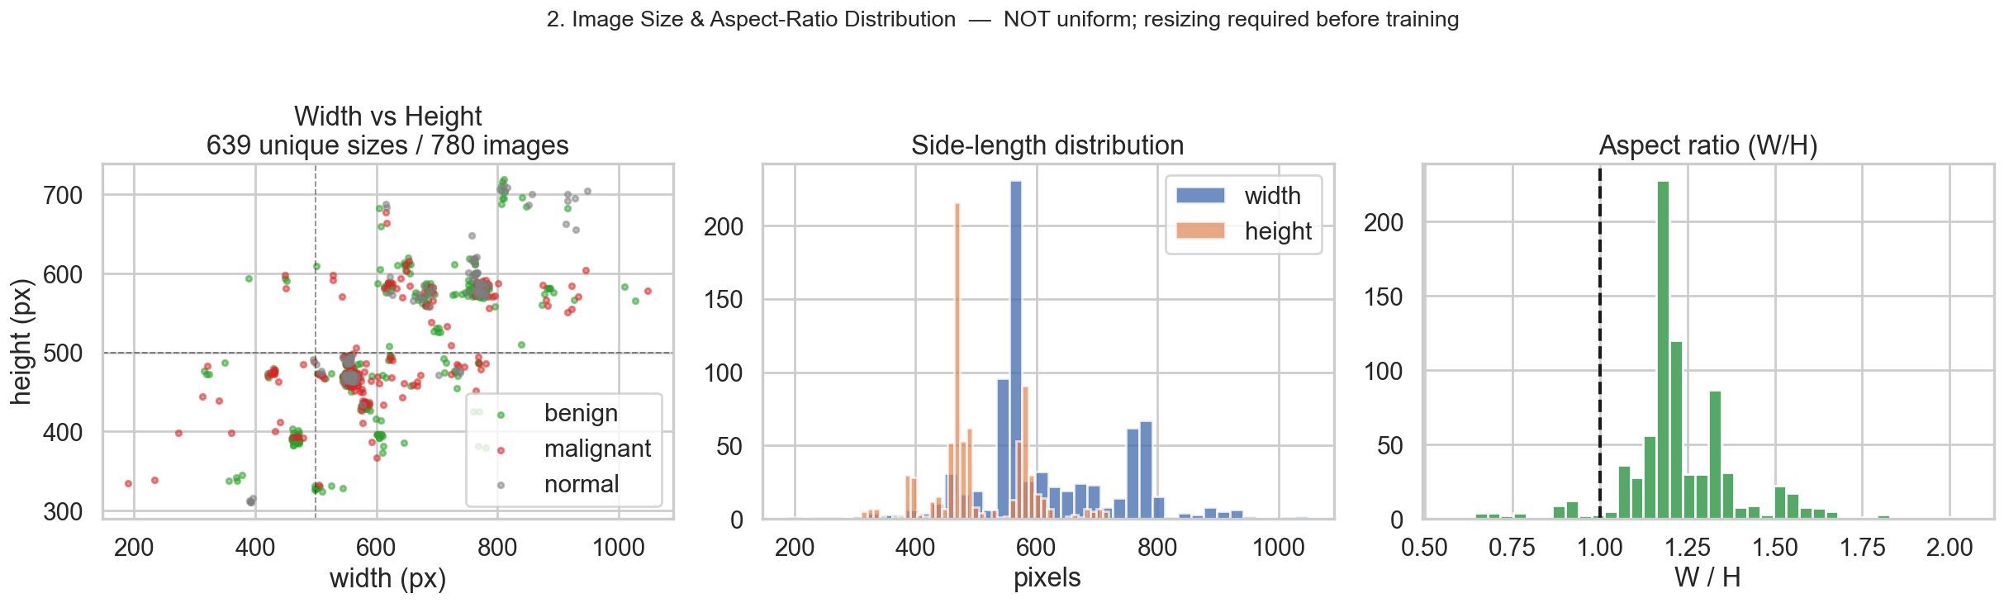
2. Image Size & Aspect Ratio
Key takeaways
• Sizes are NOT the advertised uniform 500×500: 639 distinct sizes.
• Width 190–1048 px, height 310–719 px; most images are landscape (W/H>1).
• A fixed input size is required — resize (e.g. 256×256).
• Prefer resize-with-padding to avoid distorting lesion shape/aspect.
EDA analysis 2

Slide 5
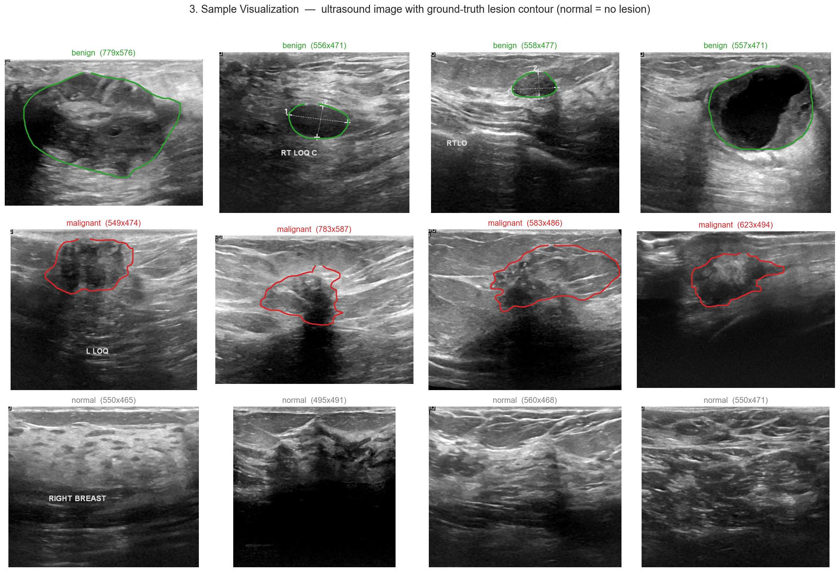
3. Sample Visualization
Key takeaways
• Benign: oval, well-circumscribed, hypoechoic lesions.
• Malignant: irregular, ill-defined, often with posterior shadowing.
• Burned-in text & calipers ('RT LOQ', 'RIGHT BREAST') appear on images.
• → risk of shortcut learning; consider cropping/inpainting annotations.
EDA analysis 3

Slide 6
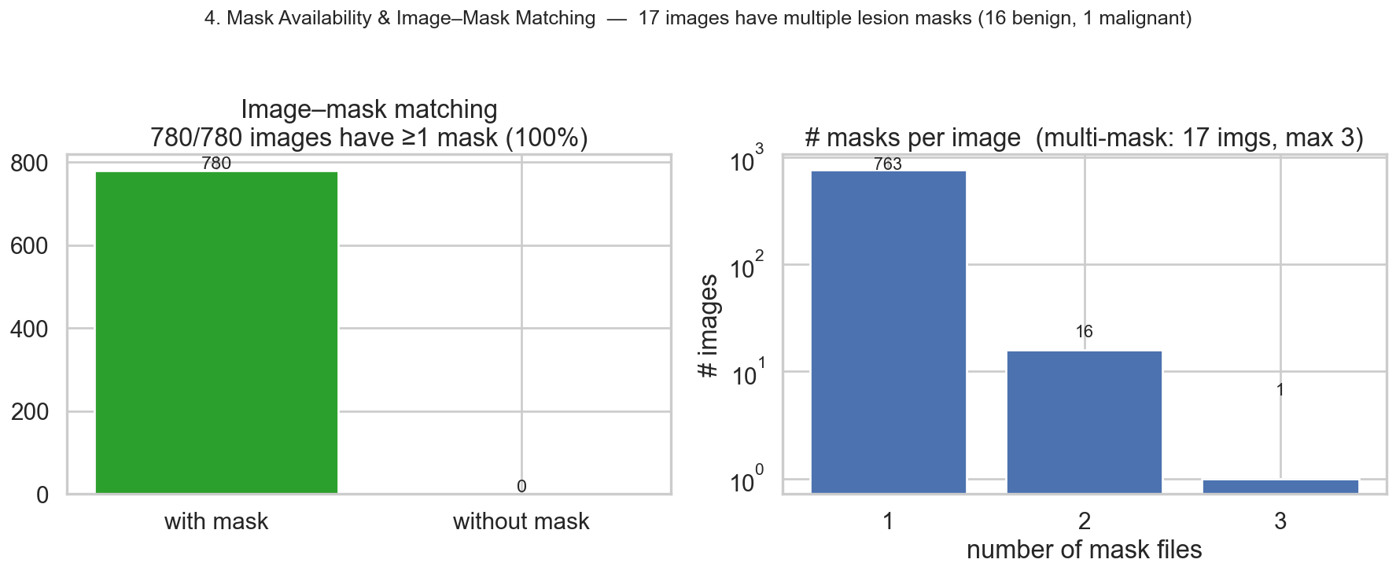
4. Mask Availability & Image–Mask Matching
Key takeaways
• Every image has at least one mask — no orphan images or masks.
• 17 images have multiple lesion masks (16 benign, 1 malignant), up to 3.
• For binary segmentation, merge multiple masks via pixel-wise union.
• Normal masks are all-zero (background only).
EDA analysis 4

Slide 7
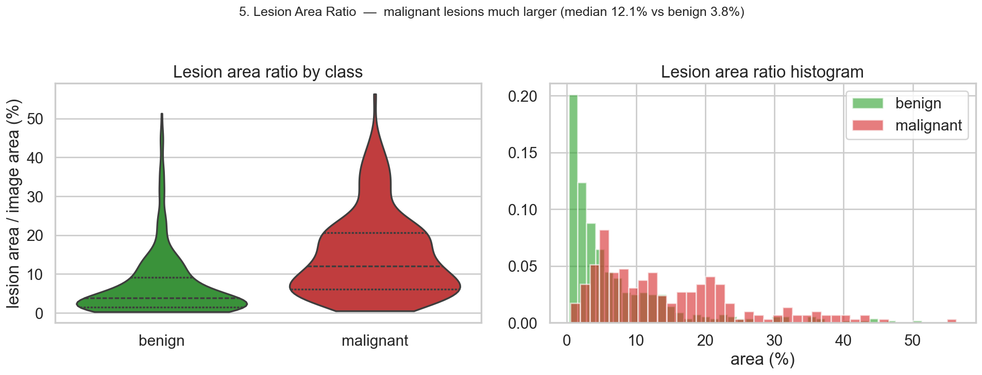
5. Lesion Area Ratio
Key takeaways
• Malignant lesions are much larger: median 12.1% of image vs benign 3.8%.
• Many benign lesions are tiny → strong foreground/background imbalance at pixel level.
• Dice/IoU are sensitive to small masks — consider Dice+BCE or Tversky loss.
• Lesion size is itself a discriminative cue for classification.
EDA analysis 5

Slide 8
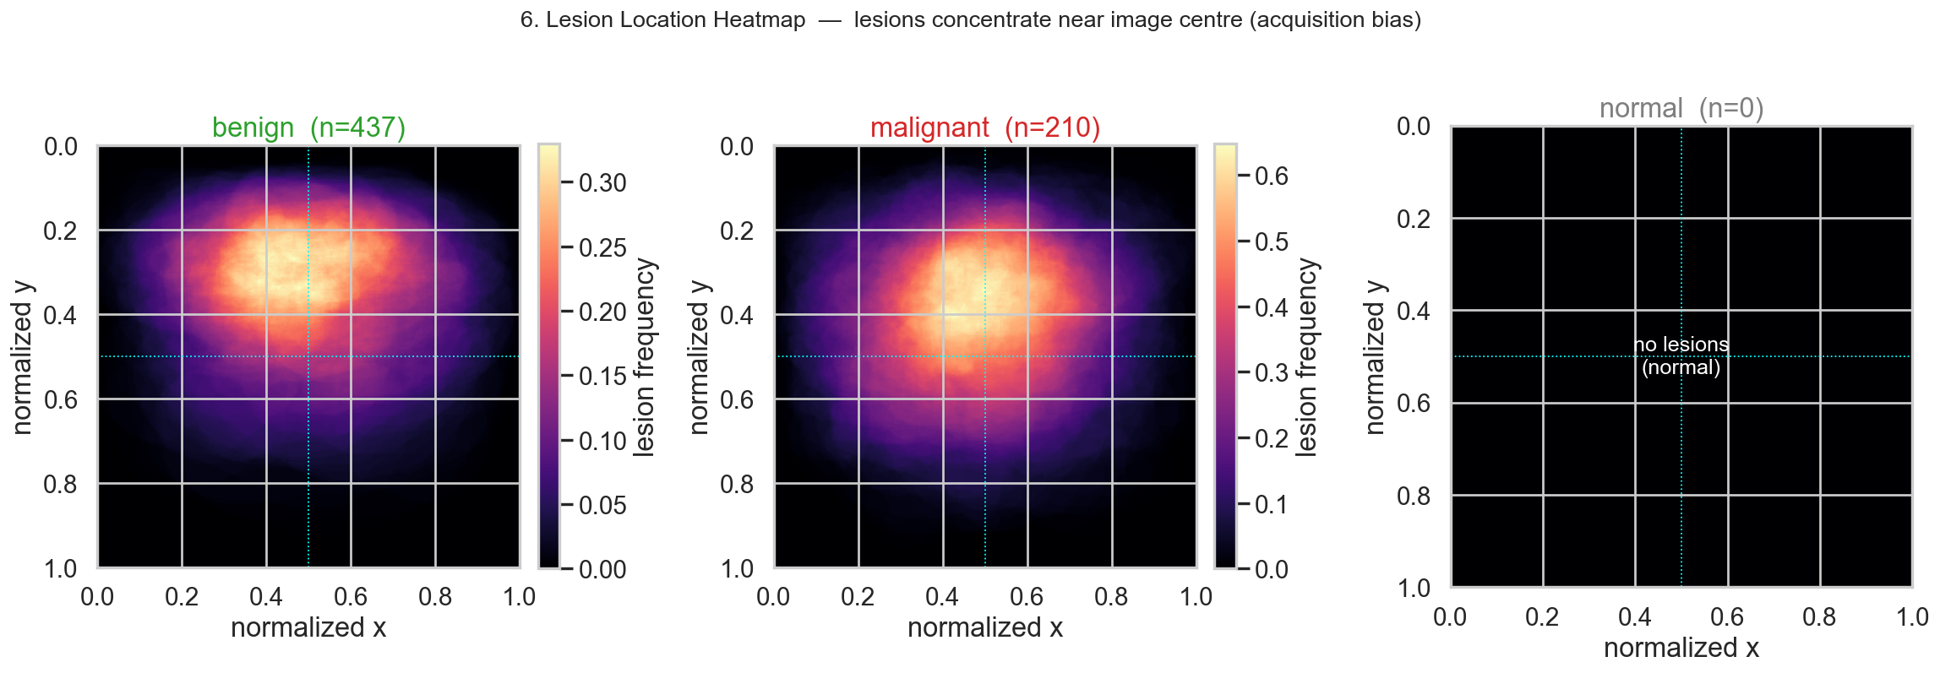
6. Lesion Location Heatmap
Key takeaways
• Lesions concentrate slightly above the image centre for both classes.
• Sonographers centre the probe on the lesion → spatial acquisition bias.
• Models can exploit position; random crops/translations improve robustness.
• Normal class has no lesion signal (empty heatmap).
EDA analysis 6

Slide 9
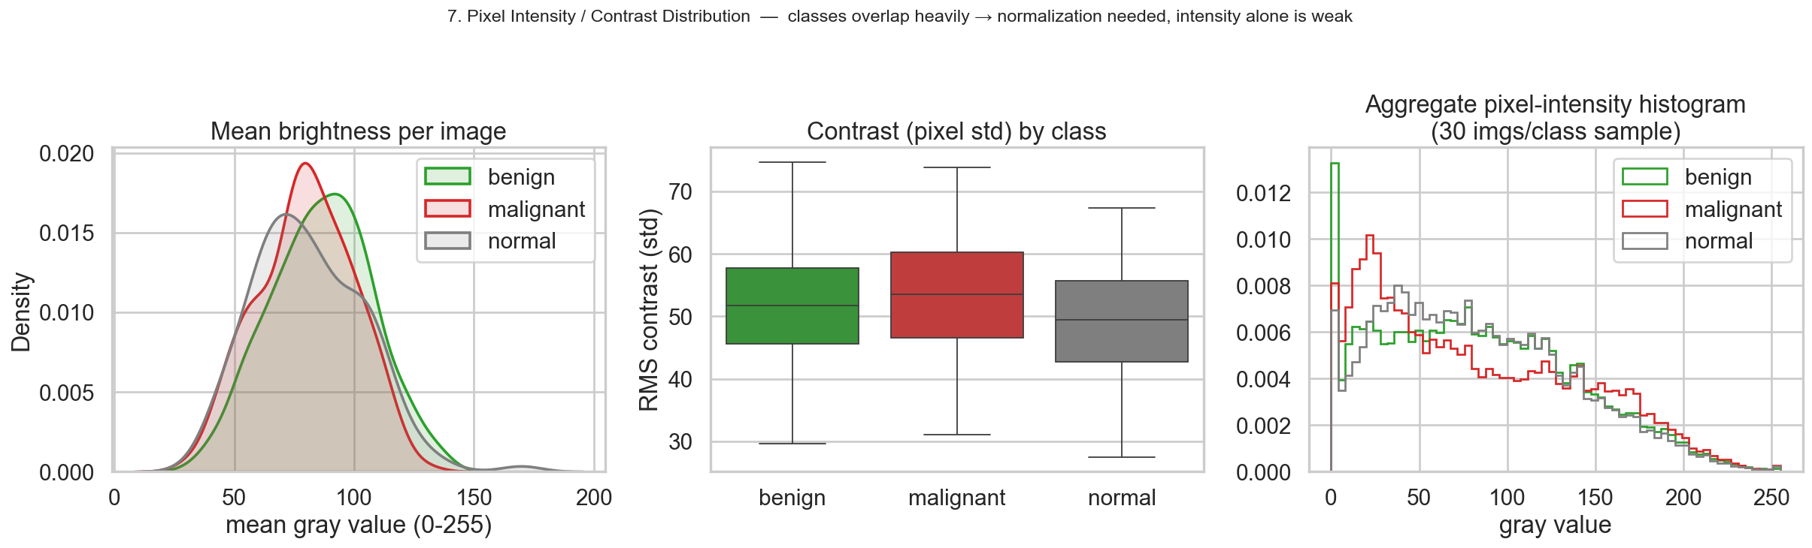
7. Pixel Intensity / Contrast
Key takeaways
• Mean brightness and contrast overlap heavily across the three classes.
• Global intensity alone is a weak class separator → need texture & shape.
• Wide brightness range across images → apply per-image normalization.
• Optional CLAHE can enhance low-contrast speckled regions.
EDA analysis 7

Slide 10
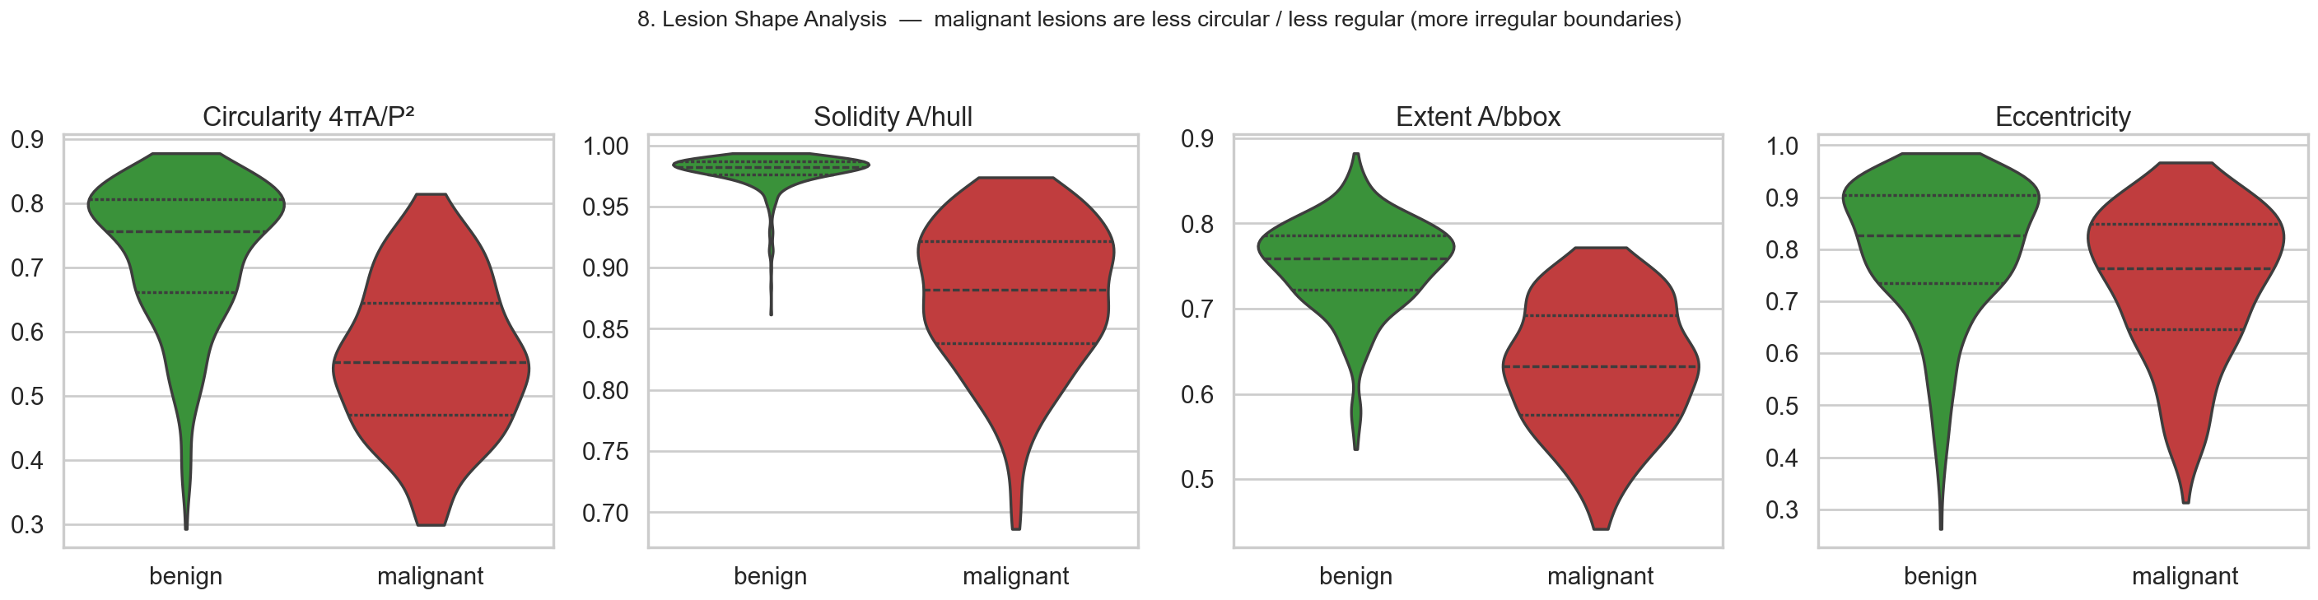
8. Lesion Shape Analysis
Key takeaways
• Malignant lesions are less circular, with lower solidity/extent.
• Higher eccentricity → more elongated / irregular boundaries.
• Shape descriptors are discriminative — supports boundary-aware models.
• Motivates Attention U-Net and boundary/contour-aware losses.
EDA analysis 8

Slide 11
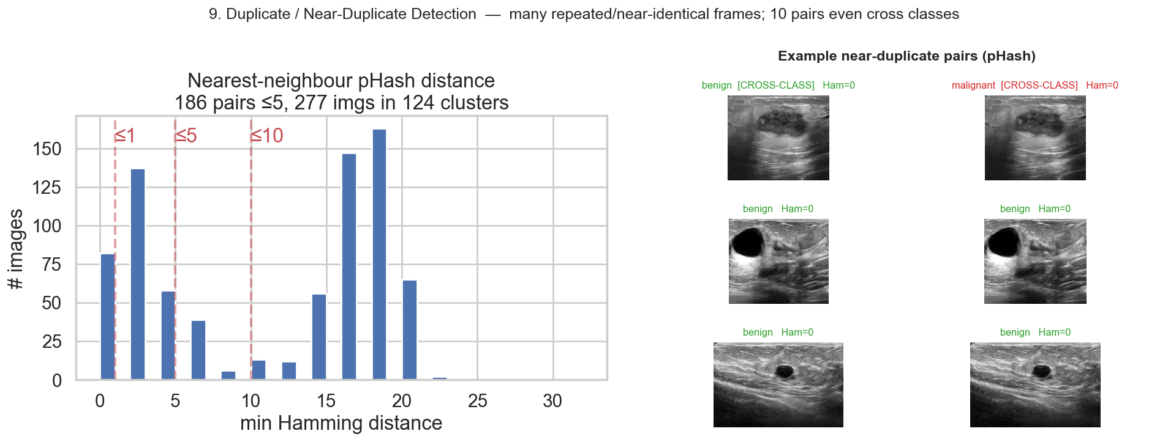
9. Duplicate / Near-Duplicate Detection
Key takeaways
• 1 EXACT duplicate (identical file) is labeled BOTH benign and malignant.
• 186 near-duplicate pairs (pHash≤5); 277 images (36%) in 124 clusters.
• 10 near-duplicate pairs cross class boundaries (label conflicts).
• Known BUSI issue (Pawłowska et al., Letter to the Editor, 2023).
EDA analysis 9

Slide 12
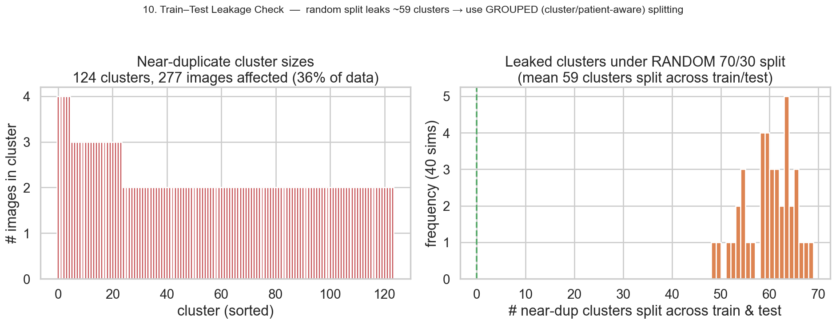
10. Train–Test Leakage Check
Key takeaways
• A naive random 70/30 split leaks ~59 near-duplicate clusters across train/test.
• Duplicates on both sides inflate reported accuracy/Dice (optimistic bias).
• Use a GROUPED split: keep each duplicate cluster (ideally each patient) on one side.
• De-duplicate and resolve cross-class conflicts before training.
EDA analysis 10

Slide 13
Data-Quality Issues & Recommendations
Issues found
Recommended actions
• Class imbalance (56 / 27 / 17%).
• Non-uniform image sizes (639 unique).
• Burned-in annotations, calipers & text.
• 1 exact + 186 near-duplicate pairs; 35% of images affected.
• 10 cross-class duplicate pairs (label conflicts).
• Center/acquisition spatial bias.
• Tiny benign lesions → pixel imbalance.
• De-duplicate; manually resolve cross-class conflicts.
• Grouped / patient-aware train-val-test split.
• Resize-with-padding to 256×256; per-image normalization.
• Stratified split + class weights + balanced augmentation.
• Merge multi-masks (union) for binary segmentation.
• Crop/inpaint burned-in annotations to avoid shortcuts.
• Report per-class metrics; Dice+BCE for small lesions.

Slide 14
Implications for Modeling (Project 047)
• Classification: transfer-learned ResNet / DenseNet / EfficientNet-B0 with class weights; add Grad-CAM for interpretability.
• Segmentation: U-Net baseline, then DeepLabv3+ and Attention U-Net; train on benign+malignant (647 imgs); merge masks.
• Loss: combine Dice + BCE (or Tversky) to handle small benign lesions and pixel imbalance.
• End-to-end pipeline (main method): segment lesion → crop ROI → classify (Bruno et al. 2025 style), reusing the same backbones.
• Evaluation: grouped cross-validation with NO duplicate leakage; report per-class Accuracy/F1/AUC and Dice/IoU.
• Preprocessing settled by EDA: resize+pad 256×256, normalize, augment (flip/rotate/scale), optional CLAHE.

