Slide 1
COMP9444 · Neural Networks & Deep Learning · Term 2, 2026
Breast Cancer Classification &
Segmentation on Ultrasound Images
A leakage-free benchmark of 15 deep-learning models on the BUSI dataset
Group Project 047
Classification · Segmentation · Dual-stage pipeline
Rui Bao,Qiyu Fan,Zihan Xia,Feiheng Wang,Haotian Xu
Group name: AreUOK?
13 reproduced + 2 improved
Notes:
Welcome. Our project (047) tackles two clinical tasks on breast ultrasound — telling normal/benign/malignant apart (classification) and outlining the tumour (segmentation). Our headline contribution is a *fair* benchmark: we reproduced 13 published models and built 2 of our own, all under one carefully cleaned, leakage-free data split, so the comparison is honest.

Slide 2
AGENDA
What we'll walk through
1
Introduction
2
Data & EDA
3
Models
Problem statement & literature review
Dataset, 10 analyses, pre-processing
13 reproduced: seg · cls · combined
4
Improvements
5
Results
6
Discussion
2 segmenters + 1 dual-stage + ablation
Horizontal & vertical comparison
Findings, limits, future work
COMP9444 · Group Project 047 · Breast Ultrasound (BUSI)
Presenter: HaoTian Xu z5578047
1
Notes:
Six parts: the clinical problem and prior work; the data and what our exploration revealed; the 13 models we reproduced; our own two improved models with an ablation; results with two kinds of comparison; and finally what we learned.

Slide 3
1 · INTRODUCTION
Problem statement: why breast-ultrasound CAD?
• Clinical stakes: breast cancer is a leading cause of cancer death in women; early detection is the single biggest lever on survival.
• Ultrasound (BUS): safe, cheap, radiation-free — ideal for screening, dense breasts and younger patients.
• But it's hard: speckle noise, low contrast, acoustic shadows, blurred lesion boundaries — reading is slow and operator-dependent, even for experts.
• Our goal: a deep-learning CAD system that supports radiologists on two tasks:
– Classification — normal / benign / malignant
– Segmentation — delineate the tumour boundary
TASK 1 · CLASSIFICATION
Assign each image to normal / benign / malignant.
3 classes · imbalanced · malignant recall matters most.
TASK 2 · SEGMENTATION
Predict a pixel-level lesion mask vs. background.
Dice / IoU · tiny benign lesions are the challenge.
COMP9444 · Group Project 047 · Breast Ultrasound (BUSI)
Presenter: HaoTian Xu z5578047
2
Notes:
Frame the clinical problem first. Ultrasound is the workhorse for breast screening because it's safe and cheap, but it is genuinely hard to read. That's the motivation for computer-aided diagnosis. We attack two complementary tasks — classify the image, and outline the mass — and note up front that missing a malignant case is the costliest error.

Slide 4
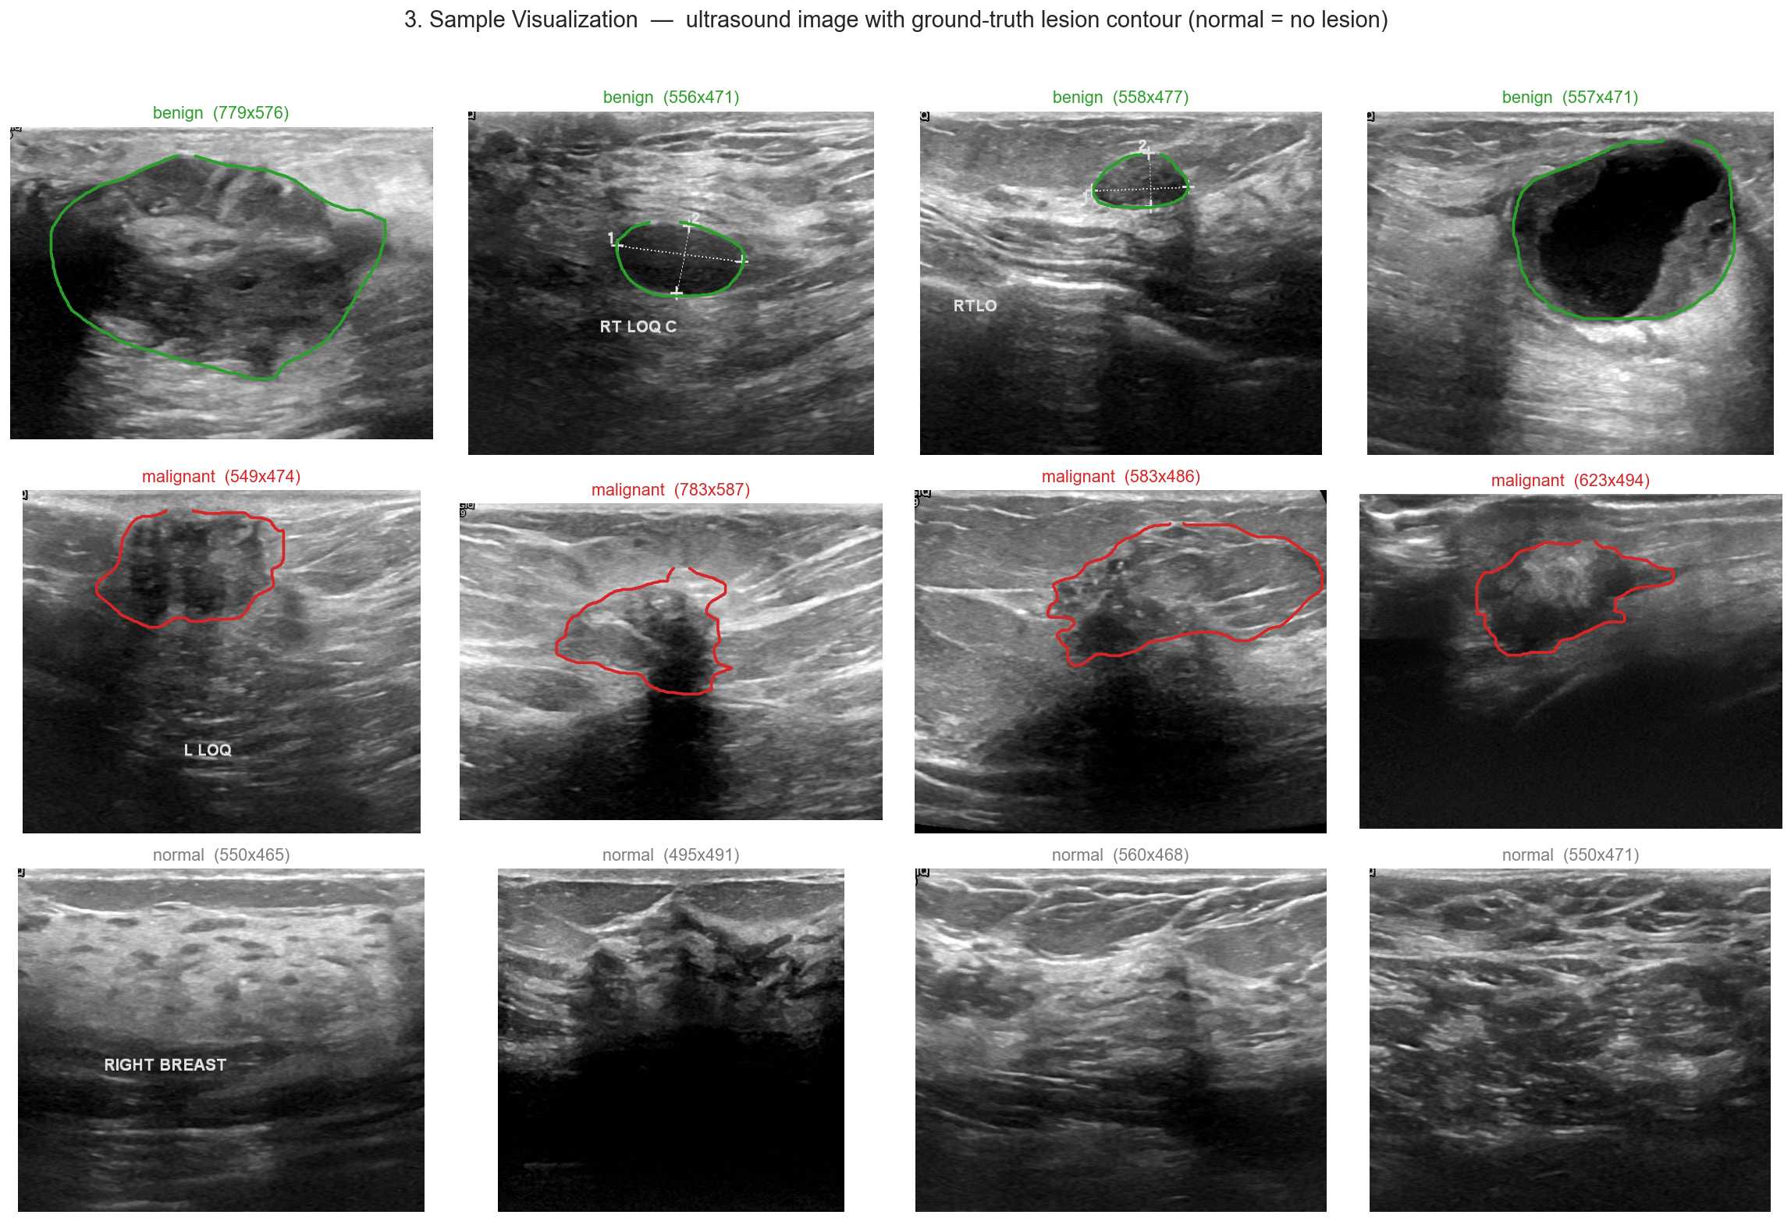
1 · INTRODUCTION
Why ultrasound is hard to read
What makes it hard
› benign & malignant masses overlap in look
› boundaries are fuzzy / low-contrast
› speckle noise + acoustic shadows
› annotation text baked into images
› normal = no lesion at all
COMP9444 · Group Project 047 · Breast Ultrasound (BUSI)
Presenter: HaoTian Xu z5578047
3
Notes:
These are real BUSI images with the radiologist's ground-truth contour. Notice benign (green) and malignant (red) masses can look similar; boundaries blur into surrounding tissue; there's speckle, shadowing and even caliper/text annotations burnt into the frame. Normal images have no lesion. This is why hand-crafted features struggle and why we need learned representations.

Slide 5
1 · LITERATURE REVIEW
Foundation: the three papers in the project brief
[1] BUSI dataset
[2] Yap et al.
[3] U-Net
Al-Dhabyani et al., 2020
CNN lesion detection, 2018
Ronneberger et al., 2015
780 images, 3 classes + ground-truth masks. The de-facto benchmark; small, so augmentation matters.
First deep BUS study: patch-LeNet vs. U-Net vs. transfer-learned FCN-AlexNet (FCN best).
Encoder–decoder with skip connections — the foundational biomedical segmentation net.
These three define our required reproductions. We reproduce all three (U-Net, patch-LeNet, FCN-AlexNet) — then go far beyond them.
COMP9444 · Group Project 047 · Breast Ultrasound (BUSI)
Presenter: HaoTian Xu z5578047
4
Notes:
The brief points us at three papers: the BUSI dataset itself, Yap's early CNN detection study, and the original U-Net. These are our mandatory reproductions and the backbone of the literature. Everything else we added builds outward from here.

Slide 6
1 · LITERATURE REVIEW
The architecture landscape we drew from
CLASSIFICATION BACKBONES
SEGMENTATION ARCHITECTURES
• ResNet [4]: residual shortcuts → very deep nets trainable (ILSVRC'15).
• DenseNet [5]: dense connectivity → feature reuse, parameter-efficient, good on small data.
• EfficientNet [6]: compound depth/width/resolution scaling; small variants transfer well.
• Note: Grad-CAM for interpretable heatmaps; caution on 'near-perfect' BUSI numbers (leakage).
• Skip-connection: U-Net family — UNet++, UNet3+, Attention U-Net (learns *where to look*).
• DeepLabV3+ [7]: atrous separable conv + ASPP for multi-scale context.
• AAU-Net [12]: BUS-specific attention for fuzzy boundaries / irregular shapes.
• CResU-Net [13]: residual + dense Co-Blocks; strong reported BUSI Dice.
• nnU-Net [20]: self-configuring U-Net; strong general baseline.
COMP9444 · Group Project 047 · Breast Ultrasound (BUSI)
Presenter: HaoTian Xu z5578047
5
Notes:
For classification we lean on the three canonical CNN backbones — ResNet, DenseNet, EfficientNet — all ImageNet-pretrained. For segmentation we cover the U-Net family plus attention variants, DeepLab's atrous convolutions, two BUS-specific nets (AAU-Net, CResU-Net), and nnU-Net as a strong self-configuring baseline. A recurring theme in the literature is inflated BUSI scores from data leakage — which we deliberately fix.

Slide 7
1 · LITERATURE REVIEW
Combining the two tasks — our design space
SEQUENTIAL · Dual-stage [17]
JOINT · Multi-task [24]
Bruno et al., 2025
Segment first → crop the lesion ROI → classify the ROI (benign/malignant).
Focusing the classifier on the lesion removes background clutter.
Lu et al., 2025 (MTL-OCA)
One shared encoder feeds two heads: a segmentation head (object-contextual attention) and a classification head.
Solves both at once — but sharing capacity is a compromise.
→ We adopt this and then improve it.
→ We reproduce it as the joint alternative.
These two lines — sequential vs. joint — frame our combined-task experiments.
COMP9444 · Group Project 047 · Breast Ultrasound (BUSI)
Presenter: HaoTian Xu z5578047
6
Notes:
The most relevant prior work combines both tasks two ways. Bruno's dual-stage pipeline is sequential: segment, crop, classify. Lu's MTL-OCA is joint: one backbone, two heads. We reproduce both, and then extend the dual-stage line into our own improved pipeline. This slide sets up the design space for our combined experiments.

Slide 8
2 · DATA
The BUSI dataset at a glance
780
3
600
~500²
ultrasound images
classes (n/b/m)
female patients (25–75y)
avg px · PNG + masks
We ran a 10-part exploratory analysis; four questions drove every downstream design choice:
How imbalanced?
How big are lesions?
benign 56% · malignant 27% · normal 17% → class weights
benign median just 3.8% of image → hard to segment
Can intensity classify?
Is the data clean?
distributions overlap → need learned features + normalisation
36% are near-duplicates, some cross-class → leakage risk!
COMP9444 · Group Project 047 · Breast Ultrasound (BUSI)
Presenter: Zihan Xia z5579843
7
Notes:
BUSI: 780 images from 600 patients, three classes, with ground-truth masks. We didn't just look — we ran ten analyses. Four of them changed what we did next: the class imbalance drove loss weighting; the tiny benign lesions explain why segmentation is hard; overlapping intensities mean we can't threshold, we need learned features; and — crucially — a third of the data are near-duplicates, which forces a special data split.

Slide 9
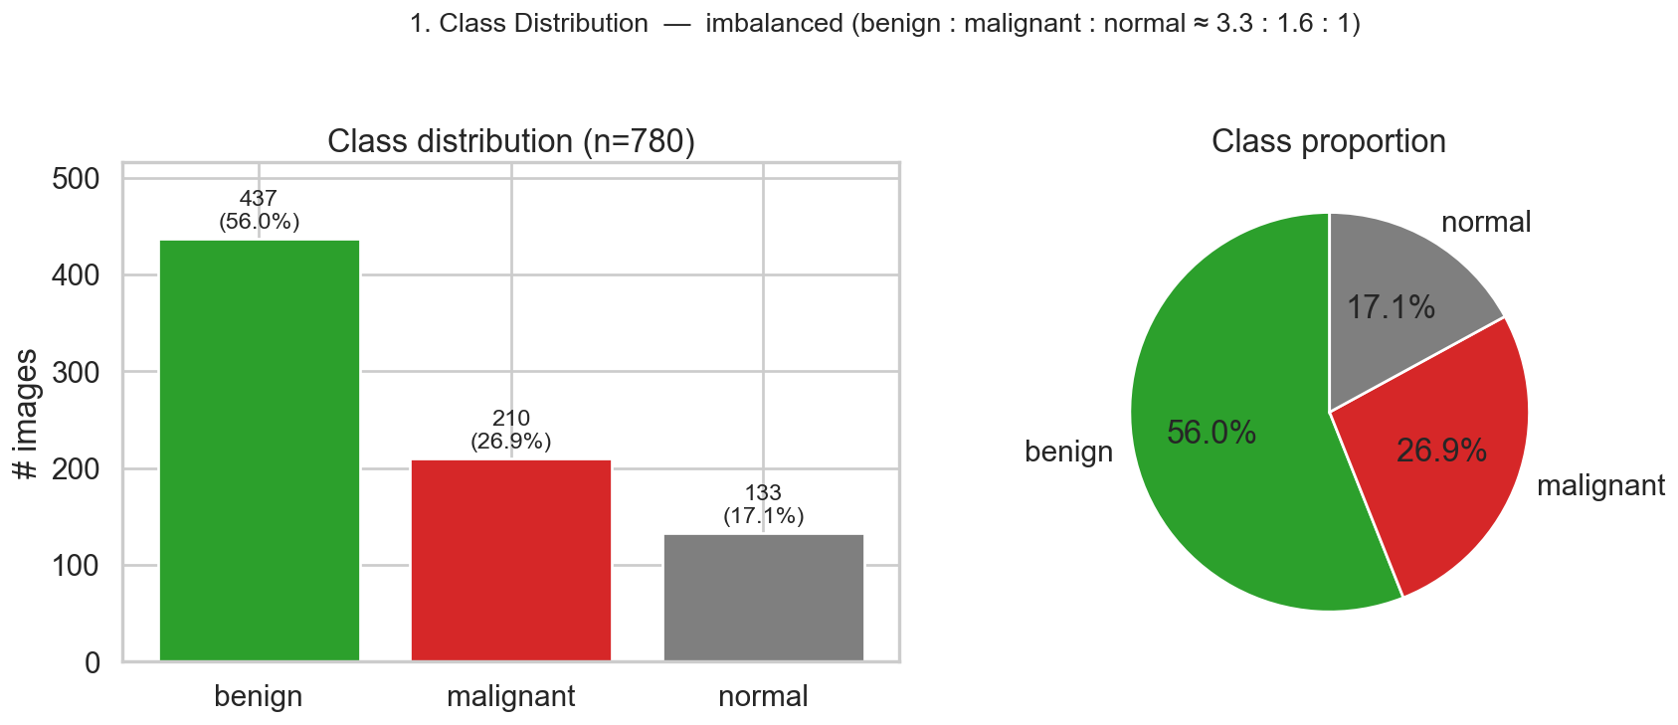
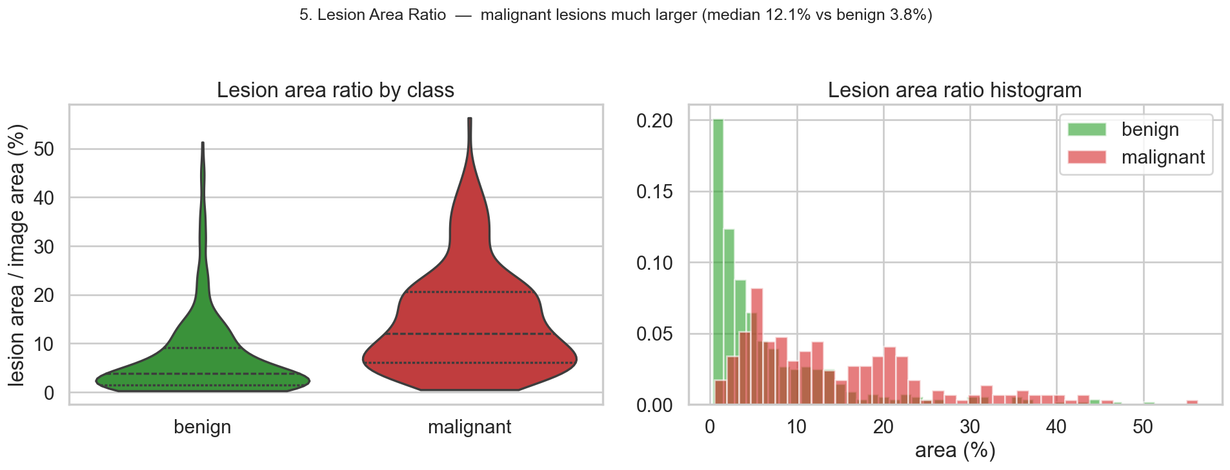
2 · EDA
Imbalanced classes & tiny benign lesions
Read-outs → design choices
• Imbalance: benign 56% / malignant 27% / normal 17%.
– → inverse-frequency class weights in the loss; report macro-F1 not accuracy.
• Lesion size: malignant median 12.1% of image vs. benign only 3.8%.
– → tiny benign masses are the hardest to segment; Dice is very sensitive here.
– → score Dice per-image then average (don't pool pixels — big lesions would dominate).
COMP9444 · Group Project 047 · Breast Ultrasound (BUSI)
Presenter: Zihan Xia z5579843
8
Notes:
Two findings. Top: the classes are imbalanced — benign dominates, normal is rare — so we weight the loss by inverse frequency and report macro-F1, which treats every class equally. Bottom: malignant lesions are large but benign lesions are tiny, a median of under 4% of the image. Small targets are exactly where Dice punishes you, so we average Dice per image rather than pooling all pixels.

Slide 10
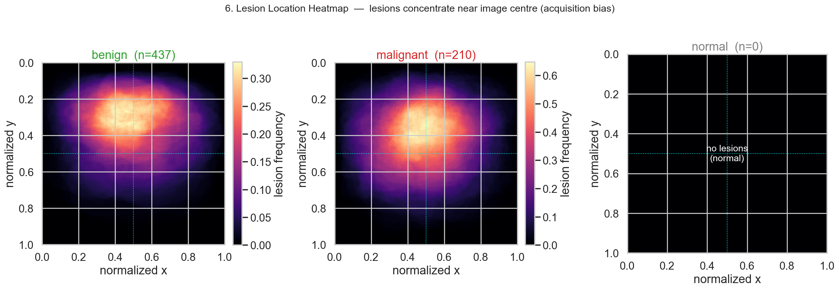
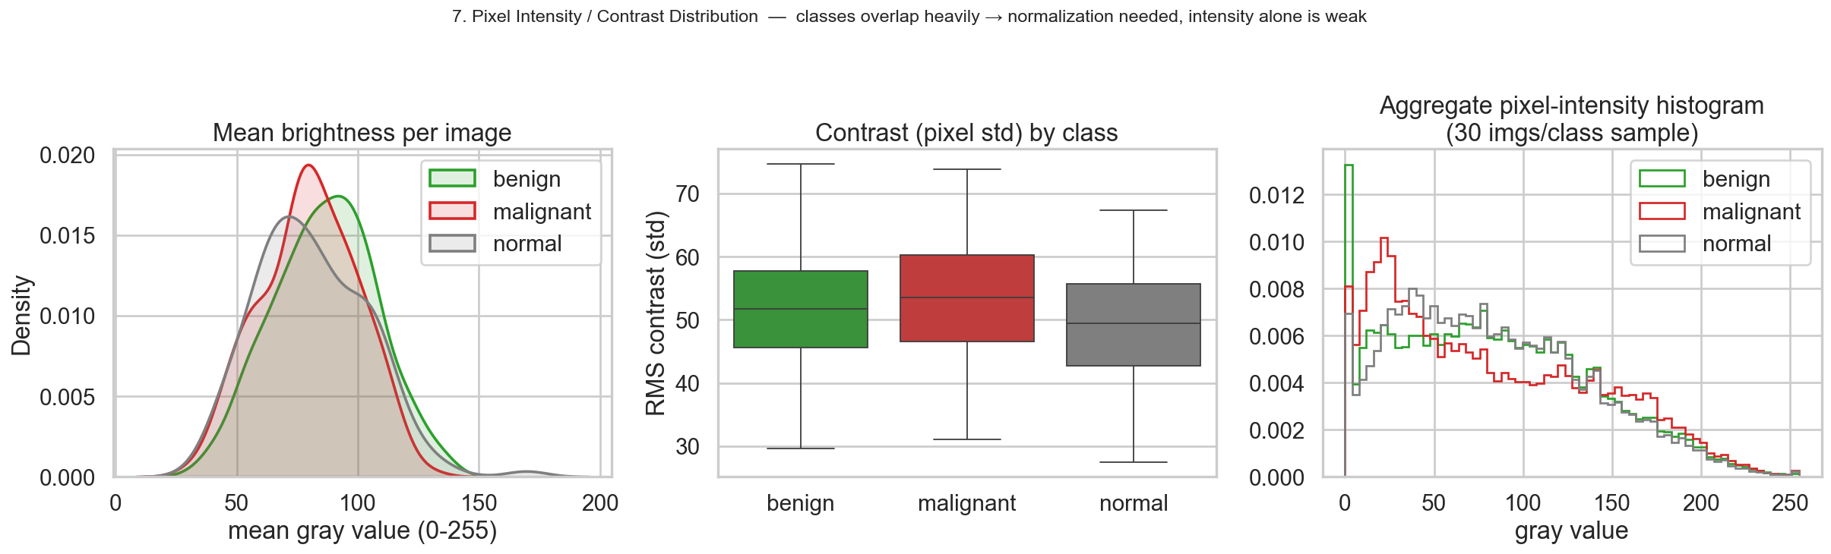
2 · EDA
Location bias & why intensity alone fails
Takeaways
› lesions cluster near image centre (acquisition bias).
› class intensity/contrast overlap heavily.
› → pixel brightness is a weak feature; need learned features + normalisation.
COMP9444 · Group Project 047 · Breast Ultrasound (BUSI)
Presenter: Zihan Xia z5579843
9
Notes:
Top: lesions concentrate near the image centre — an acquisition bias worth knowing when we crop ROIs. Bottom-left: the brightness and contrast distributions of the three classes overlap almost completely. So a simple intensity threshold can't separate classes — we genuinely need learned features, and we normalise inputs so brightness differences don't dominate training.

Slide 11
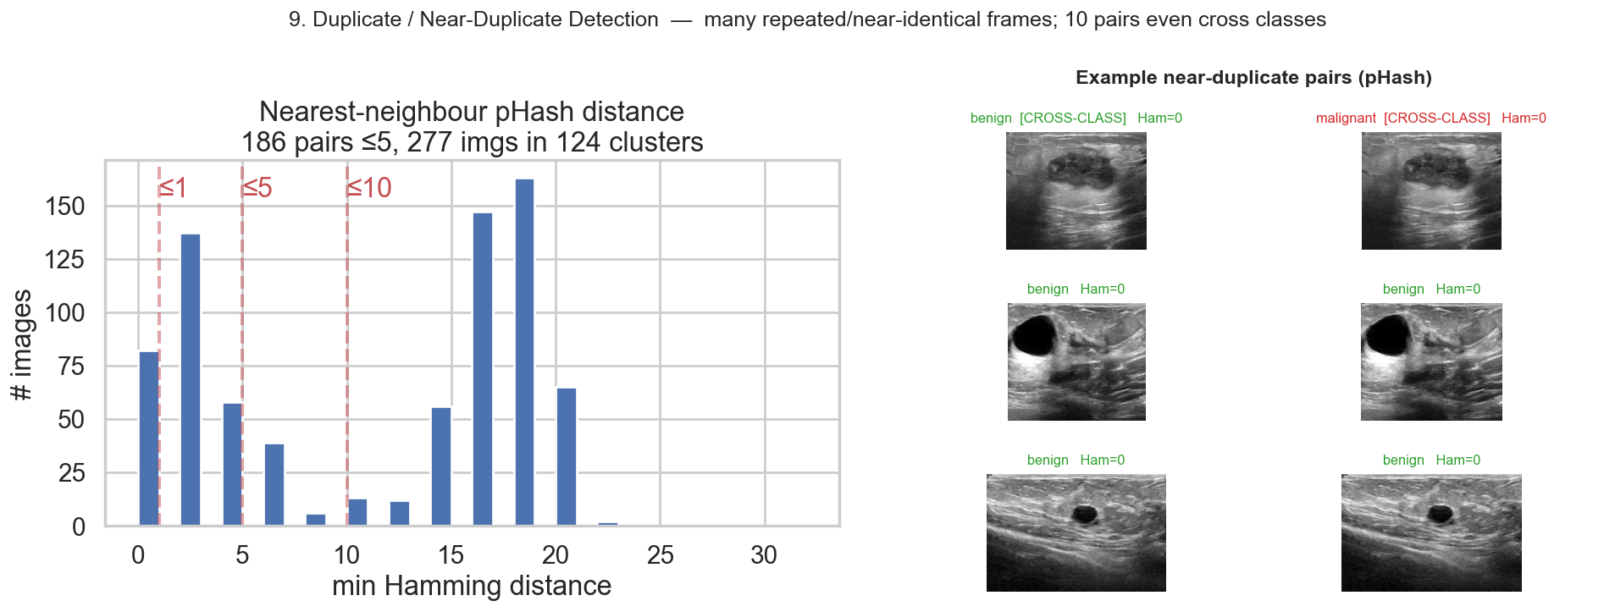
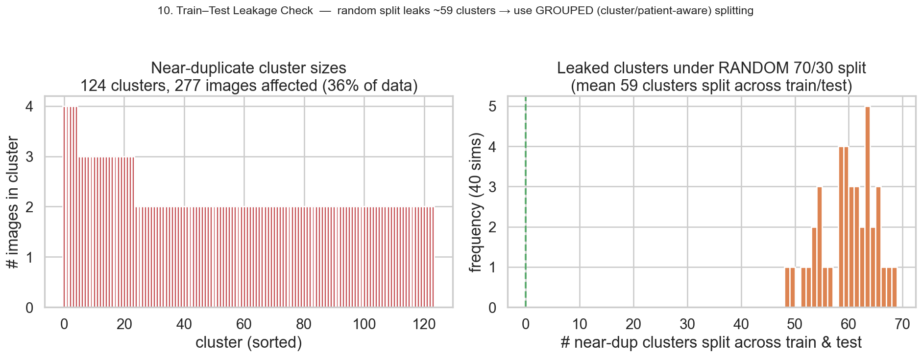
2 · EDA — KEY FINDING
Hidden trap: near-duplicates cause data leakage
THE PROBLEM
› pHash finds 277 imgs (36%) in 124 near-duplicate clusters.
› some duplicates even span classes (benign≈malignant copy!).
› a random 70/30 split leaks ~59 clusters across train & test.
Our fix:
cluster-level, class-stratified 70/15/15 split — no duplicate can cross the train/test line.
COMP9444 · Group Project 047 · Breast Ultrasound (BUSI)
Presenter: Zihan Xia z5579843
10
Notes:
This is our most important methodological finding. Using perceptual hashing we discovered that a THIRD of BUSI images are near-duplicates — repeated frames of the same scan — and a few duplicates even carry conflicting benign/malignant labels. If you split randomly, the same lesion lands in both train and test, and your scores are inflated. Our fix is a cluster-level split: near-duplicates stay together on one side. This single decision is why our numbers are lower — but honest — than many published papers.

Slide 12
2 · PRE-PROCESSING
One shared, leakage-free data pipeline
CLEAN
DE-LEAK
PRE-PROCESS
AUGMENT
drop cross-class duplicate · merge multi-masks by union
pHash → 124 clusters · cluster-level stratified 70/15/15
letterbox 256×256 · grayscale · normalise [-1,1] or ImageNet
train-only: h-flip · affine · brightness/contrast jitter
How the splits are used
Evaluation metrics
• Segmentation: 645 benign+malignant lesion images → 445 / 102 / 98.
• Classification: all 3 classes, 778 → 540 / 120 / 118.
• Same split: every model sees the identical split → fair comparison.
• Classification: macro-F1 (primary), balanced-acc, macro-AUC, confusion matrix.
• Segmentation: Dice & IoU (per-image mean) + pixel P/R; Yap detection metrics.
• Robustness: multi-seed mean ± std + bootstrap 95% CI on final pipeline.
COMP9444 · Group Project 047 · Breast Ultrasound (BUSI)
Presenter: Zihan Xia z5579843
11
Notes:
Every model runs through the same four-stage pipeline. We clean conflicting labels and merge masks; we de-leak with cluster-level splitting; we letterbox to 256×256 preserving aspect ratio, go grayscale, and normalise; and we augment the training split only. Because the split is identical for all models, differences in the results come from the architecture, not from data handling. Metrics: macro-F1 for classification, per-image Dice/IoU for segmentation, and confidence intervals for our final pipeline.

Slide 13
3 · MODELS & METHODS
13 reproduced models + 2 of our own
SEGMENTATION (8)
CLASSIFICATION (3)
COMBINED (2)
OUR IMPROVEMENTS (2)
U-Net [3]*
ResNet-18 [4]
Dual-stage [17]
★ Improved segmenter
(pretrained EffB4 U-Net)
Attention U-Net [9]
DenseNet-121 [5]
MTL-OCA [24]
DeepLabV3+ [7]
EfficientNet-B0 [6]
nnU-Net [20]
AAU-Net [12]
★ Improved dual-stage
(rigorous eval)
CResU-Net [13]
FCN-AlexNet [2]*
Patch-LeNet [2]*
* = the three papers named in the project brief. Every reused backbone is pretrained torchvision; every head, loss & training loop is our own.
COMP9444 · Group Project 047 · Breast Ultrasound (BUSI)
Presenter: Feiheng Wang z5531339
12
Notes:
Here's the full menu. Eight segmentation models — including the three mandatory reproductions marked with a star — three classification backbones, and two combined models. Then our two contributions in amber: an improved segmenter and an improved dual-stage pipeline. For each reproduction we reused only the pretrained backbone where relevant; the heads, losses and training loops are our own implementation, which matters for the marking rubric.

Slide 14
3 · REPRODUCTION
The three required papers, from scratch
U-Net [3]
Patch-LeNet [2]
FCN-AlexNet [2]
Ronneberger 2015
Yap 2018
Yap 2018 · best
4-level encoder/decoder, skip connections, Dice+BCE. Built entirely from scratch in PyTorch.
Tiny LeNet classifies 28×28 patches; balanced hard-negative sampling; sliding-window detection map.
Pretrained AlexNet → fully-convolutional; fc6/fc7 recast as conv + bilinear upsample. Yap's best method.
from-scratch
detection
transfer
Own work: full U-Net; the LeNet + hard-negative patch sampler + sliding-window inference; the FCN head & fine-tuning. Only the AlexNet backbone is a pretrained component.
COMP9444 · Group Project 047 · Breast Ultrasound (BUSI)
Presenter: Feiheng Wang z5531339
13
Notes:
The three mandatory reproductions. We wrote the U-Net from scratch. We reproduced Yap's patch-based LeNet detector — including the tricky balanced hard-negative sampling and sliding-window inference — and Yap's best model, the transfer-learned FCN-AlexNet. We're careful to state exactly what is our own code versus a reused pretrained backbone, which the rubric explicitly rewards.

Slide 15
3 · SEGMENTATION
Five stronger segmentation architectures
Attention U-Net [9]
additive attention gates on skips — *same recipe* as our U-Net, so it isolates the gate's effect.
DeepLabV3+ [7]
pretrained ResNet-50 + ASPP (atrous rates 6/12/18) + light decoder. Our strongest reproduced baseline.
nnU-Net [20]
the fixed blueprint 2D U-Net + deep supervision (InstanceNorm, poly-LR, SGD). A strong general baseline.
AAU-Net [12]
BUS-specific Hybrid Adaptive Attention Module: multi-receptive-field + channel & spatial self-attention.
CResU-Net [13]
block-scheduled encoder: Co-Block (dense concat) + ResNet + MultiRes blocks; pure-Dice loss.
COMP9444 · Group Project 047 · Breast Ultrasound (BUSI)
Presenter: Feiheng Wang z5531339
14
Notes:
Beyond the required nets we reproduced five stronger segmenters. Attention U-Net is a controlled comparison — same recipe as our U-Net — so any change is due purely to the attention gate. DeepLabV3+ with a pretrained ResNet-50 is our best baseline. nnU-Net is the famous self-configuring net, here as its blueprint. AAU-Net and CResU-Net are BUS-specific designs with reported state-of-the-art numbers we test honestly under our split.

Slide 16
3 · CLASSIFICATION
Three ImageNet-pretrained backbones
ResNet-18 [4]
DenseNet-121 [5]
EfficientNet-B0 [6]
He 2016
Huang 2017
Tan & Le 2019
smallest residual net (BUSI is tiny) · fresh 3-way head · SGD fine-tune
dense feature reuse · dropout + 3-way head · AdamW + early stop
smallest compound-scaled variant · dropout + 3-way head · Adam
Shared recipe
3-channel ImageNet-normalised 256×256 (grayscale→pseudo-RGB) · final layer replaced by a fresh 3-way head · inverse-frequency weighted cross-entropy to counter class imbalance.
COMP9444 · Group Project 047 · Breast Ultrasound (BUSI)
Presenter: Feiheng Wang z5531339
15
Notes:
For classification we fine-tune the three canonical pretrained backbones. We deliberately pick the smallest variant of each — ResNet-18, DenseNet-121, EfficientNet-B0 — because BUSI is small and larger nets overfit. All share the same recipe: pseudo-RGB inputs, a fresh three-way head, and class-weighted cross-entropy so the rare malignant class isn't ignored.

Slide 17
4 · IMPROVEMENT
Baseline combined models we reproduced
Dual-stage [17] — segmentation-guided classification (sequential)
Input
image
DeepLabV3+
(segment)
ROI crop
(mask→bbox)
EfficientNet-B0
(classify)
Benign /
Malignant
MTL-OCA [24] — multi-task, one shared backbone (joint)
Shared Res-UNet encoder
Segmentation head (OCA attention)
Loss = 0.4·CE(soft) + CE(final) + CE(cls).
Solves both tasks at once, but shares capacity — we'll see it underperforms specialists.
Classification head
COMP9444 · Group Project 047 · Breast Ultrasound (BUSI)
Presenter: Rui Bao z5532117
16
Notes:
Two combined baselines. The dual-stage pipeline is a clean sequence: DeepLabV3+ segments, we crop the lesion ROI, and EfficientNet classifies that crop — so the classifier only sees the tumour, not the clutter. MTL-OCA is the joint alternative: one Res-UNet backbone with two heads and a weighted three-term loss. We reproduce both, and we'll show the joint model pays a price for sharing capacity.

Slide 18
4 · IMPROVEMENT — DESIGN DECISION
Which combined model do we improve — and why?
We reproduced both combined approaches — sequential dual-stage [17] and joint multi-task MTL-OCA [25]. We chose to optimise the dual-stage line. Here's the reasoning:
HEAD-TO-HEAD (our reproductions)
① Modular & swappable
② Controlled science
improve Stage 1 (segmenter) and Stage 2 (classifier) independently.
fix Stage 2 byte-for-byte, swap Stage 1 → isolate the segmenter's effect (impossible in a joint net).
Segmentation Dice
MTL-OCA
0.612
dual-stage seg
0.760
Classification macro-F1
③ Best-of-breed reuse
④ Clinical interpretability
MTL-OCA
0.720
plug in our strongest segmenter + strongest classifier; gains compound.
explicit lesion mask + ROI shows the radiologist *where* — not just a label.
Dual-stage cls
0.828
One shared backbone makes MTL-OCA underperform on both tasks. Dual-stage instead plugs in our best specialists.
Decision: extend & rigorously evaluate the dual-stage pipeline.
Stage 1 = our improved segmenter · Stage 2 = strengthened classifier.
COMP9444 · Group Project 047 · Breast Ultrasound (BUSI)
Presenter: Rui Bao z5532117
17
Notes:
Before improving, we had to pick which combined design to build on. Head-to-head, the joint MTL-OCA model loses on both tasks because it forces one backbone to serve segmentation and classification at once — a compromise that's too costly on small data. The dual-stage pipeline instead lets us plug in our best specialist for each stage. Four reasons sealed it: it's modular, so we can improve each stage on its own; it enables a controlled experiment — fix the classifier, swap the segmenter, and measure the segmenter's true contribution; it reuses our strongest models; and it produces an explicit mask and ROI, which is far more interpretable for a clinician. So we extend the dual-stage line.

Slide 19
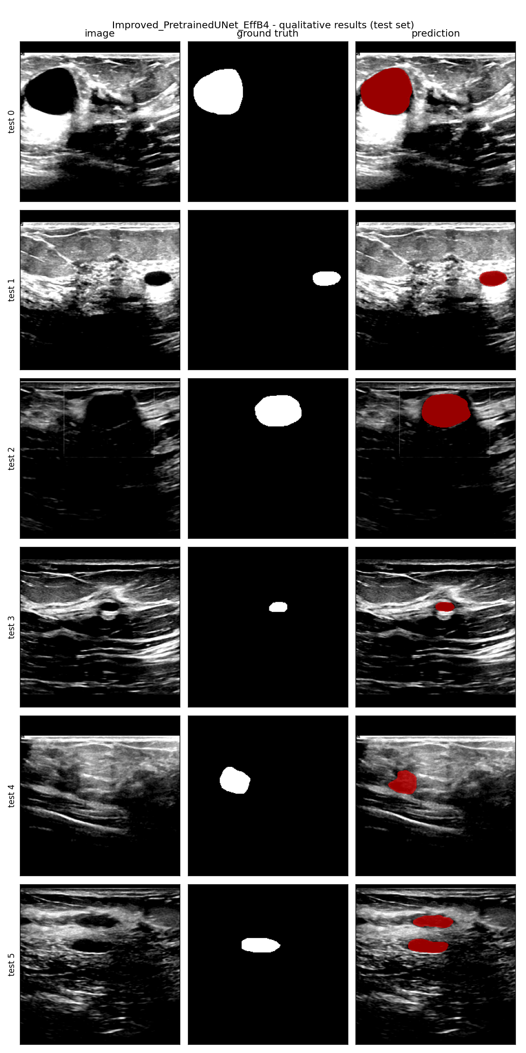
4 · IMPROVEMENT
Improved segmenter: transfer learning first
Insight from baselines: the only nets that used transfer learning (DeepLabV3+) beat the from-scratch ones. So we build a pretrained-encoder U-Net.
① Pretrained EffB4 encoder
② Focal Tversky + BCE loss
③ TTA + post-processing
ImageNet EfficientNet-B4 encoder + U-Net decoder (via smp).
penalises false negatives to attack the missed-lesion tail.
flip/multi-scale test-time aug + largest-connected-component.
the decisive ingredient
trades precision↔recall
no Dice gain here
Every idea is tested in a controlled ablation →
We add one component at a time and measure test Dice, so we can attribute the gain precisely — not just claim it. (Result on next slide.)
COMP9444 · Group Project 047 · Breast Ultrasound (BUSI)
Presenter: Rui Bao z5532117
17
Notes:
Our improved segmenter is motivated directly by the baselines: transfer learning helped, so we make it central. We take a U-Net decoder but swap in an ImageNet-pretrained EfficientNet-B4 encoder. On top we add a Focal Tversky loss to chase missed lesions, and test-time augmentation with post-processing. Crucially, we don't just stack tricks — we ablate each one to see what actually helps.

Slide 20
4 · ABLATION
What actually makes the segmenter work?
Configuration (add one component each row) | Dice | Dice std | pixel recall
From-scratch U-Net (Dice+BCE) | 0.648 | 0.362 | 0.637
+ ImageNet-pretrained EffB4 encoder | 0.765 | 0.285 | 0.763
+ Focal Tversky loss | 0.760 | 0.282 | 0.800
+ TTA + post-processing (full model) | 0.760 | 0.307 | 0.790
Verdict
• Pretrained encoder = +0.117 Dice, and far fewer completely-missed lesions (std 0.362→0.285).
– essentially the ENTIRE gain.
• Focal Tversky: no overall Dice gain, but raises recall 0.76→0.80 — a precision/recall knob.
• TTA + post-proc: no measurable Dice gain on this data.
Lesson: on small, noisy BUSI, transfer learning beats architectural/loss cleverness.
COMP9444 · Group Project 047 · Breast Ultrasound (BUSI)
Presenter: Rui Bao z5532117
18
Notes:
This is the payoff of ablating. Read down the table: the from-scratch U-Net scores 0.648. Adding the pretrained encoder jumps it to 0.765 — that one change is essentially the entire improvement, and it also halves the number of completely-missed lesions. The fancy Focal Tversky loss doesn't raise Dice; it just trades precision for recall. TTA does nothing measurable. The lesson is blunt: transfer learning matters more than architectural cleverness on a dataset this small.

Slide 21
4 · IMPROVEMENT
Improved dual-stage pipeline
Input US
image
STAGE 1
Improved U-Net
ROI extract
STAGE 2
EfficientNet-B0
Benign /
Malignant
256×256 grayscale
EffB4 encoder → mask
largest CC · bbox +15% crop
classify the ROI crop
optional shape features
Controlled substitution: Stage-1 swapped for our stronger segmenter; Stage-2 kept byte-for-byte → any change is attributable to segmentation alone.
Rigorous evaluation
Out-of-fold masks
5-seed ensemble
Bootstrap 95% CI
5-fold cross-fitting: each training image's mask comes from a segmenter that never saw it (no train/test mismatch).
every configuration run with 5 seeds and ensembled — kills single-run luck.
confidence interval on the 98-image test set — is a difference real or just noise?
COMP9444 · Group Project 047 · Breast Ultrasound (BUSI)
Presenter: Rui Bao z5532117
19
Notes:
Our improved pipeline. Same skeleton as Bruno, but Stage 1 is now our pretrained segmenter, and — importantly — Stage 2 is kept identical, so any change in the end-to-end score is due to segmentation alone. The real contribution is the evaluation rigour along the bottom: masks generated out-of-fold so the classifier never trains on its own test-time inputs, five-seed ensembling to remove luck, and a bootstrap confidence interval to tell a real gain from noise. This is what most BUSI papers skip.

Slide 22
4 · ABLATION
Dual-stage ablation: which ideas survive honest evaluation?
We test every pipeline idea the honest way — out-of-fold masks · 5 seeds · bootstrap 95% CI — and ask which gains are actually real.
Configuration (all OOF cross-fit) | per-seed F1 | 5-seed ens. | 95% CI
Strengthened Stage-2 (pure CNN) | 0.847 ± 0.011 | 0.875 | [0.80, 0.94]
+ shape features | 0.861 ± 0.016 | 0.875 | [0.80, 0.94]
+ radiomics (shape + texture) | 0.862 ± 0.013 | 0.863 | [0.79, 0.93]
WHAT IS OUT-OF-FOLD (OOF)?
each row = one fold
its mask is predicted by
a model trained on the
other 4 folds only.
held-out image (mask predicted, never self-seen)
Why: Stage-2 must train on predicted-mask crops. OOF generates realistic (imperfect) masks for the training images without a segmenter ever seeing its own image.
→ removes the train-on-clean / test-on-imperfect mismatch. A correctness fix, not a score trick.
Verdict
• Hand features: shape / radiomics CIs fully overlap the pure-CNN baseline → NO reliable gain. Dropped.
• 5-seed ensembling: per-seed 0.847 → ensemble 0.875 — the ONLY component that robustly helps.
• Lesson: on 98 test images, single-run gains up to ~±0.05 are noise → always report CIs.
COMP9444 · Group Project 047 · Breast Ultrasound (BUSI)
Presenter: Rui Bao z5532117
21
Notes:
This is the dual-stage counterpart to the segmenter ablation — and arguably the most important methodological result of the project. First, OOF: to train the Stage-2 classifier on predicted-mask crops, we need predicted masks for the TRAINING images. If we used a segmenter that had already seen those images, the masks would be unrealistically perfect. So we use 5-fold cross-fitting — each image's mask comes from a segmenter trained only on the other folds. That gives realistic masks and removes the train-clean / test-imperfect mismatch. It's a correctness fix, not a way to inflate the score. Then the ablation: we add shape features, then radiomics. Read the confidence intervals — they all overlap the pure-CNN baseline, so hand-crafted features give no reliable gain and we drop them. The only thing that survives is ensembling: averaging five seeds lifts the per-seed 0.847 to 0.875. The lesson: on 98 images, single-run differences of a few points are just noise.

Slide 23
5 · RESULTS
Segmentation leaderboard (leakage-free, 98 imgs)
Model | Type | Dice | IoU | F-meas | Params | Paper
Improved Pretrained-UNet (ours) | ours | 0.760 | 0.688 | 0.854 | 20.2M | —
DeepLabV3+ | transfer | 0.739 | 0.652 | 0.810 | 26.7M | —
AAU-Net | reprod. | 0.730 | 0.638 | 0.723 | 42.7M | 0.775
nnU-Net | reprod. | 0.717 | 0.627 | 0.781 | 8.5M | —
CResU-Net | reprod. | 0.693 | 0.600 | 0.772 | 33.5M | 0.829
U-Net | scratch | 0.648 | 0.570 | 0.779 | 31.0M | —
Attention U-Net | scratch | 0.629 | 0.540 | 0.631 | 31.4M | —
MTL-OCA (seg) | joint | 0.612 | 0.515 | — | 8.2M | 0.838
FCN-AlexNet | transfer | 0.582 | 0.471 | 0.804 | 28.7M | —
Reading the board
• ① our pretrained U-Net wins (Dice 0.760).
• ② reproductions fall below paper numbers (CResU 0.829→0.693) — leakage removed = honest.
• ③ nnU-Net (0.717) does NOT dominate — a good pretrained encoder beats a heavy framework.
• ④ U-Net 0.648 vs Attn 0.629 (same recipe) → attention gate doesn't help here.
COMP9444 · Group Project 047 · Breast Ultrasound (BUSI)
Presenter: QIyu Fan z5555929
20
Notes:
Segmentation results, ranked by Dice. Four things to notice. First, our improved segmenter is top. Second, our reproductions of published models score below their reported numbers — that's the leakage removal, and it's the honest number. Third, the heavyweight nnU-Net does not win; a good pretrained encoder beats it. Fourth, the controlled U-Net versus Attention U-Net pair shows the attention gate actually hurts slightly here. Bigger and fancier is not better on small ultrasound data.

Slide 24
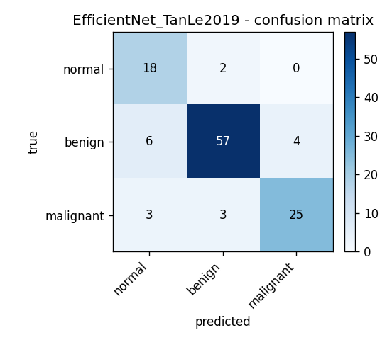
5 · RESULTS
Classification results (3-class, 118 imgs)
Model | Type | macro-F1 | Accuracy | AUC
EfficientNet-B0 | transfer | 0.828 | 0.848 | 0.969
ResNet-18 | transfer | 0.810 | 0.822 | 0.966
DenseNet-121 | transfer | 0.793 | 0.805 | 0.947
MTL-OCA (cls) | joint | 0.720 | 0.746 | 0.900
Analysis
• Winner: EfficientNet-B0 leads (macro-F1 0.828, AUC 0.969).
• Specialists win: all 3 pretrained backbones beat the joint MTL-OCA (0.720).
• Why: MTL underperforms on BOTH tasks — sharing one backbone is a compromise too costly on small data.
• Error analysis: malignant (minority class) is the hardest and the main error source for every model.
Best model confusion matrix
COMP9444 · Group Project 047 · Breast Ultrasound (BUSI)
Presenter: QIyu Fan z5555929
21
Notes:
Classification. EfficientNet-B0 wins with macro-F1 0.828 and an excellent AUC. All three specialist backbones clearly beat the joint multi-task model, which underperforms on both tasks — confirming that on small data a shared backbone is a false economy. The confusion matrix shows the expected clinical pattern: the minority malignant class is hardest, and it's where every model makes most of its mistakes — exactly the errors that matter most.

Slide 25
5 · RESULTS
Dual-stage: the bottleneck is the classifier
(a) single-run ladder — looks like a tidy climb…
Pipeline | St-1 Dice | F1 | Acc | GT-ROI F1
Bruno (DeepLabV3+→EffB0) | 0.739 | 0.804 | 0.827 | 0.865
Ours: Improved-UNet Stage 1 | 0.760 | 0.807 | 0.827 | 0.884
Ours: + strengthened Stage 2 | 0.760 | 0.817 | 0.837 | 0.882
Ours: + shape features | 0.761 | 0.840 | 0.857 | 0.850
Two messages
• ① Bottleneck: a much stronger Stage-1 (Dice 0.739→0.760) barely moves F1 (0.804→0.807). The gap to the GT-ROI upper bound (~0.87) is the classifier's own error.
• ② Rigour: the tidy ladder in (a) dissolves under CIs in (b): shape/texture features give no reliable gain — only ensembling survives (0.847→0.875).
(b) rigorous: out-of-fold + 5-seed ensemble + bootstrap 95% CI
Pipeline (rigorous) | Ensemble F1 | per-seed mean±std | 95% CI
OOF + no hand features (pure CNN) | 0.875 | 0.847 ± 0.011 | [0.80, 0.94]
OOF + shape | 0.875 | 0.861 ± 0.016 | [0.80, 0.94]
OOF + radiomics (shape+texture) | 0.863 | 0.862 ± 0.013 | [0.79, 0.93]
COMP9444 · Group Project 047 · Breast Ultrasound (BUSI)
Presenter: QIyu Fan z5555929
22
Notes:
The dual-stage story has two punchlines. First, the bottleneck: a much stronger segmenter barely changes the end-to-end F1, and the perfect-segmentation upper bound sits far above what we reach — so the limiting factor is the classifier, not the mask. Second, rigour: table (a) looks like every trick helps, a neat climb from 0.804 to 0.840. But once we add confidence intervals in table (b), those gains overlap and vanish. Hand-crafted features do nothing reliable; the only thing that survives is ensembling. On a 98-image test set, single-run differences are mostly noise — a central lesson of the project.

Slide 26
5 · COMPARISON
Two comparisons: across models & vs. reported
HORIZONTAL — best per task (ours vs baseline)
VERTICAL — our leakage-free vs. paper-reported Dice
Seg · Improved U-Net
CResU-Net
0.760
paper 0.829
Seg · DeepLabV3+ (base)
ours 0.693
0.739
Cls · EfficientNet-B0
AAU-Net
0.828
paper 0.775
ours 0.730
Cls · MTL-OCA (base)
0.720
MTL-OCA
Dual · OOF+ensemble (ours)
paper 0.838
0.875
ours 0.612
Dual · Bruno (base)
0.804
The drop = removed near-duplicate leakage. Our numbers are lower but trustworthy.
COMP9444 · Group Project 047 · Breast Ultrasound (BUSI)
Presenter: QIyu Fan z5555929
23
Notes:
Two ways to compare. On the left, horizontal: for each task our model versus the strongest baseline — we win on all three. On the right, vertical: our leakage-free Dice against the numbers those same papers reported. The consistent drop is not our models being weak — it's the near-duplicate leakage we removed. Same models, honest split, lower-but-trustworthy numbers. This contrast is, in a sense, our main scientific point.

Slide 27
6 · DISCUSSION
Three findings that generalise
1
Evaluation hygiene matters most
Removing near-duplicate leakage drops published BUSI scores substantially (CResU 0.829→0.693). Much 'SOTA' rests on how you split.
2
Transfer learning is decisive
An ImageNet encoder alone lifts Dice 0.648→0.765 and slashes missed lesions — beating attention gates, custom losses & nnU-Net.
3
Fix the real bottleneck
The dual-stage pipeline is limited by its classifier, not its segmenter. Invest capacity where the measured gap is — and report CIs.
COMP9444 · Group Project 047 · Breast Ultrasound (BUSI)
Presenter: QIyu Fan z5555929
24
Notes:
Zooming out, three findings that go beyond BUSI. One: evaluation hygiene dominates — how you split the data changes the headline more than the architecture does. Two: transfer learning is the decisive lever on small medical datasets, beating clever losses and self-configuring frameworks. Three: always find and fix the real bottleneck — here it was the classifier, not the segmenter — and report confidence intervals so you don't chase noise.

Slide 28
6 · DISCUSSION
Strengths, limitations & future work
STRENGTHS
LIMITATIONS
FUTURE WORK
› one leakage-free split for all 15 models → truly fair
› controlled ablations & substitutions attribute gains
› multi-seed + bootstrap CIs → statistically honest
› best-in-class segmenter (0.760) & pipeline (0.875)
› single small dataset (98-image test) → wide CIs
› no full nested cross-validation (compute)
› 2D only; no external / multi-centre validation
› hand-crafted radiomics gave no reliable lift
› foundation-model segmenters (MedSAM)
› stronger / ensembled ROI classifiers
› nested CV under the same leakage-free protocol
› multi-centre external validation
COMP9444 · Group Project 047 · Breast Ultrasound (BUSI)
Presenter: QIyu Fan z5555929
25
Notes:
Strengths: one fair split, controlled experiments, honest statistics, and best-in-class results on both our segmenter and our pipeline. Limitations: it's a single small dataset with a 98-image test set, so confidence intervals are wide; we couldn't afford full nested cross-validation; we're 2D and single-centre; and our radiomics features didn't help. Future work: try foundation models like MedSAM, strengthen and ensemble the ROI classifier, run nested cross-validation, and validate on external multi-centre data.

Slide 29
IN ONE SENTENCE
On small, noisy ultrasound data,
clean evaluation + transfer learning beat
architectural complexity — every time.
0.760
0.828
0.875
best Dice (segmenter)
best macro-F1 (classifier)
dual-stage F1 (CI 0.80–0.94)
COMP9444 · Group Project 047
Breast Cancer Classification & Segmentation · BUSI
Thank you
Notes:
To close: the whole project distils to one line — on small, noisy ultrasound data, clean evaluation and transfer learning beat architectural complexity every time. Our headline numbers: 0.760 Dice for the segmenter, 0.828 macro-F1 for the classifier, and 0.875 for the dual-stage pipeline with a reported confidence interval. Thank you — we're happy to take questions.

Slide 30
