Slide 1


Genotype Coding
DNA Sequences at a SNP Position (T is risk allele)
Individual 1 | Individual 2 | Individual 3 | Individual 4 | Individual 5
CC | CT | TT | CC | CT
Genotype Coding Models $X_{raw}$
Coding Model | Individual 1 | Individual 2 | Individual 3 | Individual 4 | Individual 5 | Mean
Additive (0,1,2) Count risk alleles | 0 | 1 | 2 | 0 | 1 | 0.8
Dominant (0,1,1) 1 if any risk allele | 0 | 1 | 1 | 0 | 1 | 0.6
Recessive (0,0,1) 1 if both alleles are risk alleles | 0 | 0 | 1 | 0 | 0 | 0.2
The additive model is particularly valuable
as genetic effects often scale with the number of risk alleles.
Standardized Genotype Vector $X=\frac{X_{raw}−mean}{sd}$
Model | Individual 1 | Individual 2 | Individual 3 | Individual 4 | Individual 5 | Mean | Sd
Additive | -0.96 | 0.24 | 1.43 | -0.96 | 0.24 | 0.8 | 0.84

Slide 2
Minor Allele Frequency (MAF)
Step 1: Raw Genotype Data
Individual 1 | Individual 2 | Individual 3 | Individual 4 | Individual 5
CC | CT | TT | CC | CT
C (Cytosine)
T (Thymine)
Step 2: Count Alleles
All alleles extracted from genotypes from all individuals:
CC CT TT CC CT
Count:
C: 7 (70%)
T: 3 (30%)
Step 3: Calculate MAF
Major allele: C (70%)
Minor allele: T (30%)
Minor Allele Frequency (MAF) = 0.3

Slide 3





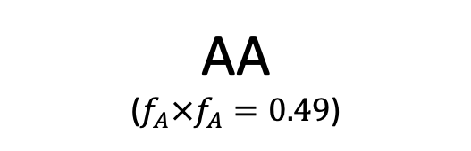

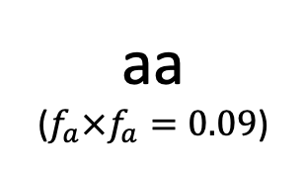

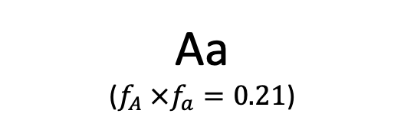

Hardy-Weinberg Equilibrium
$$f_{A}=0.7$$
$$f_{a}=0.3$$
AA
($f_{A}×f_{A}=0.49$)
Aa
($f_{A} ×f_{a}=0.21$)
$$f_{A} =0.7$$
Aa
($f_{A} ×f_{a}=0.21$)
aa
($f_{a}×f_{a}=0.09$)
$$f_{a}=0.3$$
AA (Homozygous dominant)
Aa (Heterozygous)
AA (Homozygous recessive)
$$f_{A}^{2}=0.49$$
$$2f_{A}f_{a}=0.42$$
$$f_{a}^{2}=0.09$$
$${f_{A}}^{2}+2f_{A}f_{a}+{f_{a}}^{2}=1$$
$$0.49+0.42+0.09=1$$

Slide 4
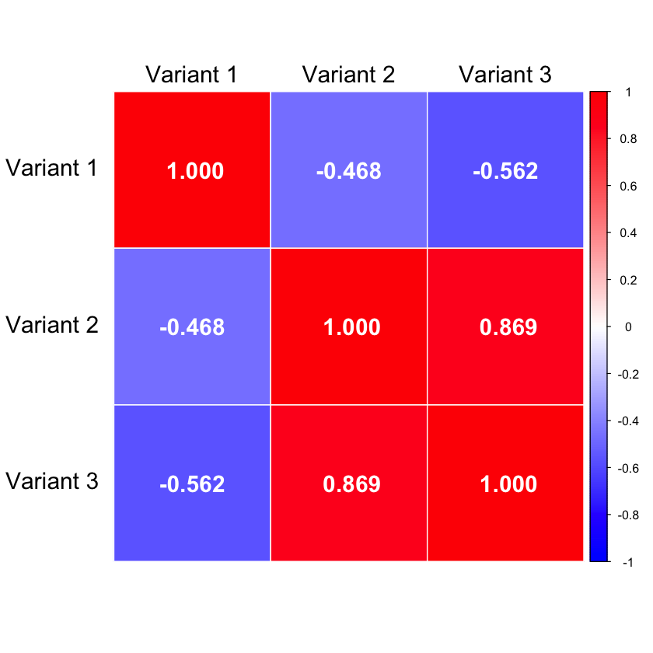
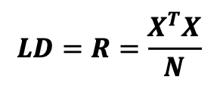
Linkage Disequilibrium (LD)
Non-random association between alleles at different genetic loci,
where certain combinations occur more or less frequently than expected by chance
Raw Genotype Matrix
Standardized Genotyped Matrix
 | Variant 1 | Variant 2 | Variant 3
Individual 1 | CC | CT | AT
Individual 2 | TT | TT | AA
Individual 3 | CT | CT | AA
Individual 4 | CC | TT | AA
Individual 5 | CC | CC | TT
 | Variant 1 | Variant 2 | Variant 3
Individual 1 | -0.671 | 0.239 | 0.447
Individual 2 | 1.565 | -0.956 | -0.671
Individual 3 | 0.447 | 0.239 | -0.671
Individual 4 | -0.671 | -0.956 | -0.671
Individual 5 | -0.671 | 1.434 | 1.565
Standardize
$$LD=R=\frac{X^{T}X}{N}$$
LD Matrix (correlation)

Slide 5
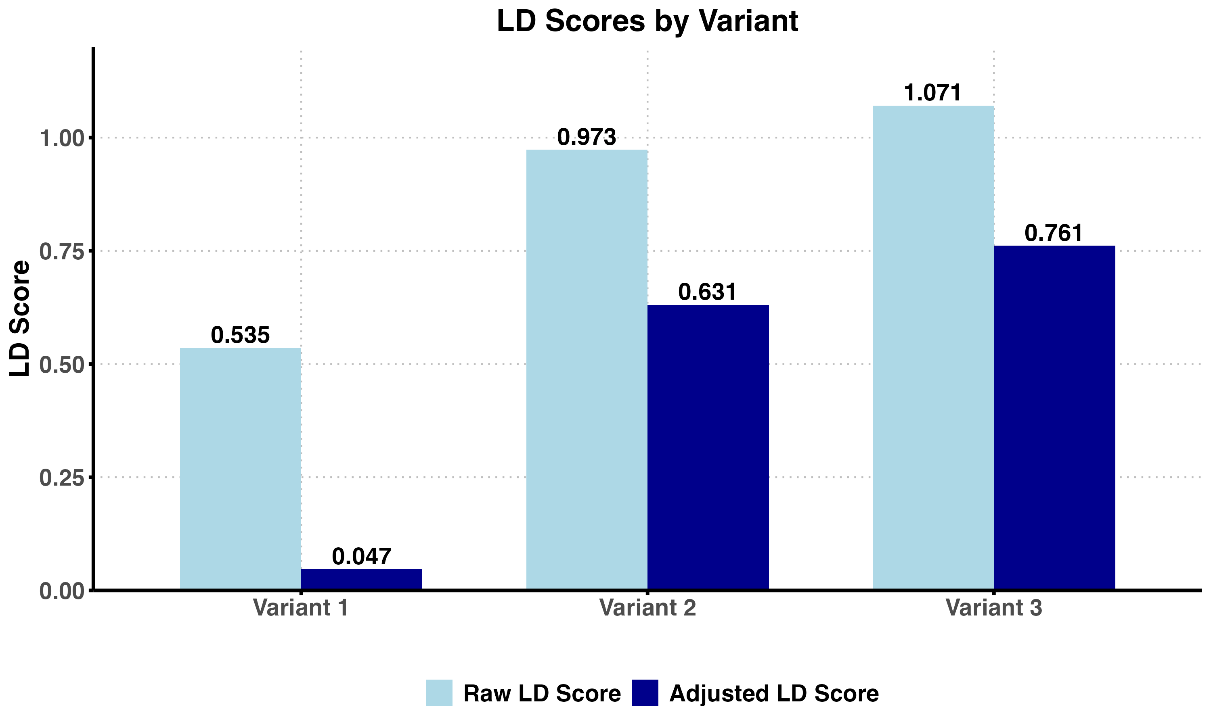

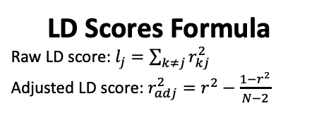



Linkage Disequilibrium (LD) Scores
LD matrix (correlation)
 | Variant 1 | Variant 2 | Variant 3
Individual 1 | CC | CT | AT
Individual 2 | TT | TT | AA
Individual 3 | CT | CT | AA
Individual 4 | CC | TT | AA
Individual 5 | CC | CC | TT
Squared Correlations ($r^{2}$)
$$r^{2}=0.219$$
$$r^{2}=0.754$$
1
2
3
$$r^{2}=0.316$$
LD Scores
LD Scores Formula
Raw LD score: $l_{j}=\sum_{k≠j}{r_{kj}^{2}}$
Adjusted LD score: $r_{adj}^{2}=r^{2}−\frac{1−r^{2}}{N−2}$
Variant 3 shows the highest connectivity.

Slide 6





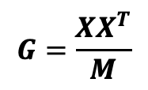
Genetic Relationship Matrix (GRM)
Quantifying Genetic Similarity Between Individuals
Population with 5 individuals
Standardized Genotyped Matrix X
 | Variant 1 | Variant 2 | Variant 3
Individual 1 | -0.671 | 0.239 | 0.447
Individual 2 | 1.565 | -0.956 | -0.671
Individual 3 | 0.447 | 0.239 | -0.671
Individual 4 | -0.671 | -0.956 | -0.671
Individual 5 | -0.671 | 1.434 | 1.565
Genetic Relationship Matrix (G)
 | Individual 1 | Individual 2 | Individual 3 | Individual 4 | Individual 5
Individual 1 | 0.236 | -0.526 | -0.181 | -0.026 | 0.498
Individual 2 | -0.526 | 1.271 | 0.307 | 0.105 | -1.157
Individual 3 | -0.181 | 0.307 | 0.236 | -0.026 | -0.336
Individual 4 | -0.026 | 0.105 | -0.026 | 0.605 | -0.657
Individual 5 | 0.498 | -1.157 | -0.336 | -0.657 | 1.652
$$G=\frac{{XX}^{T}}{M}$$

Slide 7
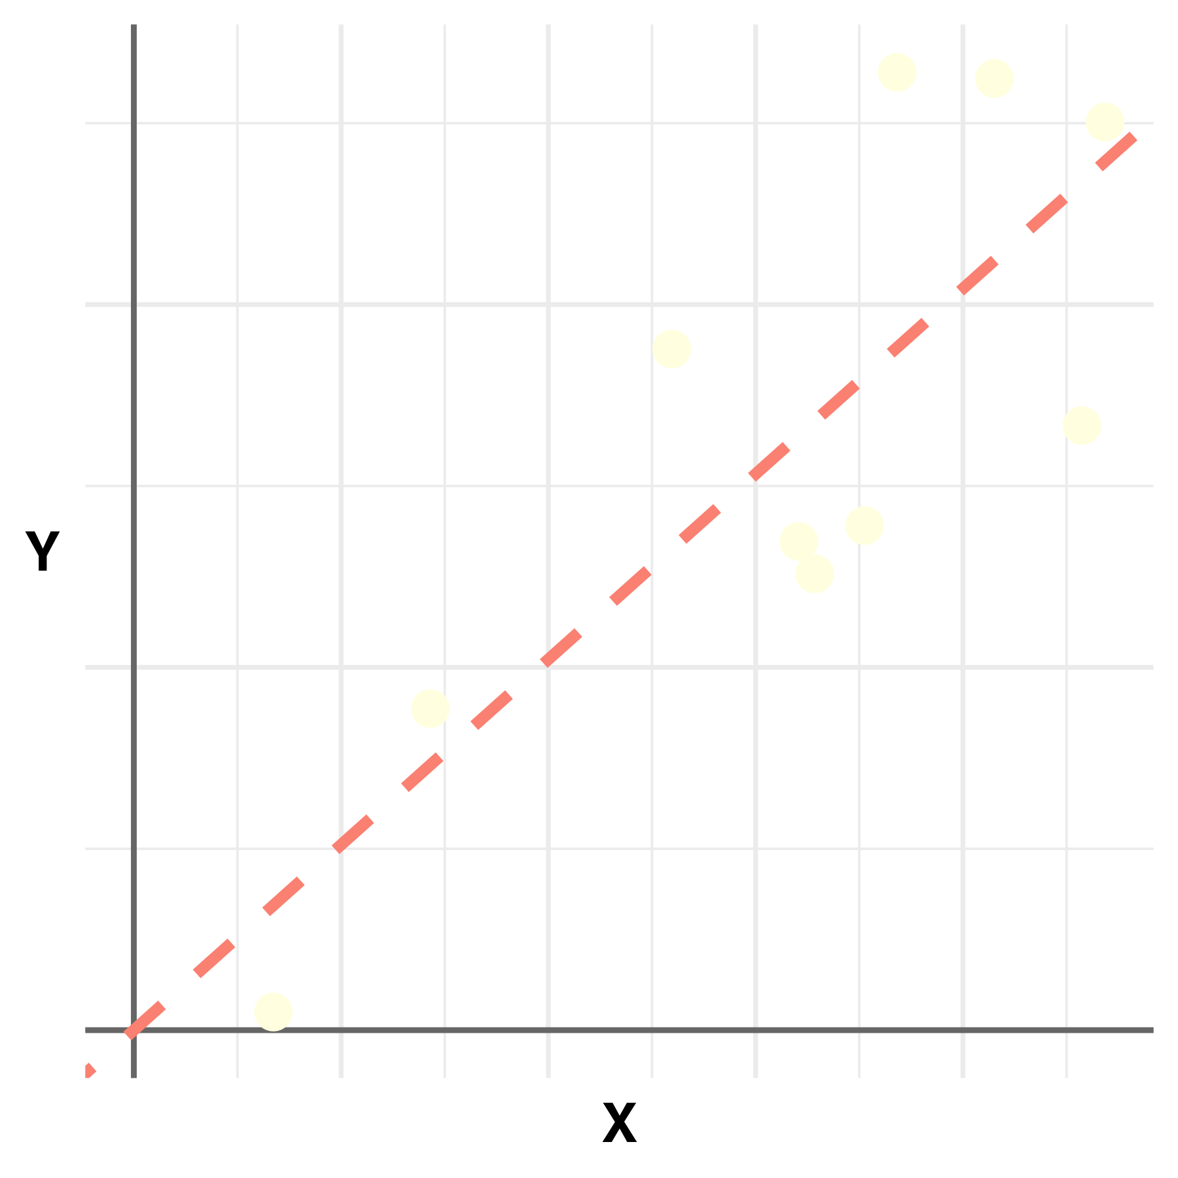
























Single Marker Linear Regression and OLS
Single Variant Regression
Ordinary Least Squares (OLS)
$$ε$$
$${\hat{β}}_{OLS}={(X_{j}^{T}X_{j})}^{−1}X_{j}^{T}Y$$
$$X_{j}$$
$$Y$$
=
$$×$$
$$β$$
+
$$\hat{β}$$
=
$$X_{j}^{T}$$
$$Y$$
$$×$$
$$×$$
$${(X_{j}^{T}X_{j})}^{−1}$$
$$N×1$$
Trait
$$N×1$$
Genotype
scalar
Genetic
Effect
$$N×1$$
Error
scalar
Genetic
Effect
Scalar
(scale for X)
$$N×1$$
Transpose of $X_{j}$
$$N×1$$
Trait
Ordinary Least Squares Visualization
Geometry Intuition
$${\hat{β}}_{OLS}$$
$$Y$$
$${\hat{β}}_{OLS}={(X_{j}^{T}X_{j})}^{−1}X_{j}^{T}Y$$
$$=\frac{|X_{j}||Y|cosθ}{{|X_{j}|}^{2}}=\frac{|Y|cosθ}{|X_{j}|}$$
$$θ$$
$$X_{j}$$
$X_{j}^{T}Y$: inner product of $X_{j}$ and $Y$
Describes how $X_{j}$ and $Y$ align
Project $Y$ to the direction of $X_{j}$
$X_{j}^{T}X_{j}$: squared length of $X_{j}$
Scale so that it is independence of ${|X}_{j}|$
OLS finds $\hat{β}$ that minimizes the sum of the squared residuals.

Slide 8
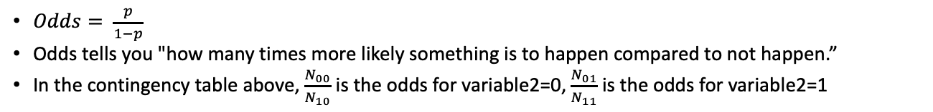

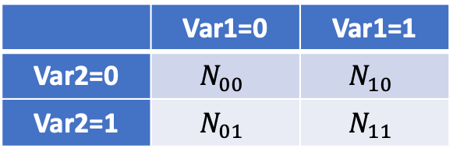
Odds, Odds Ratio and Logistic Regression
Odds ratio measures how strongly two binary variables are associated with each other.
Assume that we have two binary (0 or 1) variables, are they associated with each other?
In other words, if I see 1 for the first variable, am I more likely to see 1 for the second variable?
Question
Contingency Table
 | Var1=0 | Var1=1
Var2=0 | $$N_{00}$$ | $$N_{10}$$
Var2=1 | $$N_{01}$$ | $$N_{11}$$
Interpretation:
OR = 1: No association – two variables are independent with each other
OR > 1:
00 and 11 appears more often than 10 and 01
Positive association between two variables
OR < 1:
01 and 10 appears more often than 00 and 11
Negative association between two variables
$$OR=\frac{N_{00}×N_{11}}{N_{10}×N_{01}}$$
Examples
Hardy-Weinberg Equilibrium: Are maternal allele (A,a) and paternal allele (A,a) choices independent across the population?
Disease Studies: Are exposure (1/0) and disease status (1/0) independent?
Pathway Enrichment: Are pathway membership (1/0) and overexpression (1/0) associated?
GWAS: Are genetic variants (1/0) and trait presence (1/0) associated?
Horse Racing: Is being horse 'Jenny' (1/0) associated with winning the race (1/0)?
…
What is Odds?
$Odds= \frac{p}{1−p}$
Odds tells you "how many times more likely something is to happen compared to not happen.”
In the contingency table above, $\frac{N_{00}}{N_{10}}$ is the odds for variable2=0, $\frac{N_{01}}{N_{11}}$ is the odds for variable2=1

Slide 9
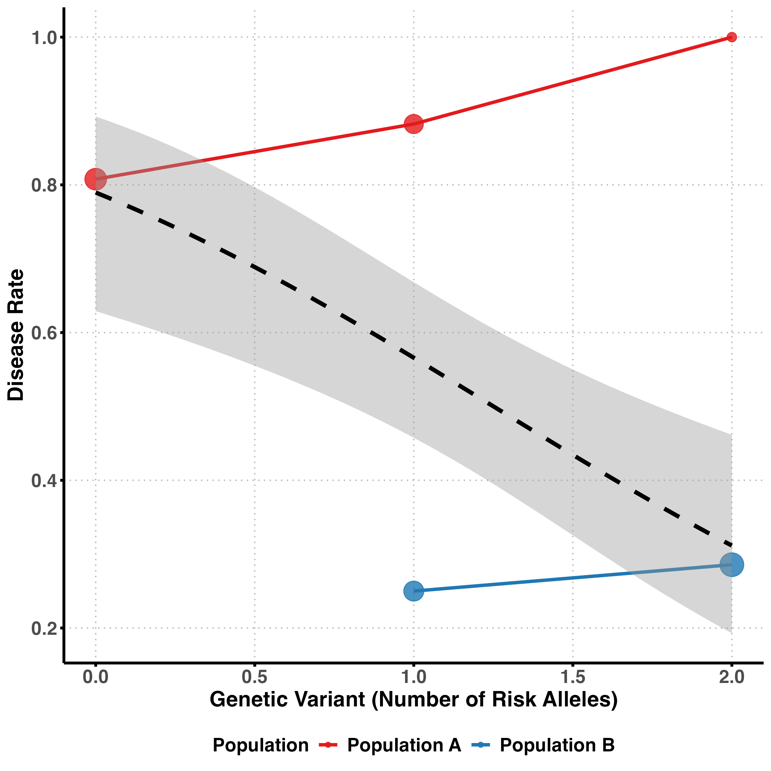









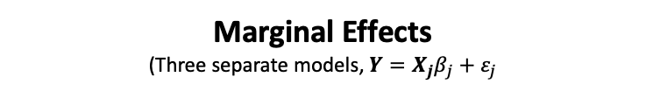























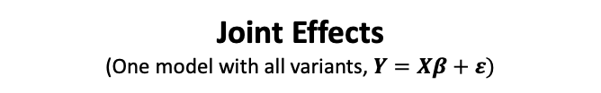

Marginal vs. Joint Effects
Marginal Effects
(Three separate models, $Y=X_{j}β_{j}+ε_{j}$
Joint Effects
(One model with all variants, $Y=Xβ+ε)$
$$X_{13}$$
$$ε$$
$$X_{11}$$
$$X_{12}$$
$$X_{11}$$
$$X_{22}$$
$$X_{21}$$
$$X_{21}$$
$$X_{23}$$
$$X_{32}$$
$$\left(\begin{matrix}β_{1} \\ β_{2} \\ β_{3}\end{matrix}\right)$$
$$X_{31}$$
$$Y$$
=
$$X_{31}$$
$$X_{33}$$
+
$$ε_{1}$$
$$Y$$
=
$$×$$
$$β_{1}$$
+
…
…
…
…
$$X_{N2}$$
$$X_{N1}$$
$$X_{N1}$$
$$X_{N3}$$
$$N×1$$
Trait
$$N×1$$
Genotype
scalar
Genetic
Effect
$$N×1$$
Error
Accounts the correlations between variants (i.e., LD)
…
Example: Simpson’s Paradox
$$X_{13}$$
$$X_{23}$$
$$X_{33}$$
$$β_{3}$$
$$Y$$
=
$$×$$
+
$$ε_{3}$$
…
$$X_{N3}$$
$$N×1$$
Trait
$$N×1$$
Genotype
scalar
Genetic
Effect
$$N×1$$
Error
Each variant is analyzed independently.

Slide 10
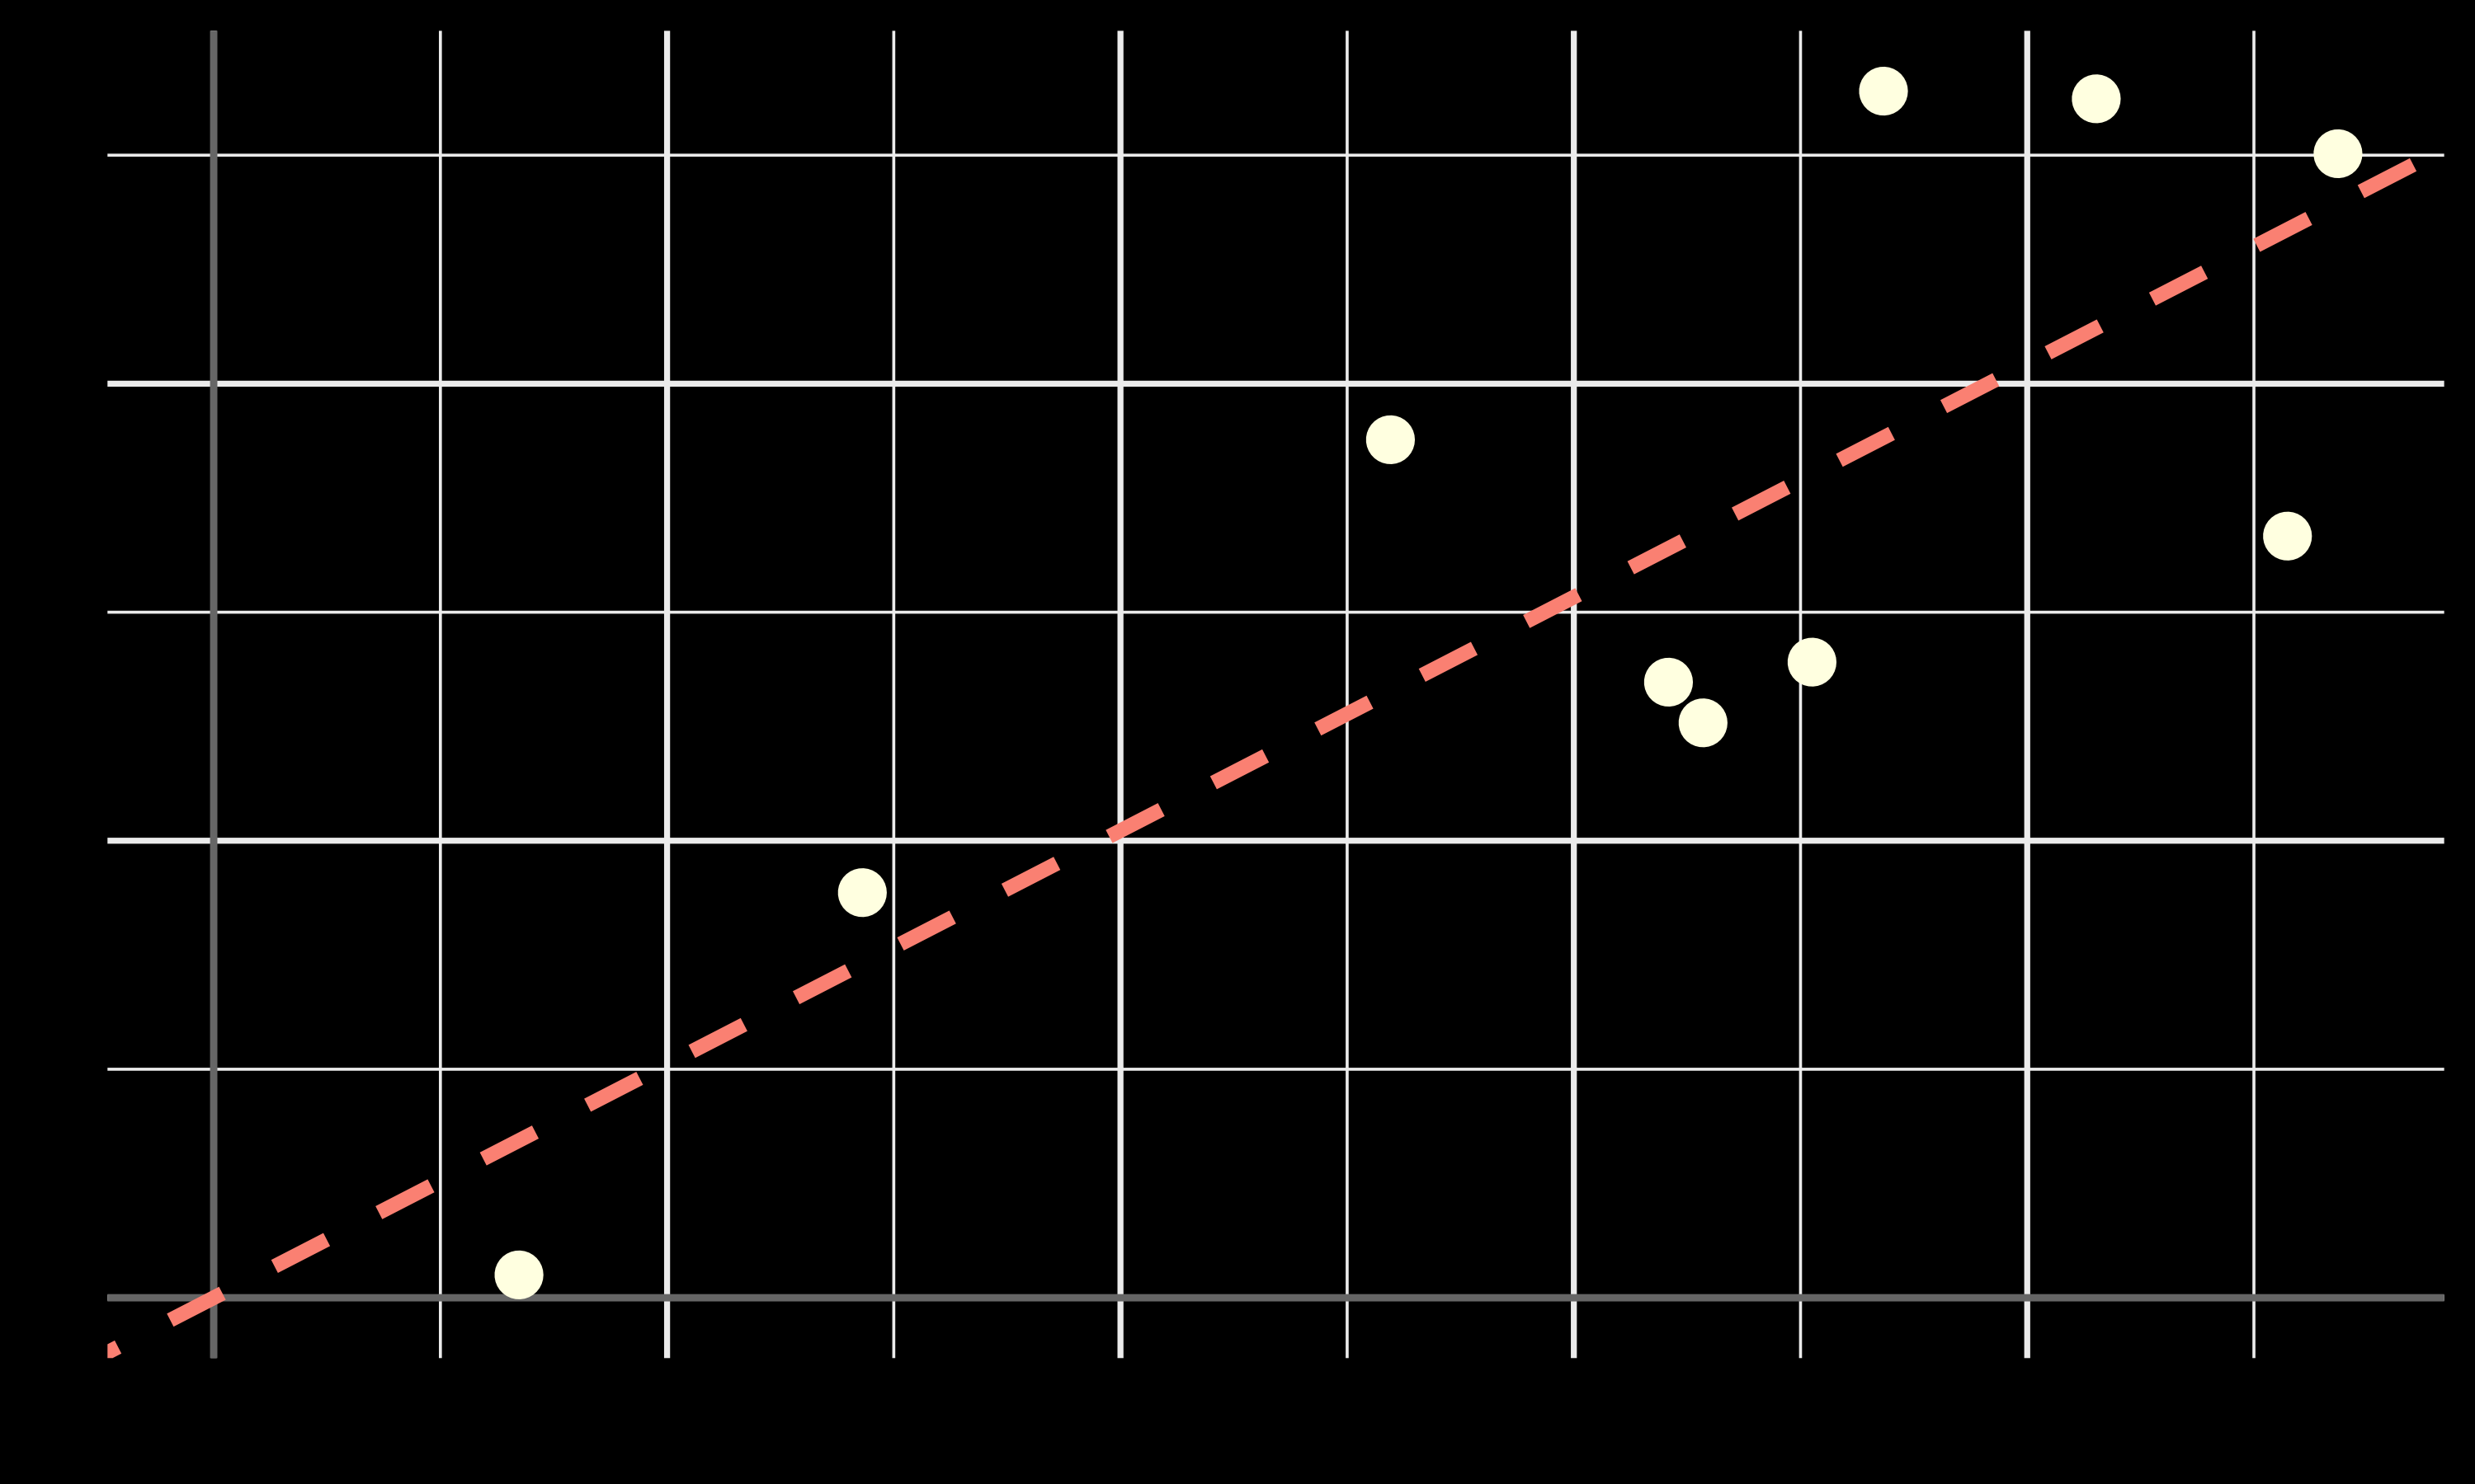
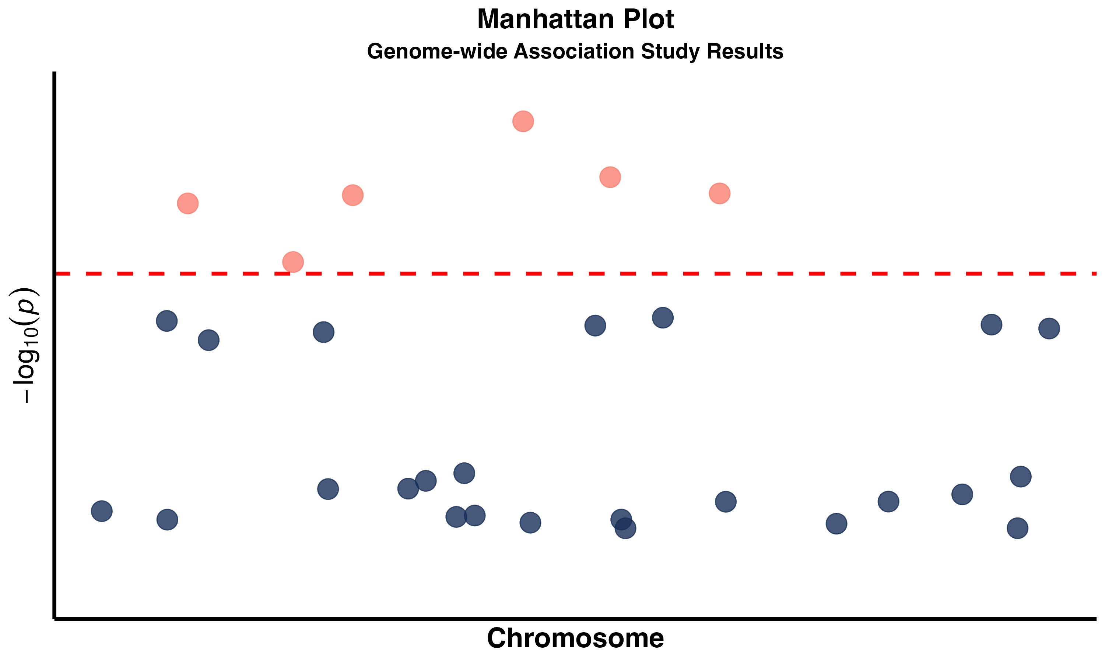












Summary Statistics
Individual-level Data
Summary Statistics
SNP | BETA | SE | Z | P | MAF
rs1 | 0.85 | 0.32 | 2.64 | 0.02 | 0.40
rs2 | -0.31 | 0.28 | -1.10 | 0.27 | 0.30
rs3 | 0.42 | 0.30 | 1.40 | 0.16 | 0.25
$$X$$
$$X_{1}$$
$$X_{2}$$
$$X_{3}$$
…
$$X_{M}$$
Test one
at a time
$$Z=\frac{\text{BETA}}{SE}$$
Millions of SNPs
$${SNP}_{1}$$
$${SNP}_{3}$$
$${SNP}_{2}$$
$${SNP}_{M}$$
Large file size (GB - TB)
Small file size (MB)
Summary statistics summarizes the key information in the individual-level data
and servers as data input for many downstream analysis.
BETA, Z and P
$\hat{β}$: a noisy measurement of the X-Y relationship, which we can use many methods (such as OLS) to estimate
Z: a standardized measurement that quantifies how many standard deviations the $\hat{β}$is away from zero
Compact Storage
MB vs. GB-TB
Privacy Protection
Fewer Constraints
Association Information
P below $5×{10}^{−8}$

Slide 11
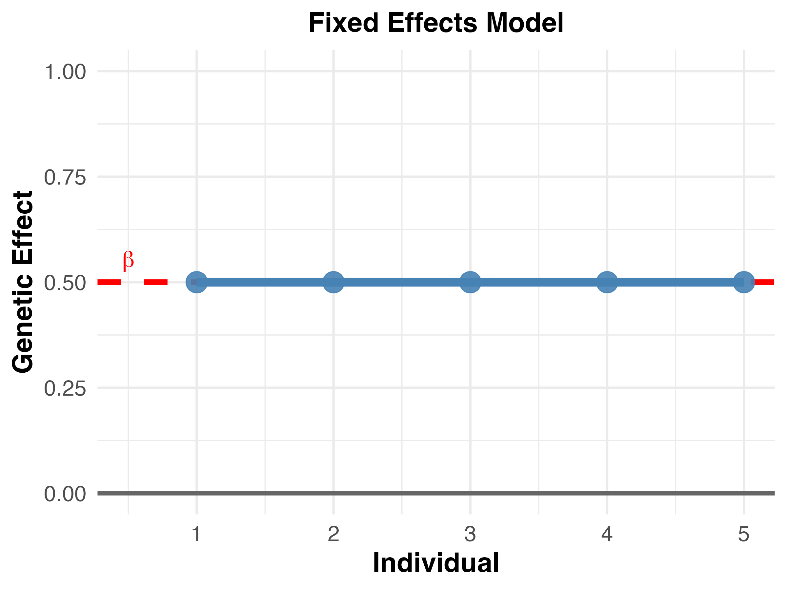
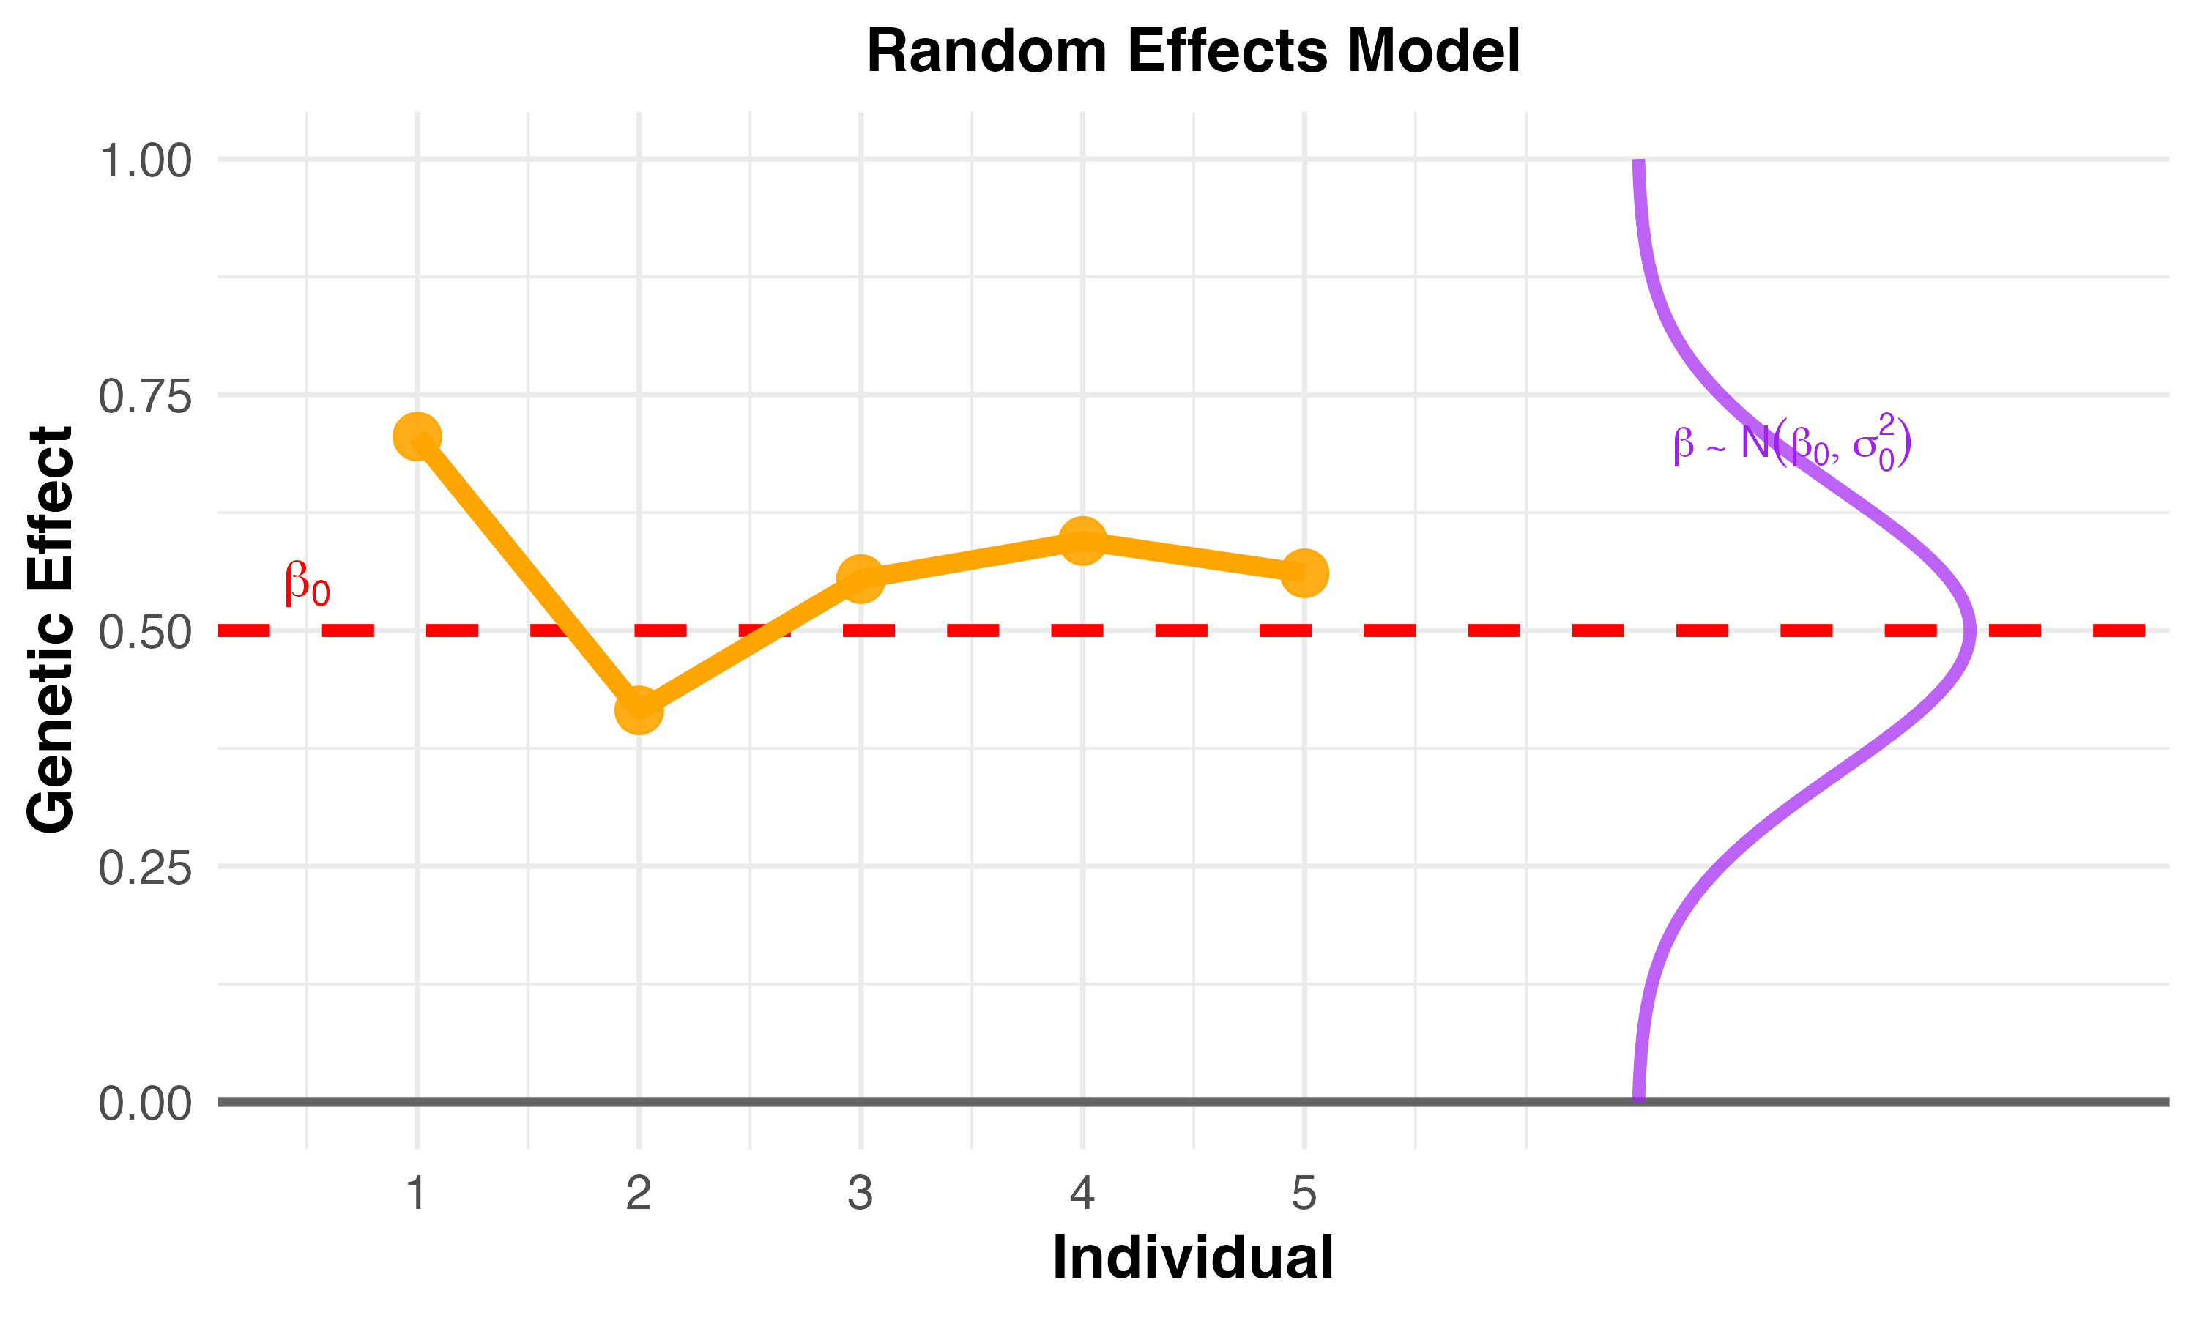

















Random Effect
Fixed Effect
Assuming that we can condition on all factors
Random Effect
Account for the uncertainty that we can never condition on all factors
$$X_{11}$$
$$X_{11}$$
$$X_{21}$$
$$X_{21}$$
=
$$X_{31}$$
+
$$ε_{1}$$
=
$$X_{31}$$
+
$$ε_{1}$$
$$Y$$
$$×$$
$$β_{1}$$
$$Y$$
$$×$$
$$β_{1}$$
…
…
$$X_{N1}$$
$$X_{N1}$$
$$N×1$$
Trait
$$N×1$$
Genotype
$$N×1$$
Error
$$N×1$$
Trait
$$N×1$$
Genotype
$$N×1$$
Error
Perfect conditioning -> Fixed effects
This is IDEAL but not realistic.
Incomplete conditioning -> Random effects
This is REALITY!

Slide 12
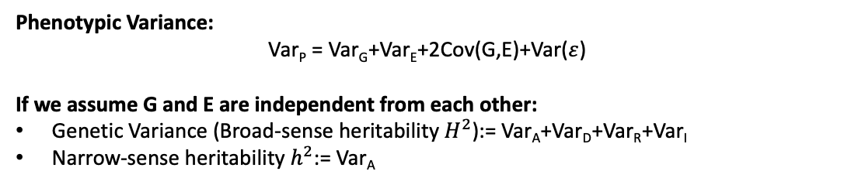
Proportion of Variance Explain (PVE) and Heritability
measures how much of the total variation in a trait (like height or disease risk) can be attributed to specific variables in the statistical model (e.g., genetic variants).
PVE and Heritability
Phenotypic Variance:
Var_{P} = Var_{G}+Var_{E}+2Cov(G,E)+Var($ε$)
If we assume G and E are independent from each other:
Genetic Variance (Broad-sense heritability $H^{2}$):= Var_{A}+Var_{D}+Var_{R}+Var_{I}
Narrow-sense heritability $h^{2}$:= Var_{A}

Slide 13










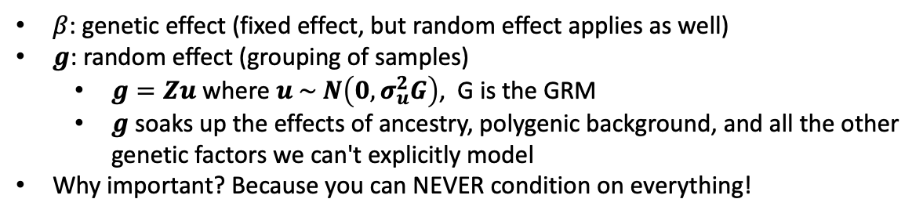


Linear Mixed Model
a practical solution to estimate genetic effect $β$:
use a random effect $g$based on genetic similarity to absorb all unmeasured heterogeneity
Key Formula
$$Y=Xβ+g+ε$$
$β$: genetic effect (fixed effect, but random effect applies as well)
$g$: random effect (grouping of samples)
$g=Zu$ where $u \sim N\left(0,σ_{u}^{2}G\right)$, G is the GRM
$g$ soaks up the effects of ancestry, polygenic background, and all the other genetic factors we can't explicitly model
Why important? Because you can NEVER condition on everything!
$$X_{11}$$
$$g_{1}$$
$$ε$$
GRM
$$X_{21}$$
$$g_{2}$$
Captures the relatedness between samples, where family/ancestry reflects shared genetics!
$$X_{31}$$
$$β_{1}$$
$$g_{3}$$
$$Y$$
=
+
+
…
…
1 | 0.5 | 0.5 | 0 | 0
0.5 | 1 | 0.5 | 0 | 0
0.5 | 0.5 | 1 | 0 | 0
0 | 0 | 0 | 1 | 0.5
0 | 0 | 0 | 0.5 | 1
$$X_{N1}$$
$$g_{N}$$
What information does $g$ include?
Population structure and ancestry differences
Polygenic effects from thousands of small-effect variants
Family relationships and shared genetic background
Gene-gene interactions we haven't discovered
Any other source of genetic similarity between individuals

Slide 14
Confounder
Example
Confounder
(Ancestry)
Allele
frequencies
Environmental factors
Genetic Variant
Trait
(Height)
Incorrect
Association
When ancestry is not controlled for in the analysis, it might create a misleading association between genotype and trait.
Common Confounders in Genetics Study
Solutions for Confounder Control
Principal Components Analysis (PCA) Control for population stratification by including top principal components as covariates in regression models
Linear Mixed Models (LMM) Use genetic relationship matrices to account for population structure and cryptic relatedness simultaneously
Stratified Analysis Perform separate analyses within homogeneous ancestry groups, then meta-analyze results across populations
Covariate Adjustment Include known confounders (age, sex, batch) as fixed effects in regression models
Family-based Tests Use transmission disequilibrium tests (TDT) or within-family analyses to control for population stratification
Population stratification/genetic ancestry
Different allele frequencies and trait values between populations (e.g., Europeans vs East Asians)
Age
Both allele frequencies and disease risk change with age; birth cohort effects
Sex
Hormonal differences, X-chromosome effects, and sex-specific genetic associations
Batch effects
Technical variation from samples processed at different times or laboratories

Slide 15
Collider
Example
Collider
(BMI)
Genetic Variant
Trait
(waist circumference)
Misleading association
We should NOT control for collider in analysis.
When the collider is controlled for in the analysis, it might create a misleading association between genotype and the other variable.
Collider bias
Common Colliders in Genetic Studies
Collider structure: X -> Collider <- Y
Conditioning effect: When you control for the collider, you're selecting specific combinations of X and Y
Induced association: This selection creates an artificial association between X and Y
Study Participation/Selection:
Genetic Risk → Study Participation ← Disease Status
Hospital Admission: Genetic Variant → Hospital Admission ← Disease Severity
Survival to Study Age: Protective Alleles → Survival ← Disease Resistance. Studying only elderly survivors can bias estimates of genetic effects on longevity.

Slide 16
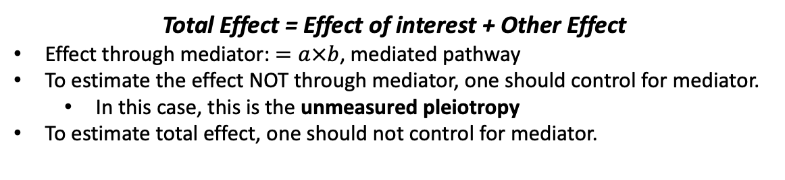

Mediator
Example
Genetic Variant
𝑎
Mediator
(Growth Hormone)
$$b$$
Trait
(Height)
Regulate
hormone production
Promotes
growth
Other Effect (e.g., through nutritional absorption)
Total Effect = Effect of interest + Other Effect
Effect through mediator: $=a×b$, mediated pathway
To estimate the effect NOT through mediator, one should control for mediator.
In this case, this is the unmeasured pleiotropy
To estimate total effect, one should not control for mediator.
Intuition
A variable that explains HOW a genetic variant affects an outcome by lying in the causal pathway between them.
Key Principle
Controlling for a mediator removes the indirect effect
When to Suspect Mediation
SNP significantly associated with both mediator and outcome
SNP effect on outcome reduces/disappears when controlling for mediator
Biologically plausible pathway exists
Common Examples
SNP → Gene Expression → Disease
SNP → Protein Levels → Trait
SNP → Metabolites → Phenotype

Slide 17


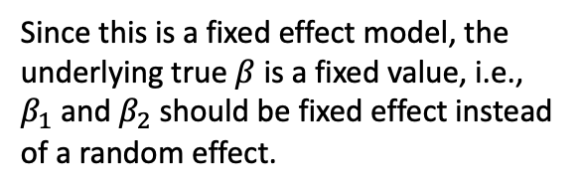


Meta-Analysis Fixed Effect
Synthesizes statistical evidence across multiple independent studies using weighted averaging techniques
Several Independent Cohorts
Sumstats 1
$$β_{1}$$
$${SE}_{1}$$
$$N_{1}$$
$$…$$
Study 2
N2=8,000
Sumstats 2
$$β_{2}$$
$${SE}_{2}$$
$$N_{2}$$
$$…$$
Study 1
N1=5,000
What we believe about $β_{1}$ and $β_{2}\text{?}$
Since this is a fixed effect model, the underlying true $β$ is a fixed value, i.e.,
$β_{1}$ and $β_{2}$ should be fixed effect instead of a random effect.
Meta-Analysis
Equivalent to:
Merged set
N=13,000
Equivalent to merging individuals from two studies together
$\hat{β}=\frac{\sum_{k}{w_{k}{\hat{β}}_{k}}}{\sum_{k}{w_{k}}}$
$w_{k}$ is the weight for study $k$, for example, Inverse Variance Weighting:
$$w_{k}=\frac{1}{{SE}_{k}^{2}}$$

Slide 18
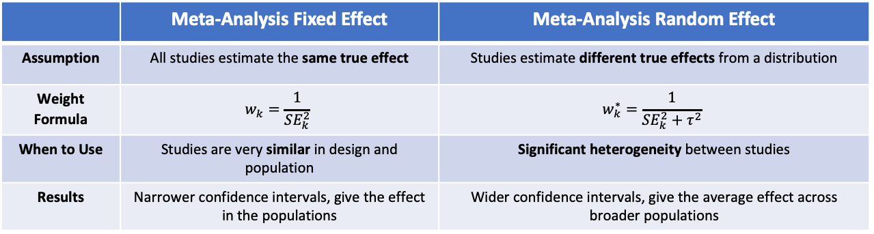
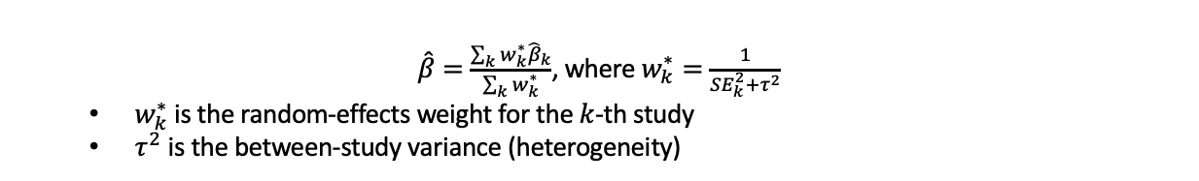
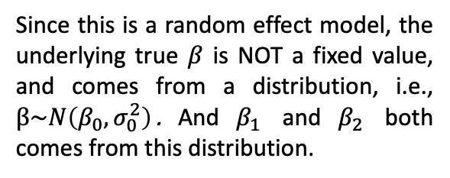

Meta-Analysis Random Effect
Synthesizes statistical evidence across multiple independent studies assuming the true effect is random
Several Independent Cohorts
Sumstats 1
$$β_{1}$$
$${SE}_{1}$$
$$N_{1}$$
$$…$$
Study 2
N2=8,000
Sumstats 2
$$β_{2}$$
$${SE}_{2}$$
$$N_{2}$$
$$…$$
Study 1
N1=5,000
What we believe about $β_{1}$ and $β_{2}\text{?}$
Since this is a random effect model, the underlying true $β$ is NOT a fixed value, and comes from a distribution, i.e., $β\sim N\left(β_{0},σ_{0}^{2}\right)$. And $β_{1}$ and $β_{2}$ both comes from this distribution.
Meta-Analysis
$\hat{β}=\frac{\sum_{k}{w_{k}^{∗}{\hat{β}}_{k}}}{\sum_{k}{w_{k}^{∗}}}$, where $w_{k}^{∗}=\frac{1}{{SE}_{k}^{2}+τ^{2}}$
$w_{k}^{∗}$ is the random-effects weight for the $k$-th study
$τ^{2}$ is the between-study variance (heterogeneity)
 | Meta-Analysis Fixed Effect | Meta-Analysis Random Effect
Assumption | All studies estimate the same true effect | Studies estimate different true effects from a distribution
Weight Formula | $$w_{k}=\frac{1}{{SE}_{k}^{2}}$$ | $$w_{k}^{∗}=\frac{1}{{SE}_{k}^{2}+τ^{2}}$$
When to Use | Studies are very similar in design and population | Significant heterogeneity between studies
Results | Narrower confidence intervals, give the effect in the populations | Wider confidence intervals, give the average effect across broader populations

Slide 19
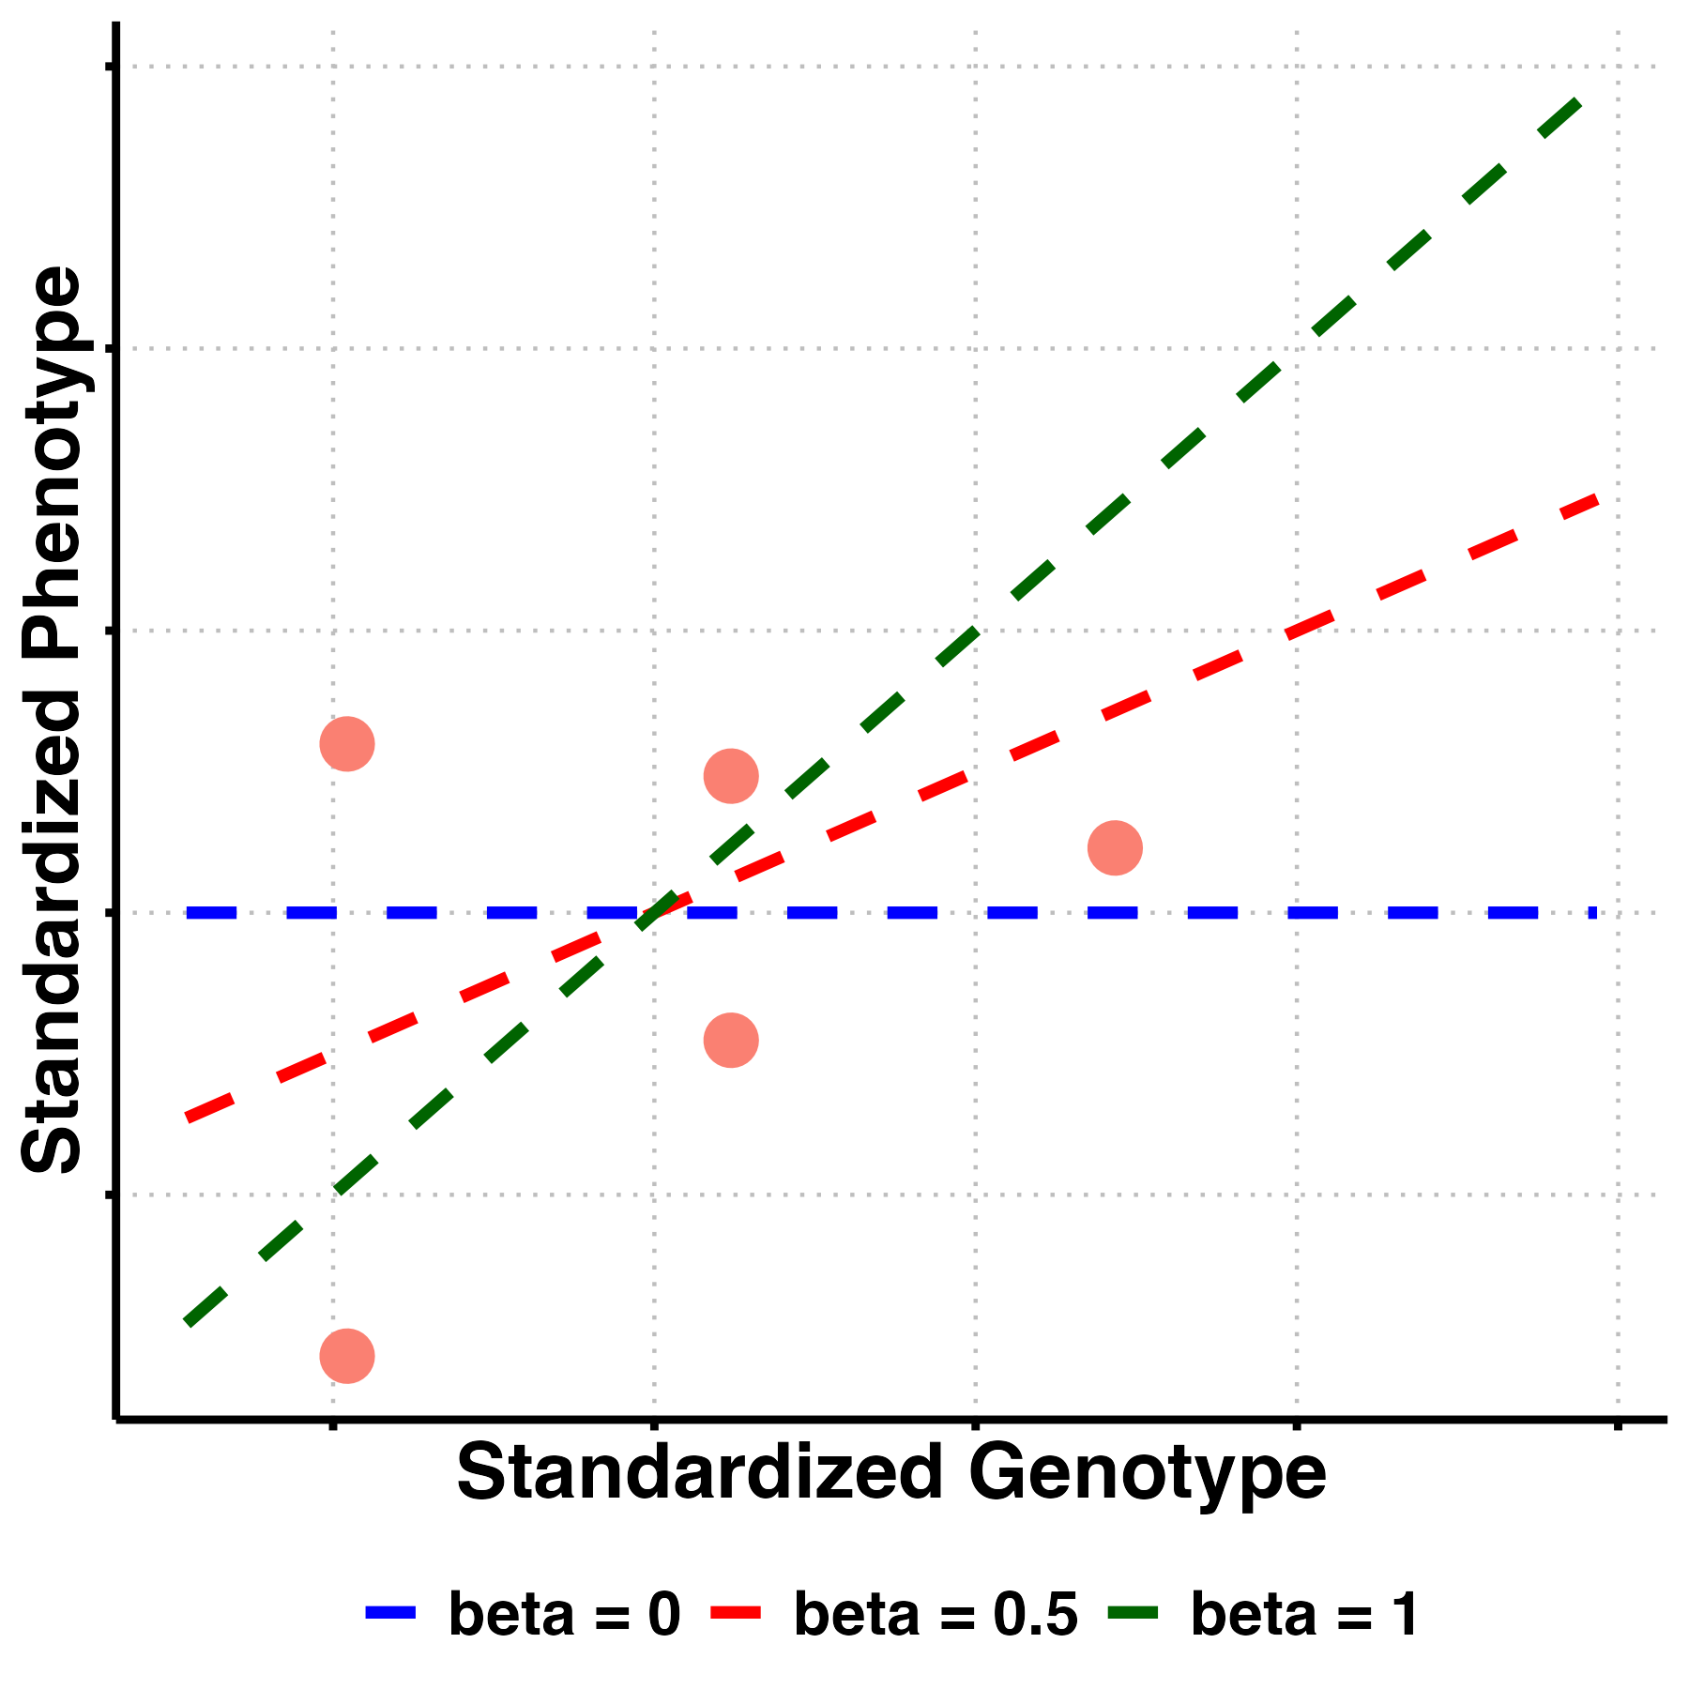
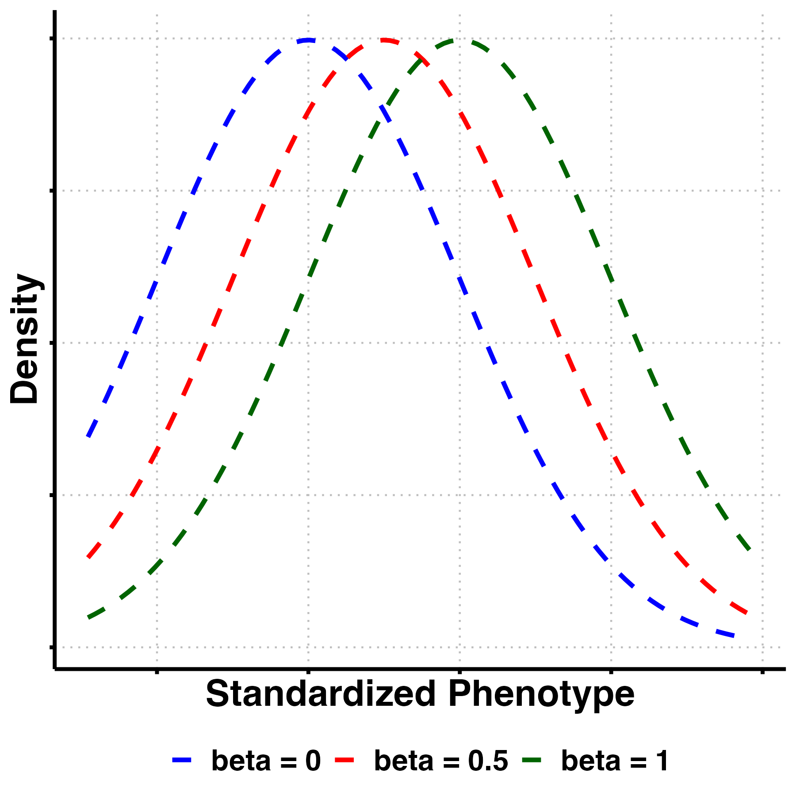







Likelihood
Finding the best model to explain the data
1. Three Competing Models
2. Observe Data
$$M_{3}$$
Model 1
$$β=0$$
No effect
$$M_{2}$$
Model 2
$$β=0.5$$
Moderate effect
$$M_{1}$$
Model 3
$$β=1.0$$
Strong effect
3. Likelihood Function
4. Likelihood Calculation
$$ℒ\left(M | D\right)=P\left(D | M\right)$$
$ℒ$: the likelihood function for model M under data D
M: the model
D: the observed data
P(D|M): the probability of observing data D given the model M

Slide 20
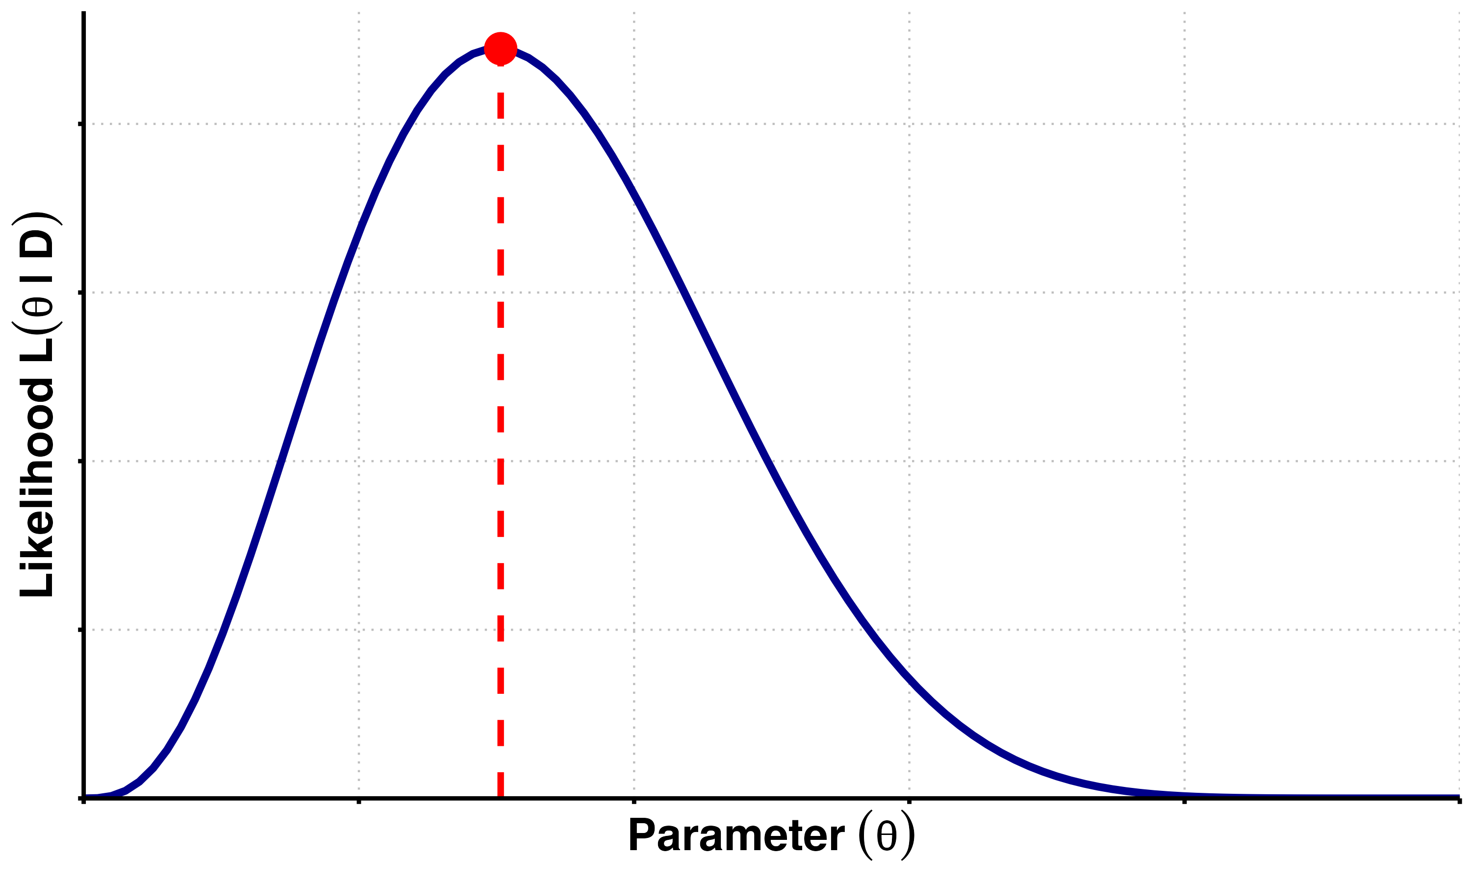
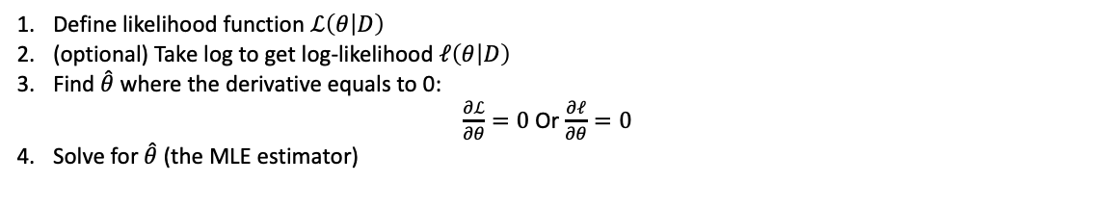
Maximum Likelihood Estimation (MLE)
Find parameter values that maximize the likelihood function
Likelihood Function and MLE
Key Steps
Define likelihood function $ℒ\left(θ | D\right)$
(optional) Take log to get log-likelihood $ℓ\left(θ | D\right)$
Find $\hat{θ}$ where the derivative equals to 0:
$\frac{∂ℒ}{∂θ}=0$Or $\frac{∂ℓ}{∂θ}=0$
Solve for $\hat{θ}$ (the MLE estimator)
Properties
Consistent – Converges to the true parameter as sample size increases
Asymptotically Efficient – Achieves lowest possible variance among unbiased estimators (attains the Cramér-Rao bound)
Asymptotically Normal – Distribution approaches normality as sample size grows
Invariant – MLE of a function of the parameter is the function of the MLE
No Closed-Form in General – Often requires numerical optimization

Slide 21
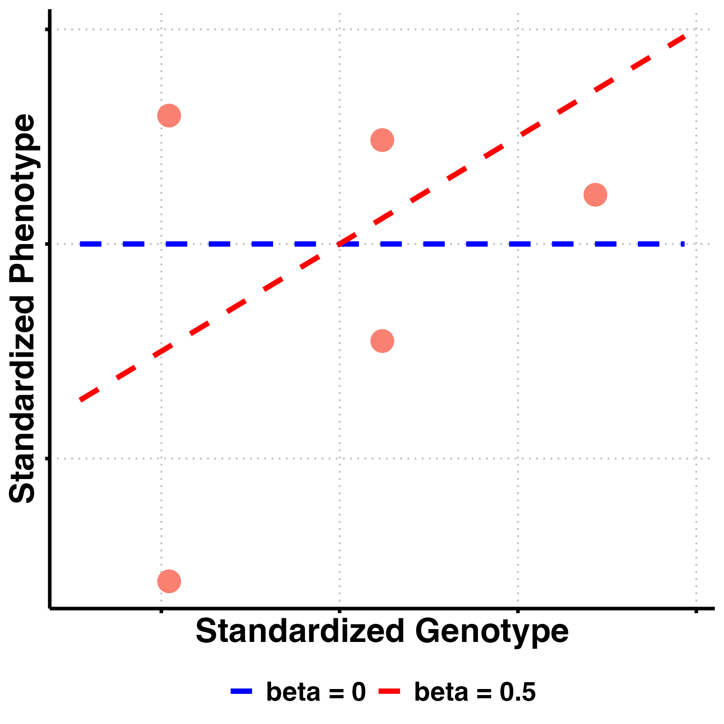
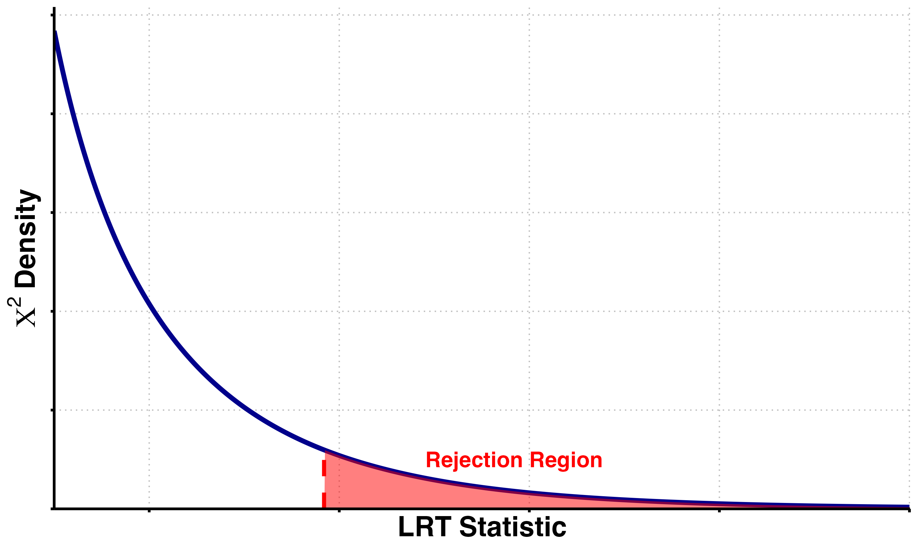

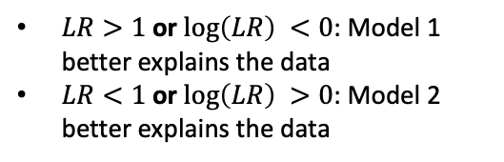
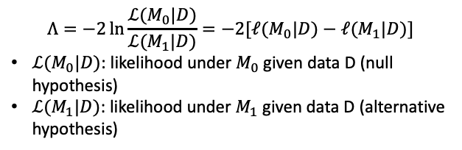





Likelihood Ratio and Likelihood Ratio Test
Compare the likelihoods for two models
1. Two Competing Models
2. Which Model Fits Best?
$$M_{2}$$
Model 1
$$β=0$$
No effect
$$M_{1}$$
Model 2
$$β=0.5$$
Moderate effect
3. Likelihood Ratio Calculation
Likelihood Ratio Test
$$Λ=−2\ln{\frac{ℒ(M_{0}|D)}{ℒ(M_{1}|D)}}=−2[ℓ{{(M}_{0}|D)}−ℓ{{(M}_{1}|D)}]$$
$ℒ(M_{0}|D)$: likelihood under $M_{0}$ given data D (null hypothesis)
$ℒ(M_{1}|D)$: likelihood under $M_{1}$ given data D (alternative hypothesis)
Likelihood Ratio:
$$LR=\frac{ℒ(M_{1}|D)}{ℒ\left(M_{2} | D\right)}$$
or equivalently, calculate log-likelihood
$$\log\left(LR\right)$$
$Λ$ asymptotically follows $χ^{2}$ distribution
degree of freedom (df) $=\dim\left(Θ_{1}\right)−\dim\left(Θ_{0}\right)$
Large $Λ$ values lead to the rejection of $H_{0}$
$LR>1$ or $\log\left(LR\right) <0$: Model 1 better explains the data
$LR<1$ or $\log\left(LR\right) >0$: Model 2 better explains the data

Slide 22
Being a Frequentist is all about evaluating what happens if I do this procedure in long-run practice across a population of situations, and choosing procedures that work well across this population; then, when faced with one real situation, assume that this one situation is randomly drawn from all possible situations; subtleties involve conditioning on observed aspects of the real situation to choose more apposite procedures. Bayesians attempt to condition on everything that is known, implying that everything that is unknown has a distribution.
--- Donald Rubin

Slide 23





Bayes Rule
Start with what you believe (prior), update it with what you see (likelihood), and get a new belief (posterior).
Being a Frequentist is all about evaluating what happens if I do this procedure in long-run practice across a population of situations, and choosing procedures that work well across this population; then, when faced with one real situation, assume that this one situation is randomly drawn from all possible situations; subtleties involve conditioning on observed aspects of the real situation to choose more apposite procedures. Bayesians attempt to condition on everything that is known, implying that everything that is unknown has a distribution.
--- Donald Rubin
Key formula
$$P\left(θ | D\right)=\frac{P(D|θ)×P(θ)}{P(D)}$$
$P\left(θ | D\right)$: the posterior (probability of parameter $θ$given data D)
$P\left(D | θ\right):$ the likelihood (probability of observing data D given parameter $θ$)
$P\left(θ\right):$ the prior (initial belief about parameter $θ$)
$P(D)$: the evidence/marginal likelihood (total probability of observing data D)
Prior
$$×$$
Data
Posterior
Bayes’ Rule Components: Prior, Likelihood, Posterior
Prior belief favored no effect: Started with 60% confidence in Model 1 ($β=0$)
Data supported moderate effect: Likelihood was highest for Model 2 ($β=0.5$)
Posterior balanced both sources: Final belief is 60.5% for Model 1, 34.6% for Model 2
Strong priors resist change: Despite data favoring Model 2, Model 1 remained most probable (because small sample size)
Bayes rule shows how prior knowledge and new data combine - strong priors require strong evidence to overcome.

Slide 24


Bayes Factor
The ratio of two marginal likelihoods, which generalizes the likelihood ratio by integral.
Definition
The Bayes factor is the ratio of two marginal likelihoods; that is, the likelihoods of two statistical models integrated over the prior probabilities of their parameters.
Key Formula
$${BF}_{21}=\frac{L(M_{2}|D)}{L(M_{1}|D)}=\frac{\int{\operatorname{Pr}\left(θ_{2} | M_{2}\right)Pr⁡(D|}θ_{2},M_{2})ⅆθ_{2}}{\int{\operatorname{Pr}\left(θ_{1} | M_{1}\right)}Pr⁡(D|θ_{1},M_{1})ⅆθ_{1}}$$
$L(D|M_{1})$, $L(D|M_{2})$: the likelihood of Model 1 and 2 given data D
$θ_{1}$, $θ_{2}$: model-specific parameters under Model 1 and 2, respectively
$\operatorname{Pr}\left(θ_{1} | M_{1}\right)$, $\operatorname{Pr}\left(θ_{2} | M_{2}\right)$: the prior distributions over the parameters under each model.
$Pr⁡(D|θ_{1},M_{1})$, $\operatorname{Pr}\left(D | θ_{2},M_{2}\right):t$he likelihood of the data D given parameters and the model.
Bayes Factor vs. Likelihood Ratio Test
 | Bayes Factor (BF) | Likelihood Ratio Test (LRT)
Definition | Ratio of marginal likelihoods (integrated over priors) | Ratio of likelihoods at MLEs (maximum likelihood estimates)
Formula | $$\frac{L(M_{2}|D|)}{L(M_{1}|D|)}$$ | $$\frac{\max_{θ_{1}}{P(D|}θ_{1},M_{1})}{\max_{θ_{2}}{P(D|}θ_{2},M_{2})}$$
Treatment of Parameters | Integrates over parameter space using prior $\operatorname{Pr}\left(θ | M\right)$ | Uses fixed parameter estimates (point estimates)
Includes Prior Information | Yes | No
Interpretation | Posterior odds / prior odds | Hypothesis testing via test statistic distribution
Model Comparison Type | Bayesian | Frequentist

Slide 25


Bayesian Normal Mean Model
Posterior = our prior belief about a normal distribution's mean + observed data
The Bayesian normal mean model takes your initial guess about a parameter and adjusts it based on new data, with the final estimate being a weighted average that depends on how confident you were initially versus how informative the data is.
Model Setting
$$Y=Xβ+ε$$
$Y$: phenotype vector (i.e., height)
$X$: genotype vector (considered as just a coefficient of $β$ because for each individual it is fixed)
$β$: genetic effect size (unknown, to be estimated) and the prior distribution is $β \sim 𝒩\left(β_{0},σ_{0}^{2}\right)$ and $τ_{0}=\frac{1}{σ_{0}^{2}}$
The posterior distribution is $β|Y \sim 𝓝(β_{1},σ_{1}^{2})$ where $β_{1}=\frac{τXY+τ_{0}β_{0}}{τX^{2}+τ_{0}}$, $σ_{1}^{2}=\frac{1}{τ+τ_{0}}$
Prior, Likelihood and Posterior

Slide 26


Bayesian Multivariate Normal Mean Model
Posterior = our prior belief about a multivariate normal distribution's mean + observed data
Key: considers the correlation between variables
The Bayesian multivariate normal mean model allows us to simultaneously learn about multiple related mean parameters by combining our prior beliefs with observed data, where the model naturally accounts for correlations between the parameters and updates our uncertainty about each mean based on how much information the data provides.
Key Formula
In the bivariate normal mean model, if the prior is
$$β=\left({β_{a} \atop β_{b}}\right)\sim 𝒩\left(\left({β_{a,0} \atop β_{b,0}}\right), \left(\begin{matrix}σ_{a,0}^{2} & ρ_{0}σ_{a,0}σ_{b,0} \\ ρ_{0}σ_{a,0}σ_{b,0} & σ_{b,0}^{2}\end{matrix}\right)\right)$$
And with observed data D, the posterior is:
$$β|D=\left({β_{a} \atop β_{b}}\right)|D\sim 𝒩\left(\left({β_{a,1} \atop β_{b,1}}\right), \left(\begin{matrix}σ_{a,1}^{2} & ρ_{1}σ_{a,1}σ_{b,1} \\ ρ_{1}σ_{a,1}σ_{b,1} & σ_{b,1}^{2}\end{matrix}\right)\right)$$
Example
• Bayesian learning: Prior beliefs (blue) update to posterior (red) after observing data
• Uncertainty reduction: Posterior contours are tighter, showing less uncertainty
• Balanced compromise: Posterior mean balances prior beliefs with data evidence
• Correlation structure: Elliptical shape captures parameter relationships
• Learning from data: Posterior moves closer to true effects (green)

Slide 27



Bayesian Mixture Model
A Bayesian mixture model assumes that parameters come from a weighted combination of different distributions rather than a single distribution, allowing the model to automatically identify and handle heterogeneity in parameter types while providing uncertainty quantification about which component each parameter belongs to.
Key Formula
$$p\left(β\right)=\sum_{c=1}^{C}{π_{c}p_{c}(β)}$$
$β$ comes from a weighted sum of $C$ different distributions (components), each with weight $π_{c}$
$π_{c}$: mixture weight for the $c$-th component, $\sum_{c=1}^{C}{π_{c}}=1$
$p_{c}\left(β\right)$: probability density function of the $c$-th component
Why important? Genetic architectures naturally have multiple classes of effects.
Example

Slide 28

Bayesian Model Comparison
Bayesian model comparison evaluates competing models by measuring how well they predict observed data while accounting for model complexity, which is reflected in how broadly the prior distribution spreads probability across the parameter space.
Workflow
Prior
Posterior
Model
Comparison
Data
+
• Model Selection: Posterior odds = Bayes Factor × Prior odds. With equal priors, BF directly gives model preference
• Conjugate Case: When prior and likelihood are conjugate, marginal likelihood has closed-form solution
• Non-conjugate Case: Requires numerical integration (grid methods, MCMC, variational Bayes, etc.)
• Computational Challenge: Real GWAS with millions of variants needs efficient approximation methods

