Slide 1

Monty Carlo - Code for the Simulation of Particle Transport in Python
Rui Campos¹, Pedro Teles²
¹Department of Physics and Astronomy, Faculty of Sciences of the University of Porto, Porto, Portugal
²Department of Physics and Astronomy, Faculty of Sciences of the University of Porto, Porto, Portugal
1. Introduction
Monty Carlo (MyCo) is an experimental general purpose simulation code of particle transport. This work serves as a proof of concept for the development of an MC simulation whose front-end experience is provided by a high level interpreted language. The idea of writing such a code entirely in a high level interpreted language is not new, but progress has been slow or rather non-existent due to legitimate concerns over the computational speed capacities of such languages. MyCo shows that such problems can be readily addressed through the use of mature tools offered by the Python community as well as the clever adaptations of algorithms developed by the Computer Graphics Scientific Community.

Slide 2
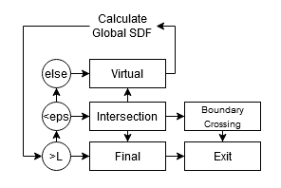
2. Materials and Methods
2.2. Particle Transport Trough Space
MyCo has a custom made particle transport algorithm that is suitable for MC simulations. It is an hybrid between ray and sphere tracing [4, 5]. The path length between the numerous electron interactions is very small. Performing intersection tests is therefore very expensive. This algorithm consists in calculating the distance to the nearest surface and determining if it is safe for the particle to move without intersecting any surface.
2.1. Cython Back-End
The first step in ensuring that MyCo could compete with the computational speed of codes like PENELOPE (FORTRAN) [1], Geant4(C++) [2] was to have its backend written in a low level language. However, this would take from developers the advantages that Python offers them (fast developing time, high productivity, etc…).
Cython[3] is the ideal compromise. It is a superset language of Python that allows for an optional low level syntax inspired by C. Cython code gets translated to C and is compiled to an executable that the Python interpreter treats as a normal python module. Additionally, when time is truly critical, external C/C++ code can be embedded in a Cython module.
Global SDF: Function that calculates the safest distance.
L: Distance proposed by the physics engine.
Virtual: Particle displacement that is not visible to the physics engine (will not be tallied).
Final: Particle displacement that places the particle in its final position.
Boundary Crossing: Algorithm that explores the Bounding Volume Hierarchy.
Figure 1. Flow chart of the ray/sphere tracing hybrid.

Slide 3
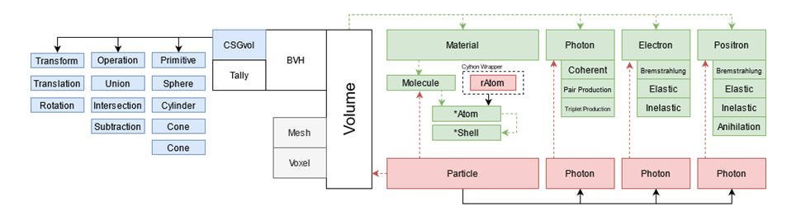
2. Materials and Methods
2.4. Tallying
The results present in this poster presentation were obtained with a simple tally that subdivides space with planes oriented in the z-direction. Each plane is separated by dz = 0.001cm, forming a volumetric region representing bins. Photons and electrons that are found to be bellow threshold (10keV for photons, 100keV for electrons) deposit their energy in the bin containing their current location (local deposition). Electrons deposit their energy continuously using a linear approximation to the stopping power between steps. Electrons of 25, 50, 100 and 150 MeV were simulated in Gold, emitted by a unidirectional point source located within the tally (z = 10cm).
2.3. Physics, Software and Data
Most of the random sampling has been based on previous works. For example:
Atomic Relaxation: C++ implementation using EADL[6] vacancy transition probabilities.
Compton: Based on the EGSrnc[7] and Geant4 implementation.
Electron Condensed History: Reproduced from PENELOPE’s class II simulation scheme[8].
GOS model: Generalized Oscillator model adapted from PENELOPE[9].
MyCo uses the high quality pseudo random number generator, MIXMAX[10], developed by Dr. Konstantin.
Data was extracted from EADL/EPDL/EEDL and from Geant4 repositories.
Figure 2. Class structure of MyCo. (Blue: CSG implementation; purple: data classes; green: particle implementation, gray: to be implemented). Solid line between A and B indicate that B inherits from A. Red dashed lines indicate void pointers from held in an instance of A, pointing to an instance to B. Green dashed lines from A to B indicate that instances of A hold a python object reference to instances of B.

Slide 4
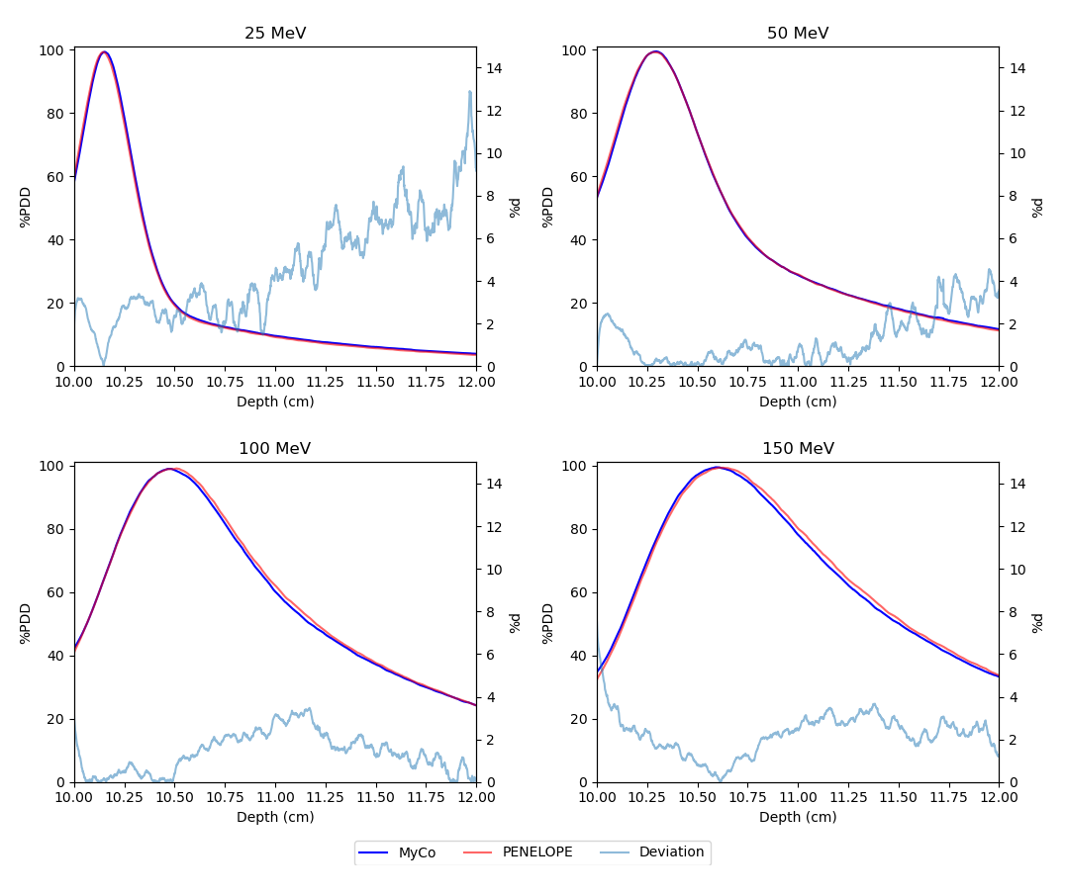
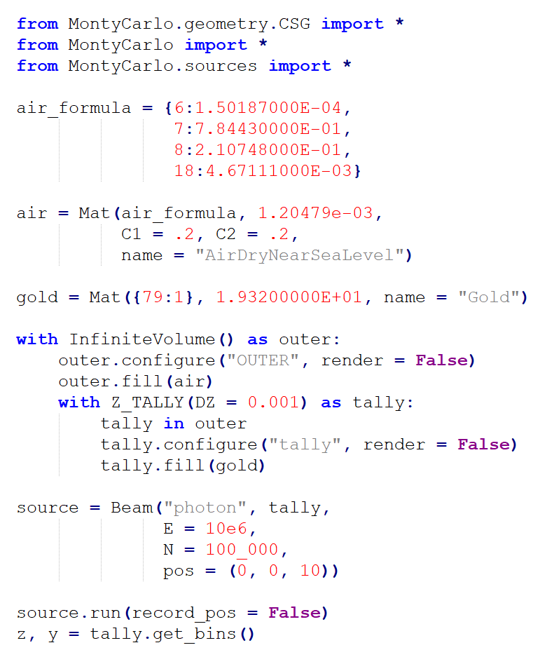
3. Results and Discussion
Figure 3 shows the flexibility of Pythons syntax. The indentations of the ‘with’ statements are used to give the user a strong visual cue of the BVH that is being constructed. Each volume may be rendered, in which case the generated triangular mesh is stored in a .obj file.
Instances of Material are stored automatically when first created. Each material only compiles once.
Results from the Z_TALLY are similar (within 4% deviation) to its equivalent tally in penEasy.
Figure 4. Results from the Z_TALLY and penEasy tally1DdoseDistribution, All data was fed to an average filter. In each graph, the deviation near the peak is 0-4%. Larger deviations are seen consistently at larger depths where convergence hasn’t been reached.
Figure 3. Minimum code to reproduce one of the graphs in figure 4.

Slide 5
4. Conclusion
MyCo has successfuly shown that monte carlo simulations are possible in the context of an interpreter. Since Python is one of the most widely used programming languages in the world, MyCo opens up the field of MC simulations in Medical Physics to a much wider audience. In its current form, it is intended as a stepping stone for students, so that they can learn about MC simulations without requiring them to have advanced programming skills from the get go. A comparison of PDD results obtained with MyCo and PENELOPE show agreement (< 4% deviation) in regions with satisfactory convergence of results. As an evolving project, it has the potential to grow into a mature tool for radiation and medical physics application simulations in the future.
5. References
[1] Salvat, F., Fernández-Varea, J. M., & Sempau, J. (2006, July). PENELOPE-2006: A code system for Monte Carlo simulation of electron and photon transport. In Workshop proceedings (Vol. 4, No. 6222, p. 7). Universitat de Barcelona.
[2] Agostinelli, S., Allison, J., Amako, K. A., Apostolakis, J., Araujo, H., Arce, P., ... & Geant4 Collaboration. (2003). GEANT4—a simulation toolkit. Nuclear instruments and methods in physics research section A: Accelerators, Spectrometers, Detectors and Associated Equipment, 506(3), 250-303.
[3] Smith, K. W. (2015). Cython: a guide for python programmers. " O'Reilly Media, Inc.".
[4] Roth, S. D. (1982). Ray casting for modeling solids. Computer graphics and image processing, 18(2), 109-144.
[5] Hart, J. C. (1996). Sphere tracing: A geometric method for the antialiased ray tracing of implicit surfaces. The Visual Computer, 12(10), 527-545.
[6] Perkins, S. T., Cullen, D. E., Chen, M. H., Rathkopf, J., Scofield, J., & Hubbell, J. H. (1991). Tables and graphs of atomic subshell and relaxation data derived from the LLNL Evaluated Atomic Data Library (EADL), Z= 1--100 (No. UCRL-50400-Vol. 30). Lawrence Livermore National Lab., CA (United States).
[7] Kawrakow, I., & Rogers, D. W. O. (2000). The EGSnrc code system. NRC Report PIRS-701, NRC, Ottawa.
[8] Fernández-Varea, J. M., Mayol, R., Baró, J., & Salvat, F. (1993). On the theory and simulation of multiple elastic scattering of electrons. Nuclear Instruments and Methods in Physics Research Section B: Beam Interactions with Materials and Atoms, 73(4), 447-473.
[9] Fernández-Varea, J. M., Mayol, R., Liljequist, D., & Salvat, F. (1993). Inelastic scattering of electrons in solids from a generalized oscillator strength model using optical and photoelectric data. Journal of Physics: Condensed Matter, 5(22), 3593.
[10] Savvidy, K. G. (2015). The MIXMAX random number generator. Computer Physics Communications, 196, 161-165.

