Slide 1
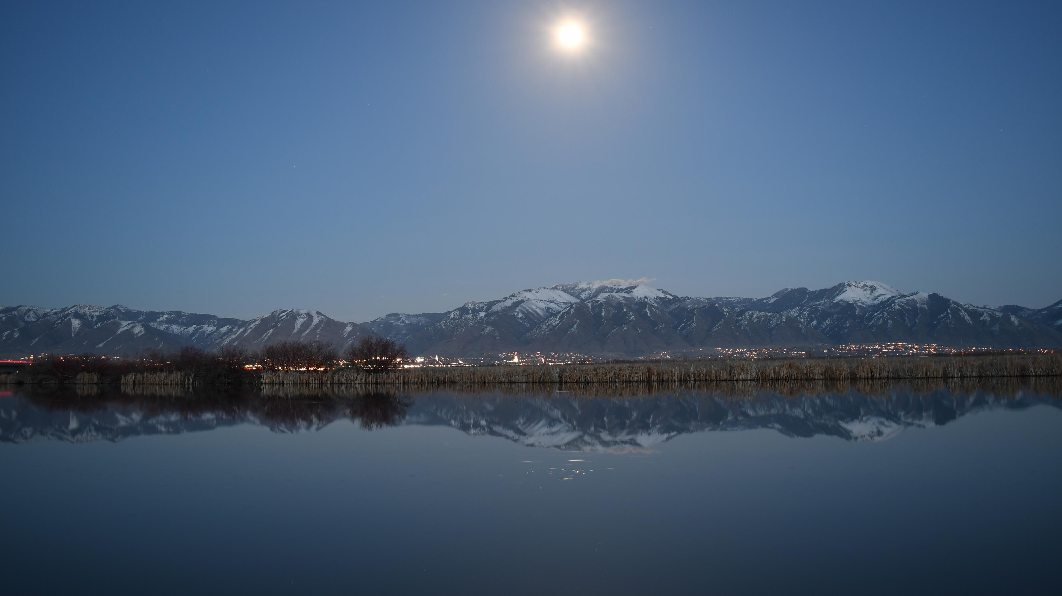
Hillshade calculation
Rui Gao
Rui.Gao@usu.edu

Slide 2
Content of this class
Basic concepts need to know.
How do we use the “Hillshade” tool in ArcGIS Pro for 1 image processing?
How do we write python code for the same processing? Write the code by ourselves?
How can we repeat the same process via Jupyter Notebook?
How do we write a general python code (a function) for more data processing?

Slide 3
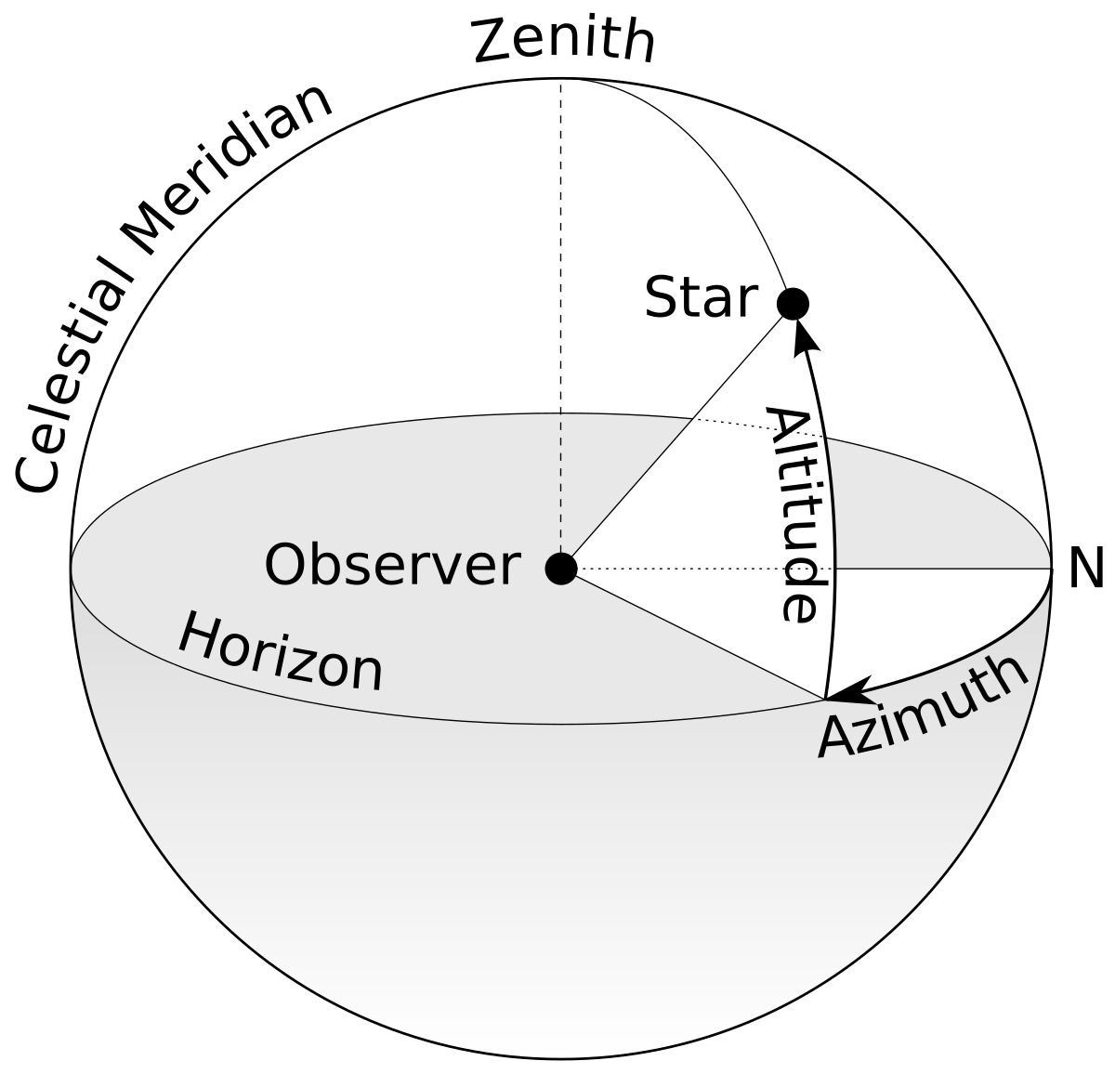
1. Basic concepts you need to know
Altitude
Azimuth
Parameter calculation
https://gml.noaa.gov/grad/solcalc/azel.html
https://en.wikipedia.org/wiki/Azimuth

Slide 4
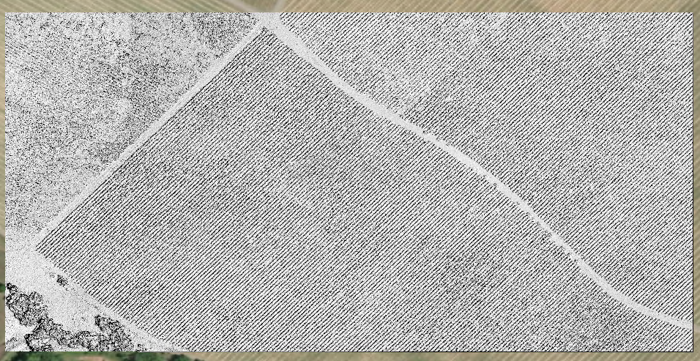
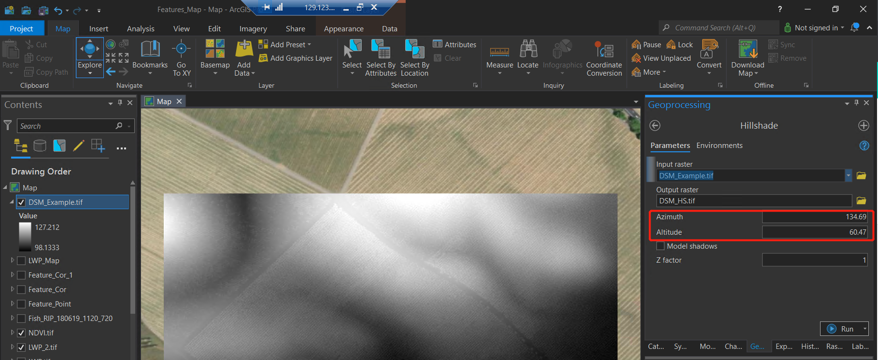
2. How do we use the “Hillshade” tool in ArcGIS Pro for 1 image processing?
Put parameters there

Slide 5
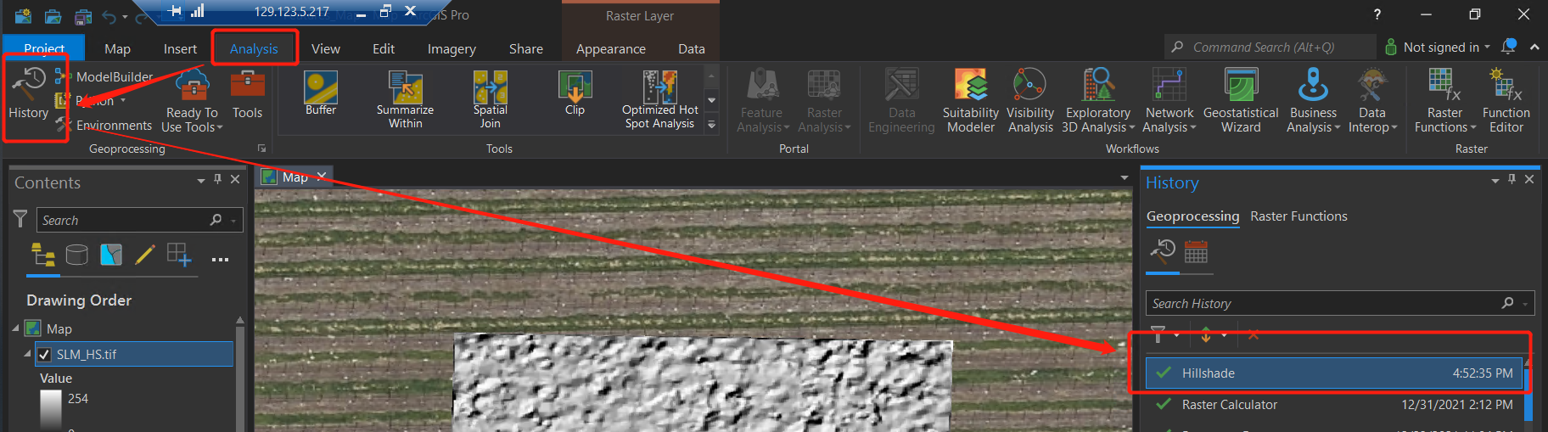
3. How do we write python code for the same processing? Write the code by ourselves? – No!

Slide 6
3. How do we write python code for the same processing? Write the code by ourselves? – No!
Get the code from “Analysi – History”, and right click the “Hillshade.”
“Copy Python Command”
arcpy.ddd.HillShade("DSM_Example.tif", r"C:\Users\grui9\Box\GitHub_Rui\CEE6190_GIS_Hillshade\3_Results\DSM_HS_1.tif", 315, 45, "NO_SHADOWS", 1)

Slide 7
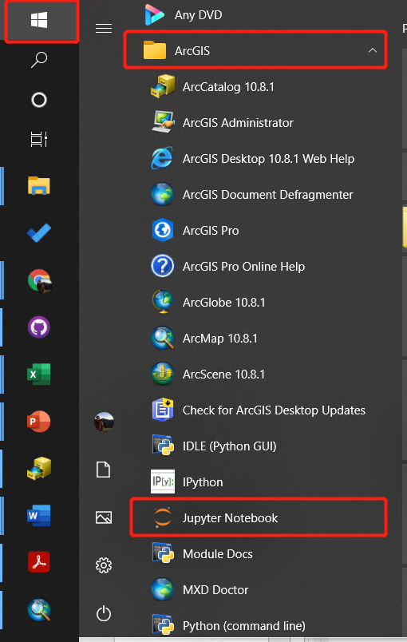
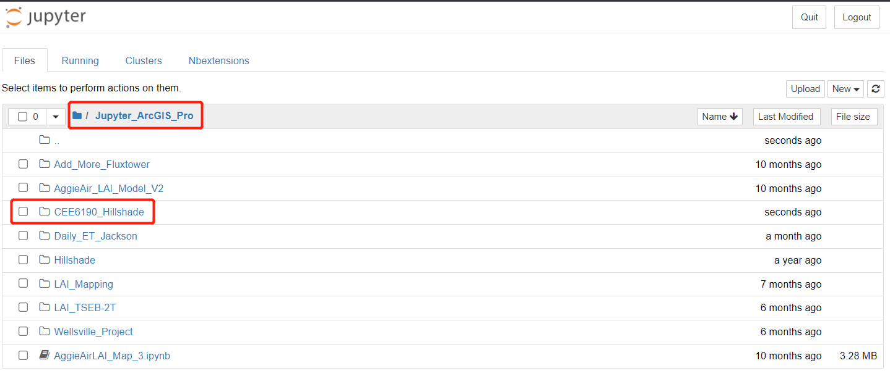
4. How can we repeat the same process via Jupyter Notebook?
Create a folder to organize your code(s).

Slide 8
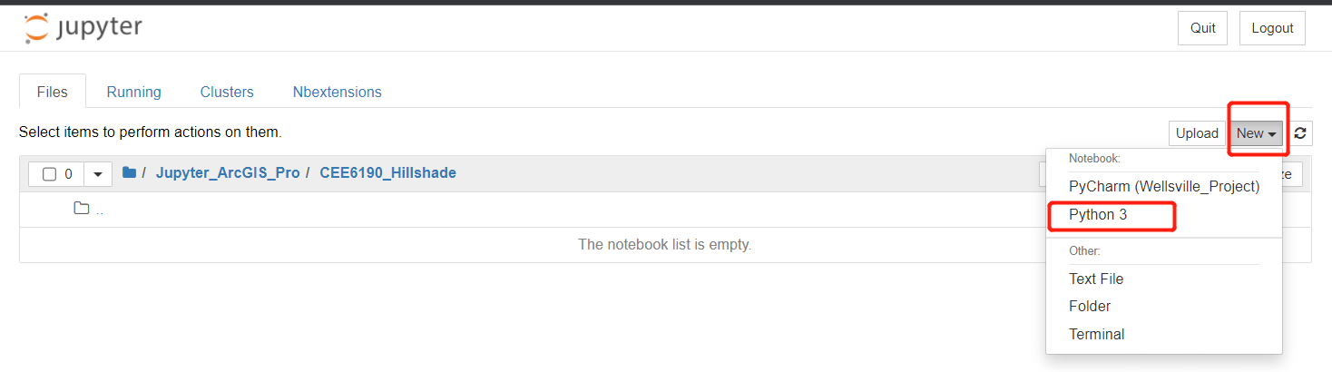
4. How can we repeat the same process via Jupyter Notebook?
Create a folder to organize your code(s).

Slide 9
4. How can we repeat the same process via Jupyter Notebook?
Create a folder to organize your code(s).

Slide 10
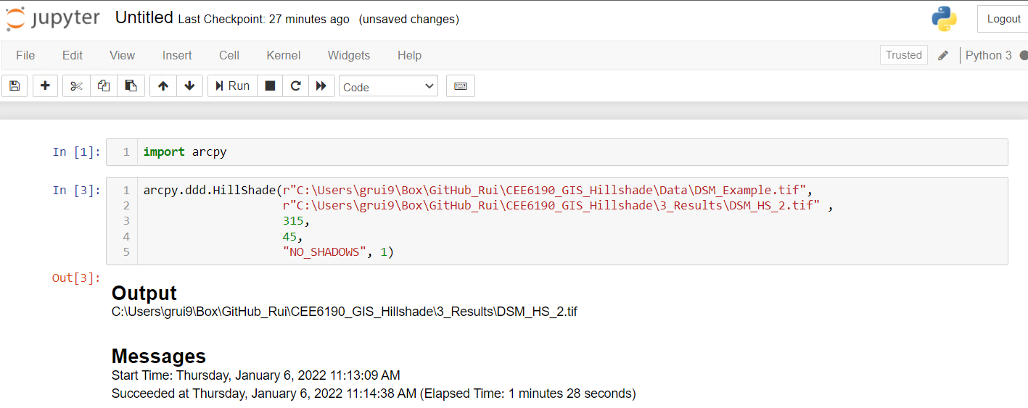
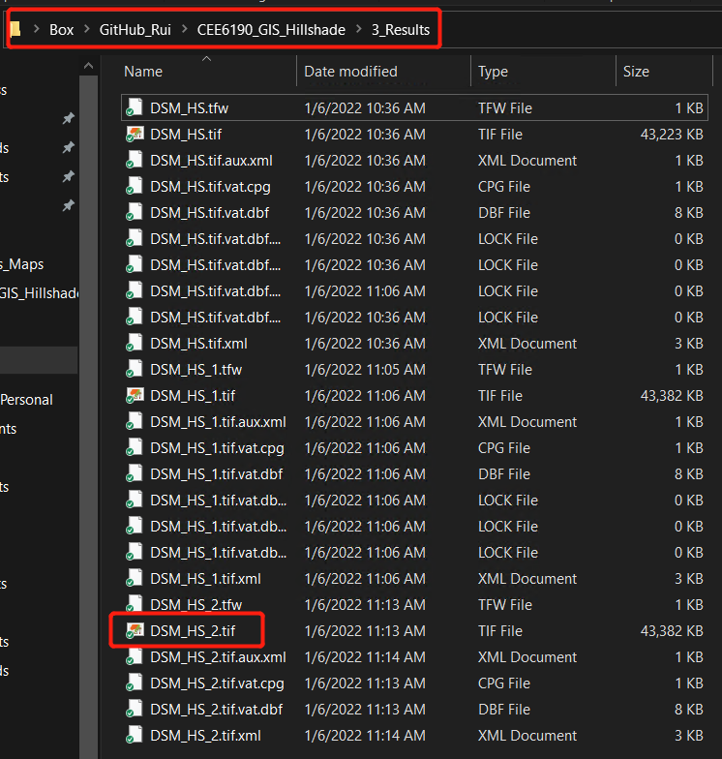

Slide 11
5. How do we write a general python code (a function) for more data processing?
Make the parameters in the “Hillshade” function easier to access.
Providing table, list, etc. for the function, and then setting up a loop for automation.
Example for how to set up the function:

Slide 12
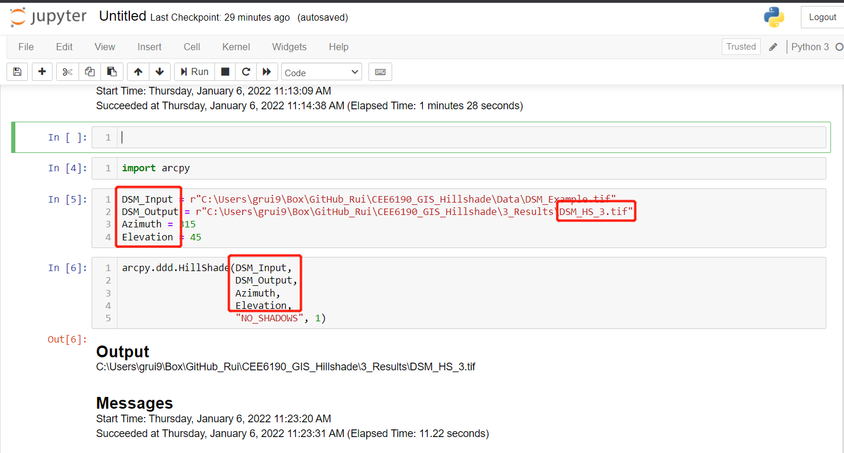
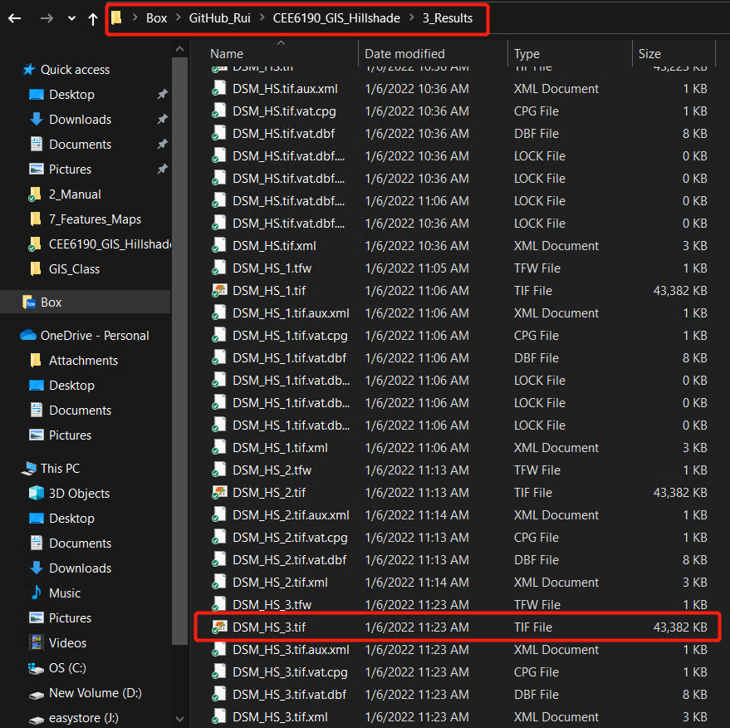

Slide 13
Now, Can you write your own python program to process 1,000⁺ DSM images at different times during a year? How can we expand this work? Such as knowing the shadow area for each 10-meter pixel? Do you have a big picture for your research by using these tools?

