Slide 1
CEE-5190/6190 GIS for civil engineering Instructor: Dr. Alfonso Torres 2022 Spring semester

Slide 2
Questions we may have before we knowing how to use python and ArcGIS Pro work for us:
Appetizer: using Hillshade to process one DEM data at 2:00 pm to get the shadow pixels.
Followed questions:
Using the same tool to process 1000 DEM images at the same time (ideal situation).
1000 DEM images come from different times (azimuth and elevation vary from time to time).
Knowing more information when running the model for different DEM images at different times, such as knowing the statistics (e.g., what is the area of the shadow pixel in every 10-m pixel).
Is this cup of your tea? If not, do not leave ☺

Slide 3
Skills that you need to obtain after this course:
Have some ideas about:
Anaconda
Python
arcpy from ArcGIS Pro
GitHub
How to set up your working environment
You will also have your first python function as a reference for your later research if you still need to use the ArcGIS Pro for your research.

Slide 4
Course content
Software installation
Hillshade calculation

Slide 5
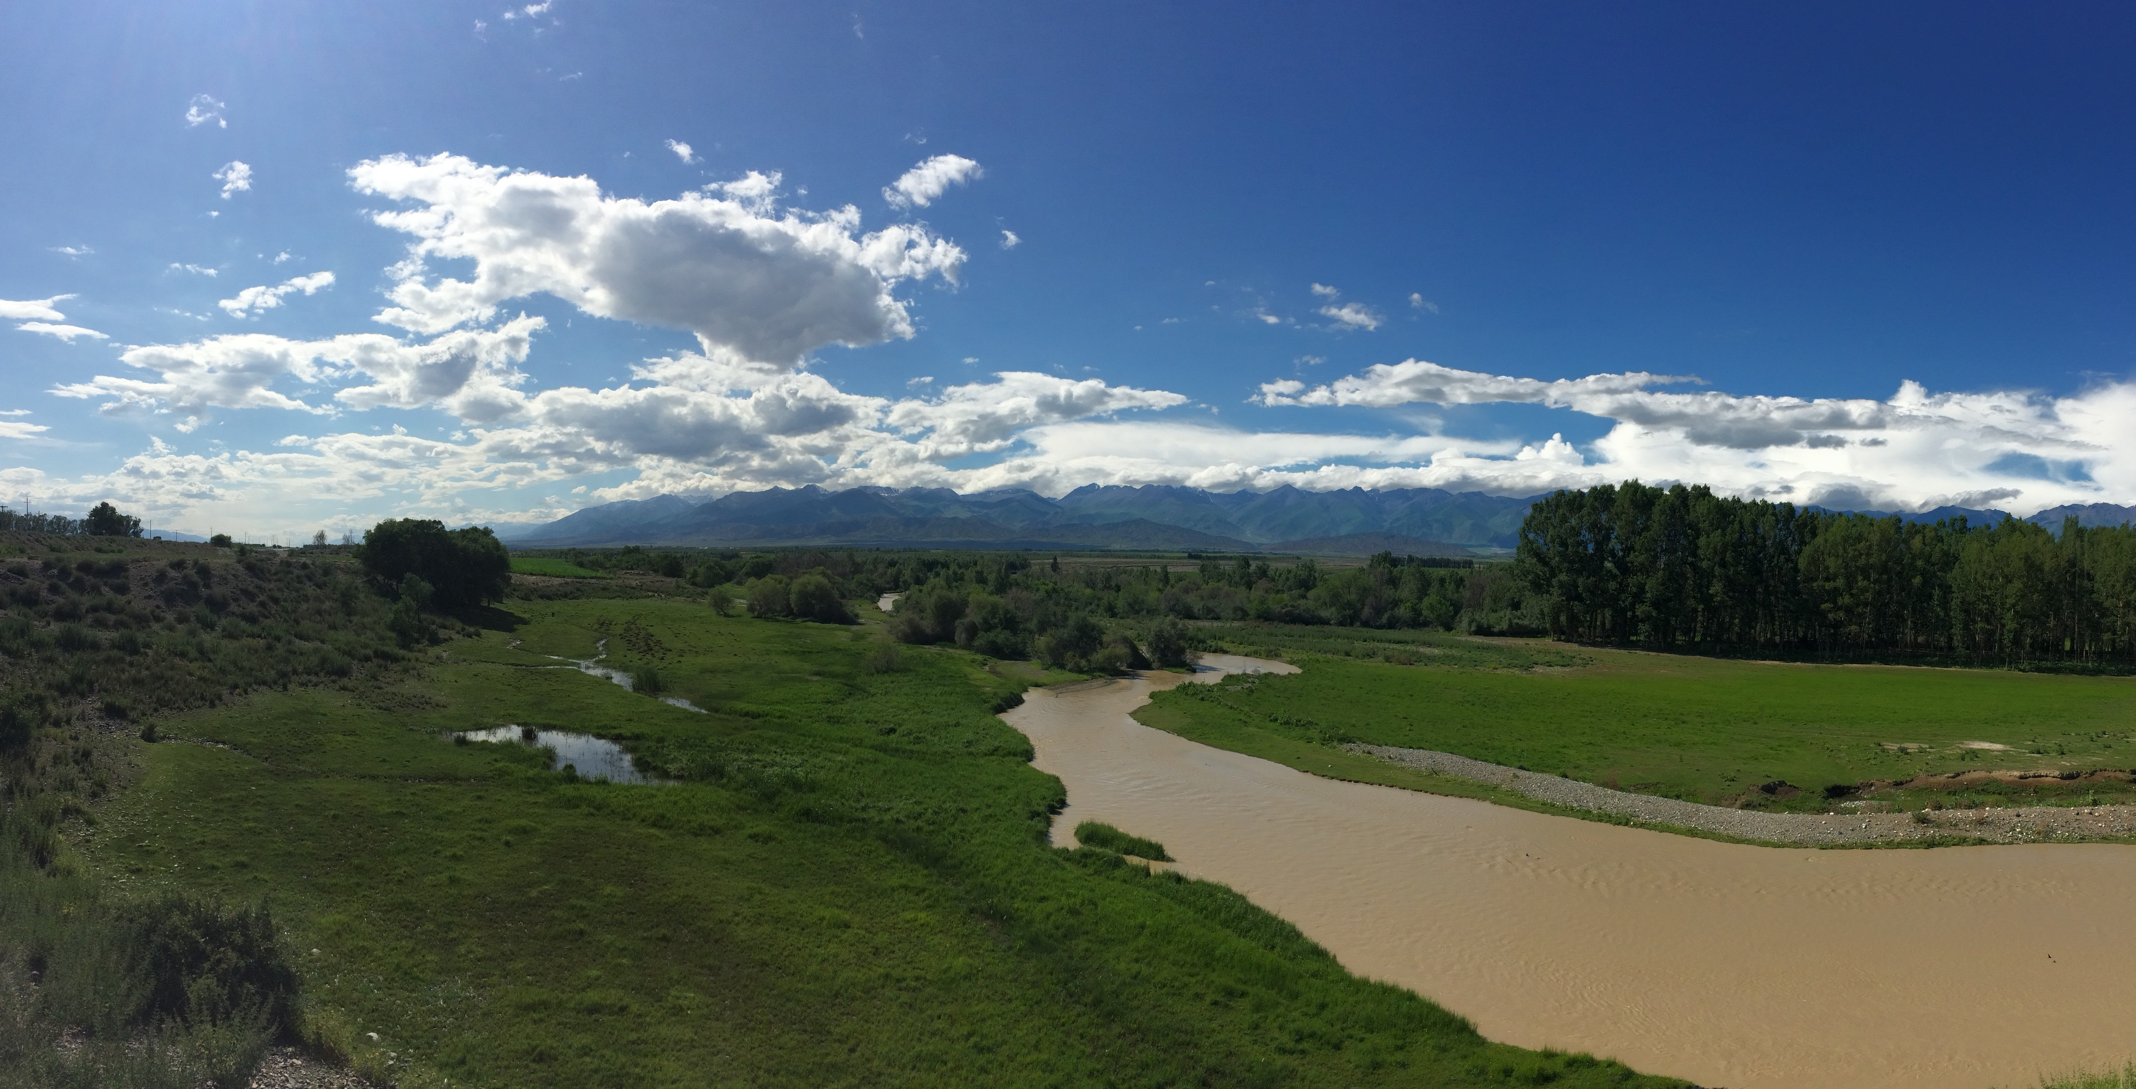
Software installation
Rui Gao
Rui.Gao@usu.edu

Slide 6
Required software
ArcGIS Pro
Anaconda
Download from https://www.anaconda.com/products/individual
Basic knowledge about Python, Jupyter Notebook (or Jupyter Lab)

Slide 7
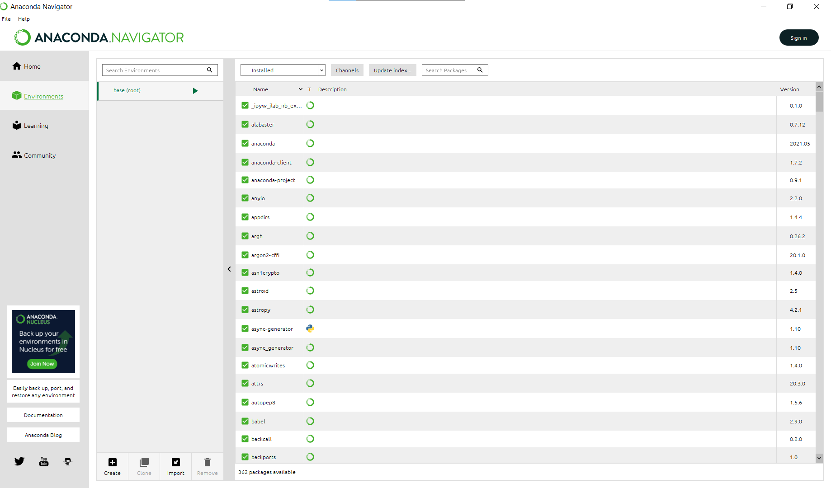
Environment setting in Anaconda
1. Install Anaconda
After the installation, open Anaconda, the right screenshot will show up.

Slide 8
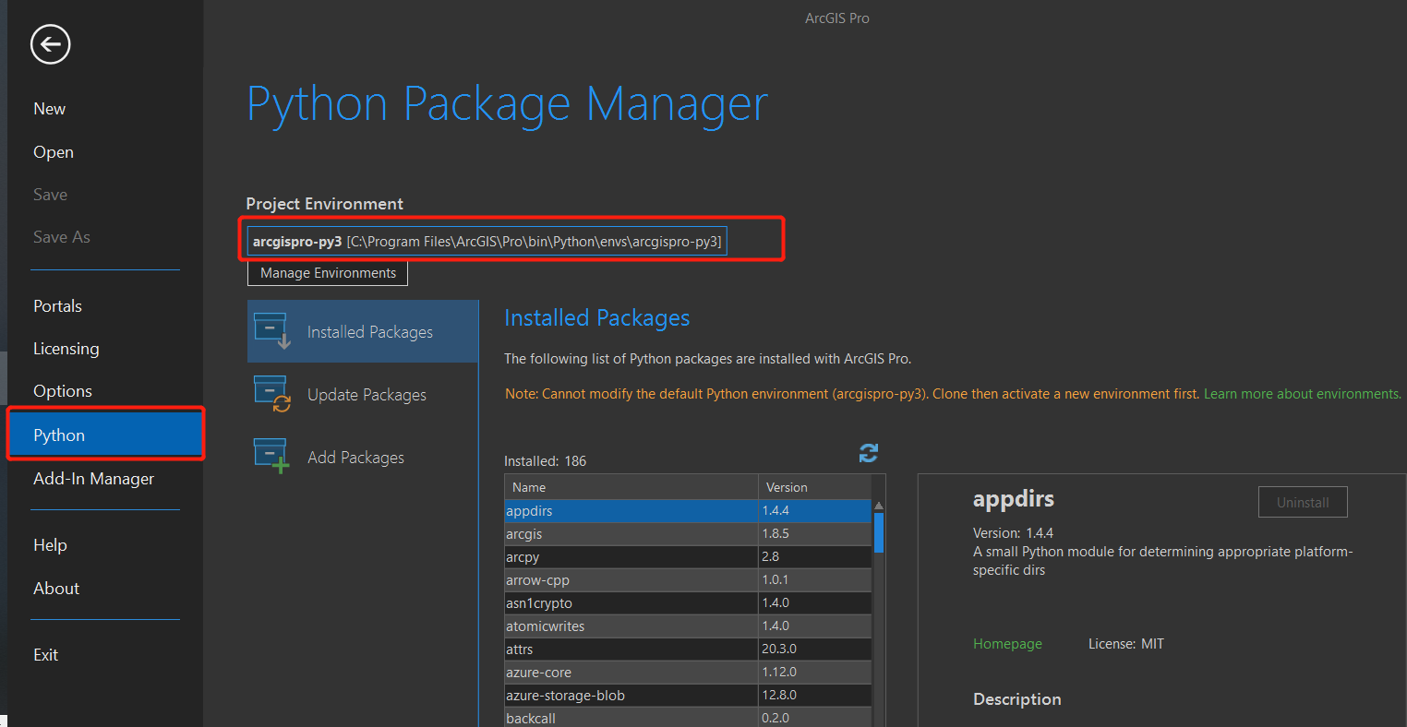
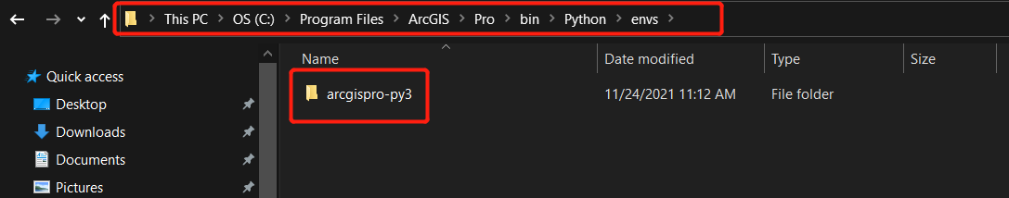
Environment setting in Anaconda
2. Find python environment of the ArcGIS Pro
Open ArcGIS Pro
“Setting”
“Python”
Go to the folder and copy the folder into the “environment” folder of the Anaconda software.

Slide 9
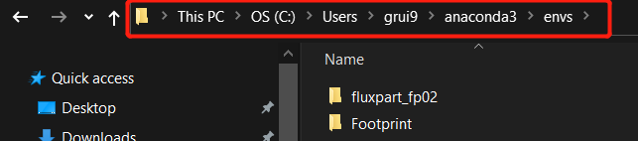
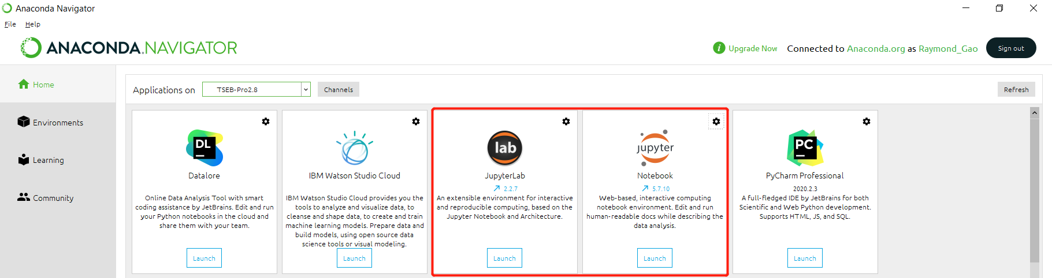
Environment setting in Anaconda
3. Build new environment in Anaconda
Find the folder for the environment of Anaconda
Past that folder into this folder, and you can rename it
Open the Anaconda again, and now we should see the activated environment
Open jupyter notebook and/or jupyter lab through Anaconda and good to code

Slide 10
To get more ideas
A YouTube video to have more knowledge: https://www.youtube.com/watch?v=9q3U9EKSutk
Feature extraction approaches for leaf area index estimation in California vineyards via machine learning algorithms. https://doi.org/10.4211/hs.923cf9a7a3bb49369a4e65d48237002b
Footprint area generating based on eddy covariance records. https://doi.org/10.4211/hs.9118e2c1034e40e4ba4721cd17702f70
TSEB modeling and the comparison between the model results and the eddy-covariance monitored data within the footprint area. https://doi.org/10.4211/hs.eb6eeeccdbe546fc941f3c219cb05a34
Features extraction from the LAI2200C Plant Canopy Analyzer. https://doi.org/10.4211/hs.6d0c4a14289742d0951ba5ab9eca7dc0

Slide 11
Start coding and ‘fun’ !!!

