Slide 1
AC
AC
AC
Reply
Reply
Reply
Reply
Query

Slide 2
AC
AC
…
AC
Reply
Reply
Reply
Reply
Query

Slide 3


$$Ag$$

Slide 4
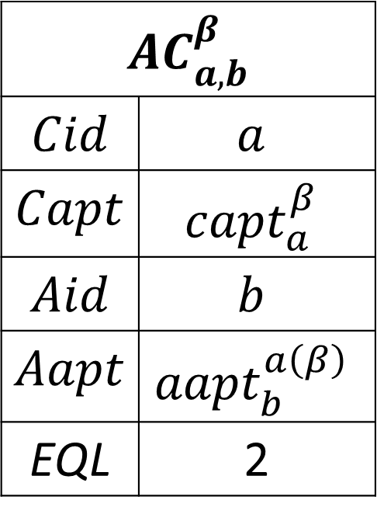
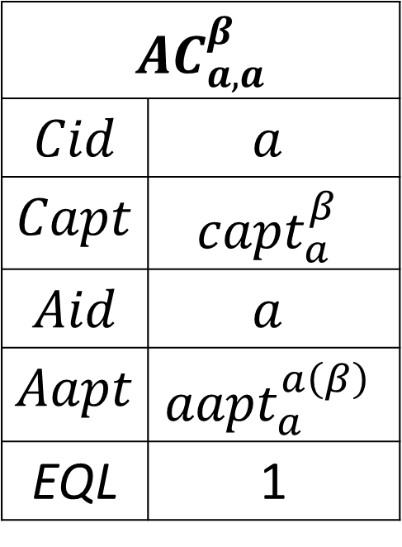
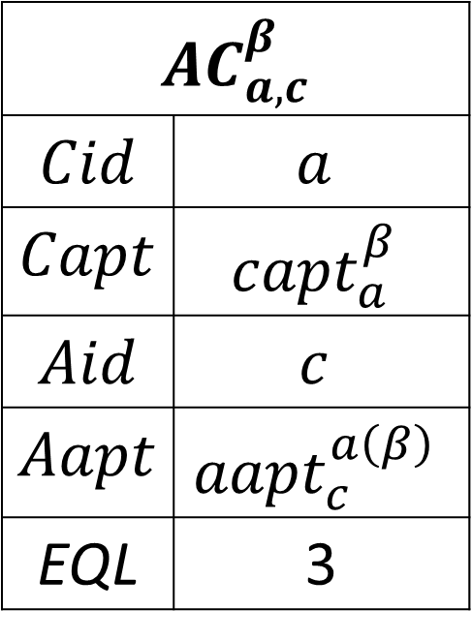
$${AC}_{a,a}^{β}$$
$$Cid$$ | $$a$$
$$Capt$$ | $${capt}_{a}^{β}$$
$$Aid$$ | $$a$$
$$Aapt$$ | $${aapt}_{a}^{a\left(β\right)}$$
EQL | 1
$${AC}_{a,b}^{β}$$
$$Cid$$ | $$a$$
$$Capt$$ | $${capt}_{a}^{β}$$
$$Aid$$ | $$b$$
$$Aapt$$ | $${aapt}_{b}^{a\left(β\right)}$$
EQL | 2
$${AC}_{a,c}^{β}$$
$$Cid$$ | $$a$$
$$Capt$$ | $${capt}_{a}^{β}$$
$$Aid$$ | $$c$$
$$Aapt$$ | $${aapt}_{c}^{a\left(β\right)}$$
EQL | 3

Slide 5
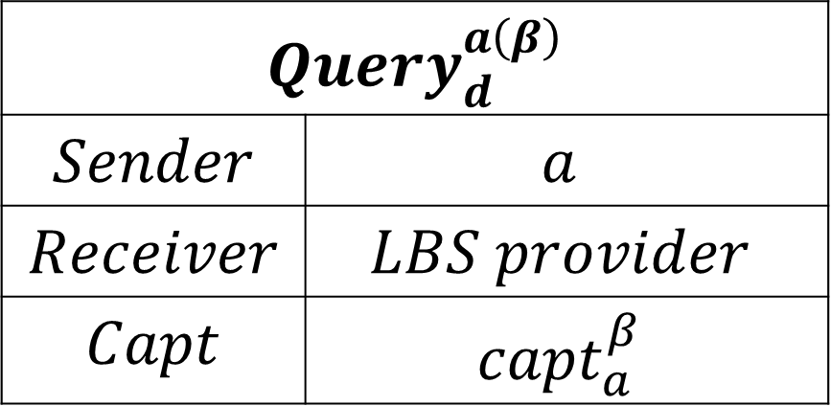
$${Query}_{d}^{a\left(β\right)}$$
$$Sender$$ | $$a$$
$$Receiver$$ | $$LBS provider$$
$$Capt$$ | $${capt}_{a}^{β}$$

Slide 6
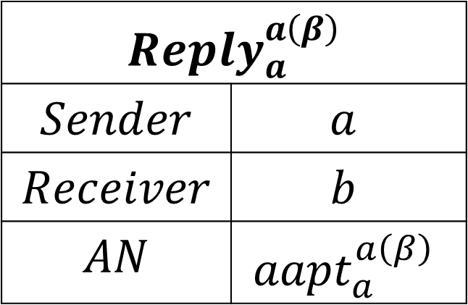
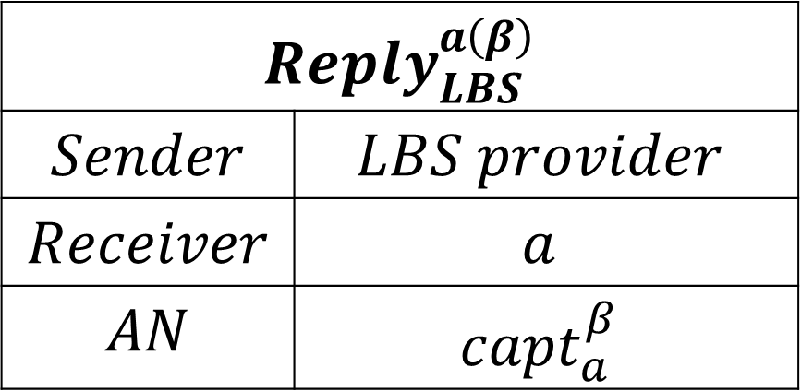
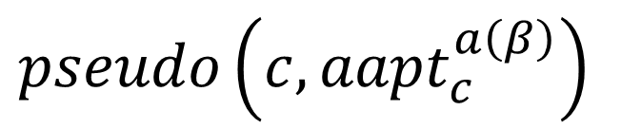
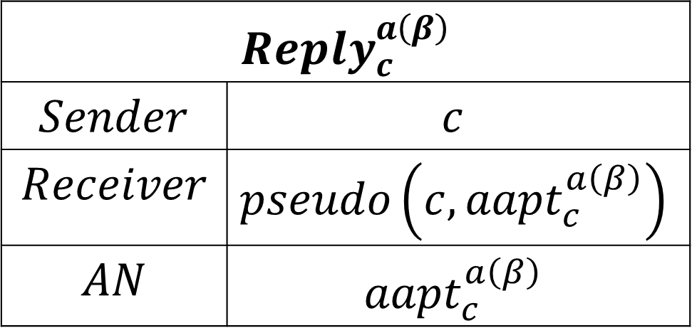
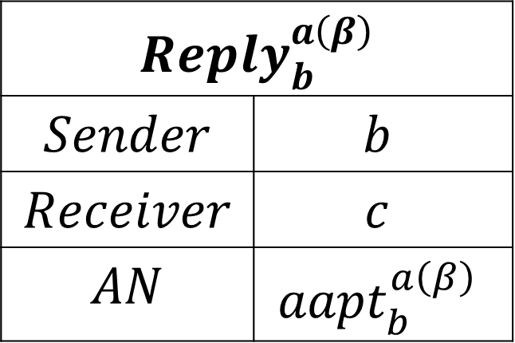
$${Reply}_{LBS}^{a\left(β\right)}$$
$$Sender$$ | $$LBS provider$$
$$Receiver$$ | $$a$$
$$AN$$ | $${capt}_{a}^{β}$$
$${Reply}_{a}^{a\left(β\right)}$$
$$Sender$$ | $$a$$
$$Receiver$$ | $$b$$
$$AN$$ | $${aapt}_{a}^{a\left(β\right)}$$
$${Reply}_{c}^{a\left(β\right)}$$
$$Sender$$ | $$c$$
$$Receiver$$ | $$pseudo\left(c,{aapt}_{c}^{a\left(β\right)}\right)$$
$$AN$$ | $${aapt}_{c}^{a\left(β\right)}$$
$${Reply}_{b}^{a\left(β\right)}$$
$$Sender$$ | $$b$$
$$Receiver$$ | $$c$$
$$AN$$ | $${aapt}_{b}^{a\left(β\right)}$$
$$pseudo\left(c,{aapt}_{c}^{a\left(β\right)}\right)$$

Slide 7
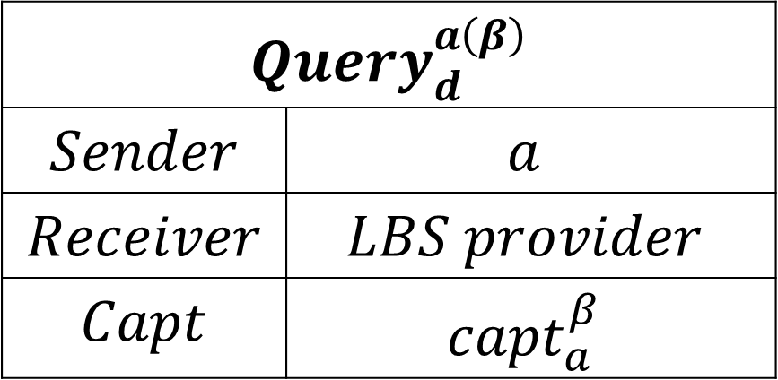
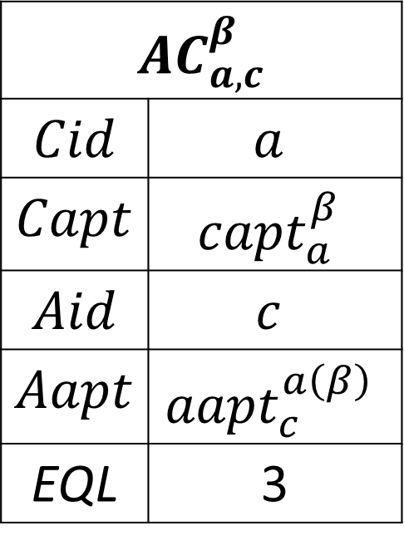
$${AC}_{a,c}^{β}$$
$$Cid$$ | $$a$$
$$Capt$$ | $${capt}_{a}^{β}$$
$$Aid$$ | $$c$$
$$Aapt$$ | $${aapt}_{c}^{a\left(β\right)}$$
EQL | 3
$${Query}_{d}^{a\left(β\right)}$$
$$Sender$$ | $$a$$
$$Receiver$$ | $$LBS provider$$
$$Capt$$ | $${capt}_{a}^{β}$$

Slide 8
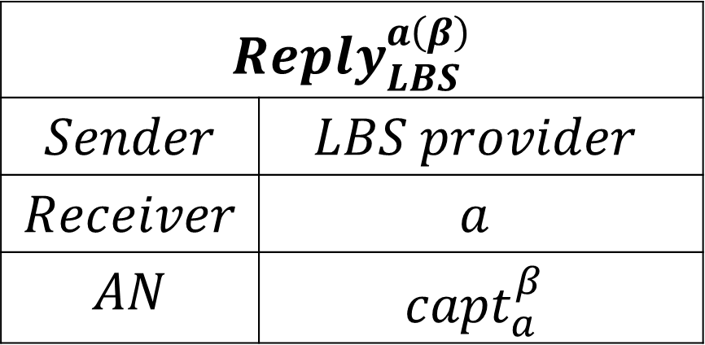
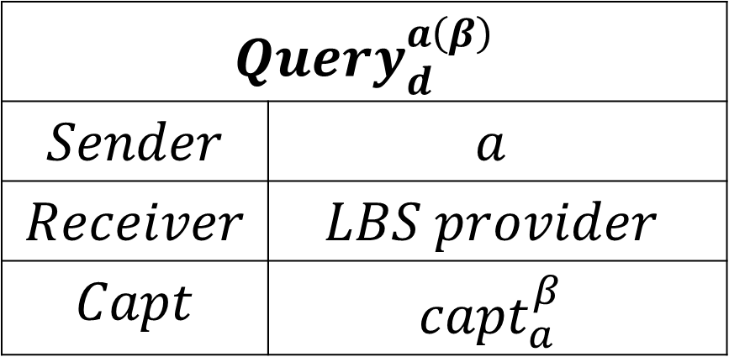
$${Query}_{d}^{a\left(β\right)}$$
$$Sender$$ | $$a$$
$$Receiver$$ | $$LBS provider$$
$$Capt$$ | $${capt}_{a}^{β}$$
$${Reply}_{LBS}^{a\left(β\right)}$$
$$Sender$$ | $$LBS provider$$
$$Receiver$$ | $$a$$
$$AN$$ | $${capt}_{a}^{β}$$

Slide 9
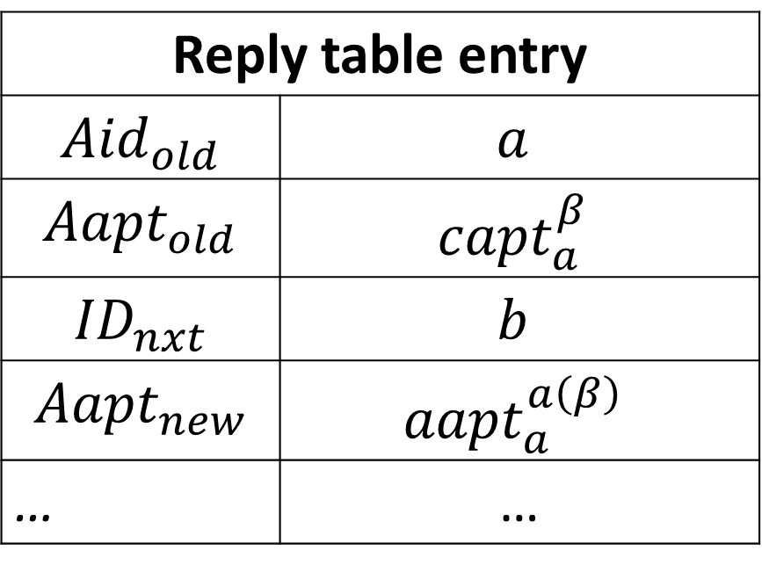
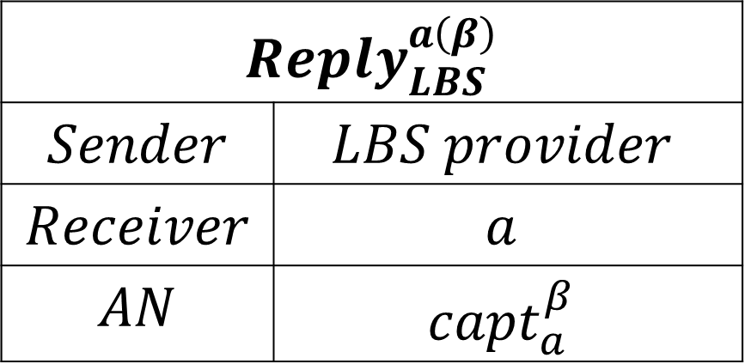
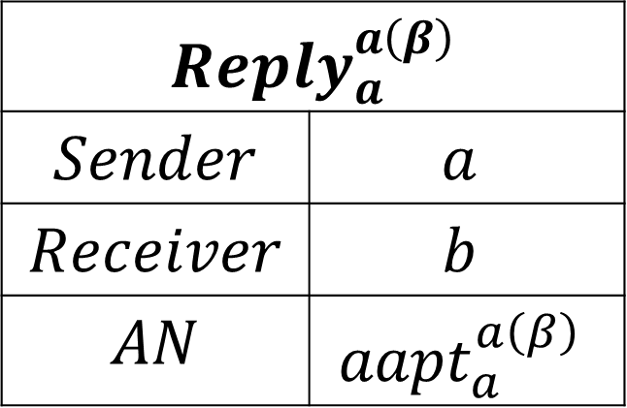
Reply table entry
$${Aid}_{old}$$ | $$a$$
$${Aapt}_{old}$$ | $${capt}_{a}^{β}$$
$${ID}_{nxt}$$ | $$b$$
$${Aapt}_{new}$$ | $${aapt}_{a}^{a\left(β\right)}$$
… | …
$${Reply}_{LBS}^{a\left(β\right)}$$
$$Sender$$ | $$LBS provider$$
$$Receiver$$ | $$a$$
$$AN$$ | $${capt}_{a}^{β}$$
$${Reply}_{a}^{a\left(β\right)}$$
$$Sender$$ | $$a$$
$$Receiver$$ | $$b$$
$$AN$$ | $${aapt}_{a}^{a\left(β\right)}$$

Slide 10
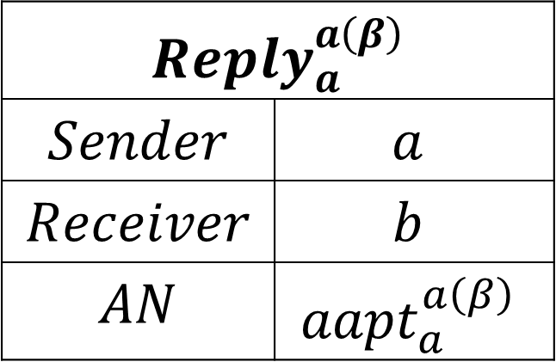
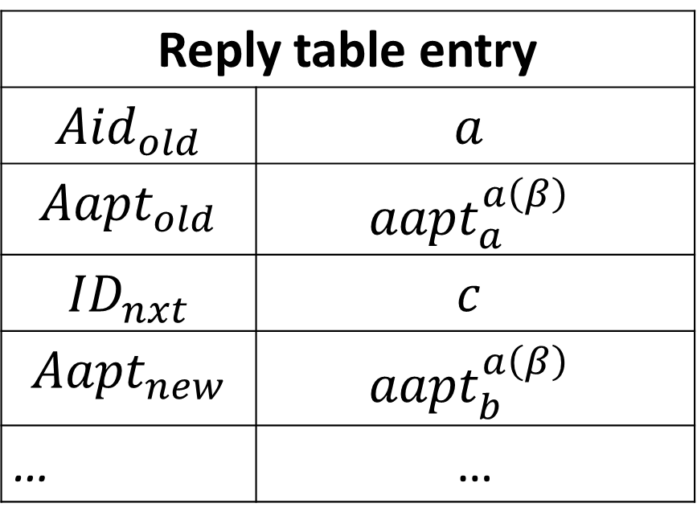
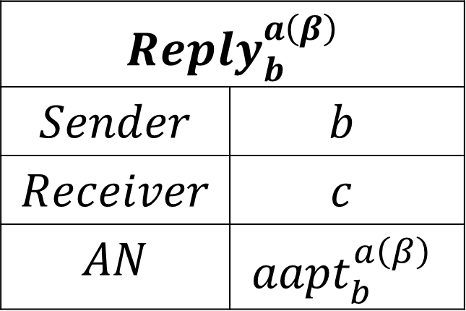
Reply table entry
$${Aid}_{old}$$ | $$a$$
$${Aapt}_{old}$$ | $${aapt}_{a}^{a\left(β\right)}$$
$${ID}_{nxt}$$ | $$c$$
$${Aapt}_{new}$$ | $${aapt}_{b}^{a\left(β\right)}$$
… | …
$${Reply}_{a}^{a\left(β\right)}$$
$$Sender$$ | $$a$$
$$Receiver$$ | $$b$$
$$AN$$ | $${aapt}_{a}^{a\left(β\right)}$$
$${Reply}_{b}^{a\left(β\right)}$$
$$Sender$$ | $$b$$
$$Receiver$$ | $$c$$
$$AN$$ | $${aapt}_{b}^{a\left(β\right)}$$

Slide 11
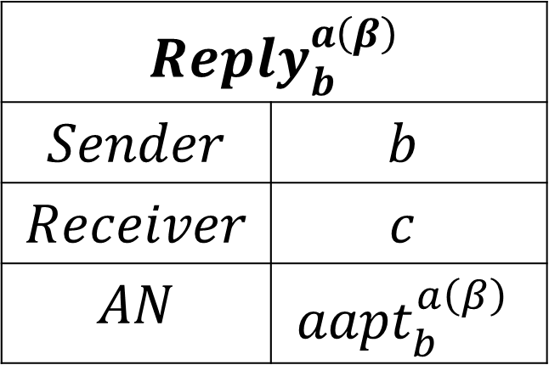



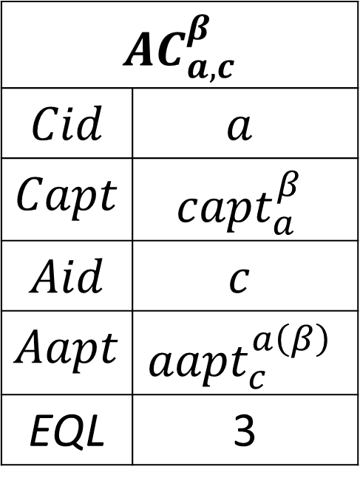
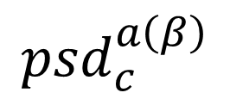
Reply table entry
$${Aid}_{old}$$ | $$b$$
$${Aapt}_{old}$$ | $${aapt}_{b}^{a\left(β\right)}$$
$${ID}_{nxt}$$ | $$VOID$$
$${Aapt}_{new}$$ | $${aapt}_{c}^{a\left(β\right)}$$
… | …
$${AC}_{a,c}^{β}$$
$$Cid$$ | $$a$$
$$Capt$$ | $${capt}_{a}^{β}$$
$$Aid$$ | $$c$$
$$Aapt$$ | $${aapt}_{c}^{a\left(β\right)}$$
EQL | 3
$${Reply}_{b}^{a\left(β\right)}$$
$$Sender$$ | $$b$$
$$Receiver$$ | $$c$$
$$AN$$ | $${aapt}_{b}^{a\left(β\right)}$$
$${psd}_{c}^{a\left(β\right)}$$
$$U_{c}$$
$$U_{d}$$

Slide 12
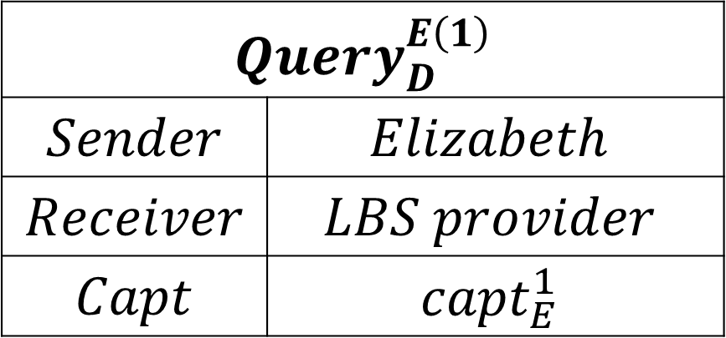
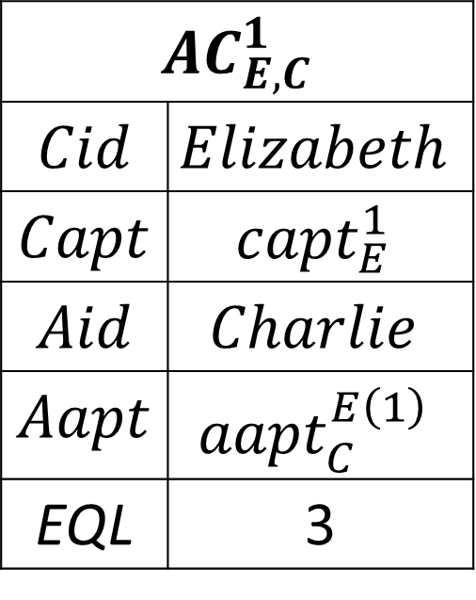
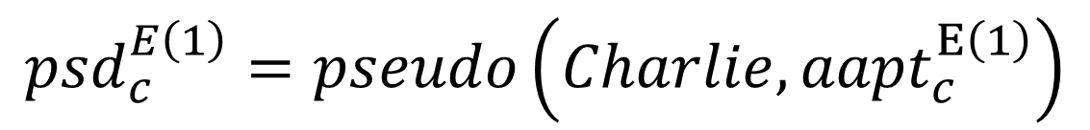
$${AC}_{E,C}^{1}$$
$$Cid$$ | $$Elizabeth$$
$$Capt$$ | $${capt}_{E}^{1}$$
$$Aid$$ | $$Charlie$$
$$Aapt$$ | $${aapt}_{C}^{E\left(1\right)}$$
EQL | 3
$${Query}_{D}^{E\left(1\right)}$$
$$Sender$$ | $$Elizabeth$$
$$Receiver$$ | $$LBS provider$$
$$Capt$$ | $${capt}_{E}^{1}$$
$${psd}_{c}^{E\left(1\right)}=pseudo\left(Charlie,{aapt}_{c}^{E\left(1\right)}\right)$$

Slide 13
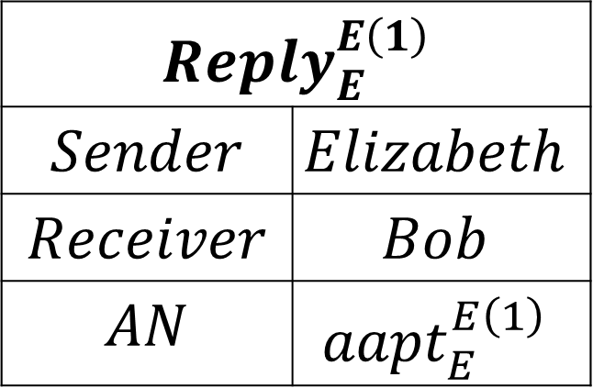
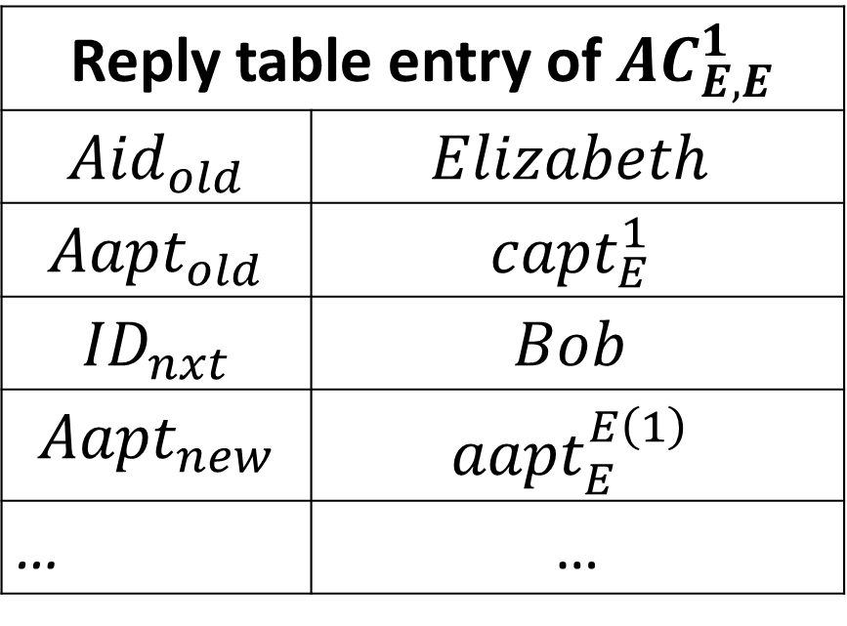
Reply table entry of ${AC}_{E,E}^{1}$
$${Aid}_{old}$$ | $$Elizabeth$$
$${Aapt}_{old}$$ | $${capt}_{E}^{1}$$
$${ID}_{nxt}$$ | $$Bob$$
$${Aapt}_{new}$$ | $${aapt}_{E}^{E\left(1\right)}$$
… | …
$${Reply}_{E}^{E\left(1\right)}$$
$$Sender$$ | $$Elizabeth$$
$$Receiver$$ | $$Bob$$
$$AN$$ | $${aapt}_{E}^{E\left(1\right)}$$

Slide 14
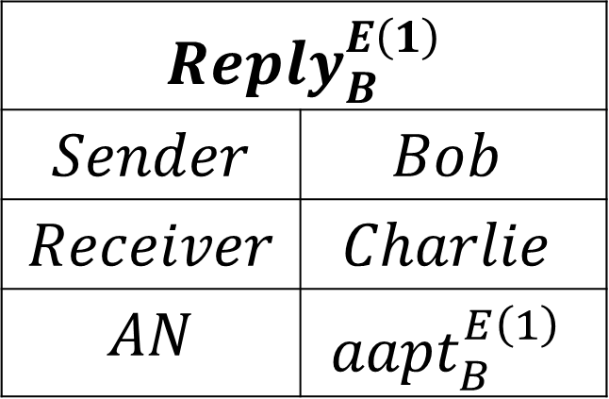
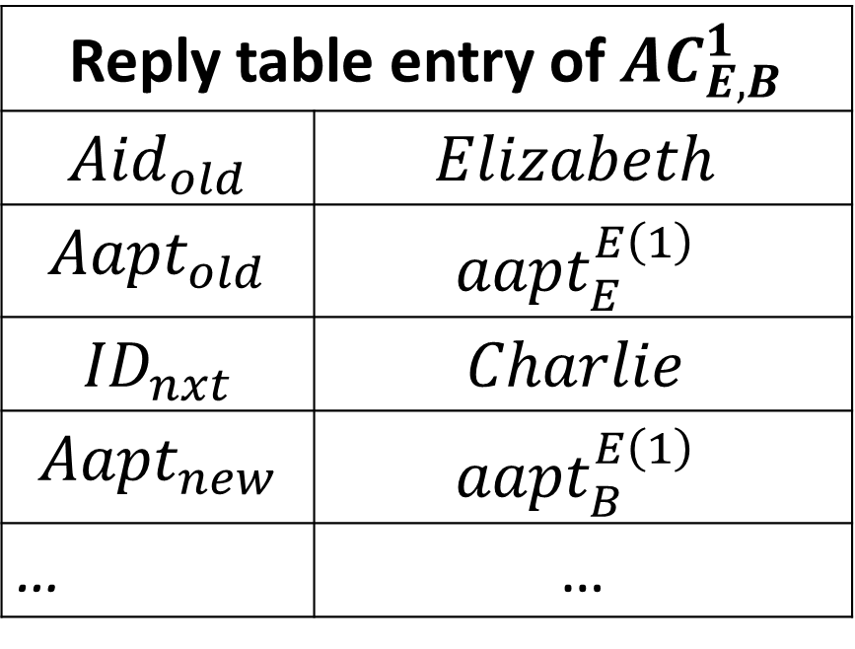
Reply table entry of ${AC}_{E,B}^{1}$
$${Aid}_{old}$$ | $$Elizabeth$$
$${Aapt}_{old}$$ | $${aapt}_{E}^{E\left(1\right)}$$
$${ID}_{nxt}$$ | $$Charlie$$
$${Aapt}_{new}$$ | $${aapt}_{B}^{E\left(1\right)}$$
… | …
$${Reply}_{B}^{E\left(1\right)}$$
$$Sender$$ | $$Bob$$
$$Receiver$$ | $$Charlie$$
$$AN$$ | $${aapt}_{B}^{E\left(1\right)}$$

Slide 15
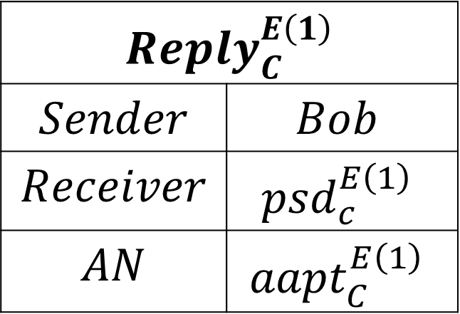
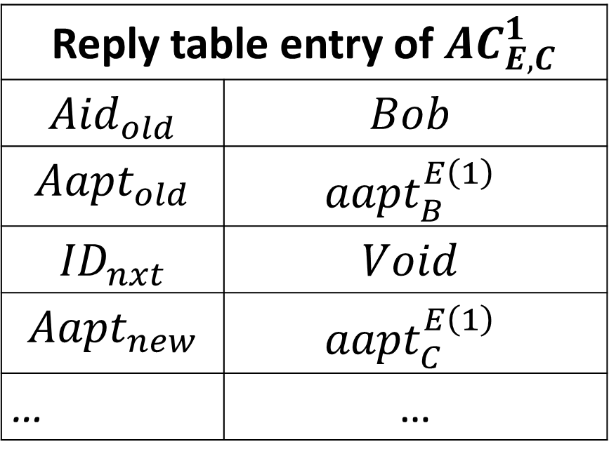
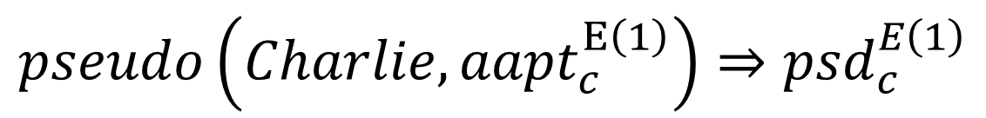
$$pseudo\left(Charlie,{aapt}_{c}^{E\left(1\right)}\right)⇒{psd}_{c}^{E\left(1\right)}$$
Reply table entry of ${AC}_{E,C}^{1}$
$${Aid}_{old}$$ | $$Bob$$
$${Aapt}_{old}$$ | $${aapt}_{B}^{E\left(1\right)}$$
$${ID}_{nxt}$$ | $$Void$$
$${Aapt}_{new}$$ | $${aapt}_{C}^{E\left(1\right)}$$
… | …
$${Reply}_{C}^{E\left(1\right)}$$
$$Sender$$ | $$Bob$$
$$Receiver$$ | $${psd}_{c}^{E\left(1\right)}$$
$$AN$$ | $${aapt}_{C}^{E\left(1\right)}$$

Slide 17
S
A
B
C
D
S
A
C
D
B

Slide 19
A
C
B

Slide 20
A
B
C
A
B
C

