Slide 1
Emotion Analysis in a
Noisy Environment
Samuel Bentlin, Harshith Chennupati, Mingrui Liang, JiaHao Lu

Slide 2
Overview
Background
Problem Set Up
Denoising Problem
Multimodal Problem
Demonstration
Findings / Future Research

Slide 3
Background
Emotion analysis
  Using natural language processing, text analysis, and computational linguistics to identify, quantify, and study affective states and subjective information
Notes:
About Emotion Recognition
Why it is important to be able to detect emotion from speech
Why Noisy situations ?

Slide 4
Motivation
Existing emotion analysis research typically includes low noise
Noise is a problem for emotion classification, especially in deep learning based techniques which are especially susceptible to noise
Goal: Develop a more robust framework that performs better under noisy conditions
Notes:
About Emotion Recognition
Why it is important to be able to detect emotion from speech
Why Noisy situations ?

Slide 5
Problem Set Up
“Easier” Dataset
“Harder” Dataset
Original
Get Baseline
Add noise
Diminish Accuracy
Denoise
Recover Accuracy
Original
Get Baseline
Original
Improve Accuracy
Notes:
Conventional Methods
- Spectral Gating
- TF Techniques
- PCA Denoising
- GAN’s
- SEGAN
- MetricGAN/ Speech brain.

Slide 6

RAVDESS Dataset
1440 audio recordings
  24 professional actors (12 m, 12 f)
  60 speeches per actor
8 emotions
1 of 2 statements…
Emotions
Neutral | Calm | Happy | Sad
Angry | Fearful | Surprise | Disgust
1) “Kids are talking by the door”
2) “Dogs are sitting by the door”
Examples: A) Happy B) Sad C) Fearful D) Disgust

Slide 7
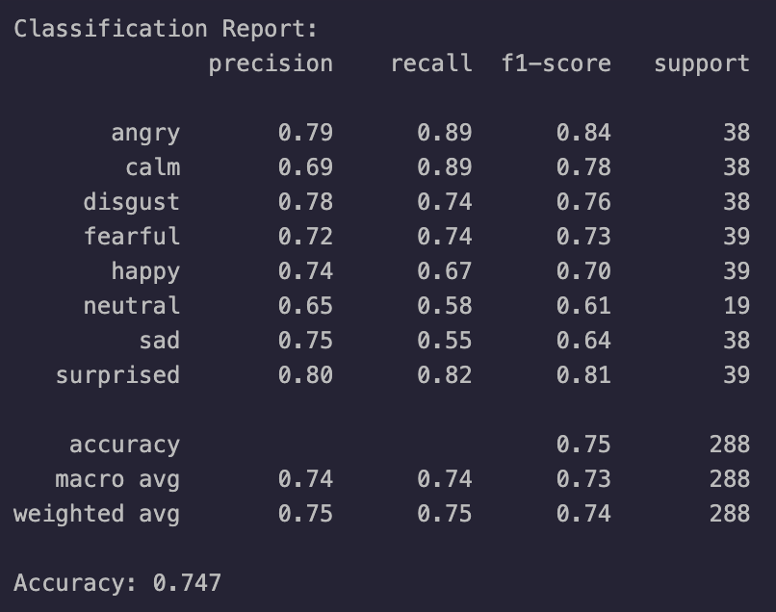
Baseline Results
SVM performed best
  Over GMM, KNN, CNN

Slide 8
Reverse Turing Test
Are you better than an SVM?
Test 1
Test 2
Test 3
Emotions
Neutral | Calm | Happy | Sad
Angry | Fearful | Surprise | Disgust

Slide 9

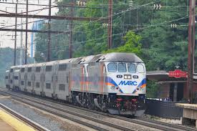
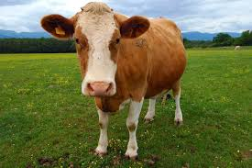

Noise
Gaussian White Noise
ESC-50 Dataset
  Environmental sounds. 50 classes
Procedure
  Choose random noise
  Normalize audio
  Define target SNR
  Add noise to audio to match SNR
Spectrograms (next slide)

Slide 10
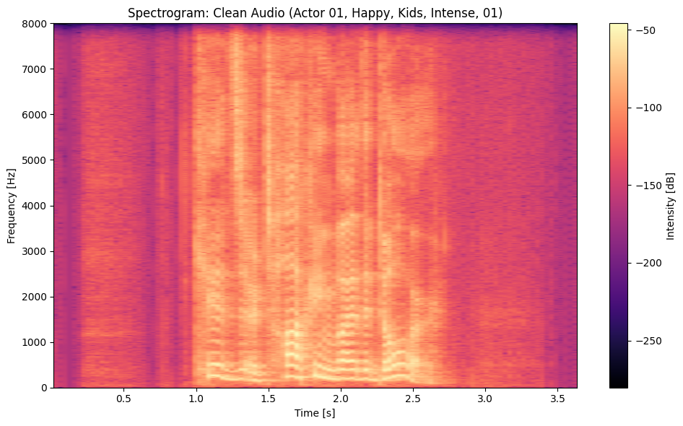
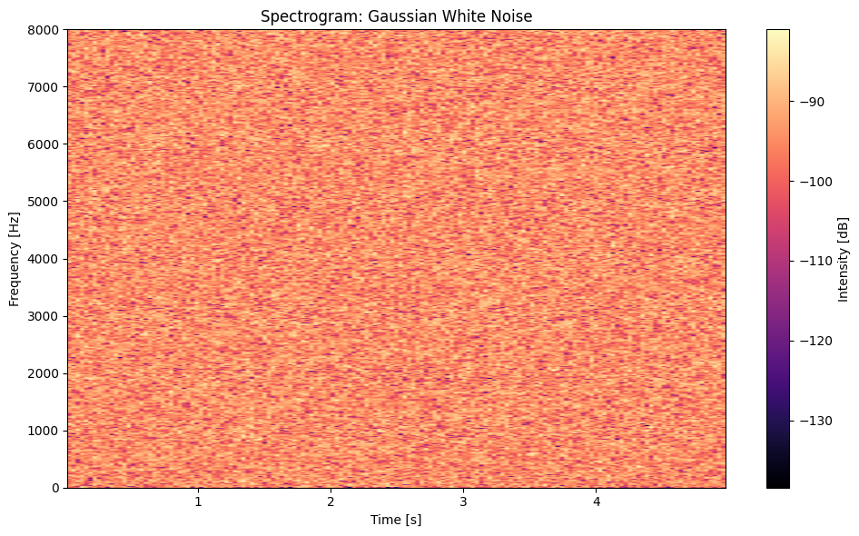
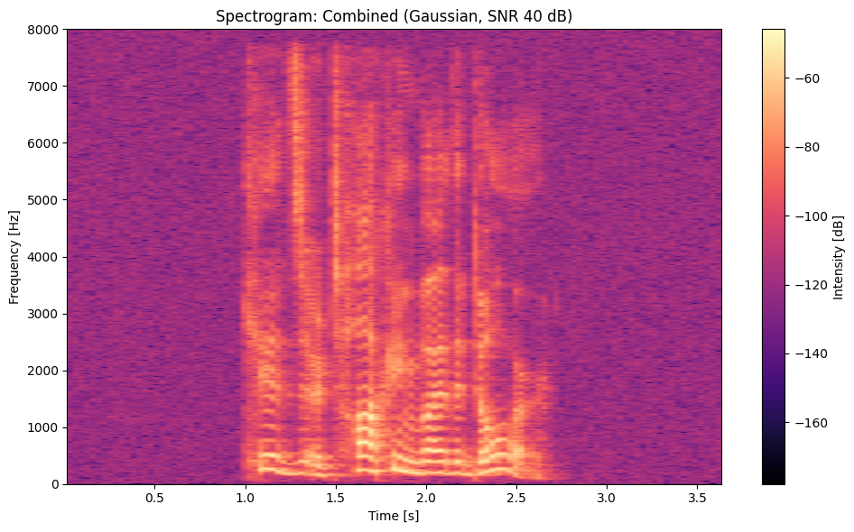
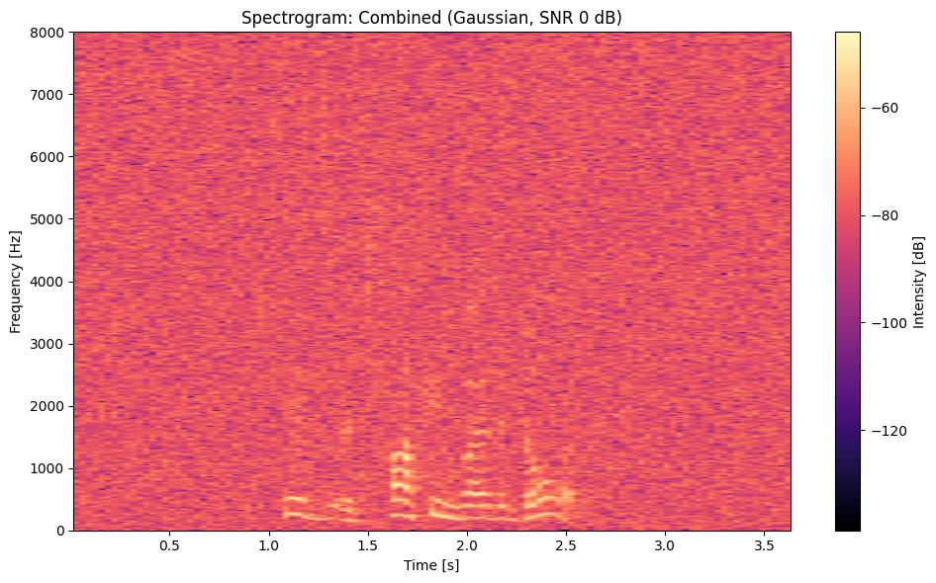
Noise Addition - Gaussian
Audio
SNR 40 dB
Noise
SNR 0 dB
Notes:
1. Clean
2. Noise (Typing)
3. Combined 40 dB, 4 Combined 0 dB

Slide 11
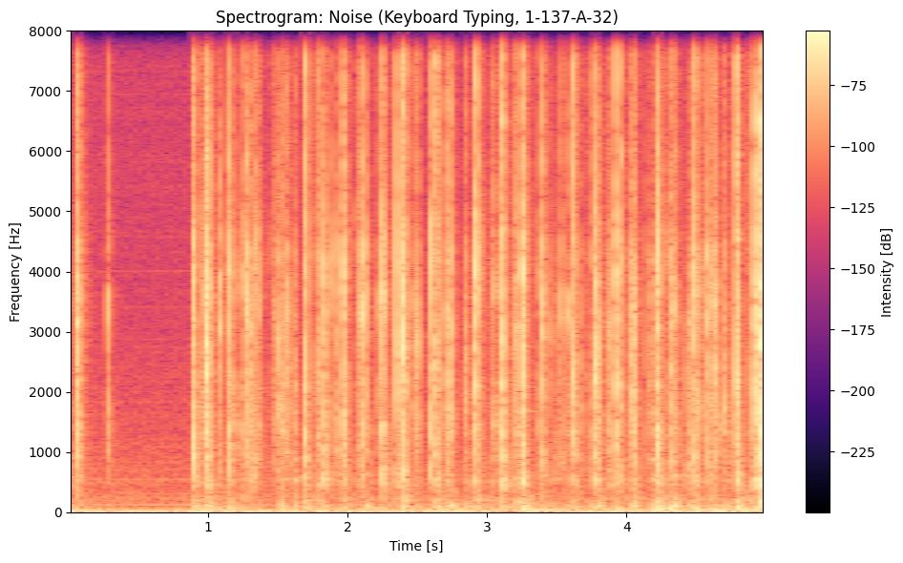
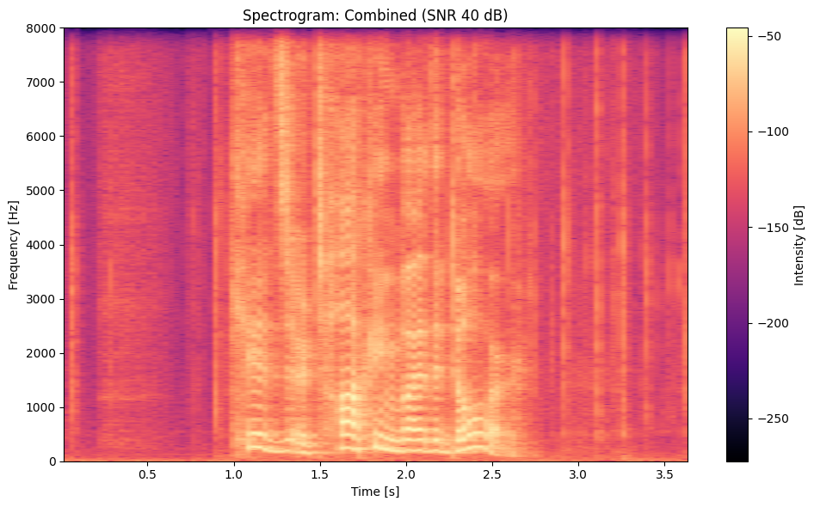
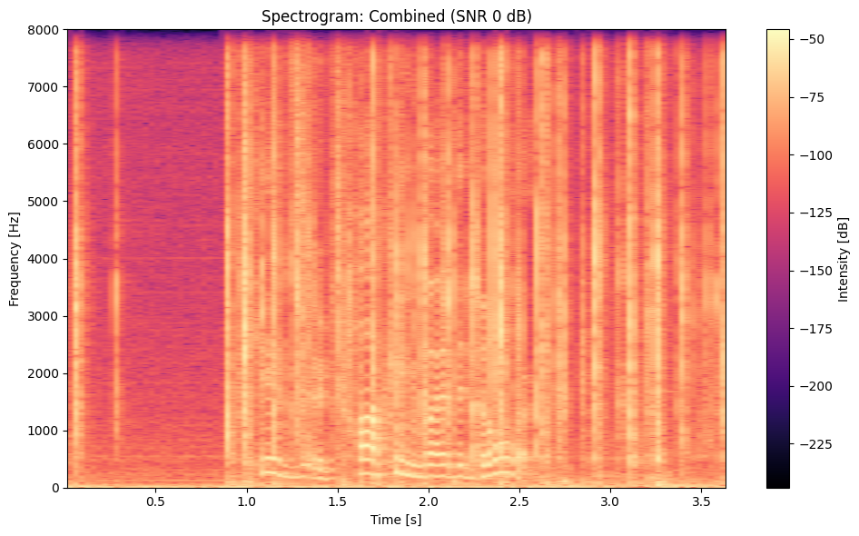
Noise Addition - ESC-50
Audio
SNR 40 dB
Noise
SNR 0 dB
Notes:
1. Clean
2. Noise (Typing)
3. Combined 40 dB, 4 Combined 0 dB

Slide 12
Initial Results
Classification performance on noisy data using same SVM
Environmental noise has much greater impact on accuracy
Gaussian
ESC-50
Clean | 74.7%
SNR 40 dB | 65.6%
SNR 20 dB | 55.9%
SNR 5 dB | 49.0%
SNR 0 dB | 46.5%
Clean | 74.7%
SNR 40 dB | 56.6%
SNR 20 dB | 33.0%
SNR 5 dB | 20.1%
SNR 0 dB | 18.8%

Slide 13
Denoising
Using conventional feature extraction
  MFCC’s
  Spectral Centroid
  Spectral Bandwidth
  Zero-Crossing Rate
  Chroma Frequencies
Using robust feature extraction
  Spectral Contrast
  RMS Energy
  Increasing the number for features extracted in conventional features
Key Challenges:
Feature loss
Source separation
Noise type sensitivity (white, colored, impulsive)

Slide 14
Explored Denoising Techniques
Spectral Gating
PCA-Based Denoising
Based on threshold-based
filtering in spectrogram
Parallel frequency time
Signal reconstruction using
PCA and STFT
Limitations
Limitations
Hybrid time-frequency domain processing
Ineffective for non-stationary noise
Poor separation of overlapping signals
Limitations
High complexity and overfitting issues
Key Challenges:
Non-stationary noise handling
Model complexity management

Slide 15
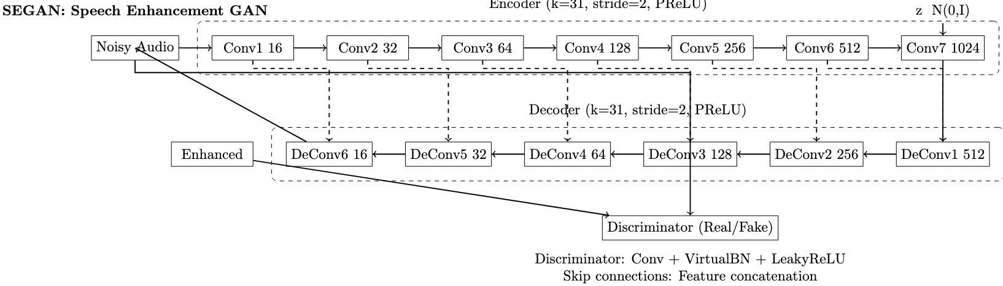
SEGAN
Uses an effective encoder-decoder architecture to denoise the signals
Encoder generates the denoised signal and compares with decoder
Both clean and noisy version of the signal are fed to the GAN

Slide 16
Metric GAN+ and Wav2Vec
Speech Brain
  Open-source toolkit for speech technologies; solutions for speech recognition
MetricGAN
  GAN for Speech Enhancement
  Pretrained on the Voice Bank Dataset
  Less Adversarial Loss
Wav2Vec Classifier
  Self-supervised model for learning speech representations
  Has variants fined tuned for Emotion Recognition
  Includes a convolutional feature encoder and a Transformer for sequence modeling
Metric GAN+ to clean noisy input
Extracting features using Wav2Vec2
Map emotion labels using trained label encoder
Load data

Slide 17
GAN Comparison
Using SNR 5 dB noise
Original
  74%
Noisy
  18%
SEGAN
  30%
MetricGAN
  51%

Slide 18
Results
Using MetricGAN denoising on RAVDESS + ESC-50 with SNR 5 dB
CLEAN
74.7%
NOISY
18.8%
DENOISED
51.4%

Slide 19
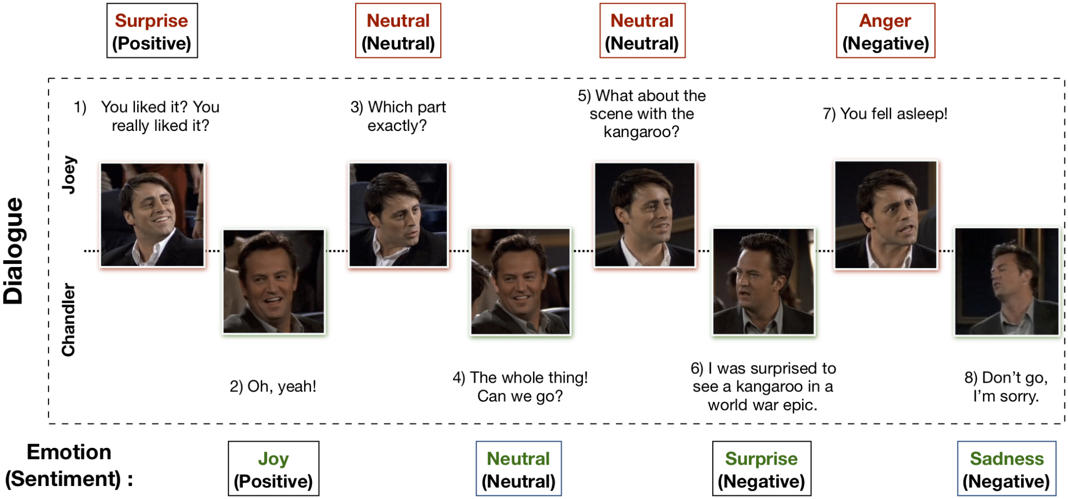
MELD Dataset
Introduction:
Multimodal EmotionLines Dataset (MELD) has been created by enhancing and extending EmotionLines dataset. MELD contains the same dialogue instances available in EmotionLines, but it also encompasses audio and visual modality along with text. MELD has more than 1400 dialogues and 13000 utterances from Friends TV series. Multiple speakers participated in the dialogues. Each utterance in a dialogue has been labeled by any of these seven emotions -- Anger, Disgust, Sadness, Joy, Neutral, Surprise and Fear. MELD also has sentiment (positive, negative and neutral) annotation for each utterance.

Slide 20
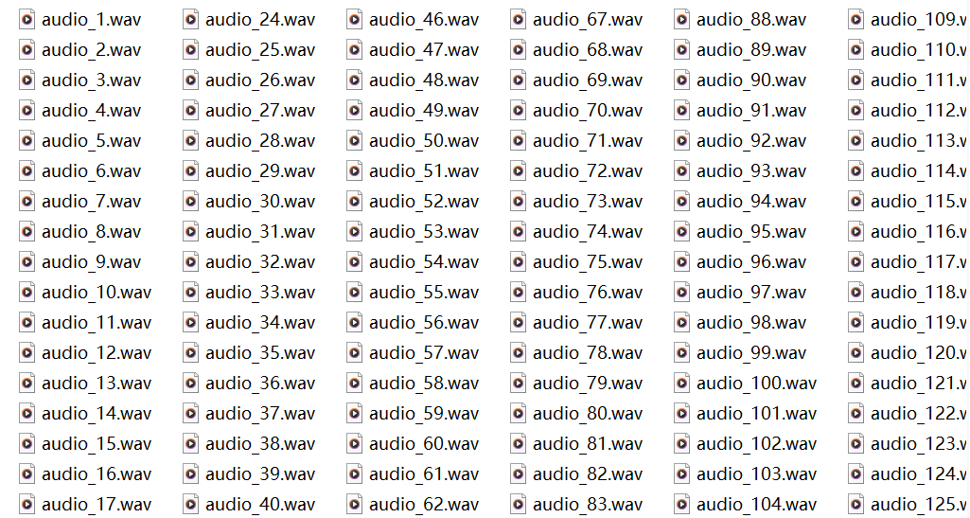
Data Preprocessing
Converting Videos to Audios
The reasons we did not use videos are listed below:
While more information, such as facial expressions and body language, provides more context, these features do not always directly correspond to the emotion of a single sentence.
This will include some emotion-unrelated features such as lighting conditions, background objects, or camera angles.
Video processing requires more computational resources and involves more complex models.

Slide 21
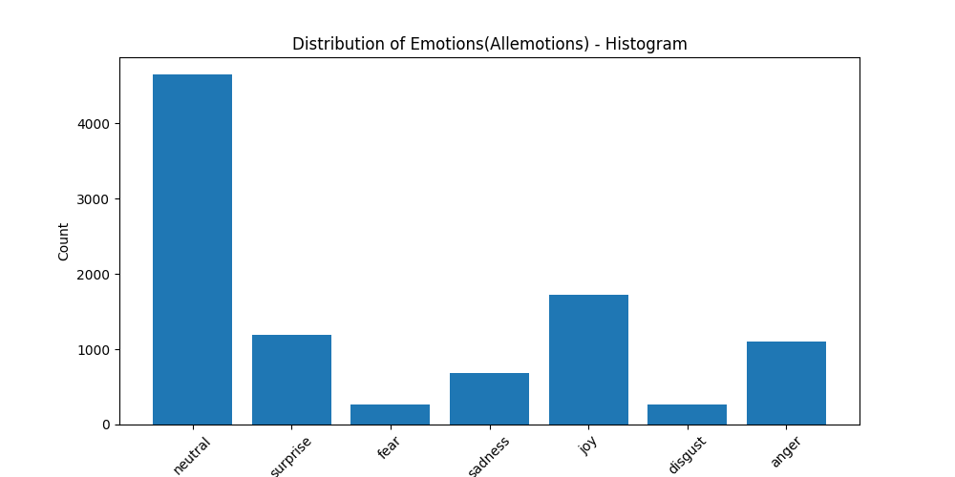
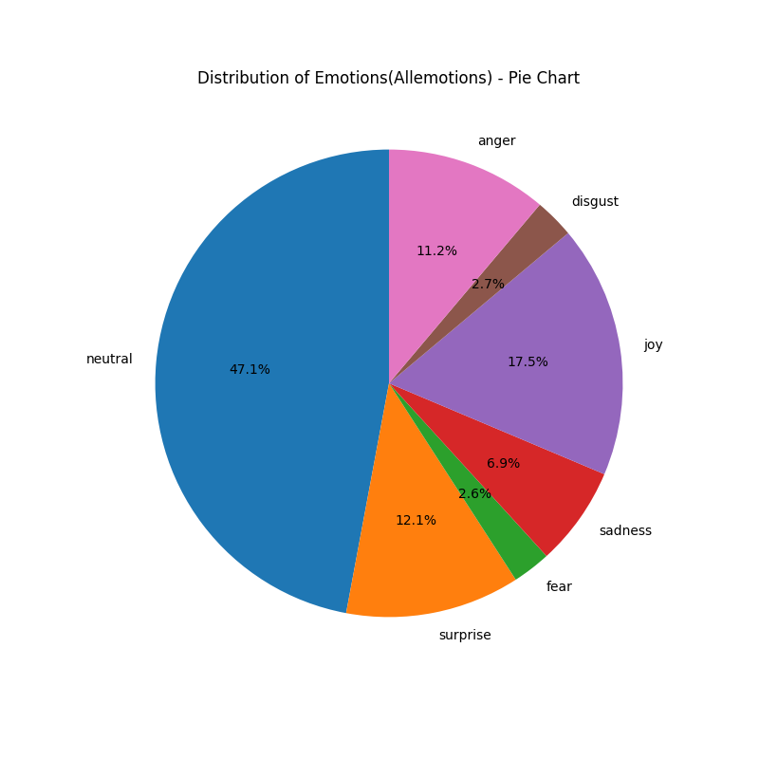
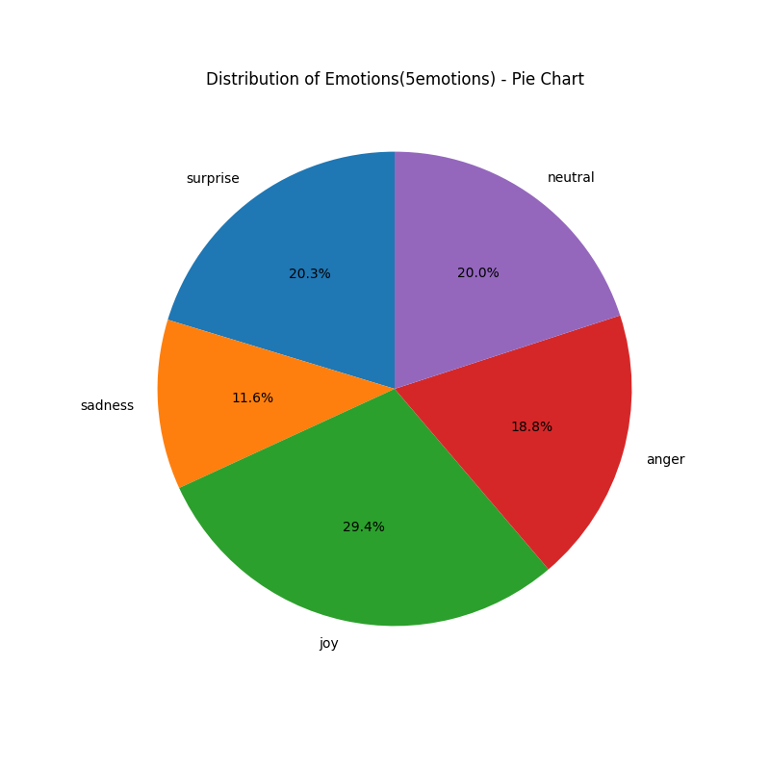
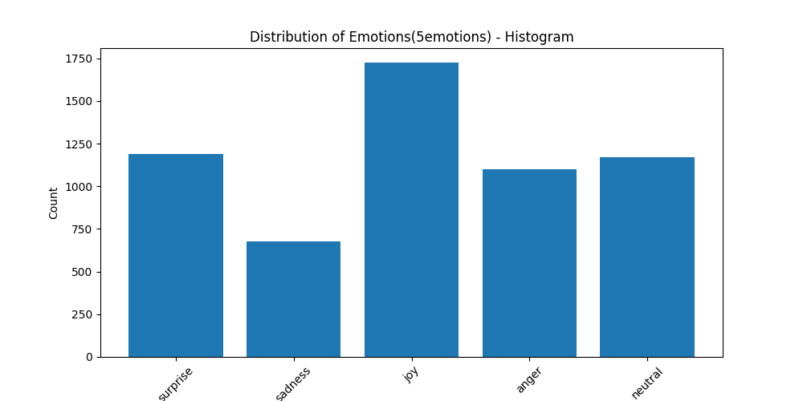
Data Preprocessing
Balancing Data

Slide 22
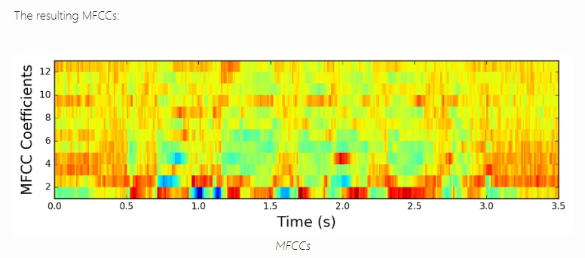
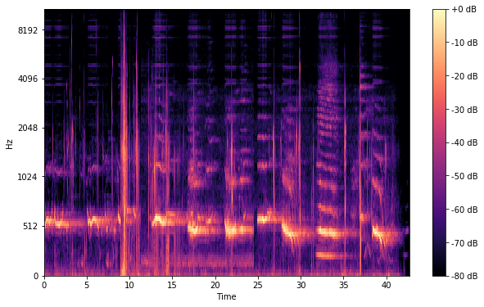
Data Preprocessing
Cleaning Nonexistent/Repeated Data
Since there exist some repeated Sr. No. in the CSV file and some Sr. No. do not have correlated audio files, we need to write a script to deal with the data.
Feature Extraction
MFCCs
Mel Spectrogram
def clean_csv(csv_file_path,folder_path,store_path):
df = pd.read_csv(csv_file_path)
existing_files = []
for index, row in df.iterrows():
file_name = f"audio_{row['Sr No.']}.wav"
file_path = os.path.join(folder_path, file_name)
if os.path.exists(file_path):
existing_files.append(row)
filtered_df = pd.DataFrame(existing_files)
filtered_df.to_csv(store_path, index=False)
print(f"files are stored in {store_path}")

Slide 23
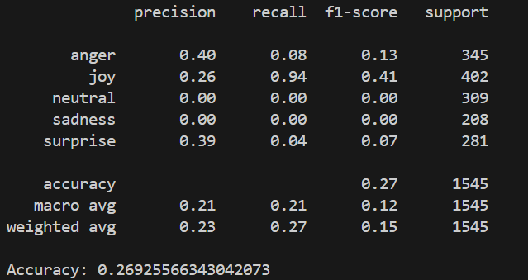
Machine Learning Approach
SVM

Slide 24
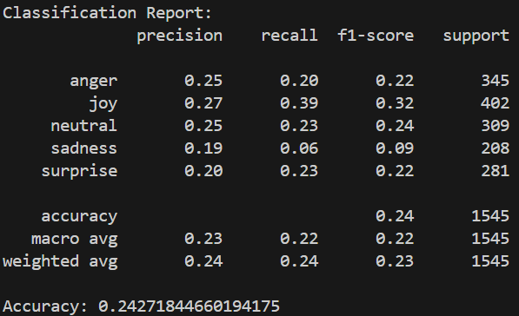
Machine Learning Approach
GMM

Slide 25
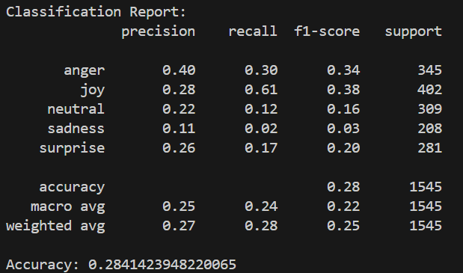
Machine Learning Approach
Gradient Boosting

Slide 26
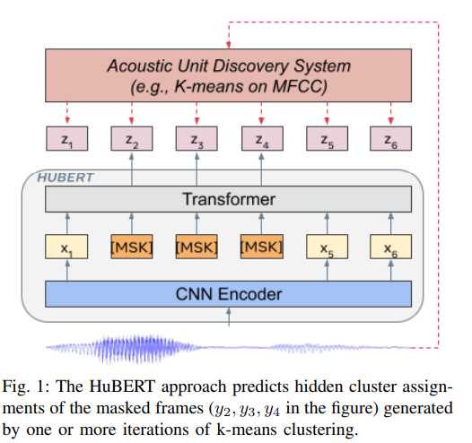
Deep Learning Approach
Hidden Unit BERT (HuBERT)
HuBERT (Hidden-Unit BERT) is a self-supervised speech representation learning model developed by Facebook AI. It is designed to learn robust audio representations from raw speech without the need for labeled data.
HuBERT works by first clustering the input audio into discrete units and then using these clusters as a form of supervision to train a model, similar to how BERT learns by predicting masked tokens in text. The model is trained in two stages: first, it learns to predict these hidden speech units, and in the second stage, it fine-tunes on a speech task such as speech recognition.

Slide 27
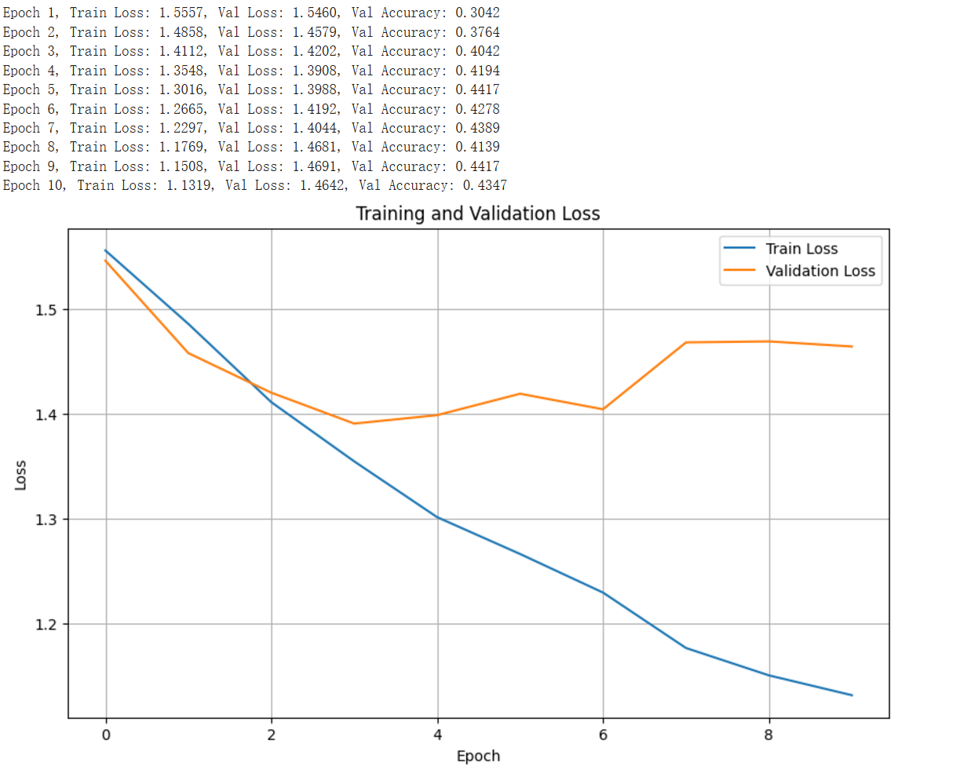
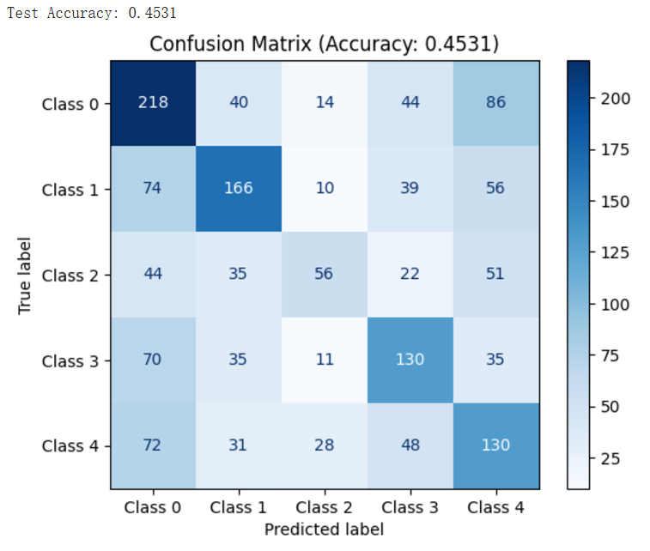
Deep Learning Approach
HuBERT

Slide 28
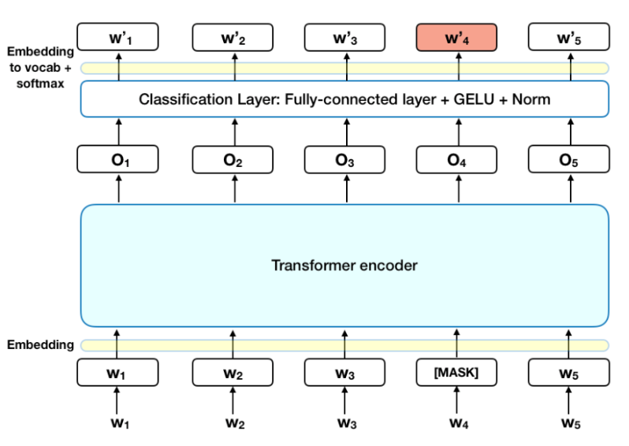
Deep Learning Approach
Bidirectional Encoder Representations from Transformers (BERT)
BERT is a powerful model for NLP developed by Google. It is designed to understand language by looking at both the words before and after a specific word in a sentence, unlike older models that only read text in one direction. This approach allows BERT to capture the meaning of words more accurately in different contexts.
BERT uses a self-attention mechanism to focus on relationships between words in a sentence. It is pre-trained on large text datasets using two tasks: masked language modeling (MLM) and next sentence prediction (NSP).

Slide 29
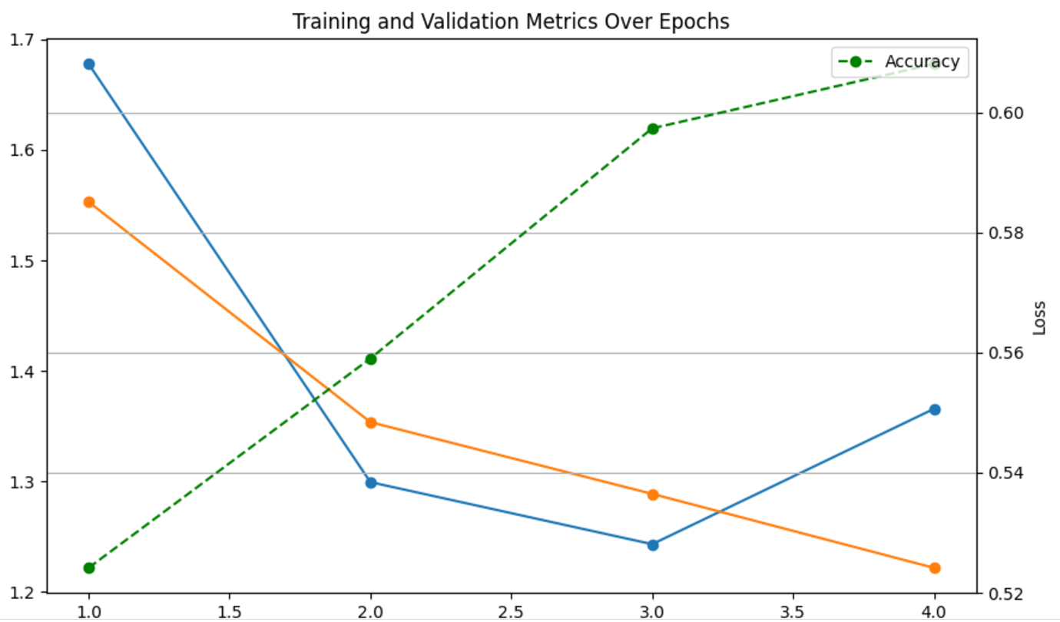
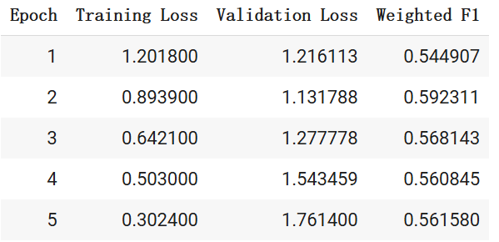
Deep Learning Approach
BERT
Test Set Accuracy: 52.4%

Slide 30
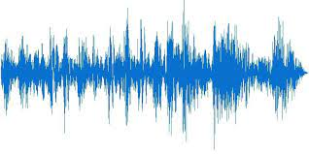
Deep Learning Approach (Multimodal)
HuBERT + BERT (Concatenated)
5 Emotions
Dim: 256
HuBERT
Audio
Concatenate
…
…
Whisper
Text
BERT
Specifically, we used “hubert-large-ls960-ft” for HuBERT, “:turbo” for Whisper, and “bert-base-uncased” for BERT.

Slide 31
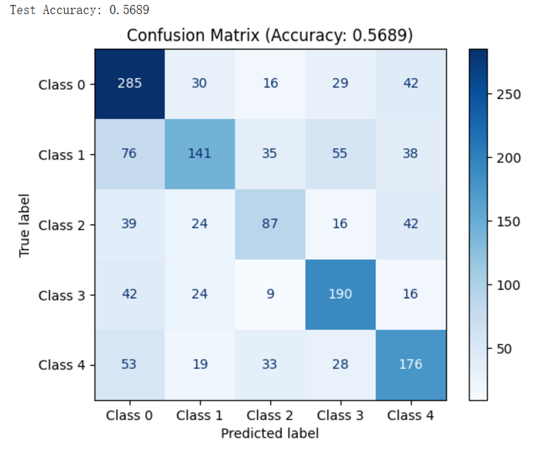
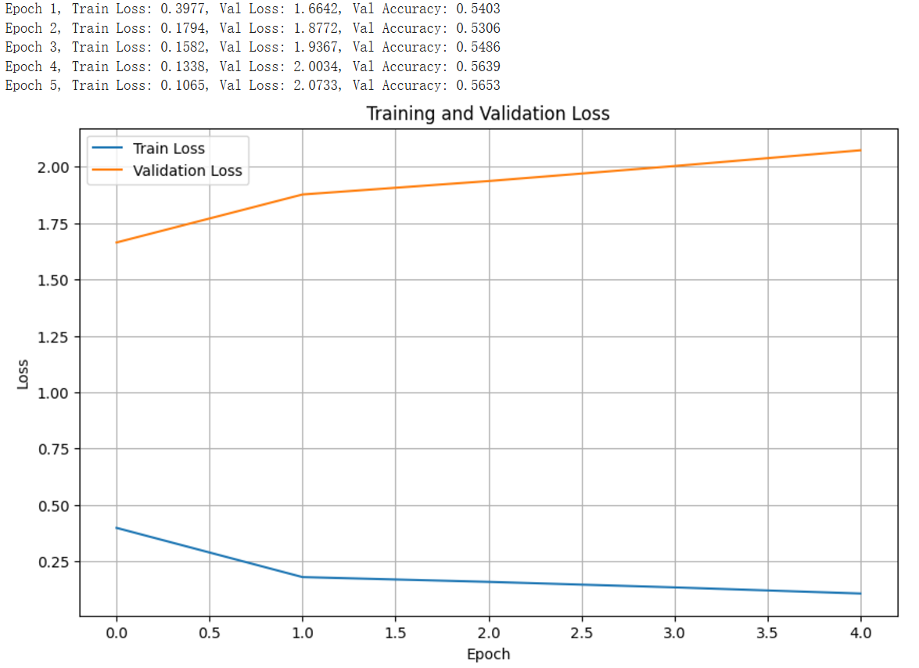
Deep Learning Approach (Multimodal)
HuBERT + BERT (Concatenated)

Slide 32
Deep Learning Approach (Multimodal)
HuBERT + BERT (Attention)
5 Emotions
Dim: 256
HuBERT
Audio
Attention
…
…
Whisper
Text
BERT
For attention, we first use PCA to make two features have the same dimension, and then we take text as Query and audio as Key and Value to do the attention.

Slide 33
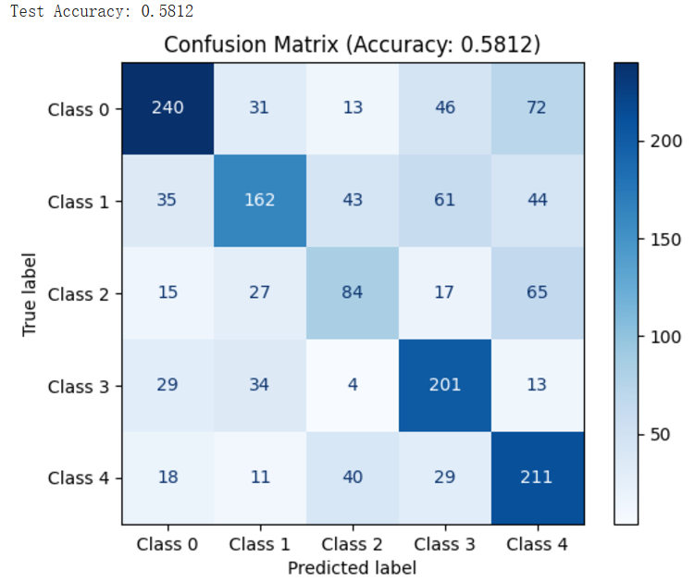
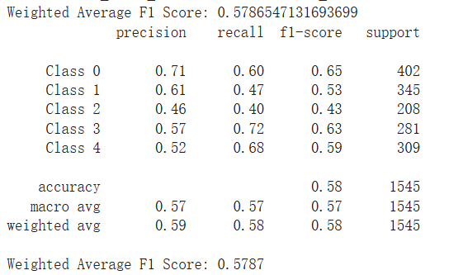
Deep Learning Approach (Multimodal)
HuBERT + BERT (Attention)

Slide 34
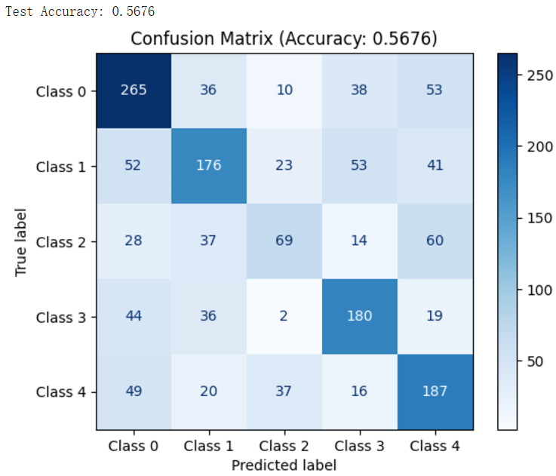
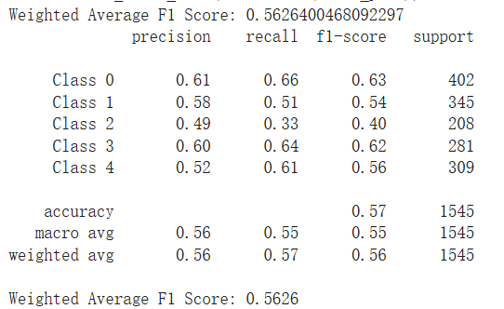
Deep Learning Approach (Multimodal)
WaveLM + BERT (Attention)

Slide 35
Experiment Result Table (MELD)
 | SVM/ GMM/ Gradient Boosting | HuBERT | BERT | HuBERT+ BERT+ Concatenate | HuBERT+ BERT+ Attention | WaveLM+ BERT+ Attention
Accuracy | 24% ~ 28% | 45.31% | 52.4% | 56.89% | 58.12% | 56.26%
Model
Score

Slide 36
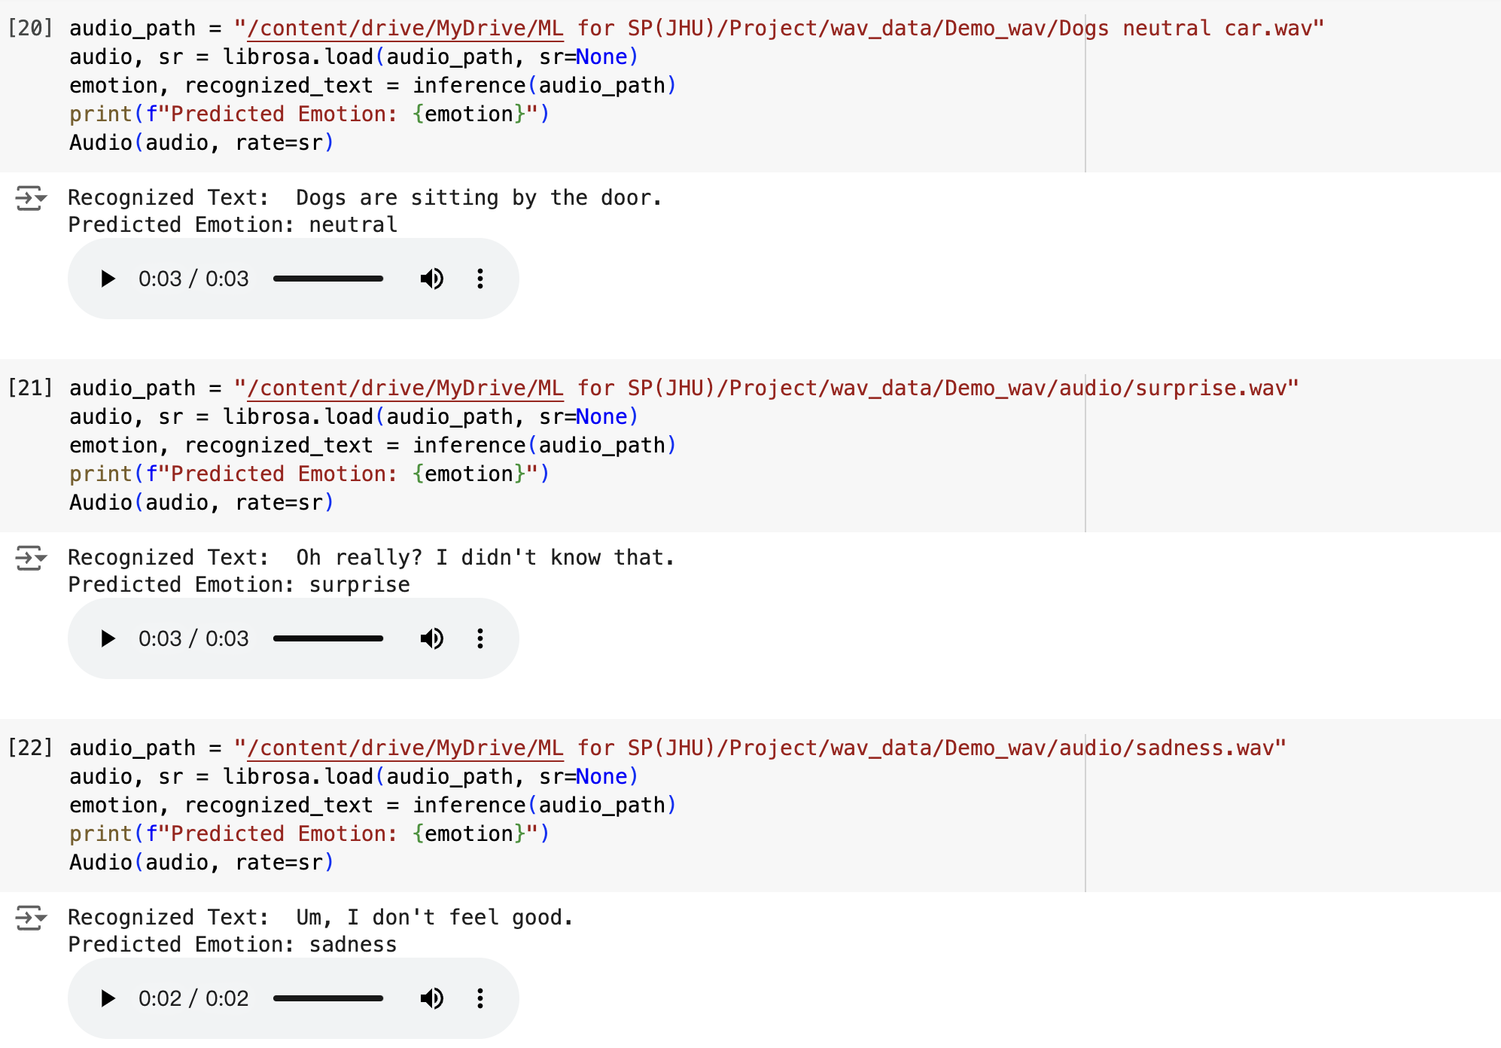
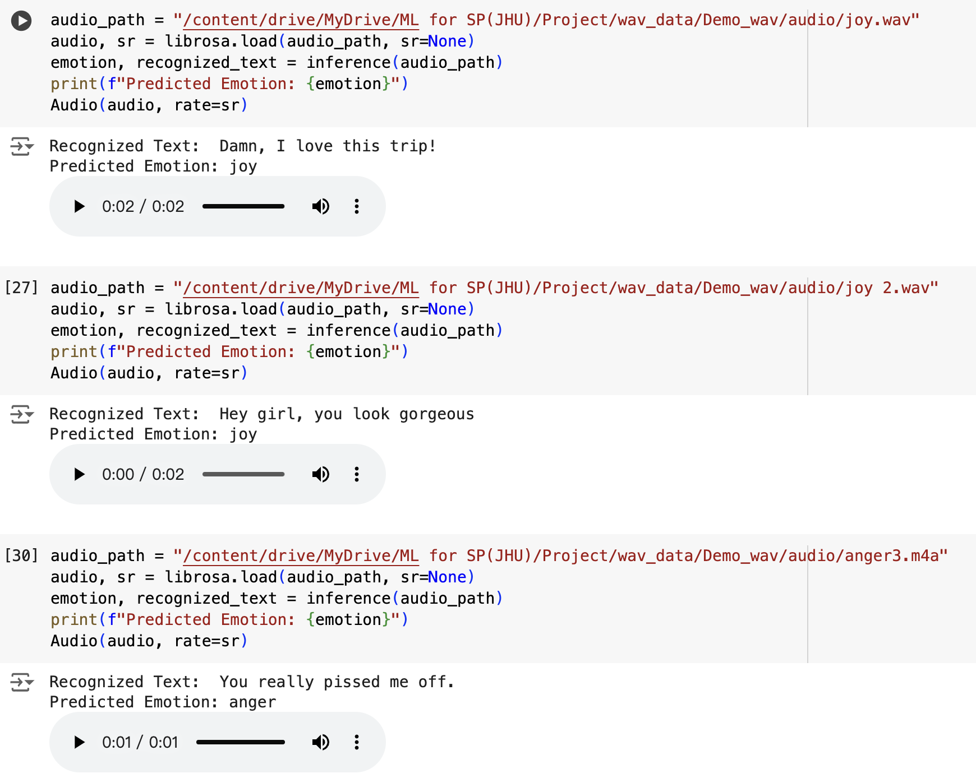
Demo

Slide 37
Findings
RAVDESS with Denoising
  Environmental noise is impactful in emotion analysis
  Standard filtering techniques struggle with environmental noise
  Deep learning techniques can tackle environmental noise
  The RAVDESS training set does extend well to real data
MELD with Multimodal
  Multimodal can perform better than a single input model
  The attention mechanism can better fuse features than concatenation
  MELD is a nice dataset for the model to solve real-world problems

Slide 38
Future Research
Build an end-to-end pipeline for emotion analysis
  1 Input
  2 Denoise
  3 Speech to Text
  4 Multimodal Classification
Train with more diverse speech
Find other ways to keep improving the accuracy of multimodal output

Slide 39
Thank you!

Slide 40
References
A. Baevski, H. Zhou, A. Mohamed, and M. Auli, “wav2vec 2.0: A Framework for Self-Supervised Learning of Speech Representations,” Oct. 22, 2020, arXiv: arXiv:2006.11477. Accessed: Nov. 01, 2024. [Online]. Available: http://arxiv.org/abs/2006.11477
Chen, S., Wang, C., & Chen, Z. (2022). WavLM: Large-Scale Self-Supervised Pre-Training for Full Stack Speech Processing. arXiv. https://arxiv.org/abs/2110.13900
Devlin, J., & Chang, M. (2019). BERT: Pre-training of Deep Bidirectional Transformers for Language Understanding. arXiv. https://arxiv.org/abs/1810.04805
Hsu, W., Bolte, B., & Tsai, Y. (2021). HuBERT: Self-Supervised Speech Representation Learning by Masked Prediction of Hidden Units. arXiv. https://arxiv.org/abs/2106.07447
L. Wan, H. Liu, L. Shi, Y. Zhou, and L. Gan, “Cross Domain Optimization for Speech Enhancement: Parallel or Cascade?,” IEEE/ACM Trans. Audio Speech Lang. Process., vol. 32, pp. 4328–4341, 2024, doi: 10.1109/TASLP.2024.3468026.
O. Julius, Ibidun. C. Obagbuwa, A. A. Adebiyi, and E. B. Michael, “Implementation of Audio Signals Denoising for Perfect Speech-to-Speech Translation Using Principal Component Analysis,” in 2023 International Conference on Science, Engineering and Business for Sustainable Development Goals (SEB-SDG), Omu-Aran, Nigeria: IEEE, Apr. 2023, pp. 1–6. doi: 10.1109/SEB-SDG57117.2023.10124385.
S. Pascual, A. Bonafonte, and J. Serrà, “SEGAN: Speech Enhancement Generative Adversarial Network,” Jun. 09, 2017, arXiv: arXiv:1703.09452. Accessed: Nov. 02, 2024. [Online]. Available: http://arxiv.org/abs/1703.09452
S.-W. Fu, C.-F. Liao, Y. Tsao, and S.-D. Lin, “MetricGAN: Generative Adversarial Networks based Black-box Metric Scores Optimization for Speech Enhancement,” May 13, 2019, arXiv: arXiv:1905.04874. doi: 10.48550/arXiv.1905.04874.
Vaswani, A., & Shazeer, N. (2023). Attention Is All You Need. arXiv. https://arxiv.org/abs/1706.03762

