Slide 1

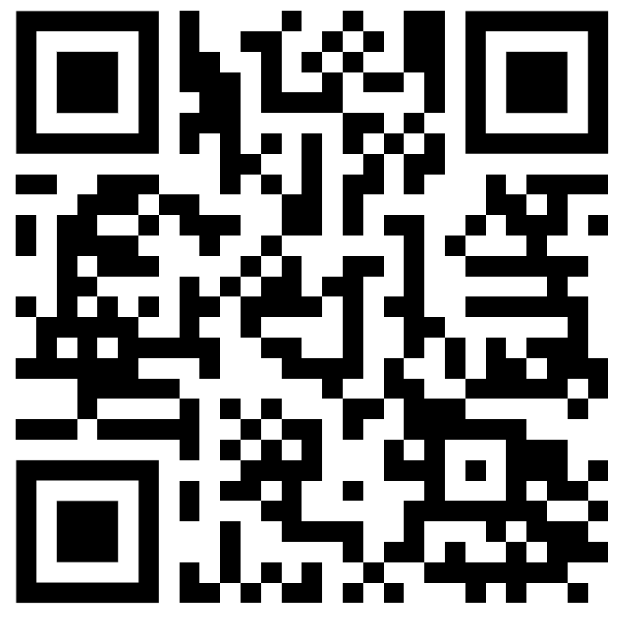
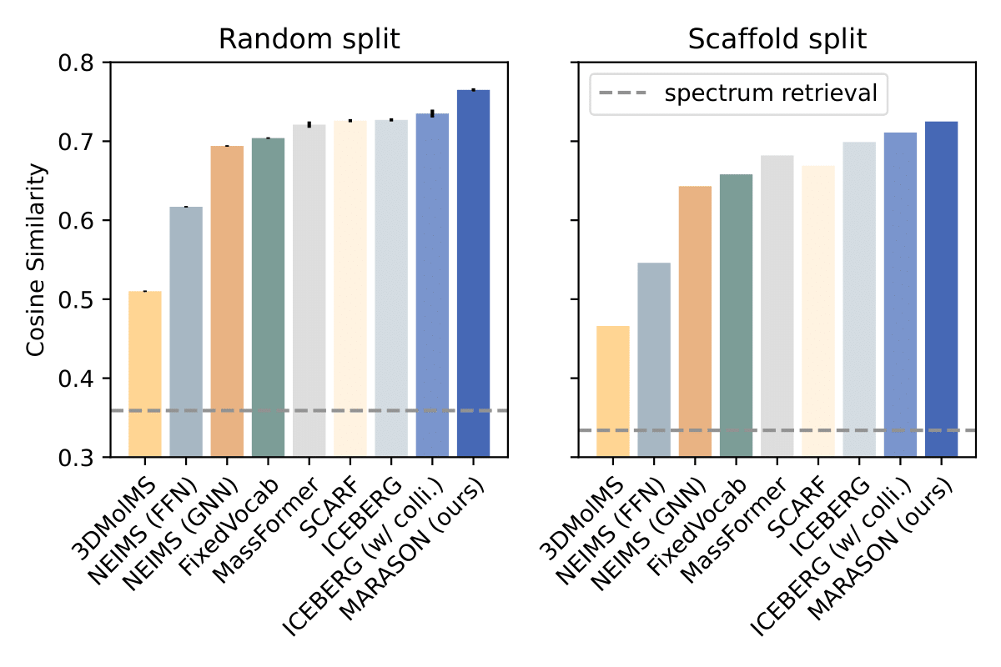
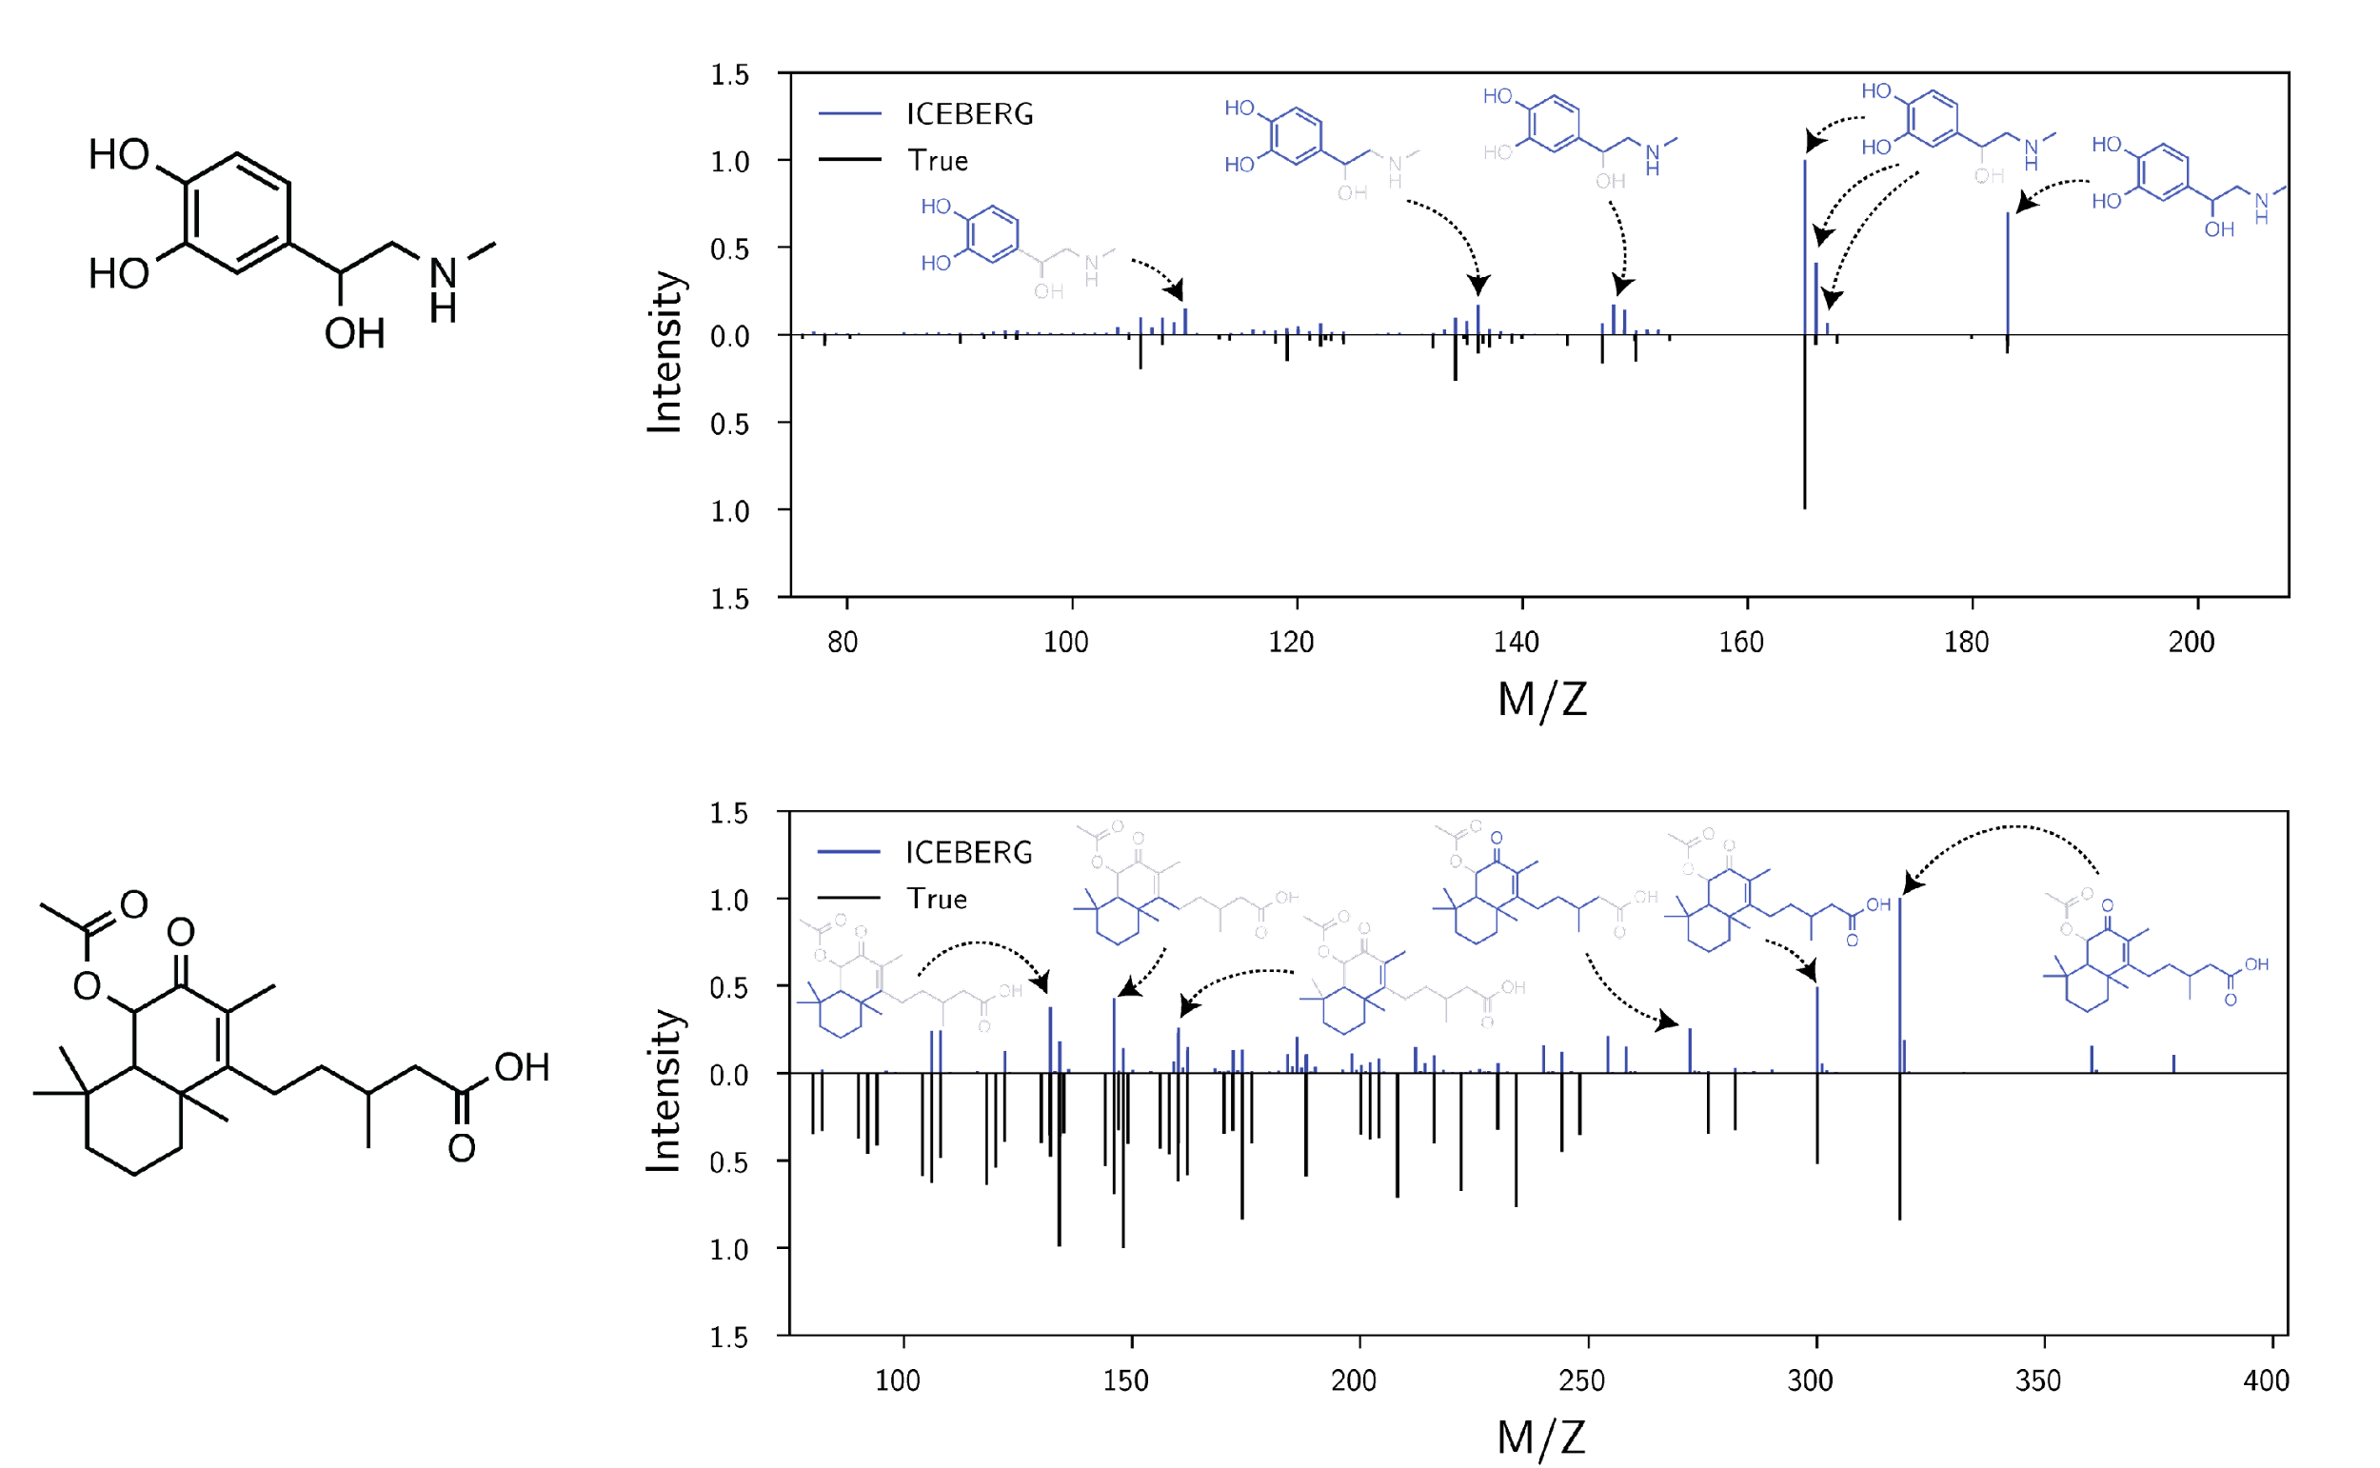
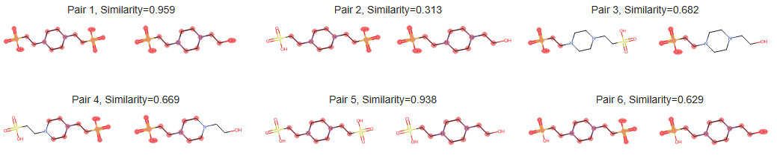
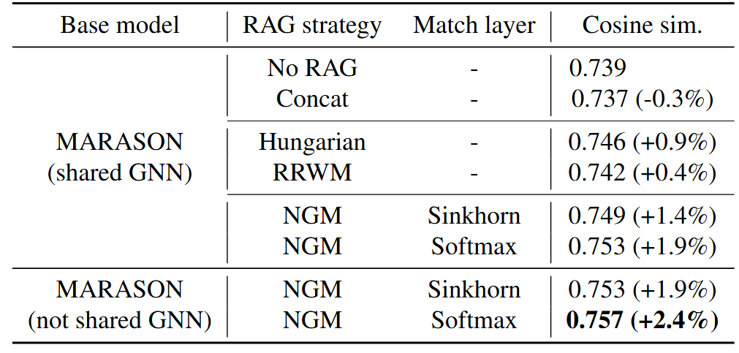
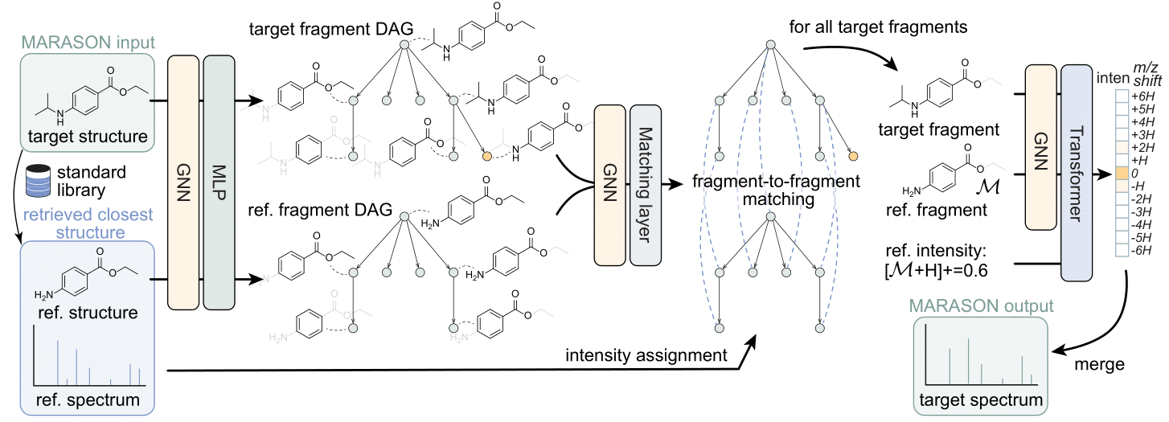



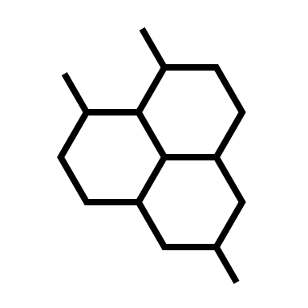
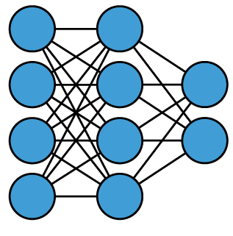


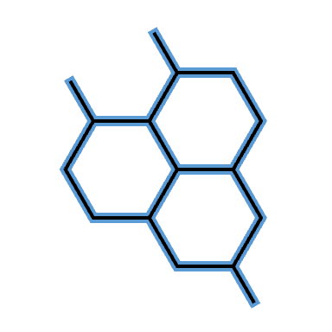

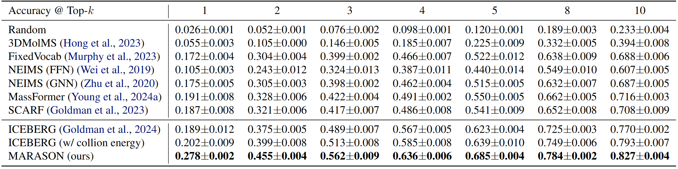
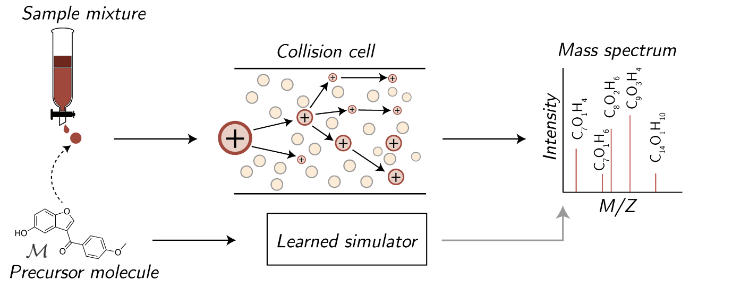
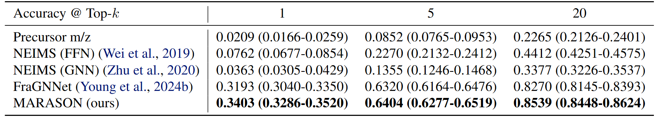
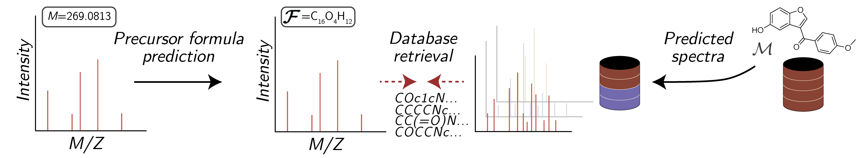
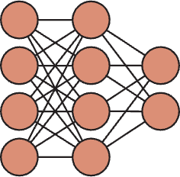
Neural Graph Matching Improves Retrieval Augmented Generation in Molecular Machine Learning
Runzhong Wang*, Rui-Xi Wang*, Mrunail Manjrekar, Connor W. Coley
Massachusetts Institute of Technology
Code
Abstract
Key insight: matching reference and target molecules
In mass spectrometry, peaks are attributed to molecular fragments
Neural graph matching (linear matching formulation)
Molecular machine learning has gained popularity with the advancements of geometric deep learning. In parallel, retrieval-augmented generation has become a principled approach commonly used with language models. However, the optimal integration of retrieval augmentation into molecular machine learning remains unclear. Graph neural networks stand to benefit from clever matching to understand the structural alignment of retrieved molecules to a query molecule. Neural graph matching offers a compelling solution by explicitly modeling node and edge affinities between two structural graphs while employing a noise-robust, end-to-end neural network to learn affinity metrics. We apply this approach to mass spectrum simulation and introduce MARASON, a novel model that incorporates neural graph matching to enhance a fragmentation-based neural network. Experimental results highlight the effectiveness of our design, with MARASON achieving 28% top-1 accuracy, a substantial improvement over the non-retrieval state-of-the-art accuracy of 19%. Moreover, MARASON outperforms both naive retrieval-augmented generation methods and traditional graph matching approaches.
0.0
Graph 1
Graph 2
The reference structure might have fragments with distinct masses, and the mapping is not obvious until the molecular graphs are matched
GNN
GNN
Embedding
Embedding
m/z=301.0965
m/z=237.1251
m/z=284.0937
m/z=220.1223
Similarity metric
 | No RAG | Concat RAG | Matching RAG
Cosine sim. | 0.739 | 0.737 (-0.3%) | 0.757 (+2.4%)
Sinkhorn / Softmax
Average Cosine Similarity of predicted Spectra of MARASON. MARASON outperforms all SOTA model.
Wang et al. TPAMI. 2023
MARASON: RAG with graph matching for MS/MS simulation
Retrieval Augmented Generation (RAG)
Text generation (LLMs) Molecular machine learning
(focus of this paper)
Ablation Study of MARASON over different model architecture and Graph matching method. Note that Neural Graph Matching (Sinkhorn, Softmax) outperforms Hard Coded Feature Graph Matching (Hungarian, RRWM)
Inquiry
LLM
Answer
Molecule
Neural Net
Property
prediction
with RAG: with RAG:
Inquiry
LLM
Answer
(better quality)
Molecule
Neural Net
Property
prediction
MARASON
RAG query by Tanimoto similarity on the training dataset (could further extend)
Once target and reference fragments are generated, MARASON uses a nested neural graph matching layer to match them
Database (e.g., Bing’s search, Wikipedia)
Database
Reference molecules with known property
Case Study: Mass Spectrum
Task: mimic what’s happening in the analytical tool, mass spectrometer (MS)
Retrieval accuracy of MARASON over 50 decoy structures from PubChem. Note that MARASON outperforms other state of the art model.
Scientific value: MS simulation models could help structural elucidation
Visualization of experimental, reference, and predicted spectra by MARASON with or without RAG. MARASON with RAG can generate a predicted spectrum highly similar to the experimental one, while the spectrum predicted by MARASON without RAG contains more noise.
Retrieval accuracy of MARASON over 250 decoy structures from the MassSpecGym Dataset. Note that MARASON outperforms SOTA benchmark by around 7%
MARASON

