Slide 1
I’m Jayden Rivers
I’m studying computer science while working at InfoSect
I’m interested in binary exploitation and software engineering

Slide 2
This talk will cover
Allocating Memory
Dynamic memory management
Exploiting Malloc
Exploiting the TCache
Bypassing Safe-Linking
TCache list head poisoning

Slide 3
Allocating memory

Slide 4
Three main ways of managing program memory
Automatically
Managed via a Stack data structure - because a stack is LIFO so it’s good for nested function calls.
The duration of a Stack region (or Frame) is dependent on the lifetime of the function which manages it.

Slide 5
Dynamically
The duration of a Dynamically allocated region is constrained by the programmer’s choices as well as how the memory allocator is designed
These regions can exist beyond the lifetime of any single function
It is the responsibility of the client to allocate and deallocate correctly
Statically
These regions are defined in the global context, so they exist
for the duration of the process

Slide 6
The distinction between automatic, dynamic, and static, is the duration and scope for which a region is well-defined
But we may also be able to access regions outside of their intended duration, scope, or linear boundary.
This is the basis for memory-use errors.

Slide 7
Automatic memory management is easy
you call a function from another function
your arguments get passed
enough room for local variables is prepared
and a reference to the next instruction for the CPU to carry out when the called function is complete, is kept on the stack Frame
or in a register

Slide 8
Dynamic memory management

Slide 9
Dynamic memory management is hard.
PtMalloc, which is part of GNU Libc, is the implementation we will focus on.
Malloc is a heap-style memory allocator.
There are other types of allocation mechanisms, such as slab and buddy. The FreeBSD userspace allocator ‘jemalloc’ employs both of these styles.
But we will focus only on Malloc as used in GNU Linux systems.

Slide 10
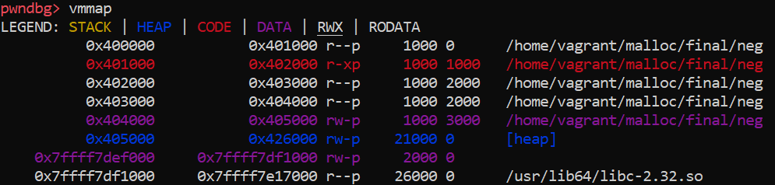
A heap-style memory allocator has a range of possible sizes of memory which the user can request from Malloc.
These regions are all stored together in a larger region of memory called the Heap.

Slide 11
Each new allocation sits at a higher address in Heap space.
However, as we will see, not every region returned by Malloc is new as deallocated regions may be recycled for the sake of efficiency.
We don’t want to keep cutting up the virtual address space when we can just reuse already cut out chunks.
This reduces fragmentation and speeds things up a bit.

Slide 12
The memory regions which the client can request are called “chunks”. They are the fundamental unit of Malloc
There are two perspectives and two states which relate to each chunk
To the client, a chunk appears as a region of memory which can be written to and read from
To Malloc (the server) a chunk appears as management data plus the user data portion

Slide 13
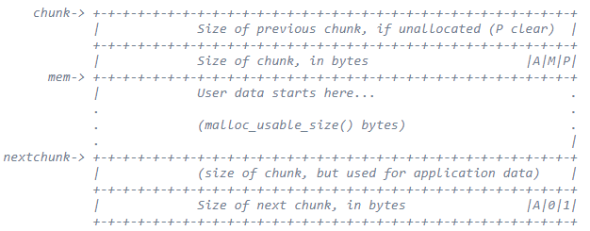
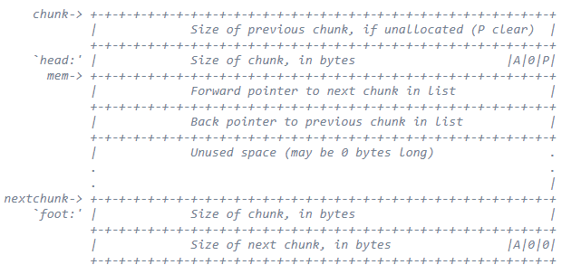
A chunk can be in an allocated state or a free state.
These two states define the metadata associated with each chunk.
Just like in Stack memory, there’s both metadata and data.
(images taken from malloc.c)

Slide 14
Let’s request two chunks of size 10
char *a = malloc(10);
char *b = malloc(10);
What will they look like in memory?
a
Chunk(addr=0x5555555592a0, size=0x20, flags=PREV_INUSE)
==
0x5555555592a0: 0x0000000000000000 0x0000000000000000
0x5555555592b0: 0x0000000000000000
b
Chunk(addr=0x5555555592c0, size=0x20, flags=PREV_INUSE)
==
0x5555555592c0: 0x0000000000000000 0x0000000000000000
0x5555555592d0: 0x0000000000000000

Slide 15
But where is the metadata stored?
0x555555559290: 0x0000000000000000 0x0000000000000021
0x5555555592a0: 0x0000000000000000 0x0000000000000000
0x5555555592b0: 0x0000000000000000 0x0000000000000021
0x5555555592c0: 0x0000000000000000 0x0000000000000000
0x5555555592d0: 0x0000000000000000
If we look at the memory which just precedes each chunk, we can see a size field

Slide 16
Chunk(addr=0x5555555592a0, size=0x20, flags=PREV_INUSE)
Chunk size: 32 (0x20)
Usable size: 24 (0x18)
Previous chunk size: 0 (0x0)
PREV_INUSE flag: On
IS_MMAPPED flag: Off
NON_MAIN_ARENA flag: Off
Here I used the GEF-GDB plugin to view some other metadata related to
the chunk which a points to

Slide 17
Say we free a and then b
free(a);
free(b);
gef➤ p a
$3 = (int *) 0x5555555592a0
gef➤ p b
$4 = (int *) 0x5555555592c0
gef➤ x/8gx b
0x5555555592c0: 0x00005555555592a0 0x0000555555559010
As you can see, there’s a pointer to a at the first bytes of b.

Slide 18
The reason for these pointers is that when chunks are freed they are linked into lists of free chunks.
These chunks may then be recycled in future requests made by the client.
In turn, the lists are grouped together in “bins”.

Slide 19
There’s
a small bin,
a fast bin,
a large bin,
and an unsorted bin
These bins correspond to different size ranges of chunks. The unsorted bin also performs a special staging role.
Then there’s the Per-thread Cache for each Thread of execution (TCache)
The TCache also has its own set of freelists

Slide 20
The TCache is has these dimensions:
chunks must be in the range of 0x20 → 0x408
where the number of lists is 64
each list can have a maximum of 7 chunks linked into it
each list has chunk nodes which are singly linked
The TCache aims to solve an additional problem compared to the other set of freelists
To understand what this problem is, I will now mention the units of Malloc

Slide 21
Units of Malloc in order of generality:
Thread Management
Arenas
Heaps
Chunks

Slide 22
A chunk will belong to a Heap, a Heap to an Arena, and an Arena to a Thread, if said Thread has locked the Arena for itself.
This implies that Threads may access multiple Arenas over time, but that an Arena can only be accessed by one Thread at a time.

Slide 23
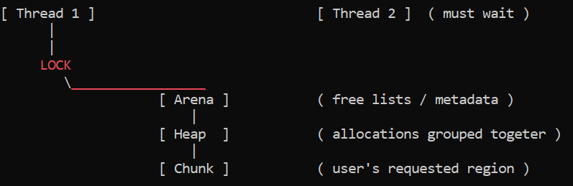
Here is a representation of Thread 1 gaining exclusive access to the Arena and all its chunks
You can see the problem here. If Thread 2 has to wait long this might negate the power of Malloc’s freelist optimisation.

Slide 24
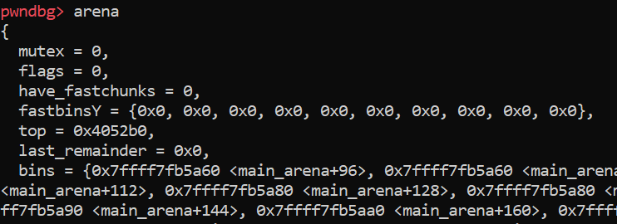
Arenas serve as a structure for storing the lists of freed chunks.
They also have pointers to other Arenas and other metadata such as where the top chunk is in memory – where allocations are serviced from.
Some of the fields present in an Arena:

Slide 25
This problem relates to the contention between Threads for control over a region of memory and its data
It’s a general problem and in heavily multithreaded applications it can become inefficient to lock and wait at certain scales.
For Malloc, the solution is the use of Thread-Local Storage
This is data which belongs to each Thread and transcends the regions of memory over which multiple Threads contend

Slide 26
There’s much more in Malloc which is not relevant for our discussion today
But now we should have a general grasp on the notions of:
data and metadata
the units of Malloc
the justification for the TCache

Slide 27
Exploiting Malloc

Slide 28
Exploitation of Malloc has a long history but many techniques are no longer possible in the latest versions of Malloc.
The first notable technique in heap exploitation was formulated by Solar Designer. This was the Unlinking style attack
Essentially, we overwrite the value at some location in memory by having Malloc consolidate free chunks
The consolidation mechanism is called ‘unlinking’ and one aspect of it allows a hacker to gain a write-what-where primitive by targeting the pointers of freed chunks in a linked list

Slide 29
struct Node {
char data;
struct Node *forward, *backward;
};
node2->data = ‘B';
node2->forward = node1;
node2->backward = node3;
Before explaining this further, it’s good to see a representation of a doubly linked list.
[ node1 ] -> [ node2 ] -> [ node3 ]
<- <-

Slide 30
[ node1 ] -> [ node2 ] -> [ node3 ]
<- <-
In order to consolidate node1 and node2, we would update the size of node1 to consume node2, and then we would unlink node2 from the free list leaving the list like this
[ node1 + node2 ] -> [ node3 ]
<-

Slide 31
The Macro to achieve this list unlinking mechanism, in previous versions of Glibc was:
#define unlink( P, BK, FD ) { \
BK = P->bk; \
FD = P->fd; \
FD->bk = BK; \
BK->fd = FD; \
}
Say P is a chunk which we want to have consume the chunk ahead of it,
we set P -> bk to the address of shellcode, and
P -> fd to the address of a function pointer or hook minus 12 bytes as struct offset, then
FD - > bk ( FD + 12 ) will be set to P -> bk, the address of our shellcode

Slide 32
In a stack overflow, we often want to overwrite the instruction pointer saved on the stack frame
But here we are further removed from code execution
All we are doing is linking and unlinking a specially crafted piece of Data into a linked list Data structure

Slide 33
Our machines need to refer to both the Code and the Data to run, but Data is used to direct Code.
For example, storing function pointers in a struct.
These pointers are Data, but they can also be dereferenced in order to invoke the function they point to.
Overwriting this Data, we can alter execution.

Slide 34
Unlinking has been followed by the House of * series.
These also target metadata used in Malloc.
It might be in House of Force which targets the available size of Malloc chunks, allowing an attacker to allocate a chunk which overlaps a function hook or the address of a function pointer in the GOT.
It might be House of Spirit which frees a fake chunk, targeting list links so that Malloc returns a pointer to sensitive data.

Slide 35
Exploiting the TCache

Slide 36
The TCache was introduced as part of Glibc 2.26. At that time it had little to no security checks. Many older freelist-based attacks were reintroduced in the TCache
Though it operates differently, the general idea is that given the misuse of the deallocation mechanism, such as through a UAF or double free condition, the attacker may be able to get Malloc to return a pointer to an arbitrary address
It is also important to note that the TCache lists are singly linked
Their nodes only have forward pointers

Slide 37
We’ll now look at a double free
Recall that a freed chunk will be linked into a list
Freeing it twice will link the same chunk twice.
So free(A), free(A) will produce this
[ TCache root node ] → [ A ] → < Loopback to A >

Slide 38
If we then request a chunk of a similar size to [ A ], then the list will still look like this [ TCache root node ] → [ A ] → < Loopback to A >
Now we will also be able to write to this same chunk while it is in the TCache
Essentially what we can do here is write the address of a target in memory to the foremost bytes of the [ A ] chunk such that the linked list now looks like [ TCache root node ] → [ A ] → [ target address ]

Slide 39
A use after free is extremely similar. Basically we have this: [ TCache root node ] → [ A ]
Then we write to the foremost bytes of [ A ] and we have:
[ TCache root node ] → [ A ] → [ target address ]

Slide 40
More concretely, starting in Glibc 2.27
a double free of the region of memory pointed at by a
(gdb) x/4gx a
0x555555756260: 0x0000555555756260 0x0000000000000000
0x555555756270: 0x0000000000000000 0x0000000000020d91
As you can see, the freed chunk a has a forward pointer to itself
This is the same as the linked list cycle we saw previously
Not so interesting

Slide 41
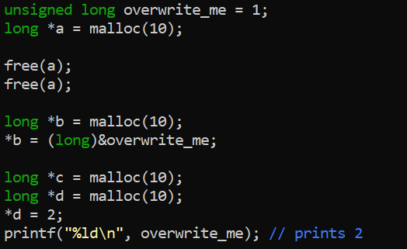
But take this, we have a variable which we managed to overwrite using Malloc’s own mechanisms.

Slide 42
A use after free condition may allow us to overwrite
the forward pointer directly
long *a = malloc(10);
free(a);
*a = 0x41414141; //maybe a memcpy or write to field
Not so interesting
(gdb) x/4gx a
0x555555756260: 0x0000000041414141 0x0000000000000000
0x555555756270: 0x0000000000000000 0x0000000000020d91

Slide 43
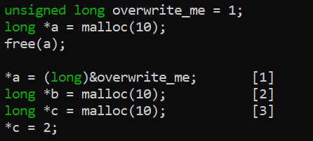
But take this
1 [ T-cache root node ] → [ A ] → [ target address ]
2 [ T-cache root node ] → [ target address ]
3 c == [ target address ]

Slide 44
Mitigations

Slide 45
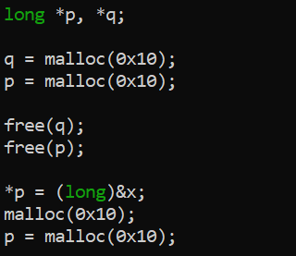
TCache count checking
Basically, we can’t have Malloc return more chunks than were legitimately linked into freelists.
if (tcache->counts[tc_idx] < mp_.tcache_count)
But we can maintain the TCache count between calls
Here, we freed an extra chunk to set the count > 0.
Then we freed another chunk, launching our use-after-free attack.

Slide 46
Mark freed chunks with a key field
Even harder to bypass. But basically there are a few ways
One way is to overwrite the key field as detailed by Silvio here:
“Linux Heap glibc TCache Double Free Mitigation Bypass”
https://drive.google.com/file/d/1g2qIENh2JBWmYgmfTJMJUier8w0XAGDt/view

Slide 47
This mitigation marks chunks which are freed into
the tcache by setting the key field of a tcache node:
tcache_put (mchunkptr chunk, size_t tc_idx)
{
tcache_entry *e = (tcache_entry *) chunk2mem (chunk);
e->key = tcache;
e->next = PROTECT_PTR (&e->next, tcache->entries[tc_idx]);
tcache->entries[tc_idx] = e;
++(tcache->counts[tc_idx]);
}

Slide 48
When we attempt to free an already freed chunk into a
tcache list, malloc checks the key field and stops us.
if (__glibc_unlikely (e->key == tcache))
{
tcache_entry *tmp;
LIBC_PROBE (memory_tcache_double_free, 2, e, tc_idx);
for (tmp = tcache->entries[tc_idx];
tmp;
tmp = REVEAL_PTR (tmp->next))
{
[...]
if (tmp == e)
malloc_printerr ("free(): double free detected in tcache 2");}
[...]

Slide 49
So how can we get around this?
Essentially, we can free a chunk, and then overwrite the key field to ensure that the previous check fails.
Here is a demonstration of the technique from the article I mentioned earlier.

Slide 50
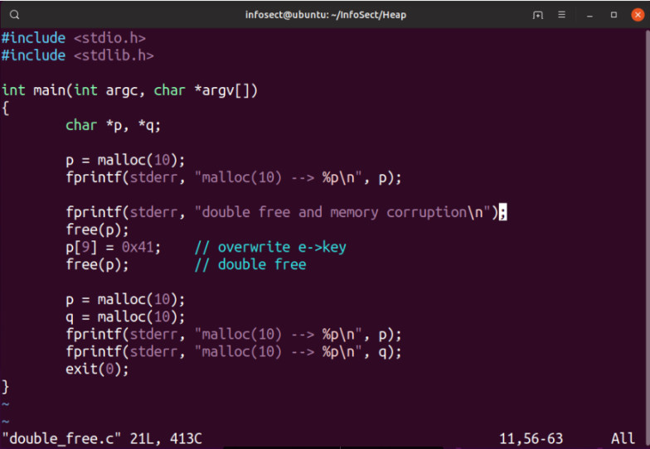

Slide 51
Size toggling
Another way to bypass the key check is to confuse Malloc as to which list to check for a double free condition.
We can achieve this by toggling the size of an adjacent chunk.
If we can change an adjacent chunk’s size metadata then we can get the same chunk placed on different lists

Slide 52
So while we fail the first check, we ensure that Malloc can’t find our already-freed chunk because it’s searching along the wrong list
if (__glibc_unlikely (e->key == tcache))
{
tcache_entry *tmp;
LIBC_PROBE (memory_tcache_double_free, 2, e, tc_idx);
for (tmp = tcache->entries[tc_idx];
tmp;
tmp = REVEAL_PTR (tmp->next))
{
[...]
if (tmp == e)
malloc_printerr ("free(): double free detected in tcache 2");}
[...]

Slide 53
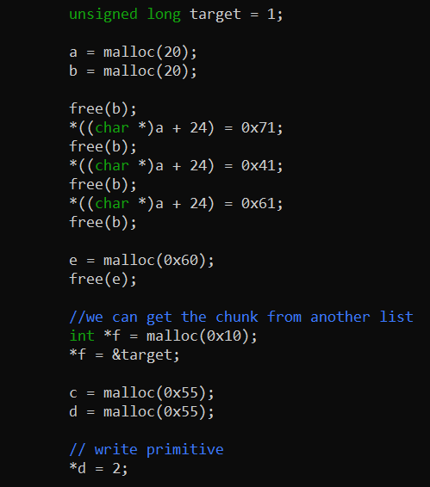
In this example we repeatedly toggled the size of an adjacent chunk which we know will be freed.
Then we created cycles in the linked lists and retrieved our target address from a bin whose count is greater than 0.

Slide 54
Safe-linking
Very hard to bypass
The constraints are harsh and generally you’d need an information leak
in order to demangle pointers.
But given the right circumstances we can bypass it by attacking
the TCache list heads directly

Slide 55
Safe-Linking

Slide 56
Safe-Linking was introduced by Check Point Research, in particular by their researcher:
Eyal Itkin
The idea, as detailed in CPR’s article, is to make “use of randomness from the Address Space Layout Randomization (ASLR) to “sign” the list’s pointers.“

Slide 57
Eyal Itkin refers to the glibc unsafe unlinking mitigation as inspiration for this mitigation
This is because the doubly-linked lists have already been protected from the unlinking style attack I mentioned earlier
But mitigations over unsafe linking / unlinking in the singly linked lists such as those in the TCache have remained bypassable

Slide 58
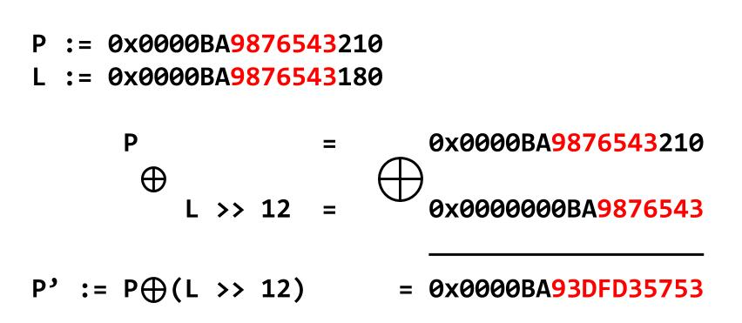
Safe-linking is able to mask and unmask forward pointers
With unlinking operations over the lists, the forward pointers become mangled and demangled.
From the original blog post, the bitwise operations which mangle our pointers is represented here, which we’ll see as code soon.

Slide 59
If they are legitimate pointers, having gone through a legitimate process of linking, the process of demangling will produce the original pointer.
But if the pointer has not gone through the legitimate process,
it will become mangled and will not be dereferenceable, resulting in a segfault.

Slide 60
The first piece of relevant code we will look at, is in Malloc’s tcache_get function
tcache_entry *e = tcache->entries[tc_idx];
tcache->entries[tc_idx] = REVEAL_PTR (e->next);
Here, we get the current head of the list and then set a new head, a simple list remove operation.
But if you notice the macro REVEAL_PTR, there’s a slight difference. Compare that with the Malloc of Glibc 2.31

Slide 61
As you can see, there’s no REVEAL_PTR applied to the next node from the head of the list. A stock standard removal.
static __always_inline void *
tcache_get (size_t tc_idx)
{
tcache_entry *e = tcache->entries[tc_idx];
tcache->entries[tc_idx] = e->next;
--(tcache->counts[tc_idx]);
e->key = NULL;
return (void *) e;
}

Slide 62
To visualise the difference, let’s say we’ve gotten to here with our exploit [ TCache root node ] → [ A ] → [ target address ]
So the pointer from TCache root node to [ A ] is legitimate and the pointer from [ A ] to the [ target address ] is illegitimate

Slide 63
Now we get Malloc to return [ A ]
What will happen? Ideally the [ target address ]
would now be at the head of the list and on the next call to Malloc
we’d get our arbitrary pointer
But looking at the code, we see that first e is set to the current head,
[ A ]. Then the pointer in [ TCache root node ] is not set to the next node from e
Instead, it is set to the result of the REVEAL_PTR, given the next node from e.
This is where it all goes wrong

Slide 64
Instead we have:
[ TCache root node ] → [ REVEAL_PTR (target address) ]
==
[ TCache root node ] → [ PROTECT_PTR (&ptr, ptr) ] ==
[ TCache root node ] → [ ((__typeof (ptr)) ((((size_t) pos) >> 12) ^ ((size_t) ptr))) ]
Which gives us the logic:
If the pointer was not previously mangled then demangling will
not result in the original pointer. Instead, we will get a mangled version of the pointer we wrote to the fd field of our target chunk.

Slide 65


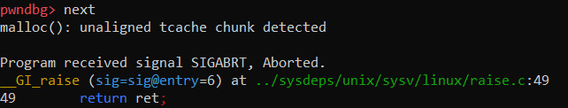
With our view into memory, we start with writing our target address:
Then we get back our first chunk. Notice the mangled pointer:
And then when we try to get this pointer returned:

Slide 66
This happens because when tcache_get is called again it will attempt to access e->next
This can either result in an abort as we saw – the result of alignment validation on chunks in the TCache. Or it will just be a plain segfault since e might not be a valid address.
The way to have a pointer demangled, rather than mangled in this process, is to perform a PROTECT_PTR before a REVEAL_PTR.
In other words, a tcache_put → tcache_get

Slide 67
From the perspective of a user, that would mean having a pointer legitimately linked via free, rather than through being overwritten
with a use-after-free or double free bug.
In the tcache_put function we can see the list add operation performing pointer signing: e->next = PROTECT_PTR (&e->next, tcache->entries[tc_idx]);
tcache->entries[tc_idx] = e;
Here we see a new head added in a legitimate way, so that a subsequent tcache_get will reverse this process and we’ll get our original pointer.

Slide 68
Safe-Linking is ingeniously simple with only a minor
performance impact.
In CPR’s threat model, an attacker must have the ability
to leak heap addresses.
This can then be used to properly demangle forward pointers, resulting in the original primitive.

Slide 69
However, something I noticed here was that the tcache_put mangling occurs only when a new head is set in a TCache list.
Which got me thinking…
If we can control the list head directly, then no demangling would be performed on the [ target address ] as our target address would never be at e->next

Slide 70
So instead of [ TCache root node ] → [ A ] → [ target address ]
We start with
[ TCache root node ] → [ target address ]
But how could this work?
The TCache root node is not part of our own freed chunk metadata
We shouldn’t be able to just access it …
or write to the head of the list which it refers to

Slide 71
To give a bit more context, the list head sits at an index in an array of pointers.
This array is part of an internal Malloc management structure called tcache_perthread_struct
Luckily, Malloc also inlines this tcache_perthread_struct in the heap. In the tcache_init function, a 0x290 sized heap allocation is made.
This is memory for the TCache management structure.

Slide 72
Here is its structure, overlaid as the first chunk in our heap:
typedef struct tcache_perthread_struct
{
uint16_t counts[TCACHE_MAX_BINS];
tcache_entry *entries[TCACHE_MAX_BINS];
} tcache_perthread_struct;

Slide 73
TCache list head poisoning

Slide 74
Targeting the free hook
Before we get started in this section, it’s worth mentioning that with a write-what-where primitive (which is what we are aiming for), we need to target data which has some effect on control flow.
We might want to target application-specific function pointers. Or, as is the case in this section, we can target memory allocator hooks.

Slide 75
A hook in this context is just an address which is checked prior to the execution of one of Malloc’s internal functions.
If the address holds a non-NULL value, then Malloc will assume this value is the address of a function to be executed in place of the default function.

Slide 76
Here we can see the code in malloc.c which reads from __free_hook to see if Malloc should call a custom free implementation.
void
__libc_free (void *mem)
{
mstate ar_ptr;
mchunkptr p;
void (*hook) (void *, const void *)
= atomic_forced_read (__free_hook);
if (__builtin_expect (hook != NULL, 0))
{
(*hook)(mem, RETURN_ADDRESS (0));
return;
}
[...]

Slide 77
If we can get Malloc to return a pointer to a hook and we subsequently write to it, then the next time the corresponding function is called, our own code will be executed.
We won’t focus on this, but usually you’d want the address of the first link in your ROP chain to be the new hook.

Slide 78
Now that we have a target in mind, for the remainder of this section I will detail a few variants of the TCache list head poisoning attack with some hypothetical bugs.
Attacking the TCache list heads could be achieved with
A negative offset write caused by
a user-controlled index
a signed integer overflow
or decrementing an index below 0
A Use-After-Free

Slide 79
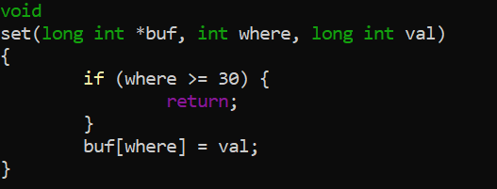
User-controlled index
Say that we have a function which performs a set operation on an array. If it only checks the requested index against the upper boundary of the buffer, then it may be possible to write at a negative offset.
Here, that would mean where is a negative integer.

Slide 80
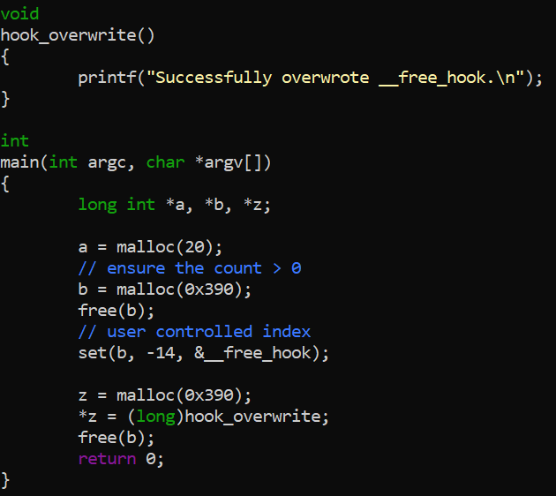
Here we wrote directly to the list head with a negative offset from the beginning of a heap buffer.
Then we overwrote a hook and got code execution.

Slide 81
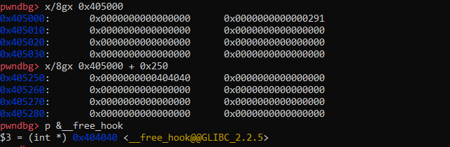
So where exactly are we writing to with this negative offset?
We can see the 0x290 tcache management struct in our heap memory.
What we have done is written the address of our target __free_hook to the list head corresponding to freed chunks of size 0x3a0

Slide 82
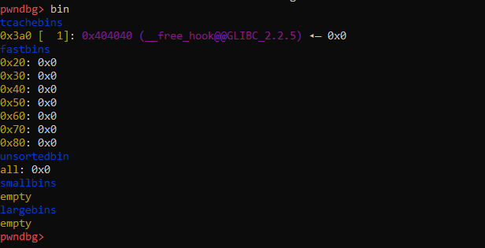
And to show it with some really nice colours, we have our previous representation and also the memory view:
[ TCache root node ] → [ target address ]

Slide 83
Code which doesn’t perform lower-bound checks on signed integer indices does exist in the real world.
But looking at the previous CVEs, it seems pretty rare.
I think this is mainly because the accepted practice is to use unsigned data types for variables which may end up being used as indices, and also to attempt to limit user-controllable indices in general.

Slide 84
Index overflow
What about overflowing a signed integer which is subsequently used as an array index?
Let’s take a custom stack implementation. Say that we store the top of the stack as a signed integer and begin pushing values.
If we increment the index beyond its data type’s range, then it will wrap around to become negative.

Slide 85
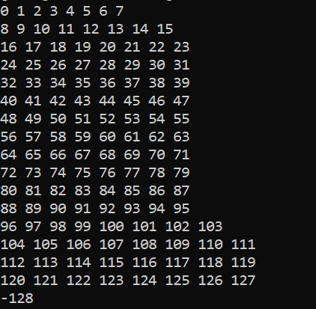
Here’s a quick example of a “signed integer overflow”.
If we keep incrementing a signed variable, then at the limit of its data type’s range it will become negative. Below is the result of incrementing a char type – which has the smallest range.
Application logic permitting, this could allow us to write to a negative offset from the beginning of the buffer.
So we can write our target address to the tcache list head.
Let’s look at the potentially buggy situation.

Slide 86
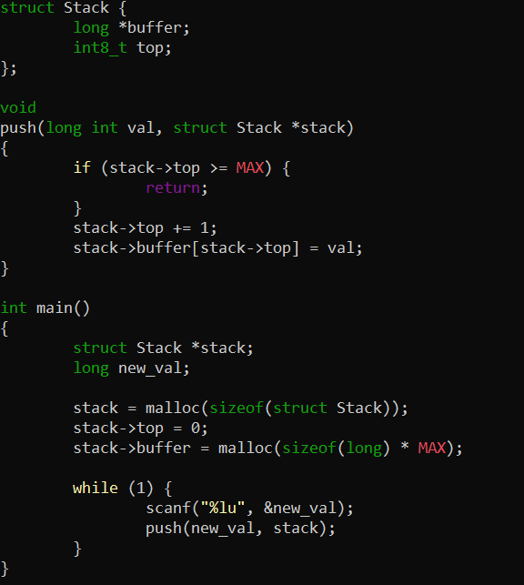
Here, a check is performed to ensure the stack hasn’t overflowed beyond its upper boundary. This check implicitly allows an off-by-one.
But more importantly, if the
stack->top variable wraps around to become negative, then we will be able to write below the lower boundary of the buffer.

Slide 87
In the SEI-Cert C Coding Standard we find this related quote
“sanitization of signed integers with respect to an array index operation must restrict the range of that integer value to numbers between zero and the size of the array minus one.”
I’ve seen a few examples of signed integers used as both iterative variables and as array indices inside for loops.

Slide 88
Index decrement
What if we decremented our index or cursor pointer below the lower boundary?
Sometimes it’s useful to parse input data in reverse, starting at the upper boundary of the buffer and working our way down.

Slide 89
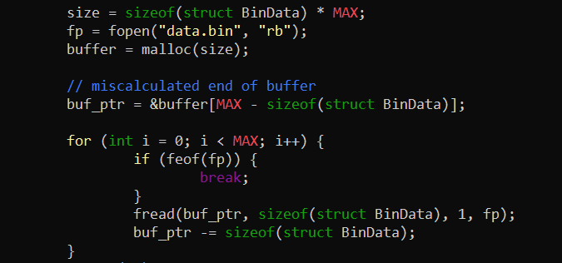
For example, say we read a binary file in reverse and we miscalculate the last index of the buffer which we are reading into, we will continue to decrement buf_ptr below the address of index 0.
This could allow us to write into the tcache management struct.

Slide 90
Some questions which we have to consider with the already seen variations of the technique:
How far away will the tcache management struct be from the chunk we control?
What other Malloc metadata will we corrupt when writing below our chunk in memory?

Slide 91
Looking back to the threat model of Safe-Linking, they say that the mitigation is aimed at stopping attackers who have a
“Controlled linear buffer overflow / underflow over a heap buffer.
or Relative Arbitrary-Write over a heap buffer.”
So we can see that this does already constitute an attack vector which Safe-Linking is modelled on, even if the conditions are harsh.
But what other variants of list head poisoning are there?

Slide 92
use-after-frees
If we look at the malloc.c source we can see the key field from the mitigation I mentioned before.
typedef struct tcache_entry
{
struct tcache_entry *next;
/* This field exists to detect double frees. */
struct tcache_perthread_struct *key;
} tcache_entry;

Slide 93
In the tcache_init and tcache_put functions
static void
tcache_init(void)
{
[...]
if (victim)
{
tcache = (tcache_perthread_struct *) victim;
[...]
static __always_inline void
tcache_put (mchunkptr chunk, size_t tc_idx)
{
[...]
/* Mark this chunk as "in the tcache" so the test in _int_free will
detect a double free. */
e->key = tcache;
The key field holds the address of the
tcache_perthread_struct object

Slide 94
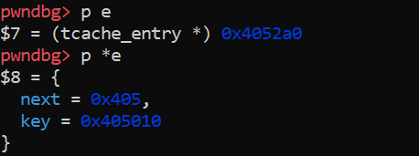
Essentially, the key field mitigation which we saw earlier initialises a pointer to the tcache management struct in every chunk linked into the TCache lists.
The fact that it’s a pointer rather than just some random hash, or maybe an xor’d pointer, means that we can dereference it directly.

Slide 95
If we can pass this pointer to free, we may be able to place the tcache management struct on a tcache list
This ensures it is legitimately pointer protected so that we can request it from Malloc in the future
Additionally, the tcache management struct is already a legitimate chunk, so freeing it won’t be a problem

Slide 96
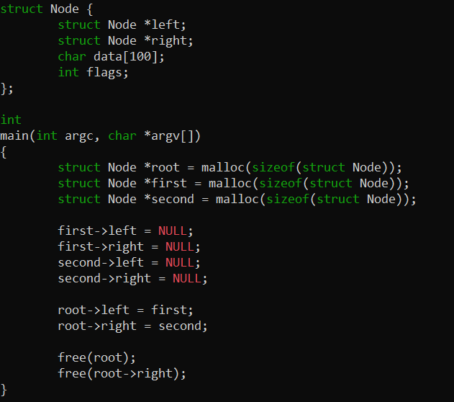
In this example we freed a pointer field after we freed its encapsulating object.

Slide 97
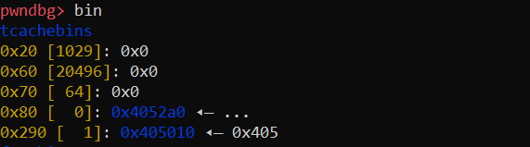
Here we see that the tcache management struct was linked into one of its own lists. Specifically, the 0x290 list.

Slide 98
And from there we can get it returned by Malloc, allowing us to write to its list-heads in the future.
This technique has three stages before it can be used to the same effect as historical TCache attacks and there’s a size constraint on getting the TCache struct returned.

Slide 99
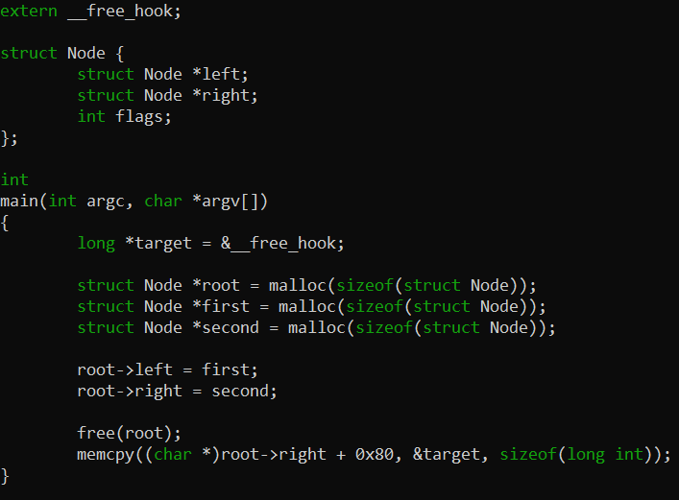
Now let’s look at writing with a use-after-free to a struct field.
In this example, we wrote to the right child of the root Node.
This incidentally wrote our target address to the tcache list head.

Slide 100
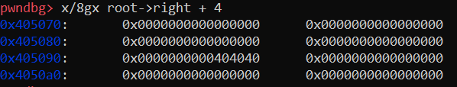

With our view into memory we can confirm that the write was successful.

Slide 101
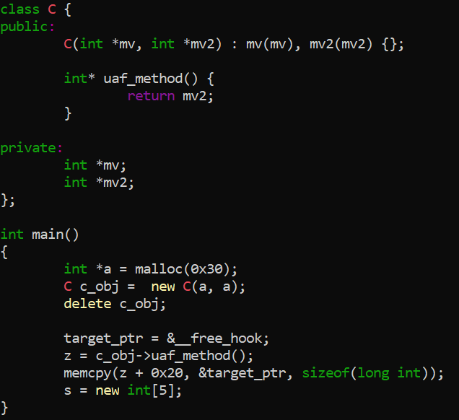
This attack is also possible in applications written with C++ which use Malloc.
As before, the second pointer is set to the tcache key.

Slide 102

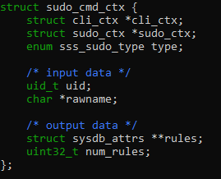
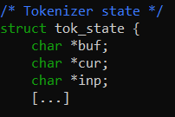
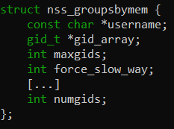
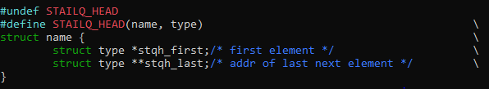
And here are a few examples of dynamically allocated structs with pointers in the correct position and of the right size.

Slide 103
The reason I included the last slide is not to pretend that having a pointer at a particular offset in a struct is necessarily a bug.
But I wanted to emphasise that it does seem very common for people to store pointers at the same place.
The worry I think with this almost default way of approaching dynamic data structures is that Malloc has no facilities to autonomously distinguish between metadata and data.

Slide 104
Given this fact, I think programmers might want to organise their dynamic data in a way which makes the boundary between Malloc’s metadata and our own data better defined.
I think this is comparable to how we don’t want Code and Data to get mixed up, hence non-executable mappings. In the same way, we want to limit the potential for metadata to be interpreted as data and vice versa.
But this is just my opinion and it comes from limited experience.

Slide 105
Regardless, there’s still something kind of unsatisfying about this pointer position constraint. Can we loosen it a bit?
Using a House of Spirit style attack, we can construct a chunk contained within the larger chunk. We do this to overwrite a pointer at whatever 16-byte aligned offset we need.

Slide 106
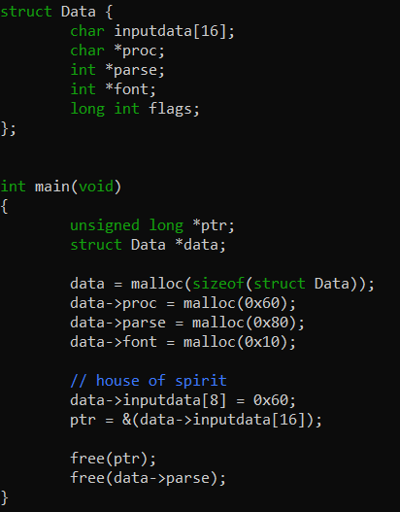
Here, we used the house of spirit to control a pointer which is passed to free.
With some influence over the data inside the chunk, we were able to pass Malloc’s security checks.
You could imagine doing a partial overwrite of a pointer to achieve this.

Slide 107
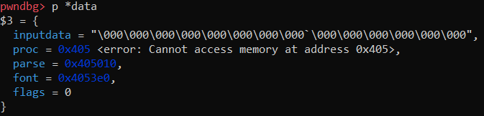
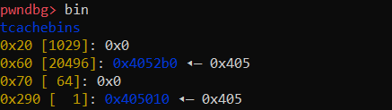
With our view into memory, we can see that we overwrote the parse pointer with the address of the tcache management struct.
And then we freed it, achieving the same thing as before.
So we’ve loosened the constraints.

Slide 108
Getting a libc address
With heap exploitation today, usually we need to leak an address from libc in order to defeat ASLR by calculating offsets.
For example, how do we know which address to write to __free_hook? One answer is to write the address of the system function to the hook.
We can extend the techniques shown here to get a libc leak or some other primitive on our way to code execution.

Slide 109
Recall the tcache count checking mitigation that I mentioned earlier.
There’s a configurable limit on the number of chunks allowed in a list.
By default, this number is 7. So what happens when we try to link up an 8th chunk?
The below check will fail.
if (tcache->counts[tc_idx] < mp_.tcache_count)
{
tcache_put (p, tc_idx);
return;
}

Slide 110
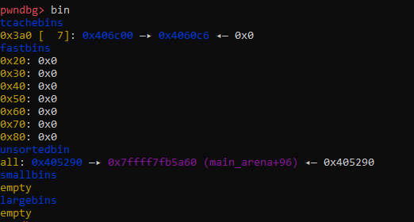
If a chunk doesn’t go onto a tcache list, it will go into a list from one of those bins that I mentioned earlier.
For this example, we target the unsorted bin.

Slide 111
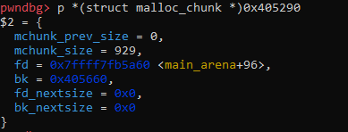
The unsorted bin has a circular doubly linked list.
If a chunk is linked into the unsorted bin, then it will be initialised with two pointers. One to the previous chunk and another to the next chunk.
Say we are dealing with the earliest added chunk. While the bk field points to our second chunk, the fd field will always point to an address we can guess is the unsorted bin root node – circular.

Slide 112
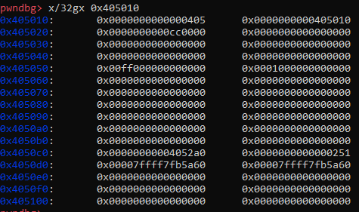
What happens if instead of only linking the tcache management struct onto one of its own lists, we linked it into the unsorted bin?
With some heap grooming to ensure chunk validation passes:

Slide 113
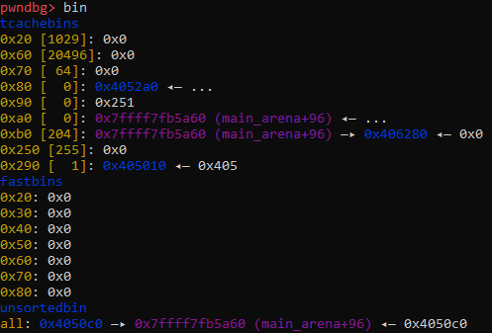
We can write the address of the unsorted bin root node to a tcache list head. This means we can get it returned in a subsequent Malloc request.

Slide 114
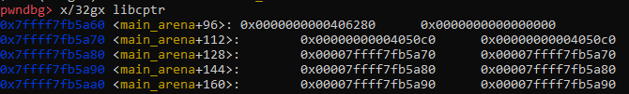
This helps us because the unsorted bin is not inlined in our heap like the tcache management struct and all its lists.
Instead, it’s part of the Arena which is stored in glibc’s own virtual address space. Assuming this is the main Arena.
At this point we can make an allocation corresponding to the list head where we wrote the libc address.
Here we requested a chunk of memory whose address was stored in our variable libcptr.

Slide 115
Once we have this Arena pointer, we could do a few things:
Read from the pointers surrounding this chunk and use them to work out the offset to the ROP gadget. We could launch a House of Force style attack by overwriting the LSB of the libc pointer to overlap the main arena field which points to where the top of the heap is.
Overwriting this, we would ensure that a future allocation is serviced at a controlled address, so the heap grows beyond its ordinary boundary to overlap other parts of memory.

Slide 116

So, here we set the top of the heap to a stack address.
On a subsequent request to Malloc, we might be able to get our chunk to overlap the current stack frame. From there we’d be able to overwrite the return address without mangling the stack canary.

Slide 117
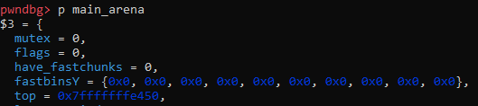
Here’s our memory view, as you can see top was overwritten.
We could probably have just written our stack address to the tcache list head directly. But setting a new top ensures that every future allocation will be made relative to that address.
I also included this just to emphasise the level of complexity that goes into dynamic memory management, and how it exposes different entries of attack.

Slide 118
As for a libc leak itself, we could achieve this by targeting the glibc I/O management structures as used in c4e’s House of Rust blog post.
This is where we get a chunk “allocated from the appropriate tcachebin overlapping with _IO_2_1_stdout_”

Slide 119
And then we can “overwrite the _IO_2_1_stdout_._flags field with the value 0xfbad1800. Null out the following 3 qwords, belonging to the fields _IO_read_ptr, _IO_read_end and _IO_read_base. Finally, null out the next qwords LSB belonging to _IO_write_base”
From there, we hopefully get a huge dump from memory once our process uses the stdout file stream. Then we just work out the libc base address, and then the relative address of our ROP gadget. This should allow us to gain code execution.

Slide 120
I have spoken with Eyal Itkin who created Safe-Linking and we wrote a blog post together about the technique before glibc 2.32 was officially released.
Eyal was helpful in putting the details of the attack in clear terms and I appreciate the interest and openness.
Additionally, Eyal states of the bypass that: “it will be a known gap in Safe-Linking’s protection, and will be a bypass that might be exploited by attackers.“

Slide 121
There are a few corner cases which need to be fulfilled and so in this way I wouldn’t say that Safe-Linking is broken.
It manages to mitigate against many examples of list poisoning attacks. The main purpose of presenting this technique today is to add something to the arsenal and also to point out some of the design decisions in Malloc.
Safe-Linking is a great mitigation and props to CPR for its simplicity.
I also recommend reading the “House of Rust” blog post by c4e because it’s awesome and presents another way to attack the tcache list heads by using the tcache stashing mechanism – matching different constraints.

Slide 122
Open problems for you to explore
The technique presented here aims at bypassing Safe-Linking within the constraints set by CPR’s threat model.
To this end, it succeeds. But there’s additional, application-specific constraints which also need to be satisfied for this to work. I haven’t had much time to explore it further so I just want to give some additional problems whose solution might further ease the restrictions on TCache list head poisoning.
Can we use the TCache key as a prev pointer in a doubly linked list node?
Can we take advantage of the consolidation mechanism to consolidate with the TCache management struct?

Slide 123
Summary
I hope you enjoyed the talk. Today we covered:
the basics of memory allocation
exploiting these mechanisms
historical attacks and their mitigations
bypassing these mitigations
and bypassing Safe-Linking in glibc2.32

Slide 124
Final shout outs
Kylie, Silvio and others for organising BSides, Faith and Josh for proofreading the slides, and everyone here for listening. Thanks :)

