Slide 1
The-Little-House
Reading Comprehension
Ruifeng Li & Jerry Xu

Slide 3

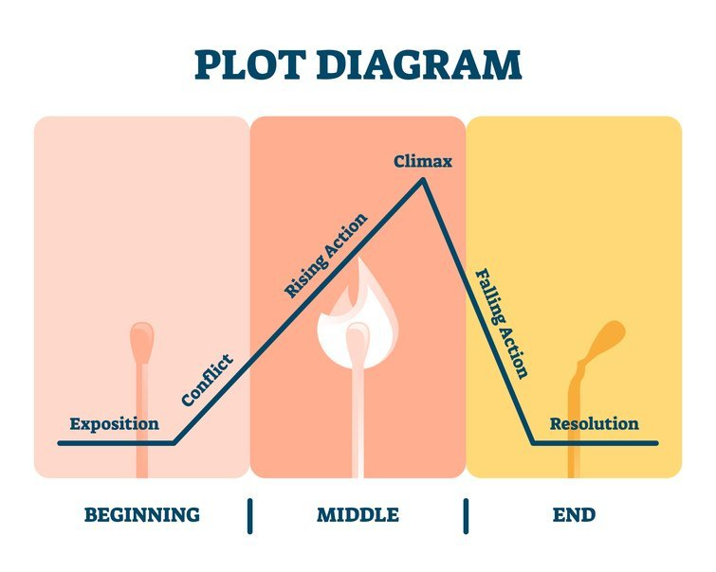
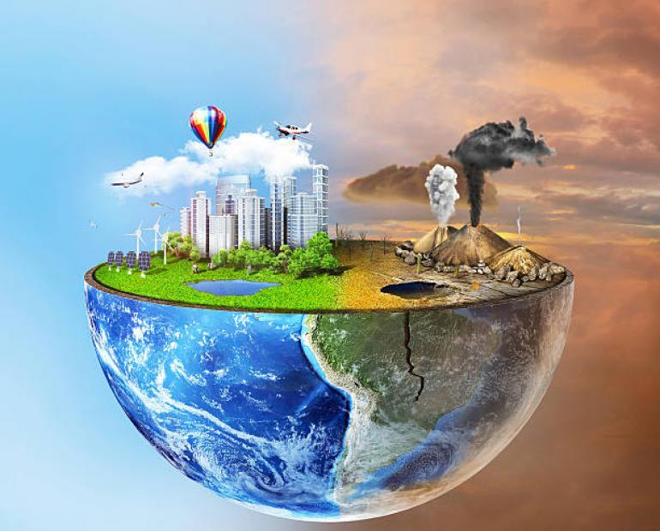
How to analyze a novel?
人物(character)
情节(plot)
环境(environment)

