Slide 1


2022
Based on intelligent voice system
covert communication design

Slide 2
Report directory
01
02
03
04
Research Background
Research progress
Project Features
Project prospects

Slide 3
Part one
The background of the research topic and the problems it aims to solve

Slide 4
The background of the research topic and the problems it aims to solve
Purpose
This team applied adversarial sample attack technology to the construction of covert channels and established two sets of communication strategies for different environments, namely a strong covert communication strategy and a strong real-time communication strategy, both of which can effectively prevent eavesdropping. It is different from the traditional covert communication model based on rules and cryptography, and is a new inspiration for the construction of covert communication.
Hazardous
High demand
Traditional communication encryption technology and physical layer security technology cannot solve privacy issues well, because eavesdroppers can obtain key encrypted information by analyzing the intercepted data. This behavior has a great impact on network operation, information transmission, and business operations.
With the increase in network communication transmission rate, the number of mobile communication users will reach 1.82 billion by the end of 2021, which is equivalent to 1.8 times that of 10 years ago. At the same time, communication security has gradually attracted people's attention.

Slide 5
Part two
Research progress
1. Current research results

Slide 6

Current research results
covert communication
a purpose
Two models with different focuses and strategies
Strong covert communication
strategy
Strong real-time
communication strategy

Slide 7
Current research results
Strong covert
communication strategy
Strong real-time
communication strategy
Through the audio adversarial model, which is a targeted attack designed for the audio-to-text engine, the content sent by the user is hidden in an audio file. Only when both communicating parties master the same model and model parameters at the same time can the hidden information be correctly parsed.
By scrambling the speaker's voice with random seeds , and hiding the seed information through the audio adversarial model, the scrambled audio is combined with the hidden information. When the receiver receives it, the seed information is transcribed through the speech recognition model, and then the scrambled audio is restored to the call content.

Slide 8

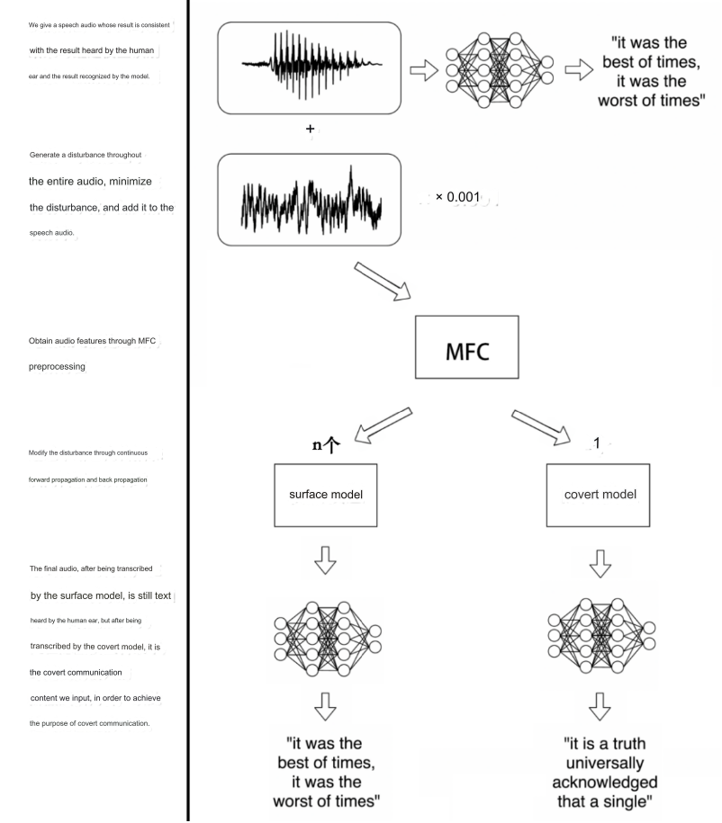
Strong covert
communication strategy

Slide 9
Strong covert
communication strategy

Slide 10
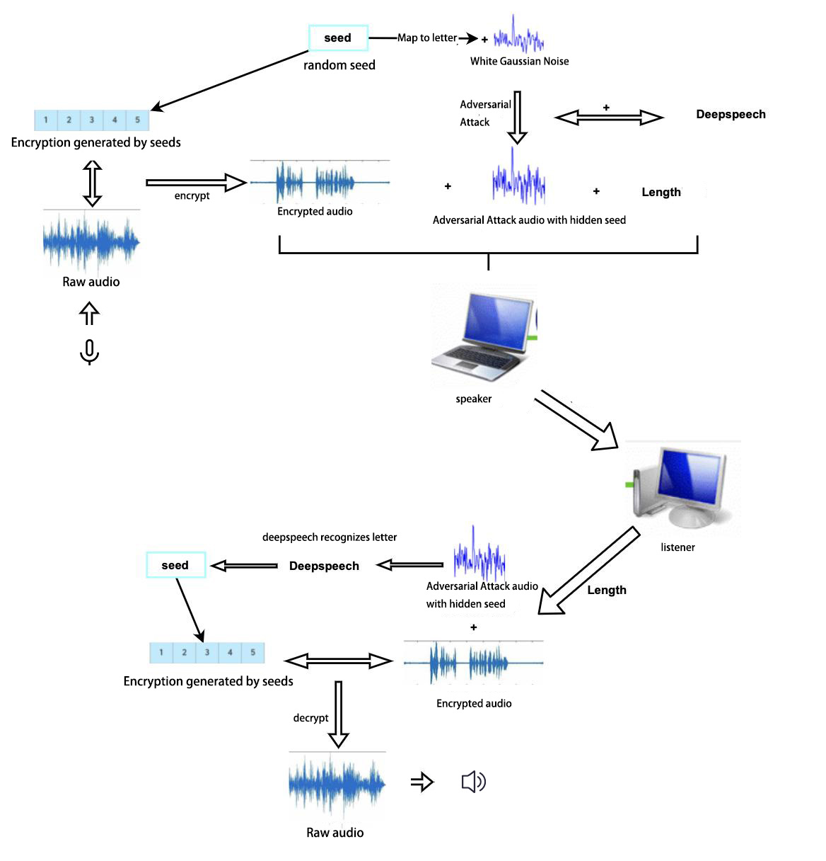
Strong real-time communication strategy

Slide 11
Strong real-time communication strategy

Slide 12
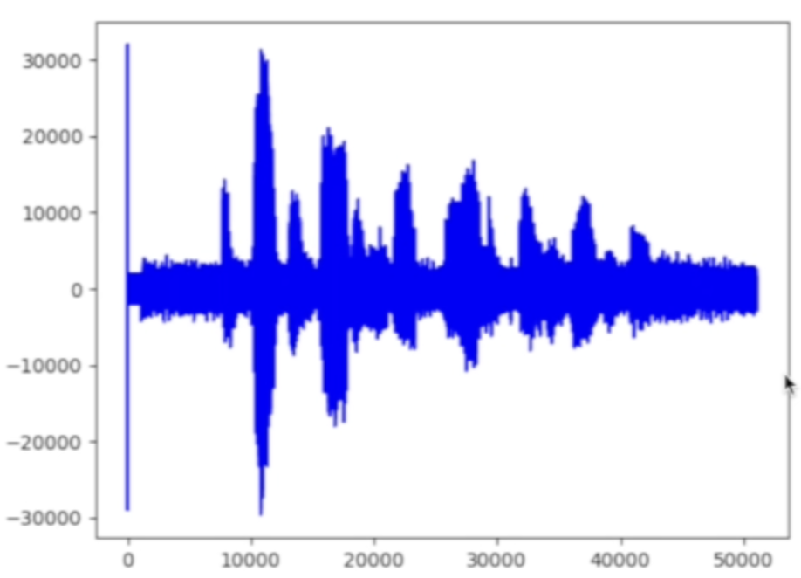

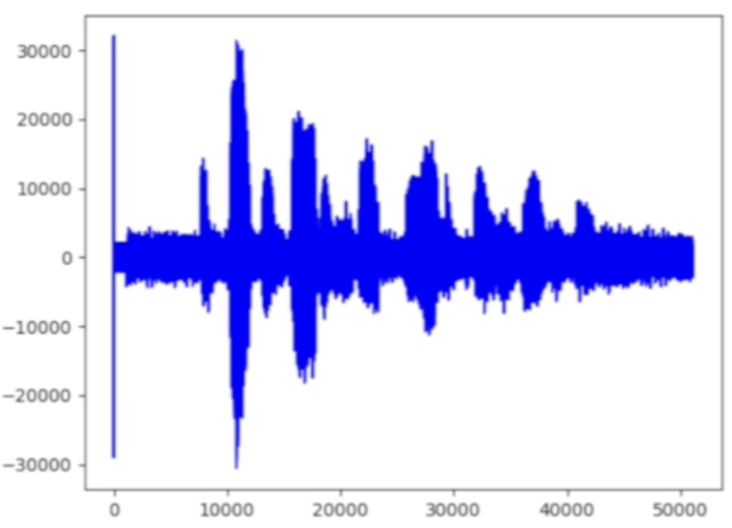
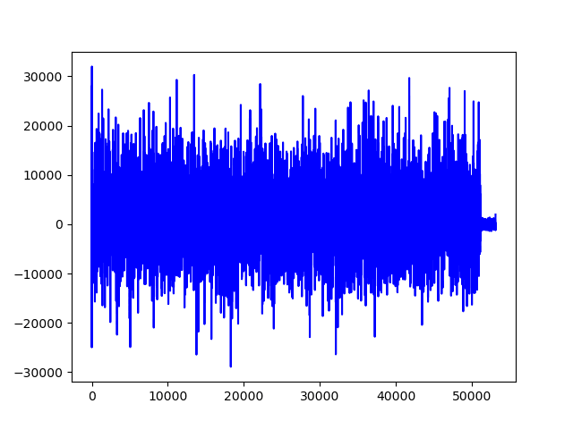
Show results
original audio
Hidden message audio
(covert communication)
Scramble audio
(real time communication )
to scramble the audio
(real time communication)

Slide 13
Part three
Project Features
1. The innovation of this study
2. Main technical indicators of this study

Slide 14



Innovation
——Strong covert communication strategy model
safety stronger
Concealment stronger
Universality stronger
The audio file constructed in this work is a selective adversarial sample, that is, unlike ordinary targeted attacks, the audio file can only extract hidden text information under specific model and parameters. Even if the model is the same but the training samples are different, the transmitted message content cannot be intercepted and deciphered.
The audio after the attack cannot be distinguished by the human ear compared with the original audio file. Human ears cannot detect that the audio contains hidden information, and can only hear the original content of the audio, such as a piece of music or a piece of speech. Therefore, this model is more concealable than some other information hiding methods, such as using a piece of blank noise to hide text information.
Through continuous testing, the weight of the loss function is continuously and slightly adjusted according to the size of the audio noise obtained, the accuracy of the recognition, and the time it takes to generate the audio, and the effect of the combination of disturbance and different audios is adjusted. Realize the universality of adversarial attacks on various audios.

Slide 15


Innovation
——Strong real-time communication strategy model
real-time stronger
safety stronger
Different from conventional cryptography encryption, the previous public-private key or chaos encryption process requires a lot of calculations and time. However, our team's model combines audio perturbation with adversarial sample attacks, and the perturbation process takes very little time. Moreover, this work hides the seeds mapped to several letters into extremely short Gaussian white noise, making the process of counterattacking less time-consuming.
flexibility stronger
After adding perturbation to the audio, neither human ears nor machines can recognize the original content. Moreover, the seeds are hidden by adversarial sample attacks. Due to the characteristics of the neural network, even if the seed content is the same, the generated perturbation audio containing seed information is very different. It is impossible to extract the rules and decipher the seed content, and the security is strong.
The team encapsulates the model and designs a specific communication plan. Based on the different conditions of the sender's machine, the specific implementation method of real-time communication can be flexibly selected to enhance the user experience.

Slide 16
Technical indicators
Given any waveform audio, the model can generate another audio that is more than 99.9% similar, which can be transcribed into any text to be communicated, and which can hide up to 50 characters per second.
Similarity
Success rate
Our team applied attacks based on white-box iterative optimization to various models in covert communication and proved that it has a 100% success rate.
The jamming time for the original audio fluctuates slightly according to the length of the communication audio, and the time is at the ms level; the attack time for hidden seeds changes with different hardware. The GPU machine time reaches 3-4s, while the CPU machine takes slightly longer. However, the MS level can still be achieved by hiding the seed strategy in advance .
delay

Slide 17
Part four
Project prospects

Slide 18
Application prospects
Strong real-time communication strategies and strong covert communication strategies can be based on various speech recognition models, including but not limited to deepspeech1, deepspeech2, lingvo, etc. Various modern theoretical and mathematical tools can be used in information hiding, which can be applied to the secure transmission of network information data and play an important role in protecting network information security. The strong covert communication strategy can be used in social software such as WeChat and QQ, and the strong real-time communication strategy can be used in calls, meetings and other occasions.

Slide 19
2022
Thank you

