Slide 1


A&B BNN: Add&Bit-Operation-Only Hardware-Friendly Binary Neural Network
Ruichen Ma, Guanchao Qiao, Yian Liu, Liwei Meng, Ning Ning, Yang Liu, Shaogang Hu
University of Electronic Science and Technology of China
Github: https://github.com/Ruichen0424/AB-BNN
Poster Session 5 & Exhibit Hall
Notes:
Hello, I am 马瑞辰, master‘s degree from University of Electronic Science and Technology of China.
Today I will introduce our work published in CVPR: Add and Bit-Operation-Only Hardware-Friendly Binary Neural Network.

Slide 2
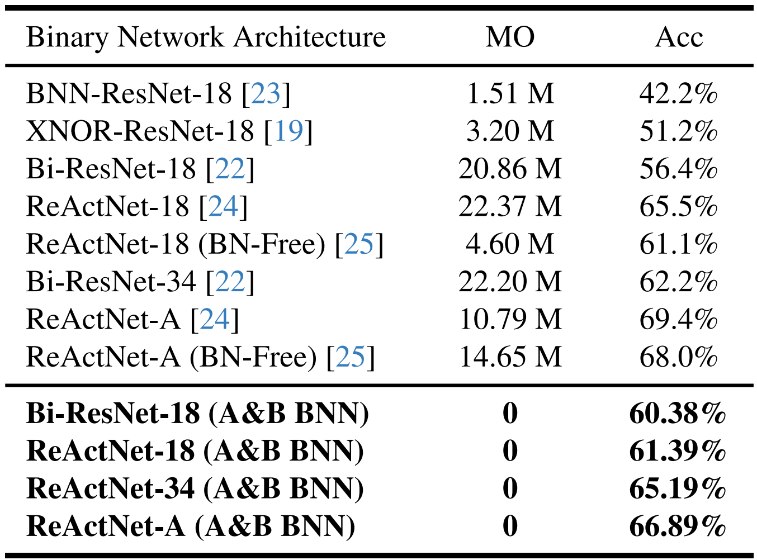
Introduction
Motivation
Existing mainstream binary neural networks still require millions of multiplication operations during inference.
The sources of these multiplication operations include:
scaling factor
BN layer
PReLU layer
real-value residual
average pooling layer
…
Notes:
Binary neural networks are proposed to minimize hardware overhead. However, existing mainstream binary networks still require millions of multiplication operations during inference, which is hardware unfriendly. The sources of these multiplication operations include: scaling factor, BN layer, P relu layer, real-value residual, average pooling layer, and so on.

Slide 3
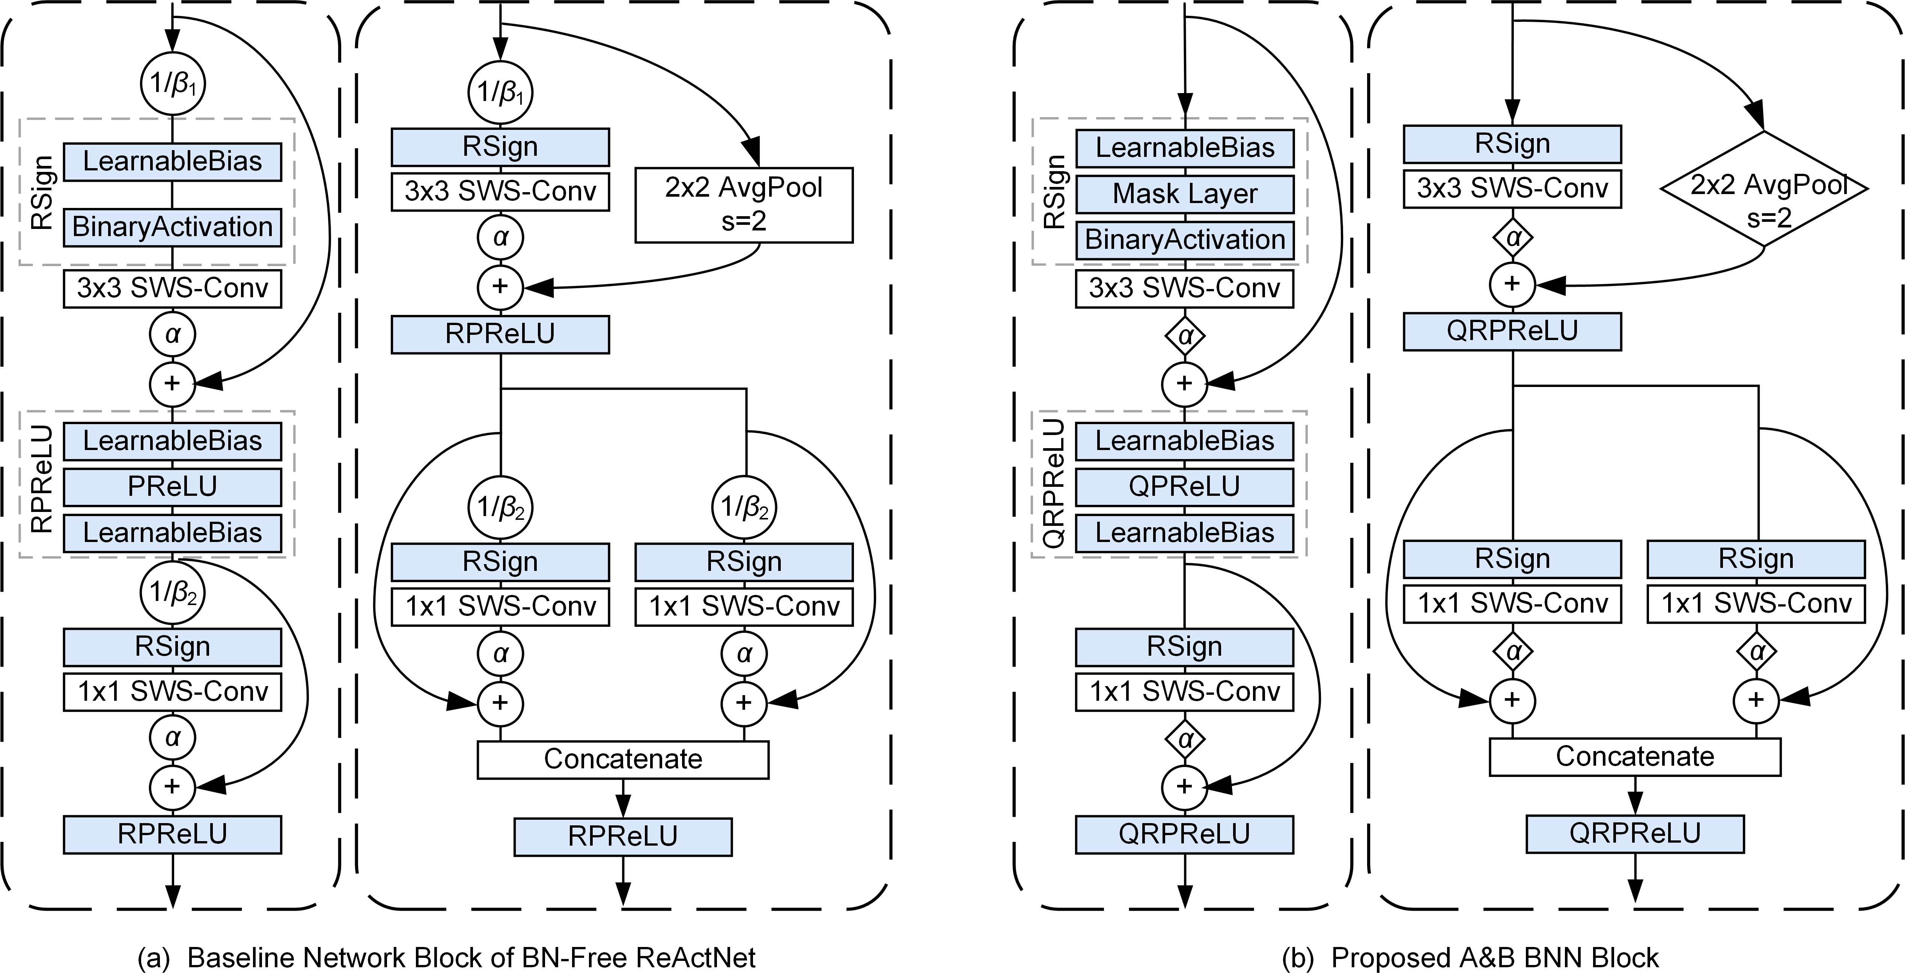
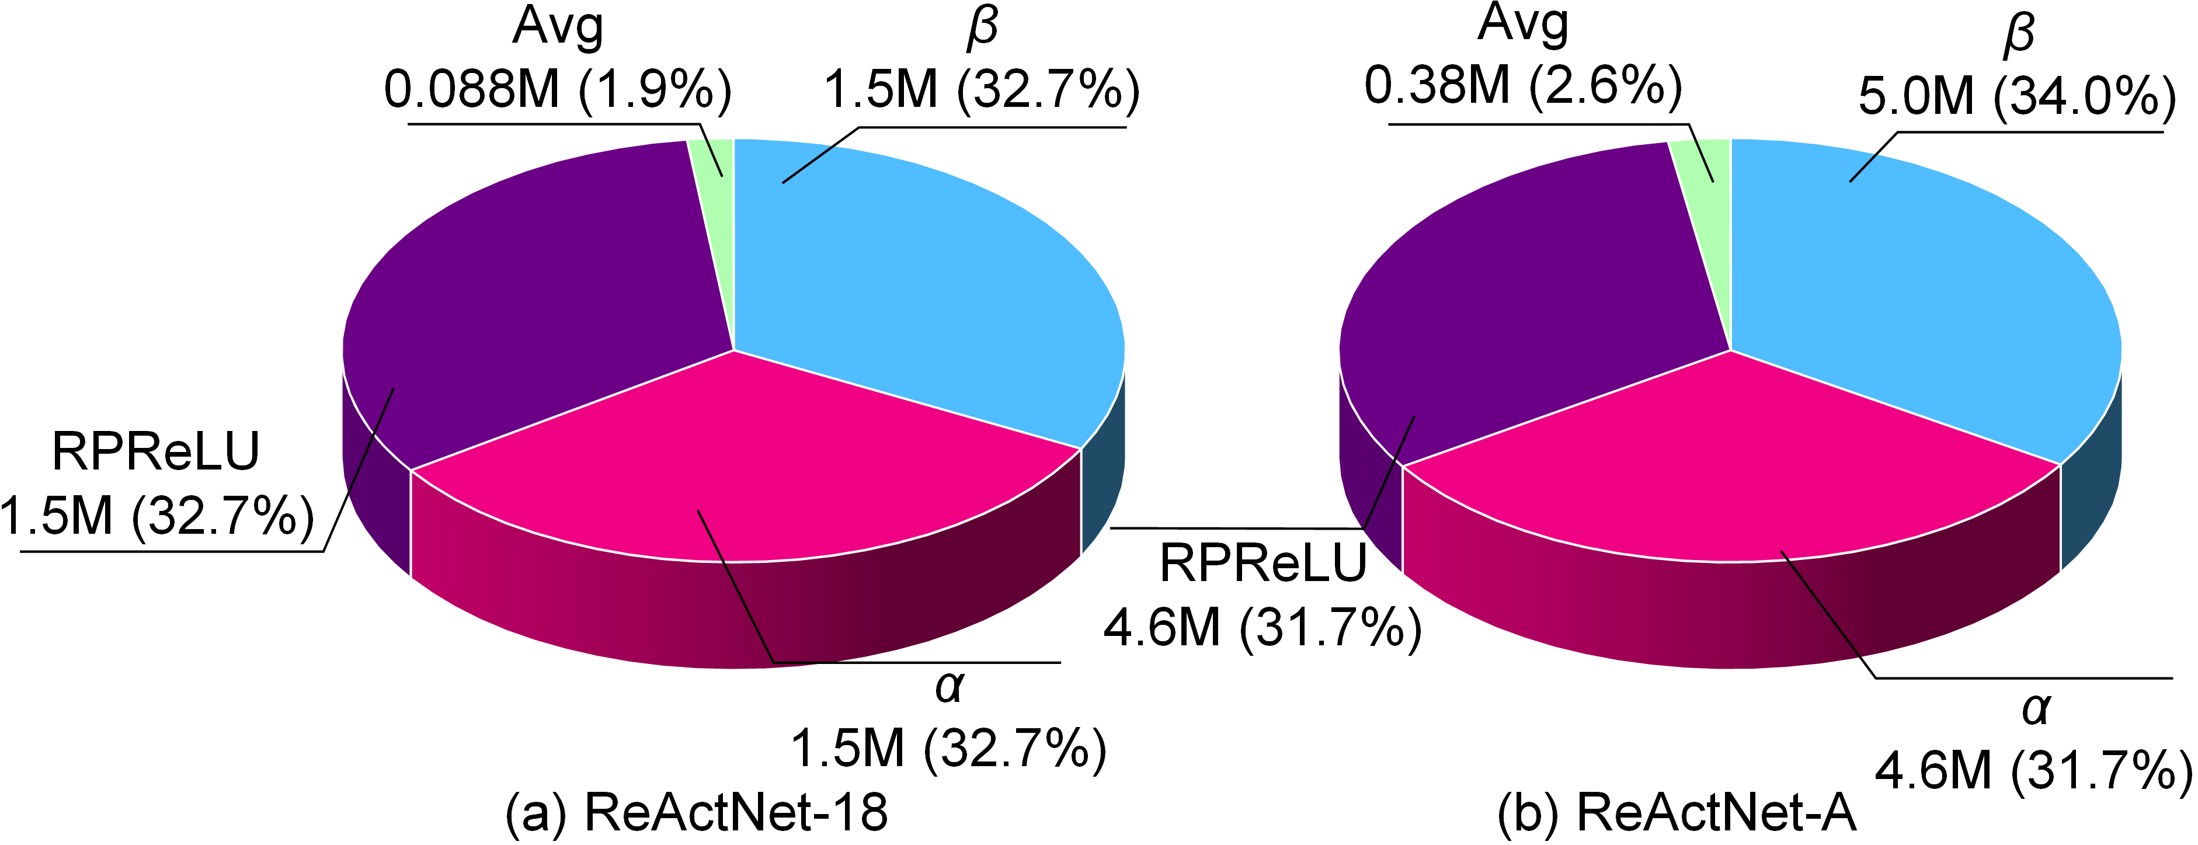
Introduction
Motivation
Existing mainstream binary neural networks still require millions of multiplication operations during inference.
For input images with a resolution of 224 × 224 in BN-Free BNN, the ReActNet-18 generates approximately 4.6 million multiplication operations, while the ReActNet-A yields approximately 14.7 million.
Notes:
a key to eliminating multiplication operations is to remove the BN layer. BN Free BNN applies the Normalizer Free technology to the BNN field.
For input images with a resolution of 224 times 224 in BN-Free BNN, the ReActNet 18 generates approximately 5 million multiplication operations, while the ReActNet A yields approximately 15 million.

Slide 4
Introduction
Motivation
Remove all multiplication operations during inference in binary neural networks.
Implementation technologies:
normalizer-free network architecture
the mask layer
quantized RPRuLU unit
Notes:
To completely eliminate all multiplication operations in binary neural network inference, we use the normalizer-free network architecture,
the mask layer, and quantized RP relu unit.

Slide 5
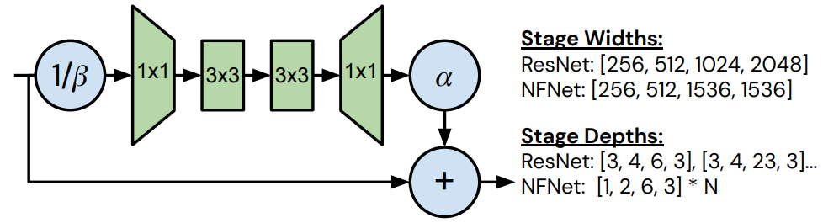

Method
Normalizer-Free (NF) Architecture
Scaled weight standardization:
The scaled weight standardization technique was introduced to address the mean shift and variance explode or vanish on activations resulting from BN removal. The weights are scaled using the following formula:
NFNet bottleneck block
Hand-crafted scaling factor
α controls the variance growth rate of the residual block and β regulates the activation distribution constituting the primary source of multiplication in BN-Free BNN.
Notes:
Normalizer-Free architecture introduced the scaled weight standardization technique to address the mean shift, variance explode or vanish on activations resulting from BN removal.
The weights are scaled using the following formula.
Meanwhile, two Hand-crafted scaling factors were introduced, while alpha controls the variance growth rate of the residual block, and beta regulates the activation distribution, constituting the primary source of multiplication in BN-Free BNN.

Slide 6

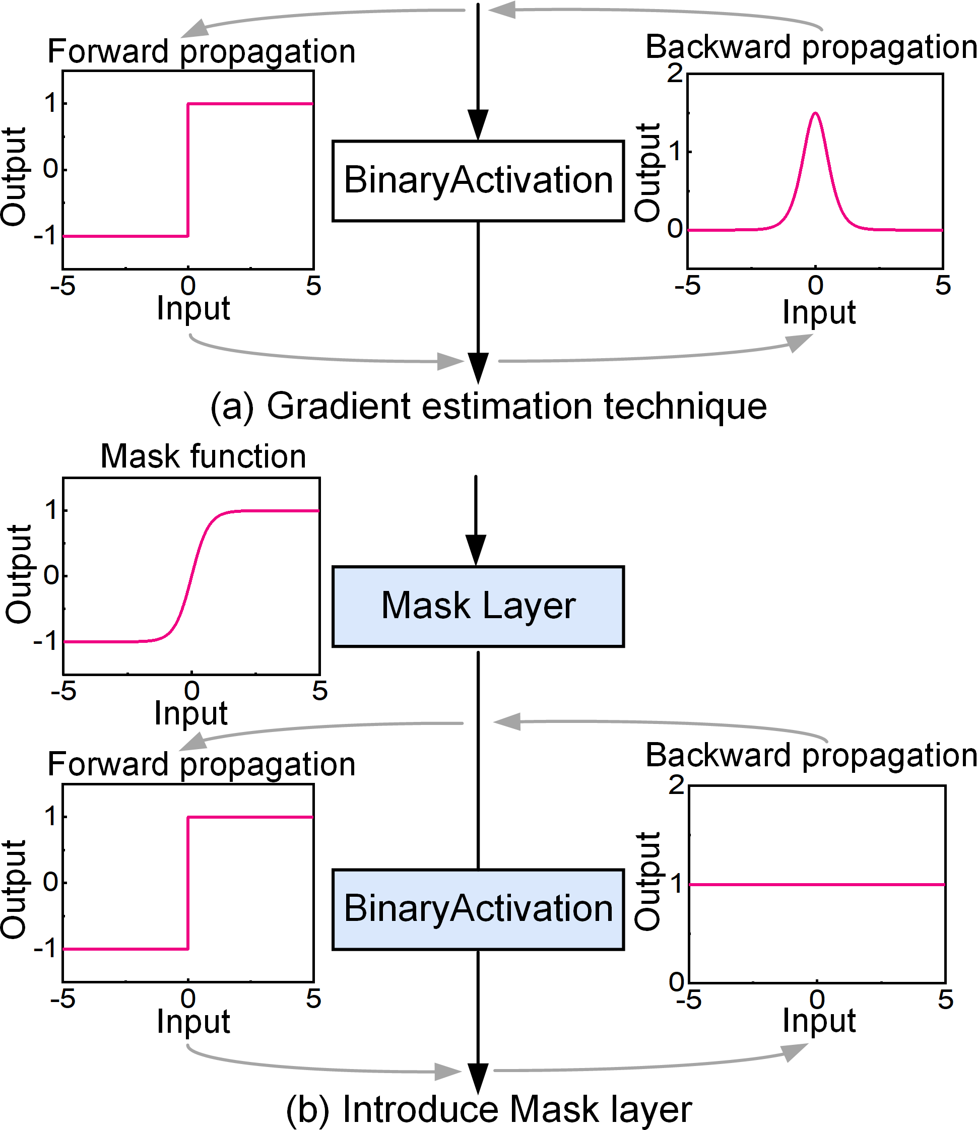
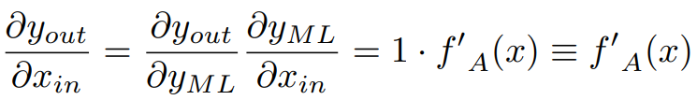
Method
The Mask Layer
The gradient estimation technique uses the Sign function to achieve binarization during the forward pass and uses approximate gradients to achieve backpropagation during the backward pass.
The same forward and backward calculations can be achieved using the proposed mask layer.
Notes:
Gradient estimation techniques are used in binary networks to solve the non-differentiable problem.
The gradient estimation technique uses the Sign function to achieve binarization during the forward pass, and uses approximate gradients to achieve backpropagation during the backward pass.
The same forward and backward calculations can be achieved using the proposed mask layer.
The schematic diagram is shown on the right.

Slide 7
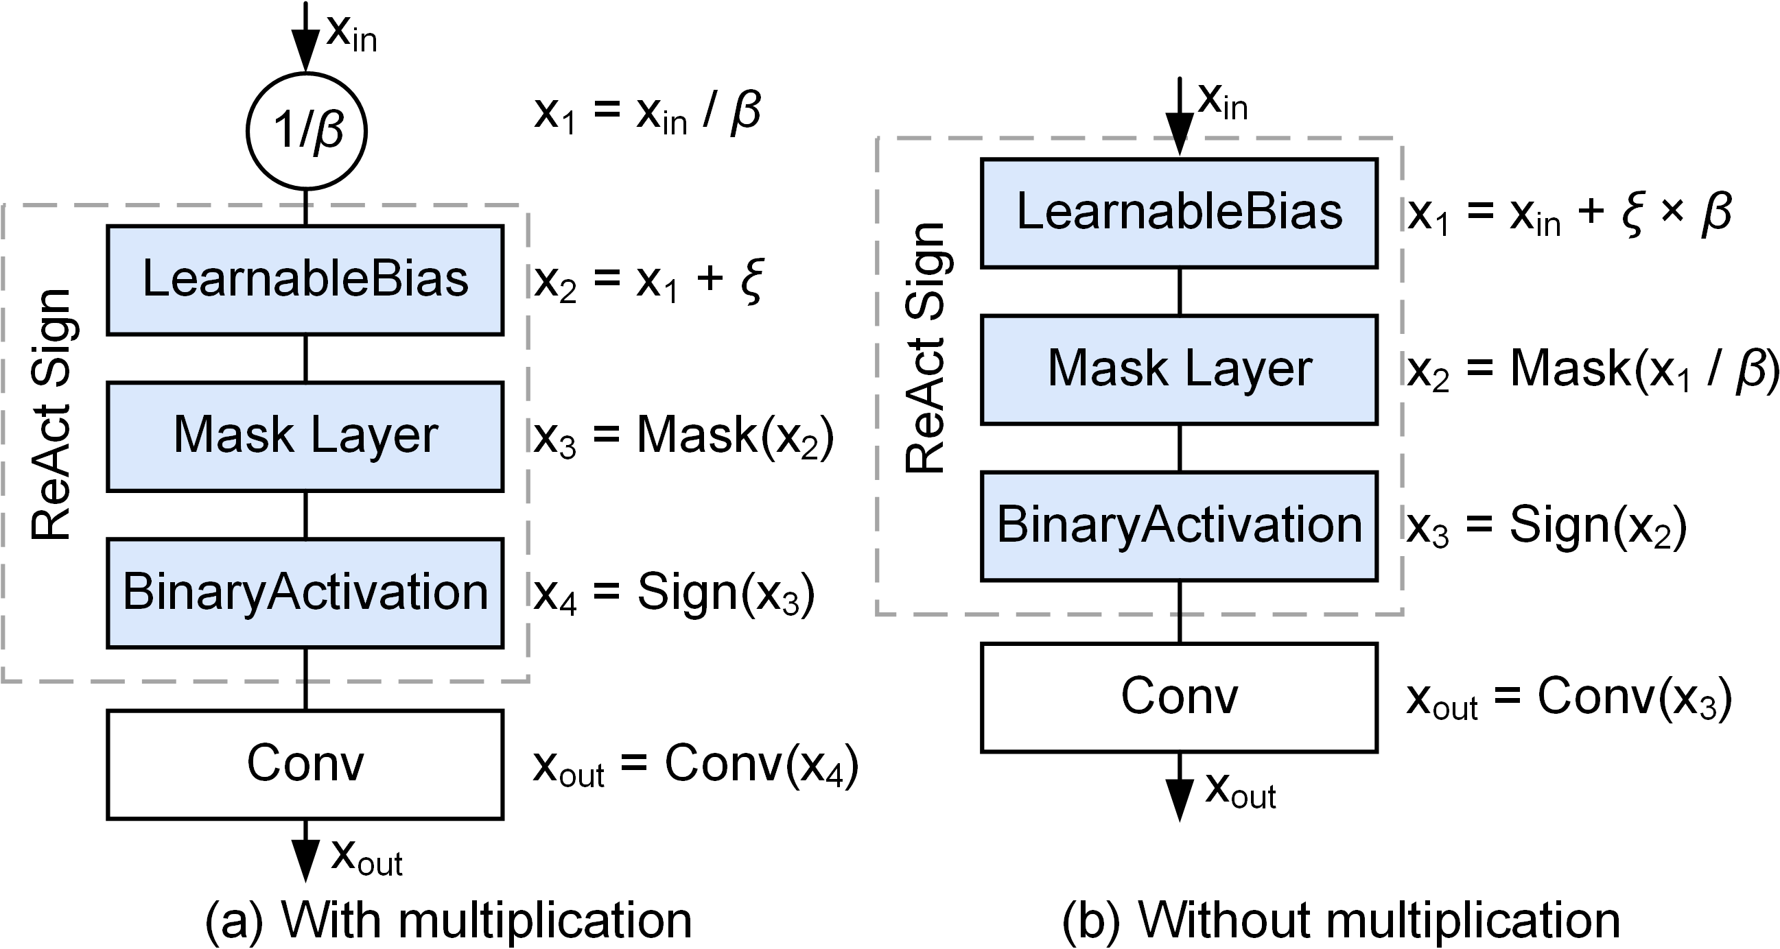
Method
The Mask Layer
The proposed mask layer combined with mathematical transformation can completely eliminate the multiplication operation introduced by β. The equivalent operation process is shown in the figure on the right.
Notes:
The proposed mask layer combined with mathematical transformation can completely eliminate the multiplication operation introduced by beta.
The equivalent operation process is shown in the figure on the right.

Slide 8
Method
Bit Operations
Using bit operations for multiplication by powers of 2 is a straightforward and efficient technique, which relies on the binary representation of numbers and the properties of shifting operations.
n = 0 1 1 0 0 1
2*n = 1 1 0 0 1 0
bit operation
Notes:
Using bit operations for multiplication by powers of 2 is a straightforward and efficient technique, which relies on the binary representation of numbers and the properties of shifting operations.

Slide 9
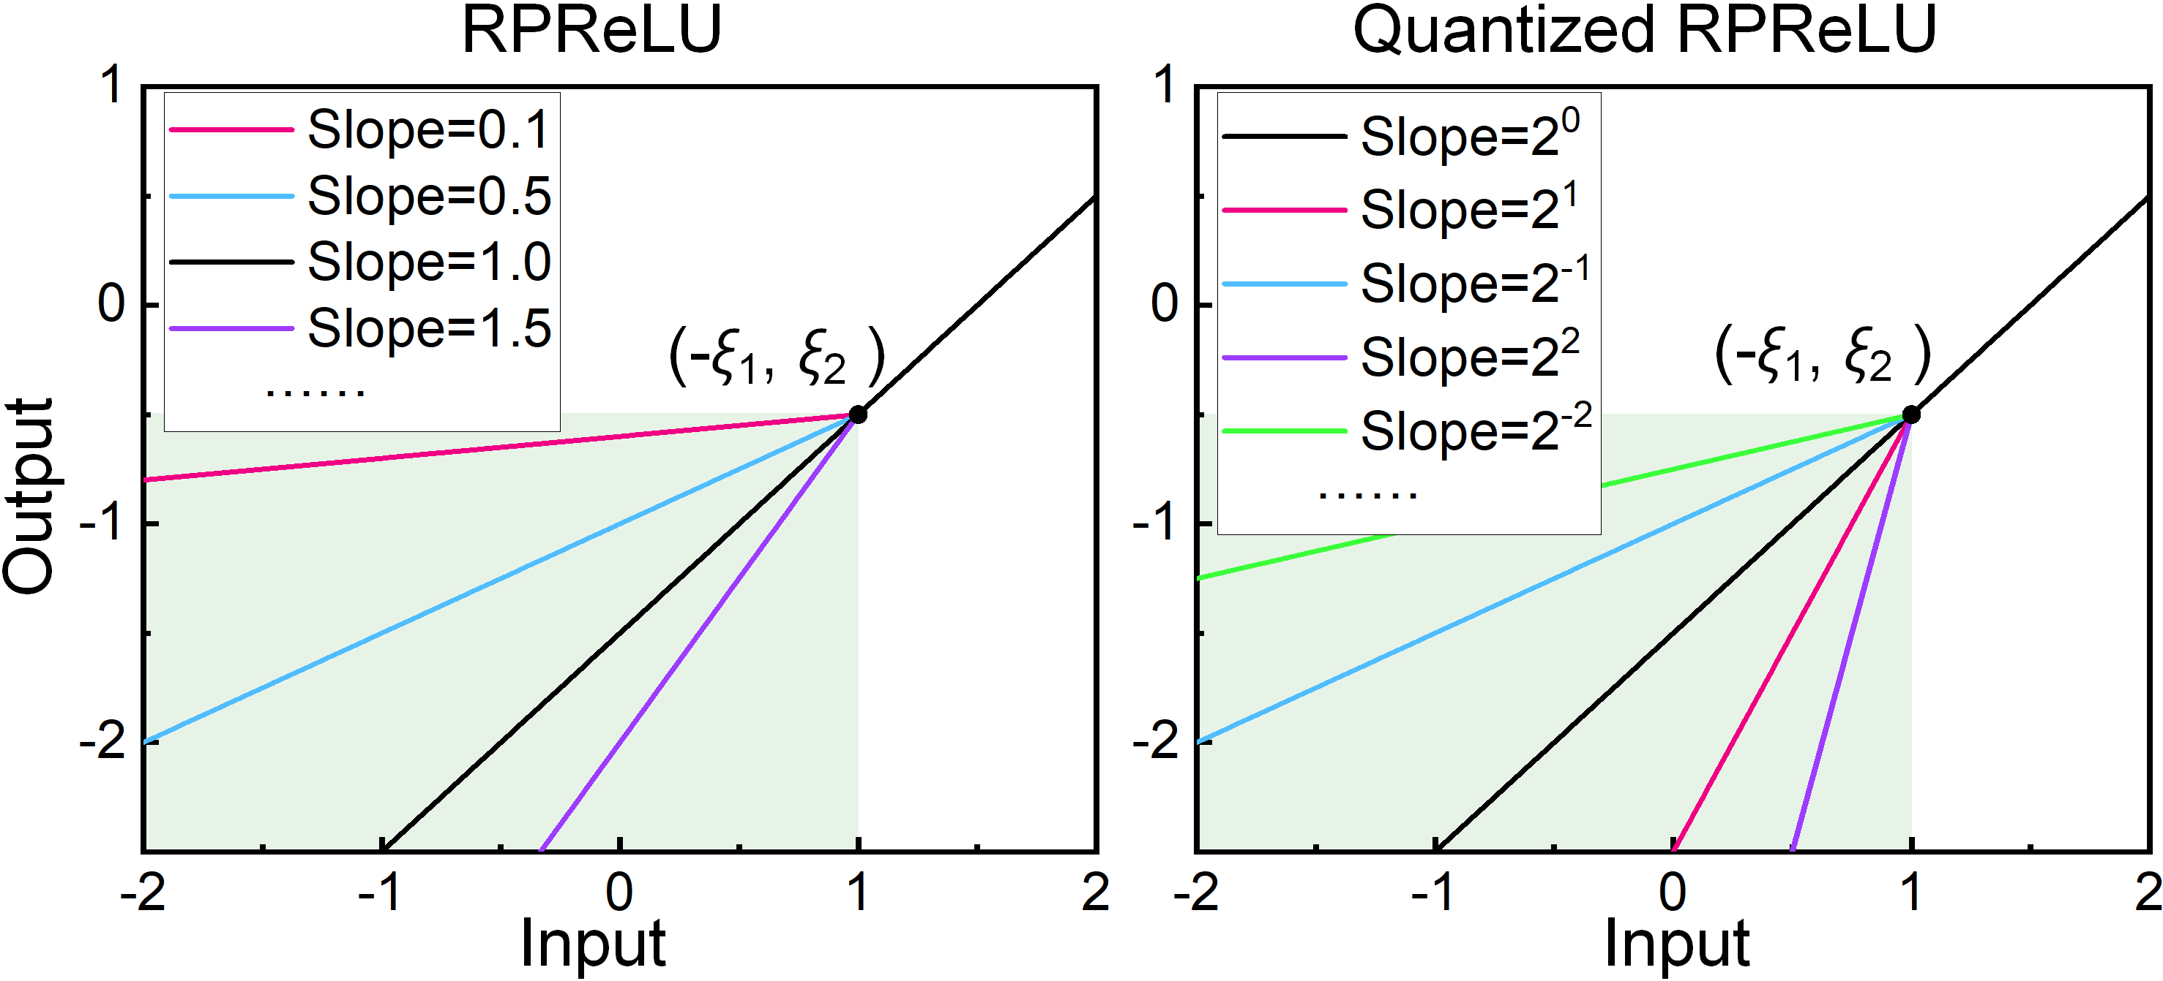

Method
Quantized RPRuLU Unit
The quantized RPReLU structure enables more efficient bit operations by constraining its slope to be integer powers of 2.
Notes:
The quantized RP relu structure enables more efficient bit operations by constraining its slope to be integer powers of 2.

Slide 10
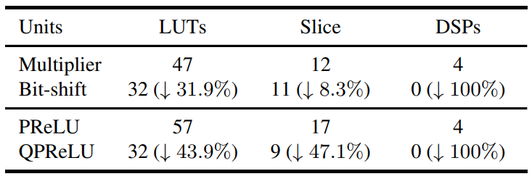
Method
Hardware Benefits
For one convolution layer without pooling, the reduction in consumption for LUTs, Slice, and DSPs resources are 57.6%, 51.2%, and 100%, respectively.
Hardware overhead table for different units
Notes:
We conducted synthesis on various units using the Xilinx FPGA, and the hardware overhead is presented in the table on the right.
For one convolution layer without pooling, the reduction in consumption for look up tables, slice, and digital signal processors resources are 57 point 6 percent, 51 point 2 percent, and 100 percent, respectively.

Slide 11
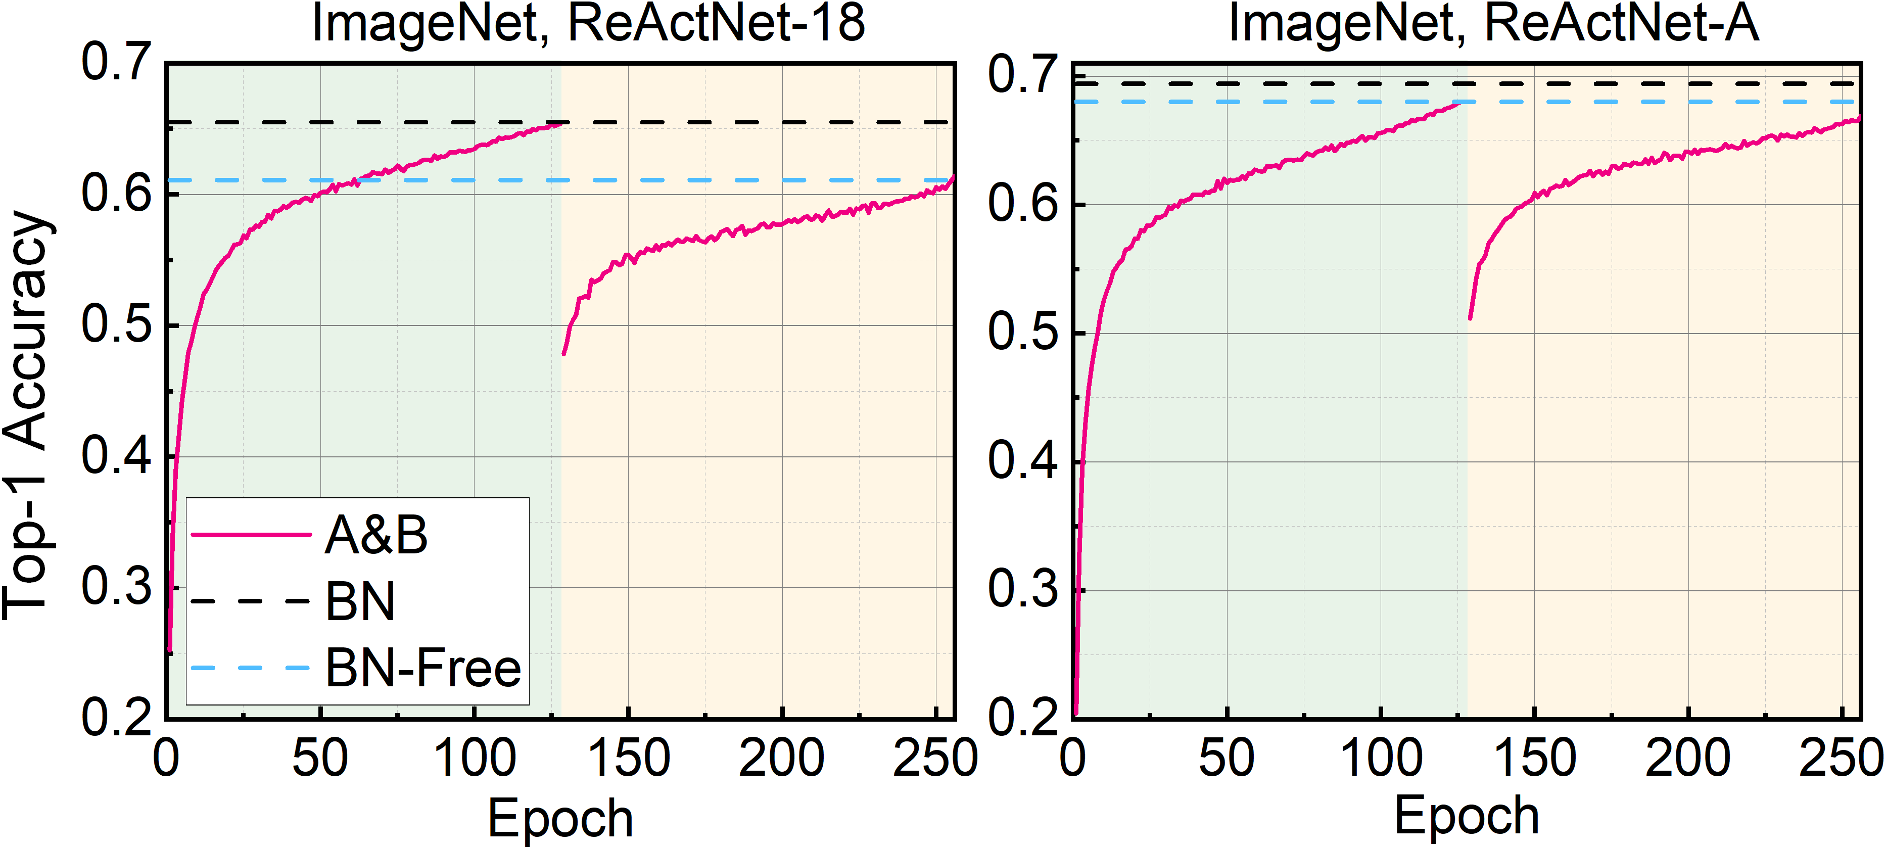
Experiments
Experiments on ImageNet
Notes:
Experiments show that the proposed BNN eliminates multiplication operations with almost no loss in performance.
Compared to the BN-Free structure, we achieved a reduction of 15 million multiplication operations with an accuracy loss of one point one one percent on ReActNet A.
And achieved a reduction of 5 million multiplication operations on ReActNet 18 while improving the accuracy by zero point two nine percent.

Slide 12
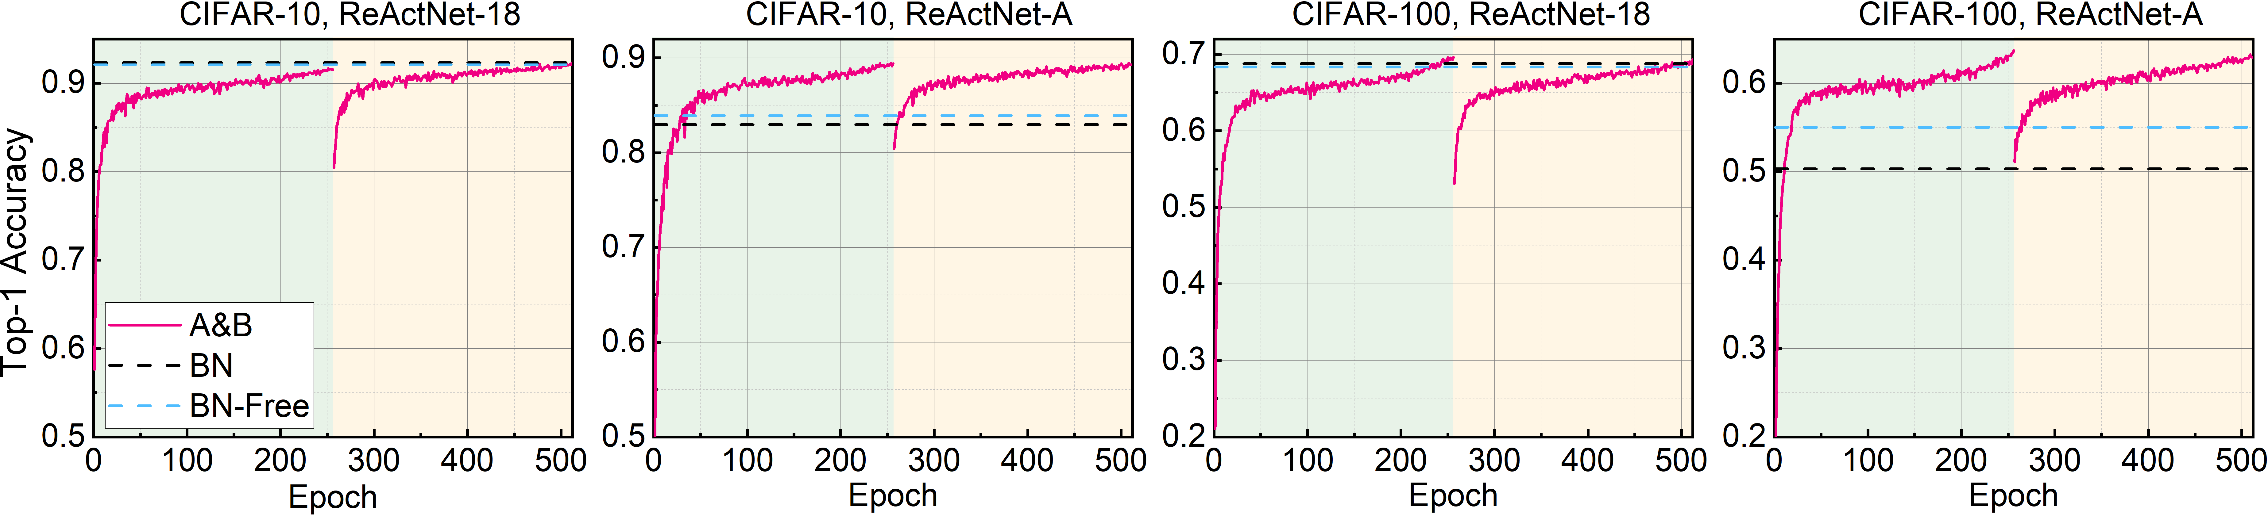
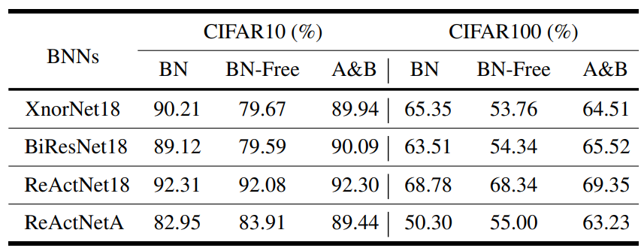
Experiments
Experiments on CIFAR
Notes:
The proposed method is also compared with the mainstream binary network architecture on the Cifar datasets, and shows good performance.

Slide 13
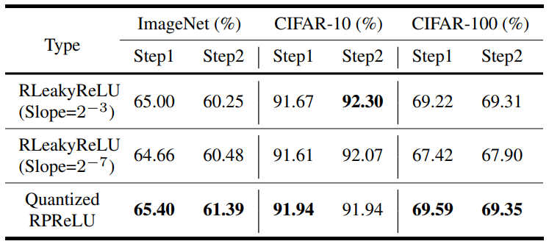
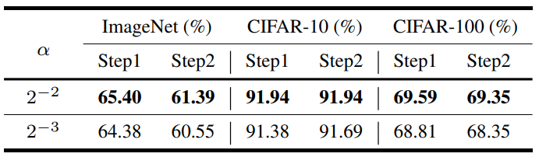
Ablation Study
Ablation studies results of different ReLU structures.
Ablation studies results of different α values.
Notes:
The ablation studies were also conducted to show the effectiveness of each component.
Experiments have shown that quantized RP relu has better performance than fixed slope R leaky relu.
The value of alpha is also determined, and the results show that zero point two five is better than zero point five.

Slide 14
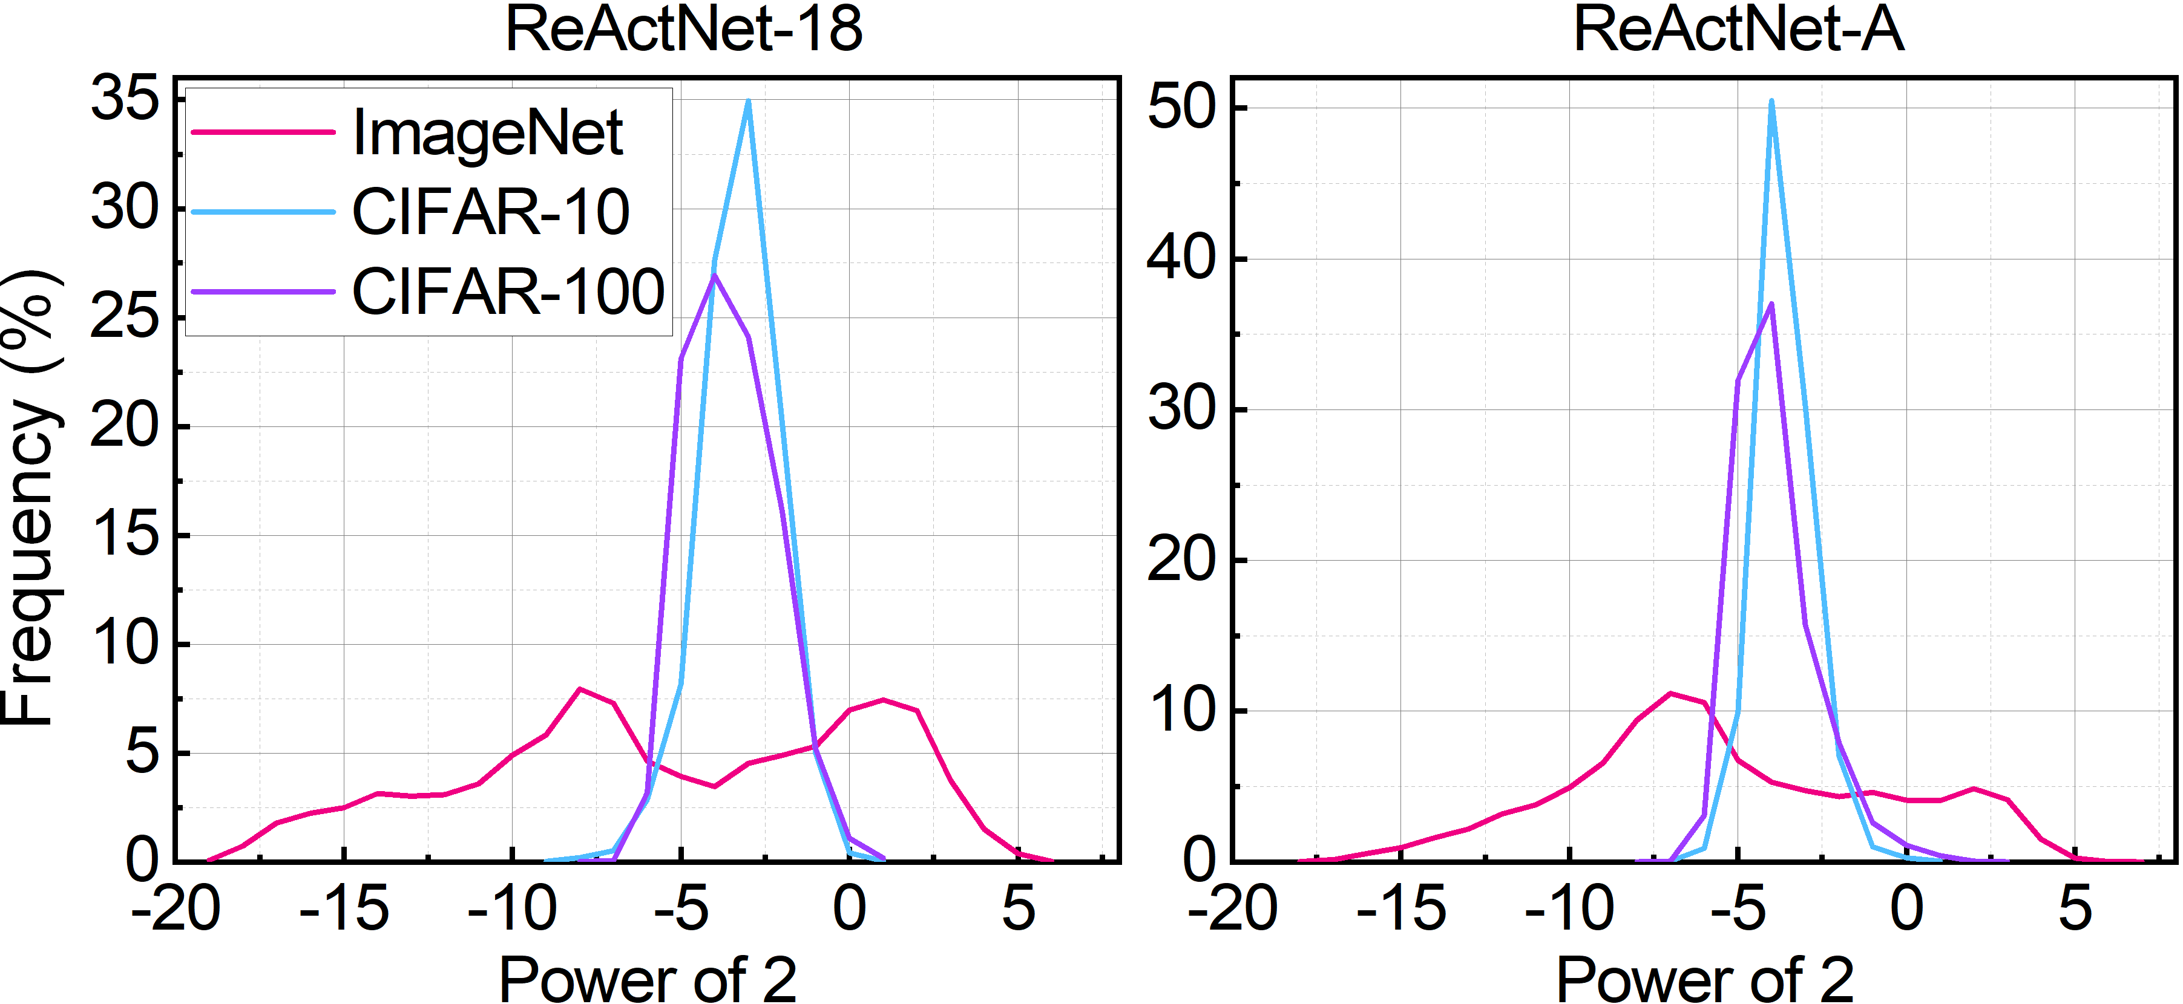
Visualization
The quantization values are mainly distributed within the range of 2⁻¹⁹ to 2⁶ . For the small dataset CIFAR, the exponential distribution ranges from -7 to 2, with a concentration around -3. For the ImageNet dataset, the quantization distribution is wider, ranging from -19 to 7, with approximately two peaks centered around -6 and 2.
The distribution of quantization slopes for the trained network
Notes:
The right figure illustrates the distribution of quantization slopes for the trained network, which quantizes RP relu on three datasets using Re ActNet 18 and Re ActNet A, respectively.
The quantization values are mainly distributed within the range of minus 19 to 6.
For the small dataset C far, the exponential distribution ranges from minus 7 to 2, with a concentration around minus 3.
For the ImageNet dataset, the quantization distribution is wider, ranging from minus 19 to 7, with approximately two peaks centered around minus 6 and 2.

Slide 15
Thank for listening!
Notes:
Thanks for your listening!

