Slide 1


I2E: Real-Time Image-to-Event Conversion for High-Performance Spiking Neural Networks
Presenter: Ruichen Ma 2026 | Singapore
Ruichen Ma, Liwei Meng, Guanchao Qiao, Ning Ning, Yang Liu, Shaogang Hu*
University of Electronic Science and Technology of China
ruichen.ma@std.uestc.edu.cn, sghu@uestc.edu.cn
Github: https://github.com/Ruichen0424/I2E
Tourmaline & Hall 3 524
Notes:
Good morning, everyone. I am Ruichen Ma from the University of Electronic Science and Technology of China.
It is a great honor to present our work: I2E, a novel framework for Real-Time Image-to-Event Conversion for High-Performance Spiking Neural Networks.

Slide 2

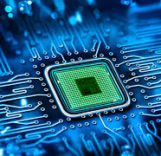
Motivation
The Core Challenge: Data Scarcity
SNNs need large-scale, high-quality data for deep learning.
Why Existing Solutions Fail
Hardware Recording (DVS Sensors)
High Cost & Low Resolution.
Too Slow: Weeks to record ImageNet-scale data.  Impossible to scale.
2. Prior Algorithm (e.g., ODG)
Computationally Heavy.
High Latency: Blocks real-time (on-the-fly) training pipelines.
Visual Evidence: Existing data suffers from significant background noise and motion blur.
Notes:
Spiking Neural Networks are well known for their energy efficiency and potential for green AI.
However, their practical use faces a big drawback: the lack of high-quality and large-scale event data.
Existing neuromorphic datasets are insufficient for training deep and complex models successfully, and standard data collection methods have big limitations.
For example, DVS sensors are costly, have low resolution, and require long capture times.
Alternatively, existing conversion algorithms, such as ODG, provide a software solution but are computationally heavy.
Their high latency makes them impractical for integration into real-time training pipelines. This forces researchers to rely on small or synthetic datasets that do not fully capture the complexity of real-world vision.

Slide 3
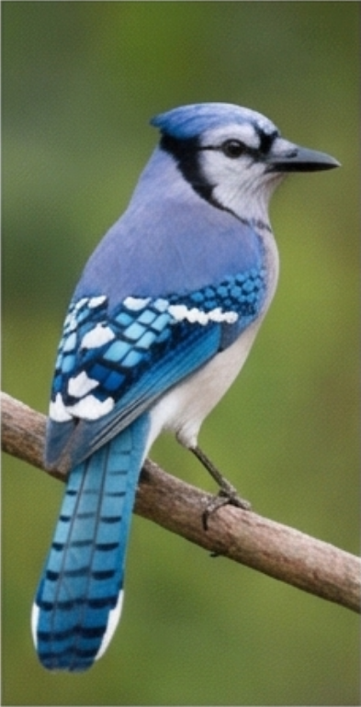
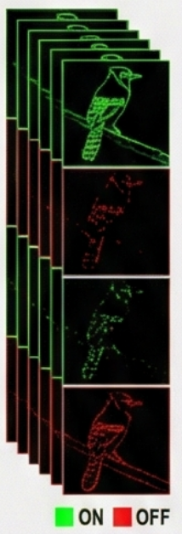
Method
Intensity
Extraction
(RGB → HSV Value Channel)
Data
Augmentation
1
1
-1
1
(Microsaccade Simulation)
Adaptive
Thresholding
I2E Algorithm Overview
Notes:
To resolve this bottleneck, we introduce I2E.
Our primary objective is Extreme Efficiency.
I2E is a framework optimized to convert static images into high-quality event streams in real-time on modern GPUs.
This real-time capability is a breakthrough because it enables On-the-fly Data Augmentation.
In standard Deep Learning, techniques like random cropping and flipping are essential for robust training.
Before I2E, applying these augmentations to SNNs was impossible due to the slow conversion process.
Our framework removes this barrier, allowing us to use standard augmentation pipelines to train deeper and stronger SNNs.

Slide 4
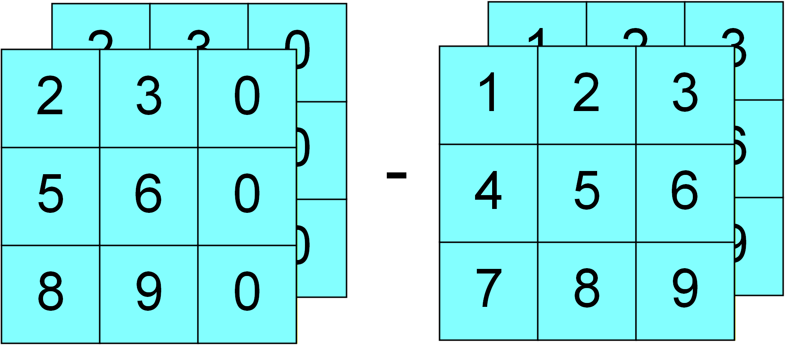
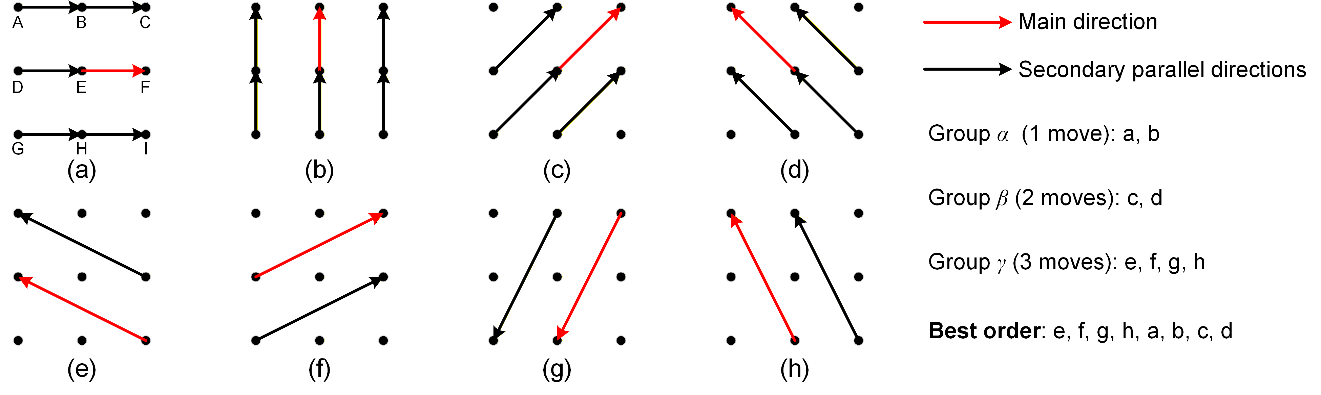
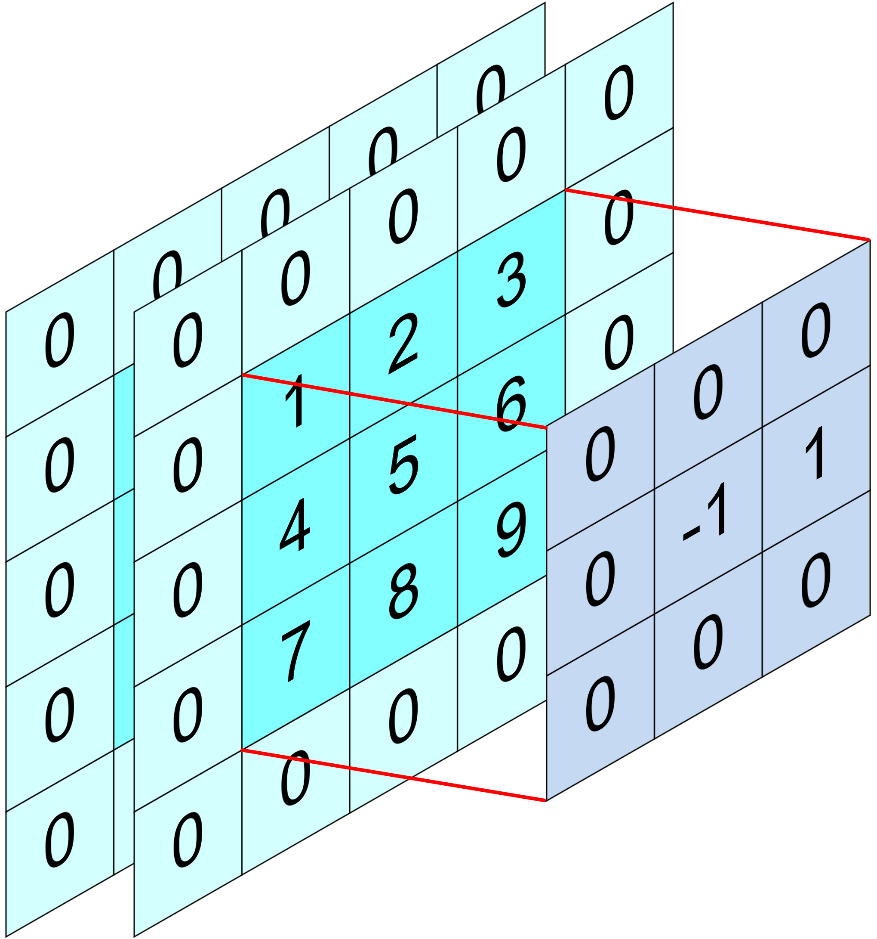
Method
Image Differencing
The I2E algorithm simulates micro-saccadic eye movements using a source image (point E) and its eight one-pixel shifted versions (the other points), represented by a 3 × 3 grid. The intensity change ∆V is calculated by differencing pairs of these images.
Parallel Convolution
Notes:
The core innovation of I2E lies in its modeling of event generation.
The method is inspired by biological vision, specifically the tiny eye movements that human eyes make to see detail.
In our framework, we simulate this process mathematically.
Instead of shifting pixels in memory—which is a slow operation—we define this movement as a Spatial Convolution.
We construct a sparse difference kernel to represent different motions.
By using convolution on the image intensity map, we compute the temporal changes in a single pass.
This formulation reduces the complexity to O(1) (Oh-of-one) per pixel.
Being highly parallel, this approach runs extremely fast on hardware like GPUs.

Slide 5
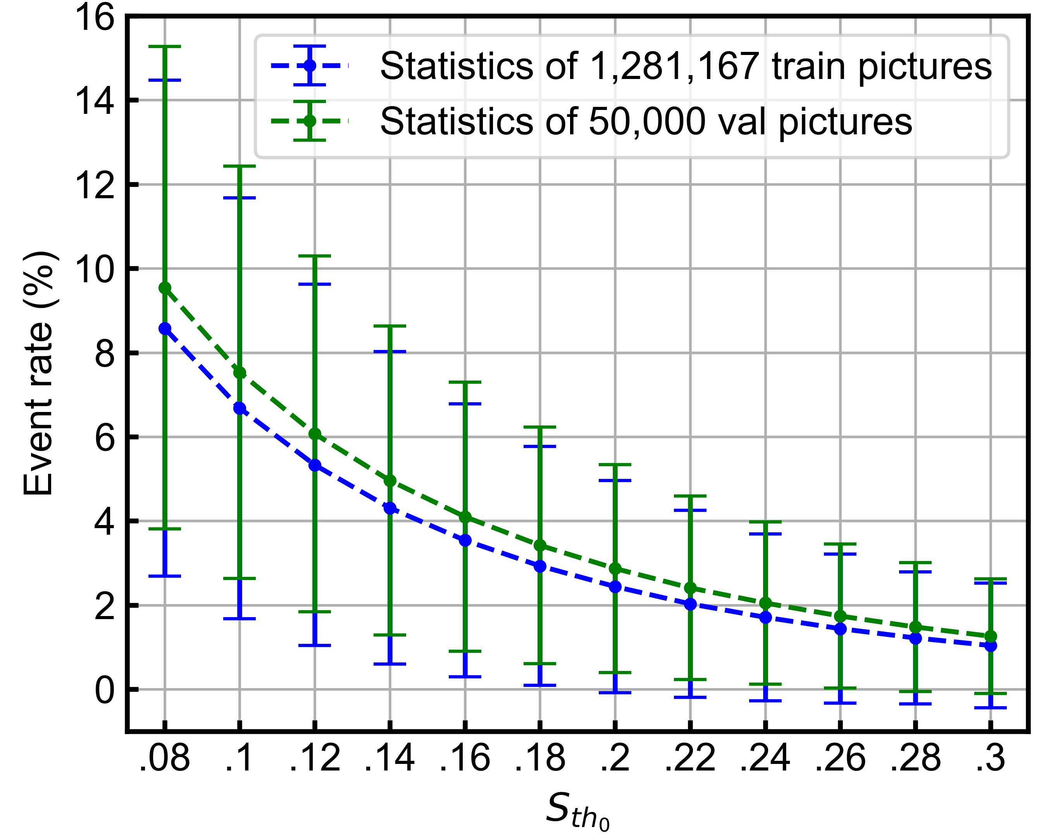

Method
Event generation:
Dynamic threshold:
Event rate statistics on ImageNet. $S_{{th}_{0}}$= 0.12 is selected to achieve a mean event rate of approximately 5%.
Notes:
Beyond speed, keeping signal quality is essential. A common challenge in conversion is selecting the suitable firing threshold. A fixed global threshold often fails to capture details in low-contrast areas or creates noise in high-contrast areas.
To address this, we propose Adaptive Thresholding.
Our method dynamically adjusts the sensitivity based on the local contrast range of each input image.
It ensures that regardless of the lighting conditions, the generated event streams keep sharp contours and rich textures.
This high signal-to-noise ratio is vital for training high-performance models.

Slide 6
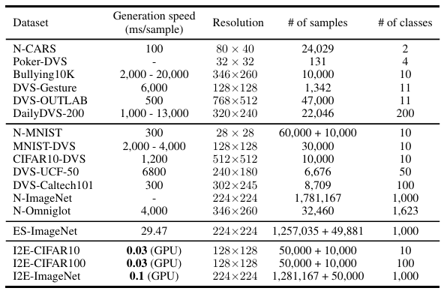
Speed
0.1ms latency (GPU)
30,000x faster than DVS
300x faster than ODG
18.9x reduction in first-layer energy consumption
Comparison of event-based dataset generation speeds. The proposed I2E algorithm demonstrates orders-of-magnitude faster per-sample generation speed compared to both hardware-based acquisition methods and previous algorithmic approaches. Hardware speeds reflect physical capture time, while algorithmic speeds reflect computation time.
Notes:
Our experimental results confirm the huge efficiency gains of the method.
As shown in the comparison, physical DVS hardware typically requires about 3000 milliseconds to capture a stable stream.
Existing algorithms take around 30 milliseconds, which remains a bottleneck for training.
In contrast, I2E completes the conversion in just 0.1 milliseconds.
This represents a thirty-thousand-fold speedup compared to hardware capture and a 300-fold improvement over existing algorithms.
Moreover, this efficiency translates directly to energy savings.
Our method reduces the energy consumption of the first layer by 19 times compared to standard artificial neural networks, making it a key enabler for scalable and low-power neuromorphic systems.

Slide 7
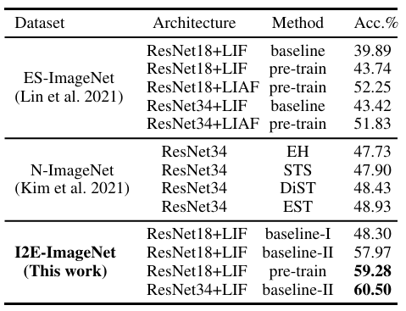
Experiment
High Generation Quality
Pre-trained on the ImageNet
State-of-the-art comparison on event-based ImageNet classification. The proposed I2E-ImageNet enables an MS-ResNet34 architecture to achieve a new state-of-the-art accuracy of 60.50%, substantially outperforming all prior results and demonstrating the superior quality of the synthetic data for training deep high-performance SNNs.
Notes:
We tested I2E on the large-scale ImageNet benchmark, comparing it against existing event-stream datasets such as N-ImageNet and ES-ImageNet.
By training a ResNet SNN on our generated data, we achieved a Top-1 accuracy of 60.50%.
This result significantly outperforms all previous baselines, establishing a new state-of-the-art in this domain.
It demonstrates that our synthetic data is not only fast to generate but also rich in useful features required for complex classification tasks.

Slide 8
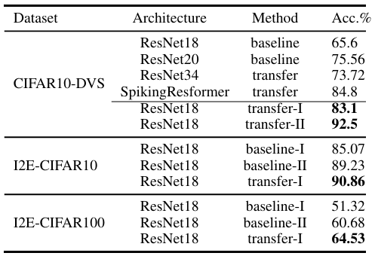
Experiment
Sim-to-Real Transfer
Pre-trained on the ImageNet
Pre-trained on the I2E-CIFAR10
Performance on CIFAR datasets. Transfer-I denotes fine-tuning after pre-training on I2E-ImageNet. Transfer-II denotes fine-tuning after pre-training on I2E-CIFAR10. The transfer-II result of 92.5% establishes a new state-of-the-art on real-world CIFAR10-DVS, demonstrating the effectiveness of the proposed sim-to-real training paradigm.
Notes:
A critical contribution of this work is the validation of the Sim-to-Real transfer paradigm.
A central challenge in the field is determining whether synthetic data can successfully train models for real-world sensors.
We addressed this through a detailed transfer learning experiment.
After pre-training a model on our synthetic I2E data, we fine-tuned it on the real-world DVS-CIFAR10 dataset.
The outcome was highly successful: we achieved 92.5% accuracy on the DVS-CIFAR10 dataset.
This confirms that our synthetic data serves as a high-fidelity proxy for real-world events, effectively bridging the domain gap and allowing researchers to develop robust models without relying on expensive hardware data.

Slide 9
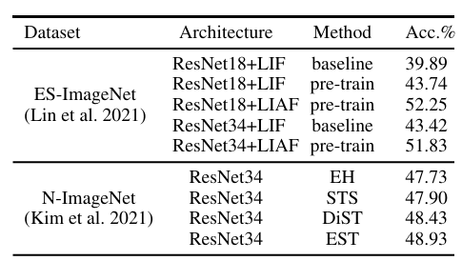
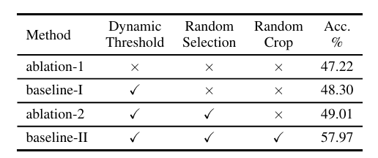
Ablation
Ablation study of I2E components on I2E ImageNet with ResNet18. Dynamic thresholding, random selection, and compatibility with standard augmentations are all essential for achieving optimal performance.
Notes:
To further validate our method, we conducted an ablation study to analyze the impact of our core conversion module combined with data augmentation.
As shown in this slide, even without applying data augmentation, our proposed I2E conversion method already achieves comparable accuracy to previous state-of-the-art works.
This shows that our bio-inspired modeling is more effective at capturing informative events.
When we enable the standard data augmentation pipeline—which is only possible due to our real-time speed—the performance improves by another 10%.
This highlights that I2E provides two key benefits: a better conversion method and the capability to leverage powerful deep learning augmentation strategies.

Slide 10
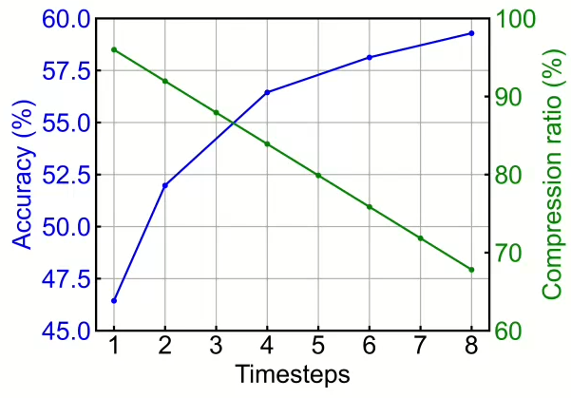
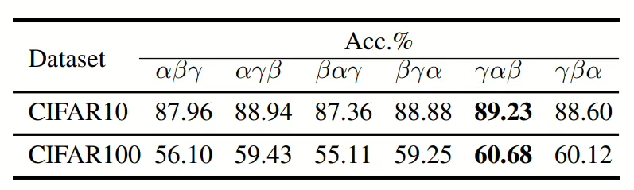
Ablation
Trade-off between timesteps, accuracy, and data compression on ImageNet. Using more timesteps improves accuracy at the cost of a lower data compression ratio.
Ablation on the timestep processing order. Presenting groups with higher event rates first consistently yields the best performance.
Notes:
We also examined how temporal settings affect performance.
Specifically, we analyzed the order of event frames and the number of timesteps.
First, regarding the sequence.
Our studies show that the order matters.
We found that placing frames with higher event rates at the beginning and end, while keeping lower-rate frames in the middle, gives the best results.
Second, we tested reducing the number of timesteps.
As shown in the chart, even with just **2** timesteps, the model keeps an accuracy of about 52%.
At this level, the data compression ratio exceeds **90%**.
This means I2E not only **speeds up** computation but also provides massive storage savings due to its sparsity."

Slide 11
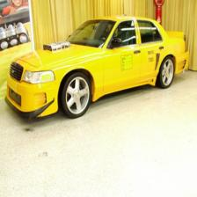
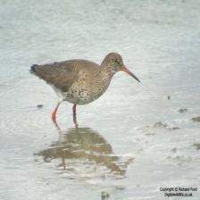


Visualization
Notes:
To visualize the quality, we show some conversion examples here.
As you can see our method effectively converts static images into sparse event streams.
Thanks to the Adaptive Thresholding, the fine details and sharp contours of the objects are well preserved.
At the same time, the background remains relatively clean, without heavy noise.

Slide 12

Q&A
We have open-sourced all the tools and the I2E dataset. For more information, please scan the QR code below.
Notes:
In conclusion, I2E resolves the long-standing data bottleneck in SNN research. It provides a fast, scalable, and high-quality solution for the community.
We have released all I2E datasets, and our goal is to build a foundational toolkit that speed up future research. We invite you to scan the QR code to access our open-source code and pre-trained models. Thank you for your attention.

