Slide 1


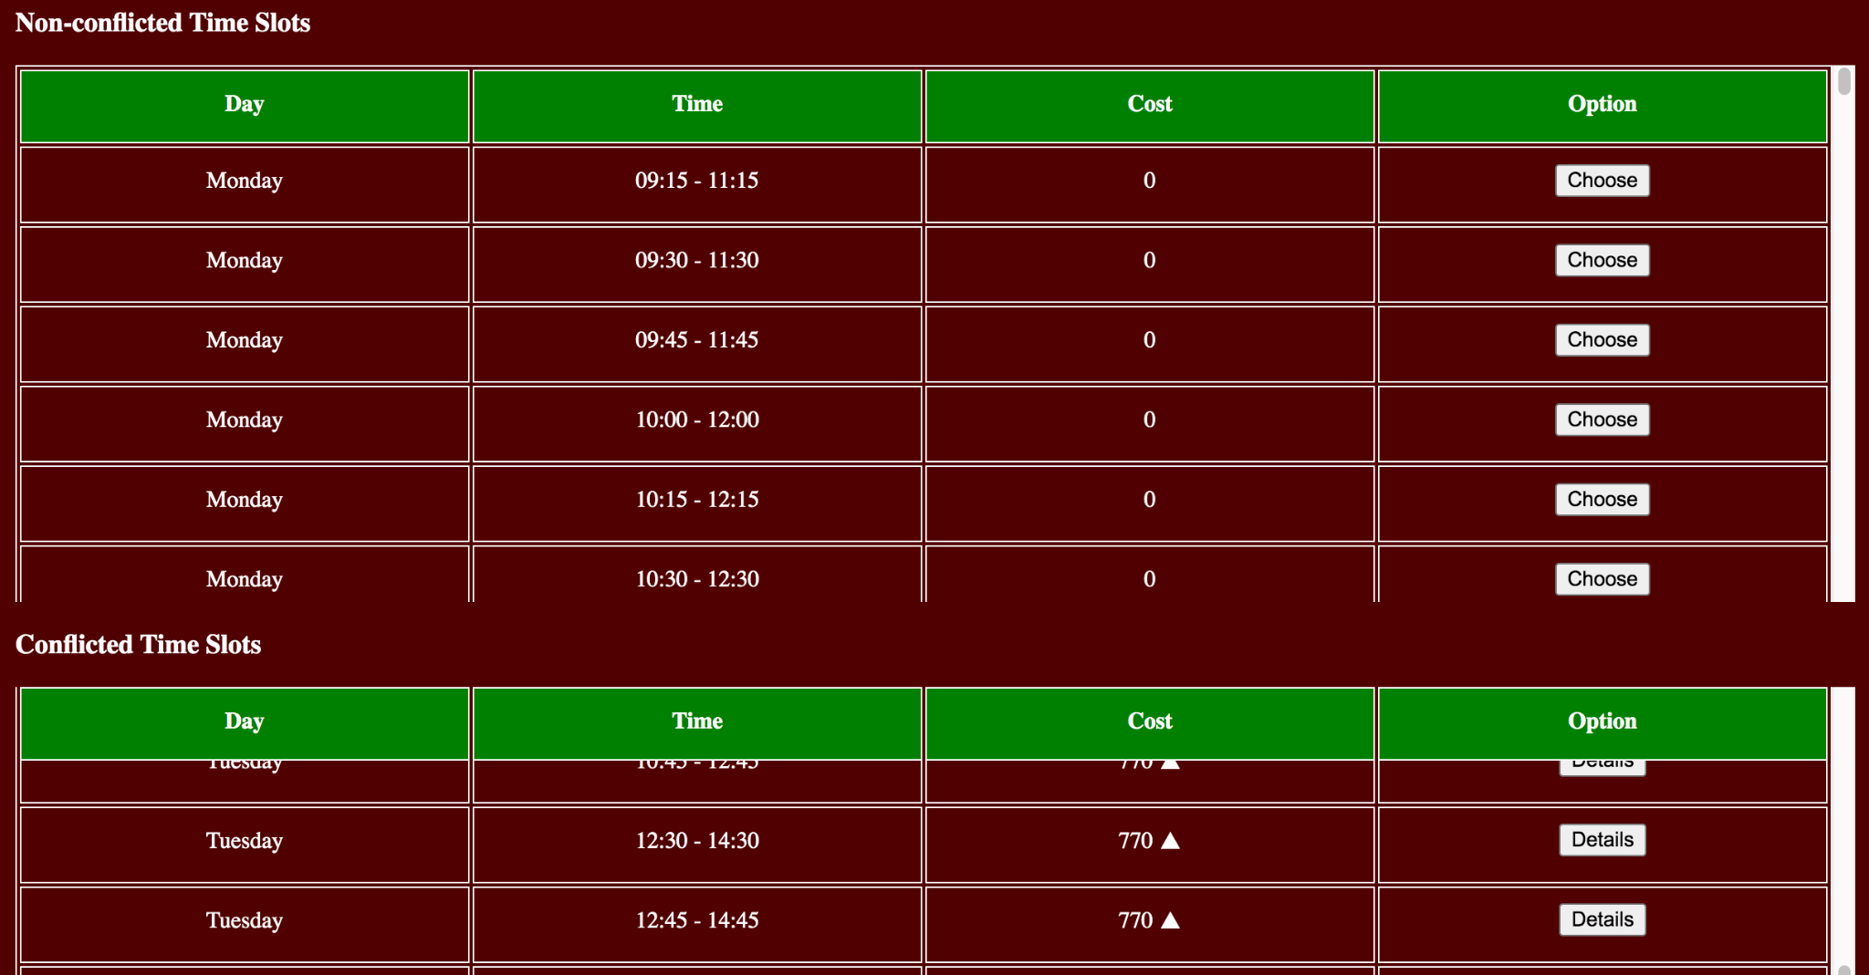
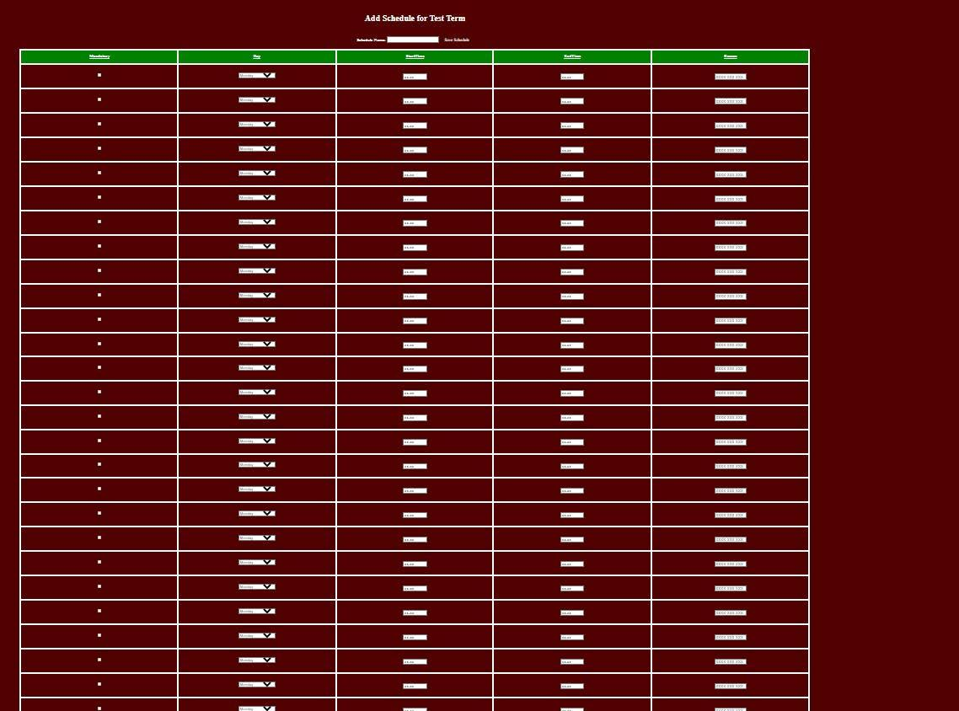
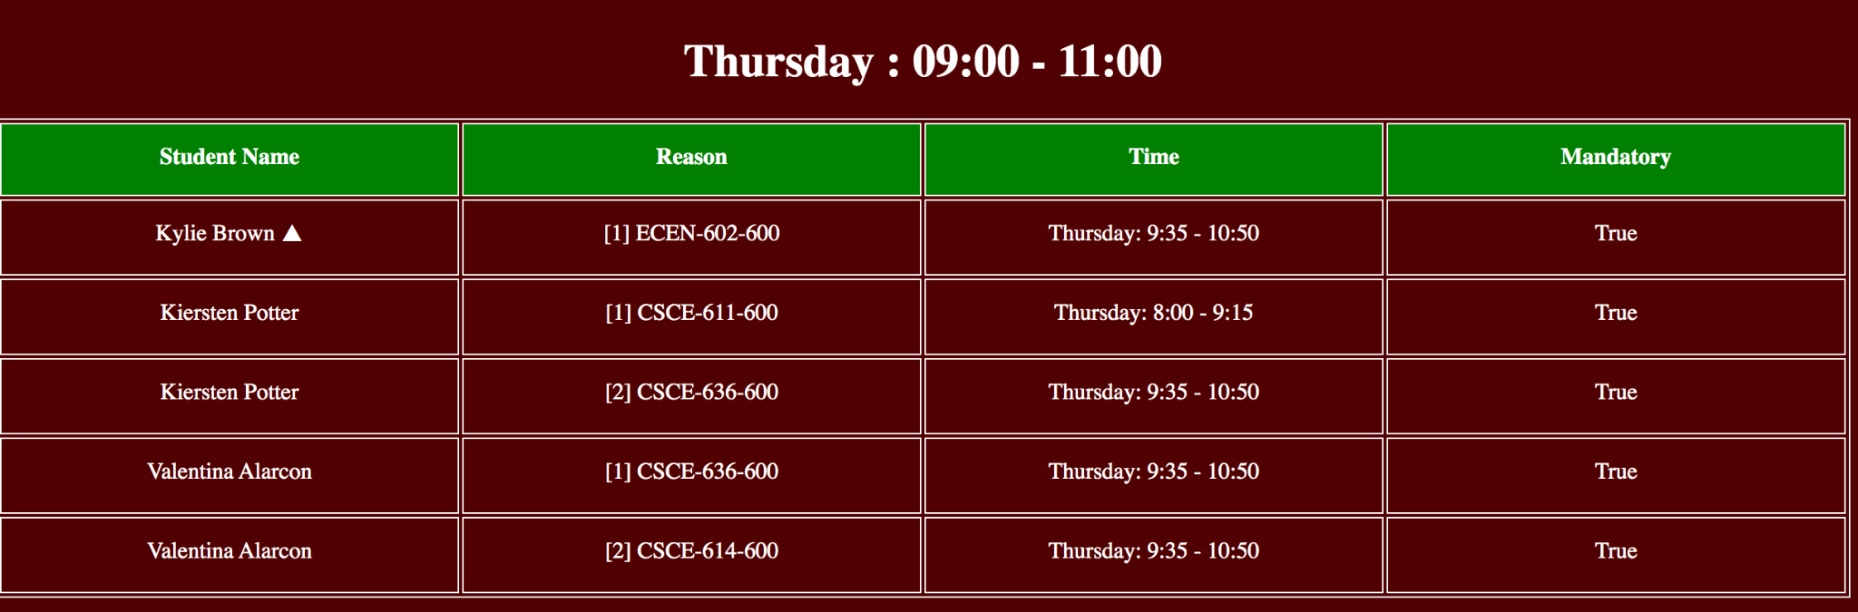
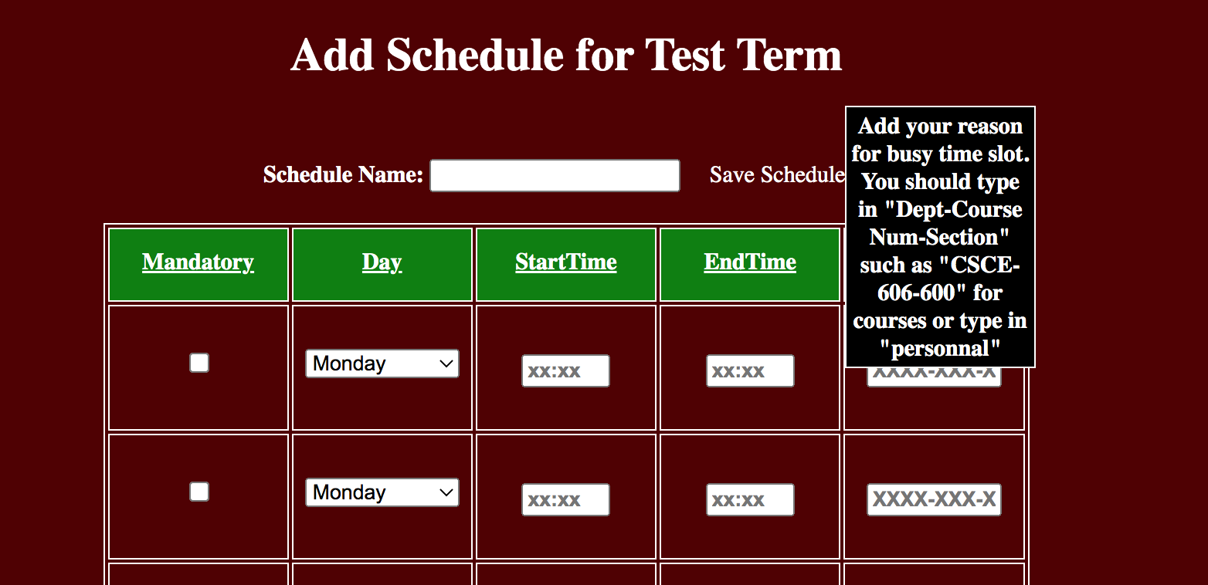
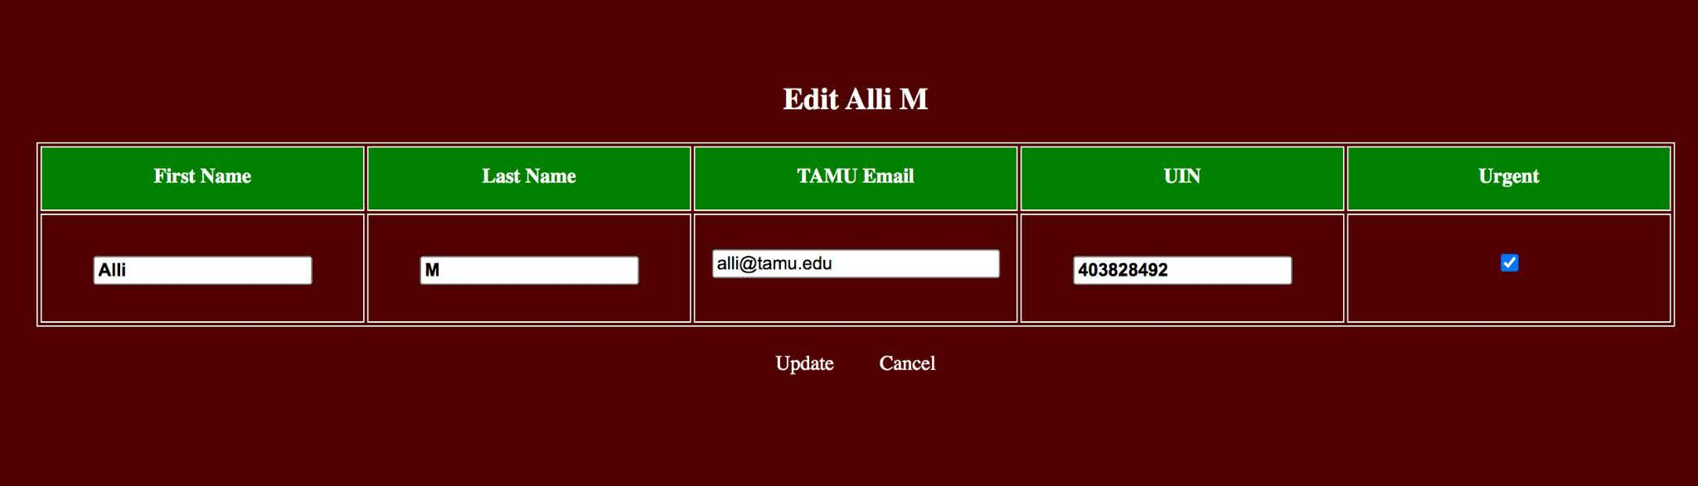
Zachry Leadership Program Lecture Scheduler
Stone Chen, Ruichen Ni, Zhiren Zhou, Huancheng Zhou, Haotian Xu
Project Advisors: Philip Ritchey, Seth Sullivan
Zachry Leadership Program Lecture Scheduler
Ming Dang, Bethany Witemeyer, Sanghyeon Lee, Shih-Chiang Wei, Austin Dauzat, Han-Yi Wang Litong Zhang
Advisors: Hank Walker, Seth Sullivan, Maria Polyzoi
Background
Student Features
The Zachry Leadership Program is divided into as many cohorts as desired of 32 students each.
A legacy website was taken over and improved.
It is designed to assist the director in finding an appropriate 2-hour time window for weekly meetings with the students.
Allow students to add schedules manually.
Extend available course input field up to 30.
Each entry has a tooltip to notify student the format of their input.
Motivation & Contribution
The algorithm of the legacy website was logically wrong and inefficient. We re-design the algorithm.
Students that are graduating are given the highest priority among all who register this program.
Our client expresses concerns about the need to enable manual input of students' schedules, instead of selecting from course list scraped from college website.
Show All Non-conflict and Conflict Time Slots with Cost
Updating Whole Schedule Page
Administrator Features
Conflit Time Slot Details
Create a new algorithm seeking all non-conflicted and conflicted time slots with costs accurately.
Add the functionality that admin can mark students as urgent to increase their chances to get enrolled.
Improve the readability of detailed results generated by the algorithm.
Add ability to show conflict details, such as conflicted time period, course name, course section number, schedule number, and urgent student.
Add triangle symbols to show admin if one or more urgent students are in any conflicted time slots.
Enable Students Edit Schedule Manually
Challenges & Lessons Learned
Always commit and create relative new branch when push a modified version of code.
Planned meetings are more productive.
Legacy codes takes time and efforts.
Create reasonable and attainable goals.
Edit a Student as Urgent

