Slide 1

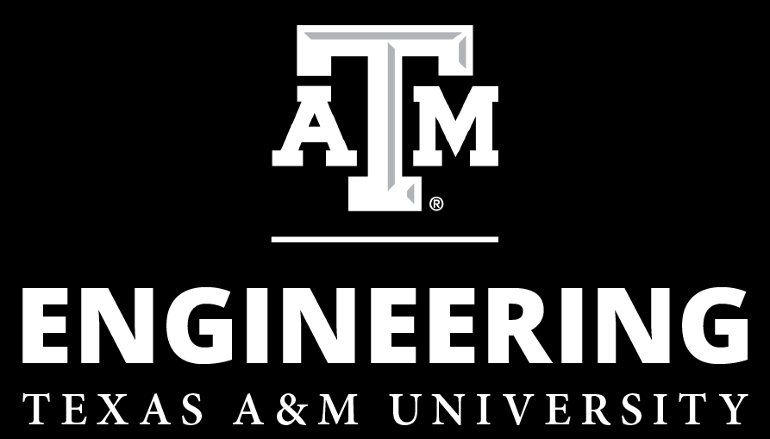
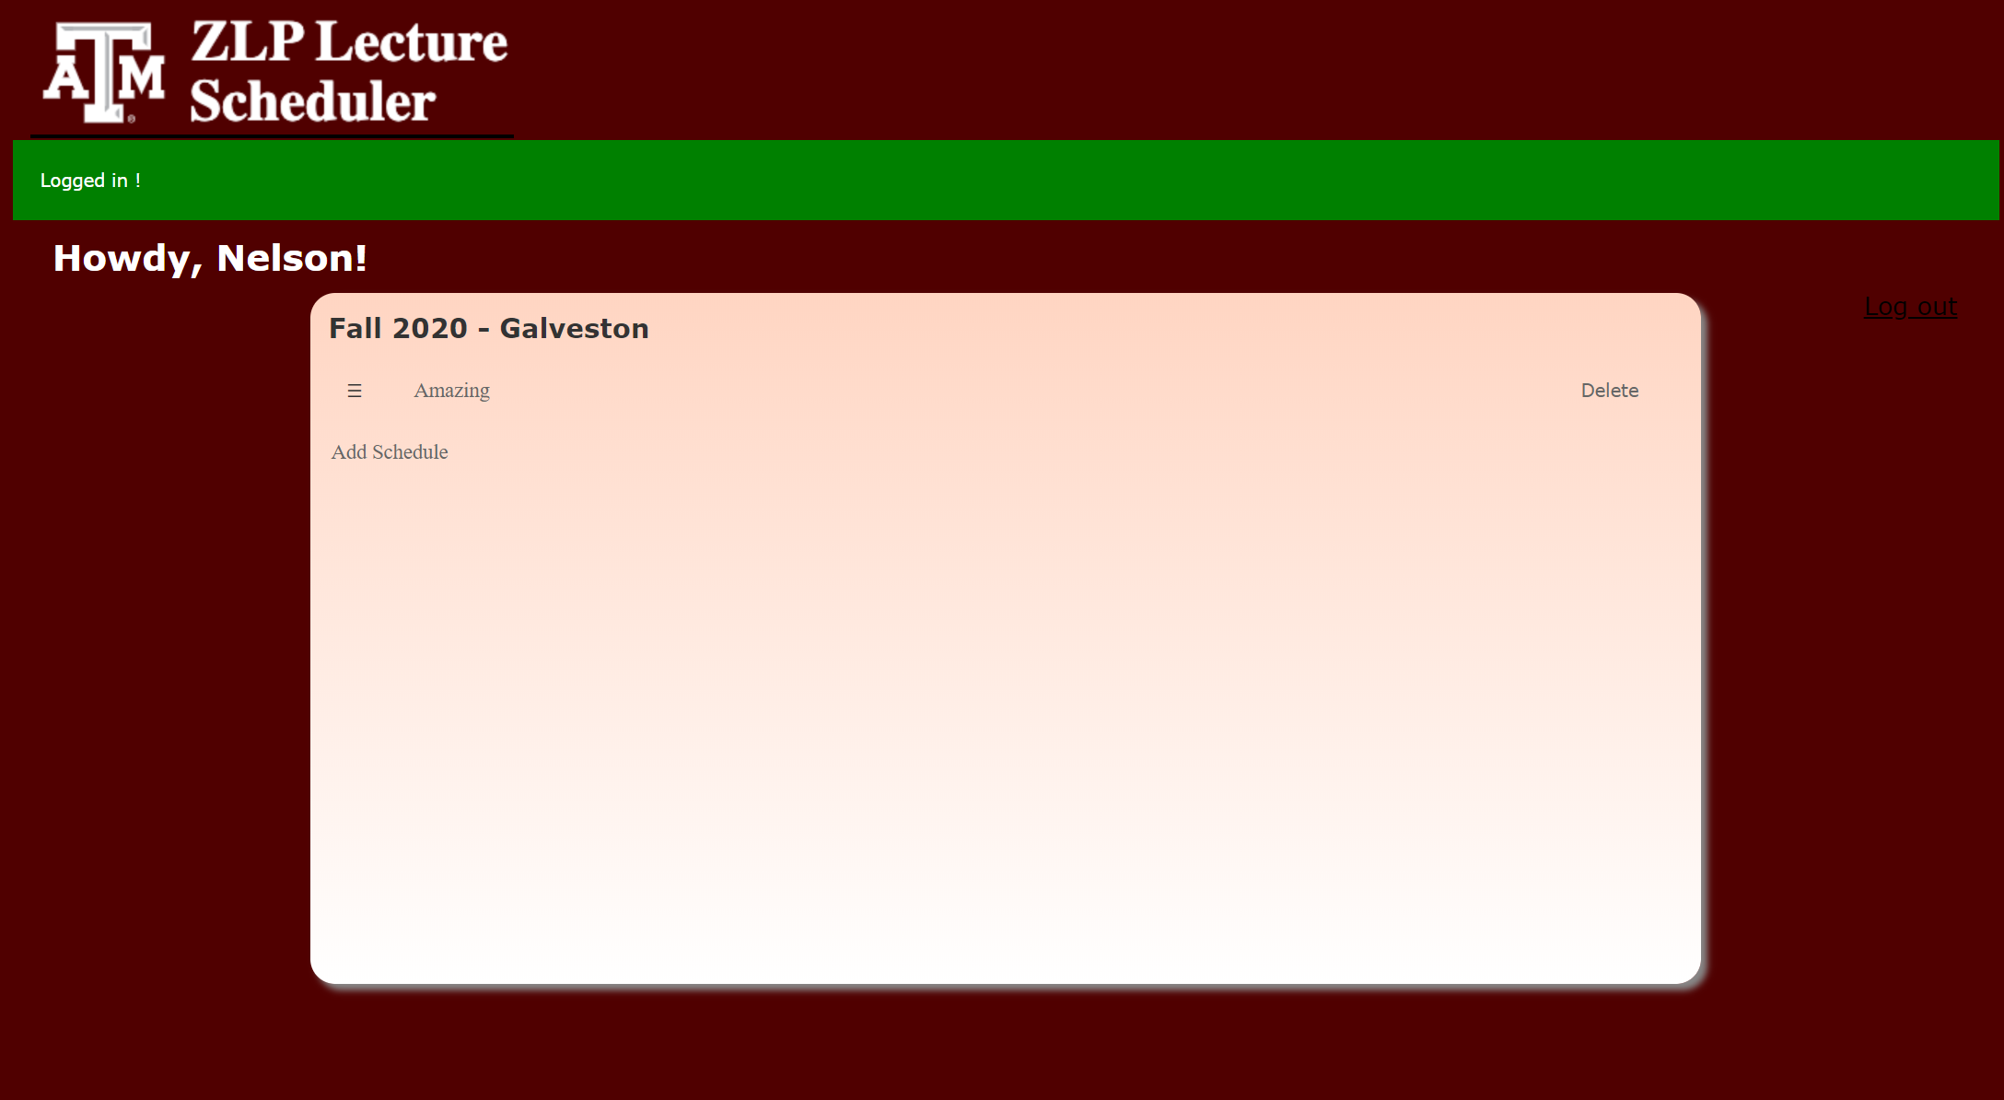
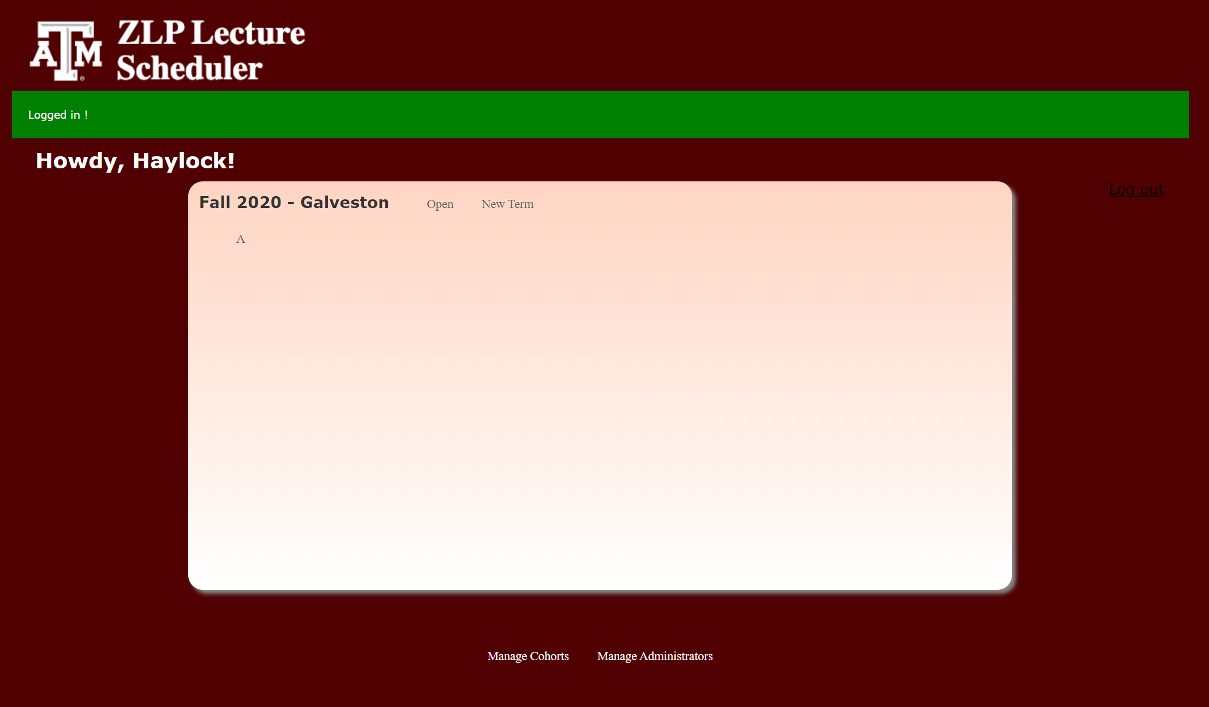
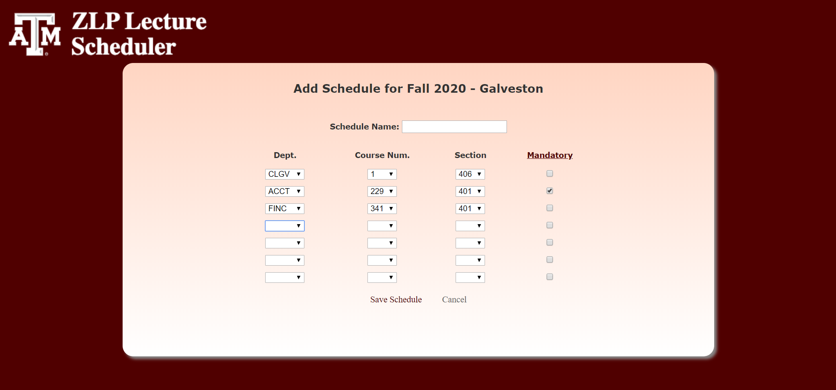
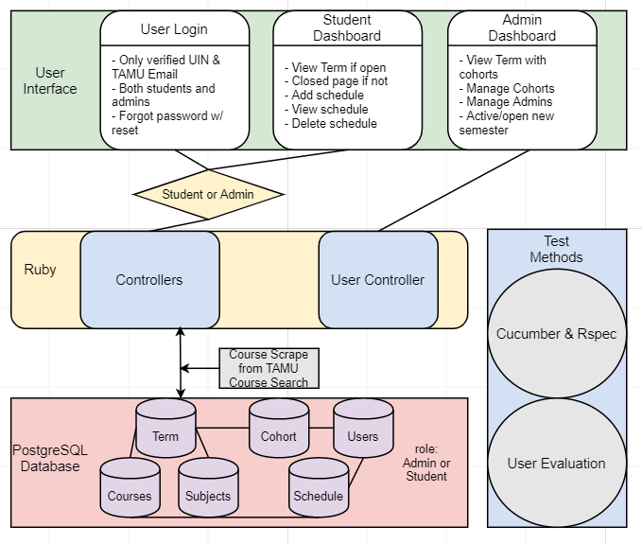
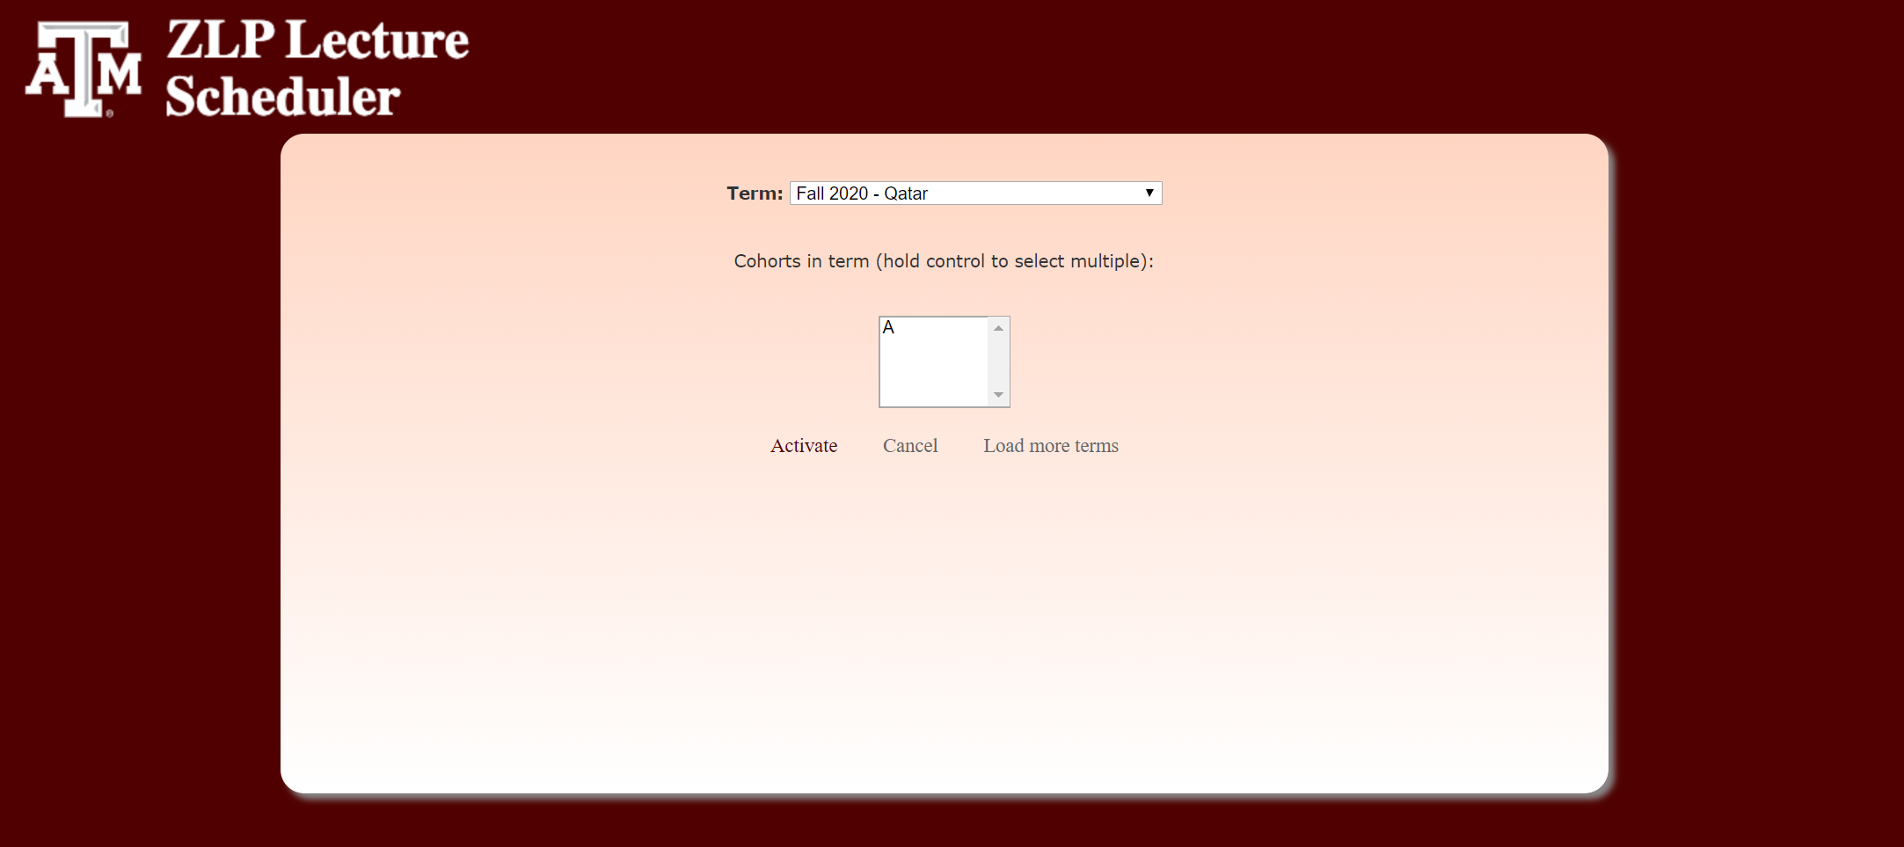
Zachry Leadership Program Lecture Scheduler
CucumberJunction: Lauren Haylock, Abhishek Deb, Arman Rezaee, Parsa Dastjerdi, Matthew Fitzpatrick
Project Advisors: Dr. Hank Walker, Seth Sullivan, and Maria Polyzoi
Our Assignment:
Application Features (Administrator):
Application Features (Student):
The Zachry Leadership Program is a 5-semester certificate program which selects 32 undergraduate sophomore engineering students each year to participate. These students must take part in each semester consecutively with the same cohort they were admitted. During each semester, every student must attend a 2-hour lecture period once a week with their cohort members. In the past, choosing a lecture time that works with all students varying schedules has been very difficult and time consuming. Thus, our team was tasked with creating an application that could analyze all students' tentative schedules before registration and select a time for the lecture period that works with the schedules.
Claim Account
Admins can claim their account and create a secure password once the master administrator has added their credentials to the system
Manage Cohorts
Admins can create new cohorts and upload student credentials for that cohort via excel file
Admins can edit or delete and student in a cohort or delete an entire cohort
Admins can add cohorts to a semester upon activation
Admins can view which students in a cohort have added schedules
Manage Administrators
Admins can add, edit, or delete other administrators
Manage Semesters
Admins can select a semester to activate and choose which cohorts will participate in that semester
Admins can define a range of time when the students are able to add schedules to a semester
Admins can click ‘find class time’ once all students of a cohort have added schedules for the application to compute the best lecture time
Claim Account
Students can claim their account and create a secure password once the administrator has added their credentials to the system
Manage Schedules
During the time range a semester is ‘open’ (specified by admin) the student can add or delete schedules they are considering for that semester
Application Goals:
Secure login for both administrators and students
Access to the application only for pre-approved users
Allow students to choose courses for their schedules from a set of confirmed TAMU courses
Mass uploading of student information by the administrator
Cohort, student, and administrator management
Allow administrators to choose an active semester and define a time range for students to add schedules for it
Algorithm to analyze student schedules
Student Dashboard
Software Design:
Admin Dashboard
Student Add Schedule
Lessons Learned & Challenges:
Test Early and Often
Without frequently testing, making small feature changes could have potentially widespread bad consequences.
Test Locally and on Heroku
Features that work locally often do not work once deployed.
Team Communication is Key
When two or more teammates have overlapping responsibilities that involve schema or controller design, it should be defined and agreed on before implementing user stories
Admin Activate New Semester

