Slide 1
StepConf: SLO-Aware Dynamic Resource Configuration for Serverless Function Workflows
Infocom 2022, HUST, Fangming Liu

Slide 2
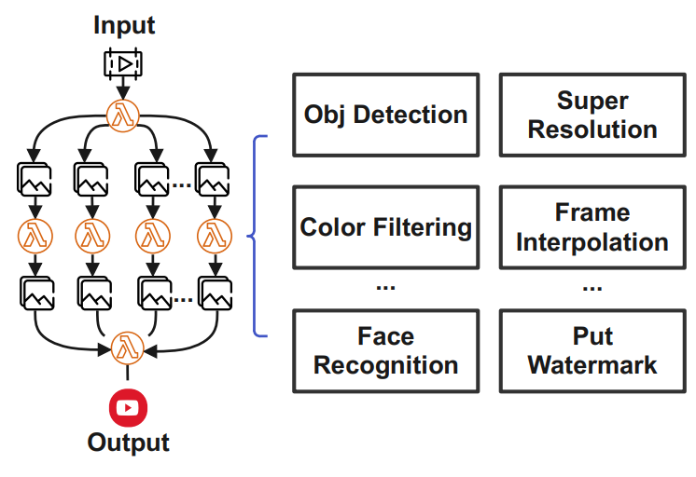
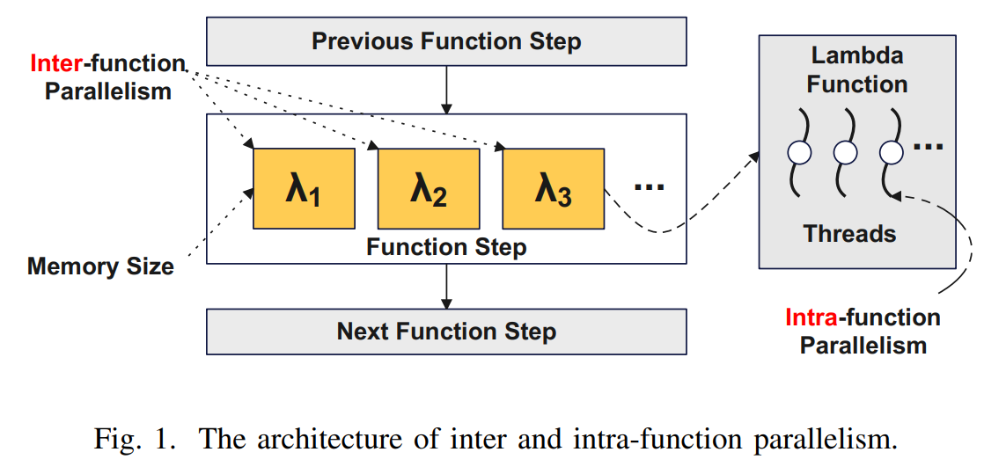
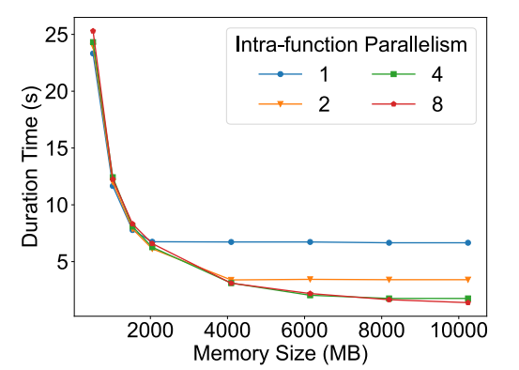
Configuration of Function
Through the experiments conducted on AWS, we find that inter and intra-function parallelism are crucial factors that we need to consider, in addition to function memory size[1].
The performance fluctuation of functions is mainly caused by function cold start and performance variation of external storage services
[1] TPDS 2022, Coordinating Fast Concurrency Adapting With Autoscaling for SLO-Oriented Web Applications
1
Notes:
在使用 Severless 的过程中，我们需要配置每个函数的并发数和Mem（AWS按比例分配CPU和MEM）。其中并发包括函数间并行数和函数内并行数。右下图展示的是，MEM增加后，最佳的函数内并行度也会增加，这和TPDS 2022的一篇文章的思路相同。这带来指数级增长的配置空间，我们需要配置这些资源以保证服务性能SLO。另外，冷启动和外存设备的性能波动也会影响性能。Openfaas配置在kubernetes上，k8s 的 etcd比较吃磁盘性能。

Slide 3
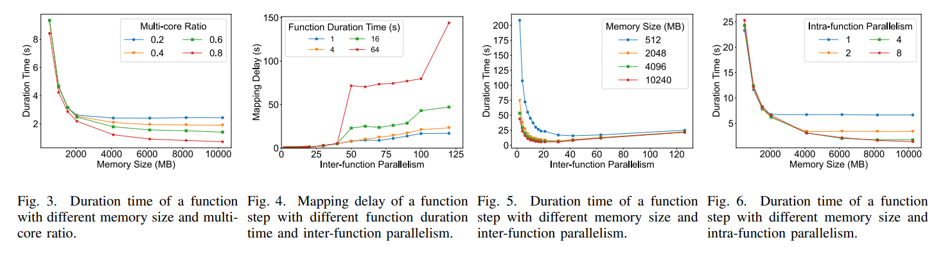
MOTIVATION
Memory size: the single-thread performance of the Lambda function would not be improved when it reaches 1769 MB. The duration time of a multi-core optimized program is reduced proportionally as the memory increases
Inter-function parallelism: mapping overheads become a bottleneck.
Intra-function parallelism: AWS allocates different numbers of available vCPUs for the functions in different memory sizes.
2
Notes:
内存大小（对于单线程优化程序，当内存增加到一定值时，性能将不再提高。多核优化程序的持续时间随着内存的增加而成比例地减少，但仍存在瓶颈1739MB）
From the results shown in Fig. 4, we find that the function step’s mapping delay is relatively low when the degree of interfunction parallelism is smaller than about 30. we find that keeping increasing the degree of inter-function parallelism will not further accelerate the computation. This is because the mapping overheads become a bottleneck.

Slide 4
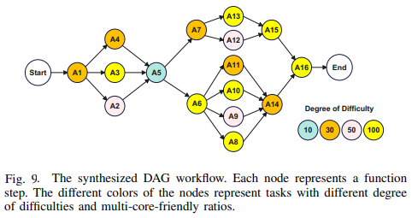
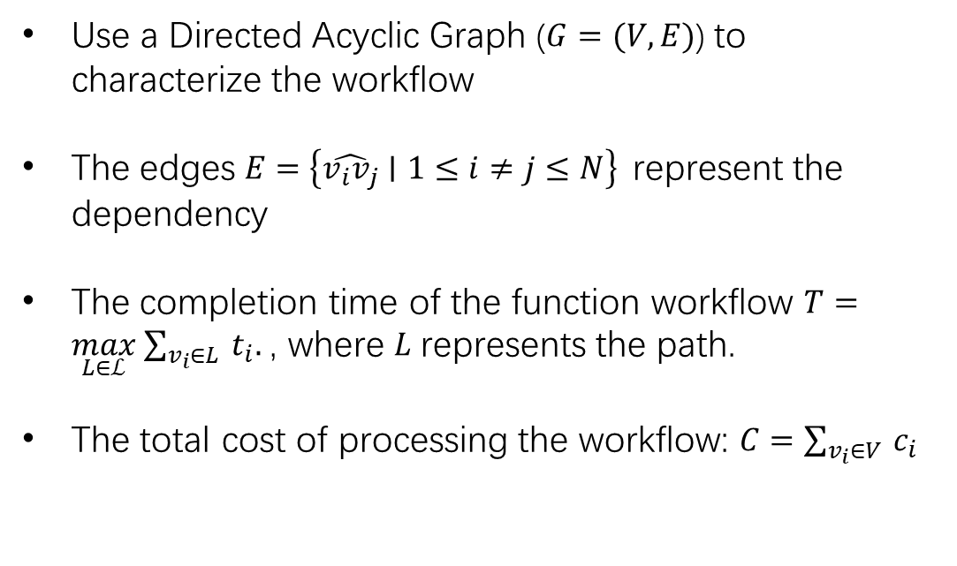
Workflow Execution Model
Use a Directed Acyclic Graph ($G=(V,E)$) to characterize the workflow
The edges $E=\left\{\hat{v_{i}v_{j}}∣1≤i≠j≤N\right\}$ represent the dependency
The completion time of the function workflow $T=\max_{L∈ℒ} \sum_{v_{i}∈L}{ }t_{i}.$ , where $L$ represents the path.
The total cost of processing the workflow: $C=\sum_{v_{i}∈V}{ }c_{i}$
Video process workflow [1]
Synthetic workflow [2]
[1] SOCC 2021, Llama: A Heterogeneous & Serverless Framework for Auto-Tuning Video Analytics Pipelines
[2] SJTU-IPADS/ServerlessBench: A benchmark suite for serverless computing (github.com)
3
Notes:
内存大小（对于单线程优化程序，当内存增加到一定值时，性能将不再提高。多核优化程序的持续时间随着内存的增加而成比例地减少，但仍存在瓶颈1739MB）
From the results shown in Fig. 4, we find that the function step’s mapping delay is relatively low when the degree of interfunction parallelism is smaller than about 30. we find that keeping increasing the degree of inter-function parallelism will not further accelerate the computation. This is because the mapping overheads become a bottleneck.

Slide 5
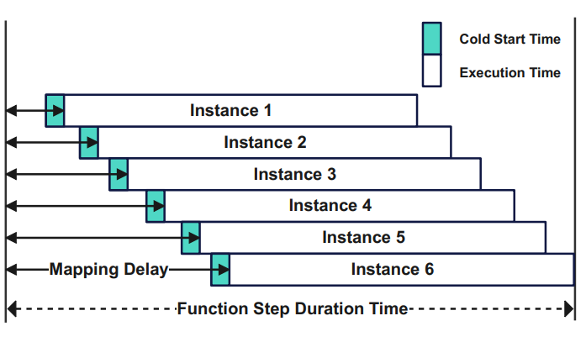
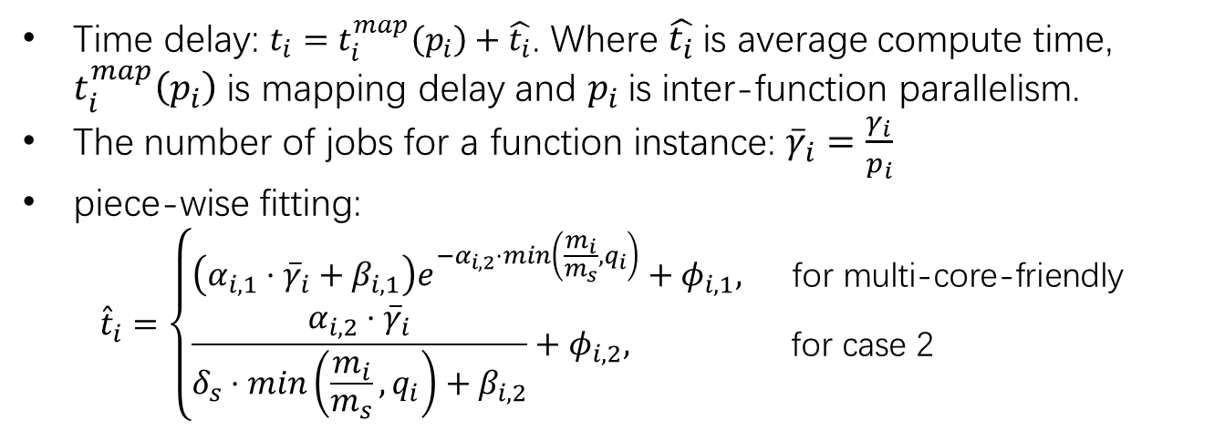
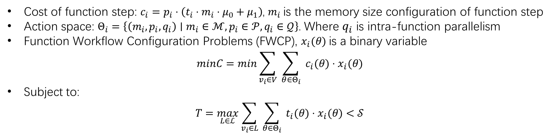
MODEL DESIGN AND PROBLEM FORMULATION
Time delay: $t_{i}=t_{i}^{map}\left(p_{i}\right)+\hat{t_{i}}$. Where $\hat{t_{i}}$is average compute time, $t_{i}^{map}\left(p_{i}\right)$ is mapping delay and $p_{i}$is inter-function parallelism.
The number of jobs for a function instance: ${\overline{γ}}_{i}=\frac{γ_{i}}{p_{i}}$
piece-wise fitting:
$${\hat{t}}_{i}=\left\{\begin{aligned}&\left(α_{i,1}⋅{\overline{γ}}_{i}+β_{i,1}\right)e^{−α_{i,2}⋅min\left(\frac{m_{i}}{m_{s}},q_{i}\right)}+φ_{i,1}, && \text{for} \text{multi}\text{−}\text{core}\text{−}\text{friendly} \\ &\frac{α_{i,2}⋅{\overline{γ}}_{i}}{δ_{s}⋅min\left(\frac{m_{i}}{m_{s}},q_{i}\right)+β_{i,2}}+φ_{i,2}, && \text{for} \text{case}\text{ 2 }\end{aligned}\right.$$
Cost of function step: $c_{i}=p_{i}⋅\left(t_{i}⋅m_{i}⋅μ_{0}+μ_{1}\right)$, $m_{i}$is the memory size configuration of function step
Action space: $Θ_{i}=\left\{\left(m_{i},p_{i},q_{i}\right)∣m_{i}∈ℳ,p_{i}∈𝒫,q_{i}∈𝒬\right\}$. Where $q_{i}$ is intra-function parallelism
Function Workflow Configuration Problems (FWCP), $x_{i}(θ)$ is a binary variable
$$minC=min\sum_{v_{i}∈V}{ }\sum_{θ∈Θ_{i}}{ }c_{i}(θ)⋅x_{i}(θ)$$
Subject to:
$$T=\max_{L∈ℒ} \sum_{v_{i}∈L}{ }\sum_{θ∈Θ_{i}}{ }t_{i}(θ)⋅x_{i}(θ)<𝒮$$
4
Notes:
我们用$\min \left(\frac{m_i}{m_s}, q_i\right)$表示单线程优化函数的多核加速比上届，采用的是函数内并行加速（intra-function parallelism）
From this, we develop a piece-wise fitting method. For the programs that are multi-core-friendly (case 1), we use an exponential function for fitting; For programs that can only take advantage of single-thread performance or the memory size is lower than ms (case 2), we use an inverse proportional function for fitting
We use a binary variable xi(Θ) to indicate whether the function step vi is configured to Θ
We set the memory size that the cloud vendor exactly allocates a full single-core resource for a function as $m_{s}$
where s stands for single and its relative performance is denoted as $δ_{s}$

Slide 6
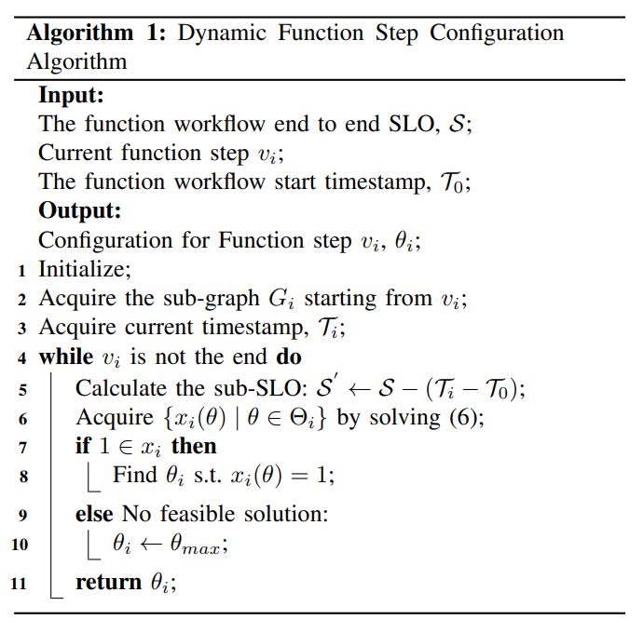
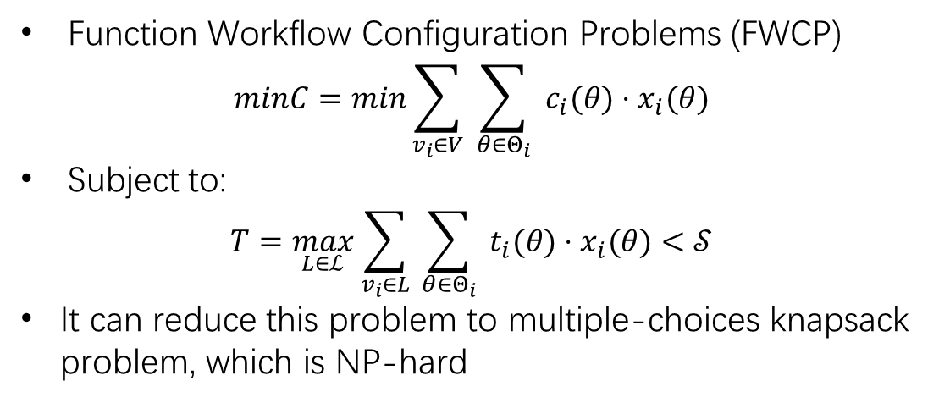
Straightforward Algorithm Is NP-hard
Function Workflow Configuration Problems (FWCP)
$$minC=min\sum_{v_{i}∈V}{ }\sum_{θ∈Θ_{i}}{ }c_{i}(θ)⋅x_{i}(θ)$$
Subject to:
$$T=\max_{L∈ℒ} \sum_{v_{i}∈L}{ }\sum_{θ∈Θ_{i}}{ }t_{i}(θ)⋅x_{i}(θ)<𝒮$$
It can reduce this problem to multiple-choices knapsack problem, which is NP-hard
5
Notes:
多选择背包问题定义为有附加约束条件的背包问题
依次划分sub-SLO，每次都求解一次问题，若有解，则配置，否则配置最多的资源
问题，如何划分子SLO才是合理的？

Slide 7
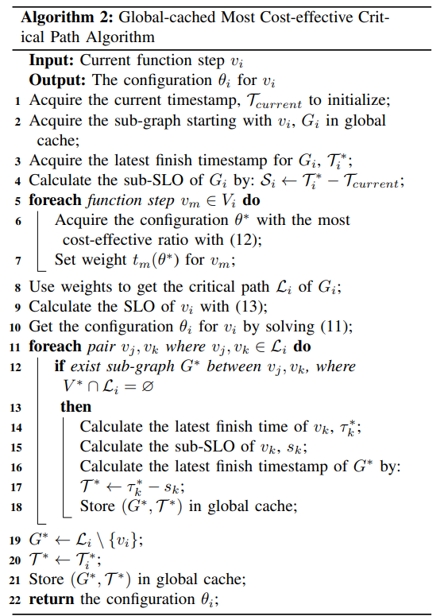
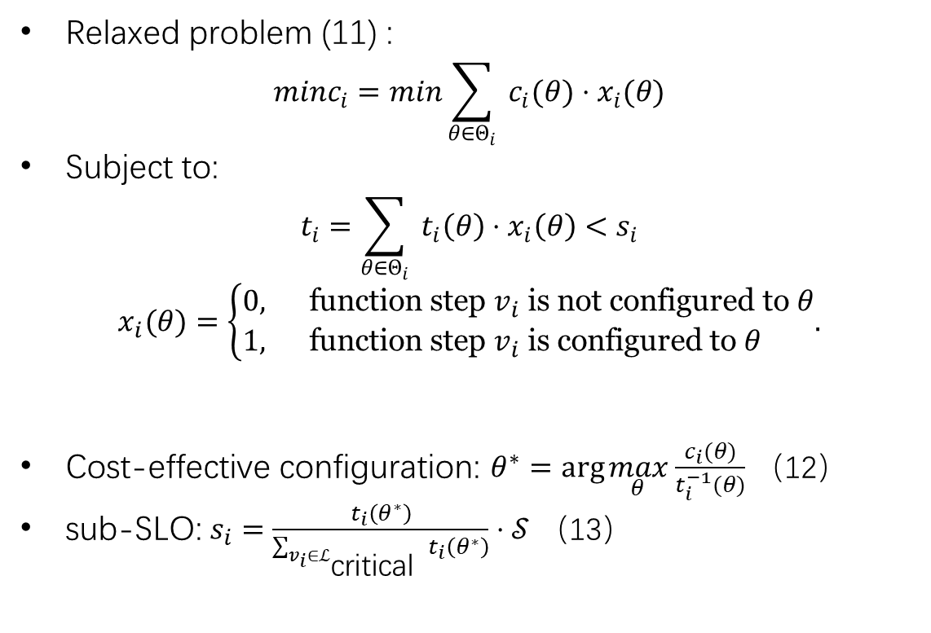
An Efficient Heuristic Solution
Relaxed problem (11) :
$$minc_{i}=min\sum_{θ∈Θ_{i}}{ }c_{i}(θ)⋅x_{i}(θ)$$
Subject to:
$$t_{i}=\sum_{θ∈Θ_{i}}{ }t_{i}\left(θ\right)⋅x_{i}\left(θ\right)<s_{i}$$
$$x_{i}(θ)=\left\{\begin{aligned}&0, && \text{function} \text{step} v_{i} \text{is} \text{not} \text{configured} \text{to} θ \\ &1, && \text{function} \text{step} v_{i} \text{is} \text{configured} \text{to} θ\end{aligned}.\right.$$
Cost-effective configuration: $θ^{∗}=arg⁡\max_{θ} \frac{c_{i}(θ)}{t_{i}^{−1}(θ)}$ （12）
sub-SLO: $s_{i}=\frac{t_{i}\left(θ^{∗}\right)}{\sum_{v_{i}∈ℒ_{\text{critical} }}{ }t_{i}\left(θ^{∗}\right)}⋅𝒮$ （13）
6
Notes:
问题松弛，按照资源效率最优配置资源，然后划分SLO。之后在关键路径上求解资源配置。并将一些关键计算结果缓存，减少计算量。

Slide 8
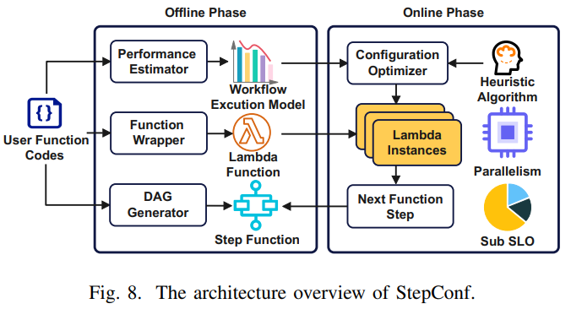
Implementation
Implement StepConf framework based on AWS Lambda. Since AWS does not support determining the memory configuration when the function are invoked, we release function versions with different memory sizes in advance, and we can use aligns to specify the memory size for invocation. To implement inter-function parallelism, we use “map” operation with Step Function.
For Intra-function Parallelism, we implement a wrapper class for invoking processes in a function. We use multiprocess.Manager() to create Queue() for the communication between processes.
7

Slide 9
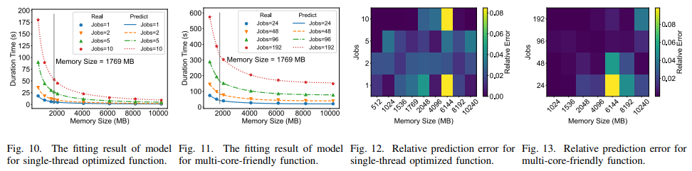
EVALUATION
Baseline:
No-No (IEEE CLOUD 2018, a static configuration strategy);
Static (the same static heuristic algorithm as No-No, but with same configuration factors, inter and intrafunction parallelism);
Optimal: the offline optimal configuration with ignorance of fluctuations in performance;
Intra-only; Inter-only
8

Slide 10
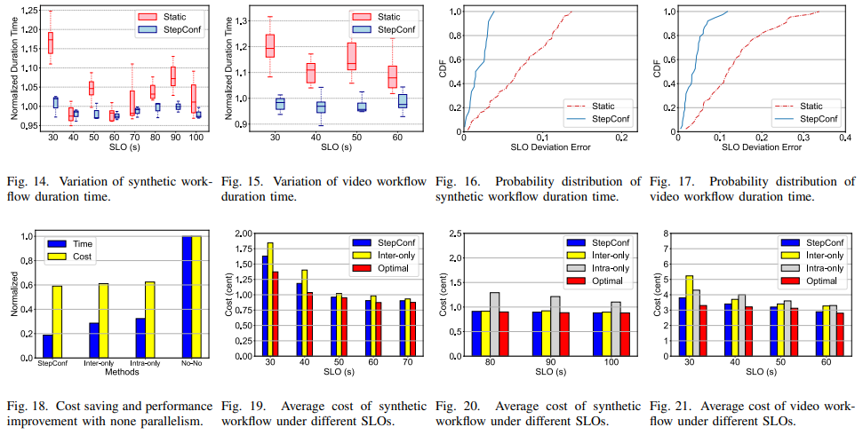
EVALUATION
Smaller performance fluctuations, cost saving and performance improvement
9
Notes:
如图14和15中的方框图和图16和17中的CDF图所示，我们的动态配置策略不仅更好地满足了SLO请求，而且带来了更小的性能波动。由于库的高度依赖性，视频处理工作流中静态和动态配置在波动级别上的差距大于合成工作流。静态方法不能保证请求的SLO。同时，当工作流运行过程中出现性能变化时，我们的动态策略可以实时调整配置以纠正错误。这些结果反映了我们动态配置策略的优势

