Slide 1
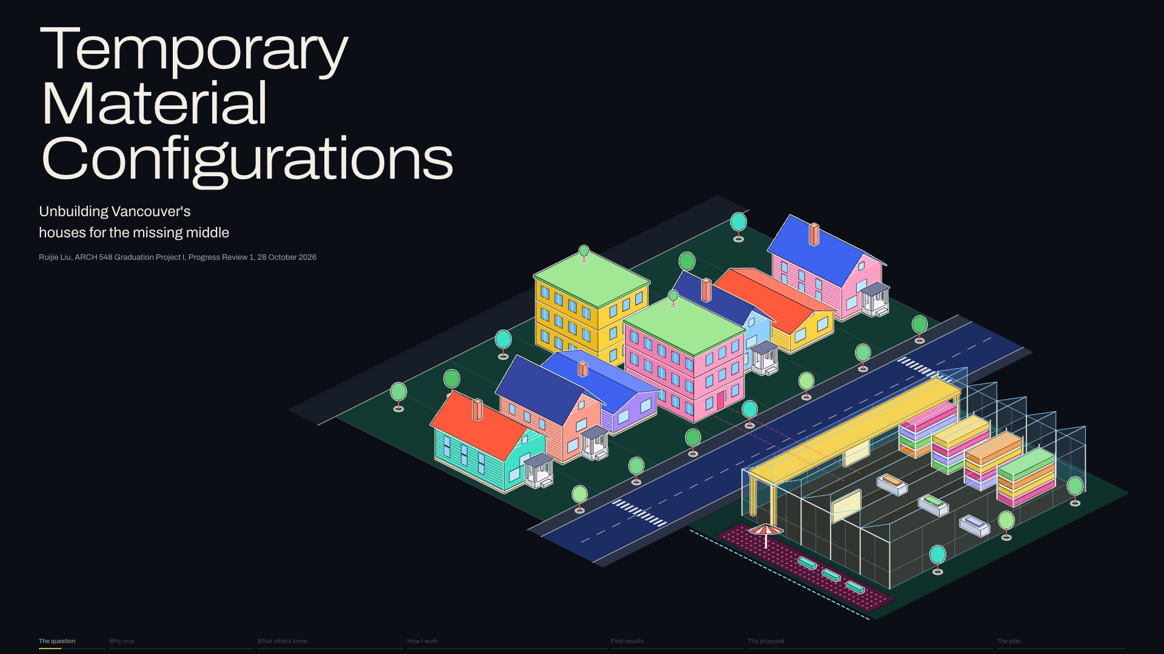
Notes:
Good afternoon. I'm Ruijie, and my project is TEMPORARY MATERIAL CONFIGURATIONS: [pause] what architecture can do with houses Vancouver takes down for denser housing.
Next click, new slide 2, Topic statement: My topic statement: [pause] I investigate how architectural design might change when buildings are understood as temporary material configurations, whose components can be evaluated, salvaged and reassembled during Vancouver's transition toward denser housing. [pause] Temporary describes the ARRANGEMENT; materials can outlast it.
Slide 1 of 32, Title (The question): sentence 1 of 1, about 13 s for the slide.

Slide 2
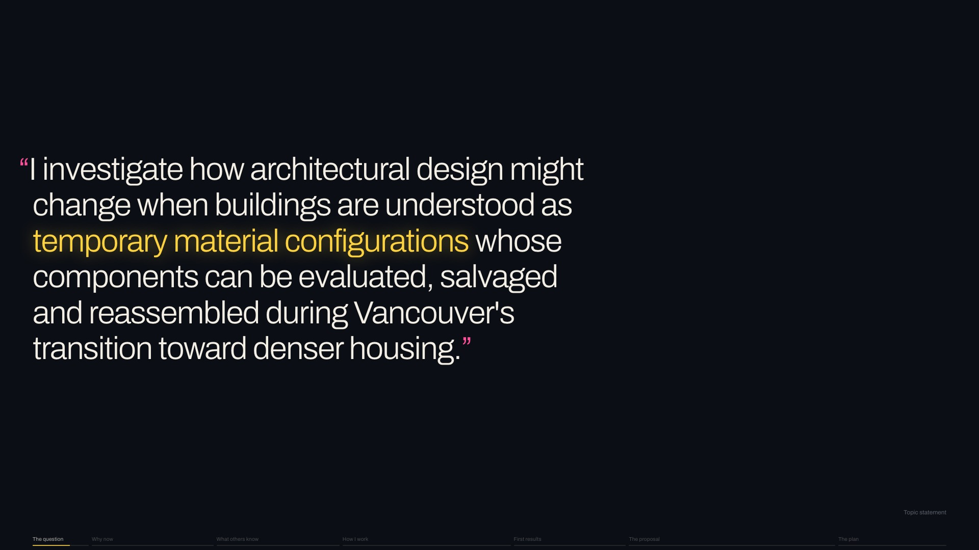
Notes:
My topic statement: [pause] I investigate how architectural design might change when buildings are understood as temporary material configurations, whose components can be evaluated, salvaged and reassembled during Vancouver's transition toward denser housing. [pause] Temporary describes the ARRANGEMENT; materials can outlast it.
Next click, new slide 3, A permanent object: We build most houses as PERMANENT objects: glued, sealed and poured together, so at the end [pause] the only way out is the excavator.
Slide 2 of 32, Topic statement (The question): sentence 1 of 1, about 19 s for the slide.

Slide 3
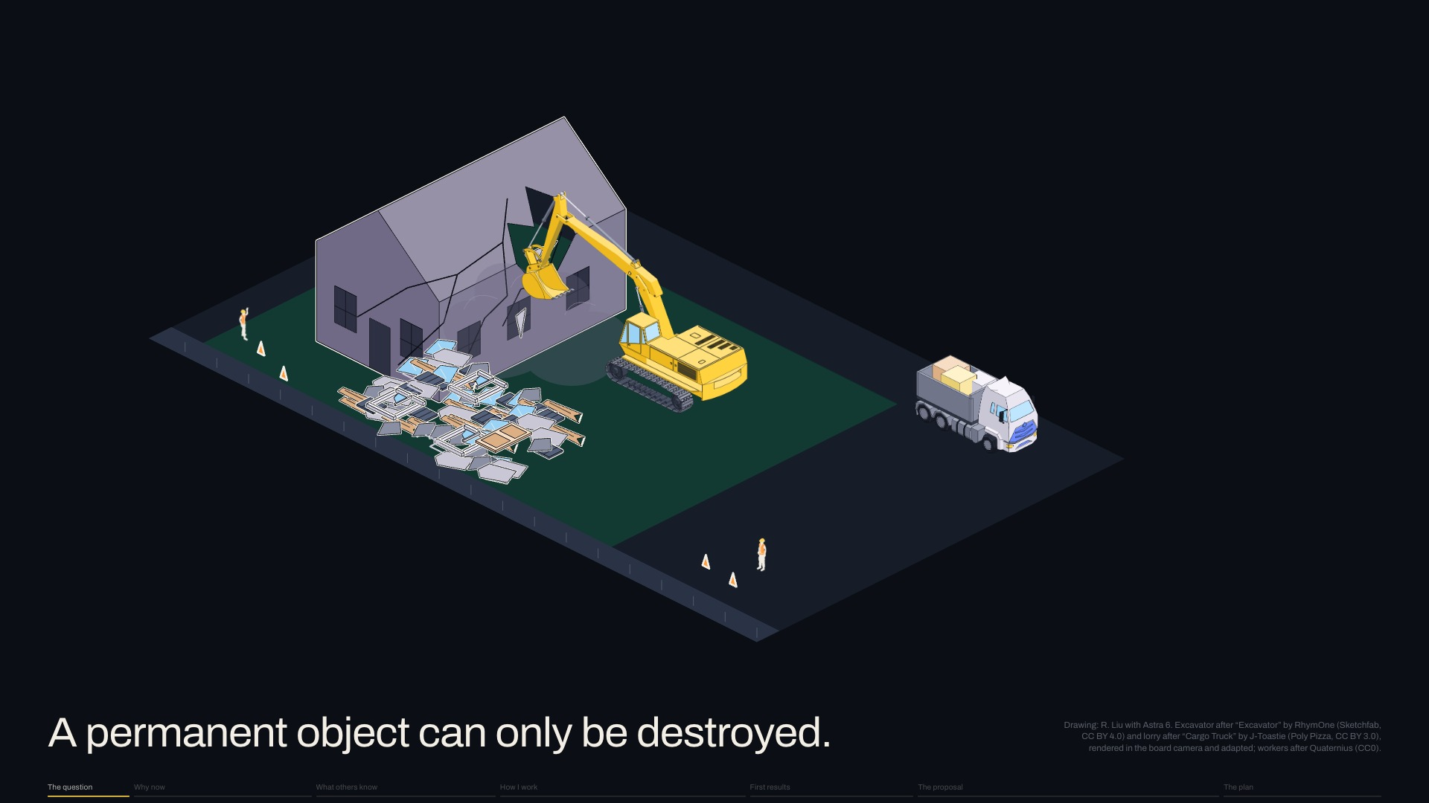
Notes:
We build most houses as PERMANENT objects: glued, sealed and poured together, so at the end [pause] the only way out is the excavator.
Next click, new slide 4, Global carbon: Why now? [pause] I'd start with carbon: the UN Environment Programme finds that buildings and construction make about A THIRD of the world's emissions.
Slide 3 of 32, A permanent object (The question): sentence 1 of 1, about 9 s for the slide.

Slide 4
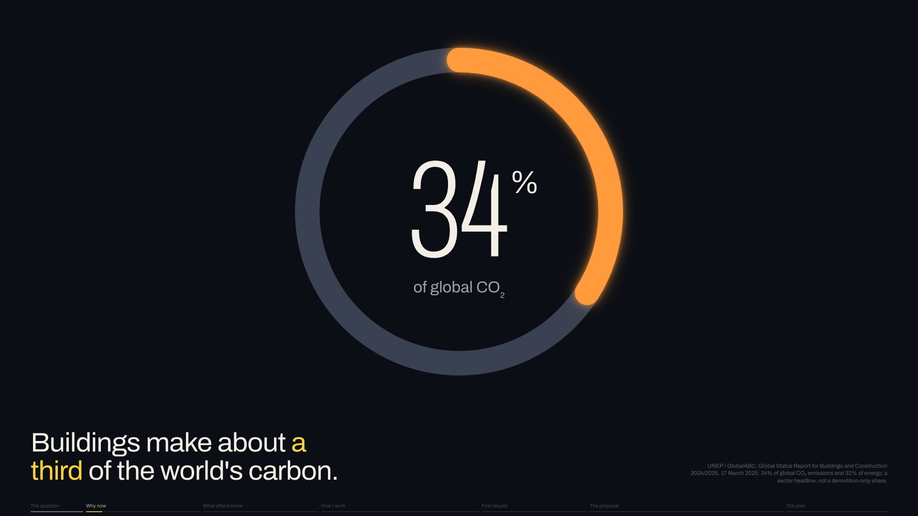
Notes:
Why now? [pause] I'd start with carbon: the UN Environment Programme finds that buildings and construction make about A THIRD of the world's emissions.
Next click, new slide 5, Landfill: Closer to home, building and demolition material makes up about A THIRD of what Metro Vancouver landfills.
Slide 4 of 32, Global carbon (Why now): sentence 1 of 1, about 9 s for the slide.

Slide 5
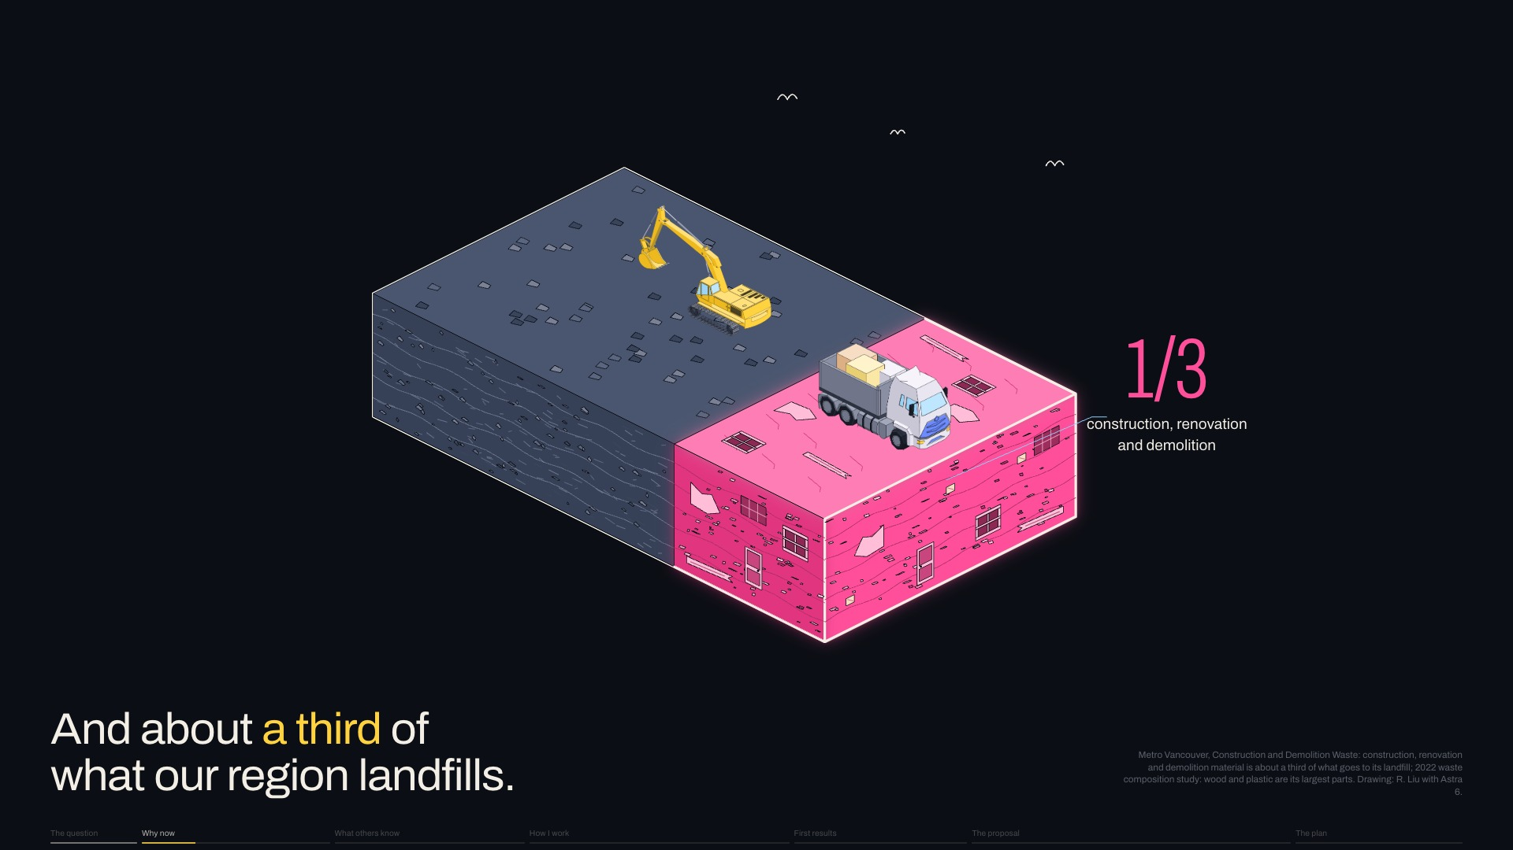
Notes:
Closer to home, building and demolition material makes up about A THIRD of what Metro Vancouver landfills.
Next click, new slide 6, A home every three hours: And homes keep coming down: [pause] across the region, about one every THREE HOURS.
Slide 5 of 32, Landfill (Why now): sentence 1 of 1, about 9 s for the slide.

Slide 6
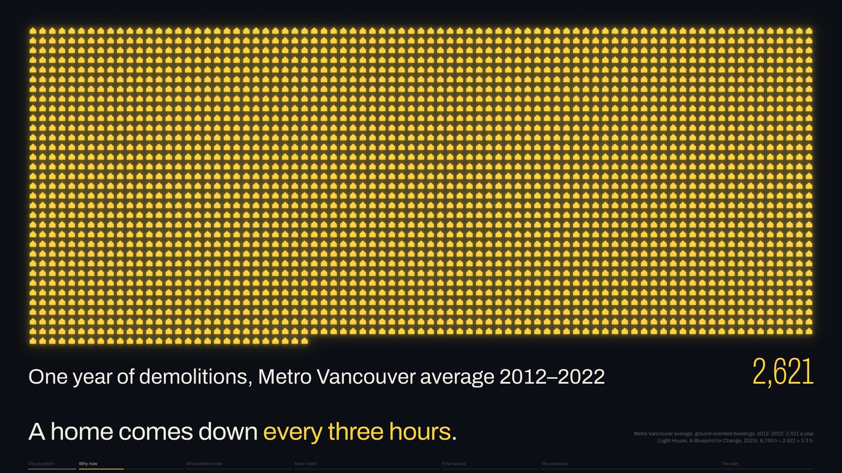
Notes:
And homes keep coming down: [pause] across the region, about one every THREE HOURS.
Next click, new slide 7, We pay for the land: Houses come down because we mostly pay for LAND.
Slide 6 of 32, A home every three hours (Why now): sentence 1 of 1, about 9 s for the slide.

Slide 7
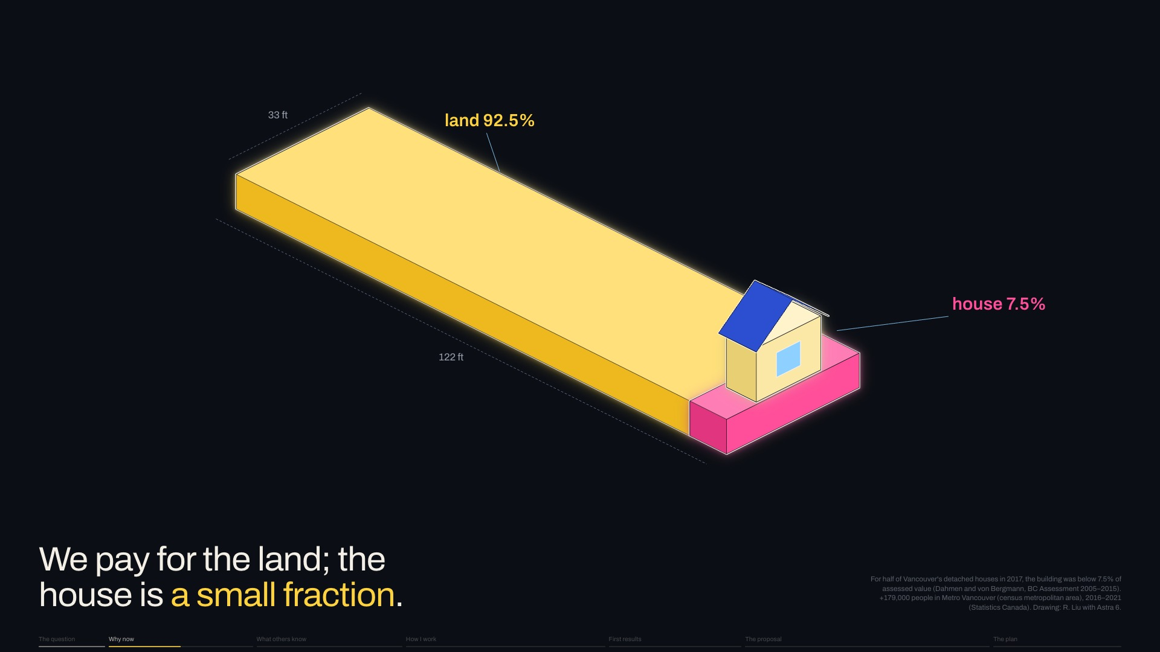
Notes:
Houses come down because we mostly pay for LAND.
Next click: Joseph Dahmen and data scientist Jens von Bergmann found that for half the city's detached houses, the building is A SMALL FRACTION of its value.
Slide 7 of 32, We pay for the land (Why now): sentence 1 of 2, about 14 s for the slide.

Slide 8
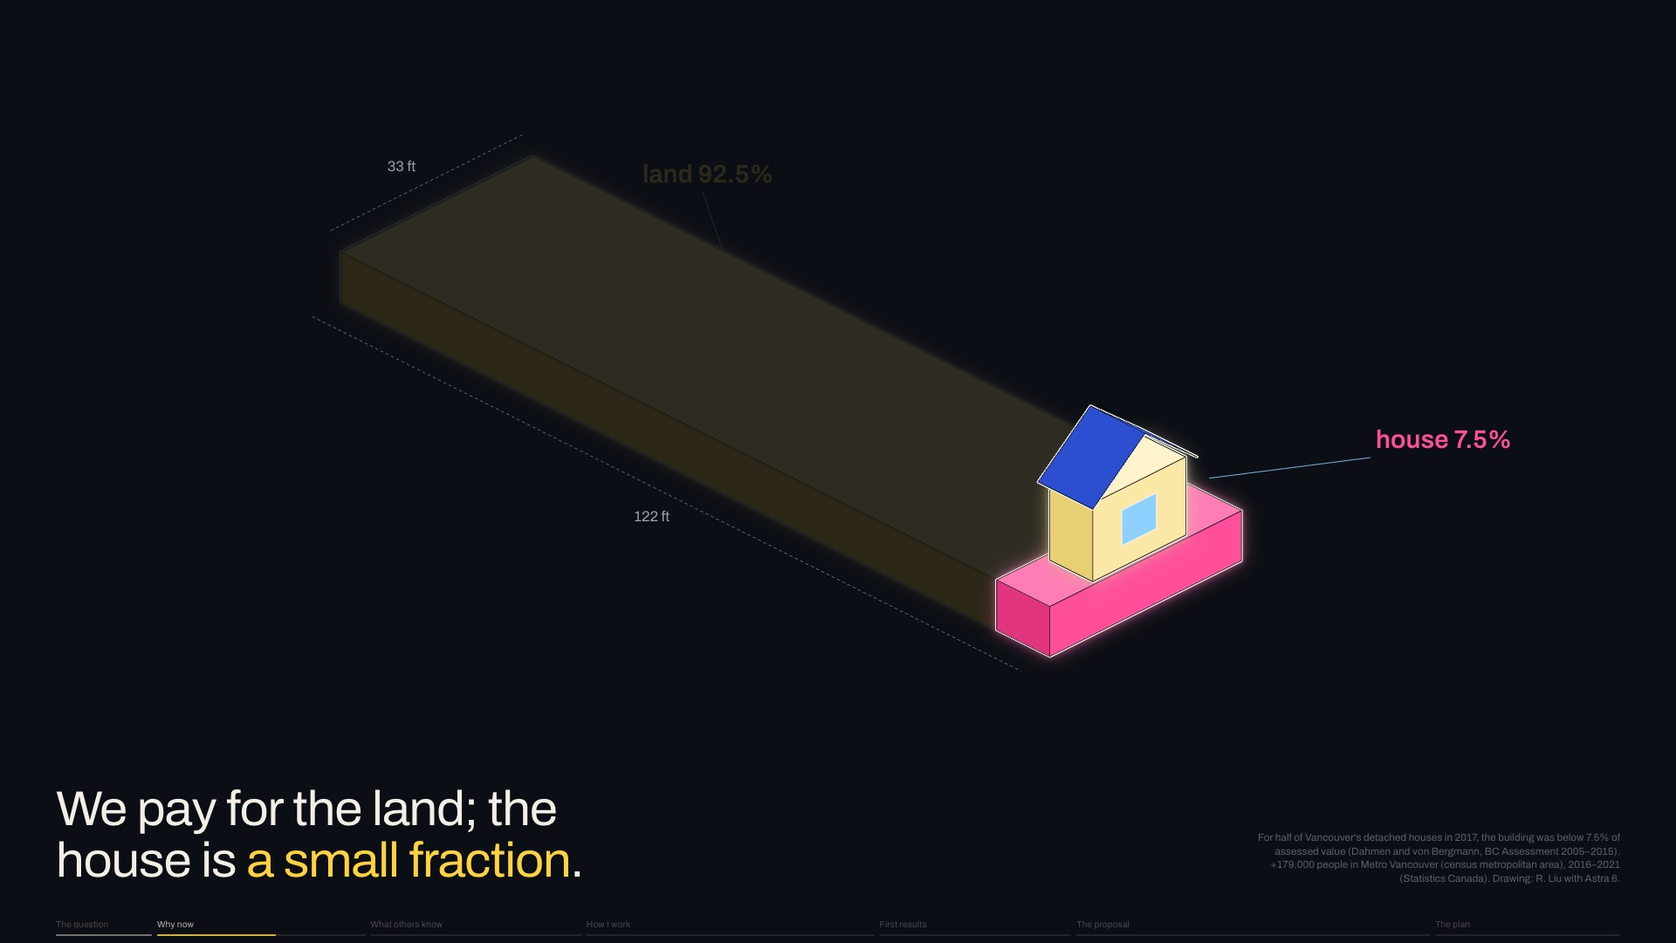
Notes:
Joseph Dahmen and data scientist Jens von Bergmann found that for half the city's detached houses, the building is A SMALL FRACTION of its value.
Next click, new slide 8, Why now: R1-1 zoning: Zoning explains the timing.
Slide 7 of 32, We pay for the land (Why now): sentence 2 of 2, about 14 s for the slide.

Slide 9
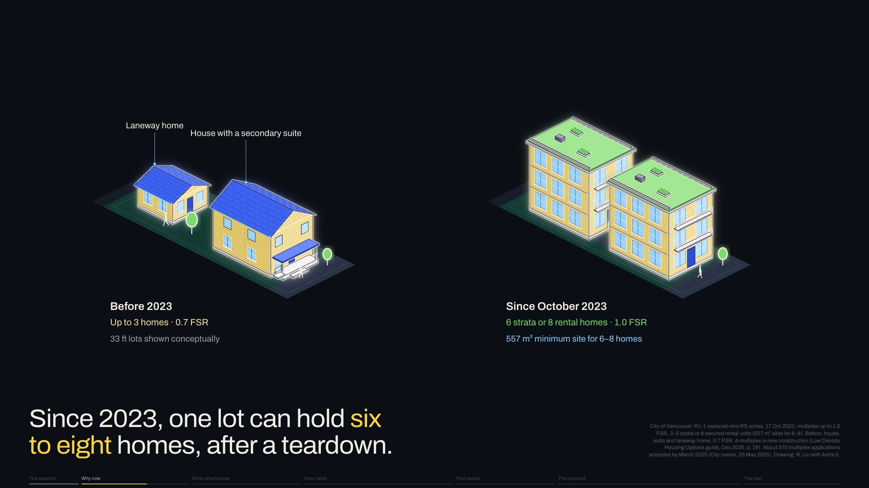
Notes:
Zoning explains the timing.
Next click: Until 2023, most lots allowed a house, suite and laneway home.
Slide 8 of 32, Why now: R1-1 zoning (Why now): sentence 1 of 4, about 19 s for the slide.

Slide 10
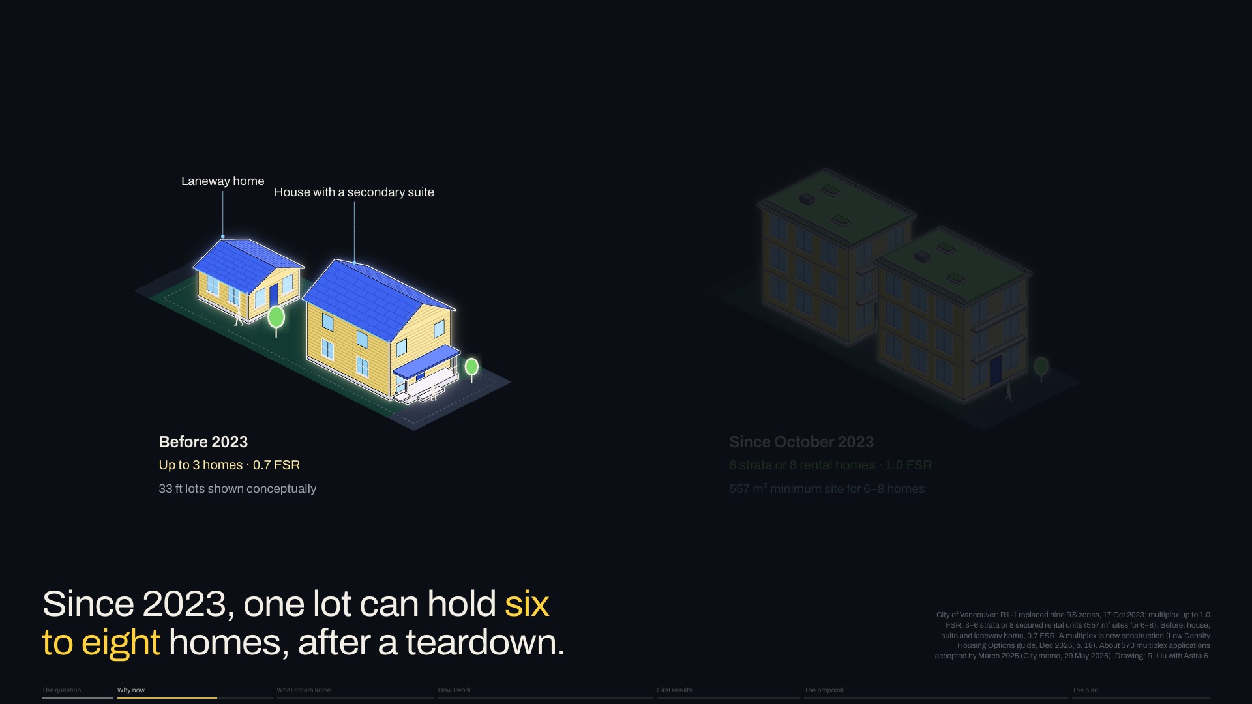
Notes:
Until 2023, most lots allowed a house, suite and laneway home.
Next click: Since 2023, new zoning allows multiplexes: [pause] six to eight homes a lot.
Slide 8 of 32, Why now: R1-1 zoning (Why now): sentence 2 of 4, about 19 s for the slide.

Slide 11
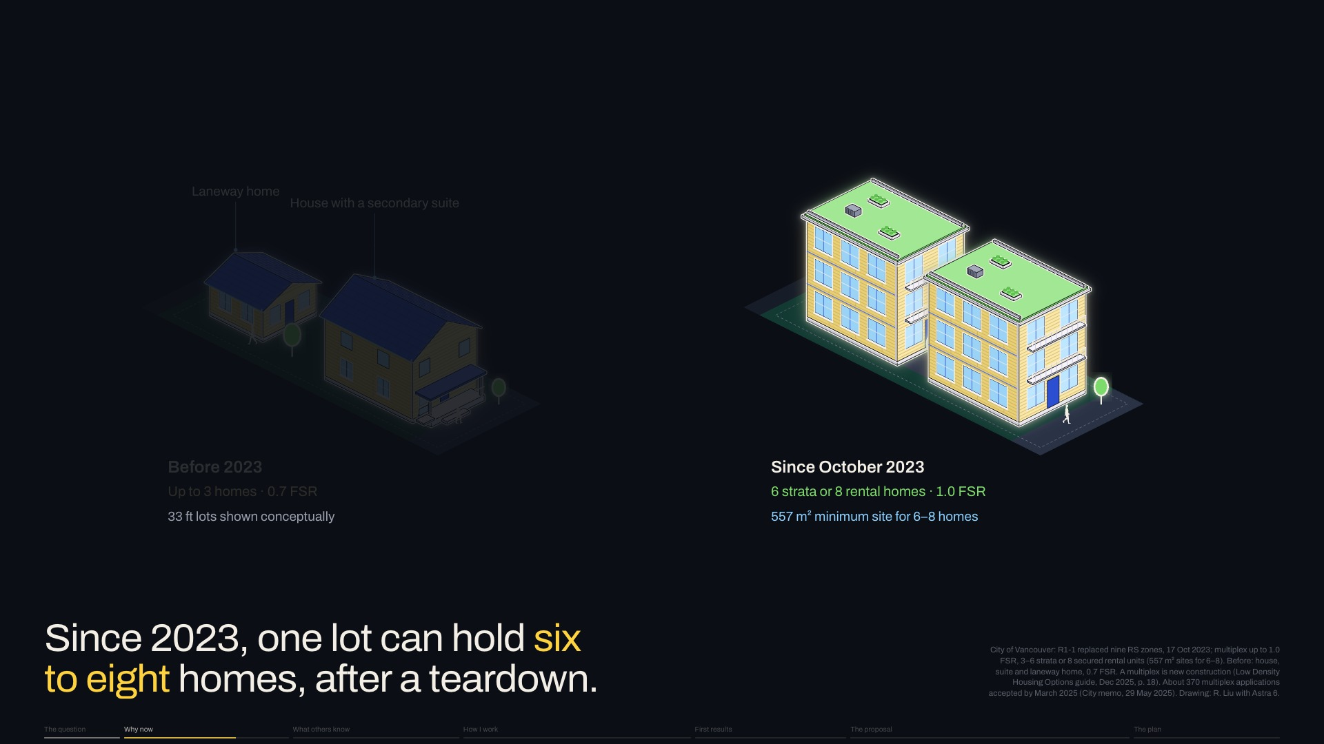
Notes:
Since 2023, new zoning allows multiplexes: [pause] six to eight homes a lot.
Next click: A multiplex must be new, so the old house comes down first. [pause] The question is what happens to its PARTS.
Slide 8 of 32, Why now: R1-1 zoning (Why now): sentence 3 of 4, about 19 s for the slide.

Slide 12
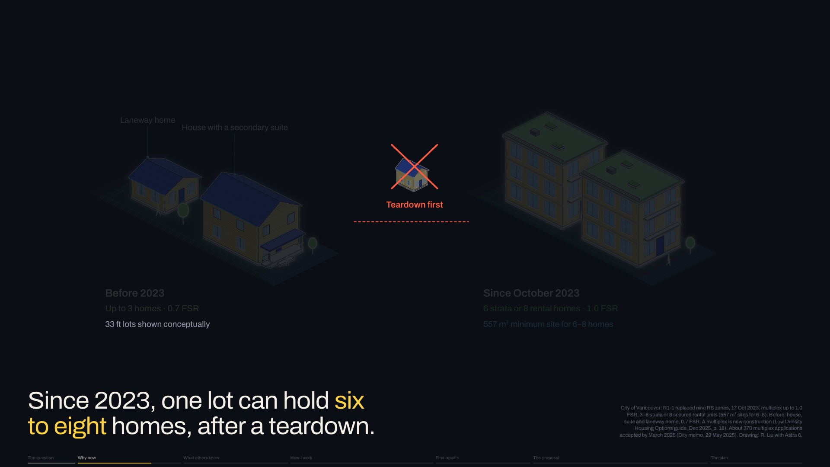
Notes:
A multiplex must be new, so the old house comes down first. [pause] The question is what happens to its PARTS.
Next click, new slide 9, Who it is for: [slower] The new homes matter to people like me: newcomers who share a house with several others to afford the city.
Slide 8 of 32, Why now: R1-1 zoning (Why now): sentence 4 of 4, about 19 s for the slide.

Slide 13

Notes:
[slower] The new homes matter to people like me: newcomers who share a house with several others to afford the city.
Next click, new slide 10, Why homes: I chose homes, though shops and factories come down too. [pause]
Slide 9 of 32, Who it is for (Why now): sentence 1 of 1, about 9 s for the slide.

Slide 14
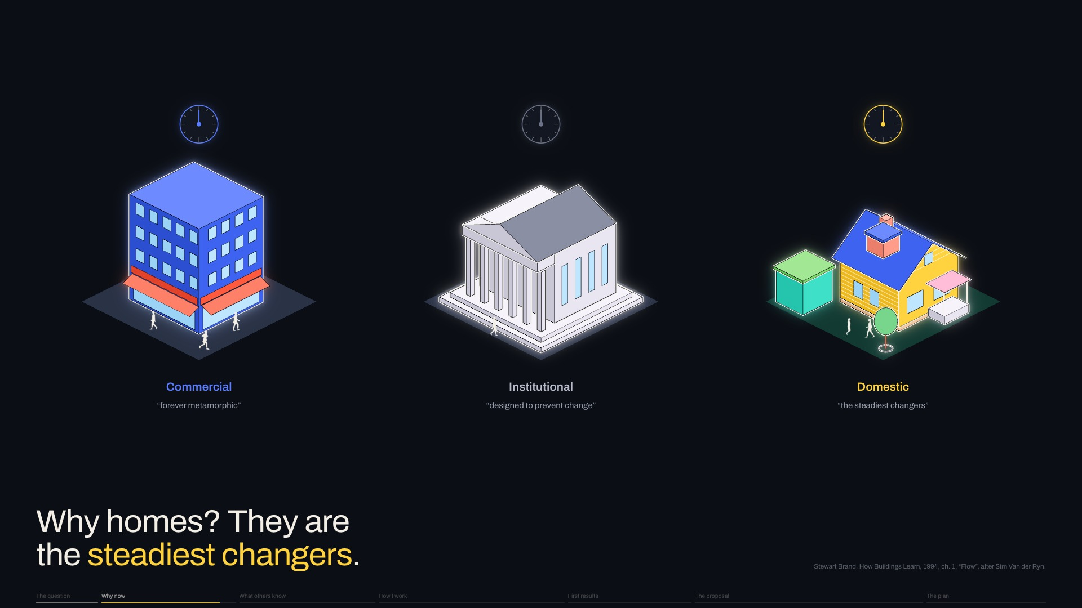
Notes:
I chose homes, though shops and factories come down too. [pause]
Next click: In How Buildings Learn, Stewart Brand sorts buildings by how they change.
Slide 10 of 32, Why homes (Why now): sentence 1 of 6, about 20 s for the slide.

Slide 15

Notes:
In How Buildings Learn, Stewart Brand sorts buildings by how they change.
Next click: Commercial buildings change FAST; [keep going]
Slide 10 of 32, Why homes (Why now): sentence 2 of 6, about 20 s for the slide.

Slide 16
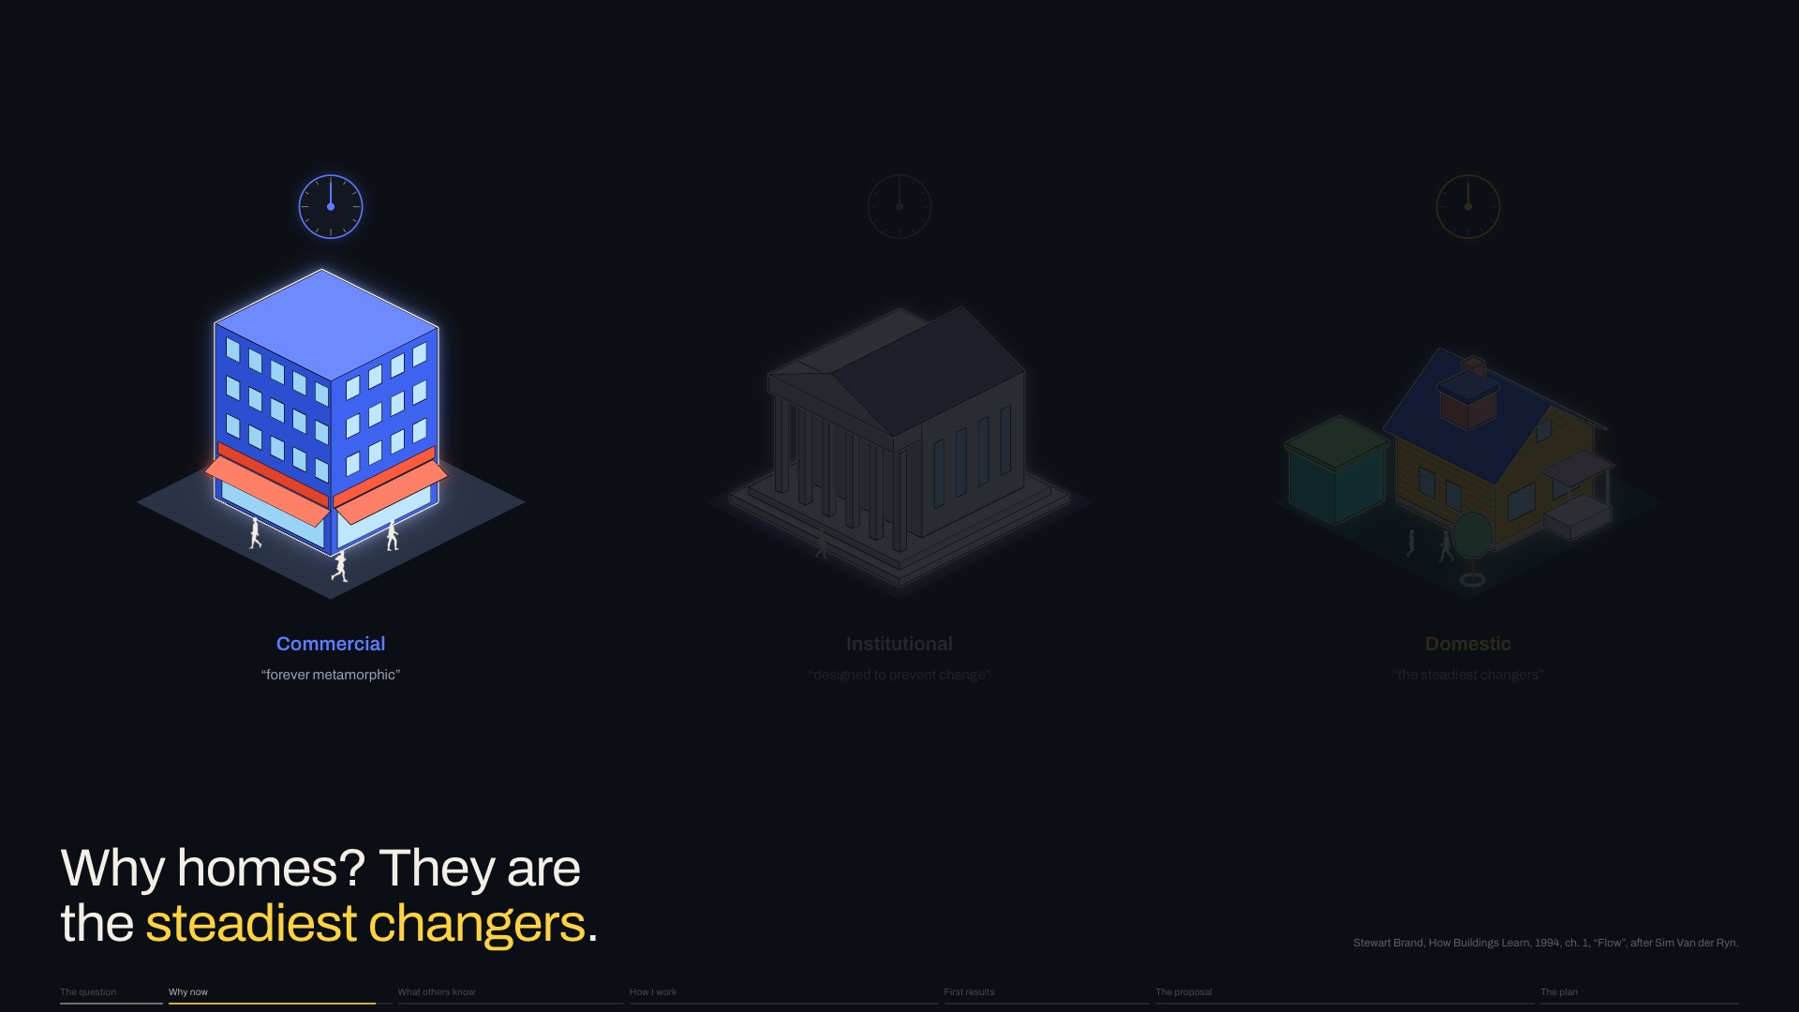
Notes:
Commercial buildings change FAST; [keep going]
Next click: institutions RESIST change; [keep going]
Slide 10 of 32, Why homes (Why now): sentence 3 of 6, about 20 s for the slide.

Slide 17
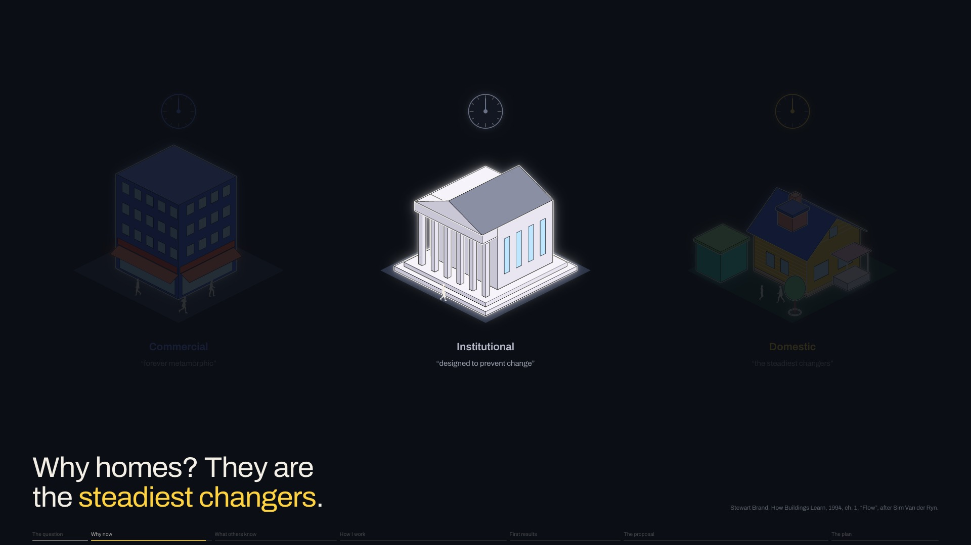
Notes:
institutions RESIST change; [keep going]
Next click: homes change STEADILY, keeping a record of the family inside.
Slide 10 of 32, Why homes (Why now): sentence 4 of 6, about 20 s for the slide.

Slide 18
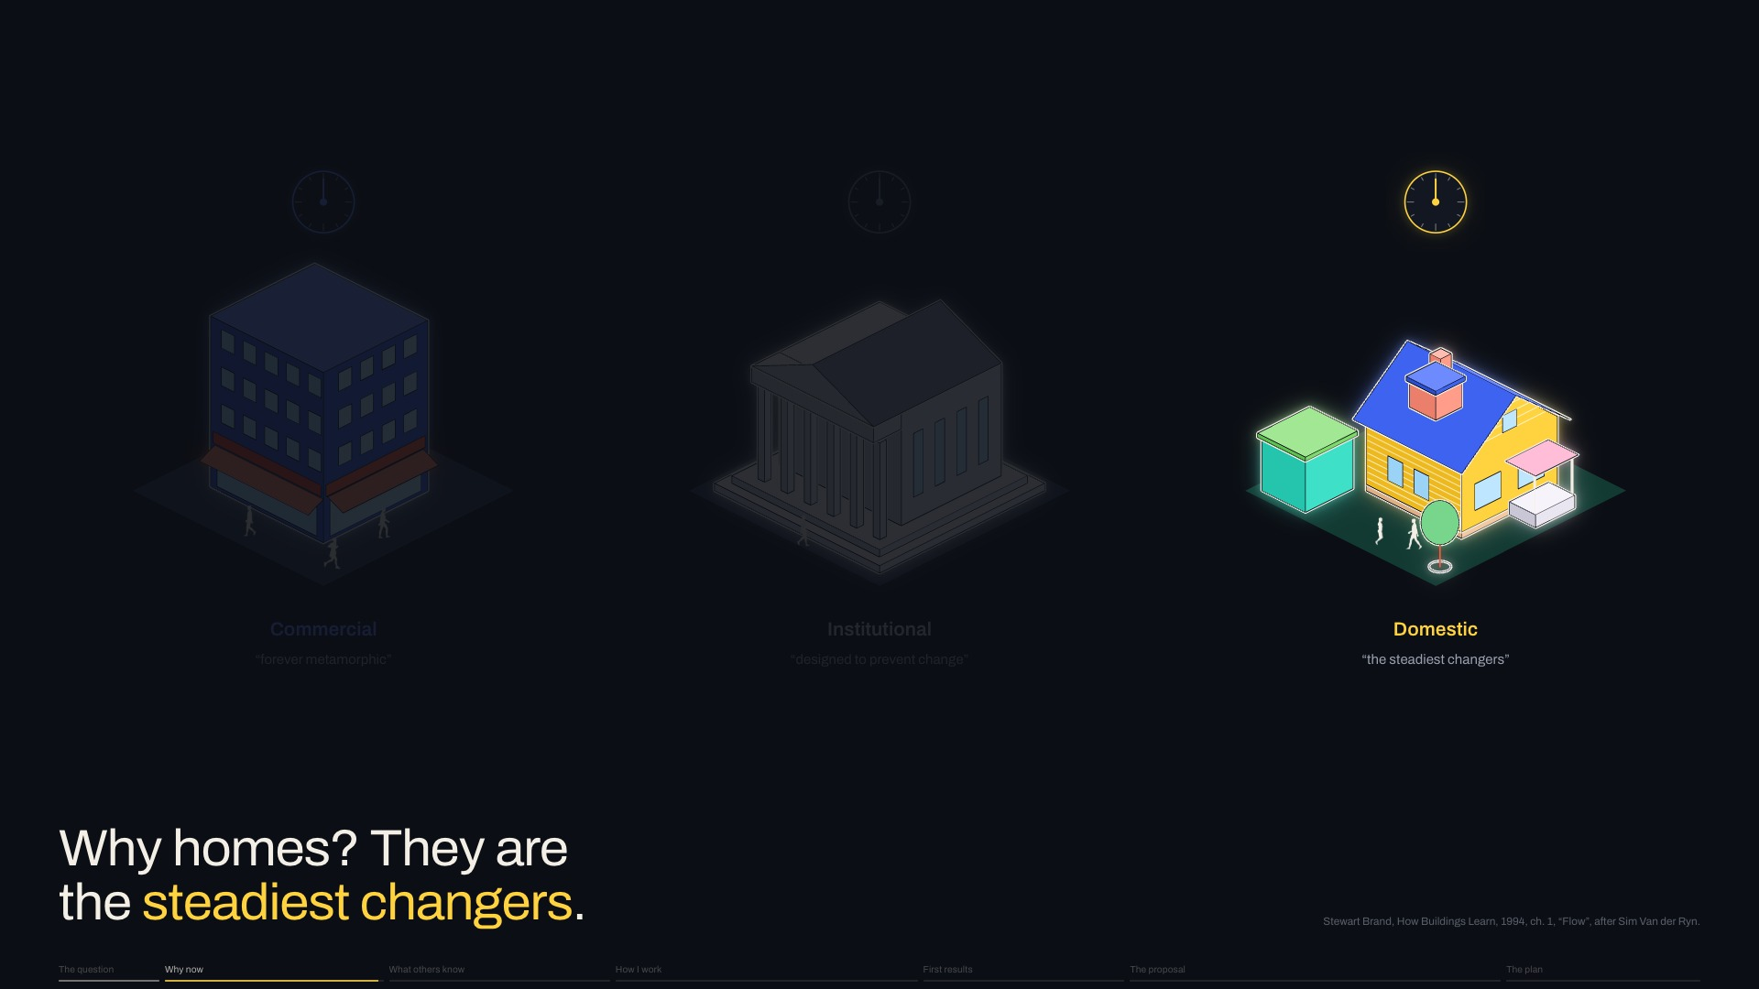
Notes:
homes change STEADILY, keeping a record of the family inside.
Next click: So homes are my test case, and that is deliberate.
Slide 10 of 32, Why homes (Why now): sentence 5 of 6, about 20 s for the slide.

Slide 19

Notes:
So homes are my test case, and that is deliberate.
Next click, new slide 11, Who is asking: I'm not the first to ask. [pause]
Slide 10 of 32, Why homes (Why now): sentence 6 of 6, about 20 s for the slide.

Slide 20
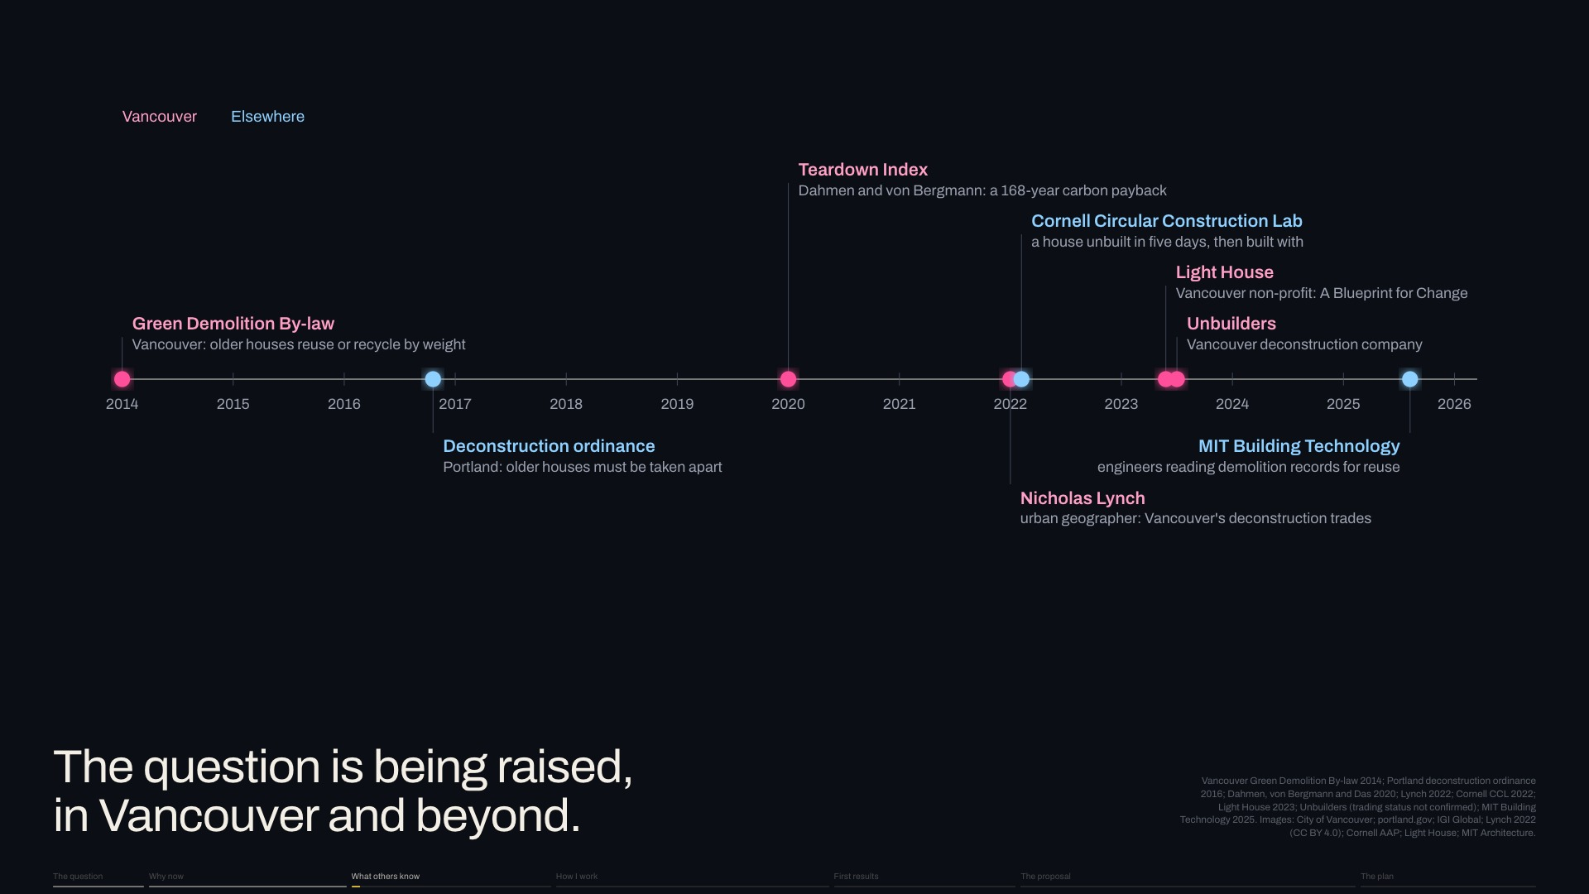
Notes:
I'm not the first to ask. [pause]
Next click: Vancouver and Portland regulate demolition waste.
Slide 11 of 32, Who is asking (What others know): sentence 1 of 6, about 24 s for the slide.

Slide 21
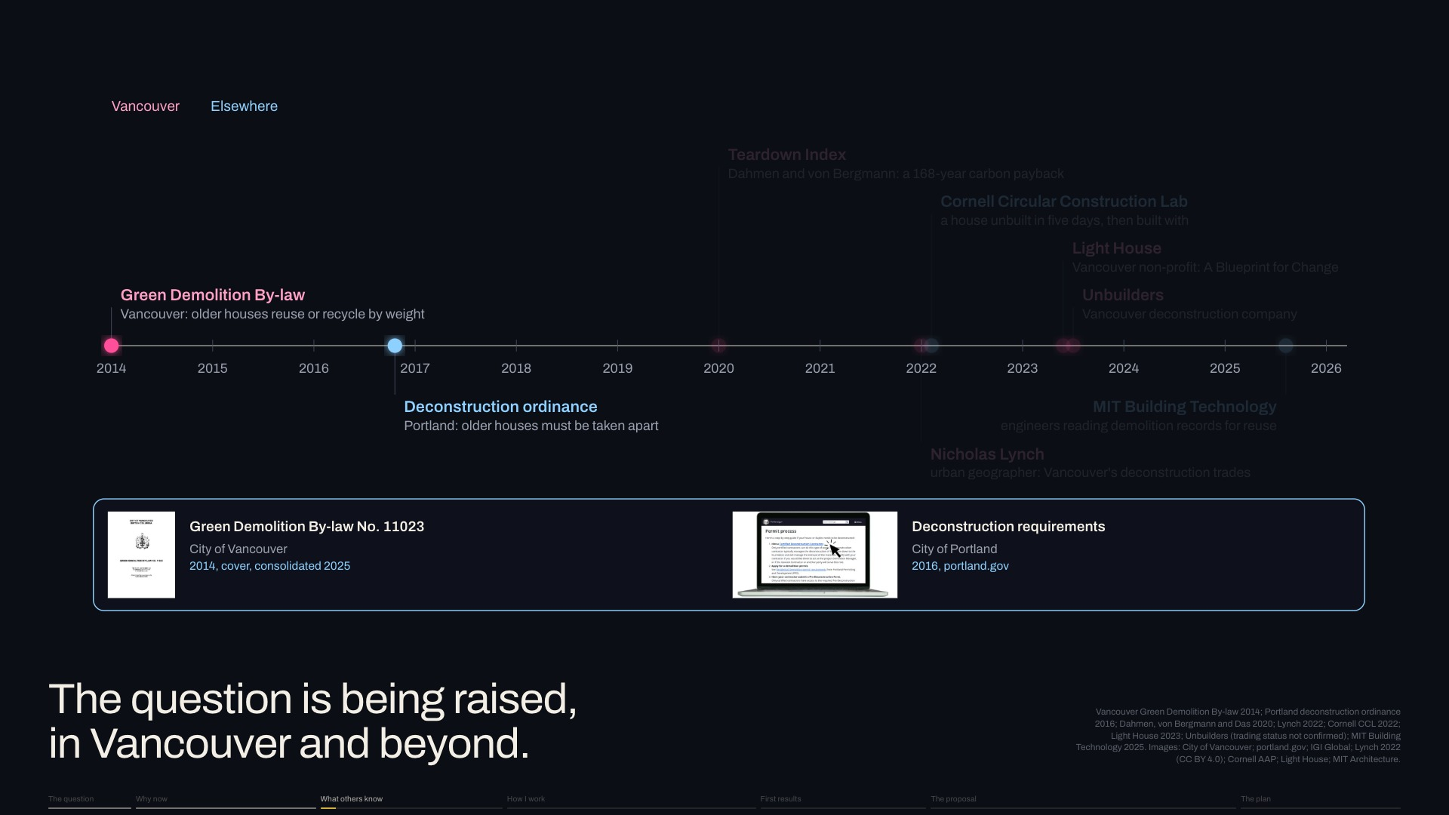
Notes:
Vancouver and Portland regulate demolition waste.
Next click: Dahmen and von Bergmann weighed the carbon of replacement.
Slide 11 of 32, Who is asking (What others know): sentence 2 of 6, about 24 s for the slide.

Slide 22
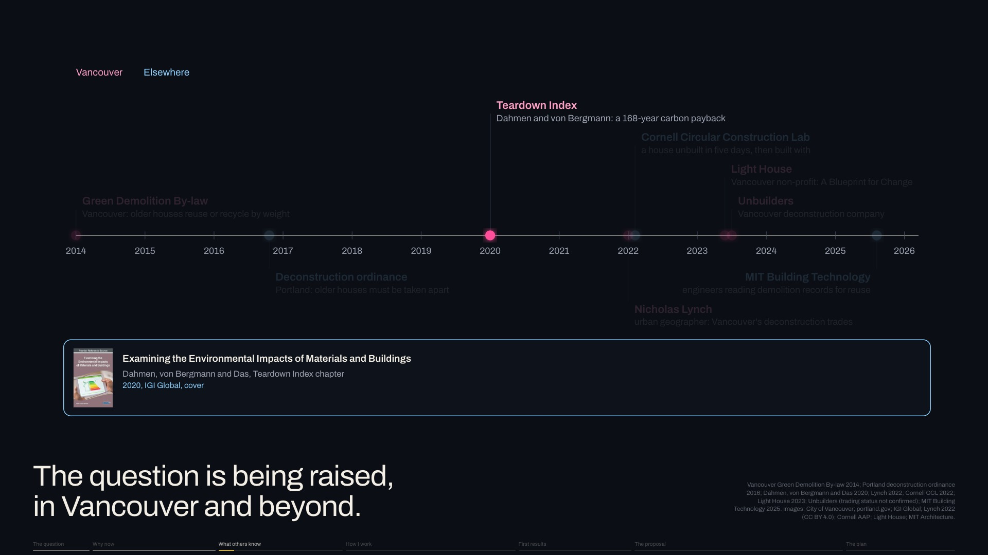
Notes:
Dahmen and von Bergmann weighed the carbon of replacement.
Next click: Geographer Nicholas Lynch studied Vancouver's deconstruction trades, and Cornell's Circular Construction Lab rebuilt with a house it took apart.
Slide 11 of 32, Who is asking (What others know): sentence 3 of 6, about 24 s for the slide.

Slide 23
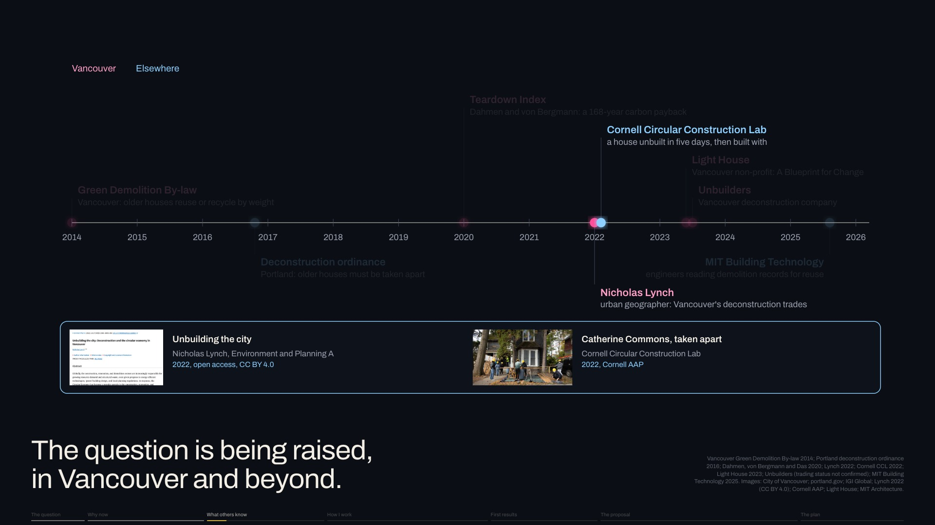
Notes:
Geographer Nicholas Lynch studied Vancouver's deconstruction trades, and Cornell's Circular Construction Lab rebuilt with a house it took apart.
Next click: The non-profit Light House and the deconstruction firm Unbuilders pushed for salvage.
Slide 11 of 32, Who is asking (What others know): sentence 4 of 6, about 24 s for the slide.

Slide 24
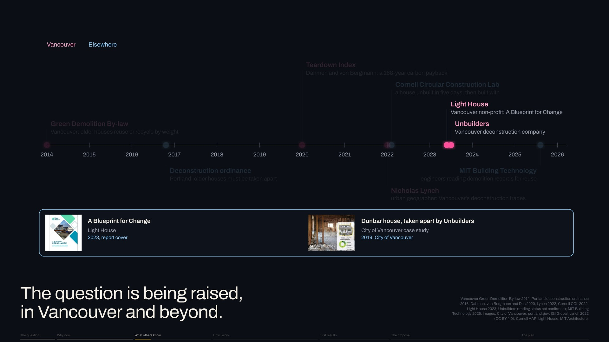
Notes:
The non-profit Light House and the deconstruction firm Unbuilders pushed for salvage.
Next click: MIT engineers read demolition records for reusable structure.
Slide 11 of 32, Who is asking (What others know): sentence 5 of 6, about 24 s for the slide.

Slide 25
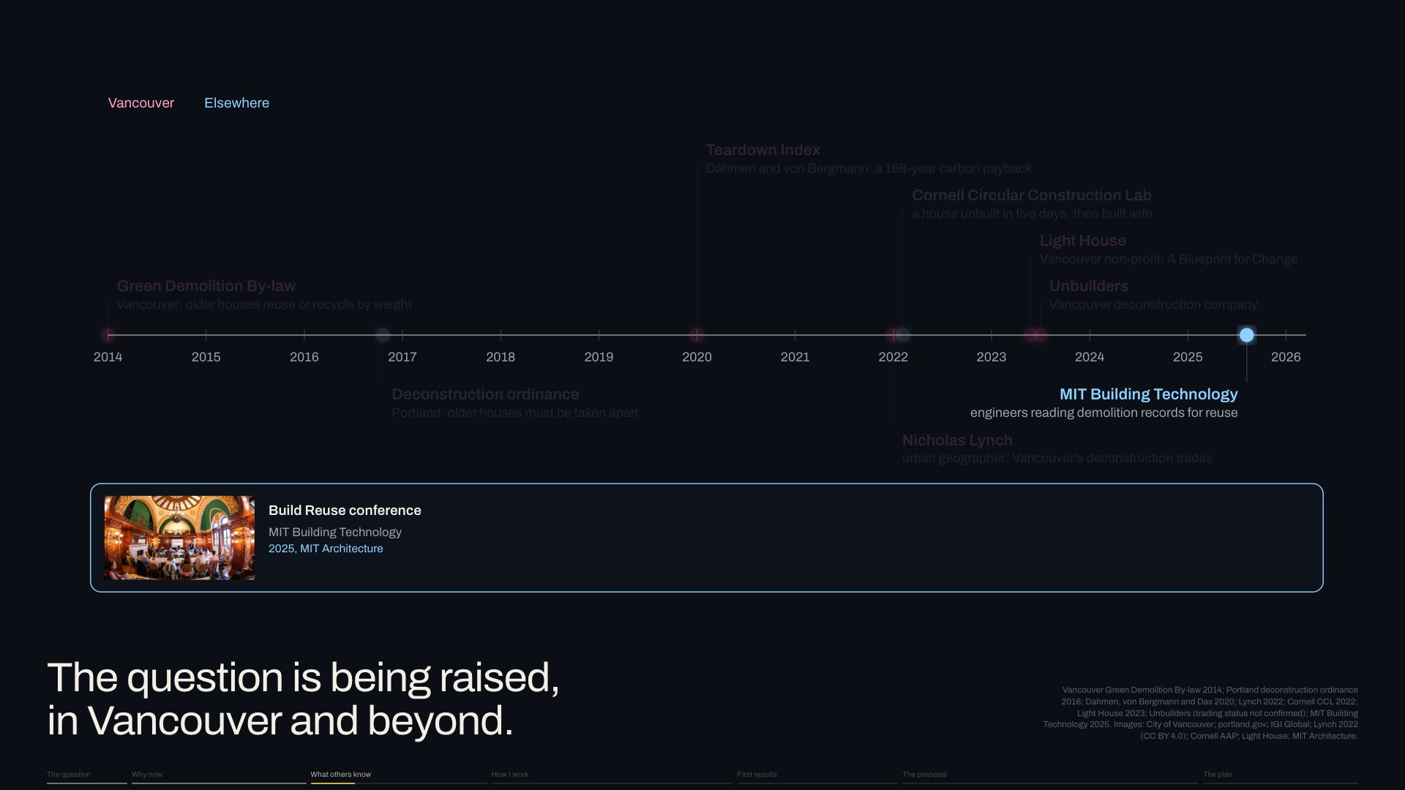
Notes:
MIT engineers read demolition records for reusable structure.
Next click, new slide 12, Layers change at different rates: Brand's six layers change at different rates, from site to stuff.
Slide 11 of 32, Who is asking (What others know): sentence 6 of 6, about 24 s for the slide.

Slide 26
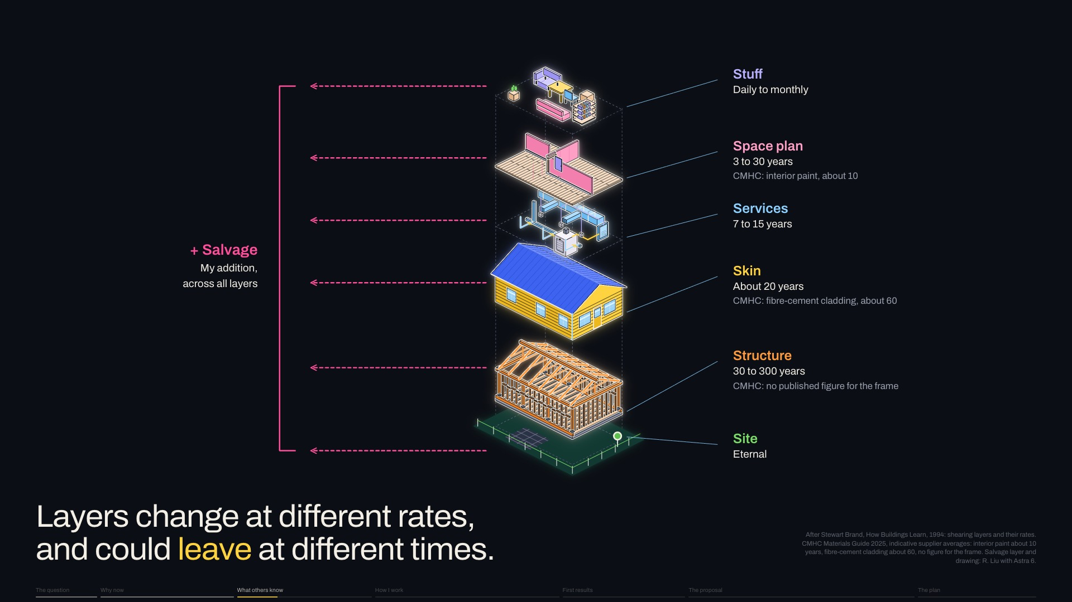
Notes:
Brand's six layers change at different rates, from site to stuff.
Next click: CMHC, Canada's housing agency, gives some of them lifespans: finishes last years, [keep going]
Slide 12 of 32, Layers change at different rates (What others know): sentence 1 of 5, about 20 s for the slide.

Slide 27
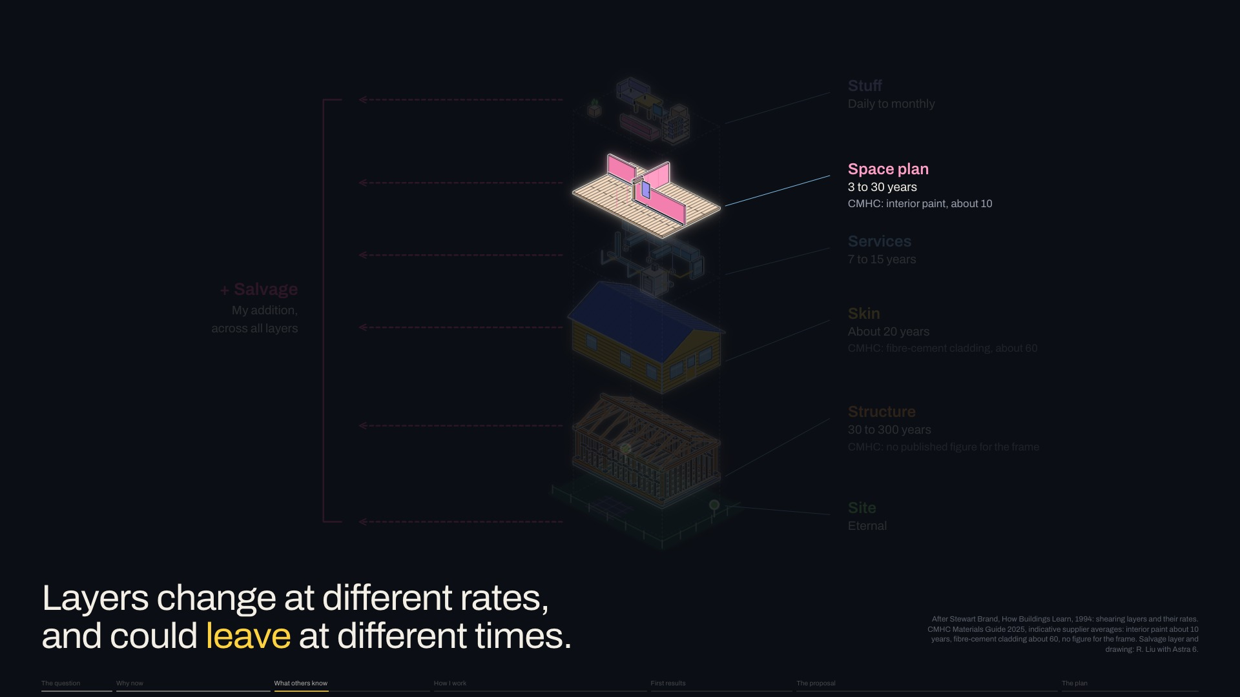
Notes:
CMHC, Canada's housing agency, gives some of them lifespans: finishes last years, [keep going]
Next click: cladding, decades, [keep going]
Slide 12 of 32, Layers change at different rates (What others know): sentence 2 of 5, about 20 s for the slide.

Slide 28
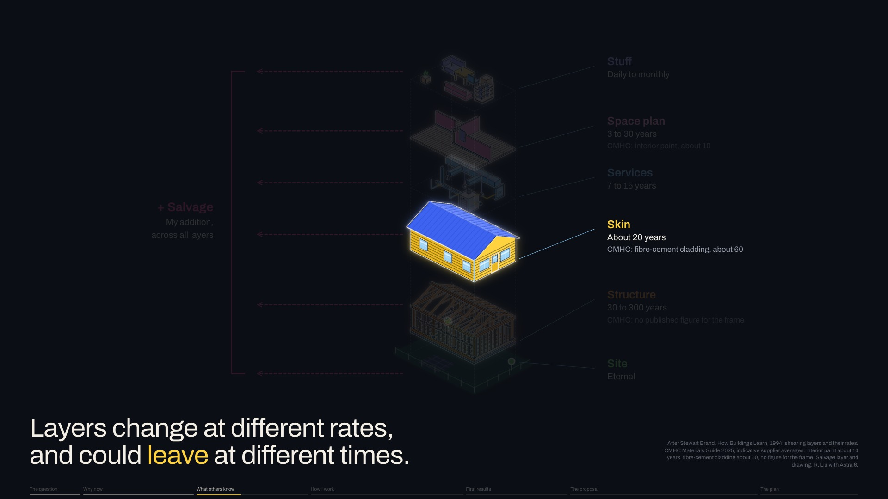
Notes:
cladding, decades, [keep going]
Next click: the structural frame, [pause] NO FIGURE AT ALL.
Slide 12 of 32, Layers change at different rates (What others know): sentence 3 of 5, about 20 s for the slide.

Slide 29
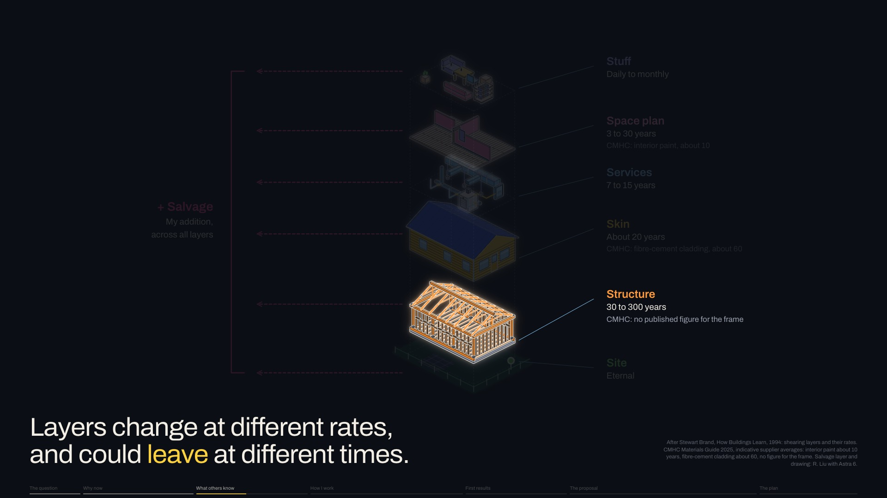
Notes:
the structural frame, [pause] NO FIGURE AT ALL.
Next click: To his six I add SALVAGE: [pause] when a configuration ends, each layer could leave on its own clock.
Slide 12 of 32, Layers change at different rates (What others know): sentence 4 of 5, about 20 s for the slide.

Slide 30

Notes:
To his six I add SALVAGE: [pause] when a configuration ends, each layer could leave on its own clock.
Next click, new slide 13, Position: Four kinds of work shape my position.
Slide 12 of 32, Layers change at different rates (What others know): sentence 5 of 5, about 20 s for the slide.

Slide 31
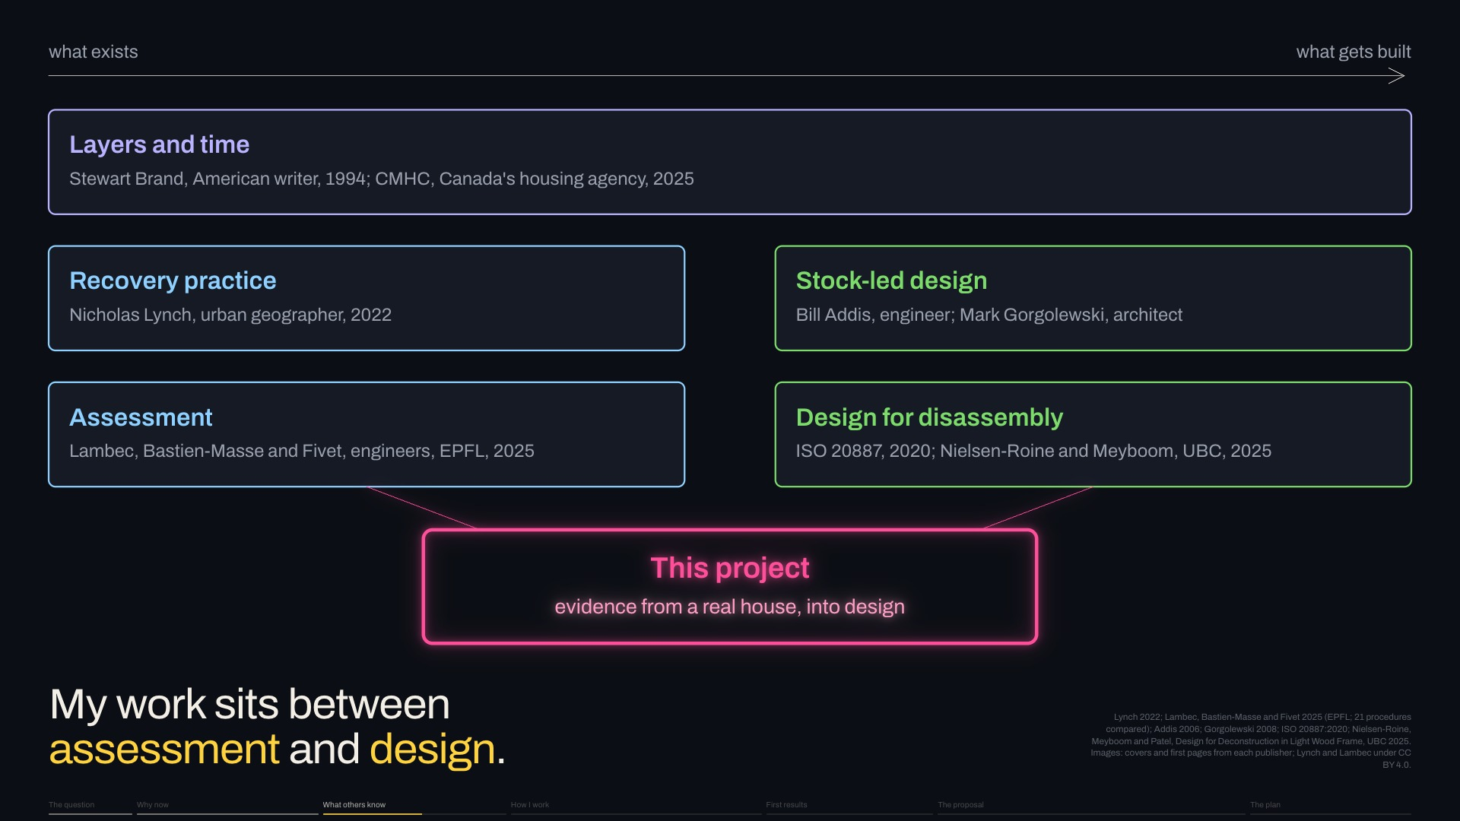
Notes:
Four kinds of work shape my position.
Next click: Recovery practice shows salvage depends on skills, timing and markets.
Slide 13 of 32, Position (What others know): sentence 1 of 6, about 31 s for the slide.

Slide 32
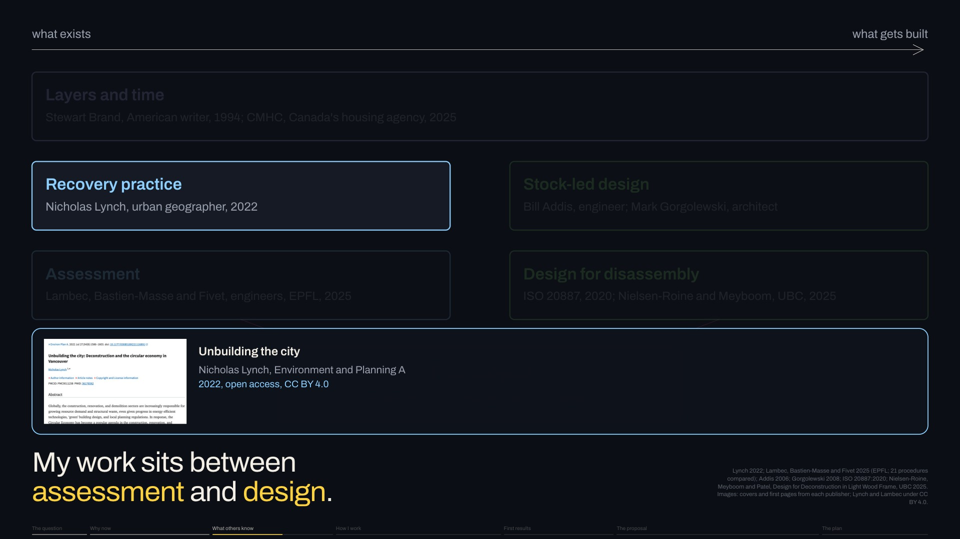
Notes:
Recovery practice shows salvage depends on skills, timing and markets.
Next click: Engineers at EPFL, the Swiss Federal Institute of Technology in Lausanne, compare ways of judging reuse.
Slide 13 of 32, Position (What others know): sentence 2 of 6, about 31 s for the slide.

Slide 33
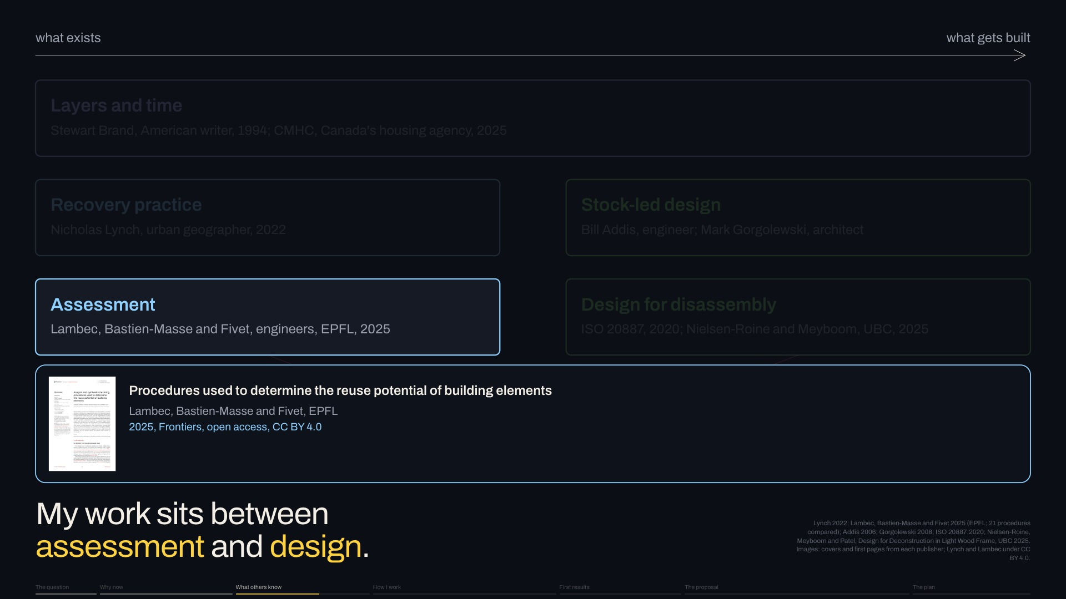
Notes:
Engineers at EPFL, the Swiss Federal Institute of Technology in Lausanne, compare ways of judging reuse.
Next click: Stock-led design, from engineer Bill Addis and architect Mark Gorgolewski, designs from what exists.
Slide 13 of 32, Position (What others know): sentence 3 of 6, about 31 s for the slide.

Slide 34
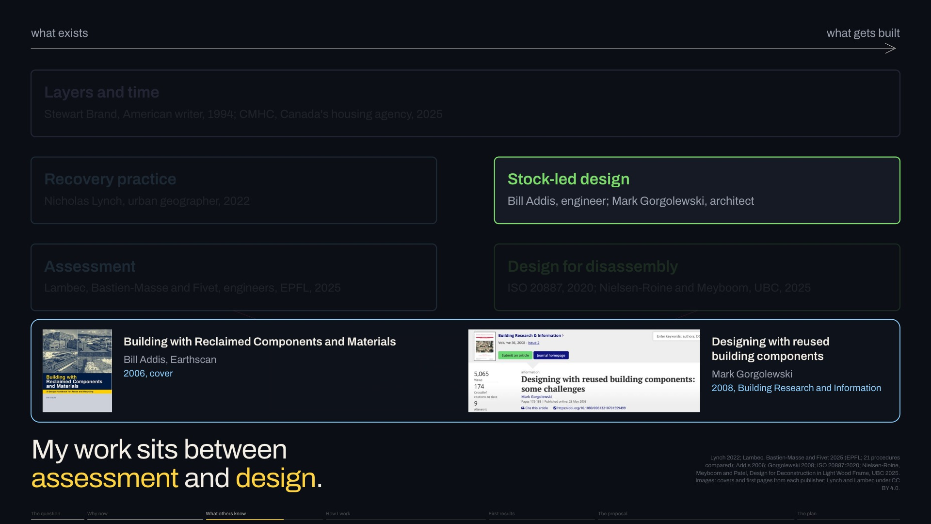
Notes:
Stock-led design, from engineer Bill Addis and architect Mark Gorgolewski, designs from what exists.
Next click: Design for disassembly, now standardised, plans the next taking apart; at SALA, AnnaLisa Meyboom and Kaia Nielsen-Roine adapted it to light wood frame.
Slide 13 of 32, Position (What others know): sentence 4 of 6, about 31 s for the slide.

Slide 35
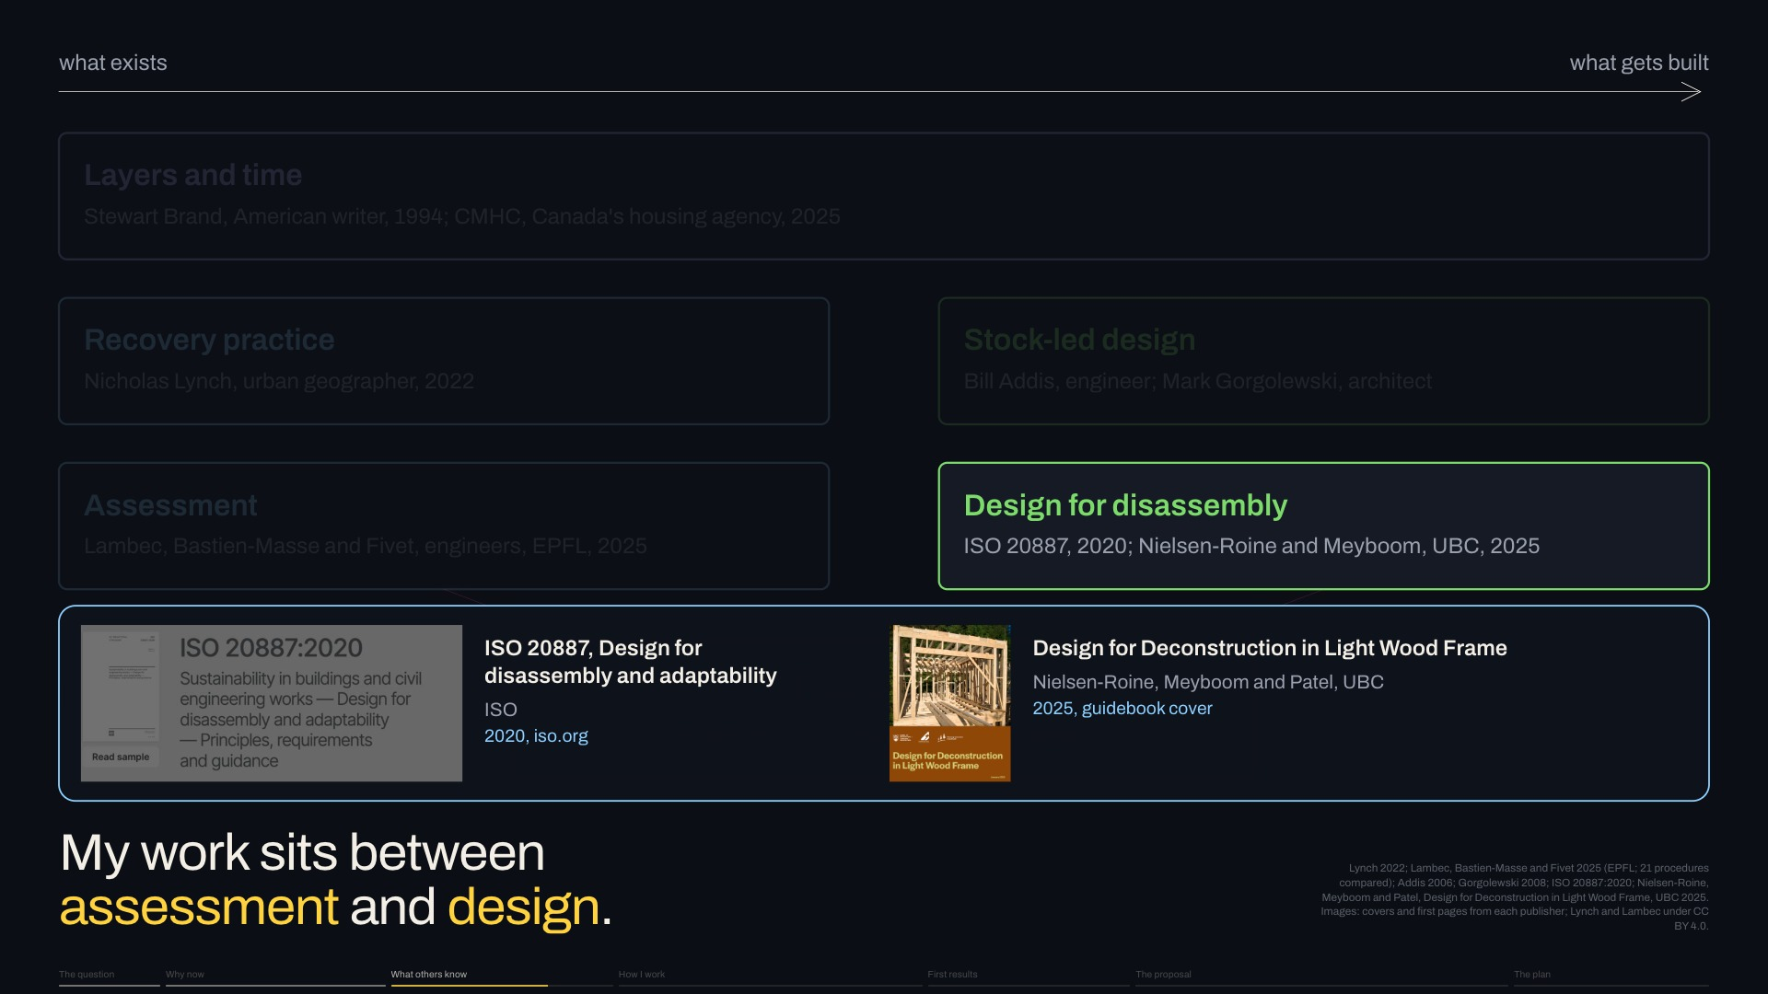
Notes:
Design for disassembly, now standardised, plans the next taking apart; at SALA, AnnaLisa Meyboom and Kaia Nielsen-Roine adapted it to light wood frame.
Next click: My work sits BETWEEN assessment and design.
Slide 13 of 32, Position (What others know): sentence 5 of 6, about 31 s for the slide.

Slide 36
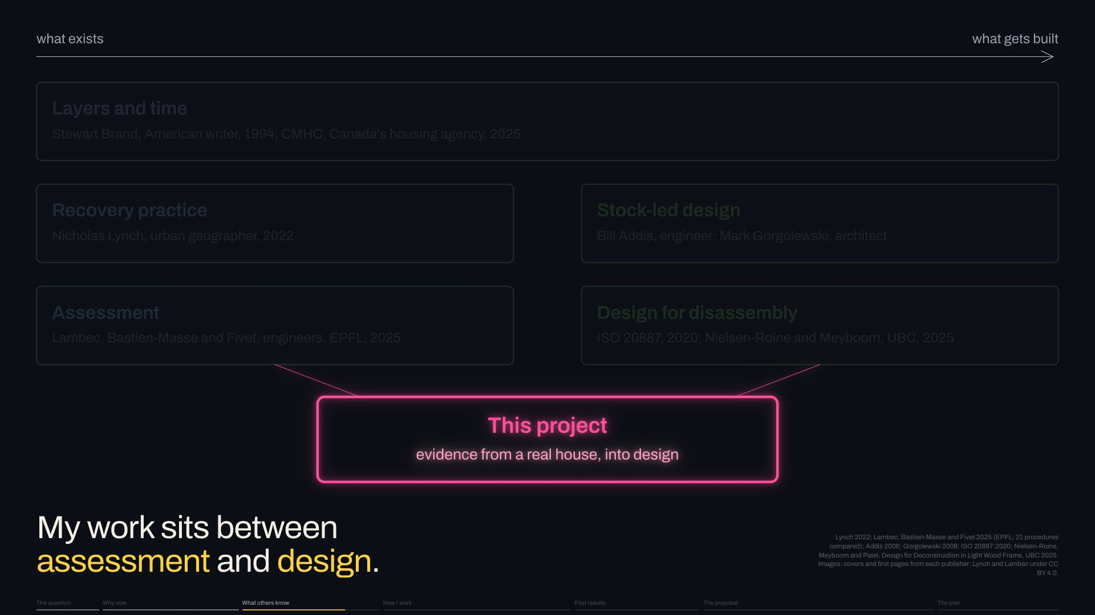
Notes:
My work sits BETWEEN assessment and design.
Next click, new slide 14, The gap: So here's the gap. [pause] We can assess parts, and design buildings that come apart. [pause] But we DON’T YET KNOW how evidence from a real Vancouver house should change the next architecture, or where parts wait in between.
Slide 13 of 32, Position (What others know): sentence 6 of 6, about 31 s for the slide.

Slide 37
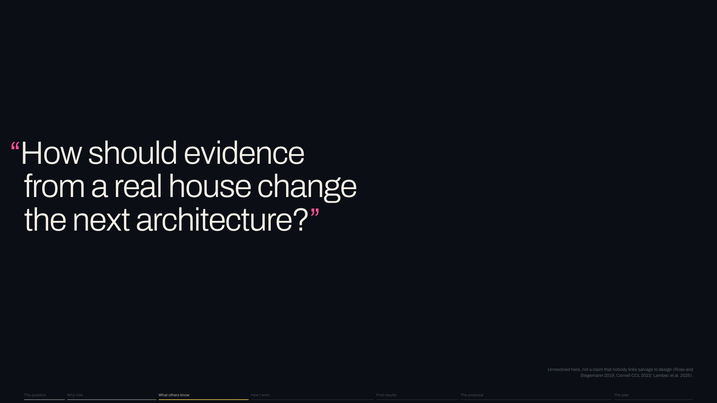
Notes:
So here's the gap. [pause] We can assess parts, and design buildings that come apart. [pause] But we DON’T YET KNOW how evidence from a real Vancouver house should change the next architecture, or where parts wait in between.
Next click, new slide 15, Where it began: I came to this gap by watching sound houses come down as waste. [pause] Could they become the NEXT BUILDING?
Slide 14 of 32, The gap (What others know): sentence 1 of 1, about 15 s for the slide.

Slide 38
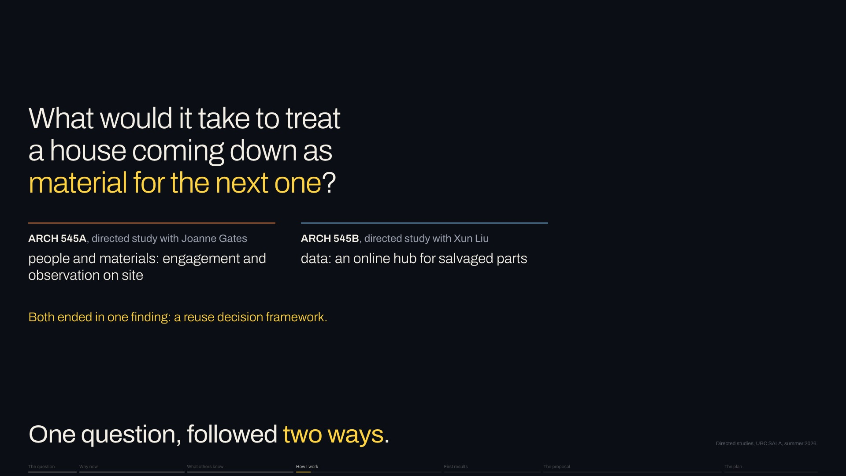
Notes:
I came to this gap by watching sound houses come down as waste. [pause] Could they become the NEXT BUILDING?
Next click: This summer I followed that through two directed studies.
Slide 15 of 32, Where it began (How I work): sentence 1 of 2, about 11 s for the slide.

Slide 39

Notes:
This summer I followed that through two directed studies.
Next click, new slide 16, Study one: on site: The first, with Joanne Gates, was observation on site.
Slide 15 of 32, Where it began (How I work): sentence 2 of 2, about 11 s for the slide.

Slide 40
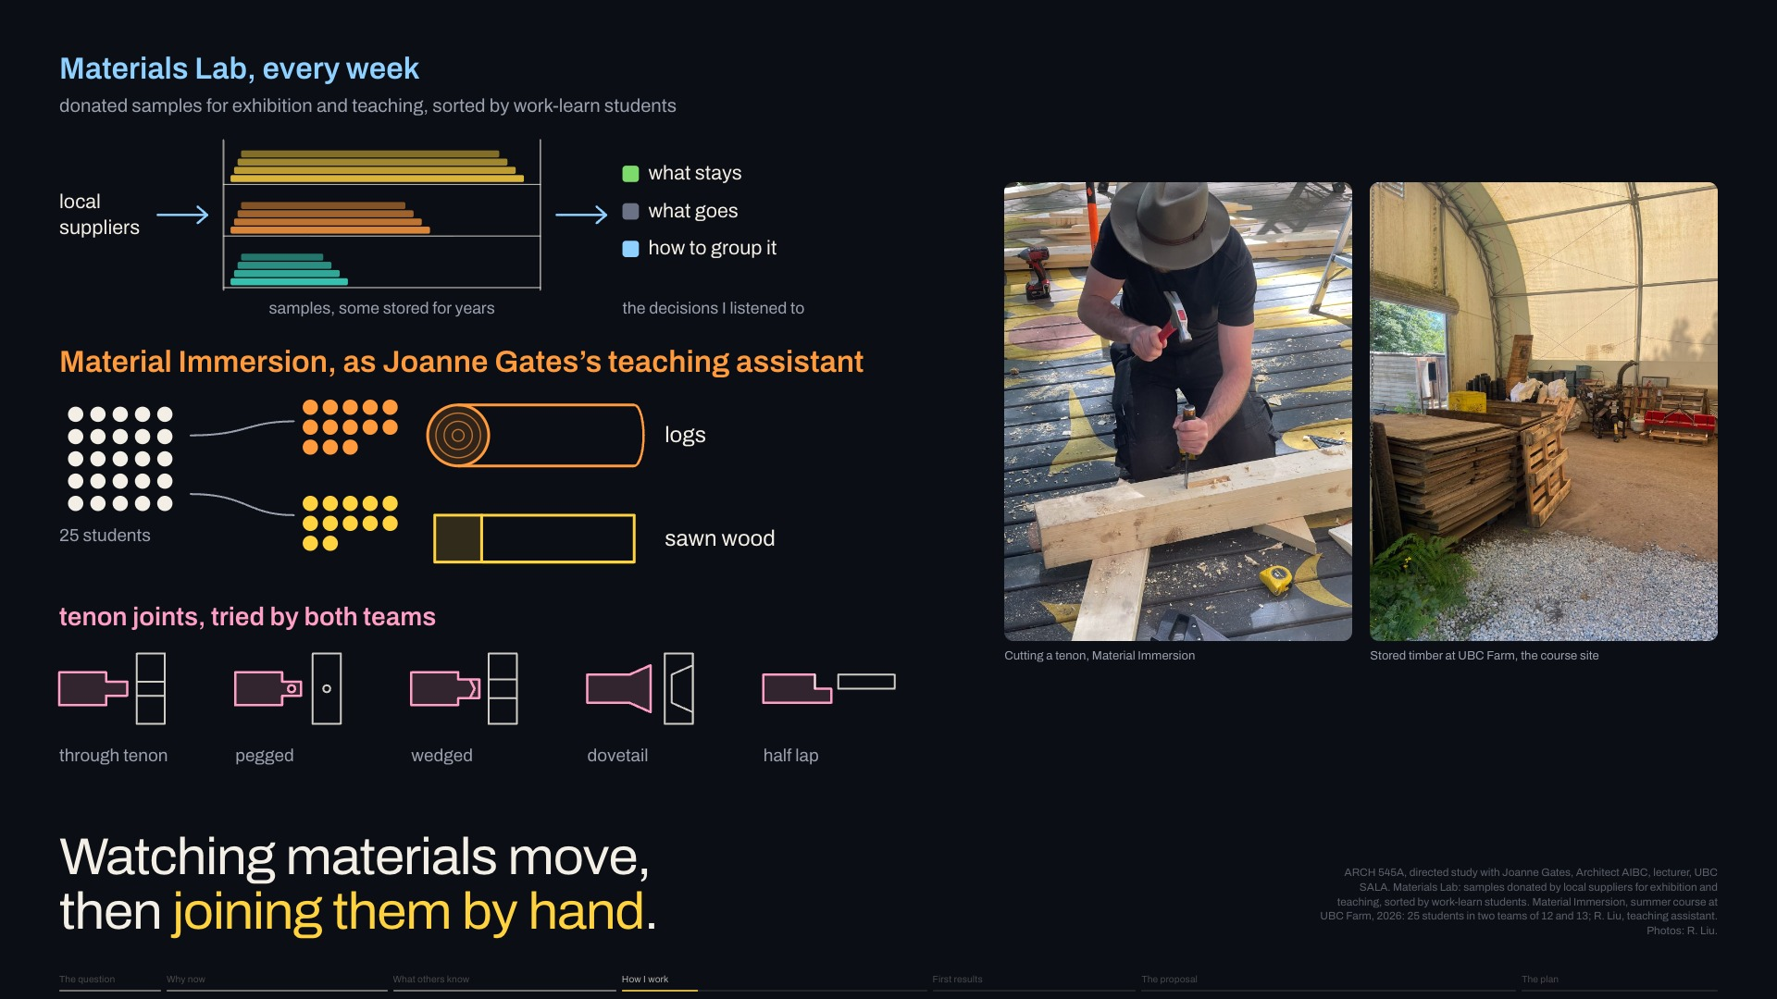
Notes:
The first, with Joanne Gates, was observation on site.
Next click: Weekly at the Materials Lab, I listened as work-learn students sorted donated samples: [pause] what stays, what goes, how to group them.
Slide 16 of 32, Study one: on site (How I work): sentence 1 of 4, about 24 s for the slide.

Slide 41
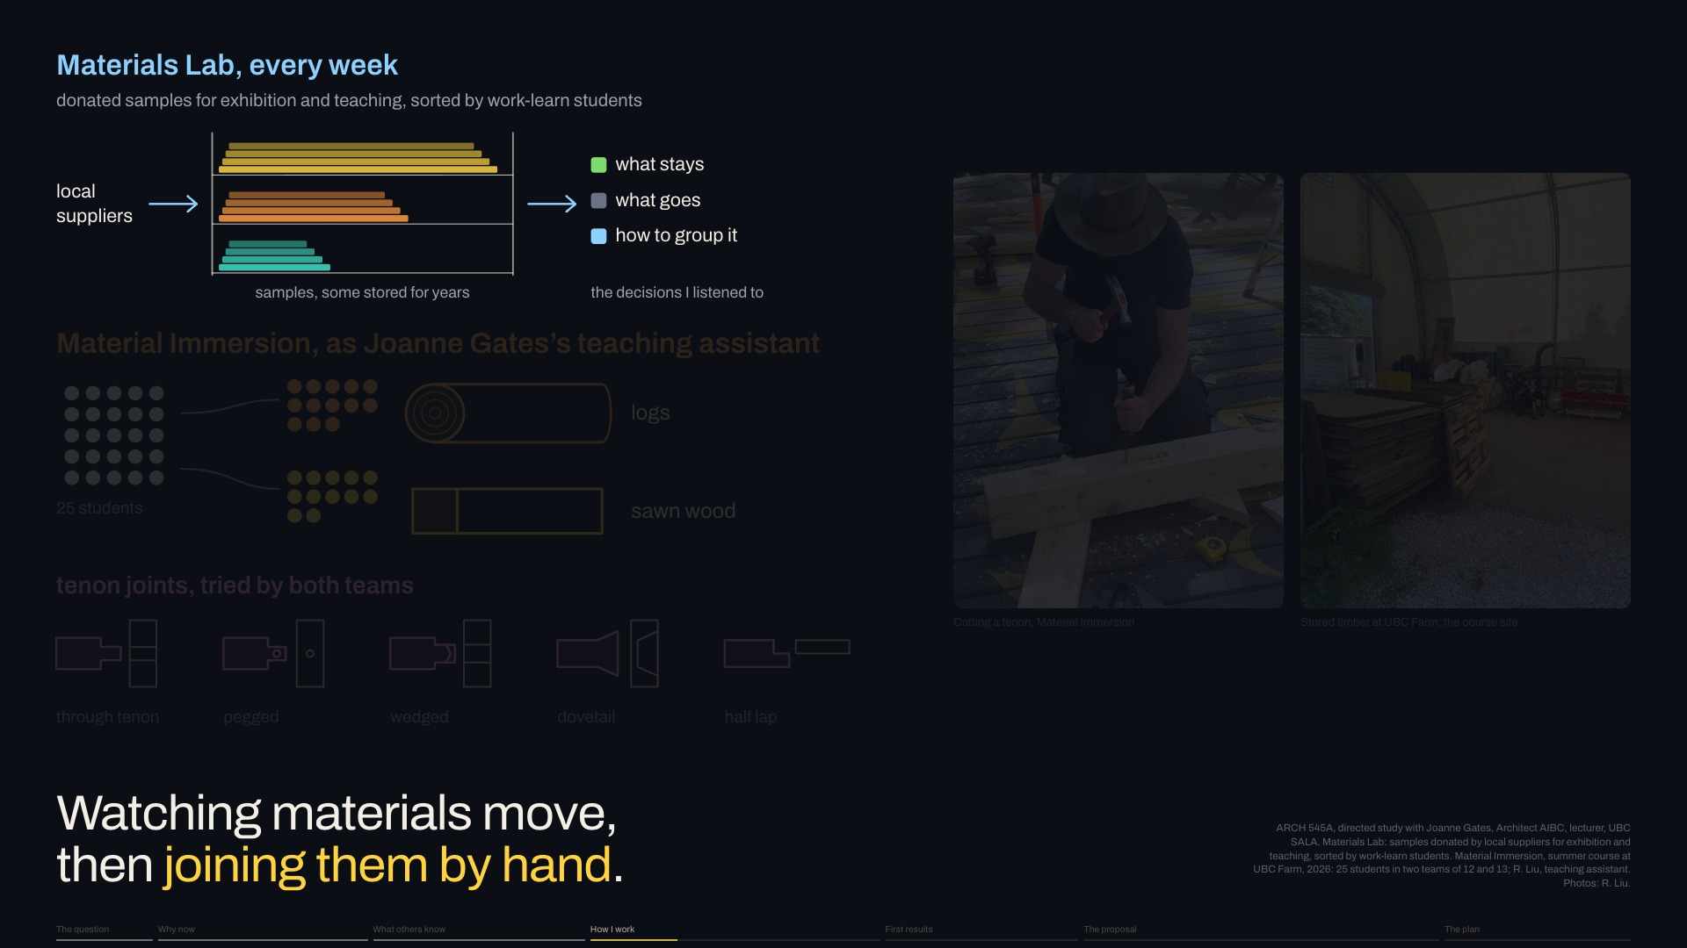
Notes:
Weekly at the Materials Lab, I listened as work-learn students sorted donated samples: [pause] what stays, what goes, how to group them.
Next click: As her teaching assistant on Material Immersion, I helped oversee twenty-five students, one team with logs, one with sawn wood, [keep going]
Slide 16 of 32, Study one: on site (How I work): sentence 2 of 4, about 24 s for the slide.

Slide 42
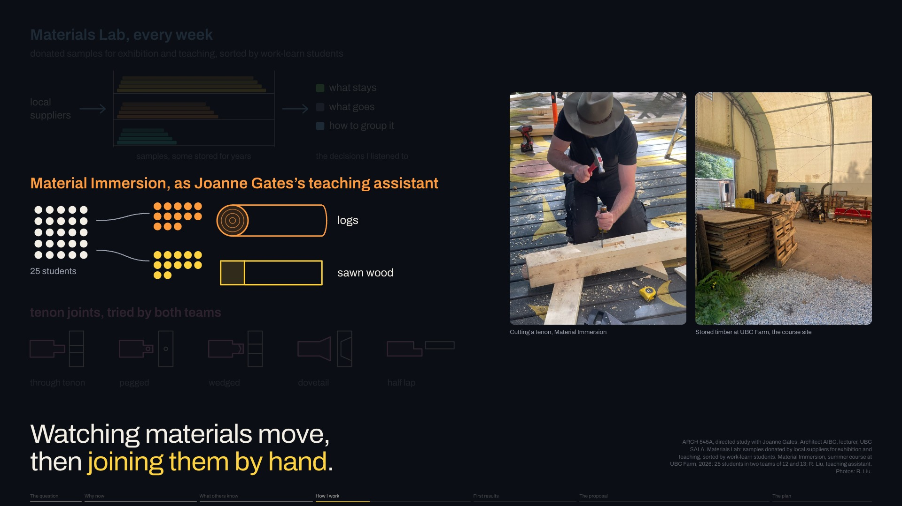
Notes:
As her teaching assistant on Material Immersion, I helped oversee twenty-five students, one team with logs, one with sawn wood, [keep going]
Next click: both trying tenon joints, where my interest in joints began.
Slide 16 of 32, Study one: on site (How I work): sentence 3 of 4, about 24 s for the slide.

Slide 43
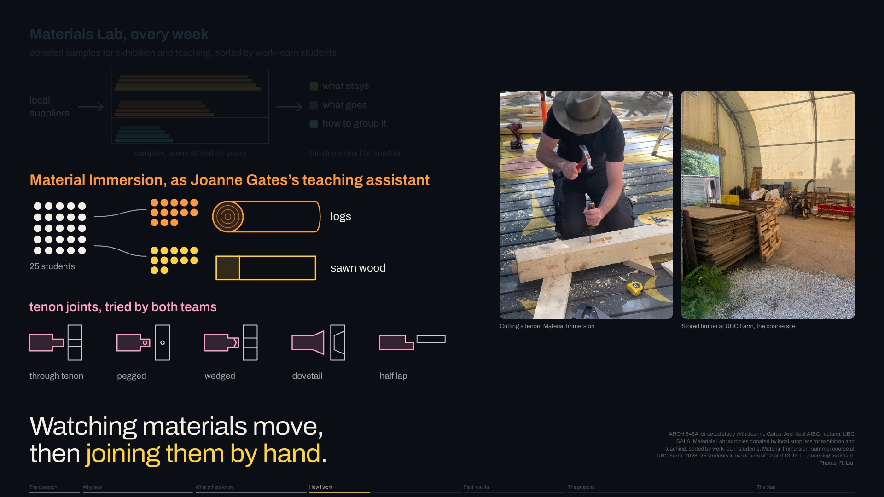
Notes:
both trying tenon joints, where my interest in joints began.
Next click, new slide 17, The pagoda study: Joints then took me to Shanxi, in China, to timber buildings the architects Liang Sicheng and Lin Huiyin drew.
Slide 16 of 32, Study one: on site (How I work): sentence 4 of 4, about 24 s for the slide.

Slide 44
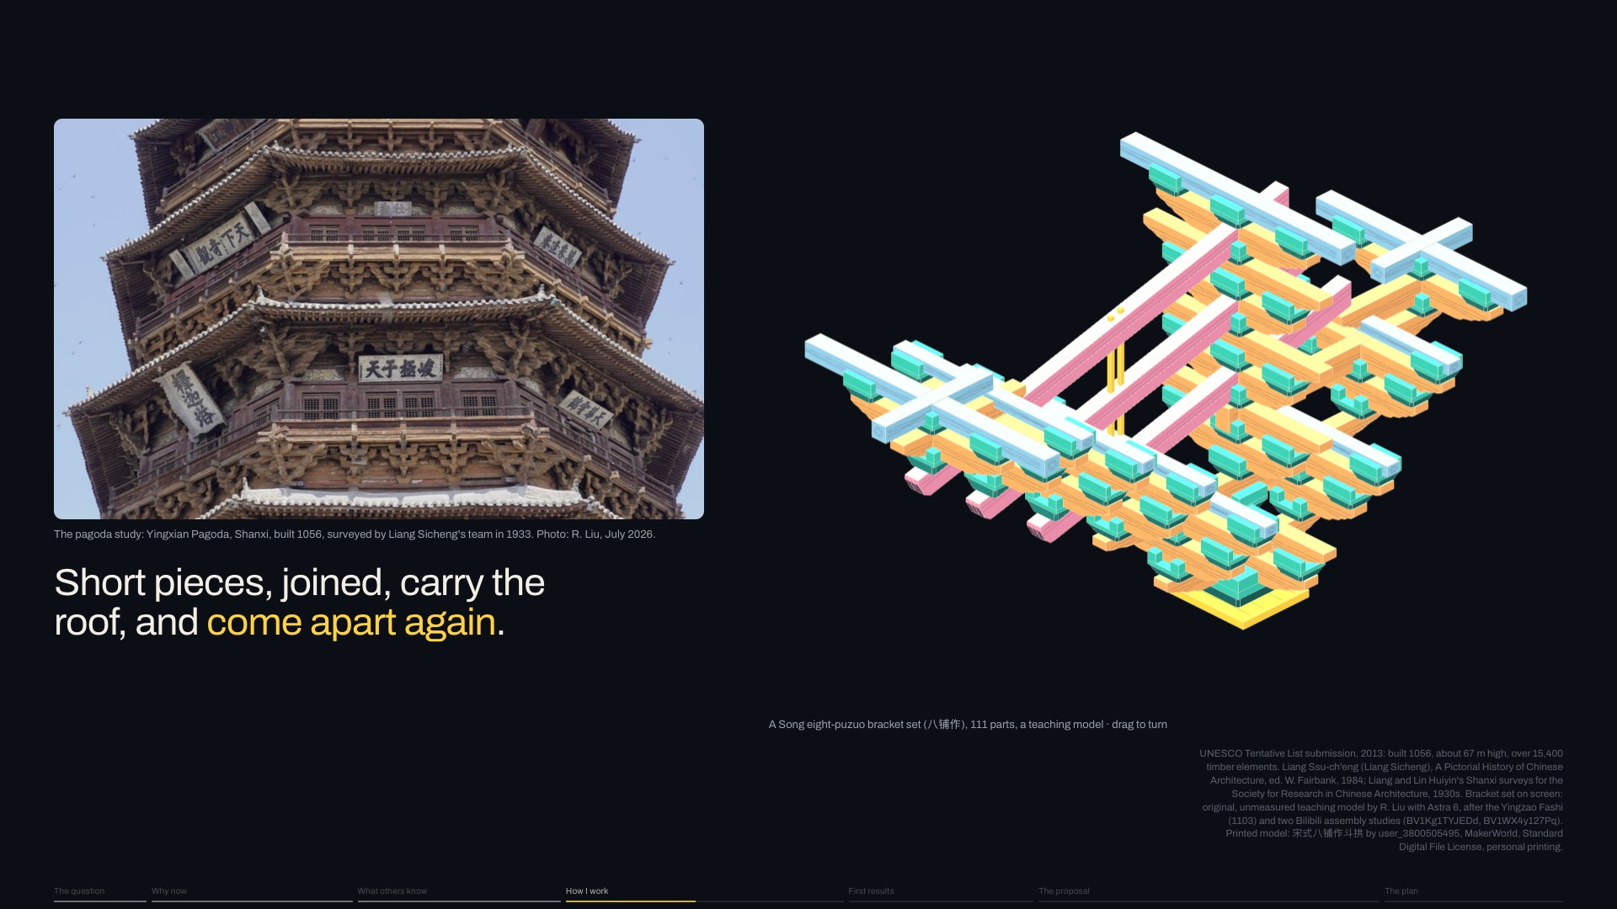
Notes:
Joints then took me to Shanxi, in China, to timber buildings the architects Liang Sicheng and Lin Huiyin drew.
Next click: In the Yingxian Pagoda, a timber tower from 1056, bracket sets called dougong lock short pieces without nails or glue, [pause] yet carry the roof far out.
Slide 17 of 32, The pagoda study (How I work): sentence 1 of 3, about 27 s for the slide.

Slide 45
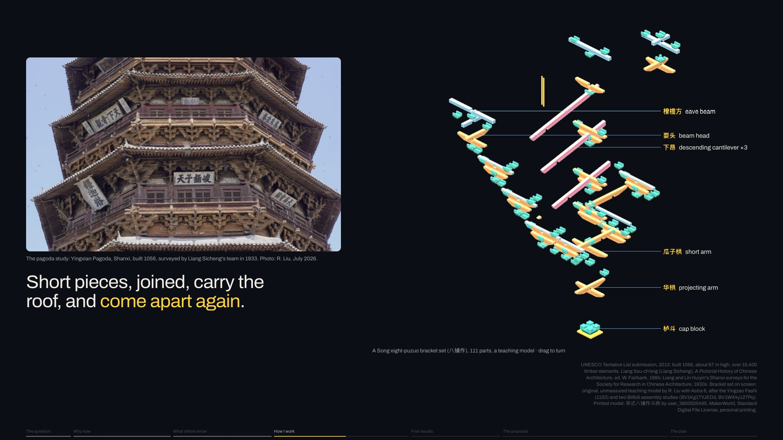
Notes:
In the Yingxian Pagoda, a timber tower from 1056, bracket sets called dougong lock short pieces without nails or glue, [pause] yet carry the roof far out.
Next click: A short piece isn't waste IF A JOINT CAN MAKE IT WORK. [pause] [hold up the printed set] Please try it.
Slide 17 of 32, The pagoda study (How I work): sentence 2 of 3, about 27 s for the slide.

Slide 46

Notes:
A short piece isn't waste IF A JOINT CAN MAKE IT WORK. [pause] [hold up the printed set] Please try it.
Next click, new slide 18, Study two: an online hub: The second, with Xun Liu, used AI to gather, structure and show data.
Slide 17 of 32, The pagoda study (How I work): sentence 3 of 3, about 27 s for the slide.

Slide 47
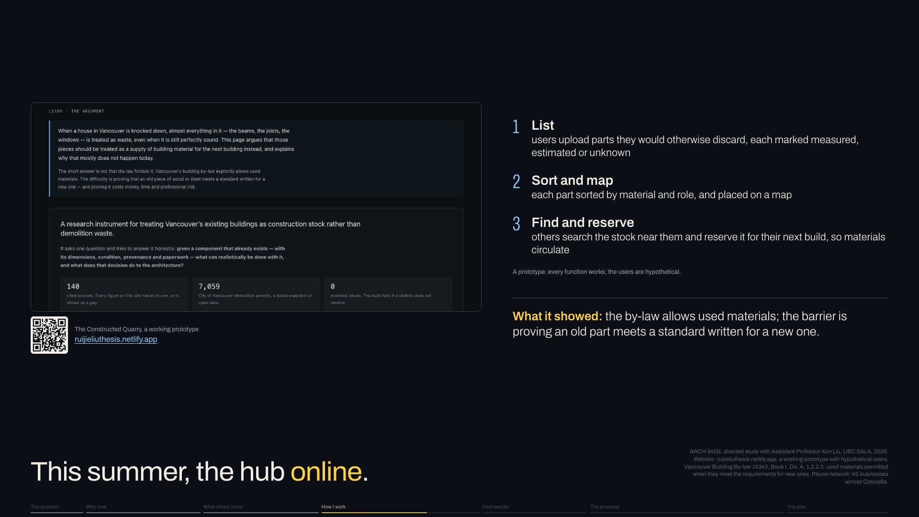
Notes:
The second, with Xun Liu, used AI to gather, structure and show data.
Next click: I built a prototype online hub: [pause] users list parts they'd discard, sorted and mapped, and others reserve them for a next build, so materials circulate. Its users are HYPOTHETICAL.
Slide 18 of 32, Study two: an online hub (How I work): sentence 1 of 3, about 26 s for the slide.

Slide 48
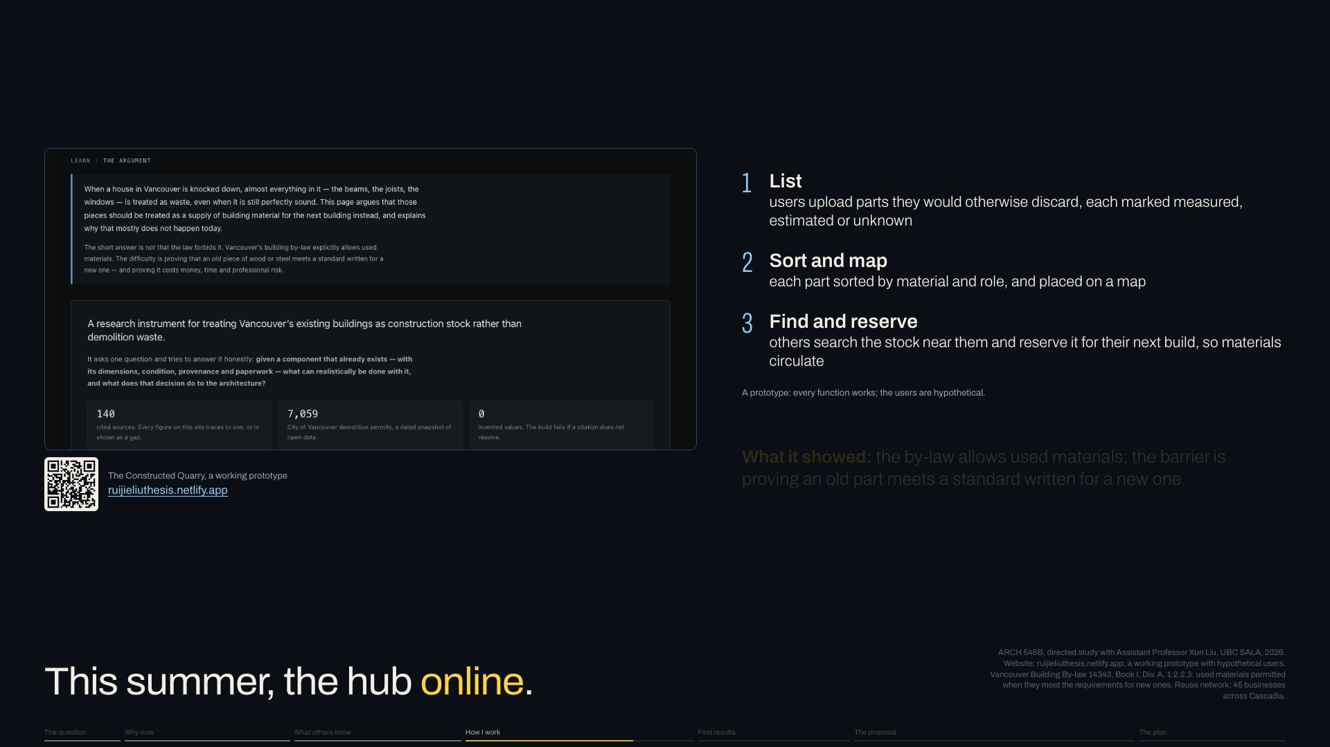
Notes:
I built a prototype online hub: [pause] users list parts they'd discard, sorted and mapped, and others reserve them for a next build, so materials circulate. Its users are HYPOTHETICAL.
Next click: It showed the barrier: [pause] the by-law allows used materials, but PROVING an old part meets a new standard costs time and money.
Slide 18 of 32, Study two: an online hub (How I work): sentence 2 of 3, about 26 s for the slide.

Slide 49

Notes:
It showed the barrier: [pause] the by-law allows used materials, but PROVING an old part meets a new standard costs time and money.
Next click, new slide 19, How I will decide: Both studies led to one outcome. [pause] From observation on site and the online research database, I built the reuse decision framework. It asks: [pause] can THIS part do THIS job, HERE?
Slide 18 of 32, Study two: an online hub (How I work): sentence 3 of 3, about 26 s for the slide.

Slide 50
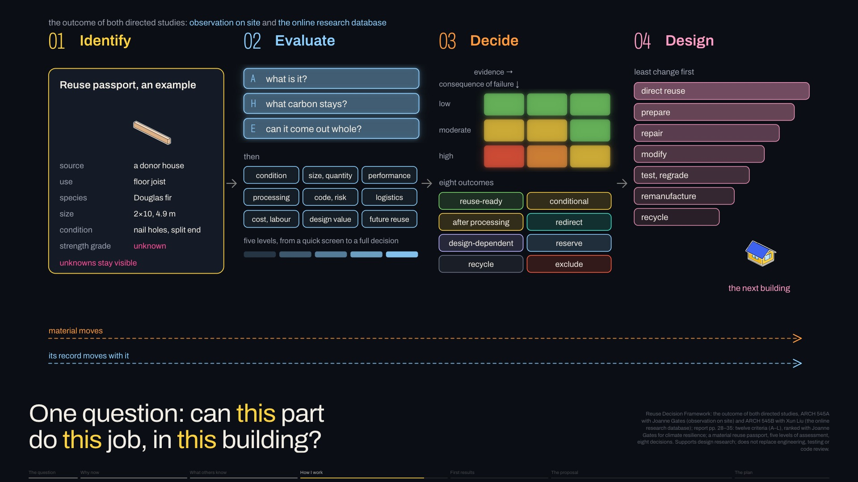
Notes:
Both studies led to one outcome. [pause] From observation on site and the online research database, I built the reuse decision framework. It asks: [pause] can THIS part do THIS job, HERE?
Next click: First, identify: a passport of what we know about each part, and what we don't.
Slide 19 of 32, How I will decide (How I work): sentence 1 of 5, about 35 s for the slide.

Slide 51
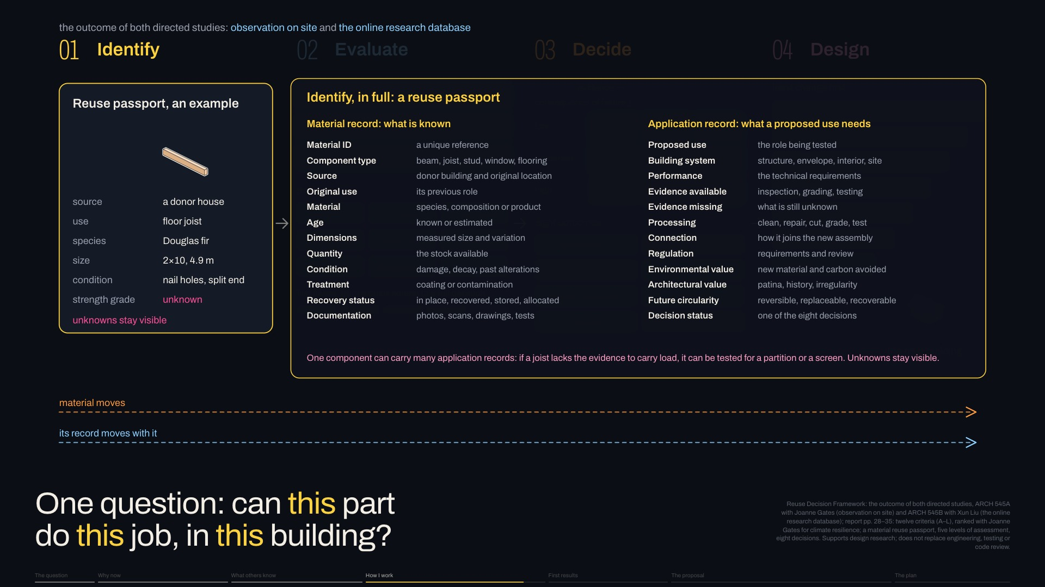
Notes:
First, identify: a passport of what we know about each part, and what we don't.
Next click: Then evaluate it for that use: what it is, its carbon, whether it comes out whole.
Slide 19 of 32, How I will decide (How I work): sentence 2 of 5, about 35 s for the slide.

Slide 52
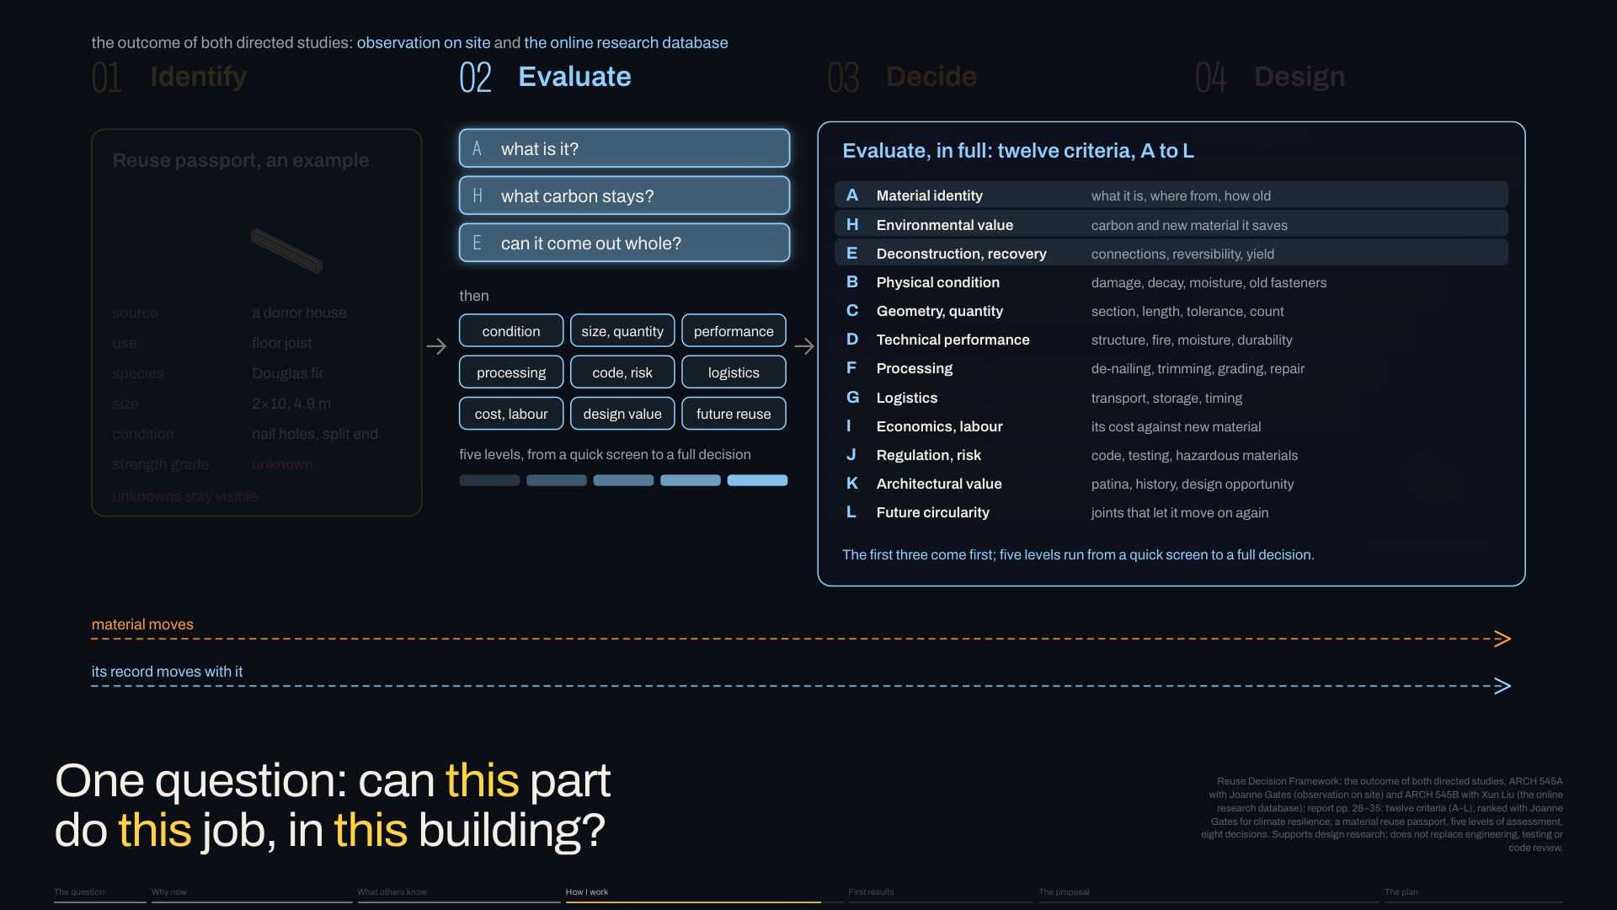
Notes:
Then evaluate it for that use: what it is, its carbon, whether it comes out whole.
Next click: Then decide, weighing evidence against the consequence of failure.
Slide 19 of 32, How I will decide (How I work): sentence 3 of 5, about 35 s for the slide.

Slide 53
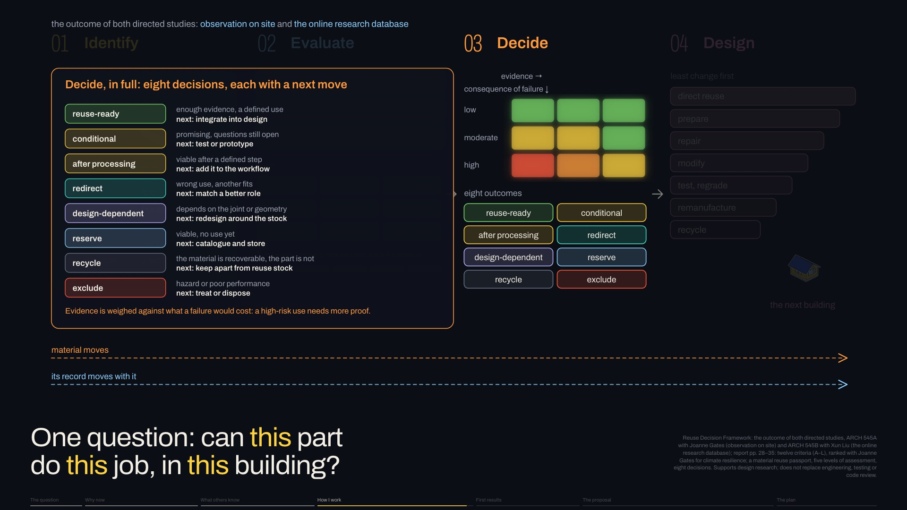
Notes:
Then decide, weighing evidence against the consequence of failure.
Next click: And design, least change first, a path into the next building, its record travelling with it.
Slide 19 of 32, How I will decide (How I work): sentence 4 of 5, about 35 s for the slide.

Slide 54
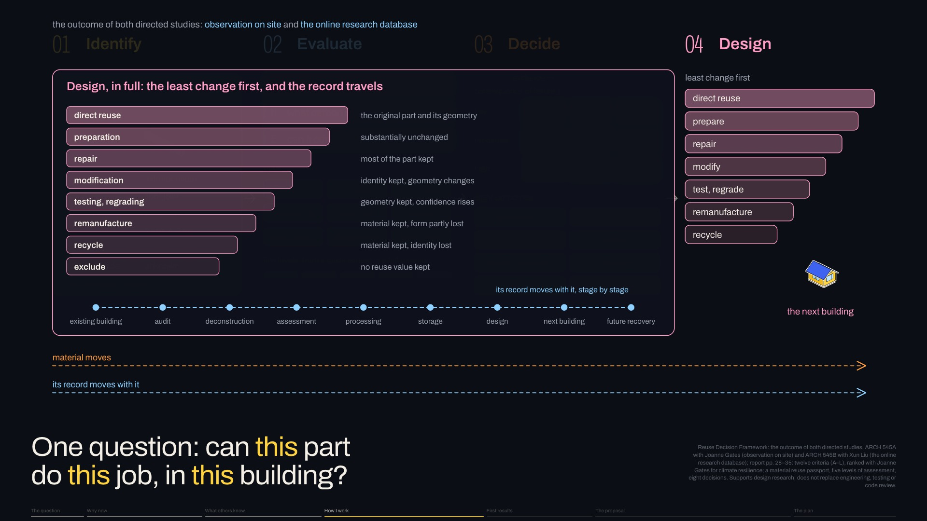
Notes:
And design, least change first, a path into the next building, its record travelling with it.
Next click, new slide 20, Every demolition permit: My first results map every demolition permit since 2017. [pause] They fill the house neighbourhoods, south and east, and almost SKIP DOWNTOWN.
Slide 19 of 32, How I will decide (How I work): sentence 5 of 5, about 35 s for the slide.

Slide 55
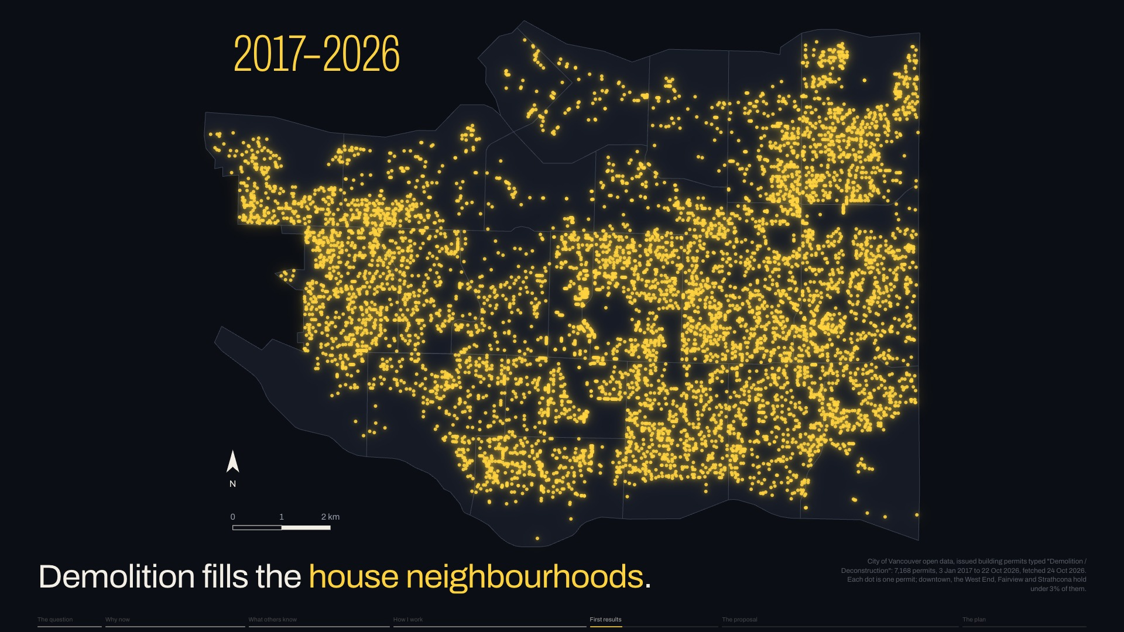
Notes:
My first results map every demolition permit since 2017. [pause] They fill the house neighbourhoods, south and east, and almost SKIP DOWNTOWN.
Next click, new slide 21, No requirement: Then I read what permits ask.
Slide 20 of 32, Every demolition permit (First results): sentence 1 of 1, about 9 s for the slide.

Slide 56
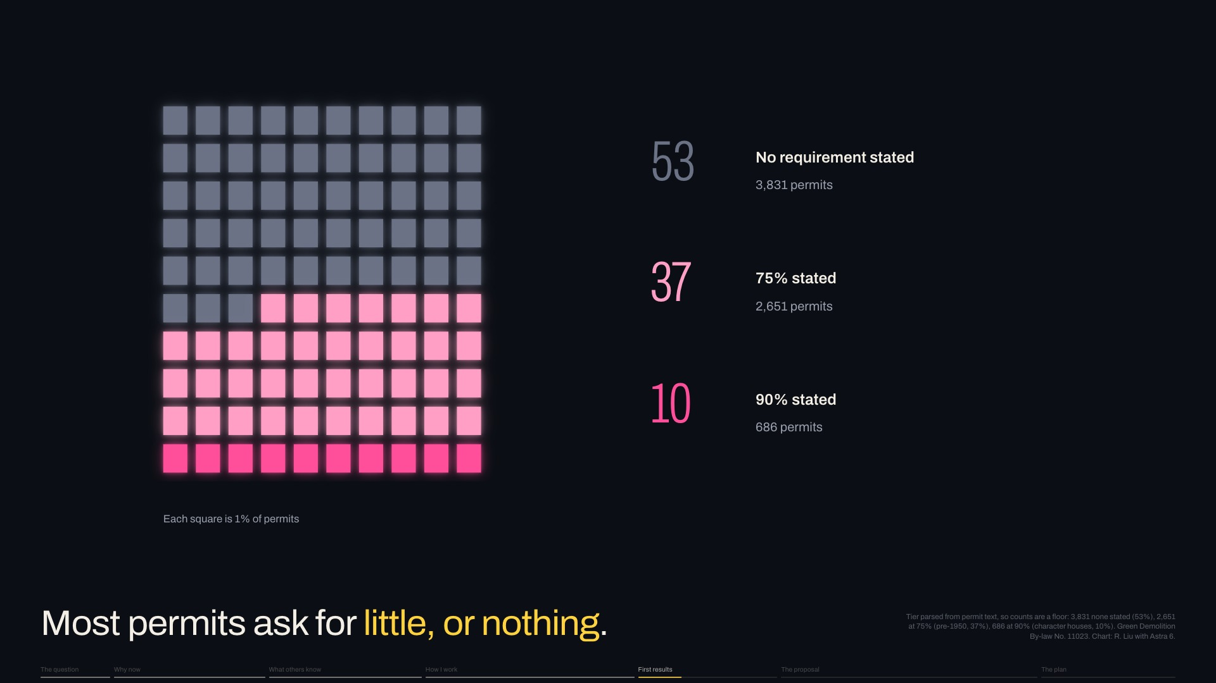
Notes:
Then I read what permits ask.
Next click: Over half ask NOTHING, because the Green Demolition By-law targets only older houses.
Slide 21 of 32, No requirement (First results): sentence 1 of 4, about 14 s for the slide.

Slide 57
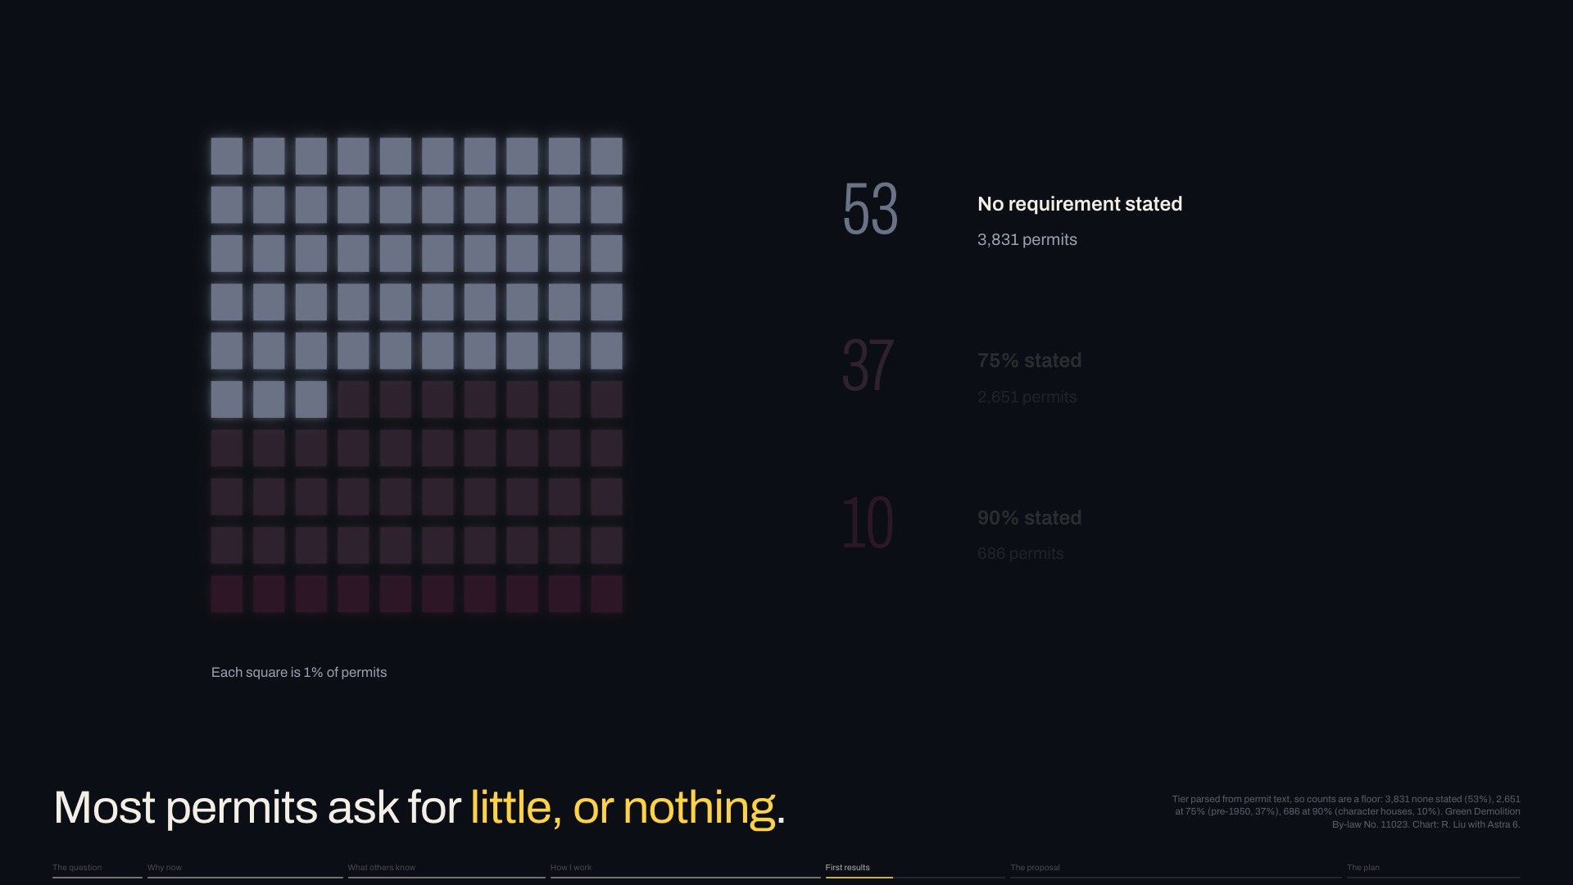
Notes:
Over half ask NOTHING, because the Green Demolition By-law targets only older houses.
Next click: The rest name a share to reuse or recycle, by weight, [keep going]
Slide 21 of 32, No requirement (First results): sentence 2 of 4, about 14 s for the slide.

Slide 58

Notes:
The rest name a share to reuse or recycle, by weight, [keep going]
Next click: the highest for character houses.
Slide 21 of 32, No requirement (First results): sentence 3 of 4, about 14 s for the slide.

Slide 59

Notes:
the highest for character houses.
Next click, new slide 22, Recycled is not reused: By weight, reuse and recycling count THE SAME.
Slide 21 of 32, No requirement (First results): sentence 4 of 4, about 14 s for the slide.

Slide 60

Notes:
By weight, reuse and recycling count THE SAME.
Next click: Portland, which requires deconstruction, finds reuse a small share of what leaves the site.
Slide 22 of 32, Recycled is not reused (First results): sentence 1 of 4, about 22 s for the slide.

Slide 61

Notes:
Portland, which requires deconstruction, finds reuse a small share of what leaves the site.
Next click: An Oregon study of thirty-six homes CONFIRMS IT: about a quarter was salvaged.
Slide 22 of 32, Recycled is not reused (First results): sentence 2 of 4, about 22 s for the slide.

Slide 62

Notes:
An Oregon study of thirty-six homes CONFIRMS IT: about a quarter was salvaged.
Next click: Vancouver counts the two together, so the city publishes no reuse rate. [pause] That EMPTY BAR is where my project starts.
Slide 22 of 32, Recycled is not reused (First results): sentence 3 of 4, about 22 s for the slide.

Slide 63

Notes:
Vancouver counts the two together, so the city publishes no reuse rate. [pause] That EMPTY BAR is where my project starts.
Next click, new slide 23, Why wood first: To see where reuse should start, I looked at one best case the City documented: [pause] a 1930 Dunbar house, taken apart by hand.
Slide 22 of 32, Recycled is not reused (First results): sentence 4 of 4, about 22 s for the slide.

Slide 64

Notes:
To see where reuse should start, I looked at one best case the City documented: [pause] a 1930 Dunbar house, taken apart by hand.
Next click: The concrete was heaviest and was crushed for road fill; flooring, doors and trim found buyers.
Slide 23 of 32, Why wood first (First results): sentence 1 of 5, about 37 s for the slide.

Slide 65

Notes:
The concrete was heaviest and was crushed for road fill; flooring, doors and trim found buyers.
Next click: But of nineteen tonnes of lumber, THREE QUARTERS were burned for energy. The City notes pieces under four feet can only be recycled.
Slide 23 of 32, Why wood first (First results): sentence 2 of 5, about 37 s for the slide.

Slide 66

Notes:
But of nineteen tonnes of lumber, THREE QUARTERS were burned for energy. The City notes pieces under four feet can only be recycled.
Next click: Across the region, wood is about half of building waste thrown away.
Slide 23 of 32, Why wood first (First results): sentence 3 of 5, about 37 s for the slide.

Slide 67

Notes:
Across the region, wood is about half of building waste thrown away.
Next click: The hub takes the whole house; [pause] my research starts with its WOOD, and joints for short pieces.
Slide 23 of 32, Why wood first (First results): sentence 4 of 5, about 37 s for the slide.

Slide 68

Notes:
The hub takes the whole house; [pause] my research starts with its WOOD, and joints for short pieces.
Next click, new slide 24, The obstacle is time: Short pieces are one reason so little is reused. Cornell's lab points to another: [pause] TIME.
Slide 23 of 32, Why wood first (First results): sentence 5 of 5, about 37 s for the slide.

Slide 69

Notes:
Short pieces are one reason so little is reused. Cornell's lab points to another: [pause] TIME.
Next click: Taking it apart took about ten times the labour of demolition; on Vancouver land, each day costs money.
Slide 24 of 32, The obstacle is time (The proposal): sentence 1 of 3, about 19 s for the slide.

Slide 70

Notes:
Taking it apart took about ten times the labour of demolition; on Vancouver land, each day costs money.
Next click: But much of that slow work needs a roof and bench, NOT THE SITE.
Slide 24 of 32, The obstacle is time (The proposal): sentence 2 of 3, about 19 s for the slide.

Slide 71

Notes:
But much of that slow work needs a roof and bench, NOT THE SITE.
Next click, new slide 25, What exists, and what is missing: A place like this exists, [pause] but only in pieces.
Slide 24 of 32, The obstacle is time (The proposal): sentence 3 of 3, about 19 s for the slide.

Slide 72

Notes:
A place like this exists, [pause] but only in pieces.
Next click: Around Vancouver, firms take houses apart and stores resell parts, loosely organised, Lynch found.
Slide 25 of 32, What exists, and what is missing (The proposal): sentence 1 of 5, about 32 s for the slide.

Slide 73

Notes:
Around Vancouver, firms take houses apart and stores resell parts, loosely organised, Lynch found.
Next click: Depots from Portland to Basel resell parts; in Winterthur, Switzerland, an extension was built largely from reused parts.
Slide 25 of 32, What exists, and what is missing (The proposal): sentence 2 of 5, about 32 s for the slide.

Slide 74

Notes:
Depots from Portland to Basel resell parts; in Winterthur, Switzerland, an extension was built largely from reused parts.
Next click: Here, salvaged wood has no grading rule, so only engineers can approve it for load.
Slide 25 of 32, What exists, and what is missing (The proposal): sentence 3 of 5, about 32 s for the slide.

Slide 75

Notes:
Here, salvaged wood has no grading rule, so only engineers can approve it for load.
Next click: The City backed a hub in 2018; the closest thing today, Habitat for Humanity's Rebuild Hub, gathers salvage but sells OUTSIDE THE CITY.
Slide 25 of 32, What exists, and what is missing (The proposal): sentence 4 of 5, about 32 s for the slide.

Slide 76

Notes:
The City backed a hub in 2018; the closest thing today, Habitat for Humanity's Rebuild Hub, gathers salvage but sells OUTSIDE THE CITY.
Next click, new slide 26, The deconstruction hub: [slower] So my proposal for GP Two turns the online hub into a building: [pause] a public deconstruction hub, sketched as first thoughts.
Slide 25 of 32, What exists, and what is missing (The proposal): sentence 5 of 5, about 32 s for the slide.

Slide 77

Notes:
[slower] So my proposal for GP Two turns the online hub into a building: [pause] a public deconstruction hub, sketched as first thoughts.
Next click: Houses arrive in large components, so sites clear in days.
Slide 26 of 32, The deconstruction hub (The proposal): sentence 1 of 8, about 37 s for the slide.

Slide 78

Notes:
Houses arrive in large components, so sites clear in days.
Next click: Each part is measured and tested, wood regraded, for its next use; [keep going]
Slide 26 of 32, The deconstruction hub (The proposal): sentence 2 of 8, about 37 s for the slide.

Slide 79

Notes:
Each part is measured and tested, wood regraded, for its next use; [keep going]
Next click: unbuilt by hand, indoors; [keep going]
Slide 26 of 32, The deconstruction hub (The proposal): sentence 3 of 8, about 37 s for the slide.

Slide 80

Notes:
unbuilt by hand, indoors; [keep going]
Next click: sorted by lifespan and condition; [keep going]
Slide 26 of 32, The deconstruction hub (The proposal): sentence 4 of 8, about 37 s for the slide.

Slide 81

Notes:
sorted by lifespan and condition; [keep going]
Next click: and offered first to the multiplexes replacing them.
Slide 26 of 32, The deconstruction hub (The proposal): sentence 5 of 8, about 37 s for the slide.

Slide 82

Notes:
and offered first to the multiplexes replacing them.
Next click: A multiplex adds homes but no shared room, so the hub could add rooms along the street.
Slide 26 of 32, The deconstruction hub (The proposal): sentence 6 of 8, about 37 s for the slide.

Slide 83

Notes:
A multiplex adds homes but no shared room, so the hub could add rooms along the street.
Next click: A classroom could look into the work, so students and trades learn by watching.
Slide 26 of 32, The deconstruction hub (The proposal): sentence 7 of 8, about 37 s for the slide.

Slide 84

Notes:
A classroom could look into the work, so students and trades learn by watching.
Next click, new slide 27, Where hubs go: To place hubs, I mapped three things: [keep going]
Slide 26 of 32, The deconstruction hub (The proposal): sentence 8 of 8, about 37 s for the slide.

Slide 85

Notes:
To place hubs, I mapped three things: [keep going]
Next click: where houses come down, [keep going]
Slide 27 of 32, Where hubs go (The proposal): sentence 1 of 5, about 17 s for the slide.

Slide 86

Notes:
where houses come down, [keep going]
Next click: where multiplexes go up, [keep going]
Slide 27 of 32, Where hubs go (The proposal): sentence 2 of 5, about 17 s for the slide.

Slide 87

Notes:
where multiplexes go up, [keep going]
Next click: and land a workshop could use, by a truck route.
Slide 27 of 32, Where hubs go (The proposal): sentence 3 of 5, about 17 s for the slide.

Slide 88

Notes:
and land a workshop could use, by a truck route.
Next click: Six sites reach most of both within a twenty-minute walk, and over a quarter of city households.
Slide 27 of 32, Where hubs go (The proposal): sentence 4 of 5, about 17 s for the slide.

Slide 89

Notes:
Six sites reach most of both within a twenty-minute walk, and over a quarter of city households.
Next click, new slide 28, What kind of building: What kind of building is it? [pause] My answer is half workshop, half community centre.
Slide 27 of 32, Where hubs go (The proposal): sentence 5 of 5, about 17 s for the slide.

Slide 90

Notes:
What kind of building is it? [pause] My answer is half workshop, half community centre.
Next click: Building new, on a cleared lot or under housing, spends carbon and land.
Slide 28 of 32, What kind of building (The proposal): sentence 1 of 5, about 27 s for the slide.

Slide 91

Notes:
Building new, on a cleared lot or under housing, spends carbon and land.
Next click: So it reuses a low building already there, a store or warehouse, for slow work, [keep going]
Slide 28 of 32, What kind of building (The proposal): sentence 2 of 5, about 27 s for the slide.

Slide 92

Notes:
So it reuses a low building already there, a store or warehouse, for slow work, [keep going]
Next click: and adds a civic front of salvaged parts.
Slide 28 of 32, What kind of building (The proposal): sentence 3 of 5, about 27 s for the slide.

Slide 93

Notes:
and adds a civic front of salvaged parts.
Next click: Most sites have several such buildings nearby, and this year's City assessments show they still stand.
Slide 28 of 32, What kind of building (The proposal): sentence 4 of 5, about 27 s for the slide.

Slide 94

Notes:
Most sites have several such buildings nearby, and this year's City assessments show they still stand.
Next click, new slide 29, What it brings to Vancouver: It would bring three kinds of resilience.
Slide 28 of 32, What kind of building (The proposal): sentence 5 of 5, about 27 s for the slide.

Slide 95

Notes:
It would bring three kinds of resilience.
Next click: First, time: buildings that change one part at a time.
Slide 29 of 32, What it brings to Vancouver (The proposal): sentence 1 of 4, about 19 s for the slide.

Slide 96

Notes:
First, time: buildings that change one part at a time.
Next click: Second, climate: deep eaves, raised bases, replaceable skins keep timber dry.
Slide 29 of 32, What it brings to Vancouver (The proposal): sentence 2 of 4, about 19 s for the slide.

Slide 97

Notes:
Second, climate: deep eaves, raised bases, replaceable skins keep timber dry.
Next click: And third, material: parts that can be checked, repaired and moved on, [pause] which I learned from the pagoda study.
Slide 29 of 32, What it brings to Vancouver (The proposal): sentence 3 of 4, about 19 s for the slide.

Slide 98

Notes:
And third, material: parts that can be checked, repaired and moved on, [pause] which I learned from the pagoda study.
Next click, new slide 30, The year ahead: This plan is still open, [pause] until I work it through with my chair.
Slide 29 of 32, What it brings to Vancouver (The proposal): sentence 4 of 4, about 19 s for the slide.

Slide 99

Notes:
This plan is still open, [pause] until I work it through with my chair.
Next click: To assess, I will follow three houses near the first hub site into their multiplexes, and catalogue one.
Slide 30 of 32, The year ahead (The plan): sentence 1 of 4, about 23 s for the slide.

Slide 100

Notes:
To assess, I will follow three houses near the first hub site into their multiplexes, and catalogue one.
Next click: To design, I will test joints for short lumber, then design the hub.
Slide 30 of 32, The year ahead (The plan): sentence 2 of 4, about 23 s for the slide.

Slide 101

Notes:
To design, I will test joints for short lumber, then design the hub.
Next click: Two readings guide it: Brand, and the Swiss compendium Re-Use in Construction.
Slide 30 of 32, The year ahead (The plan): sentence 3 of 4, about 23 s for the slide.

Slide 102

Notes:
Two readings guide it: Brand, and the Swiss compendium Re-Use in Construction.
Next click, new slide 31, Buildings adapt anyway: I'll end with Brand: [pause] “Architecture, we imagine, is permanent.” [pause]
Slide 30 of 32, The year ahead (The plan): sentence 4 of 4, about 23 s for the slide.

Slide 103

Notes:
I'll end with Brand: [pause] “Architecture, we imagine, is permanent.” [pause]
Next click: [slower] “Almost no buildings adapt well.
Slide 31 of 32, Buildings adapt anyway (The plan): sentence 1 of 4, about 29 s for the slide.

Slide 104

Notes:
[slower] “Almost no buildings adapt well.
Next click: They're designed not to adapt; also budgeted and financed not to, constructed not to, administered not to, maintained not to, regulated and taxed not to, even remodeled not to.
Slide 31 of 32, Buildings adapt anyway (The plan): sentence 2 of 4, about 29 s for the slide.

Slide 105

Notes:
They're designed not to adapt; also budgeted and financed not to, constructed not to, administered not to, maintained not to, regulated and taxed not to, even remodeled not to.
Next click: But all buildings, except monuments, ADAPT ANYWAY, however poorly, because the usages in and around them are changing constantly.” [pause]
Slide 31 of 32, Buildings adapt anyway (The plan): sentence 3 of 4, about 29 s for the slide.

Slide 106

Notes:
But all buildings, except monuments, ADAPT ANYWAY, however poorly, because the usages in and around them are changing constantly.” [pause]
Next click, new slide 32, Questions: [slower] To close, I have one question, and two doubts of my own.
Slide 31 of 32, Buildings adapt anyway (The plan): sentence 4 of 4, about 29 s for the slide.

Slide 107

Notes:
[slower] To close, I have one question, and two doubts of my own.
Next click: Is this hub, a reused workshop with a civic front, the right building to keep these materials in use?
Slide 32 of 32, Questions (The plan): sentence 1 of 4, about 27 s for the slide.

Slide 108
Notes:
Is this hub, a reused workshop with a civic front, the right building to keep these materials in use?
Next click: Few records show how houses come apart; are online videos enough, or should I be on site?
Slide 32 of 32, Questions (The plan): sentence 2 of 4, about 27 s for the slide.

Slide 109
Notes:
Few records show how houses come apart; are online videos enough, or should I be on site?
Next click: And should I study multiplexes going up, not only houses coming down? [pause] Thank you.
Slide 32 of 32, Questions (The plan): sentence 3 of 4, about 27 s for the slide.

Slide 110
Notes:
And should I study multiplexes going up, not only houses coming down? [pause] Thank you.
End of the talk.
Slide 32 of 32, Questions (The plan): sentence 4 of 4, about 27 s for the slide.

Slide 111
Notes:
References. Not presented.

