Slide 1
HATE VIDEO DETECTION WITH MULTI-MODEL
-Shailesh Mahto -Wendan Zhao -Ruijun Liu
This study is conducted purely for academic purposes. We do not harbor any bias or prejudice towards any individual or group based on race, ethnicity, or cultural background.

Slide 2
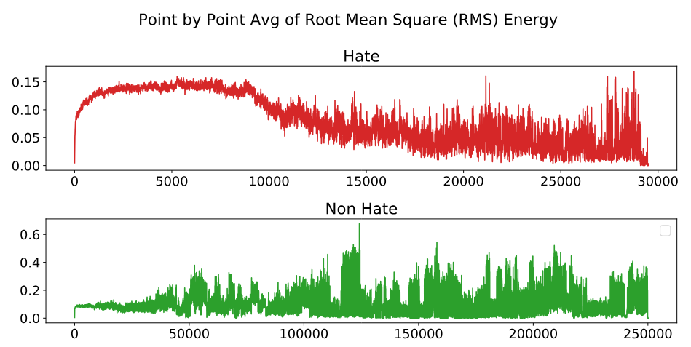
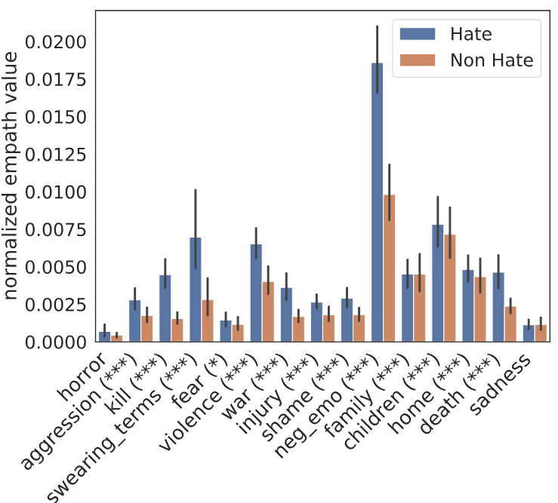
Dataset
Statistics:
1083 videos: 431 hate and 652 non-hate (2:3 ratio)
Audio: Analysis of average root mean square energy indicate instances of shouting which possibly manifests in the form of high loudness. (Figure1)
Transcript: obtained through Vosk, lexical analysis shown certain words more likely to appear in hate videos. (Figure2)
Video: Appearance of certain objects, such as religious persons, cartoonish mockery, and stereotypical depictions.
Figure1 Avg RMS Energy
Figure2 Lexical analysis of transcript
Notes:
text, audio and video have certain latent indicators that should be helpful in differentiating the hate from the nonhate class of videos. This observation, as we shall see, is corroborated by the superior performance of the joint model as observed in section

Slide 3
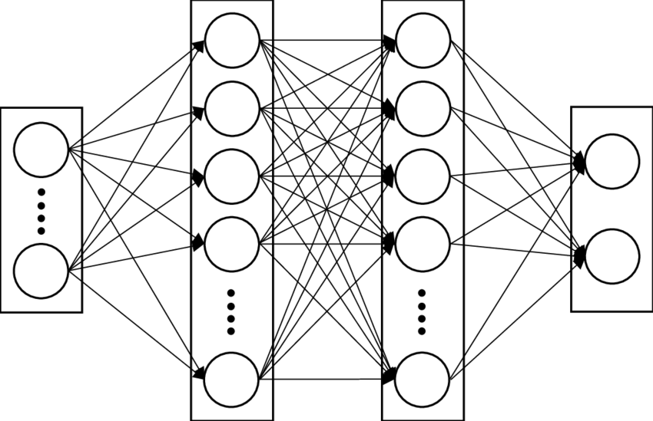
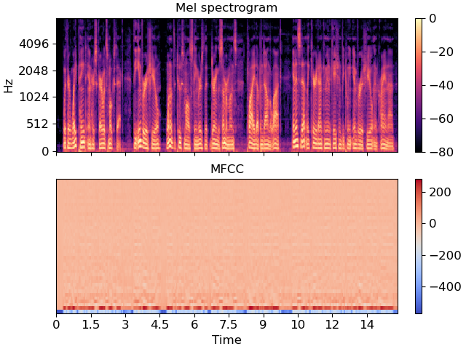
Audio
MFCC:
Robust features of audio.
40 dimensional vectors. (padded to keep uniformity)
Represent the short-term power spectrum of a sound.
Easy to obtain and trained on.
Saved in pickle files with names, features and labels.
Fully-connected layers:
Simple but works well with MFCC features
Fully-connected layers with ReLU
2 hidden layers
Notes:
Mel-Frequency Cepstral Coefficients as features from audio files. MFCCs represent the short-term power spectrum of a sound and are widely used in speech and audio processing tasks due to their effectiveness in capturing key aspects of the audio signal.
employs padding to ensure uniform duration across audio samples, mitigating distortions during feature extraction. Additionally, by computing the mean of MFCC coefficients, temporal information is condensed into representative feature vectors, enhancing robustness and facilitating subsequent analysis or machine learning model training.

Slide 4
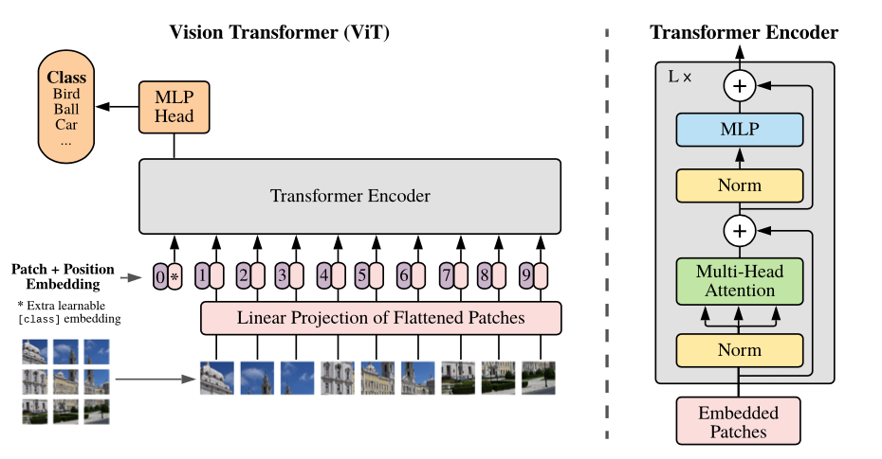
Video frames preprocessing
Frames extraction
100 frames extracted uniformly for all videos.
Feature extraction using pre-trained ViT(Vision Transformer)
Transformer-based architecture.
Self-attention mechanisms, allowing for interactions between image patches at different spatial locations.
Divides the input image into fixed-size patches and linearly embeds each patch into a sequence of tokens.
Notes:
uniformly extracts 100 frames from both long and short videos by sampling frames at regular intervals.
long videos, frames are evenly distributed throughout the entire duration,
short videos with white frames padding
take 100 frames for each video , divided into sequences of patches and pass it through
the pre-trained Vision Transformer(ViT) model to get a 768 dimensional feature vector for each
frame
ViT:
The Vision Transformer (ViT) divides an input image into fixed-size patches, then linearly embeds each one into a higher-dimensional space, adding positional embeddings to retain spatial information. These embedded patches are processed by a Transformer encoder, utilizing layers of multi-head self-attention and multilayer perceptrons for holistic analysis. Finally, the transformed patch representations are input into an MLP head that classifies the image. This architecture allows ViT to capture complex spatial hierarchies and relationships across different parts of the image.

Slide 5
ViT model + LSTM
Vit model deals with spatial features of images, but video contains sequence of images
To further capture the temporal interactions between the images, pass these feature vectors to LSTM model
Finally Apply a classifier header layer to obtain the prediction.
Frame feature vector
(768x100)
LSTM
FL
Notes:
ViT architecture, unimodal approach, performance tabel

Slide 6

Transcript preprocessing
Transcripts extraction
vosk, offline speech recognition toolkit.
save all transcripts including hate and non hate categories into a pickle file labeled with video names.
Basic statistics for words in text, measured in mean value, hate 253 words, non hate 227 words, total 237
words
string formatted text
(e.g. "five gyms we were in his case we was the real jews in the real egyptians man bang bang")
vosk model
Notes:
text preprocessing,vosk

Slide 7
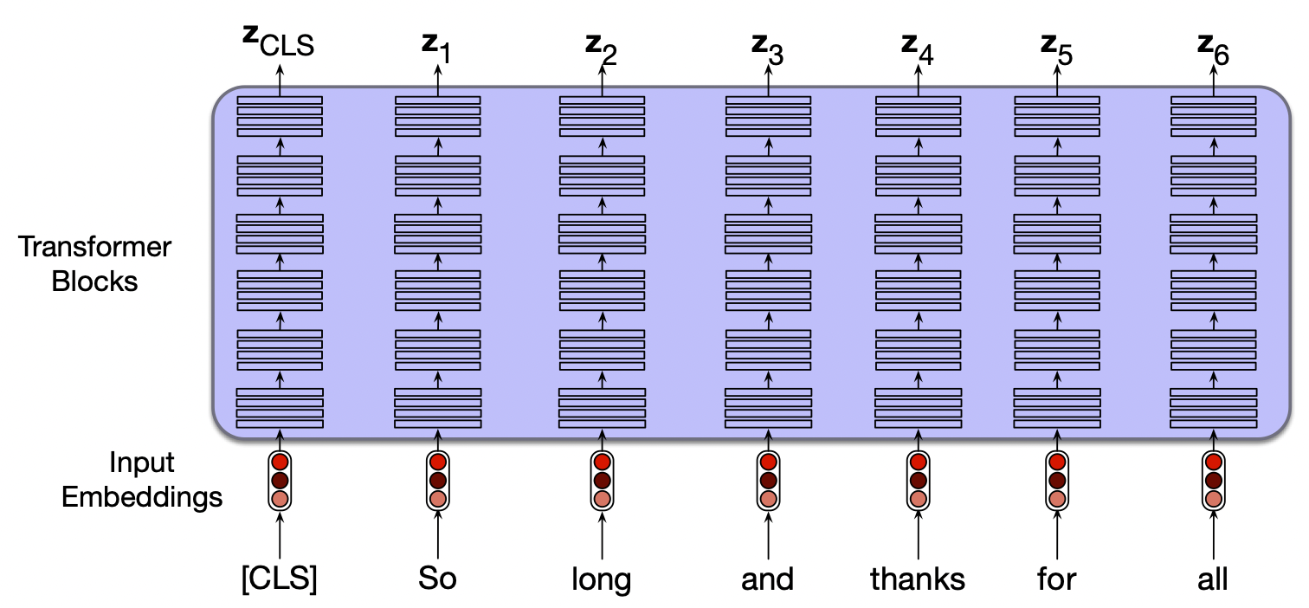
Transcript modeling
Transcripts tokenization & contextual embeddings extraction
Bert Tokenizer, built-in tokenizer for BERT model.
tokenizer takes text as input, transforms words or
tokens in the text with ids and attention masks
as the words length of transcripts vary, use max
length acceptable by the model, padding text with
short length and truncate text with exceeded part
Sum of token embeddings, segmentation embeddings and position embeddings are fed forwarded to the BertEncoder with 12 layers.
Use CLS token to represent the entire text and fed forwarded to classifier
Notes:
Bert model
need to attach some performance here??

Slide 8
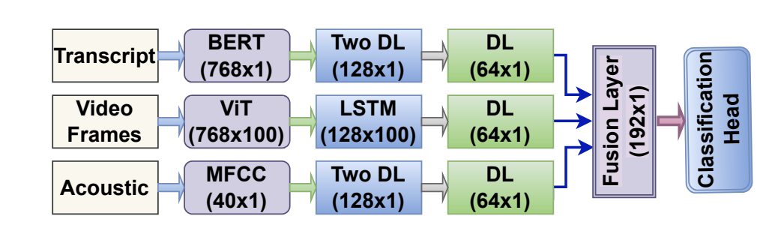
Multimodal approach
Models we tested:
Transcript + Frames
Transcript + Audio
Frames + Audio
Transcript + Frames + Audio
Notes:
fusion layer, performance tabel

Slide 9
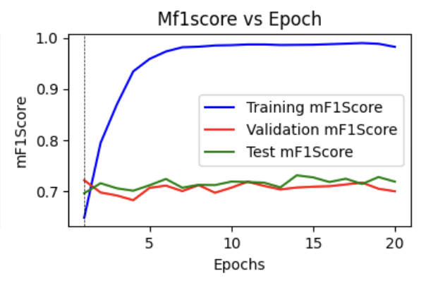
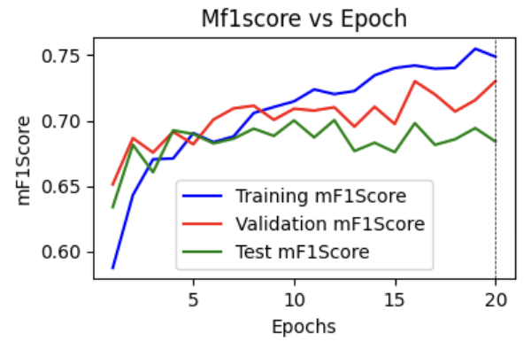
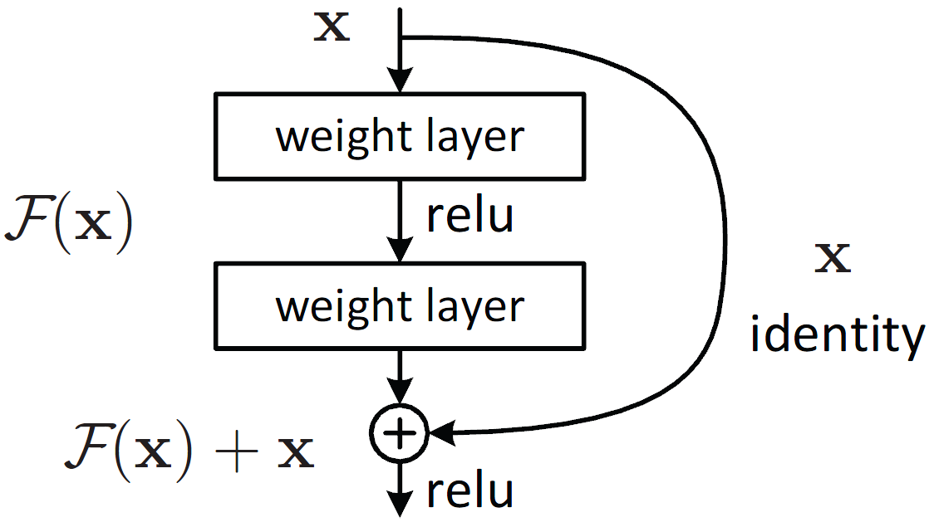
Improving performance
Best performing model achieved after first epoch:
batch normalization
Learning Rate Scheduler (ReduceLROnPlateau)
Xavier Initialization
For further improvement, we tried
Increase model complexity
Residual blocks with FCL
Notes:
hyperparameter tuning, optimization methods,

Slide 10
Initial Architecture
Architecture after increasing complexity:
ViT
(768 x 100)
LSTM (Multilayer, Bidirectional)
(256 x 100)
Attention
(256)
FCL
(64)
Fusion Layer
(64)
Input Vector
(X x 1)
Linear
128x1
Linear
128x1
FCL
(64)
Fusion Layer
(64)
+

Slide 11
Results(Accuracy, Macro-F1 Score)
Modality | Baseline | Reduce LR On Plateau | Xavier Initialization | Linear Complexity ↑ | Add Residual Blocks (?)
MFCC | 71.28% 70.04% | 70.82% 69.77% | 67.40% 66.27% | 71.09% 70.14%(2) | 71.38% 70.39%(3)
VIT | 70.91% 69.41% | 70.91% 69.41% | 74.95% 72.67% | 72.85% 71.03%(2) | 73.96% 72.45%(1)
BERT | 76.91% 75.48% | 76.91% 75.48% | 74.42% 73.13% | 71.46% 72.48%(3) | 74.24% 72.78%(1)
BERT+MFCC | 76.45% 75.49% | 78.48% 77.09% | 78.48% 77.02% | 77.47% 76.32%(3,2) | 78.12% 76.77%(1,1)
BERT+VIT+MFCC | 78.21% 76.39% | 79.22% 78.01% | 78.66% 77.49% | 77.65% 76.52%(3,2,2,) | 79.78% 78.56%(1,1)

Slide 12
Questions?
Notes:
reference,

Slide 13
References
HateMM: A Multi-Modal Dataset for Hate Video Classification
https://alphacephei.com/vosk/

