Slide 1
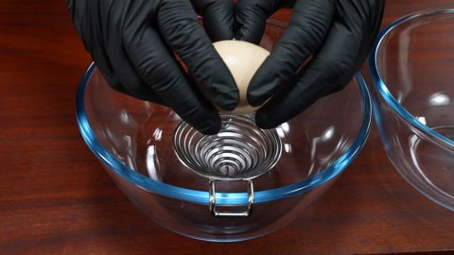
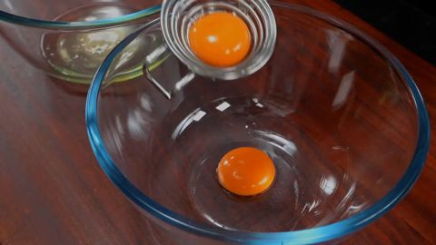
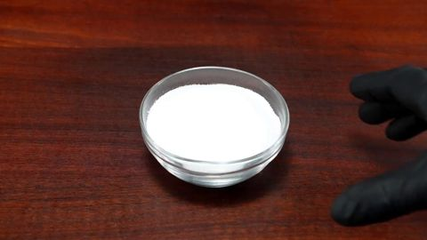
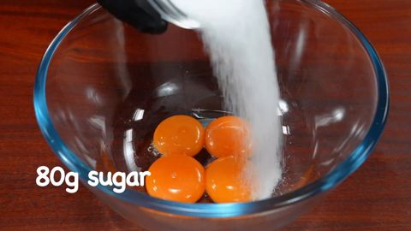
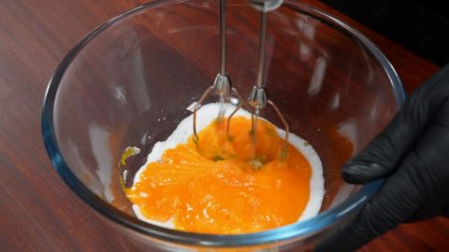
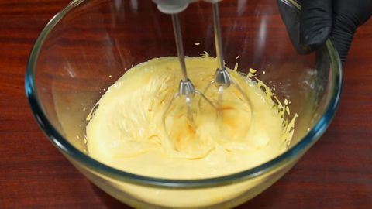
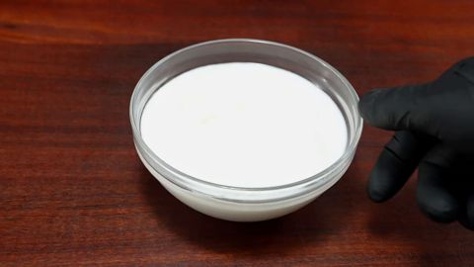
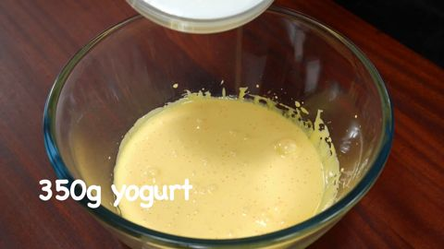
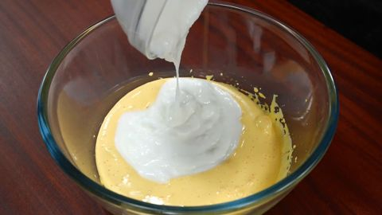
① Pre-study
② Recording
③ Aggregation
④ Answering
processed
observing
not yet
{ }
?
?
?
Question
+ options
Task definitions
of the dataset
chunk 1
chunk 2
chunk t
…
Aggregation
rule-based code
time
Prompt
event rules
Stage A
merge repeats
+ study notes
Pre-study Agent
Claude
Recording Agent
Qwen3-VL-4B
Stage B
person IDs
Answer Agent
Qwen3-VL-4B, text only
Study notes
Questions point to a scene
by how it looks
event log
one line per event: [time] who does what
memory
A
time
P01
time
P02
time
answer
P01
time

