Slide 1


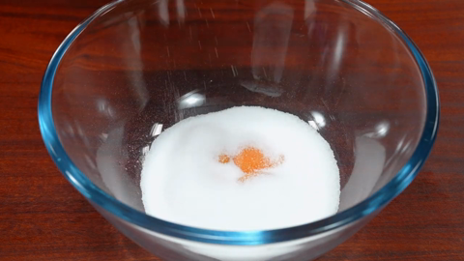
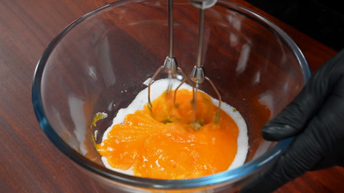
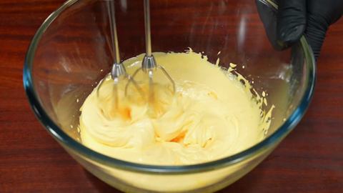
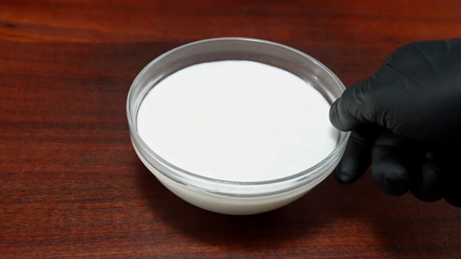
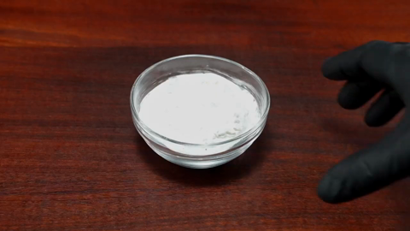
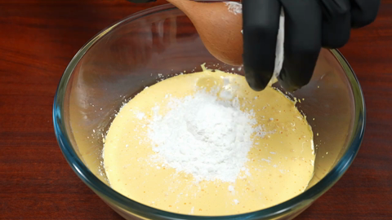
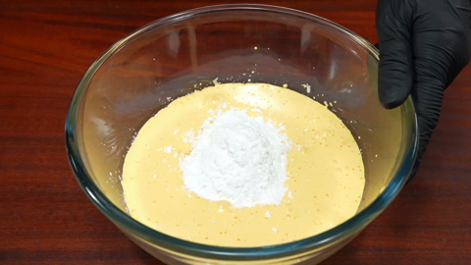
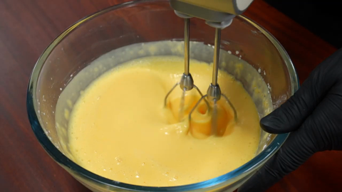
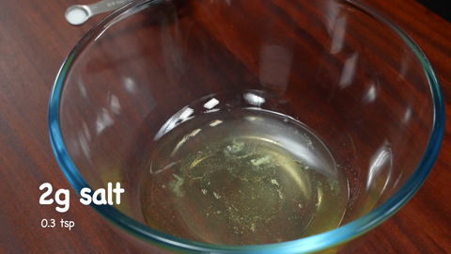






① Pre-study offline
② Recording streaming
③ Aggregation
④ Answering
streaming video
…
chunk 1
chunk 2
chunk t
time
question
arrives later
Dataset
training questions
prompt
Pre-study Agent
LLM
+ study notes
Recording Agent
VLM (Qwen3-VL-4B)
Aggregation
merge & link events
Answering
VLM (Qwen3-VL-4B)
study notes
event_log.md
divide & conquer
Questions will ask:
• what a person does
• objects, color, shape
• what happens before / after
• where it appears again
[00:20-00:28] EVENT: person in black gloves
whisks egg yolks in a bowl
[00:28-00:33] EVENT: person in black gloves
pours sugar into the bowl
...
memory
merged events
person IDs
multi-scale
answer (B)
dashed = planned (not implemented yet)

