Slide 1
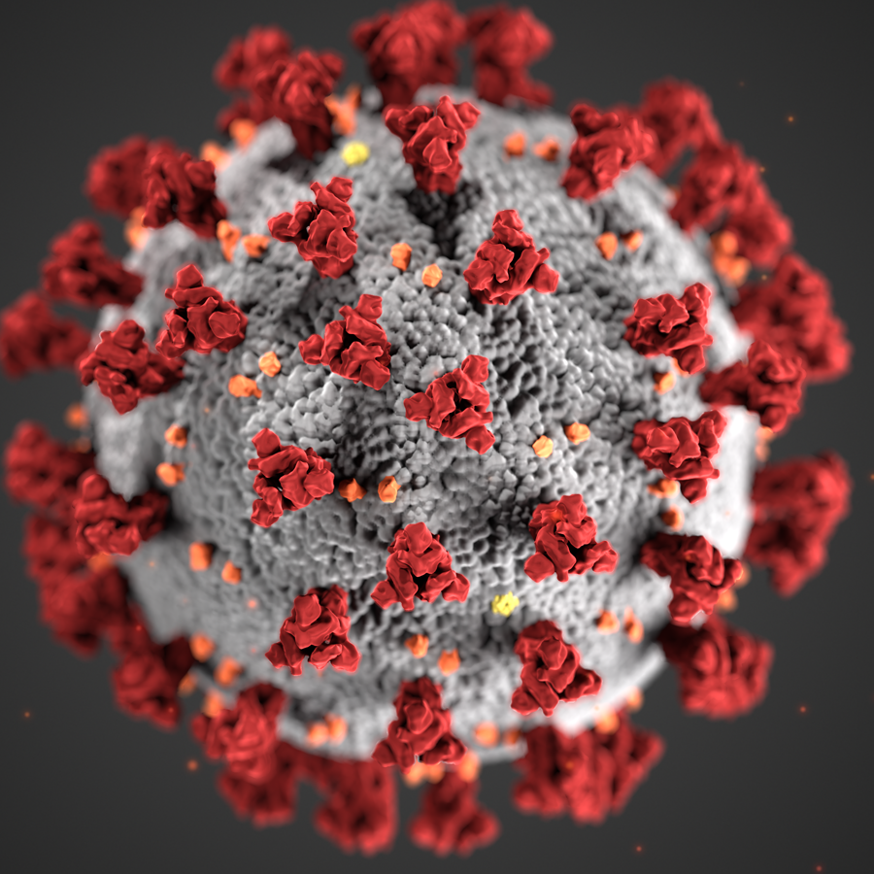
CPSC 483-02 Project Covid-19 Prediction using Machine Learning
Done by,
Merin Joseph
Tianhao Shen
Ruiling Wang

Slide 2
Introduction
Covid-19 has caused havoc all over the globe since December, 2019.
It has affected people’s lives, caused millions of deaths, severe health conditions for many people, economy crisis, and so on.
The common symptoms include fever, shortness of breath, lack of taste and/or smell, fatigue, or even no symptoms at all.

Slide 3
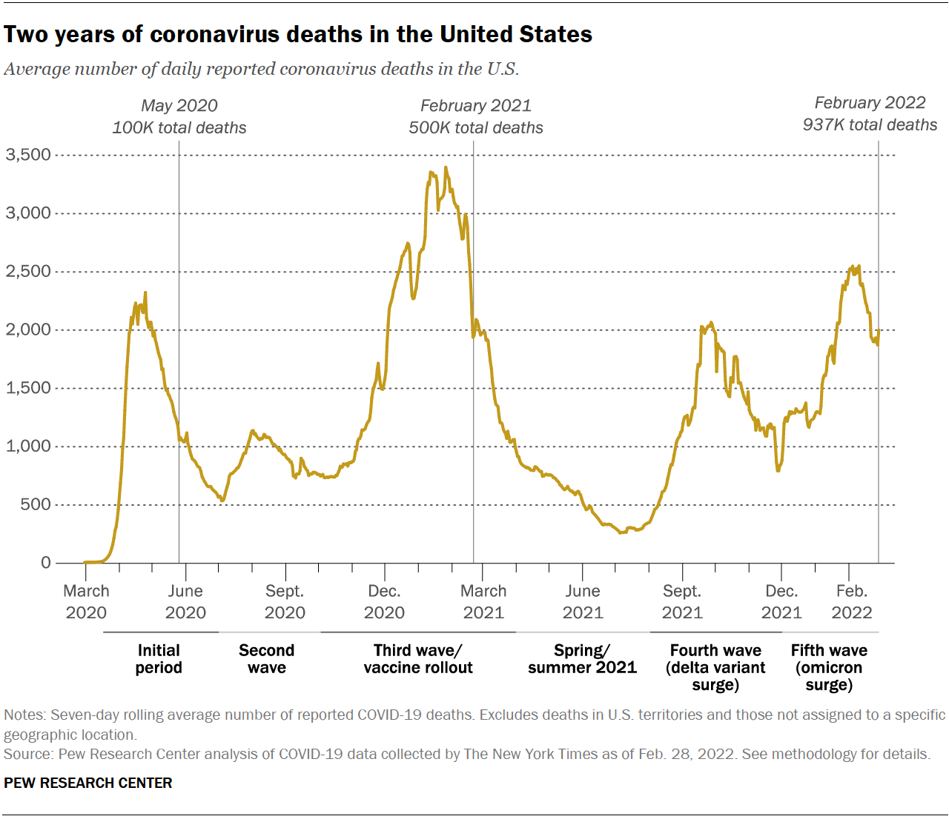
Covid-19 Statistics since 2019 in the USA

Slide 4
Our Solution
Class | Group A | Group B
Class 1 | 82 | 95
Class 2 | 76 | 88
Class 3 | 84 | 90

Slide 5
Steps involved in developing the model
Step 1
Task Description
Task Description
Step 2
Task Description
Task Description
Step 3
Task Description
Task Description

