Slide 1
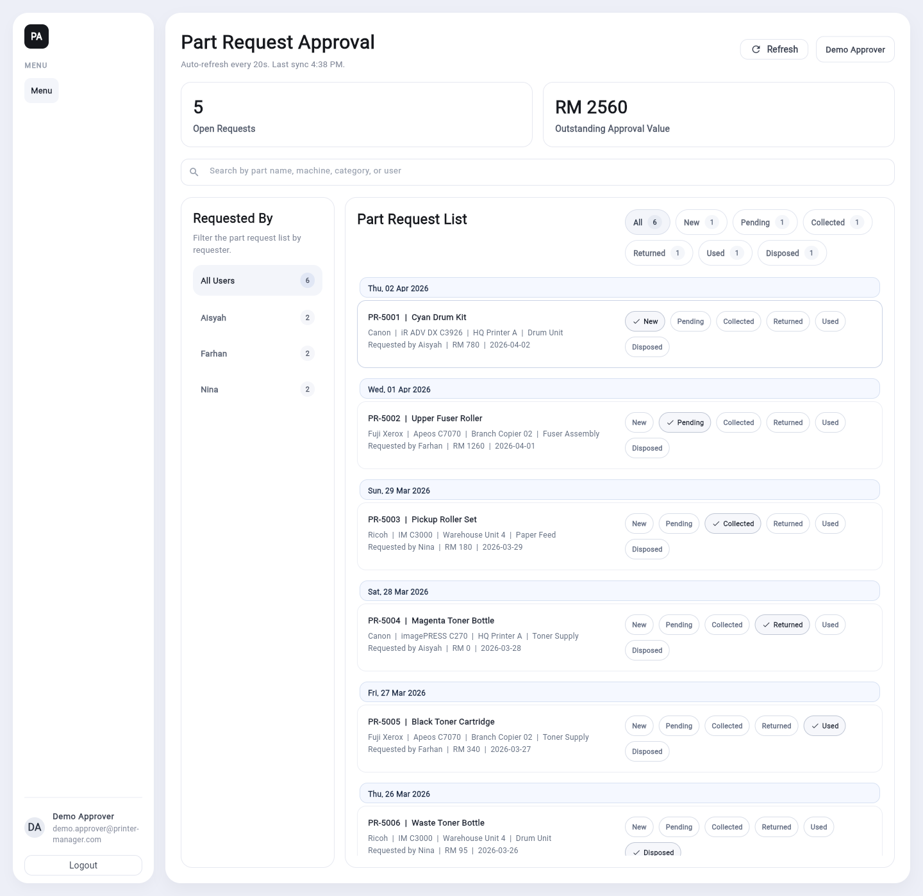
Part Approval Request User Guide
This presentation summarizes the real Flutter user workflow using browser-captured screenshots from the built application running in demo mode.
Screens included: login, dashboard overview, live search, approval detail, and status confirmation.

Slide 2
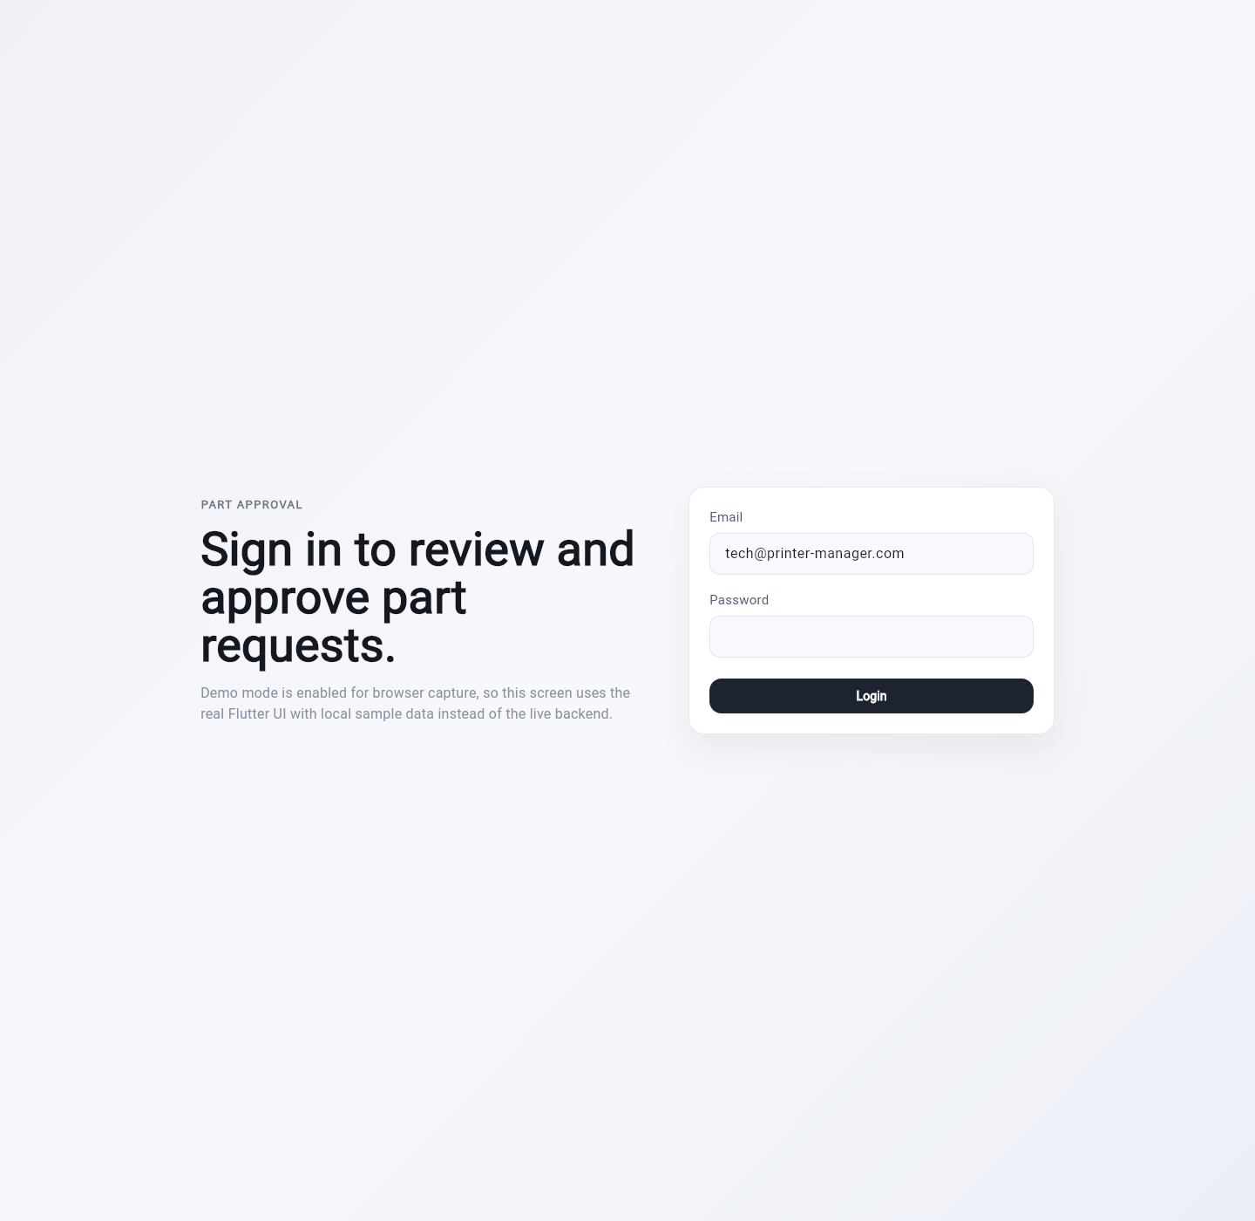
Sign In To The Real Flutter App
Step-by-step reference for daily use
Open the Part Approval web app built from the real Flutter code.
Enter the password and click Login.
After sign-in, the dashboard loads the request list automatically.

Slide 3
Review The Dashboard Overview
Step-by-step reference for daily use
Use the summary cards to monitor open requests and total approval value.
Review the Requested By panel on the left to understand who submitted requests.
Use the Part Request List on the right to review status chips for each request.

Slide 4
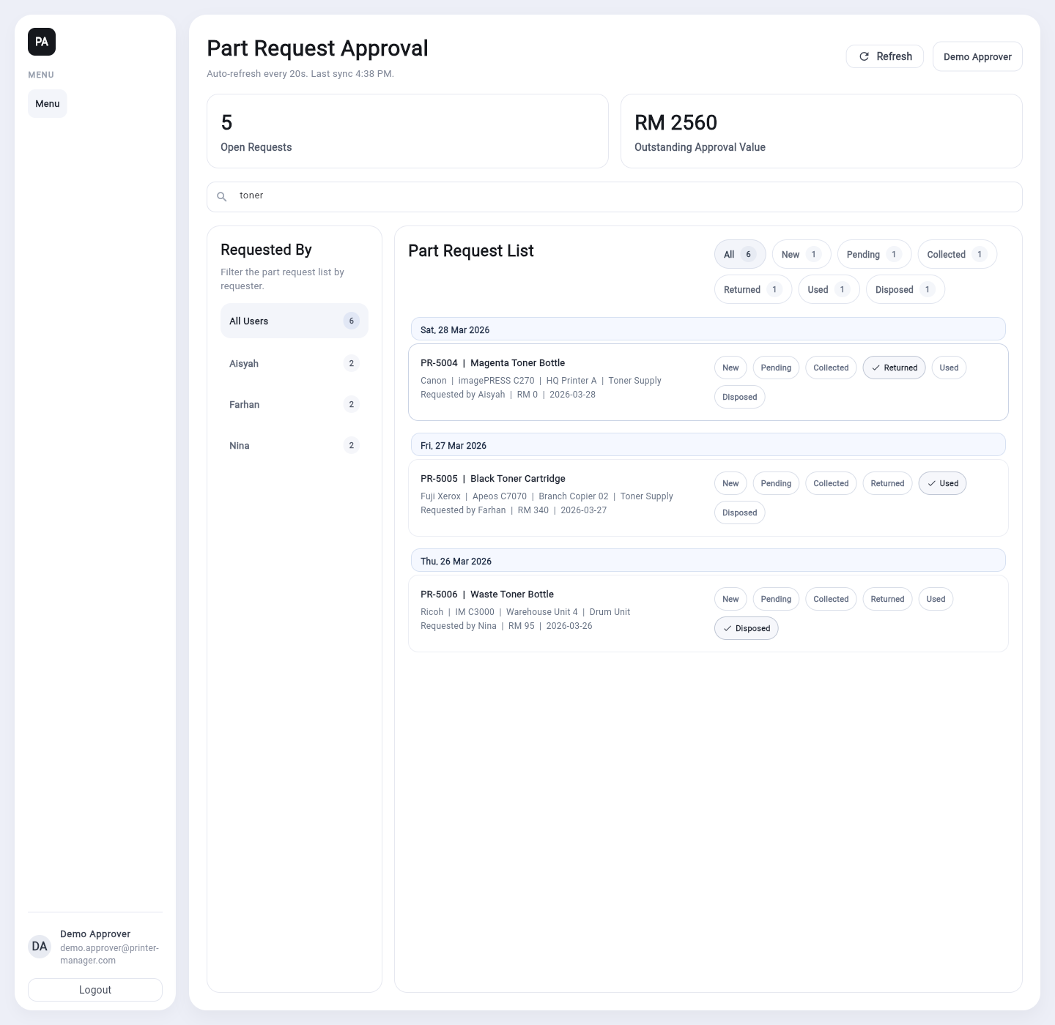
Search The Request List
Step-by-step reference for daily use
Use the search bar to find requests by part name, machine, category, or requester.
As you type, the list filters immediately without leaving the page.
Use this search flow to narrow the queue before reviewing or approving a request.

Slide 5
Open Approval Detail
Step-by-step reference for daily use
Select a request in the list to open the Approval Detail dialog.
Review the request info, description, and remark before making a status change.
Close the dialog to return to the list after your review is complete.

Slide 6
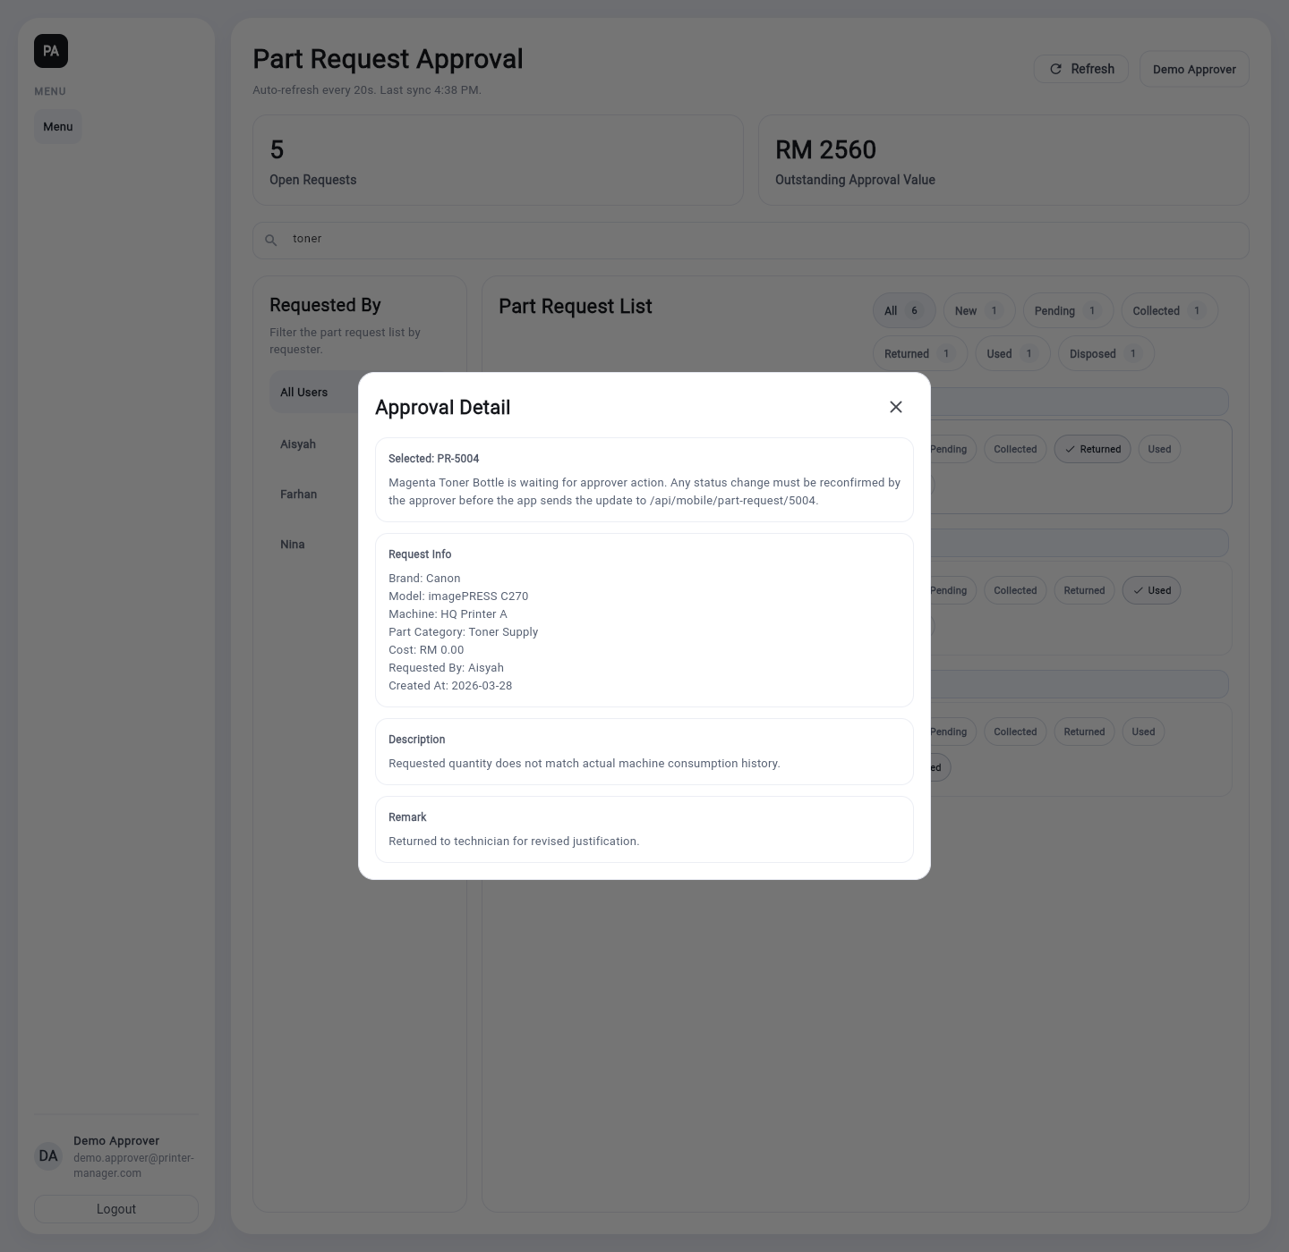
Confirm A Status Change
Step-by-step reference for daily use
Use the status chips inside a request row to choose the next approval stage.
When prompted, review the confirmation dialog carefully before proceeding.
Click Confirm to apply the update, or Cancel to keep the current status unchanged.

