Slide 1
What Drives a Warming Climate?
Exploring the Physical Mechanisms Behind Regional Climate Change
EART60702 Earth and Environmental Data Science
Group 4
Members： Ruiqi Huang， Kedi Li， Yuhui Duan

Slide 2
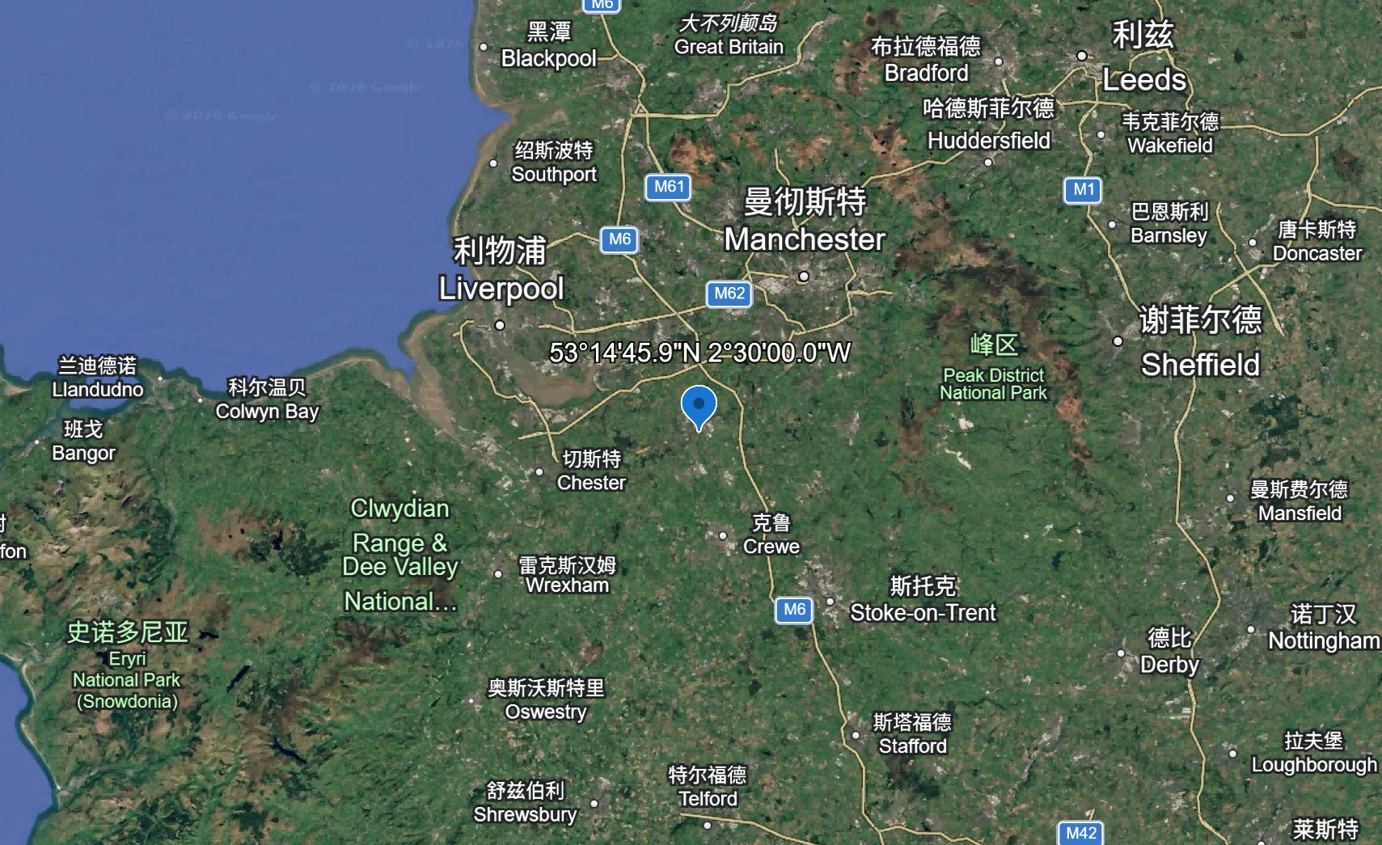
Study Area & Research Question
The coordinate of study area is 53.246° N, 2.5° W, which are located in Cheshire, UK, in northwest England , near Manchester and Liverpool..
The region has a typical temperate maritime climate.
The climate is mild and humid year-round (Minobe, Kuwano-Yoshida et al. 2008, Palter 2015).
However, the frequence of extreme weathers events are increasing in europe (Weilnhammer, Schmid et al. 2021)
How does the weather change with time,
and their potential controlling factors?

Slide 3
Trend Analysis——Temperature Trend & Seasonal Distribution
Temperature Trend Line Plot
Key findings:
The data shows a significant upward trend in linear regression.
• Mean annual temperature: 10–13.5°C
• Strong upward trend (R ≈ 0.92)
• Approx. 0.4°C per decade
Physical significance:
• The region is experiencing long-term climate warming
• Showing the potential influence of greenhouse effect (Manabe 2019).
Clear regional warming signal.

Slide 4
Trend Analysis——Temperature Trend & Seasonal Distribution
Heatmap of Monthly Mean Temperature
Key findings:
• In the mid-to-late 21st century, “deep red spots” (extreme high temperatures) frequently appear in summer.
• The frequency and intensity increase over time
Physical significance:
• Non-uniform global warming
• Regional seasonal climate structures may potentially being reshaped (Qin, Xie et al. 2024).

Slide 5
Trend Analysis——Precipitation Trend & Seasonal Distribution
Precipitation Trend Line Plot
Key findings:
The line shows sharp, jagged fluctuations, lacking a smooth, monotonous trend.
Physical significance:
This illustrates that precipitation systems exhibit extremely high interannual variability and inherent uncertainty.

Slide 6
Trend Analysis——Precipitation Trend & Seasonal Distribution
Heatmap of Monthly Total Precipitation
Key findings:
Clearly outlines the local precipitation pattern of "more rain in autumn and winter, and relatively less rain in spring and summer".
Physical significance:
As shown in the heatmap, the combination of "extreme high temperatures in summer" and "relatively low precipitation" will significantly increase the risk of seasonal drought in the region.

Slide 7
Trend Analysis——Surface Net Shortwave Radiation Trend (FSNS)
Radiation Trend Line Plot
Key findings:
Tracked the changing trajectory of solar energy as it penetrates the atmosphere to reach the Earth's surface.
Physical significance:
Fluctuations in radiation are directly affected by local cloud cover and atmospheric transparency, serving as the direct "fuel" and energy source driving abnormal fluctuations in surface temperature.

Slide 8
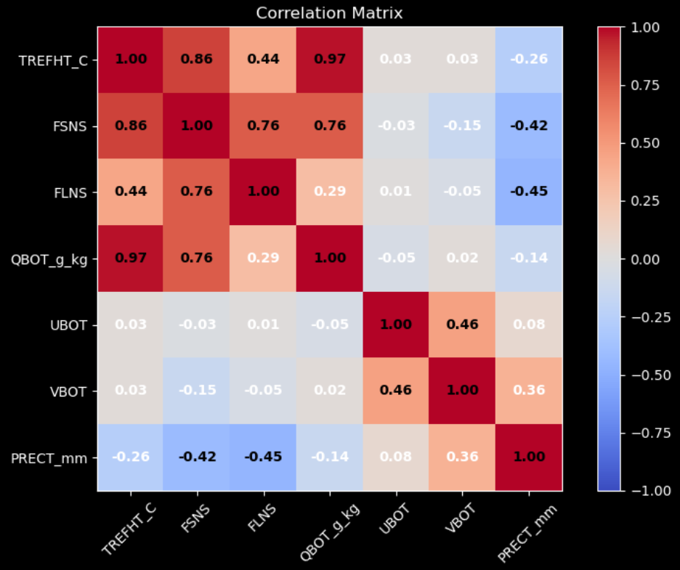
Correlation Analysis——Correlation Matrix
Correlation Matrix
Key findings:
Surface temperature (TREFHT) shows a strong positive correlation with shortwave radiation (FSNS) and bottom specific moisture (QBOT) (deep red block).

Slide 9
Relationship Analysis——Temperature–Radiation Relationship
Scatter Regression Plot of Temperature vs. Radiation
Key findings:
Net shortwave radiation reaching the Earth's surface shows a clear positive linear fit with surface temperature.
Less cloud → More sunshine → Ground warms up
The chart reveals the first physical driver of global warming: radiative forcing.

Slide 10
Relationship Analysis——Temperature–QBOT Relationship
Scatter Regression Plot of Temperature vs. Specific Humidity (QBOT)
Key finding:
The actual water content (specific humidity) of the atmosphere shows a very close, synchronous increase with rising temperature.
Warming → increased water vapor → stronger warming.

Slide 11
Conclusions and Key Findings
A
Evolution of the phenomenon: Warming and hydrological extremes
Summer mean temperatures show a significant upward trend, while precipitation does not exhibit a statistically significant long-term change but displays notable interannual variability.
B
Core Driver: Radiative Forcing
Enhanced net downward shortwave surface flux, largely controlled by atmospheric (cloud) variations, contributes to regional anomalous warming.(Loeb, Wang et al. 2019).
C
Mechanism Scale-Up: Thermodynamic Feedback
This illustrates the Clausius-Clapeyron effect: rising temperatures force the atmosphere to absorb more water vapor, which in turn locks in more heat (Pall, Allen et al. 2007, O’Gorman and Muller 2010).
D
Final Conclusion: The New Normal of Climate Change
Driven by rigorous thermodynamics, the region is irreversibly moving toward a high-energy climate state characterized by warmer, wetter, and more extreme fluctuations.

Slide 12
References
Loeb, N. G., et al. (2019). "Decomposing shortwave top-of-atmosphere and surface radiative flux variations in terms of surface and atmospheric contributions." Journal of Climate 32(16): 5003-5019.
Manabe, S. (2019). "Role of greenhouse gas in climate change." Tellus A: Dynamic Meteorology and Oceanography 71(1): 1620078.
Minobe, S., et al. (2008). "Influence of the Gulf Stream on the troposphere." Nature 452(7184): 206-209.
O’Gorman, P. A. and C. J. Muller (2010). "How closely do changes in surface and column water vapor follow Clausius–Clapeyron scaling in climate change simulations?" Environmental Research Letters 5(2): 025207.
Pall, P., et al. (2007). "Testing the Clausius–Clapeyron constraint on changes in extreme precipitation under CO2 warming." Climate Dynamics 28(4): 351-363.
Palter, J. B. (2015). "The role of the Gulf Stream in European climate." Annual review of marine science 7(1): 113-137.
Qin, P., et al. (2024). "Characteristics of population exposure to climate extremes from regional to global 1.5° C and 2.0° C warming in CMIP6 models." Environmental Research Letters 19(1): 014018.
Weilnhammer, V., et al. (2021). "Extreme weather events in europe and their health consequences–A systematic review." International Journal of Hygiene and Environmental Health 233: 113688.

Slide 13
Team Task Distribution Table
Group members | Student ID | Main responsibilities
Ruiqi Huang | 14180111 | Drawing annual trend charts and scatter plots, integrating code, writing README, and creating PPT presentations.
Kedi Li | 14200199 | Creating monthly average trend charts (Heatmap) and creating a PowerPoint presentation.
Yuhui Duan | 14219275 | Drawing a correlation matrix and creating a PowerPoint presentation.

