Slide 1



Tensorflow Introduction
郑瑞麒11712501
朱俊达11712504

Slide 2



1. Introduction
The core purpose of tensorflow is to unify various forms of machine learning on top of the single flexible platform.
Tensorflow applications: Google RankBrain, Smart Reply

Slide 3
2. Motivation
What we have:
Well designed machine learning models
Large datasets
What we need:
large-scale training
Taking models into production
Machine learning research
System
Disbelief

Slide 4
3. Limitation of Disbelief
Layers:
Layers in Disbelief are written as C++ classes, which is not friendly when user want to create new layer.
Optimization Techniques:
optimization methods outside of stochastic gradient descent(SGD) is not easy and might not work well
Batch gradient descent Adaptive Moment Estimation (Adam)
NN structures:
Fixed execution pattern
Generative Adversarial Network(GAN) GraphGAN Dropout

Slide 5
4. Core design principles
Tensors (values of the node1 output and node2 input)
4.1 Dataflow graphs of primitive operators
TensorFlow model represents individual mathematical operators as nodes in the dataflow graph.
Node 1
Node 2
4.2 Deferred execution
Two phases:
defines the program as a symbolic dataflow graph
executes an optimized version of the program on the set of available devices.
local computation
Also called Operations
A = B + C
X = X + A
Y = Y + 1
Y = Y + 1 A = B + C
X = X + A
without waiting for intermediate results

Slide 6
4. Core design principles
4.3 heterogeneous diides
Node 1
Node 2
the same program can easily target GPUs, mobile CPUs, or
Tensor Processing Unit (TPUs)
vertices may have mutable state
4.4 parallelization
vertices may have mutable state that can be shared between different executions of the graph
Model supports multiple concurrent executions on overlapping subgraphs of the overall graph
B + X * X
A + X * X
A
X * X
B

Slide 7
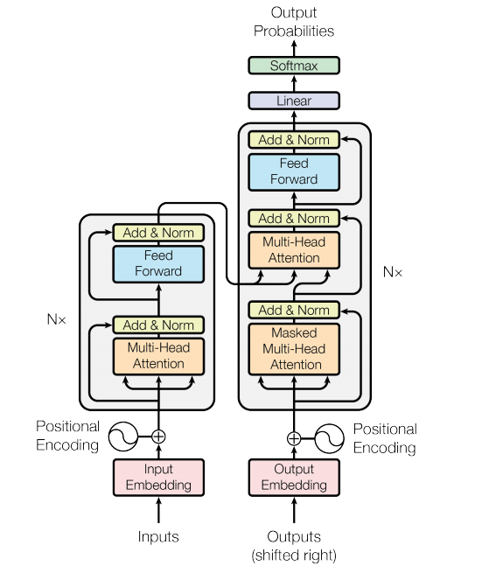
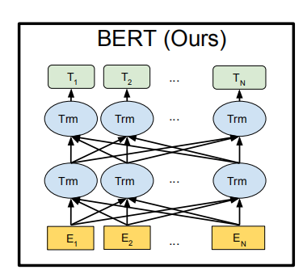
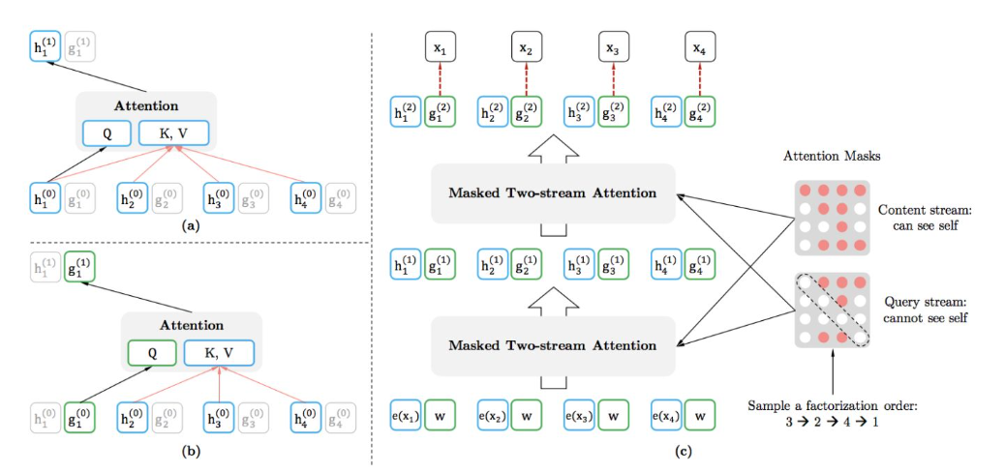
5. Application of tensorflow -- NLP
2016-2017
transformer
2018
BERT
2019
XLNet
Picture from :
[1] Attention Is All You Need
[2] BERT: Pre-training of Deep Bidirectional Transformers for Language Understanding
[3] XLNet: Generalized Auto regressive Pretraining fo rLanguage Understanding https://arxiv.org/pdf/1906.08237.pdf

Slide 8
5. Application of tensorflow -- Enterprises
in terms of marketing, Coca-Cola uses TensorFlow as a marketing tool in its customer loyalty program. Coca-Cola printed a 14-bit code on the back of bottle caps and created a machine learning system that uses TensorFlow to easily identify Numbers (often hard to see) to create proof of purchase
In terms of telecom services, China telecom business office APP builds a neural network to learn to recognize telecom recharge cards. Finally, it can be easily recognized in the case of backlight, jitter and severe digital occlusion. The success rate of model training is 99.3%, and it takes 0.05 seconds to complete the recognition.

Slide 9
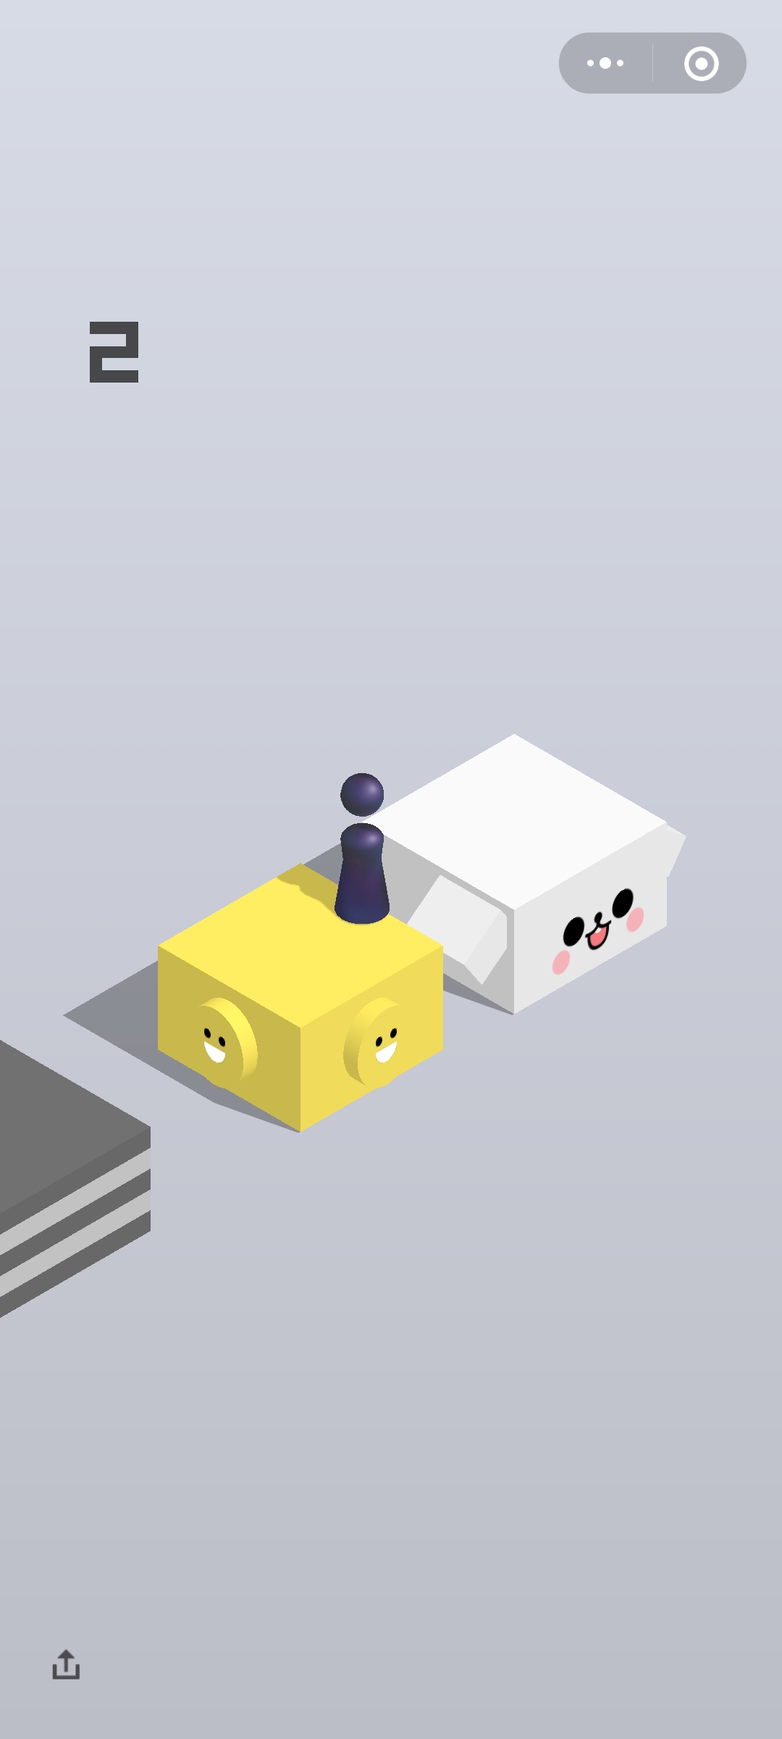
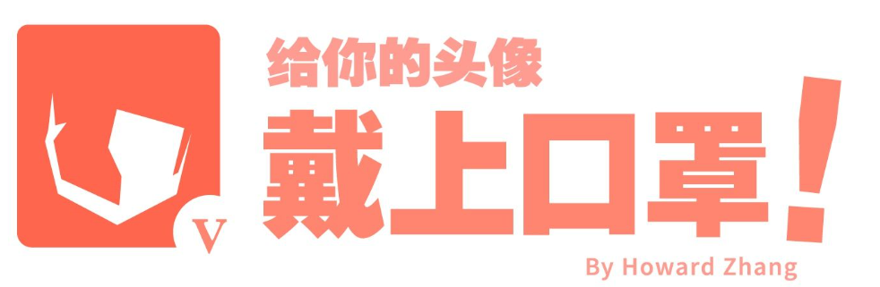
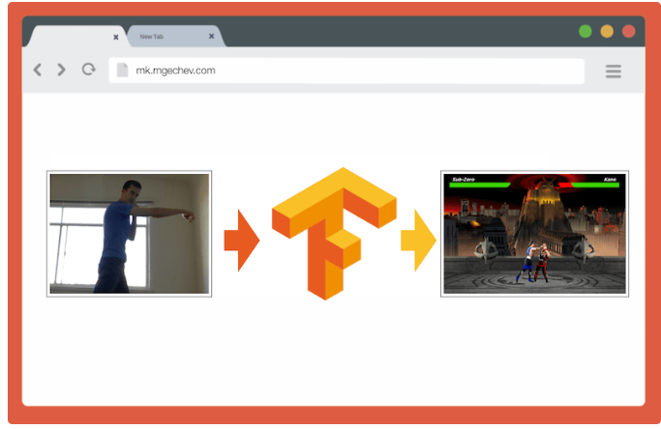
5. Application of tensorflow -- individuals
Without keyboard,all you need to play Mortal Kombat on your laptop is a front-facing camera.[5]
An implementation of TensorFlow that automatically plays WeChat hop on Android phones[6]
Wear a Mask, A very interesting app that masks your avatar. [4]
[4]https://github.com/zamhown/wear-a-mask
[5] https://github.com/mgechev/movement.js
[6]https://github.com/zhanyongsheng/LetsJum

Slide 10

6. Pros and cons
Image processing
Paddle
(Baidu)
Caffe
(UC Berkeley)
Caffe2
CNTK
(Microsoft)
Torch
(NYU/ Facebook)
PyTorch
(Facebook)
MXNet
(Amazon)
Theano
TensorFlow
(Google)

Slide 11
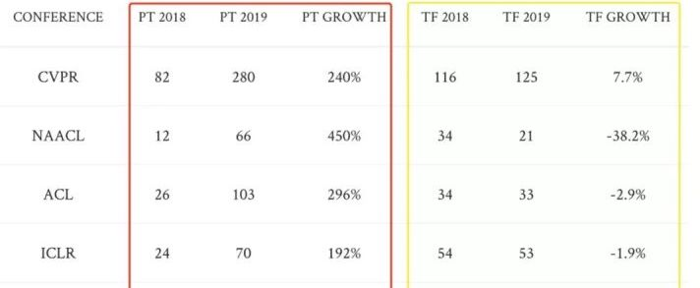
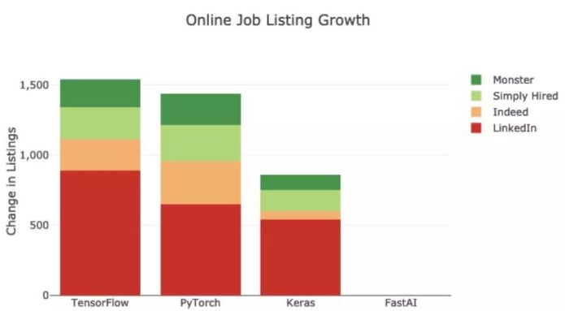
6. Pros and cons
PyTorch
(Facebook)
TensorFlow
(Google)
NAACL and ACL are the top conferences for natural language processing
Industry world: 1. python environment leads to huge consumption on servers
2. Mobility: python interpreter cannot be embedded in mobile binary files
3. Service: update without shutting down
4. deployment

Slide 12
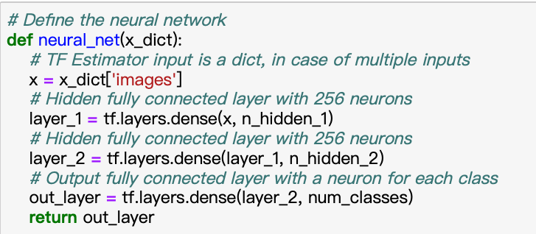
6. Pros and cons
output
input
Hidden layer1
Hidden layer2

Slide 13
Q & A

