Slide 1
Presentation
Group E
Members:
Shubhparteek Singh
Lingjun Wan
Ruiqing Zhu

Slide 2
Project: JAC Food Bank
User story: As a user, I’d like to be able to place the order online and have the option to either pick up the order or have it delivered to me.
Solution: Create a website with online shopping capabilities for John Abbott College Food Bank.

Slide 3
Requirement
Create the website using HTML, CSS, and Javascript.
Have a home page with introduction to the web site.
Have a registration page with validation of user entered data.
Have a sign in page with validation of user entered data.
Once signed it, users should be presented with an option to shop online.
Have a Contact us page.
Have a News and Events page.

Slide 4
Design
Homepage: Main landing page with menus linked to different sections of the website. Add social media links to the page.
Different CSS selectors will be used to finalize the look and feel of the project.
Registration page: Validate the following:
— username, first name, last name, email address, and password
Sign-in page: Validate exact match of username, password, and non-empty check.

Slide 5
Design
Shop page: List items with a text box to enter quantity, and have a “Place Order” button. Once the user selects an item, it’s updated in the cart, and a check is placed to avoid adding the same item twice.
Contact us page: Create a form for users to enter their information and submit. Implement non-empty check.
News and Events: Make some collapsible items
Special attention: Make sure everything is linked to the proper page. When user is logged in, it should not log the user out unless the user wants to.

Slide 6
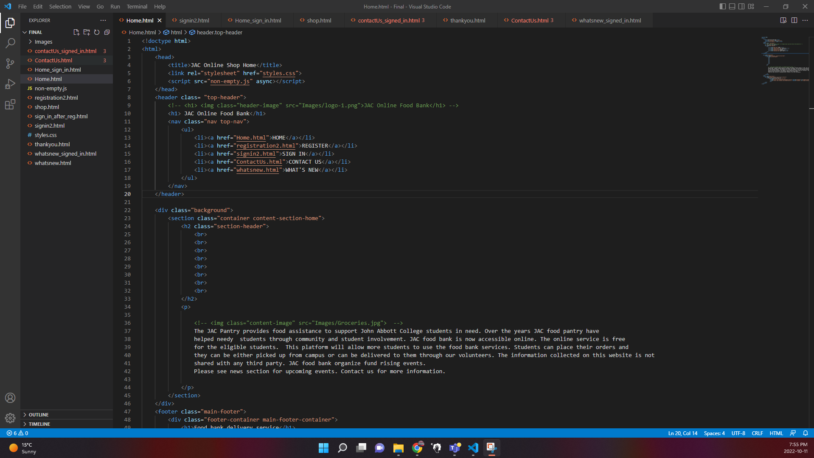
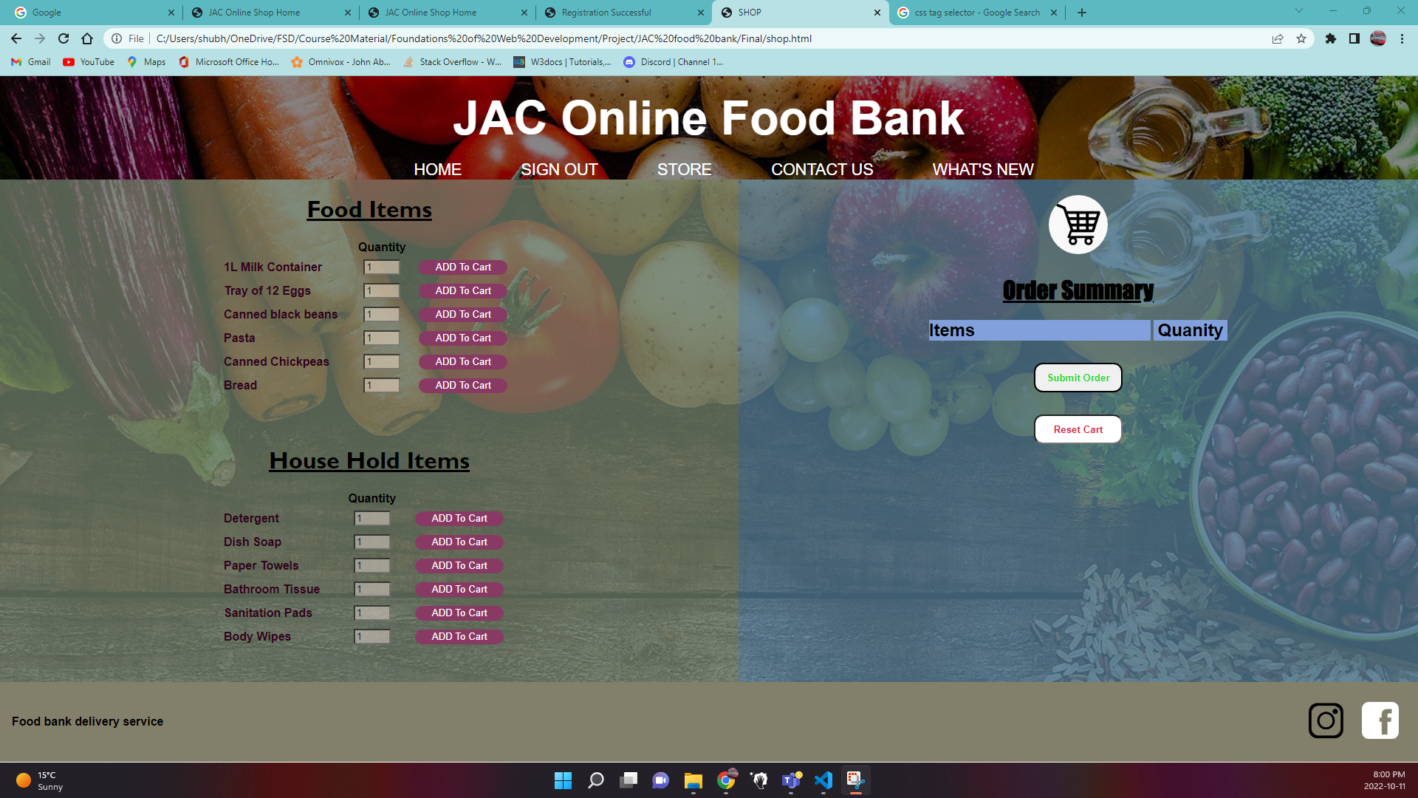
Sneak Peak

Slide 7
Future Scope
Due to the time constraint, some of the design idea couldn’t be implemented at this time but will be considered as the iteration goes:
Shopping cart could be more responsive (auto update quantities, etc.).
Forms could be implemented to save and check user login information as currently all the information/data is processed hard-coded.

Slide 8
Demo
JAC Food Bank

