Slide 1
From ImageNet to EuroSAT
Transfer Learning, When Transfer Helps, and Catastrophic Forgetting
Ruiquan Qiao Tiancheng Xia Guangde Shi
COMP6242 Deep Learning Group Project
Semester 1, 2026
From ImageNet to EuroSAT
Semester 1, 2026

Slide 2
Video Focus
5-minute project video with contributions from all group members. Explain the problem, method, and findings clearly.
Use visuals to support one coherent narrative rather than every detail.
From ImageNet to EuroSAT
Semester 1, 2026

Slide 3
Project Goal
Main task: adapt an ImageNet-pretrained ResNet-18 to classify EuroSAT remote sensing scenes.
Main question: does transfer learning help more than training from scratch? Supporting question 1: when does transfer help most?
Supporting question 2: how much ImageNet capability is forgotten after adaptation?
From ImageNet to EuroSAT
Semester 1, 2026

Slide 4
Experimental Setup
Backbone: ResNet-18 with official ImageNet-1K pretrained weights.
Main dataset: EuroSAT with 18,900 train / 4,050 val / 4,050 test images. Strategies: scratch, linear probe, partial ft, full ft.
Shared setting: 8 epochs, batch size 32, AdamW, learning rate 3 × 10⁻⁴. Extra analyses:
Same-size cross-domain: EuroSAT vs CIFAR-10
Same-domain data-size: EuroSAT 10%, 30%, 60%, 100%
From ImageNet to EuroSAT
Semester 1, 2026

Slide 5
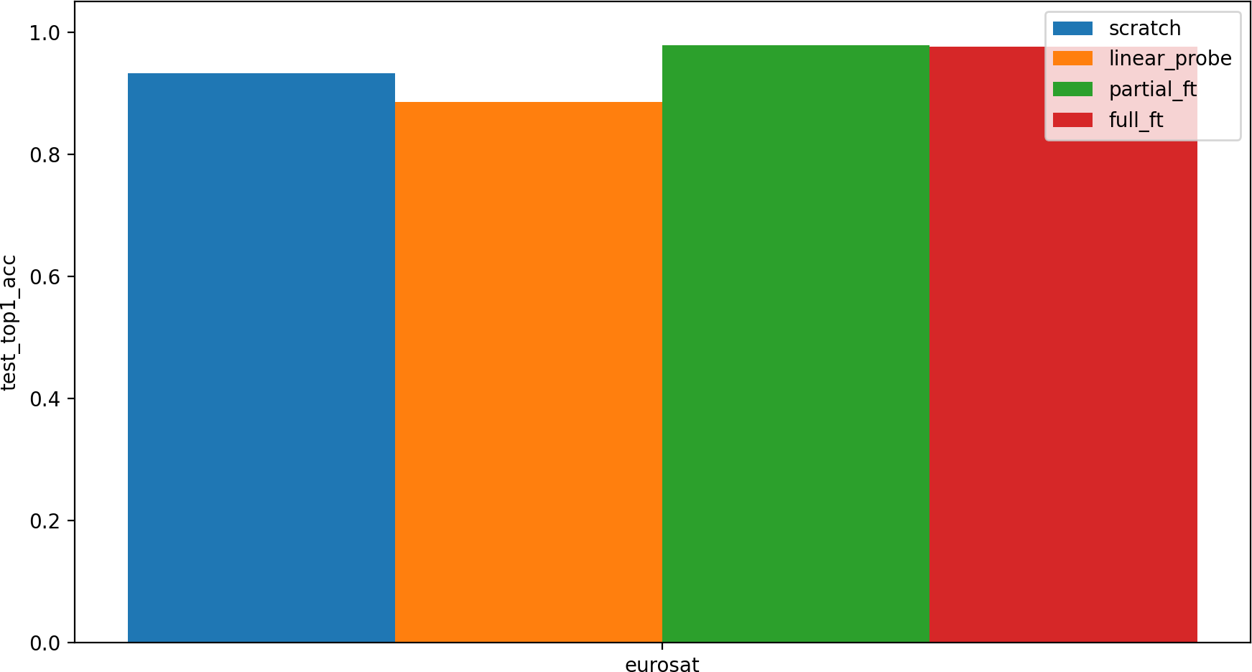
Main Result on EuroSAT
Strategy
Top-1
Macro-F1
scratch linear probe partial ft full ft
93.21
88.54
97.78
97.56
93.04
88.33
97.71
97.50
Transfer helps only when the backbone is allowed to adapt.
partial ft gives the best EuroSAT performance.
From ImageNet to EuroSAT
Semester 1, 2026

Slide 6
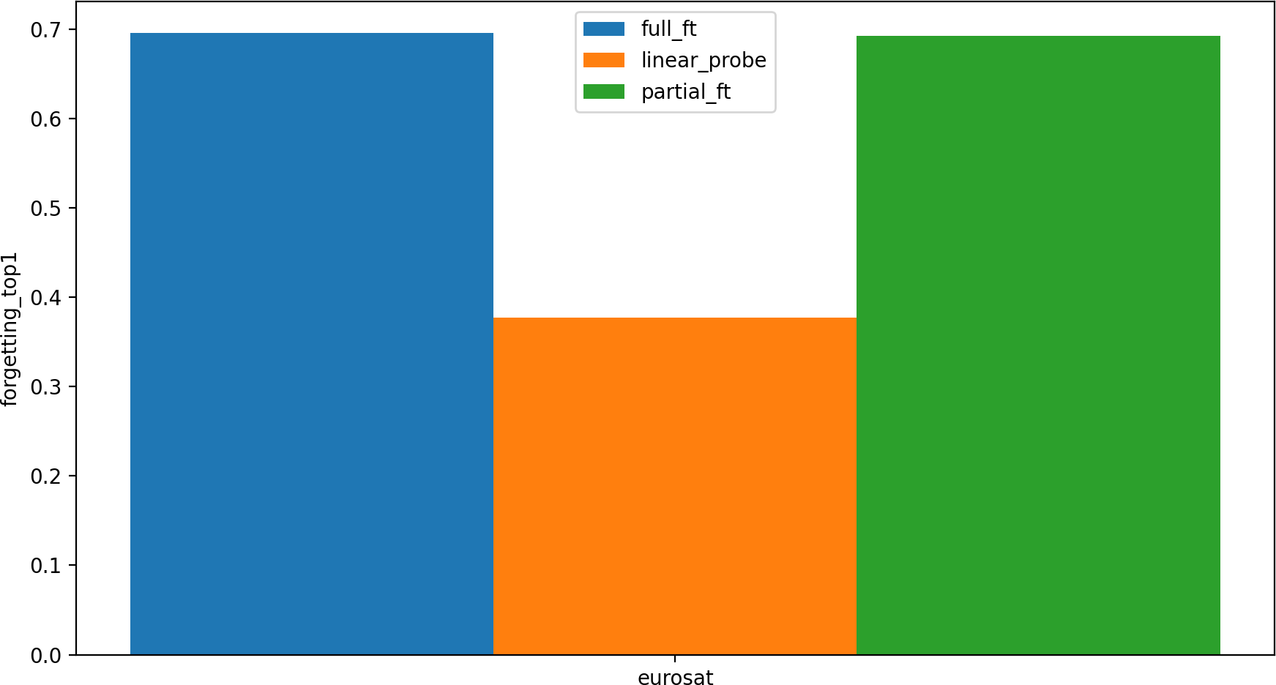
Forgetting on ImageNet
Strategy
Forgetting
EuroSAT Top-1
linear probe partial ft full ft
37.73
69.26
69.64
88.54
97.78
97.56
Linear probing preserves more ImageNet ability.
Stronger EuroSAT adaptation causes much larger forgetting.
From ImageNet to EuroSAT
Semester 1, 2026

Slide 7
When Transfer Helps
Cross-domain comparison: CIFAR-10 receives larger transfer gain than EuroSAT. Data-size comparison: transfer is most valuable in the low-data EuroSAT setting.
Together, these experiments show that transfer benefit depends on target domain and label budget.
From ImageNet to EuroSAT
Semester 1, 2026

Slide 8
Team Contributions and Takeaways
Ruiquan Qiao: main experiment and corresponding forgetting analysis.
Tiancheng Xia: same-size cross-domain analysis and corresponding forgetting analysis. Guangde Shi: data-size analysis and corresponding forgetting analysis.
Takeaway: ImageNet transfer helps EuroSAT, but strong fine-tuning also causes severe forgetting on ImageNet.
From ImageNet to EuroSAT
Semester 1, 2026

