Slide 1
Interplay between routing and forwarding
routing algorithm
routing algorithm determines
end-end-path through network
local forwarding table
forwarding table determines
local forwarding at this router
header value
output link
0100
0101
0111
1001
3
2
2
1
value in arriving
packet’s header
0111
1
3
2
the routing algorithm determines the values that are inserted into the routers' forwarding tables.

Slide 2
Connection, connection-less service
Datagram (数据报) network provides network-layer connectionless service
virtual-circuit (虚电路) network provides network-layer connection service
analogous to TCP/UDP connection-oriented / connectionless transport-layer services, but:
  service: host-to-host (not process to process)
  no choice: network provides one or the other, but not both
  implementation: in network core, fundamentally different

Slide 3
Virtual circuits
“source-to-dest path behaves much like telephone circuit”
  performance-wise
  network actions along source-to-dest path
call setup, teardown for each call before data can flow
each packet carries VC identifier (not destination host address)
every router on source-dest path maintains “state” for each passing connection
link, router resources (bandwidth, buffers) may be allocated to VC (dedicated resources = predictable service)

Slide 4

VC forwarding table
12
22
32
1
3
2
VC number
forwarding table in
northwest router:
interface
number
Incoming interface Incoming VC # Outgoing interface Outgoing VC #
1 12 3 22
2 63 1 18
3 7 2 17
1 97 3 87
… … … …
VC routers maintain connection state information!

Slide 5

Datagram networks
no call setup at network layer
routers: no state about end-to-end connections
  no network-level concept of “connection”
packets forwarded using destination host address
application
transport
network
data link
physical
application
transport
network
data link
physical
1. send datagrams
2. receive datagrams

Slide 6
Longest prefix matching
longest prefix matching（最长前缀匹配）
when looking for forwarding table entry for given destination address, use longest address prefix that matches destination address.
Destination Address Range
11001000 00010111 00010*** *********
11001000 00010111 00011000 *********
11001000 00010111 00011*** *********
otherwise
Link interface
0
1
2
3
examples:
DA: 11001000 00010111 00010110 10100001
which interface?
DA: 11001000 00010111 00011000 10101010
which interface?

Slide 7
Datagram or VC network: why?
Internet (datagram)
data exchange among computers
  “elastic” service, no strict timing req.
many link types
  different characteristics
  uniform service difficult
“smart” end systems (computers)
  can adapt, perform control, error recovery
  simple inside network, complexity at “edge”
ATM (VC)
evolved from telephony
human conversation:
  strict timing, reliability requirements
  need for guaranteed service
“dumb” end systems
  telephones
  complexity inside network

Slide 8
Router architecture overview
two key router functions:
run routing algorithms/protocol (RIP, OSPF, BGP)
forwarding datagrams from incoming to outgoing link
Four components:
Input ports: physical-layer function; link-layer function; look up the forwarding table; forward the control packet to the routing processor
Switching fabric: connects input ports to output ports
Output ports: buffer; link-layer and physical-layer functions
Routing processor: executes routing protocols

Slide 9
Router architecture overview
A router's input ports, output ports, and switching fabric collectively referred to as the router forwarding plane
  Almost always implemented in hardware
  10Gbps port ~ 51.2 ns to process an IP datagram
Router' control functions—executing the routing protocols, responding to attached links that go up or down, and performing management functions, are referred to as the router control plane
  Software running on CPU
  Much slower

Slide 10
IP datagram format
IP protocol version
number
32 bits
total datagram
length (bytes)
header length
(bytes)
head.
len
type of
service
ver
length
for
fragmentation/
reassembly
“type” of data
flgs
fragment
offset
16-bit identifier
max number
remaining hops
(decremented at
each router)
time to
live
upper
layer
header
checksum
32 bit source IP address
upper layer protocol
to deliver payload to
32 bit destination IP address
options (if any)
e.g. timestamp,
record route
taken, specify
list of routers
to visit.
data
(variable length,
typically a TCP
or UDP segment)
how much overhead?
20 bytes of TCP
20 bytes of IP
= 40 bytes + app layer overhead

Slide 11
IP fragmentation, reassembly
network links have MTU (max.transfer size) - largest possible link-level frame
  different link types, different MTUs
large IP datagram divided (“fragmented”) within net
  one datagram becomes several datagrams
  “reassembled” only at final destination
  IP header bits used to identify, order related fragments
…
fragmentation:
in: one large datagram
out: 3 smaller datagrams
reassembly
…

Slide 12
IP fragmentation, reassembly
Identification: stamped by the sending host
  Increase for every datagram sent by the host
  Fragments have a same identification as the original datagram
Multiple fragments for one original datagram, the last fragment has a flag bit set to 0, whereas all the other fragments have this flag bit set to 1.
The offset field is used to specify where the fragment fits within the original IP datagram.

Slide 13
IP fragmentation, reassembly
length
=4000
ID
=x
fragflag
=0
offset
=0
example:
4000 byte datagram
MTU = 1500 bytes
one large datagram becomes
several smaller datagrams
1480 bytes in
data field
length
=1500
ID
=x
fragflag
=1
offset
=0
offset =
1480/8
meaning the data
should be inserted
beginning at byte
1,480.
length
=1500
ID
=x
fragflag
=1
offset
=185
length
=1040
ID
=x
fragflag
=0
offset
=370
Cost of fragmentation:
  Complication at routers and hosts
  DoS attack

Slide 14
IP addressing: introduction
223.1.1.1
IP address: 32-bit identifier for host, router interface
Interface/（接口）: connection between host/router and physical link
  routers typically have multiple interfaces
  host typically has one active interface (e.g., wired Ethernet, wireless 802.11)
one IP address associated with each interface
223.1.2.1
223.1.1.2
223.1.1.4
223.1.2.9
223.1.1.3
223.1.3.27
223.1.2.2
223.1.3.1
223.1.3.2
223.1.1.1 = 11011111 00000001 00000001 00000001
223
1
1
1

Slide 15
Subnets
IP address:
  subnet part - high order bits
  host part - low order bits
what’s a subnet ?
  device interfaces with same subnet part of IP address
  can physically reach each other without intervening router
223.1.1.1
223.1.1.2
223.1.2.1
223.1.1.4
223.1.2.9
223.1.2.2
223.1.1.3
223.1.3.27
subnet
223.1.3.1
223.1.3.2
network consisting of 3 subnets
逻辑上、物理上都有要求

Slide 16
IP addressing: CIDR
CIDR: Classless InterDomain Routing
  subnet portion of address of arbitrary length
  address format: a.b.c.d/x, where x is # bits in subnet portion of address
  The x most significant bits of an address is called a prefix
subnet
part
host
part
11001000 00010111 00010000 00000000
200.23.16.0/23
200.23.16.0 --- 200.23.17.255

Slide 17
IP addressing: CIDR
The lower-order bits may (or may not) have an additional subnetting structure
  200.23.16.0/23 may contain two subnets: 200.23.16.0/24 and 200.23.17.0/24.
Broadcast address: 255.255.255.255
  Delivered to all hosts in same subnet
subnet
part
host
part
11001000 00010111 00010000 00000000
200.23.16.0/23

Slide 18
DHCP: Dynamic Host Configuration Protocol
goal: allow host to dynamically obtain its IP address from network server when it joins network
  can renew its lease on address in use
  allows reuse of addresses (only hold address while connected/“on”)
  support for mobile users who want to join network (more shortly)
DHCP overview:
  host broadcasts “DHCP discover” msg
  DHCP server responds with “DHCP offer” msg [optional]
  host requests IP address: “DHCP request” msg
  DHCP server sends address: “DHCP ack” msg

Slide 19
DHCP: more than IP addresses
DHCP returns:
  IP address
  address of first-hop router for client (gateway address)
  name and IP address of DNS sever
  network mask (indicating network versus host portion of address)
Mobility issue:
  Obtain new address when moving to a new subnet
  Can not maintain TCP connections
  Mobile IP

Slide 20
NAT: network address translation
NAT translation table
WAN side addr LAN side addr
2: NAT router
changes datagram
source addr from
10.0.0.1, 3345 to
138.76.29.7, 5001,
updates table
1: host 10.0.0.1
sends datagram to
128.119.40.186, 80
138.76.29.7, 5001 10.0.0.1, 3345
…… ……
S: 10.0.0.1, 3345
D: 128.119.40.186, 80
10.0.0.1
1
2
S: 138.76.29.7, 5001
D: 128.119.40.186, 80
10.0.0.4
10.0.0.2
138.76.29.7
S: 128.119.40.186, 80
D: 10.0.0.1, 3345
4
S: 128.119.40.186, 80
D: 138.76.29.7, 5001
3
10.0.0.3
4: NAT router
changes datagram
dest addr from
138.76.29.7, 5001 to 10.0.0.1, 3345
3: reply arrives
dest. address:
138.76.29.7, 5001

Slide 21
Traceroute and ICMP
source sends series of UDP segments to dest
  first set has TTL =1
  second set has TTL=2, etc.
  unlikely port number
when nth set of datagrams arrives to nth router:
  router discards datagrams
  and sends source ICMP messages (type 11, code 0)
  ICMP messages includes name of router & IP address
when ICMP messages arrives, source records RTTs
stopping criteria:
UDP segment eventually arrives at destination host
destination returns ICMP “port unreachable” message (type 3, code 3)
source stops
3 probes
3 probes
3 probes

Slide 22
IPv6 datagram format
priority: identify priority among datagrams in flow
flow Label: identify datagrams in same “flow.”
(concept of“flow” not well defined).
next header: identify upper layer protocol for data
ver
pri
flow label
payload len
next hdr
hop limit
source address
(128 bits)
destination address
(128 bits)
data
32 bits

Slide 23
Transition from IPv4 to IPv6
not all routers can be upgraded simultaneously
  no “flag days”, Internet is huge
  how will network operate with mixed IPv4 and IPv6 routers?
tunneling: IPv6 datagram carried as payload in IPv4 datagram among IPv4 routers
IPv4 header fields
IPv6 header fields
IPv4 payload
IPv4 source, dest addr
IPv6 source dest addr
UDP/TCP payload
IPv6 datagram
IPv4 datagram

Slide 24
Tunneling
A
B
IPv4 tunnel
connecting IPv6 routers
E
F
logical view:
IPv6
IPv6
IPv6
IPv6
A
B
C
D
E
F
physical view:
IPv6
IPv6
IPv4
IPv4
IPv6
IPv6
flow: X
src: A
dest: F
data
src:B
dest: E
src:B
dest: E
flow: X
src: A
dest: F
data
Flow: X
Src: A
Dest: F
data
Flow: X
Src: A
Dest: F
data
A-to-B:
IPv6
B-to-C:
IPv6 inside
IPv4
B-to-C:
IPv6 inside
IPv4
E-to-F:
IPv6

Slide 25
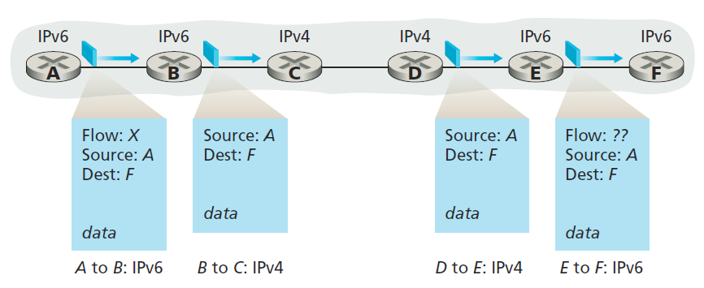
Dual-stack
Router has the ability to send and receive both IPv4 and IPv6 datagrams
IPv4 to IPv4 transition loses v6 field values
even though E and F can exchange IPv6 datagrams, the arriving IPv4 datagrams at E from D do not contain all of the fields that were in the original IPv6 datagram sent from A.

Slide 26
Routing algorithm classification
Q: global or decentralized information?
global:
all routers have complete topology, link cost info
“link state（链路状态）” algorithms
decentralized:
router knows physically-connected neighbors, link costs to neighbors
iterative process of computation, exchange of info with neighbors
“distance vector（距离矢量）” algorithms
Q: static or dynamic?
static:
routes change slowly over time
dynamic:
routes change more quickly
  periodic update
  in response to link cost changes
Q: load sensitive or insensitive:
Today’s Internet routing is load insensitive

Slide 27
A Link-State Routing Algorithm
Dijkstra’s algorithm
net topology, link costs known to all nodes
  accomplished via “link state broadcast”
  all nodes have same info
computes least cost paths from one node (‘source”) to all other nodes
  gives forwarding table for that node
iterative: after k iterations, know least cost path to k destinations
notation:
c(x,y): link cost from node x to y; = ∞ if not direct neighbors
D(v): current value of cost of path from source to dest. v
p(v): predecessor node along path from source to v
N': set of nodes whose least cost path definitively known

Slide 28
Dijsktra’s Algorithm
Algorithm executed on node u
1 Initialization:
2 N' = {u}
3 for all nodes v
4 if v adjacent to u
5 then D(v) = c(u,v)
6 else D(v) = ∞
7
8 Loop
9 find w not in N' such that D(w) is a minimum
10 add w to N'
11 update D(v) for all v adjacent to w and not in N' :
12 D(v) = min( D(v), D(w) + c(w,v) )
13 /* new cost to v is either old cost to v or known
14 shortest path cost to w plus cost from w to v */
15 until all nodes in N'

Slide 29
Dijkstra’s algorithm: example
D(v)
p(v)
D(w)
p(w)
D(x)
p(x)
D(y)
p(y)
D(z)
p(z)
Step
N'
0
u
7,u
3,u
5,u
∞
∞
1
uw
6,w
5,u
11,w
∞
2
uwx
6,w
11,w
14,x
3
uwxv
10,v
14,x
4
uwxvy
12,y
5
uwxvyz
x
9
notes:
construct shortest path tree by tracing predecessor nodes
ties can exist (can be broken arbitrarily)
5
7
4
8
u
3
w
y
z
2
3
7
4
v

Slide 30
Dijkstra’s algorithm, discussion
algorithm complexity: n nodes
each iteration: need to check all nodes, w, not in N’
n(n+1)/2 comparisons: O(n²)
more efficient implementations possible: O(nlogn)

Slide 31
Distance vector algorithm
Bellman-Ford equation (dynamic programming)
let
d_{x}(y) := cost of least-cost path from x to y
then
d_{x}(y) = min {c(x,v) + d_{v}(y) }
v
cost from neighbor v to destination y
cost to neighbor v
min taken over all neighbors v of x

Slide 32
Distance vector algorithm
D_{x}(y) = estimate of least cost from x to y
  x maintains distance vector D_{x} = [D_{x}(y): y є N ]
node x:
  knows cost to each neighbor v: c(x,v)
  maintains its neighbors’ distance vectors. For each neighbor v, x maintains
  D_{v} = [D_{v}(y): y є N ]

Slide 33
Distance vector algorithm
key idea:
from time-to-time, each node sends its own distance vector estimate to neighbors
when x receives new DV estimate from neighbor, it updates its own DV using B-F equation:
D_{x}(y) ← min_{v}{c(x,v) + D_{v}(y)} for each node y ∊ N
under minor, natural conditions, the estimate D_{x}(y) converge to the actual least cost d_{x}(y)

Slide 34
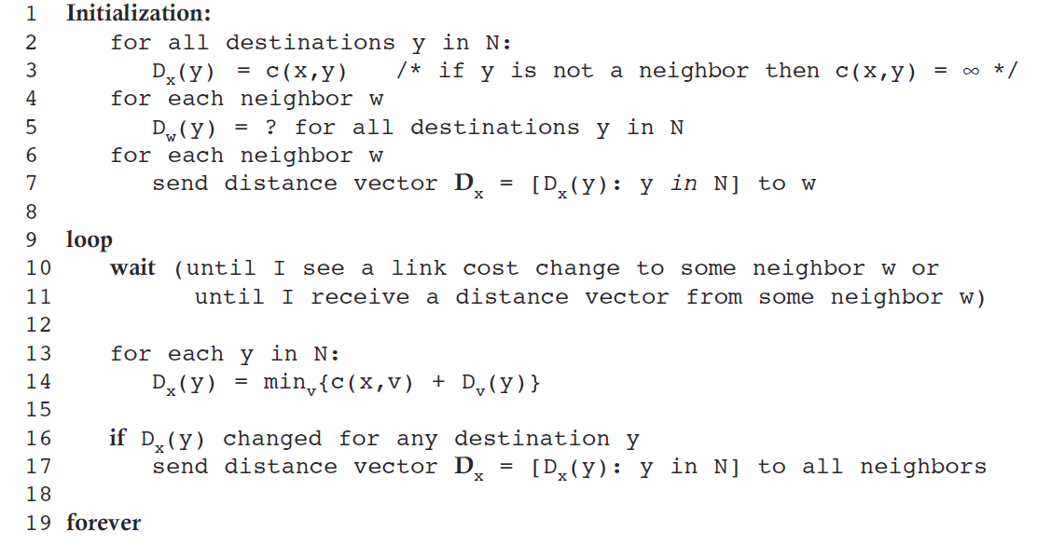
Distance vector algorithm

Slide 35
D_{x}(z) = min{c(x,y) +
D_{y}(z), c(x,z) + D_{z}(z)}
= min{2+1 , 7+0} = 3
D_{x}(y) = min{c(x,y) + D_{y}(y), c(x,z) + D_{z}(y)}
= min{2+0 , 7+1} = 2
node x
table
cost to
cost to
cost to
x y z
x y z
x y z
x
0 2 7
x
0
2
3
x
0 2 3
y
y
2 0 1
from
∞
∞
∞
from
y
2 0 1
z
z
from
∞
∞
∞
7 1 0
z
3 1 0
node y
table
cost to
cost to
cost to
x y z
x y z
x y z
y
2
1
x
∞
∞
x
0 2 7
∞
2 0 1
x
0 2 3
x
z
from
y
y
2 0 1
y
7
from
from
2 0 1
z
∞
∞
∞
z
7 1 0
z
3 1 0
node z
table
cost to
cost to
cost to
x y z
x y z
x y z
x
∞ ∞ ∞
x
0 2 7
x
0 2 3
y
y
2 0 1
from
y
∞
∞
from
2 0 1
from
∞
z
z
3 1 0
z
3 1 0
7
1
0
time
time

Slide 36
Comparison of LS and DV algorithms
message complexity
LS: with n nodes, E links, O(nE) msgs sent
DV: exchange between neighbors only
  convergence time varies
speed of convergence
LS: O(n²) algorithm requires O(nE) msgs
  may have oscillations
DV: convergence time varies
  may be routing loops
  count-to-infinity problem
robustness: what happens if router malfunctions?
LS:
  node can advertise incorrect link cost
  each node computes only its own table
DV:
  DV node can advertise incorrect path cost
  each node’s table used by others
    error propagate thru network

Slide 37
Hierarchical routing
collect routers into regions, “autonomous systems” (AS)
Each AS within an ISP
  ISP may consist of one or more ASes
routers in same AS run same routing protocol
  “intra-AS” routing protocol
  routers in different AS can run different intra-AS routing protocol
gateway router:
at “edge” of its own AS
has link to router in another AS

Slide 38
Interconnected ASes
3c
3a
2c
3b
AS3
2a
1c
2b
AS2
1a
1b
1d
AS1
forwarding table configured by both intra- and inter-AS routing algorithm
  intra-AS sets entries for internal dests
  inter-AS & intra-AS sets entries for external dests
Intra-AS
Routing
algorithm
Inter-AS
Routing
algorithm
Forwarding
table

Slide 39
RIP ( Routing Information Protocol)
included in BSD-UNIX distribution in 1982
distance vector algorithm
  distance metric: # hops (max = 15 hops), each link has cost 1
  AS should have diameter less than 15 hops
  DVs exchanged with neighbors every 30 sec in RIP Response Message (aka advertisement)
  each advertisement: list of up to 25 destination subnets (in IP addressing sense)
from router A to destination subnets:
u
v
subnet hops
u 1
v 2
w 2
x 3
y 3
z 2
A
B
w
x
z
C
D
y

Slide 40
OSPF (Open Shortest Path First)
“open”: publicly available
  rfc 2328
uses link state algorithm
  LS packet dissemination
  topology map at each node
  Shortest-path tree to all subnets locally computed by router using Dijkstra's algorithm
  How to set link weight is up to the administrator

Slide 41
OSPF (Open Shortest Path First)
advertisements flooded to entire AS
  carried in OSPF messages directly over IP (rather than TCP or UDP)
  Upper layer protocol 89
A router broadcast link-state information when
  A link's state changes
  Periodically (e.g., 30 min)
Check links with HELLO messages
IS-IS routing protocol: nearly identical to OSPF

Slide 42
Internet inter-AS routing: BGP
BGP (Border Gateway Protocol): the de facto inter-domain routing protocol
  “glue that holds the Internet together”
BGP provides each AS a means to:
  obtain subnet reachability information from neighboring AS's: eBGP
  propagate reachability information to all AS-internal routers: iBGP
  determine “good” routes to other networks based on reachability information and policy.
Basically, allows subnet to advertise its existence to rest of Internet: “I am here”

Slide 43
BGP basics
BGP session: two BGP routers (“peers”) exchange BGP messages:
  advertising paths to different destination network prefixes (“path vector” protocol)
  exchanged over semi-permanent TCP connections, port 179
when AS3 advertises a prefix to AS1:
  For example 138.16.64/22 ; AS-PATH: AS3 AS131
  AS3 promises it will forward datagrams towards that prefix
  AS3 can aggregate prefixes in its advertisement
3c
3a
BGP
message
3b
AS3
2c
other
networks
1c
2a
other
networks
1a
2b
1b
AS2
AS1
1d

Slide 44
BGP basics: distributing path information
using eBGP session between 3a and 1c, AS3 sends prefix reachability info to AS1.
  1c can then use iBGP sessions to distribute new prefix info to all routers in AS1
  1b can then re-advertise new reachability info to AS2 over 1b-to-2a eBGP session (138.16.64/22 ; AS-PATH: AS1 AS3 AS131 )
when router learns of new prefix, it creates entry for prefix in its forwarding table.
eBGP session
3a
3b
iBGP session
AS3
2c
other
networks
1c
2a
other
networks
1a
2b
1b
AS2
AS1
1d

Slide 45
BGP route selection
router may learn about more than one route to destination AS, selects route based on:
  local preference value attribute: policy decision
  shortest AS-PATH
  closest NEXT-HOP router: hot potato routing
  additional criteria
These rules are applied sequentially

Slide 46
How does entry get in forwarding table?
Summary
Router becomes aware of prefix
  via BGP route advertisements from other routers
Determine router output port for prefix
  Use BGP route selection to find best inter-AS route
  Use OSPF to find best intra-AS route leading to best inter-AS route
  Router identifies router port for that best route
Enter prefix-port entry in forwarding table

Slide 47
Why different Intra-, Inter-AS routing ?
policy:
inter-AS: admin wants control over how its traffic routed, who routes through its net.
intra-AS: single admin, so no policy decisions needed
scale:
hierarchical routing saves table size, reduced update traffic
performance:
intra-AS: can focus on performance
inter-AS: policy may dominate over performance

Slide 48
In-network duplication
Uncontrolled flooding: when node receives broadcast packet, sends copy to all neighbors
  problems: cycles & broadcast storm
controlled flooding: node only broadcasts pkt if it hasn’t broadcast same packet before
  node keeps track of packet ids already broadacsted (src. addr. + seq. num)
  or reverse path forwarding (RPF): only forward packet if it arrived on shortest path between node and source
spanning tree:
  no redundant packets received by any node

Slide 49
Spanning tree: creation
Define a center node
each node sends unicast join message to center node
  message forwarded until it arrives at a node already belonging to spanning tree
D joins by B’s message
A
A
3
B
B
c
c
4
2
D
D
F
E
F
E
1
5
G
G
stepwise construction of spanning tree (center: E)
(b) constructed spanning tree

Slide 50



Multicast routing: problem statement
goal: find a tree (or trees) connecting routers having local mcast group members
tree: not all paths between routers used
shared-tree: same tree used by all group members
source-based: different tree from each sender to rcvrs
legend
group
member
not group
member
router
with a
group
member
router
without
group
member
shared tree
source-based trees
Notes:
Notes:
3.3 Network Layer: Multicast Routing Algorithms 3-9

Slide 51
Constructing group-shared tree
Center-based approach
one router identified as “center” of tree
to join:
  edge router sends unicast join-msg addressed to center router
  join-msg “processed” by intermediate routers and forwarded towards center
  join-msg either hits existing tree branch for this center, or arrives at center
  path taken by join-msg becomes new branch of tree for this router
Notes:
Notes:
1. It’s always nice to see a PhD dissertation with impact. The earliest discussion of center-based trees for multicast appears to be D. Wall, “Mechanisms for Broadcast and Selective Broadcast,” PhD dissertation, Stanford U., June 1980.
3.3 Network Layer: Multicast Routing Algorithms 3-17

Slide 52
Constructing source-based tree
RFP (reverse path forwarding) algorithm
rely on router’s knowledge of unicast shortest path from it to sender
each router has simple forwarding behavior:
if (mcast datagram received on incoming link on shortest path back to source)
then flood datagram onto all outgoing links
else ignore datagram
Notes:
Notes:
3.3 Network Layer: Multicast Routing Algorithms 3-13

Slide 53
Software defined networking (SDN)
4. programmable control
applications
…
3. control plane functions external to data-plane switches
routing
access control
load
balance
Remote Controller
control
plane
data
plane
CA
2. control, data plane separation
CA
CA
CA
CA
1: generalized“ flow-based” forwarding (e.g., OpenFlow)

Slide 54
Adaptors communicating
datagram
datagram
controller
controller
sending host
receiving host
datagram
frame
sending side:
  encapsulates datagram in frame
  adds error checking bits, rdt, flow control, etc.
receiving side
  looks for errors, rdt, flow control, etc.
  extracts datagram, passes to upper layer at receiving side

Slide 55

Error detection
EDC= Error Detection and Correction bits (redundancy)
D = Data protected by error checking, may include header fields
Error detection not 100% reliable!
  protocol may miss some errors, but rarely
  larger EDC field yields better detection and correction
otherwise

Slide 56


Parity checking
single bit parity:
detect single bit errors
two-dimensional bit parity:
detect and correct single bit errors
Even/odd parity: parity bit is set to 1 if there is an odd/even number of one bits
偶校验：确保1 bit数是偶数
奇校验：确保1 bit数是奇数
0
0
* Check out the online interactive exercises for more examples: http://gaia.cs.umass.edu/kurose_ross/interactive/

Slide 57

Cyclic redundancy check
view data bits, D, as a binary number
choose r+1 bit pattern (generator), G
goal: choose r CRC bits, R, such that
  <D,R> exactly divisible by G (modulo 2)
  receiver knows G, divides <D,R> by G. If non-zero remainder: error detected!
  can detect all burst errors less than r+1 bits
widely used in practice (Ethernet, 802.11 WiFi, ATM)

Slide 58

CRC example
want:
  D.2^{r} XOR R = nG
equivalently:
  D.2^{r} = nG XOR R
equivalently:
if we divide D.2^{r} by G, want remainder R to satisfy:
D.2^{r}
G
R = remainder[ ]
* Check out the online interactive exercises for more examples: http://gaia.cs.umass.edu/kurose_ross/interactive/

Slide 59
Multiple access protocols
single shared broadcast channel
two or more simultaneous transmissions by nodes: interference
  collision if node receives two or more signals at the same time
multiple access protocol
distributed algorithm that determines how nodes share channel, i.e., determine when node can transmit
communication about channel sharing must use channel itself!
  no out-of-band channel for coordination

Slide 60
MAC protocols: taxonomy
three broad classes:
channel partitioning（信道划分）
  divide channel into smaller “pieces” (time slots, frequency, code)
  allocate piece to node for exclusive use
random access （随机接入）
  channel not divided, allow collisions
  “recover” from collisions
“taking turns” （轮询）
  nodes take turns, but nodes with more to send can take longer turns

Slide 61
Channel partitioning MAC protocols: TDMA
TDMA: time division multiple access
access to channel in "rounds"
each station gets fixed length slot (length = packet transmission time) in each round
unused slots go idle
example: 6-station LAN, 1,3,4 have packets to send, slots 2,5,6 idle
6-slot
frame
6-slot
frame
1
3
4
1
3
4

Slide 62
Channel partitioning MAC protocols: FDMA
FDMA: frequency division multiple access
channel spectrum divided into frequency bands
each station assigned fixed frequency band
unused transmission time in frequency bands go idle
example: 6-station LAN, 1,3,4 have packet to send, frequency bands 2,5,6 idle
time
frequency bands
FDM cable

Slide 63
Random access protocols
when node has packet to send
  transmit at full channel data rate R.
  no a priori coordination among nodes
two or more transmitting nodes ➜ “collision”,
random access MAC protocol specifies:
  how to detect collisions
  how to recover from collisions (e.g., via delayed retransmissions)
examples of random access MAC protocols:
  slotted ALOHA, ALOHA
  CSMA, CSMA/CD, CSMA/CA

Slide 64
Slotted ALOHA
assumptions:
all frames same size
time divided into equal size slots (time to transmit 1 frame)
nodes start to transmit only slot beginning
nodes are synchronized
if 2 or more nodes transmit in slot, all nodes detect collision
operation:
when node obtains fresh frame, transmits in next slot
  if no collision: node can send new frame in next slot
  if collision: node retransmits frame in each subsequent slot with prob. p until success

Slide 65
Slotted ALOHA: efficiency
efficiency: long-run
fraction of successful slots
(many nodes, all with many frames to send)
max efficiency: find p* that maximizes
Np(1-p)^{N-1}
for many nodes, take limit of Np*(1-p*)^{N-1} as N goes to infinity, gives:
max efficiency = 1/e = .37
suppose: N nodes with many frames to send, each transmits in slot with probability p
prob that given node has success in a slot = p(1-p)^{N-1}
prob that any node has a success = Np(1-p)^{N-1}
at best: channel
used for useful
transmissions 37%
of time!
!

Slide 66

Pure (unslotted) ALOHA
unslotted Aloha: simpler, no synchronization
when frame first arrives
  transmit immediately
collision probability increases:
  frame sent at t₀ collides with other frames sent in [t₀-1,t₀+1]

Slide 67
Pure ALOHA efficiency
P(success by given node) = P(node transmits) .
P(no other node transmits in [t₀-1,t₀] .
P(no other node transmits in [t₀,t₀+1]
= p . (1-p)^{N-1 .} (1-p)^{N-1}
= p . (1-p)^{2(N-1)}
… choosing optimum p and then letting n
= 1/(2e) = .18
even worse than slotted Aloha!

Slide 68
CSMA (carrier sense multiple access)
CSMA: listen before transmit:
if channel sensed idle: transmit entire frame
if channel sensed busy, defer transmission
Called carrier sensing （载波侦听）
human analogy: don’t interrupt others!

Slide 69
Ethernet CSMA/CD algorithm
4. If NIC detects another transmission while transmitting, aborts and sends jam signal
  Jam signal, inform other stations must not transmit
5. After aborting, NIC enters binary (exponential) backoff:
  after mth collision, NIC chooses K at random from {0,1,2, …, 2^{m}-1}. NIC waits K·512 bit times, returns to Step 2
  longer backoff interval with more collisions
1. NIC receives datagram from network layer, creates frame
2. If NIC senses channel idle, starts frame transmission. If NIC senses channel busy, waits until channel idle, then transmits.
3. If NIC transmits entire frame without detecting another transmission, NIC is done with frame !

Slide 70
CSMA/CD efficiency
t_{prop} = max prop delay between 2 nodes in LAN
t_{trans} = time to transmit max-size frame
efficiency goes to 1
  as t_{prop} goes to 0 (abort immediately without wasting the channel)
  as t_{trans} goes to infinity (never release the channel)
better performance than ALOHA: and simple, cheap, decentralized!
  Reason: listen and abort

Slide 71
MAC addresses and ARP
32-bit IP address:
  network-layer address for interface
  used for layer 3 (network layer) forwarding
MAC (or LAN or physical or Ethernet) address:
  function: used ‘locally” to get frame from one interface to another physically-connected interface (same network, in IP-addressing sense)
  48 bit MAC address (for most LANs) burned in NIC ROM, also sometimes software settable
  e.g.: 1A-2F-BB-76-09-AD
hexadecimal (base 16) notation
(each “numeral” represents 4 bits)

Slide 72
LAN addresses (more)
MAC flat address ➜ portability
  can move LAN card from one LAN to another
IP hierarchical address not portable
  address depends on IP subnet to which node is attached
Sending adapter: inserts the destination adapter' MAC address into the frame then sends to the LAN
Receiving adapter: Check to see whether the destination MAC matches its own MAC address
Broadcast address: FF-FF-FF-FF-FF-FF

Slide 73


ARP: address resolution protocol
Question: how to determine
interface’s MAC address, knowing its IP address?
ARP table: each IP node (host, router) on LAN has table
  IP/MAC address mappings for some LAN nodes:
< IP address; MAC address; TTL>
  TTL (Time To Live): time after which address mapping will be forgotten (typically 20 min)
137.196.7.78
1A-2F-BB-76-09-AD
137.196.7.23
137.196.7.14
LAN
71-65-F7-2B-08-53
58-23-D7-FA-20-B0
0C-C4-11-6F-E3-98
137.196.7.88

Slide 74
Addressing: routing to another LAN
  Can A put B’s MAC address in the frame? No. Why?
walkthrough: send datagram from A to B via R
  focus on addressing – at IP (datagram) and MAC layer (frame)
  assume A knows B’s IP address
  assume A knows IP address of first hop router, R (how? DHCP)
  assume A knows R’s MAC address (how? ARP)
A
B
R
111.111.111.111
222.222.222.222
74-29-9C-E8-FF-55
49-BD-D2-C7-56-2A
222.222.222.220
1A-23-F9-CD-06-9B
111.111.111.112
111.111.111.110
222.222.222.221
CC-49-DE-D0-AB-7D
E6-E9-00-17-BB-4B
88-B2-2F-54-1A-0F

Slide 75
Ethernet frame structure (more)
addresses: 6 byte source, destination MAC addresses
  if adapter receives frame with matching destination address, or with broadcast address (e.g. ARP packet), it passes data in frame to network layer protocol
  otherwise, adapter discards frame
type: indicates higher layer protocol (mostly IP but others possible, e.g., Novell IPX, AppleTalk)
CRC: cyclic redundancy check at receiver
  error detected: frame is dropped
type
preamble
dest.
address
source
address
data (payload)
CRC

Slide 76
Ethernet: unreliable, connectionless
connectionless: no handshaking between sending and receiving NICs
unreliable: receiving NIC doesn't send acks or nacks to sending NIC
  data in dropped frames recovered only if initial sender uses higher layer rdt (e.g., TCP), otherwise dropped data lost
Ethernet’s MAC protocol: unslotted CSMA/CD with binary backoff

Slide 77
Ethernet switch
link-layer device: takes an active role
  store, forward Ethernet frames
  examine incoming frame’s MAC address, selectively forward frame to one-or-more outgoing links when frame is to be forwarded on segment, uses CSMA/CD to access segment
transparent
  hosts are unaware of presence of switches
plug-and-play, self-learning
  switches do not need to be configured

Slide 78
Forwarding and filtering
Two basic functionalities:
Filtering: determines whether a frame should be forwarded to some interface or should just be dropped.
Forwarding: determines the interfaces to which a frame should be directed, and then moves the frame to those interfaces.
Done with switch table.
Q: how are entries created, maintained in switch table?
  something like a routing protocol?

Slide 79
Switch: frame filtering/forwarding
when frame received at switch:
1. record incoming link, source MAC address of sending host
  2. index switch table using destination MAC address
  3. if entry found for destination
  then {
  if destination on segment from which frame arrived
  then drop frame
  else forward frame on interface indicated by entry
  }
  else flood /* forward on all interfaces except arriving
  interface */

Slide 80


Self-learning multi-switch example
Suppose C sends frame to I, I responds to C
S₄
S₁
S₃
A
1
4
S₂
2
3
F
I
B
C
D
E
G
H
Q: show switch tables and packet forwarding in S₁, S₂, S₃, S₄
MAC addr. | Interface | TTL
A | 1
B | 2
C | 3
D、E、F、G、H、I | 4

Slide 81
Switches vs. routers
application
transport
network
link
physical
both are store-and-forward:
routers: network-layer devices (examine network-layer headers)
switches: link-layer devices (examine link-layer headers)
both have forwarding tables:
routers: compute tables using routing algorithms, IP addresses
switches: learn forwarding table using flooding, learning, MAC addresses
datagram
frame
link
physical
frame
switch
network
link
physical
datagram
frame
application
transport
network
link
physical

Slide 82
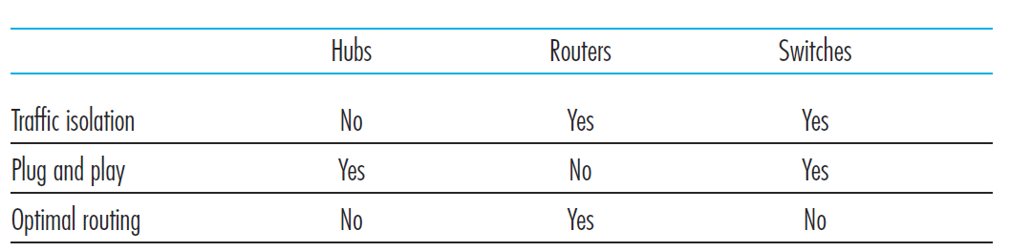
Switches vs. routers
Both are interconnecting devices

Slide 83
Port-based VLAN
router
traffic isolation: frames to/from ports 1-8 can only reach ports 1-8
  can also define VLAN based on MAC addresses of endpoints, rather than switch port
1
7
9
15
2
8
10
16
dynamic membership: ports can be dynamically assigned among VLANs
…
…
Electrical Engineering
(VLAN ports 1-8)
Computer Science
(VLAN ports 9-15)
forwarding between VLANS: done via routing (just as with separate switches)
  in practice vendors sell combined switches plus routers

Slide 84
VLANS spanning multiple switches
1
7
9
15
1
3
5
7
2
8
10
16
2
4
6
8
…
…
Electrical Engineering
(VLAN ports 1-8)
Computer Science
(VLAN ports 9-15)
Ports 2,3,5 belong to EE VLAN
Ports 4,6,7,8 belong to CS VLAN
trunk port: carries frames between VLANS defined over multiple physical switches
  frames forwarded within VLAN between switches can’t be vanilla 802.1 frames (must carry VLAN ID info)
  802.1q protocol adds/removed additional header fields for frames forwarded between trunk ports

Slide 85
802.1Q VLAN frame format
type
preamble
dest.
address
source
address
data (payload)
CRC
802.1 frame
type
preamble
dest.
address
source
address
data (payload)
CRC
802.1Q frame
2-byte Tag Protocol Identifier
(value: 81-00)
Recomputed
CRC
Tag Control Information (12 bit VLAN ID field,
3 bit priority field like IP TOS)

Slide 86
MPLS versus IP paths
entry router (R4) can use different MPLS routes to A based, e.g., on source address
R6
D
R4
R3
R5
A
R2
IP routing: path to destination determined by destination address alone
IP-only
router
MPLS routing: path to destination can be based on source and destination address
  fast reroute: precompute backup routes in case of link failure
MPLS and
IP router

Slide 87
MPLS forwarding tables
in out out
label label dest interface
10 A 0
in out out
label label dest interface
12 D 0
8 A 1
10 6 A 1
12 9 D 0
R6
0
0
D
1
1
R4
R3
R5
0
0
A
R2
R1
in out out
label label dest interface
in out out
label label dest interface
8 6 A 0
6 - A 0

Slide 88
Wireless network taxonomy
single hop
multiple hops
host connects to
base station (WiFi,
WiMAX, cellular)
which connects to
larger Internet
host may have to
relay through several
wireless nodes to
connect to larger
Internet: mesh net
infrastructure
(e.g., APs)
no base station, no
connection to larger
Internet. May have to
relay to reach other
a given wireless node
MANET, VANET
no
infrastructure
no base station, no
connection to larger
Internet (Bluetooth,
ad hoc nets)

Slide 89

Wireless Link Characteristics (2)
SNR: signal-to-noise ratio
  larger SNR – easier to extract signal from noise (a “good thing”)
SNR versus BER tradeoffs
  given physical layer: increase power -> increase SNR->decrease BER
  given SNR: choose physical layer that meets BER requirement, giving highest thruput
    SNR may change with mobility: dynamically adapt physical layer (modulation technique, rate)
10⁻¹
10⁻²
10⁻³
BER
10⁻⁴
10⁻⁵
10⁻⁶
10⁻⁷
10
20
30
40
SNR(dB)
QAM256 (8 Mbps)
QAM16 (4 Mbps)
BPSK (1 Mbps)

Slide 90


Wireless network characteristics
Multiple wireless senders and receivers create additional problems (beyond multiple access):
A
B
C
C
A’s signal
strength
C’s signal
strength
B
A
Hidden terminal problem
B, A hear each other
B, C hear each other
A, C can not hear each other means A, C unaware of their interference at B
space
Signal attenuation:
B, A hear each other
B, C hear each other
A, C can not hear each other interfering at B
CSMA/CD not work!

Slide 91
Code Division Multiple Access (CDMA)
unique “code” assigned to each user; i.e., code set partitioning
  all users share same frequency, but each user has own “chipping” sequence (i.e., CDMA code) to encode data
  allows multiple users to “coexist” and transmit simultaneously with minimal interference (if codes are “orthogonal”)
encoded signal = (original data) X (CDMA code)
decoding: inner-product of encoded signal and CDMA code

Slide 92

CDMA: two-sender interference
channel sums together transmissions by sender 1 and 2
Sender 1
Sender 2
using same code as sender 1, receiver recovers sender 1’s original data from summed channel data!

Slide 93






802.11 LAN architecture
wireless host communicates with base station
  base station = access point (AP)
Basic Service Set (BSS) (aka “cell”) in infrastructure mode contains:
  wireless hosts
  access point (AP): base station
  ad hoc mode: hosts only
Internet
hub, switch
or router
BSS 1
BSS 2

Slide 94
IEEE 802.11 MAC Protocol: CSMA/CA
802.11 sender
1 if sense channel idle for DIFS then
  transmit entire frame (no CD)
2 if sense channel busy then
  start random backoff timer value using binary exponential backoff (as in 802.3)
  timer counts down while channel idle / freeze while channel busy
3 if timer reach zero
  transmit and wait for ACK
4 if no ACK
  increase random backoff interval, repeat 2
802.11 receiver
- if frame received OK
return ACK after SIFS (ACK needed due to hidden terminal problem)
sender
receiver
DIFS
data
SIFS
ACK

Slide 95
Avoiding collisions (more)
idea: allow sender to “reserve” channel rather than random access of data frames: avoid collisions of long data frames
sender first transmits small request-to-send (RTS) packets to BS using CSMA
  RTSs may still collide with each other (but they’re short)
BS broadcasts clear-to-send CTS in response to RTS
CTS heard by all nodes
  sender transmits data frame
  other stations defer transmissions
avoid data frame collisions completely
using small reservation packets!

Slide 96
Collision Avoidance: RTS-CTS
Avoid data frame collisions completely
  The hidden station problem is mitigated, since a long DATA frame is transmitted only after the channel has been reserved.
  A collision involving an RTS or CTS frame will last only for the duration of the short RTS or CTS frame. Once the RTS and CTS frames are correctly transmitted, the following DATA and ACK frames should be transmitted without collisions.
RTS/CTS is only used when transmitting long DATA frame

Slide 97
802.11 frame: addressing
2
2
6
6
6
2
6
0 - 2312
4
frame
control
duration
address
1
address
2
address
3
seq
control
address
4
payload
CRC
Address 4: used only in ad hoc mode
Address 1: MAC address
of wireless host or AP
to receive this frame
Address 3: MAC address
of router interface to which AP is attached
Address 2: MAC address
of wireless host or AP
transmitting this frame

Slide 98



Mobility: more vocabulary
permanent address: remains constant (e.g., 128.119.40.186)
visited network: network in which mobile currently resides (e.g., 79.129.13/24)
care-of-address（转交地址）: address in visited network.
(e.g., 79,129.13.2)
home network
home agent
wide area network
foreign agent: entity in visited network that performs mobility functions on behalf of mobile.
correspondent: wants to communicate with mobile

Slide 99
Mobility: approaches
let routing handle it: routers advertise permanent address of mobile-nodes-in-residence via usual routing table exchange.
  routing tables indicate where each mobile located
  no changes to end-systems
let end-systems handle it:
  indirect routing: communication from correspondent to mobile goes through home agent, then forwarded to remote
  direct routing: correspondent gets foreign address of mobile, sends directly to mobile
not
scalable
to millions of
mobiles

Slide 100
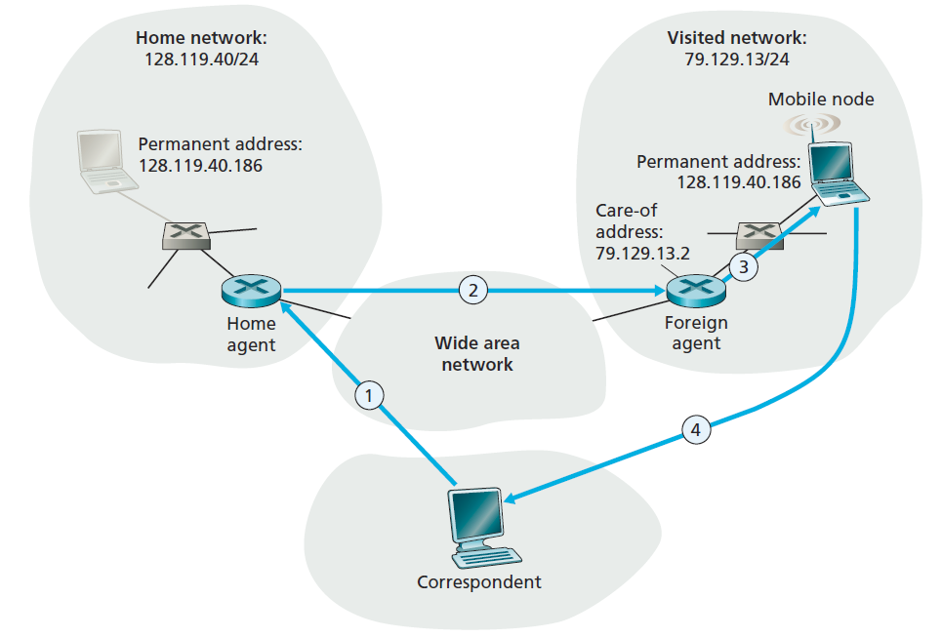
Mobility via indirect routing
foreign agent receives packets, forwards to mobile
home agent intercepts packets, forwards to foreign agent
correspondent addresses packets using home address of mobile
mobile replies directly to correspondent

Slide 101
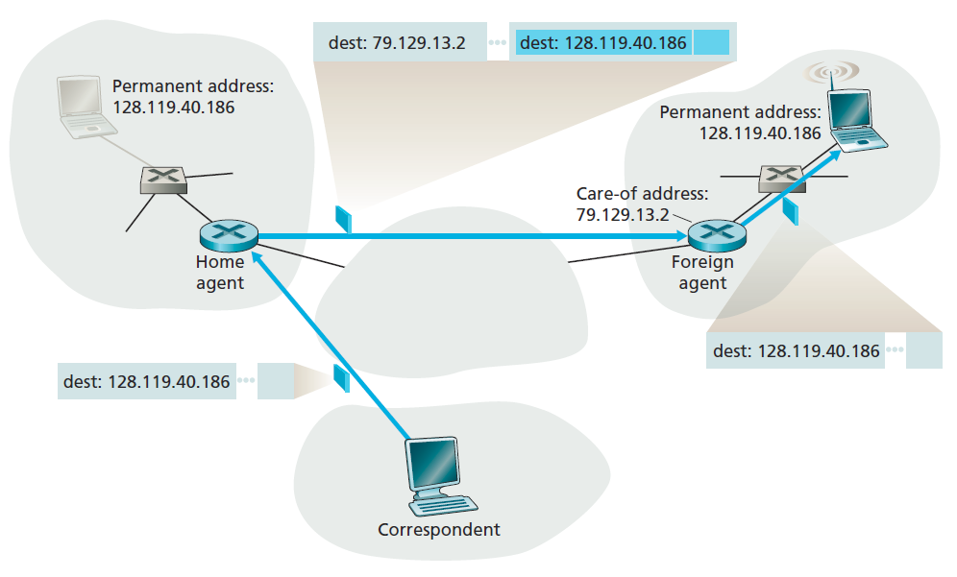
Datagram forwarding

Slide 102



Indirect Routing: comments
mobile uses two addresses:
  permanent address: used by correspondent (hence mobile location is transparent to correspondent)
  care-of-address: used by home agent to forward datagrams to mobile
foreign agent functions may be done by mobile itself
triangle routing: correspondent-home-network-mobile
  inefficient when
  correspondent, mobile
  are in same network

Slide 103



Mobility via direct routing
foreign agent receives packets, decapsulate, forwards to mobile
correspondent tunnels to foreign agent
visited
network
home
network
3
1
2
4
correspondent requests, receives foreign address of mobile
mobile replies directly to correspondent

Slide 104




Mobility via direct routing: comments
Correspondent learns mobile node’s COA
Correspondent tunnels to mobile node’s COA
overcome triangle routing problem
non-transparent to correspondent: correspondent must get care-of-address from home agent
  what if mobile changes visited network?
3
1
2
4

Slide 105
Indirect routing vs. direct routing
Transparent to correspondent
  Indirect: yes, only need to know permanent address
  Direct: no, need to tunnel.
Efficiency:
  Indirect: low, triangle routing
  Direct: high
Mobility within session:
  Indirect: Simple, just update home agent with new COA
  Direct: Complicated

Slide 106
Mobile IP: registration example
visited network: 79.129.13/24
home agent
HA: 128.119.40.7
foreign agent
care-of-addr: 79.129.13.2
mobile agent
MA (permanent addr. ):
128.119.40.186
ICMP agent adv.
COA: 79.129.13.2
….
registration req.
registration req.
Registration messages are in UPD, sent to port 434
COA: 79.129.13.2
HA: 128.119.40.7
MA: 128.119.40.186
Lifetime: 9999
identification:714
….
COA: 79.129.13.2
HA: 128.119.40.7
MA: 128.119.40.186
Lifetime: 9999
identification: 714
encapsulation format
….
HA: Home agent
MA: permanent addr. of mobile node
registration reply
HA: 128.119.40.7
MA: 128.119.40.186
Lifetime: 4999
Identification: 714
encapsulation format
….
registration reply
HA: 128.119.40.7
MA: 128.119.40.186
Lifetime: 4999
Identification: 714
….
time

Slide 107
What is network security?
Confidentiality: only sender, intended receiver should “understand” message contents
  sender encrypts message
  receiver decrypts message
authentication: sender, receiver want to confirm identity of each other
message integrity: sender, receiver want to ensure message not altered (in transit, or afterwards) without detection
access and availability: services must be accessible and available to users
8-107

Slide 108


Symmetric key cryptography
K
K
S
S
plaintext
message, m
encryption
algorithm
ciphertext
decryption
algorithm
plaintext
K (m)
m = K_{S}(K_{S}(m))
S
symmetric key crypto: Bob and Alice share same (symmetric) key: K
e.g., key is knowing substitution pattern in mono alphabetic substitution cipher
Q: how do Bob and Alice agree on key value?
S
8-108

Slide 109
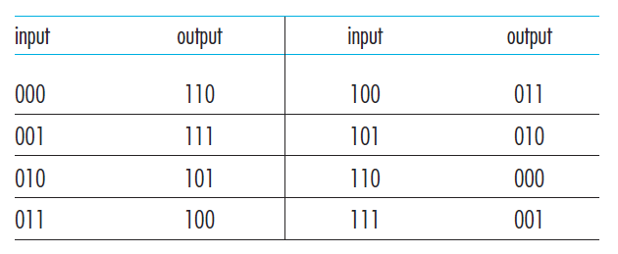
Block cipher
Message is encrypted in blocks of k bits.
Large k values against brute-force attack
  2^{k} possible mapping
  E.g, k=1024
k=3

Slide 110
Cipher-block chaining
The sender creates a random k-bit number r(i) for the ith block and calculates
c(i) = K_{S}(m(i)⊕r(i)). (⊕ means exclusive or （异或）)
  A new k-bit random number is chosen for each block.
Receiver receives c(i) and r(i), it can recover each block of the plaintext by computing m(i)=K_{S}(c(i))⊕r(i).
Example:
  k=3, plain text 010 010 010
  r(1)=001 r(2)=111 r(3)=100
  Produce different ciphertext for same plaintext

Slide 111
Cipher-block chaining
Problem: need to transmit r(i) from sender to receiver
  Transmit twice as many bits as before
Cipher-block chaining (CBC)
  Sender generates a k-bit string, Initialization Vector (IV), denoted as c(0), sent IV to receiver.
  Runs block cipher algorithm c(1)=K_{s}(m(1)⊕c(0)), send c(1) to receiver.
  c(i)=K_{s}(m(i)⊕c(i-1))
  Receiver: knows c(i-1), obtain m(i)=K_{s}(c(i))⊕c(i-1)

Slide 112
Public key cryptography
+
Bob’s public
key
K
B
-
Bob’s private
key
K
B
plaintext
message, m
encryption
algorithm
ciphertext
decryption
algorithm
plaintext
message
+
K (m)
-
+
B
m = K (K (m))
B
B
8-112

Slide 113
RSA: Creating public/private key pair
1. choose two large prime numbers（质数） p, q.
(e.g., 1024 bits each)
2. compute n = pq, z = (p-1)(q-1)
3. choose e (with e<n) that has no common factors
with z (e, z are “relatively prime（互质）”).
4. choose d such that ed-1 is exactly divisible by z.
(in other words: ed mod z = 1 ).
5. public key is (n,e). private key is (n,d).
+
-
K
K
B
B
8-113

Slide 114
RSA: encryption, decryption
0. given (n,e) and (n,d) as computed above
1. to encrypt message m (<n), compute
e
c = m mod n
2. to decrypt received bit pattern, c, compute
d
m = c mod n
magic
happens!
e
d
m = (m mod n)
mod n
c
8-114

Slide 115
RSA: another important property
The following property will be very useful later:
-
+
+
-
K (K (m)) = m
=
K (K (m))
B
B
B
B
use public key first, followed by private key
use private key first, followed by public key
result is the same!
8-115

Slide 116
Message digests
large
message
m
H: Hash
Function
computationally expensive to public-key-encrypt long messages
goal: fixed-length, easy- to-compute digital “fingerprint”
apply hash function H to m, get fixed size message digest（报文摘要）, H(m).
H(m)
Hash function properties:
many-to-1
produces fixed-size msg digest (fingerprint)
given message digest x, computationally infeasible to find m such that x = H(m)
8-116

Slide 117
Message authentication code
Alice and Bob will need a shared secret s, called the authentication key.
Alice concatenates s with m to create m + s, and calculates the hash H(m + s) (for example with SHA-1).
  H(m + s) is called the message authentication code (MAC).
Alice then appends the MAC to the message m, creating an extended message (m, H(m + s)), and sends to Bob.
Bob receives an extended message (m, h) and knowing s, calculates the MAC H(m + s).
  If H(m + s) = h, Bob concludes that everything is fine.

Slide 118
Digital signature = signed message digest
Bob sends digitally signed message:
Alice verifies signature, integrity of digitally signed message:
large
message
m
H: Hash
function
H(m)
encrypted
msg digest
-
K_{B}(H(m))
Bob’s
private
key
digital
signature
(encrypt)
large
message
m
-
Bob’s
public
key
digital
signature
(decrypt)
K
B
+
H: Hash
function
K
encrypted
msg digest
B
+
-
K_{B}(H(m))
H(m)
H(m)
equal
?
8-118

Slide 119
Certification authorities
certification authority (CA): binds public key to particular entity, E.
E (person, router) registers its public key with CA.
  E provides “proof of identity” to CA.
  CA creates certificate binding E to its public key.
  certificate containing E’s public key digitally signed by CA – CA says “this is E’s public key”
Bob’s
public
key
digital
signature
(encrypt)
+
K
+
B
K
B
CA
private
key
certificate for Bob’s public key, signed by CA
-
Bob’s
identifying information
K
CA
8-119

Slide 120
Certification authorities
when Alice wants Bob’s public key:
  gets Bob’s certificate (Bob or elsewhere).
  apply CA’s public key to Bob’s certificate, get Bob’s public key
+
digital
signature
(decrypt)
Bob’s
public
key
K
B
+
K
B
CA
public
key
+
K
CA
8-120

Slide 121
Secure e-mail (continued)
Alice wants to provide secrecy, sender authentication, message integrity.
-
K_{A}
.
.
-
-
K_{A}(H(m))
K_{S}
m
H( )
K_{A}( )
.
-
+
K_{S}(m, K_{A}(H(m)))
K_{S}( )
m
+
Internet
.
+
K_{S}
K_{B}( )
+
K_{B}(K_{S} )
+
K_{B}
Alice uses three keys: her private key, Bob’s public key, newly created symmetric key
8-121

Slide 122
Stateless packet filtering
Should arriving packet be allowed in? Departing packet let out?
internal network connected to Internet via router firewall
router filters packet-by-packet, decision to forward/drop packet based on:
  source IP address, destination IP address
  TCP/UDP source and destination port numbers
  ICMP message type
  TCP SYN and ACK bits
8-122

Slide 123
Stateful packet filtering
stateless packet filter: heavy handed tool
  admits packets that “make no sense,” e.g., dest port = 80, ACK bit set, even though no TCP connection established:
action | source address | dest address | protocol | source port | dest port | flag bit
allow | outside of 222.22/16 | 222.22/16 | TCP | 80 | > 1023 | ACK
stateful packet filter: track status of every TCP connection
  track connection setup (SYN), teardown (FIN): determine whether incoming, outgoing packets “makes sense”
  timeout inactive connections at firewall: no longer admit packets
8-123

