Slide 1



2022
Roster Management system
Datong Chihyen Bandana
Deepin Kishan Anju

Slide 2

01
Introduction
Final requirements, design proposal, project management approach based on project is included,
Roaster management system is web-based software that lets manage availability of workforce and allocate work to them,
Helps to create rostering rules, manage roasters update and create availability reports,
User friendly, simple and flexible website and allow both client and contractors to view and manage roasters
Enables to create roasters , assign different staff to different shifts and edit the shifts of the staffs

Slide 3
02
Final requirements
1. Target
In order to better manage human resources and communicate work goals more conveniently.
2. Platform
The system will be done in the form of a web page containing a database. Basic operations can be done through devices such as mobile phones or tablets.

Slide 4
work process
Staff registered an account
Log in to your account and fill in the working hours for each day of the week
Managers enter the dashboard page
Managers create work items
Select an employee's work item
Calculate the weekly working hours of employees and calculate their wages.

Slide 5
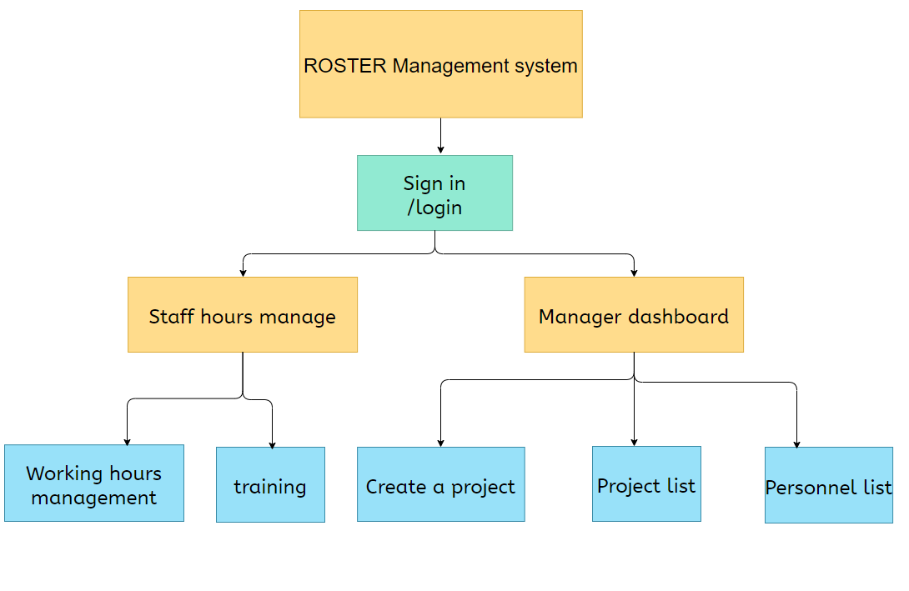
Sitemap

Slide 6
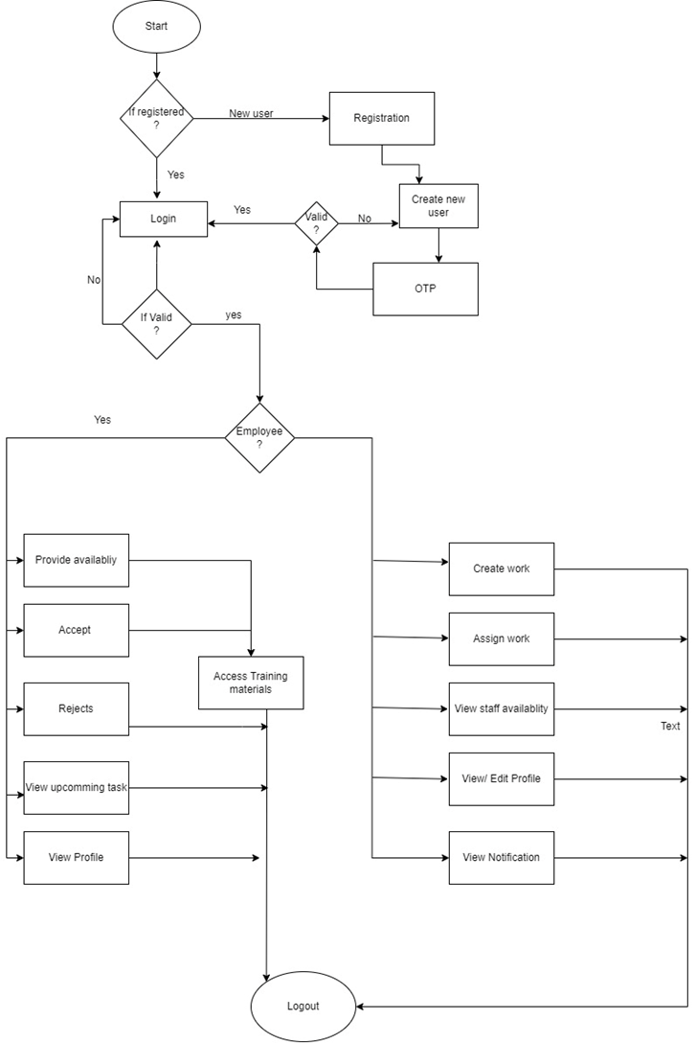
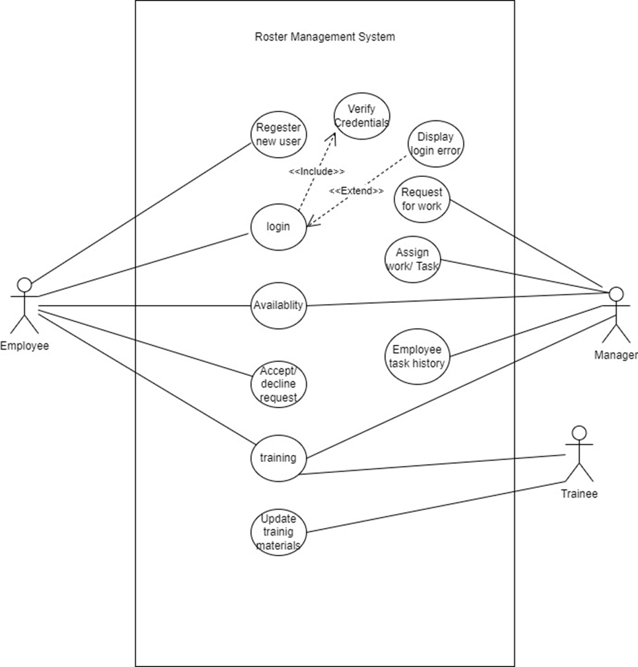
Proposed Design
03
1. System Perspective
External Perspective
Interaction Perspective
Structural Perspective
Behavioral Perspective
2. UML Diagram Type
Activity Diagrams
Use case diagrams
Sequence diagrams
Class Diagrams
State diagrams
Use Case Diagram
Behavioural Perspective

Slide 7


04
Tools to use
Miro
Monday
Whatsapp
Github
Proto.io
Notes:
7

Slide 8
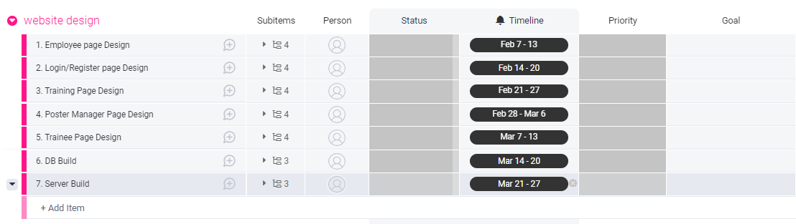
04
WBS
https://ict505436.monday.com/boards/2223686165/
Notes:
8

Slide 9
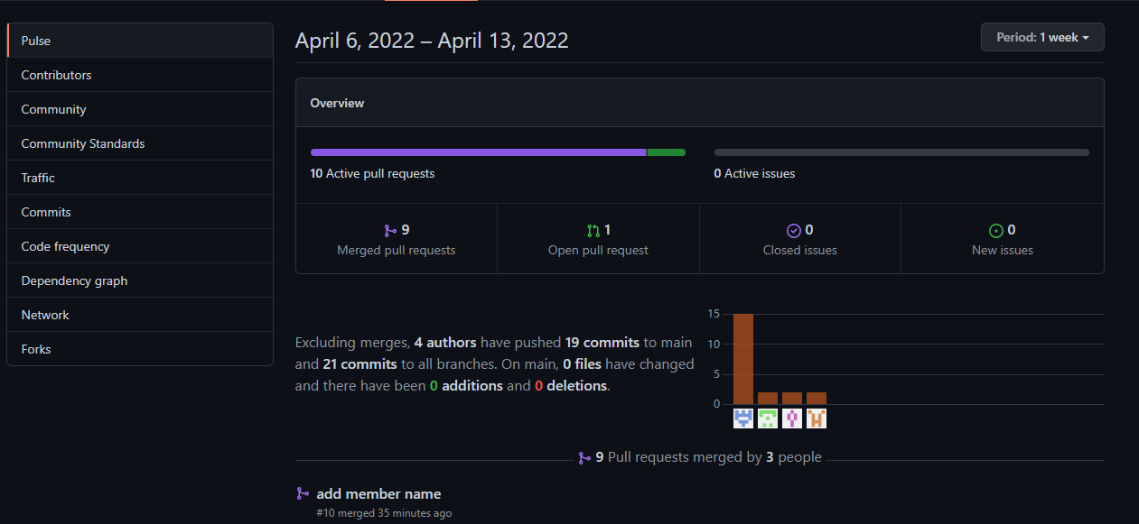

Slide 10
Deliverables
05
It support in creating roster rules and manage roster.
It also create availability update.
Manage working hours of casual staff.
Reduce or eliminate paper work in the Abacus company.
Notes:
10

Slide 11
05
Aim and Objectives
To eliminate the difficulties faced by Roster Manager in handling casual staff during big project.
To replace the paper based tracking and documentation as paper based system is not the cost effective and environment friendly.
Notes:
11

Slide 12

06
Writing to the Audience
Databases recorded with their availability and flexibility
It delivers accurate time and detailed report and gives real time communication
Staff management strategy is more effective and can be easily integrated into other system
It helps minimize mistakes and improve and increases work productivity
Notes:
12

Slide 13

07
Conclusion
Task and training are uploaded on the website to observe previous work
Provide all information like note, place, attachment, time
Staff can access their roaster via phone and will get update of everything
Provide staff with related insight that can be used to make decision
Notes:
13

Slide 14
2022
THANK YOU
Any question?

