Slide 1

Demand Response Event Analysis: 6/14/22 Heat Wave
Customer Performance, Baseline Comparison, and Financial Results
Ruiyan Huang
Mar 2, 2026

Slide 2
Event Overview & Methodology
June 14, 2022 | 2:00–6:00 PM Severe Midwest heat wave High demand + low wind output Emergency DR dispatch (first in ~6 months)
DATA
5 customer sites
15-min interval meter data (kWh), resampled to hourly kW.
Time-zone normalized to EDT
BASELINE
10of10 | Firm Service Level (FSL)
Site-specific operational baseline | Fixed system benchmark per site
Average load during the 10 most recent comparable weekdays (or weekends), at the same hour | Based on MISO system peak conditions, independent of recent customer operations.

Slide 3
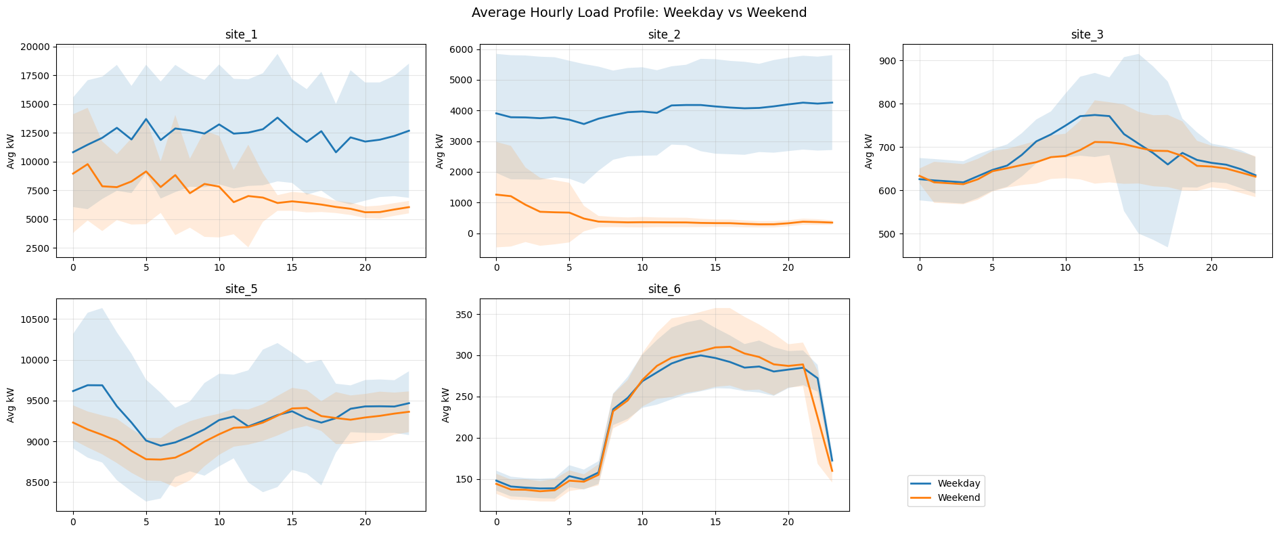
Portfolio Load Profiles
* y-axis scales differ

Slide 4
Building Type Hypothesis
Site | Likely Type | Daily Variability | Weekend Effect | Other Evidence
1 | Large Industrial(M-F) | Large hourly swings (5MW -> 20+MW) | Moderate | Lower and more stable weekend load. Likely energy-intensive manufacturing processes that spikes up the load.
2 | Mid-Sized Manufacturing (M-F) | Low | Large | Weekday mean load ~ 5MW with low volatility; nearly shut down on weekends.
3 | Office/Institutional Buildings | Midday Peak | Minimal | Stable base load with low peak-base ratio (~1.6)
5 | 24/7 Continuous Load (e.g. mall, hospital) | Low, slight overnight trough | Minimal | Relatively stable load throughout; low peak-base ratio (~1.25)
6 | Mid-sized business-hour building | Daily Cycle, high usage 8am-9pm | None | Low average demand (~200kW).

Slide 5
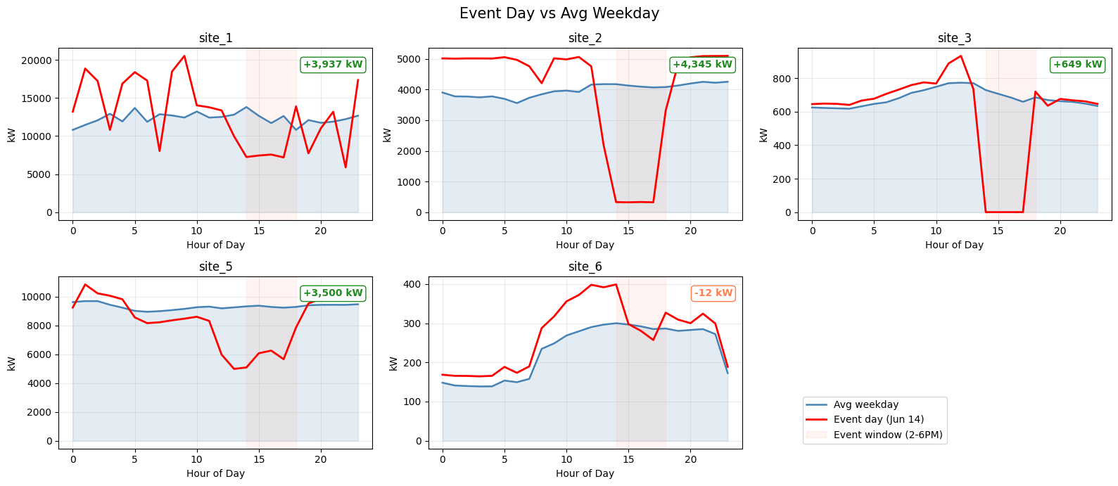
Event Response
Most sites significantly curtailed load during the June 14 event

Slide 6
Baseline Performance
Site | 10of10 Avg (kW) | FSL Avg (kW) | Higher Baseline
Site 1 | 3937 | 3337 | 10of10
Site 2 | 4345 | 5075 | FSL
Site 3 | 649 | 850 | FSL
Site 5 | 3500 | 3235 | 10of10
Site 6 | -12* | 41 | FSL
Performance = Baseline – Actual, averaged over event hours
Baseline methodology affects performance measured, and thus financial payout.
Different operational pattern benefit from different baselines: if recent load was elevated, baseline rises, which can increase measured curtailment during the event.
* Negative performance indicates load above baseline. Treated as 0 for payout calculations per hour.

Slide 7
Financial Results
Site | Gross Revenue | Customer Payment | Voltus Profit
Site 1 | $24,217 | $15,499 | $8,718
Site 2 | $30,770 | $19,077 | $11,693
Site 3 | $4,600 | $2,576 | $2,024
Site 5 | $23,873 | $15,518 | $8,356
Site 6* | $71 | $36 | $35
Sum | $83,531 | $52,706 | $30,826
Computed using the 10of10 baseline and performance.
Total portfolio profit: $30.8K across 5 sites.
Sites 1, 2, and 5 drive ~95% of total profit.

Slide 8
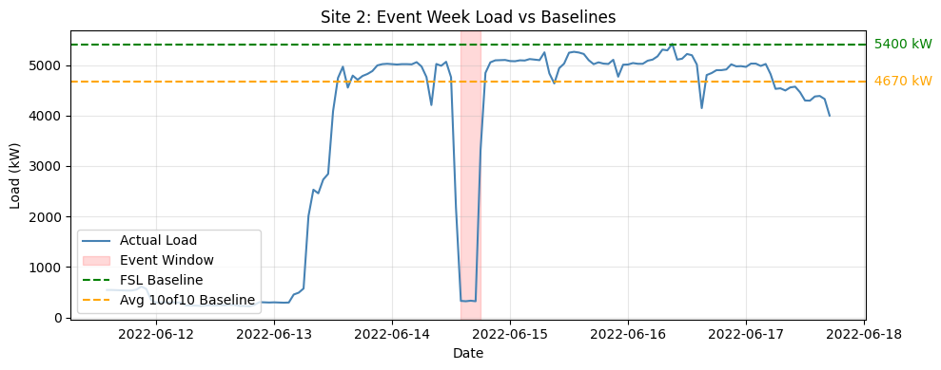
Site 2 Deep Dive
Site 2 was the strongest performer. Event load dropped to ~320 kW against a ~4,700 kW baseline, meaning it curtailed over 90% of its normal usage.

Slide 9
The 16:00 hour alone generated nearly $13K in gross revenue due to the $3,000/MWh LMP spike.
Hour | Load (kW) | 10of10 Baseline (kW) | 10of10 Performance (kW) | LMP ($/MWh) | Gross Rev | COGS | Profit
14:00 | 328 | 4,744 | 4,417 | 1,500 | $6,625 | $4,108 | $2,518
15:00 | 320 | 4,676 | 4,356 | 1,800 | $7,841 | $4,861 | $2,980
16:00 | 331 | 4,652 | 4,320 | 3,000 | $12,961 | $8,036 | $4,925
17:00 | 320 | 4,606 | 4,286 | 780 | $3,343 | $2,073 | $1,270
Total |  |  |  |  | $30,770 | $19,078 | $11,693

Slide 10
Scalability & Discussion
Q: If given 500 CSVs?
Modular code with reusable functions.
Runtime scale almost linearly with number of sites.
Primary incremental effort: QA / validation
Optionally, parallelize computations for each site
Strength of the Analysis
Scalable for larger dataset; clear separation of logic
Parameter-driven config (no hard-coded values)
Clearly documented assumptions
Future improvement:
Integrate holiday calendar and exclude them in weekday baseline calculations.
Enhance ways to detect missing values/outliers/duplicates.
Better handle edge cases: multi-day dispatch event, discontinuous event windows, etc.

