Slide 1
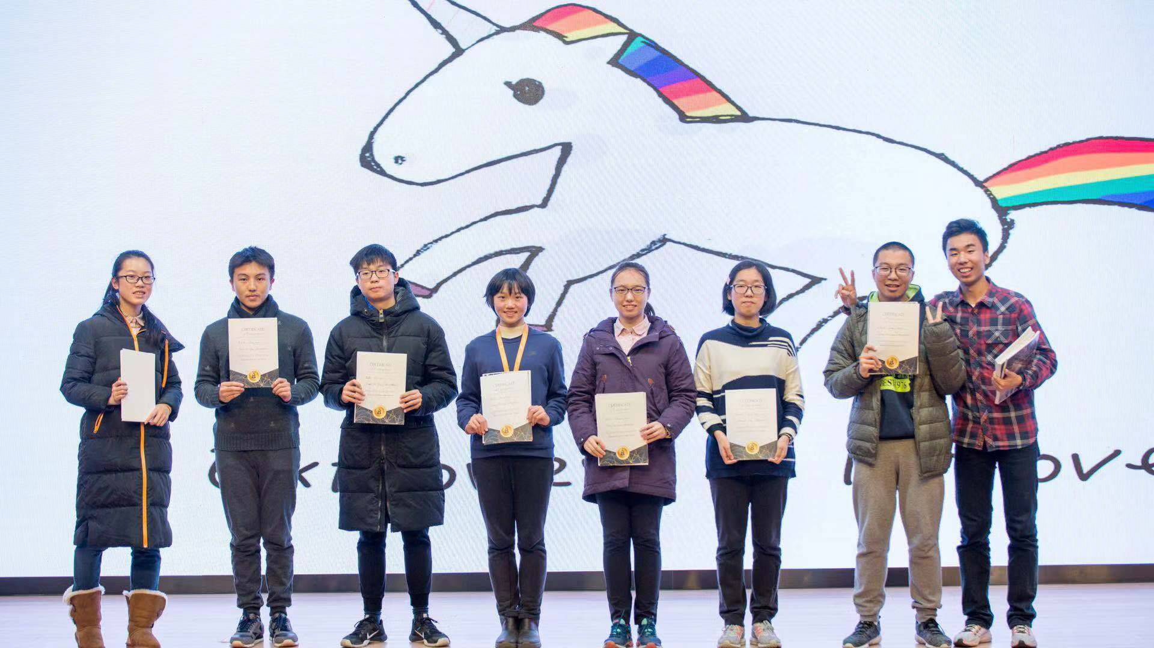
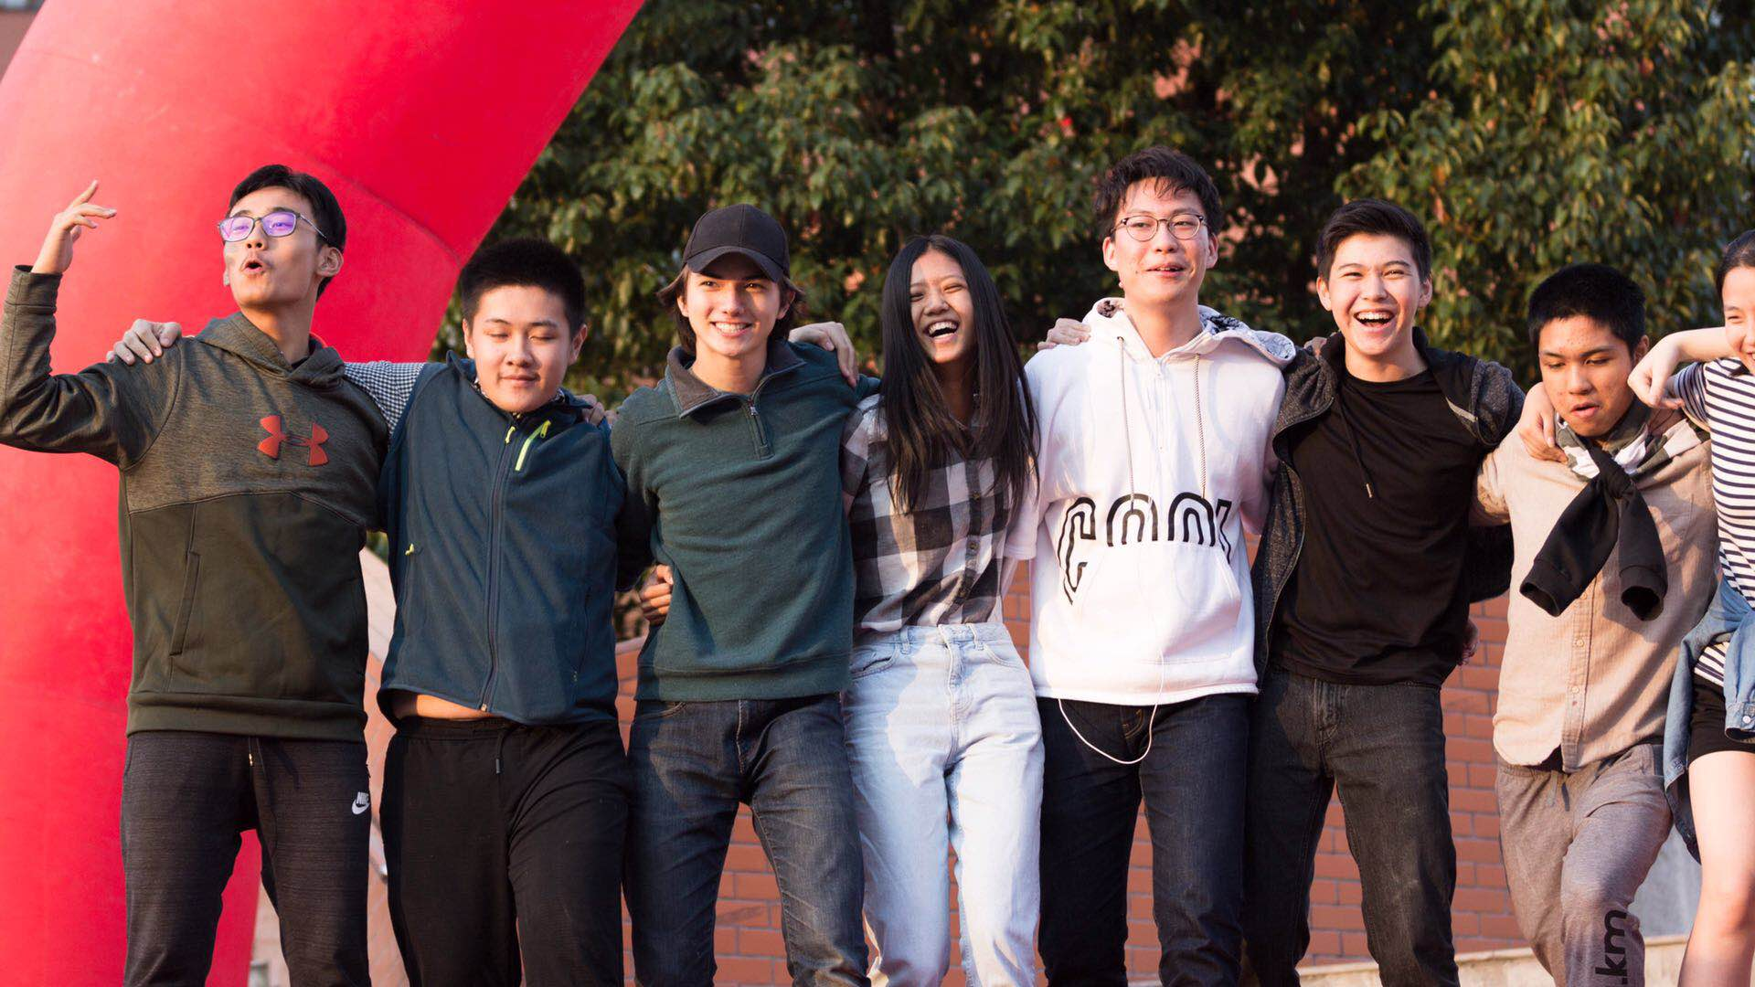
Team ID:
951054
CHANGING
Negative Opinions
towards
INTROVERSION

