Slide 1
Would you lend me your phone?
Group Ambivert

Slide 2
Are people more or less likely to borrow their phones to strangers based on their gender or speaking pace?

Slide 3
Hypothesis
1). People are more likely to lend their phones to female strangers than male ones
2). People are more likely to lend their phones to people who speak in a faster pace

Slide 4
Why did we choose these two hypotheses?
Several strangers came to us and asked for directions on first day
Interesting situation:
For men: involuntary immediate rejection
For women: explain patiently
Social norm: easier for people to trust female strangers than male ones
- less vigilant
- more likely to offer help when they are in need
Cause consequences
- easier for female criminals to succeed (human trafficking)
people are likely to determine whether they will help someone based on how urgent they are in need of that help

Slide 5
Independent Variable / LEVELS
Independent Variables:
Gender
Pace of Speaking
Four Levels:
Fast-pace Girls
Slow-pace Girls
Fast-pace Boys
Slow-pace Boys

Slide 6
DEPENDENT variable (DV)
Whether the pedestrians will lend their cell phones or not

Slide 7
Manipulation 1 - Gender
Contestants: 1 Girl (Maggie) + 1 Boy (Leslie)
Manipulation 2 - Pace of speaking
Half of trials with faster pace while other half with slower pace.

Slide 8
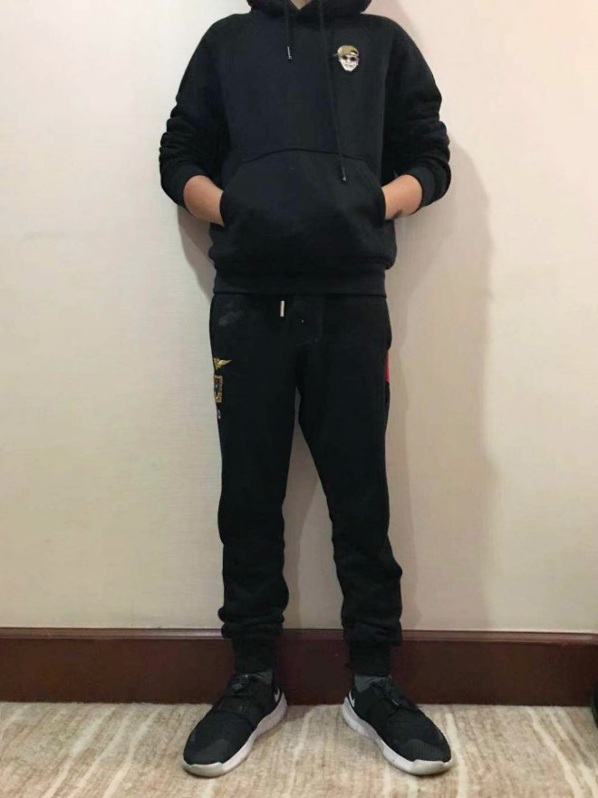
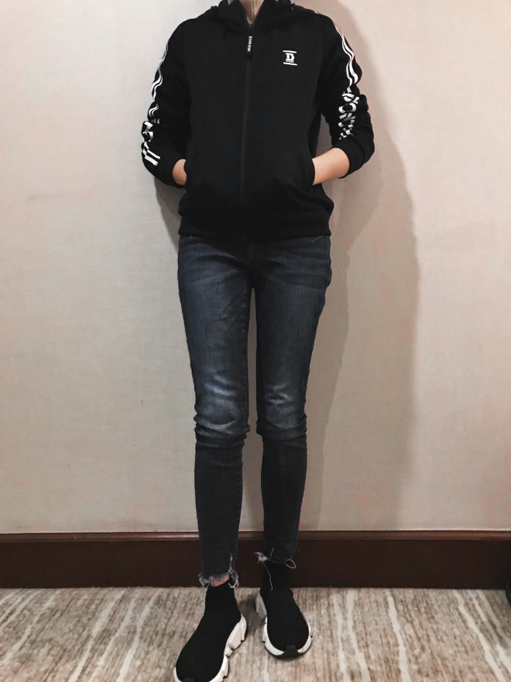
internal validity
Physical characteristics of borrower
-same age of 16
-similar heights 5’6 / 5’5
-same dressing code – a casual one with all black hoodie and black pants
Wording
“(Name), I came here with my friend for fun, but I got lost, and my phone ran out of batteries, would you please lend me your phone to call her?”

Slide 9
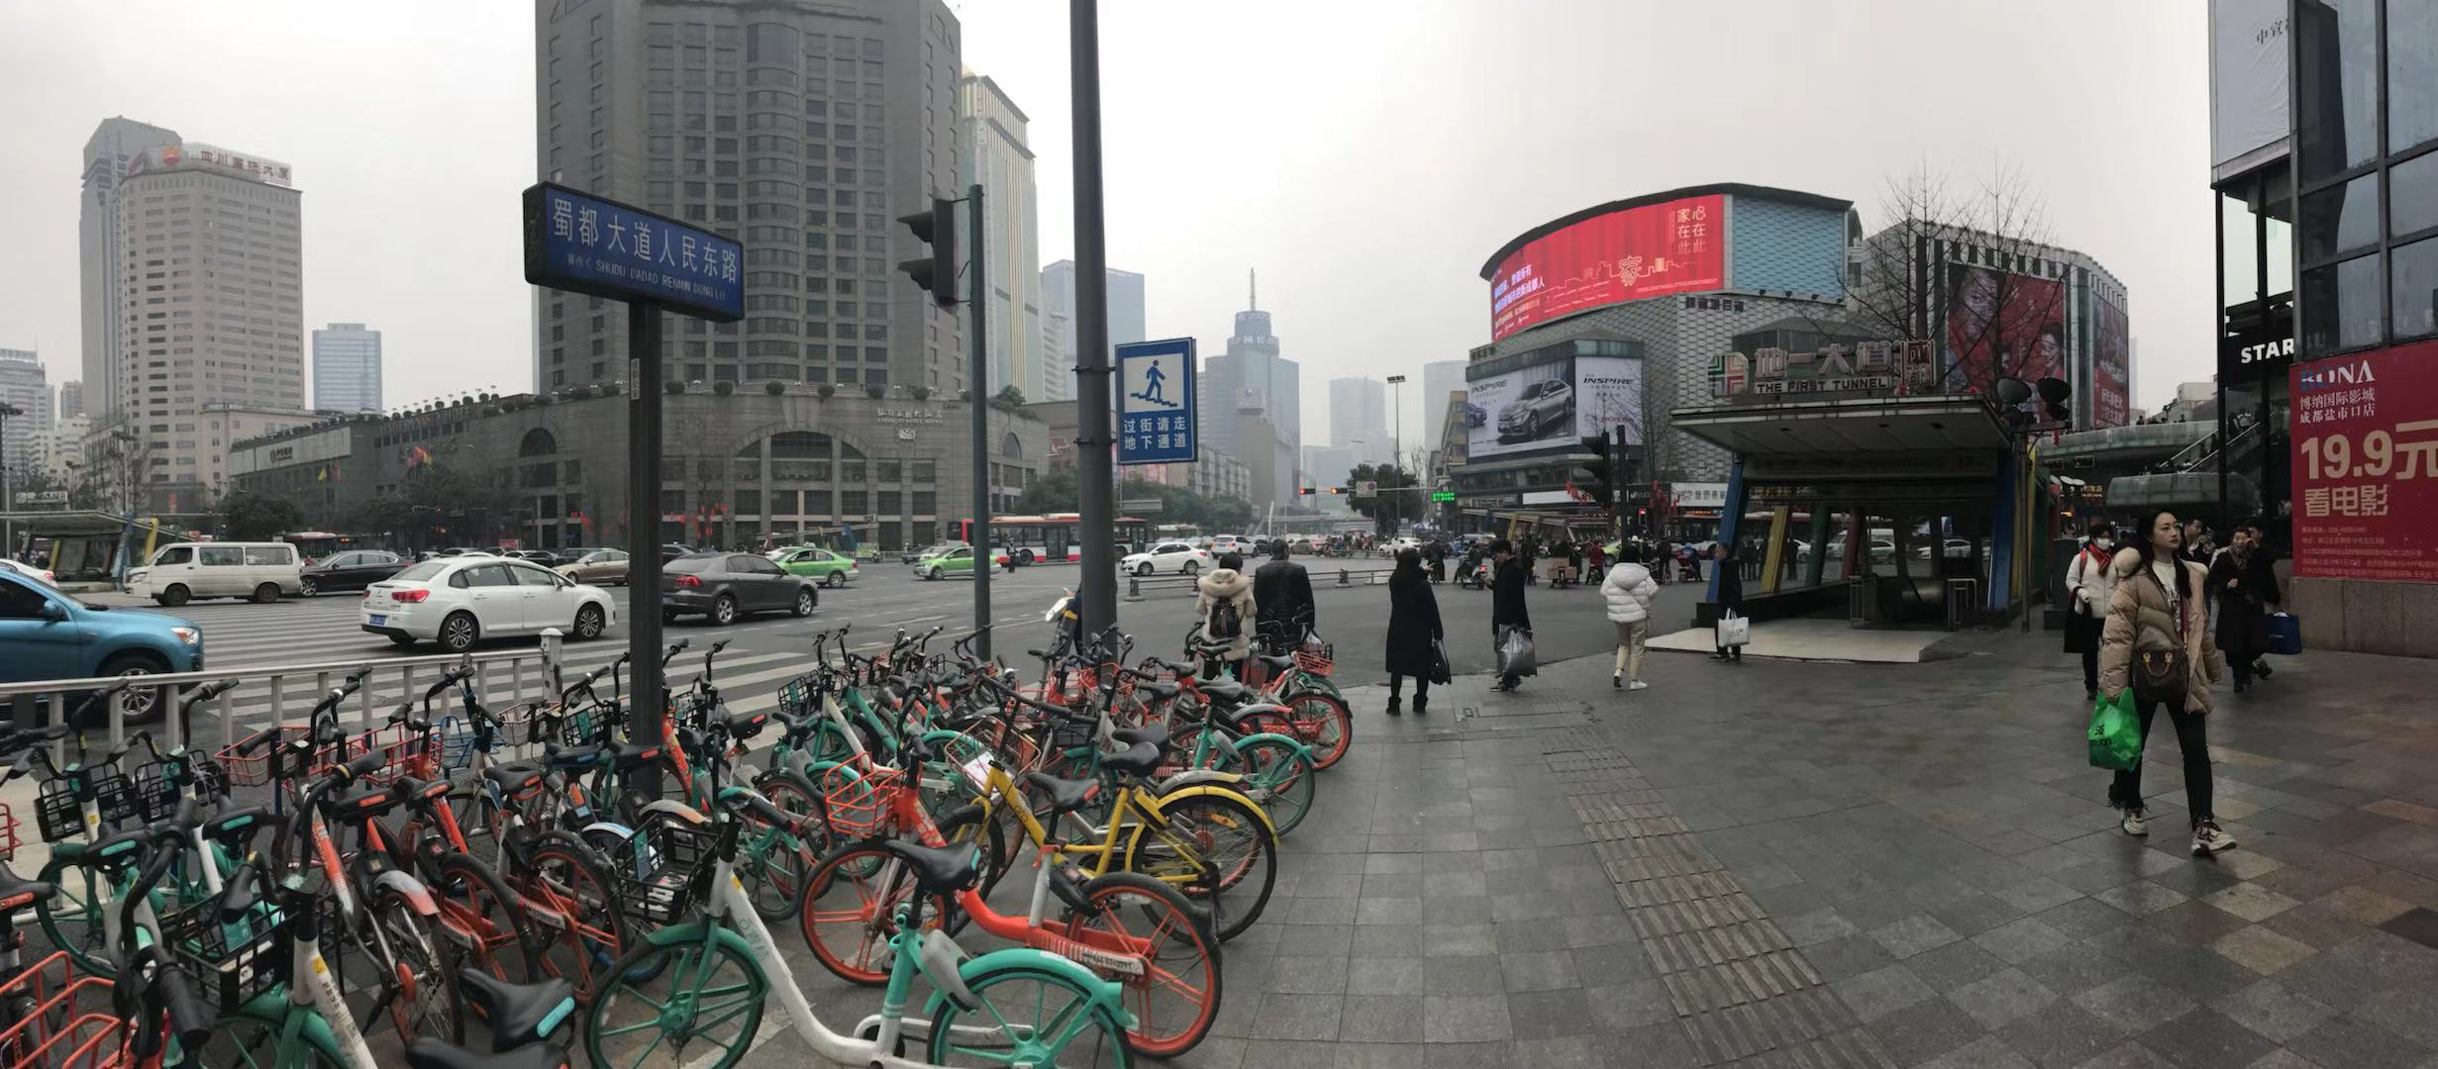
Location: Shu Du Da Dao Ren Min Dong Road busy intersection
Time: From 2:15-5:09
How?
- Pedestrian overpass
- Boy and the girl on each side
- Execute the experiment at the same time

Slide 10
External Validity: - Randomization - Naturalism
Simple Random Sample (SRS)
Randomize the sampling process
Eliminate convenience sample

Slide 11
Raw data
Sample size
Trend 1: people are more likely to trust girls rather than boys
Trend 2: people tend to trust people who speak more slowly
 | girl |  | boy
 | slow | fast | slow | fast
lend | 21 | 8 | 5 | 1
reject | 4 | 17 | 20 | 24

Slide 12
People are more likely to trust girls rather than boys
Rejection rate of boys is almost 7 times the lending rate
Notes:
maggie

Slide 13
people tend to trust people who speak more slowly
when we are speaking quickly, the rejection rate is more than 4 times larger than the lending rate
Notes:
maggie

Slide 14
Fun fact: the lending rate for a fast-speaking girl is even higher than a slow-speaking boy
Conclusion: Both gender and speaking pace impact the choice of the pedestrian, but gender has a much bigger impact than speaking pace

Slide 15
Our interpretation
Common belief:
Females are:
physically more vulnerable and fragile.
less likely or incapable of committing crimes

Slide 16
Conclusion
Hypothesis 1: People are more likely to lend their phones to female strangers than male ones (Valid)
Hypothesis 2: People are more likely to lend their phones to people who speak in a faster pace (Invalid )

Slide 17
Thank You!

