Slide 1

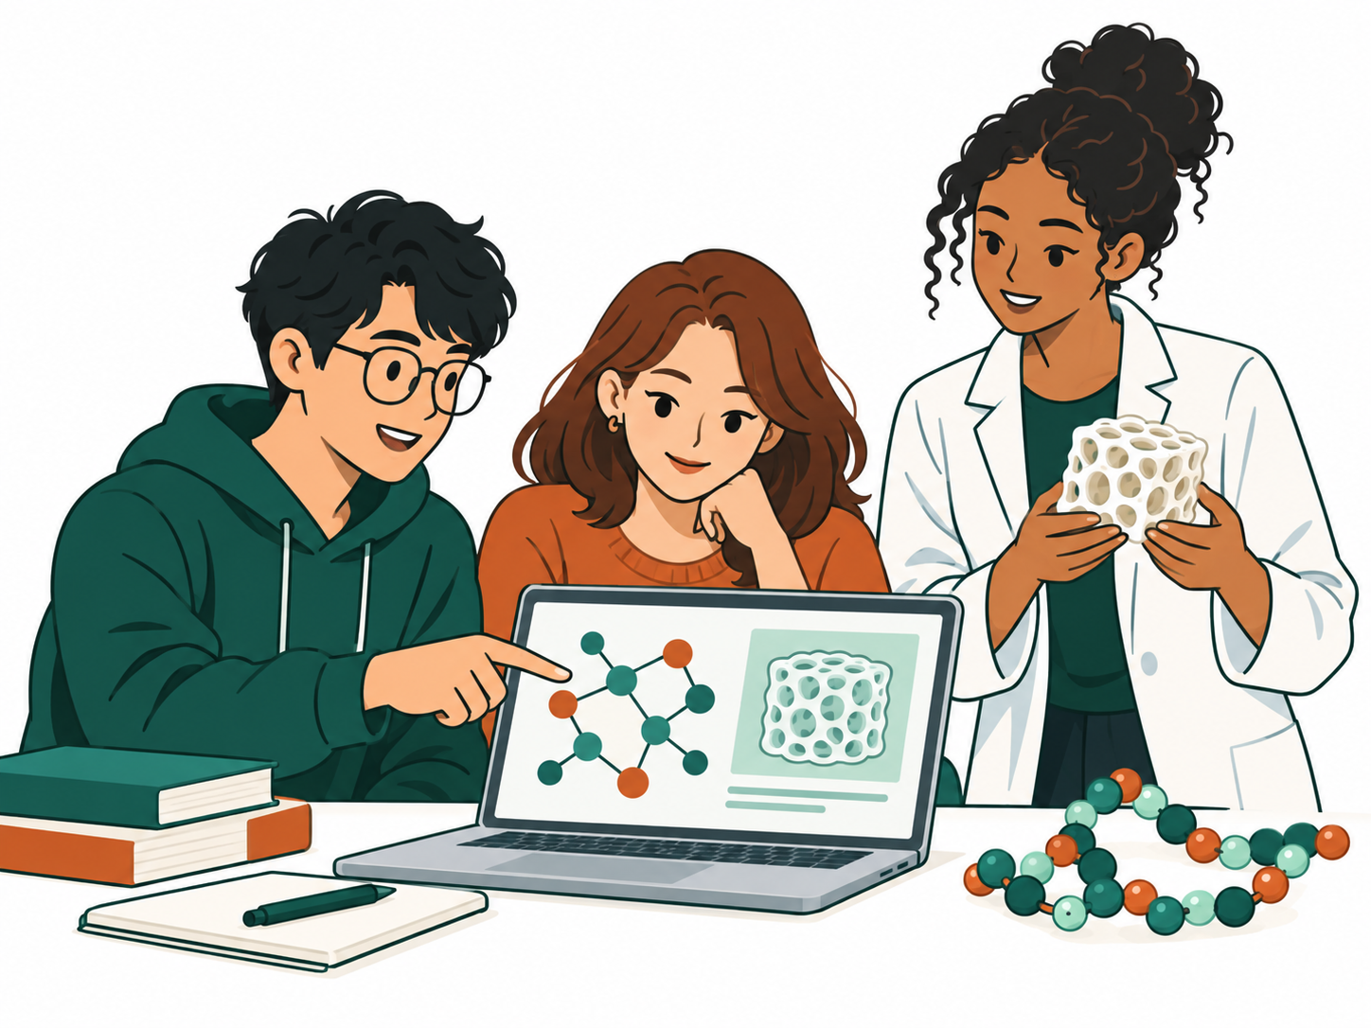
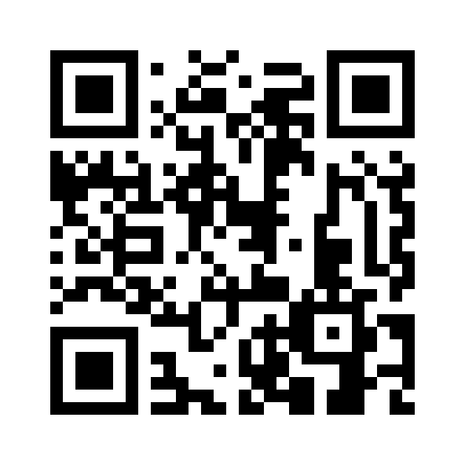
The University of Texas at Dallas
STUDENTS WILL RECEIVE COMPENSATION
Explore AI for
biomaterials research
Join CyberTraining Workshops in AI, scientific computing, and biomaterials through hands-on exercises and team projects.
For undergraduate
and graduate students
Bioengineering, computer science, materials science, chemistry, and related fields. Students from UT Dallas and other institutions are welcome to express interest.
Student collaboration illustration
CyberTraining Workshops
Guided coding
Biomaterials data
Team mini-projects
Practice scientific
computing and AI methods
Work with real datasets
and research questions
Connect computational
methods with experiments
Explore research questions that matter
Drug and gene delivery / Polymer and materials design
Tissue engineering / Reliable AI for scientific discovery
Tell us what interests you
Scan to share your academic background,
graduation plans, and research goals.
12 questions · about 3-5 minutes
forms.gle/13iPUM7vkB7HX4tK8
Compensation for confirmed participants. Interest form is not enrollment.
DRAFT · Dates, eligibility, and compensation details to be announced.
Notes:
NEXABio student recruitment draft. US Letter portrait. The selected polymer-loop logo, student collaboration illustration, and QR are separate images; body text remains editable.
Content: supplied NSF_CyberTraining.pdf and content/program.json. The original proposal is private and is not included in this repository.
Project team: Yunhui Guo (Computer Science) and Yongsheng Gao (Bioengineering)
The project owner confirmed that students with successful, confirmed program registration will receive compensation. The amount and payment details have not been specified. Dates, eligibility, and formal funding acknowledgment remain unconfirmed; the interest form is not enrollment confirmation.
Form: https://forms.gle/13iPUM7vkB7HX4tK8
Brand: user-selected concept B, polymer loops. Logo source and usage: public/brand/README.md.
Editing instructions: poster/README.md. Changing the target form requires regenerating and replacing the QR image.
Illustration: three fictional students collaborating on AI and biomaterials, selected by the project owner. Generated with the built-in imagegen tool on September 18, 2026. Original PNG shared with the website: public/images/student-collaboration.png. Exact prompt: public/images/student-collaboration-prompt.txt. Provenance: public/images/README.md. This is an illustration, not a photograph of actual participants or faculty.
Current recruitment scope: CyberTraining Workshops only, following project-team feedback.

